Slide 1
Reference monitors
Suman Jana
*Original slides from Vitaly Shmatikov

Slide 2
Reference Monitor
Observes execution of the program/process
At what level? Possibilities: hardware, OS, network
Halts or confines execution if the program is about to violate the security policy
What’s a “security policy”?
Which system events are relevant to the policy?
Instructions, memory accesses, system calls, network packets…
Cannot be circumvented by the monitored process

Slide 3
Enforceable Security Policies
Reference monitors can only enforce
safety policies [Schneider ‘98]
Execution of a process is a sequence of states
Safety policy is a predicate on a prefix of the sequence
Policy must depend only on the past of a particular execution; once it becomes false, it’s always false
Not policies that require knowledge of the future
“If this server accepts a SYN packet, it will eventually send a response”
Not policies that deal with all possible executions
“This program should never reveal a secret”

Slide 4
Reference Monitor Implementation
Kernelized
Wrapper
Modified program
Program
RM
Program
Program
RM
RM
Kernel
Kernel
Kernel
Integrate reference monitor into program code during compilation or via binary rewriting
Policies can depend on application semantics
Enforcement doesn’t require context switches in the kernel
Lower performance overhead

Slide 5
What Makes a Process Safe?
Memory safety: all memory accesses are “correct”
Respect array bounds, don’t stomp on another process’s memory, don’t execute data as if it were code
Control-flow safety: all control transfers are envisioned by the original program
No arbitrary jumps, no calls to library routines that the original program did not call
Type safety: all function calls and operations have arguments of correct type

Slide 6
OS as a Reference Monitor
Collection of running processes and files
Processes are associated with users
Files have access control lists (ACLs) saying which users can read/write/execute them
OS enforces a variety of safety policies
File accesses are checked against file’s ACL
Process cannot write into memory of another process
Some operations require superuser privileges
But may need to switch back and forth (e.g., setuid in Unix)
Enforce CPU sharing, disk quotas, etc.
Same policy for all processes of the same user

Slide 7
Hardware Mechanisms: TLB
TLB: Translation Lookaside Buffer
Maps virtual to physical addresses
Located next to the cache
Only supervisor process can manipulate TLB
But if OS is compromised, malicious code can abuse TLB to make itself invisible in virtual memory (Shadow Walker)
TLB miss raises a page fault exception
Control is transferred to OS (in supervisor mode)
OS brings the missing page to the memory
This is an expensive context switch

Slide 8
Steps in a System Call
[Morrisett]
User Process
Kernel
calls f=fopen(“foo”)
library executes “break”
saves context, flushes TLB, etc.
trap
checks UID against ACL, sets up IO buffers & file context, pushes ptr to context on user’s stack, etc.
restores context, clears supervisor bit
calls fread(f,n,&buf)
library executes “break”
saves context, flushes TLB, etc.
checks f is a valid file context, does
disk access into local buffer, copies
results into user’s buffer, etc.
Time
restores context, clears supervisor bit

Slide 9
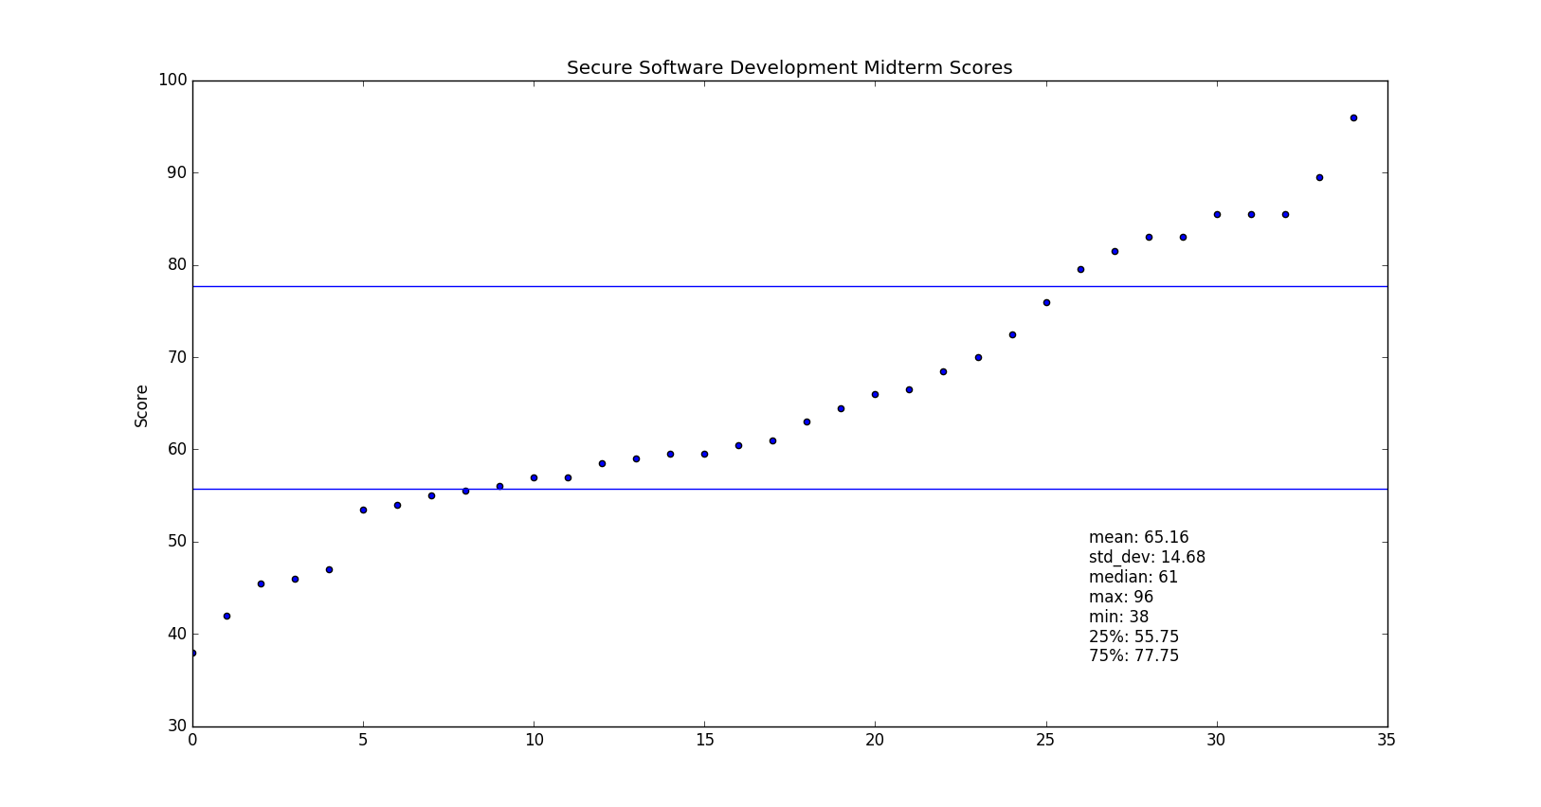
Midterm grades

Slide 10
Modern Hardware Meets Security
Modern hardware: large number of registers, big memory pages
Isolation ⇒ each process should live in its own hardware address space
… but the performance cost of inter-process communication is increasing
Context switches are very expensive
Trapping into OS kernel requires flushing TLB and cache, computing jump destination, copying memory
Conflict: isolation vs. cheap communication

Slide 11
Software Fault Isolation (SFI)
[Wahbe et al. SOSP ‘93]
Processes live in the same hardware address space; software reference monitor isolates them
Each process is assigned a logical “fault domain”
Check all memory references and jumps to ensure they don’t leave process’s domain
Tradeoff: checking vs. communication
Pay the cost of executing checks for each memory write and control transfer to save the cost of context switching when trapping into the kernel

Slide 12
Fault Domains
Process’s code and data in one memory segment
Identified by a unique pattern of upper bits
Code is separate from data (heap, stack, etc.)
Think of a fault domain as a “sandbox”
Binary modified so that it cannot escape domain
Addresses are masked so that all memory writes are to addresses within the segment
Coarse-grained memory safety (vs. array bounds checking)
Code is inserted before each jump to ensure that the destination is within the segment
Does this help much against buffer overflows?

Slide 13
Verifying Jumps and Stores
If target address can be determined statically, mask it with the segment’s upper bits
Crash, but won’t stomp on another process’s memory
If address unknown until runtime, insert checking code before the instruction
Ensure that code can’t jump around the checks
Target address held in a dedicated register
Its value is changed only by inserted code, atomically, and only with a value from the data segment

Slide 14
Simple SFI Example
Fault domain = from 0x1200 to 0x12FF
Original code: write x
Naïve SFI: x := x & 00FF
x := x | 1200
write x
Better SFI: tmp := x & 00FF
tmp := tmp | 1200
write tmp
convert x into an address that
lies within the fault domain
…
What if the code jumps right here?

Slide 15
Inline Reference Monitor
Generalize SFI to more general safety policies than just memory safety
Policy specified in some formal language
Policy deals with application-level concepts: access to system resources, network events, etc.
“No process should send to the network after reading a file”, “No process should open more than 3 windows”, …
Policy checks are integrated into the binary code
Via binary rewriting or when compiling
Inserted checks should be uncircumventable
Rely on SFI for basic memory safety

Slide 16
Policy Specification in SASI
[Cornell project]
¬ (op = “div”
∧
arg2 = 0)
No division by zero
No network send after file read
SASI policies are finite-state automata
Can express any safety policy
Easy to analyze, emulate, compile
Written in SAL language (textual version of diagrams)

Slide 17
Policy Enforcement
Checking before every instruction is an overkill
Check “No division by zero” only before DIV
SASI uses partial evaluation
Insert policy checks before every instruction, then rely on static analysis to eliminate unnecessary checks
There is a “semantic gap” between individual instructions and policy-level events
Applications use abstractions such as strings, types, files, function calls, etc.
Reference monitor must synthesize these abstractions from low-level assembly code

Slide 18
M. Abadi, M. Budiu, U. Erlingsson, J. Ligatti Control-Flow Integrity: Principles, Implementations, and Applications (CCS 2005)

Slide 19
CFI: Control-Flow Integrity
[Abadi et al.]
Main idea: pre-determine control flow graph (CFG) of an application
Static analysis of source code
Static binary analysis ← CFI
Execution profiling
Explicit specification of security policy
Execution must follow the pre-determined control flow graph

Slide 20
CFI: Binary Instrumentation
Use binary rewriting to instrument code with runtime checks (similar to SFI)
Inserted checks ensure that the execution always stays within the statically determined CFG
Whenever an instruction transfers control, destination must be valid according to the CFG
Goal: prevent injection of arbitrary code and invalid control transfers (e.g., return-oriented-programming)
Secure even if the attacker has complete control over the thread’s address space

Slide 21
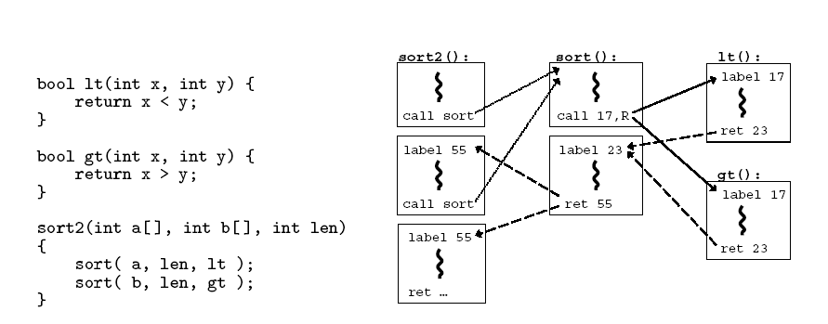
CFG Example

Slide 22
CFI: Control Flow Enforcement
For each control transfer, determine statically its possible destination(s)
Insert a unique bit pattern at every destination
Two destinations are equivalent if CFG contains edges to each from the same source
This is imprecise (why?)
Use same bit pattern for equivalent destinations
Insert binary code that at runtime will check whether the bit pattern of the target instruction matches the pattern of possible destinations

Slide 23
CFI: Example of Instrumentation
Original code
Instrumented code
Abuse an x86 assembly instruction to
insert “12345678” tag into the binary
Jump to the destination only if
the tag is equal to “12345678”

Slide 24
CFI: Preventing Circumvention
Unique IDs
Bit patterns chosen as destination IDs must not appear anywhere else in the code memory except ID checks
Non-writable code
Program should not modify code memory at runtime
What about run-time code generation and self-modification?
Non-executable data
Program should not execute data as if it were code
Enforcement: hardware support + prohibit system calls that change protection state + verification at load-time

Slide 25
Improving CFI Precision
Suppose a call from A goes to C, and a call from B goes to either C, or D (when can this happen?)
CFI will use the same tag for C and D, but this allows an “invalid” call from A to D
Possible solution: duplicate code or inline
Possible solution: multiple tags
Function F is called first from A, then from B; what’s a valid destination for its return?
CFI will use the same tag for both call sites, but this allows F to return to B after being called from A
Solution: shadow call stack

Slide 26
CFI: Security Guarantees
Effective against attacks based on illegitimate control-flow transfer
Stack-based buffer overflow, return-to-libc exploits, pointer subterfuge
Does not protect against attacks that do not violate the program’s original CFG
Incorrect arguments to system calls
Substitution of file names
Other data-only attacks

Slide 27
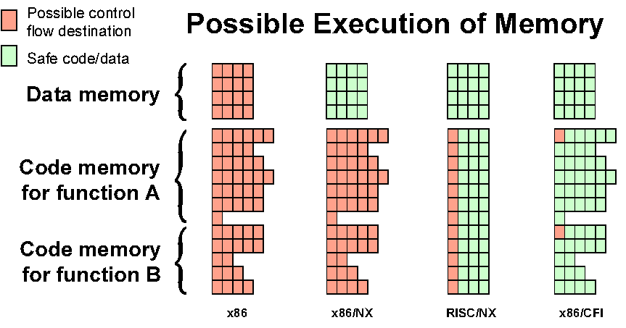
Possible Execution of Memory
[Erlingsson]

Slide 28
Next Step: XFI
[Erlingsson et al. OSDI ‘06]
Inline reference monitor added via binary rewriting
Can be applied to some legacy code
CFI to prevent circumvention
Fine-grained access control policies for memory regions
More than simple memory safety (cf. SFI)
Relies in part on load-time verification
Similar to “proof-carrying code”

Slide 29
Two Stacks
XFI maintains a separate “scoped stack” with return addresses and some local variables
Keeps track of function calls, returns and exceptions
Secure storage area for function-local information
Cannot be overflown, accessed via a computed reference or pointer, etc.
Stack integrity ensured by software guards
Presence of guards is determined by static verification when program is loaded
Separate “allocation stack” for arrays and local variables whose address can be passed around

Slide 30
XFI: Memory Access Control
Module has access to its own memory
With restrictions (e.g., shouldn’t be able to corrupt its own scoped stack)
Host can also grant access to other contiguous memory regions
Fine-grained: can restrict access to a single byte
Access to constant addresses and scoped stack verified statically
Inline memory guards verify other accesses at runtime
Fast inline verification for a certain address range; if fails, call special routines that check access control data structures

Slide 31
XFI: Preventing Circumvention
Integrity of the XFI protection environment
Basic control-flow integrity
“Scoped stack” prevents out-of-order execution paths even if they match control-flow graph
Dangerous instructions are never executed or their execution is restricted
For example, privileged instructions that change protection state, modify x86 flags, etc.
Therefore, XFI modules can even run in kernel

