Slide 1
Eternal Sunshine of the Spotless Machine: Protecting Privacy with Ephemeral Channels
Alan M. Dunn, Michael Z. Lee, Suman Jana, Sangman Kim,
Mark Silberstein, Yuanzhong Xu, Vitaly Shmatikov, Emmett Witchel
University of Texas at Austin
OSDI 2012
October 8, 2012

Slide 2

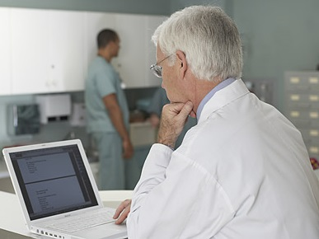
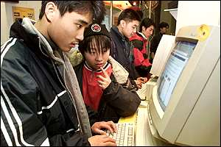

Wanted: Application Privacy
Goal: Run programs without leaving traces
VoIP conversation with lawyer
Biomedical researcher accessing data
Website access
Current state: Private browsing
  Popular feature in web browsers
  Ideal: When private browsing
  session terminates, all traces
  erased

Slide 3
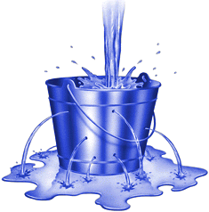
A Privacy Problem
Private browsing unachieved
  Evidence of site visits leaks into OS [Aggrawal, 2010]
Problem: No system support
  Applications interact with user and world
  Data leaks into OS, system services
  Applications cannot remove traces they leave

Slide 4
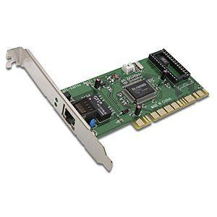
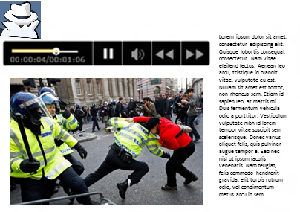
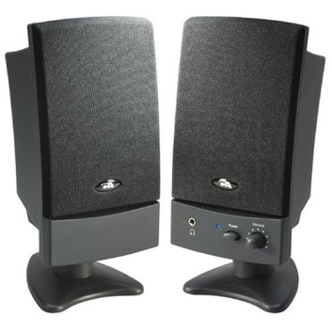
Example: Browsing a Website
X
Network
What traces still remain on the computer?
Audio

Slide 5
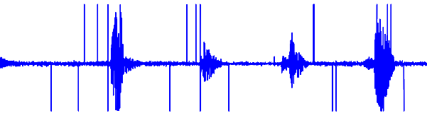
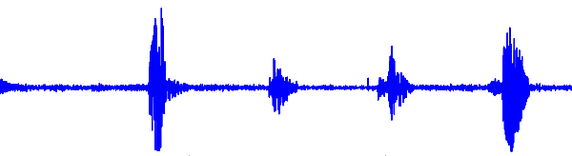
Leaks From Browsing
Memory contents:
Complete packets, like:
HTTP/1.1 200 OK
Date: Mon, 17 Sep 2012 …
Server: Apache/2.2.14 …
…
Network
PulseAudio server
X server caches, graphics drivers
Audio

Slide 6
Secure Deallocation Is Not Enough
Secure deallocation: Zero memory when freed
  Research implementation [Chow, 2005]
  PaX: Security patch for Linux kernel
Sensitive data remains allocated
  X caches, PulseAudio buffers not freed

Slide 7
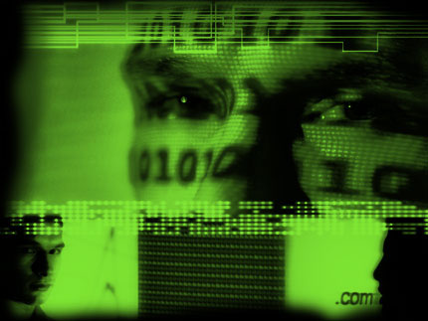
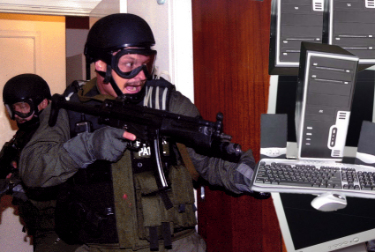
Resisting a Strong Adversary
Goal: Provide forensic deniability – no evidence left for non-concurrent attacker
Once program terminated, protection maintained under extreme circumstances
Root-level compromise (after program terminates)
Computer physically seized

Slide 8
Goals
Provide privacy
  Private sessions with forensic deniability
Maintain usability
  Simultaneous private/non-private applications
  Support a wide variety of private applications
  “Pay as you go” - costs only for private programs
  Impose low overhead

Slide 9
Lacuna
System to accomplish our privacy and usability goals
Host OS (Linux), VMM (QEMU-KVM) modified
Applications unmodified
la·cu·na [luh-kyoo-nuh]
1. a gap or missing part, as in a manuscript, series, or logical argument...

Slide 10

Outline
Design
  Erasable program container
  Allow communication with peripherals
Evaluation
  Lacuna provides privacy
  Lacuna maintains usability

Slide 11
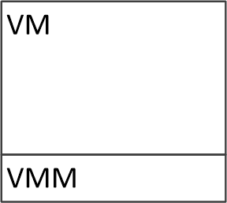
Erasable Program Container
Process
Program
Process
Process
…
VM contains Inter-Process Communication
VM alone is insufficient

Slide 12

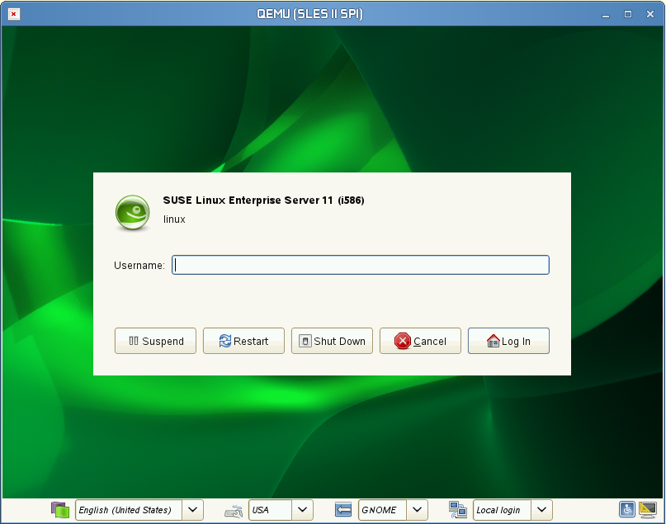


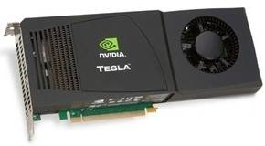
Communicating with Peripherals
- Sensitive data
Program
X
App1
App2
Program must communicate with peripheral
Driver
Dependencies on rest of OS

Slide 13
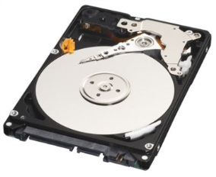
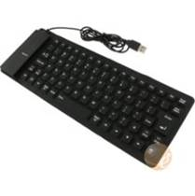
Communicating with Peripherals
0
- Sensitive data
Code with potential data exposure
Program
X
App1
X
App2
Host OS
Driver
Dependencies on rest of OS

Slide 14

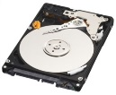

Two Peripheral Types
- Sensitive data
- Encrypted data
1) Storage
2) All other peripherals
Swap
Solve with ephemeral channels
VM writes
Encrypt before data passes through OS
Must ensure no traces left that are readable later

Slide 15
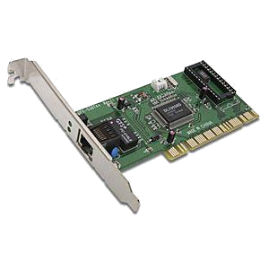
Ensuring No Readable Traces
Program
Strategy 1: Leave no trace
Strategy 2: Make traces unreadable later

Slide 16
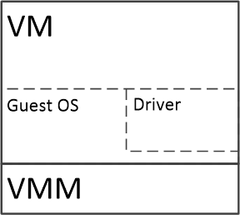


Ephemeral Channels
0
- Sensitive data
Hardware ephemeral channel
- Encrypted data
Guest control of hardware
Traces now cryptographically erased
Encrypted ephemeral channel
Erase channel key
(complex OS paths)

Slide 17
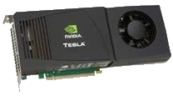
Channel Type Comparison
 | Hardware | Encrypted
Host drivers unmodified | ✓ | ✗
Host code never sees unencrypted data | ✓ | ✗
Hardware virtualization support unnecessary | ✗ (No graphics) | ✓
Guest modification unnecessary | ✗ | ✓ (Run Windows, Linux, unmodified programs)

Slide 18
Encrypted Graphics Channel
No hardware virtualization support for graphics
Solution: Encrypt VM output to GPU memory
GPU memory
CUDA
Host OS
Emulated graphics card
Driver
18

Slide 19
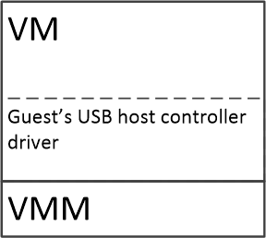
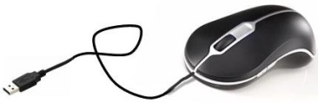
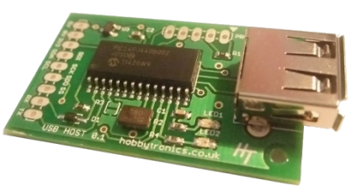
Hardware USB Channel
Controller: non-private
Controller: private
Controller under guest control
Switch into private mode
USB mouse
USB keyboard
Driver
Encrypted USB, audio, network channels described in paper
USB host controller HW

Slide 20
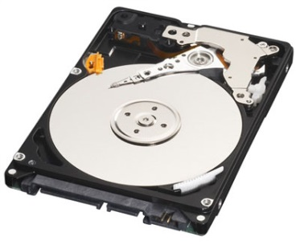
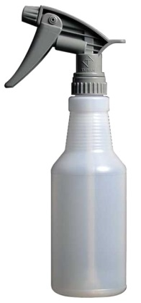
Sanitizing Storage
Encrypt VM writes to storage
  VM image file unmodified
  Diffs file contains VM writes to storage
  Diffs file encrypted
Leave no evidence of which storage locations read
  Free buffer cache pages for VM image file only
Encrypt swapped memory from private VM
  Encrypt swapped pages for VMM process only
Encryption keys erased on VM exit
Techniques here “pay as you go”

Slide 21
Evaluation
Lacuna provides privacy
  Measure that Lacuna does not leak private data
  Quantify size of code that handles sensitive data
Lacuna maintains usability
  Low switch time to private environment
  Application performance near that of running program in VM
More evaluation in paper

Slide 22
Lacuna Protects Privacy
Experiment to locate leaks
Inject random “tokens” into peripheral I/O paths, scan memory to locate [Chow, 2005]
Tokens almost always found without Lacuna
Tokens never found with Lacuna
Host OS
…
0x2a 0xbf 0x3c 0xb1 0x70 0xc6 0x6e 0x82

Slide 23
Little Code Handles Sensitive Data
Subsystem | Lines of Code
Graphics | 725 (CUDA)
Sound | 200 (out) 108 (in)
USB | 414
Network | 208
Measurements are lines of code outside of QEMU that handle unencrypted data
  Data within QEMU erased at VM exit

Slide 24
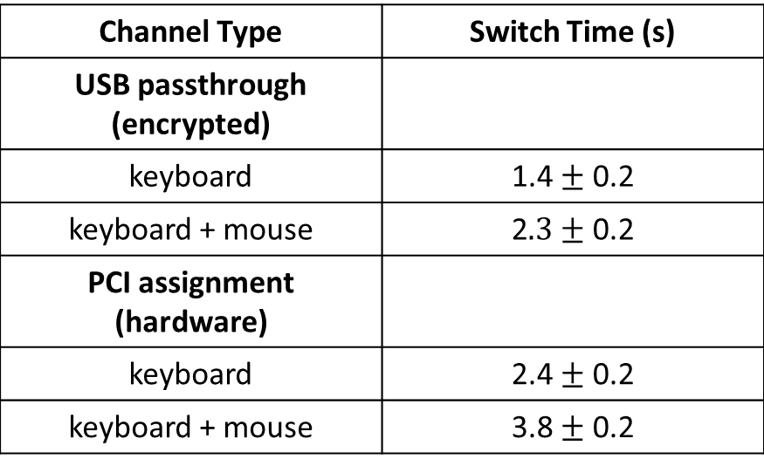
Time to Switch to Private Programs is Low
Channel Type | Switch Time (s)
USB passthrough (encrypted)
keyboard | 1.4 $±$ 0.2
keyboard + mouse | 2$.3±$ 0.2
PCI assignment (hardware)
keyboard | 2.4 $±$ 0.2
keyboard + mouse | 3.8 $±$ 0.2
USB driver disconnect significant (0.8-1.0 s)
Switch time achieved by eliminating two extra disconnects in guest USB initialization

Slide 25
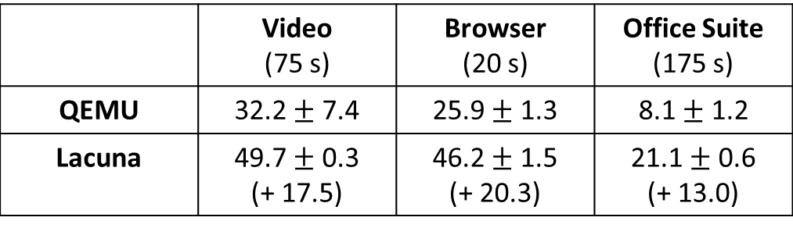
Impact on Full-System Workloads is Low
Benchmarks
  MPlayer: Watch video in across network
  Firefox: Browse Alexa top 20 websites
  LibreOffice: Create 2,994-character, 32-image document
No execution slowdown, higher CPU utilization
 | Video (75 s) | Browser (20 s) | Office Suite (175 s)
QEMU | 32.2 $±$ 7.4 | 25.9 $±$ 1.3 | 8.1 $±$ 1.2
Lacuna | 49.7 $±$ 0.3 (+ 17.5) | 46.2 $±$ 1.5 (+ 20.3) | 21.1 $±$ 0.6 (+ 13.0)
Worst case: additional 20 percentage points
Measurements are % CPU utilization
CPU utilization lowered by hardware AES (AES-NI)

Slide 26
Conclusion
Modern computer systems leak secrets
Lacuna provides forensic deniability: secrets removed after program termination
Ephemeral channels provide private peripheral I/O
Lacuna runs full-system workloads efficiently

