Slide 1
Surveillance,
Law Enforcement,
and Intelligence

Slide 2
Reasons for Surveillance
Criminal
Intelligence
Counter-intelligence
Military

Slide 3
Surveillance Types
Location
  Physical observation
  GPS trackers and beepers
  Cell phones
Communications
  Content
  Metadata
Public presence
  Published writings
  Social Media
Associates
  Physical
  Online
Focus
  Targeted
  Bulk collection

Slide 4
Surveillance Types
Location
  Physical observation
  GPS trackers and beepers
  Cell phones
Communications
  Content
  Metadata
Public presence
  Published writings
  Social Media
Associates
  Physical
  Online
Focus
  Targeted
  Bulk collection

Slide 5
Questions
What are the legalities?
How does it work?
Is it a good idea?

Slide 6
Wiretapping
Telegraph tapping: the oldest form of technical surveillance
  The insecurity of telegraph communications was recognized immediately—Samuel Morse’s business partner wrote on in in 1845
  Tapping telegraph lines was done by both sides in the US Civil War
Made into an art form by the British

Slide 7
The All-Red Route
Great Britain had the best technology for undersea cables
  When they laid cables for other countries, they routed the lines through British-controlled territories
  Their own communications went only through the British Empire
  Telegraph offices were required to give the Royal Navy a copy of all international telegrams
And: cutting Germany’s undersea cables in August 1914 arguably led to Germany’s defeat four years later

Slide 8
World War I
All parties tried to tap the others’ telegraph, telephone, and radio links
  For technical reasons, US telephone lines were vulnerable to remote taps
Naturally, everyone used encryption; equally naturally, everyone practiced cryptanalysis
The French started analyzing metadata (“traffic analysis”), originally to aid in cryptanalysis of the ADFGVX cipher but later for its own benefits

Slide 9
Traffic Volume in ADFGVX Correlated with Battles
Source: NSA, The Friedman Legacy

Slide 10
Telephone Tapping
Telephones are also easy to tap (though there aren’t written copies of calls available)
Also recognized very early on
Wiretapping was outlawed by many states—but not by the Federal government
  California’s law, passed in 1905, extended their 1862 law against tapping telegraph lines

Slide 11
Olmstead v. United States
277 U.S. 438 (1928)
Majority opinion: “that cannot justify enlargement of the language employed beyond the possible practical meaning of houses, persons, papers, and effects, or so to apply the words search and seizure as to forbid hearing or sight.”
Brandeis: “the tapping of one man's telephone line involves the tapping of the telephone of every other person whom he may call or who may call him. As a means of espionage, writs of assistance and general warrants are but puny instruments of tyranny and oppression when compared with wiretapping.”

Slide 12
Federal Communications Act of 1934
Wiretapping was illegal
Well, maybe—in 1940, at J. Edgar Hoover’s request, DoJ ruled that it was illegal to to intercept and divulge a call. Internal governmental use was OK.
FDR ordered that this be done to catch spies and “subversives”
  He also wrote, “You are requested furthermore to limit these investigations so conducted to a minimum and to limit them insofar as possible to aliens.”

Slide 13
Katz v. United States
389 U.S. 347 (1967)
“The Fourth Amendment protects people, not places.”
“Its limitation on Fourth Amendment protection is, in the present day, bad physics as well as bad law, for reasonable expectations of privacy may be defeated by electronic as well as physical invasion.”
Wiretaps were searches and required a warrant

Slide 14
Smith v. Maryland
442 U.S. 735 (1979)
Conversations are protected, but what about the metadata: the numbers dialed?
No: “we doubt that people in general entertain any actual expectation of privacy in the numbers they dial. All telephone users realize that they must "convey" phone numbers to the telephone company.”
  The “third party doctrine”: you have no expectation of privacy in information voluntarily shared with a third party
But: a list of numbers dialed “easily could reveal the identities of the persons and the places called, and thus reveal the most intimate details of a person's life.”

Slide 15
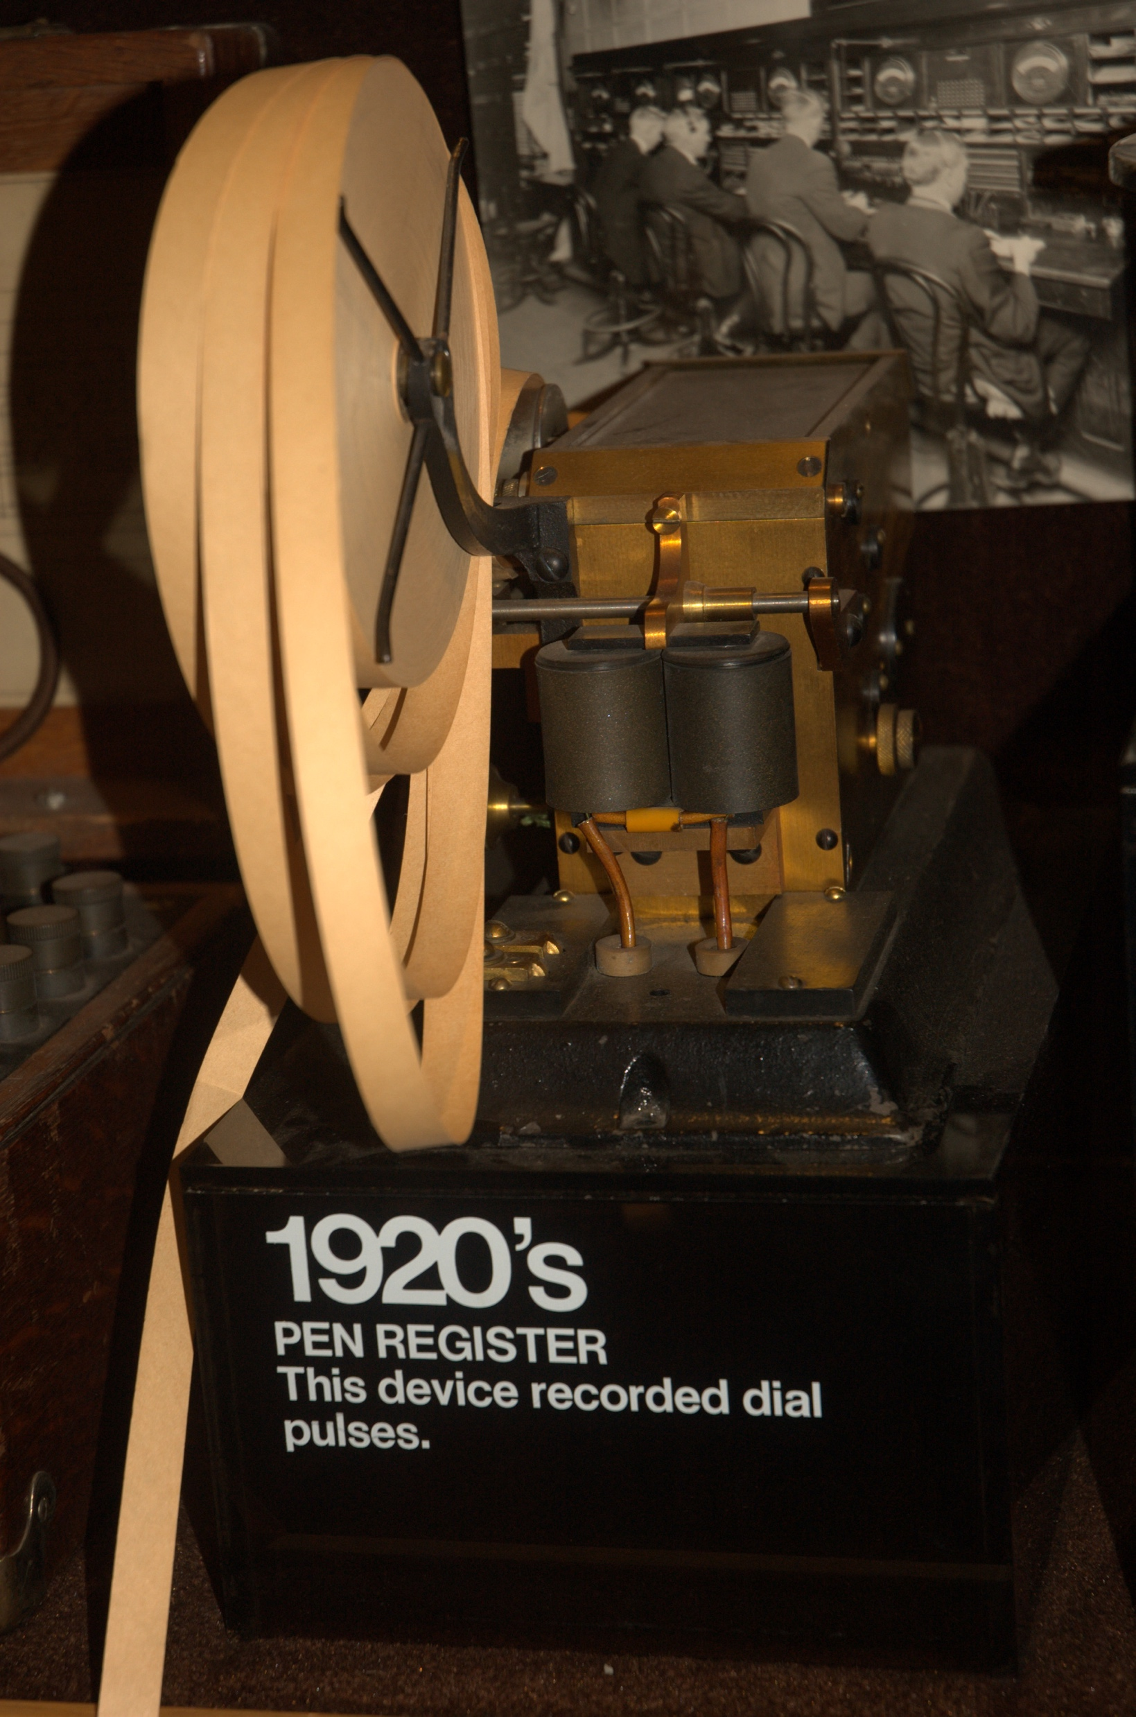
Pen Registers
Pen registers record dialed numbers
Early designs were attached to the wire pair and simply recorded the actual dial pulses

Slide 16
U.S. Wiretap Law
Obtaining content (voice or data) is a search and requires a warrant
Obtaining metadata is not a search and does not require a warrant
N.B.: There is a lot more complexity

Slide 17
National Security Issues
Collecting intelligence abroad does not (generally) require any US legal process
  The Fourth Amendment generally doesn’t protect foreigners
Is it legal to tap foreign embassies within the US?
Foreign spies? Their American assets?

Slide 18
The Church Committee (1976)
Hoover wanted (and exercised) broad power to surveil “communists”
  “Hoover stressed the danger of Communist subversion, and the FBI collected intelligence about the influence of Communists in a variety of categories, including ‘political activities, Negro question, youth matters, women’s matters, farmers’ matters, veterans’ matters’” (Diffie and Landau)
Other abuses by Hoover (e.g., tapping Supreme Court justices), the CIA, and the NSA
These were exposed by assorted Congressional committees, notably Church’s

Slide 19
The Foreign Intelligence Surveillance Act (1977)
(50 U.S.C. §1801 et seq.)
Codified rules for national security surveillance
Tapping “US persons” within the US, or US citizens anywhere, requires a warrant from the Foreign Intelligence Surveillance Court
Tapping foreign powers within the US requires Attorney-General approval and court notification
“Minimization” required: “specific procedures, which shall be adopted by the Attorney General… to minimize the acquisition and retention, and prohibit the dissemination, of nonpublicly available information concerning unconsenting United States persons”

Slide 20
Protecting Data
The 1986 Electronic Communications Privacy Act extended the Wiretap Act to cover data
The Stored Communications Act governs access to subscriber records (including call records) and to email
It also set out procedures for law enforcement access to metadata, per Smith

Slide 21
Bulk Collection
Can the government collect data in bulk, or only on particular individuals?
The Fourth Amendment requires warrants to “particularly describ[e] the place to be searched, and the persons or things to be seized”—which would seem to rule out bulk collection
But what of activities that don’t require warrants, such as metadata collection?

Slide 22
§215 of the PATRIOT Act
Was used by the NSA to collect metadata (“call detail records”) from phone companies for many domestic calls
Reasoning: until they looked at the records, no rights were violated
But: 50 U.S.C. §1842 requires “the information likely to be obtained is … is relevant to an ongoing investigation” [emphasis added]
What does “relevant” mean?

Slide 23
Why §215?
Start with a “selector”—the phone number of a known terrorist
Whom did that person call in the past? Who called that person in the past?
Repeat the process for the new number, two or even three hops out
Bulk collection acts as a “time machine”
  Extremely useful for investigations after an incident

Slide 24
The USA Freedom Act
The Second Circuit did not like the §215 program:
  “[T]he government takes the position that the metadata collected… are nevertheless "relevant" because they may allow the NSA, at some unknown time in the future, utilizing its ability to sift through the trove of irrelevant data it has collected up to that point, to identify information that is relevant. We agree with appellants that such an expansive concept of ‘relevance’ is unprecedented and unwarranted.”
They essentially asked Congress to pass a better law—which it did
New version: phone companies keep the metadata, but NSA can query it

Slide 25
Technology Issues

Slide 26
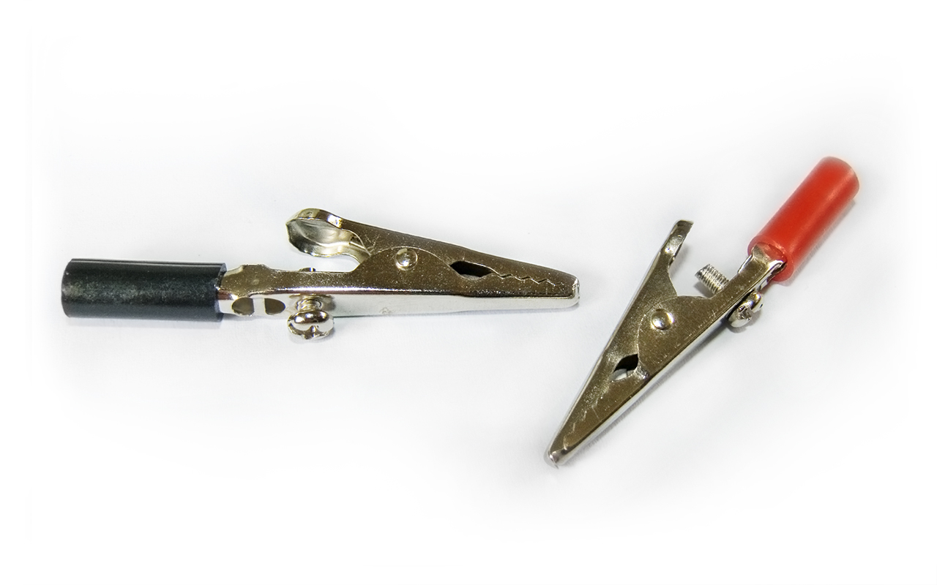
How To Tap Phones
Originally, very simple—no technology was needed
© Benjamint444:
https://en.wikipedia.org/wiki/File:
Alligator_clips_444.jpg

Slide 27
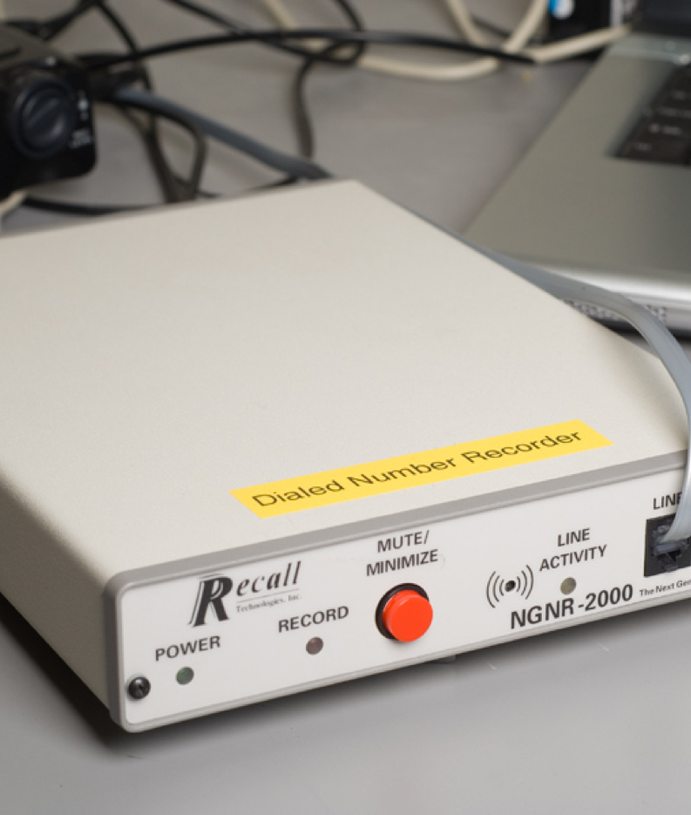
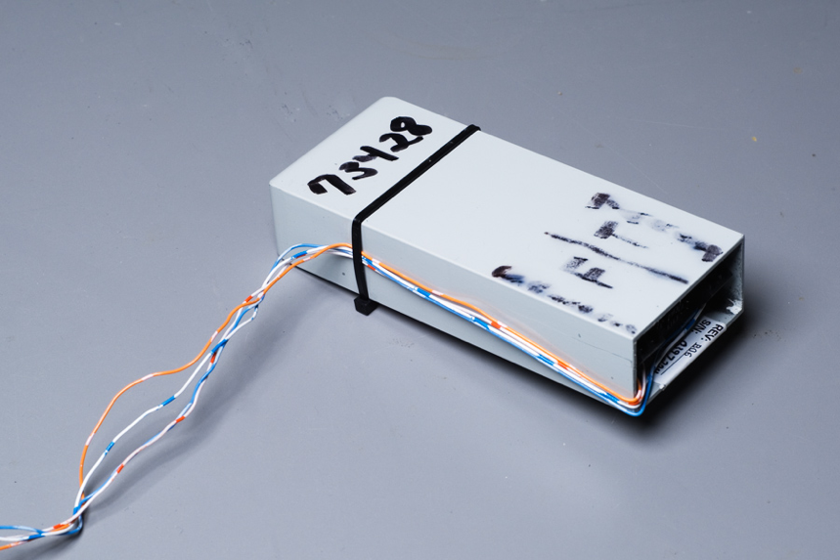
The Modern Version Isn’t Much More Complicated
Photos ©Matt Blaze; used by permission

Slide 28
Not Many Twisted Pair Lines These Days…
In 1994, Congress passed the Communications Assistance to Law Enforcement Act (CALEA); it mandates standardized wiretap interfaces on all phone switches
The concept was adopted in many other countries under the name “lawful intercept”
Computer scientists warned there would be trouble
We were right…

Slide 29
The Athens Affair
Modern phone switches are simply specialized computers, run by very complex software
As such, they can be hacked
About 100 mobile phones in Athens, including the Prime Minister’s, were tapped by someone who abused the lawful intercept mechanism
The conversations were relayed to prepaid mobile phones located elsewhere in Athens

Slide 30
Tapping Computer Communications
What is desired? Real-time conversations? Email?
Where is the target? At home? At work? At a public hotspot?
What does law enforcement know about the target? A name? An email address? A MAC address? An IP address?
  IP addresses change very frequently, and are often assigned by ISPs

Slide 31
Where Do We Tap?
On the target’s LAN?
On the access link to the customer from the ISP?
On the Internet backbone?

Slide 32
Where Do We Tap?
On the target’s LAN?
  Hard to get access; may be detectable
On the access link to the customer from the ISP?
  Best—but may be a shared medium and carry traffic for many customers
On the Internet backbone?
  Too much volume, and paths are asymmetric
  May be done for intelligence taps

Slide 33
Tapping a Link
Every Mac and Linux computer comes with the tcpdump command; this can tap networks
  (Exercise: what about 18 U.S.C. § 2512—Manufacture, distribution, possession, and advertising of wire, oral, or electronic communication intercepting devices prohibited?)
The tcpdump command even does some protocol analysis

Slide 34
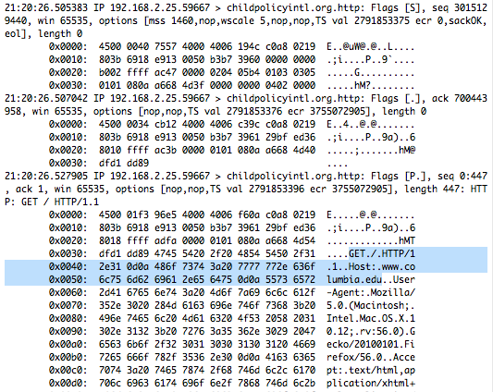

Slide 35
Getting the Right User’s Traffic
We want to tap a person
We may or may not know that person’s email address
IP addresses are dynamically assigned, so we don’t know them a priori
We need smart, protocol-aware filtering

Slide 36
Carnivore
A late 1990s FBI network-tapping device
Very controversial, so there was an external review
As a result, we know much more about it than about other specialized tapping software

Slide 37
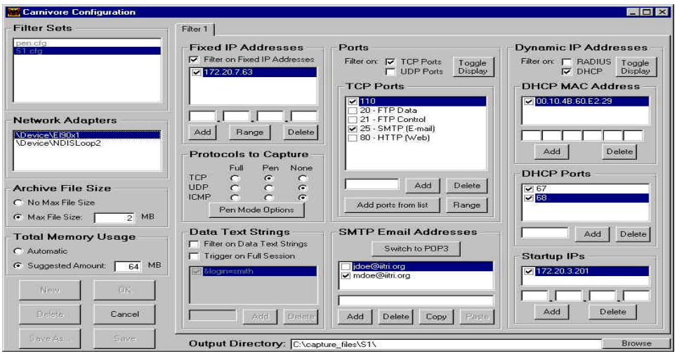
Configuring Carnivore

Slide 38
Configuring IP Address

Slide 39
Filtering on Email Address

Slide 40
Selecting Protocols

Slide 41
Full Content or
Pen Register

Slide 42
Filtering on Content

Slide 43
Reading Email
Pick it up over the wire? Hard, and most transfers are encrypted
Better: pick it up from the recipient’s email server
  Is this a tap, or is this a stored communication?
Or: hack into the email server

Slide 44
Foreign Intelligence Surveillance Act §702
Downstream—compulsory process to ISPs (PRISM)
Upstream collection—look at wires, possibly in the US, for legal foreign intelligence information

Slide 45
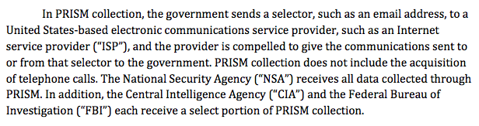
PRISM
(PCLOB §702 report)

Slide 46
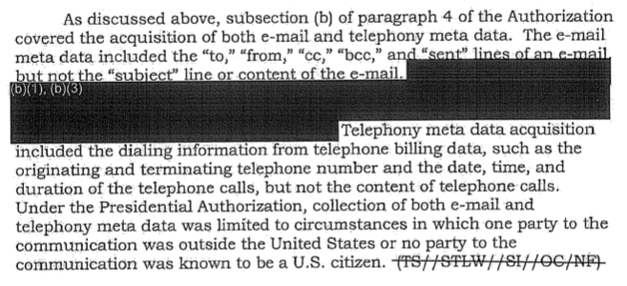
What is Metadata?

Slide 47
Collecting Internet Metadata
You have to collect an entire SMTP or IMAP session
You have to parse the protocol and the email message
  (It’s actually not at all clear that addresses in email header are legally metadata, at least per Smith)
Note the difference from phone calls
  But—what about “post cut-through dialed digits”?
  Hard to tell from content

Slide 48
“About” Collection
Under the §702 program, the NSA can collect messages that mention a selector, i.e., that are “about” that selector
The selector still has to be a valid target
This can sweep up messages to and from US persons
Note: In April 2017, the NSA voluntarily halted “about” collection

Slide 49
Doing “About” Collection
In the IP header, selectors are at fixed offsets
In email messages, the selectors are near the start of the session
With “about” collection, they can be anywhere—much more expensive!

Slide 50
Multi-Communications Transactions
Sometimes, a single intercept contains permitted and prohibited (i.e., purely domestic) traffic
Picking out just the foreign traffic is technically infeasible

Slide 51
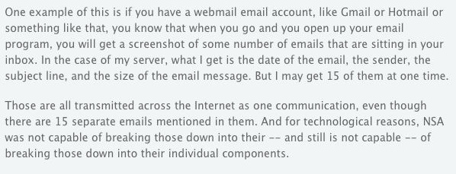
From ODNI
https://www.eff.org/deeplinks/2013/08/intelligence-agency-attorney-explains-how-multi-communication-transactions-allowed

Slide 52
A Gmail Screenshot

Slide 53
Hacking: The New
Alligator Clips
The FBI (apparently) converted a cellphone into a roving bug (allowed, US v. Tomero, 471 F. Supp. 2d 448, 2007)
  The details in the order are suggestive but not definitive
The FBI used a car’s cellular “help” system to eavesdrop on conversations in the car (excluded, Company v. United States, 349 F.3d 1132, 1145 (9th Cir. 2002))
Researchers have shown how to activate a Mac’s camera without turning on the light (“iSeeYou: Disabling the MacBook Webcam Indicator LED”, Brocker and Checkoway, Usenix Security 2014)
  Criminals have used similar abilities to spy on (mostly) women

Slide 54
How It’s Done: Many Ways
Hack the phone or computer to install new code
Control the server
Control the server and use it to push new code to the device (the UAE tried that: http://news.bbc.co.uk/2/hi/8161190.stm)
Control the vendor and have it push new code to the device (most have the ability: http://www.extremetech.com/computing/196391-apple-pushes-its-first-ever-silent-automatic-security-update-to-mac-os-x-to-fix-ntp-bug)
Order other companies to issue bogus cryptographic authentication credentials
Physical intrusion
Infected USB sticks

Slide 55
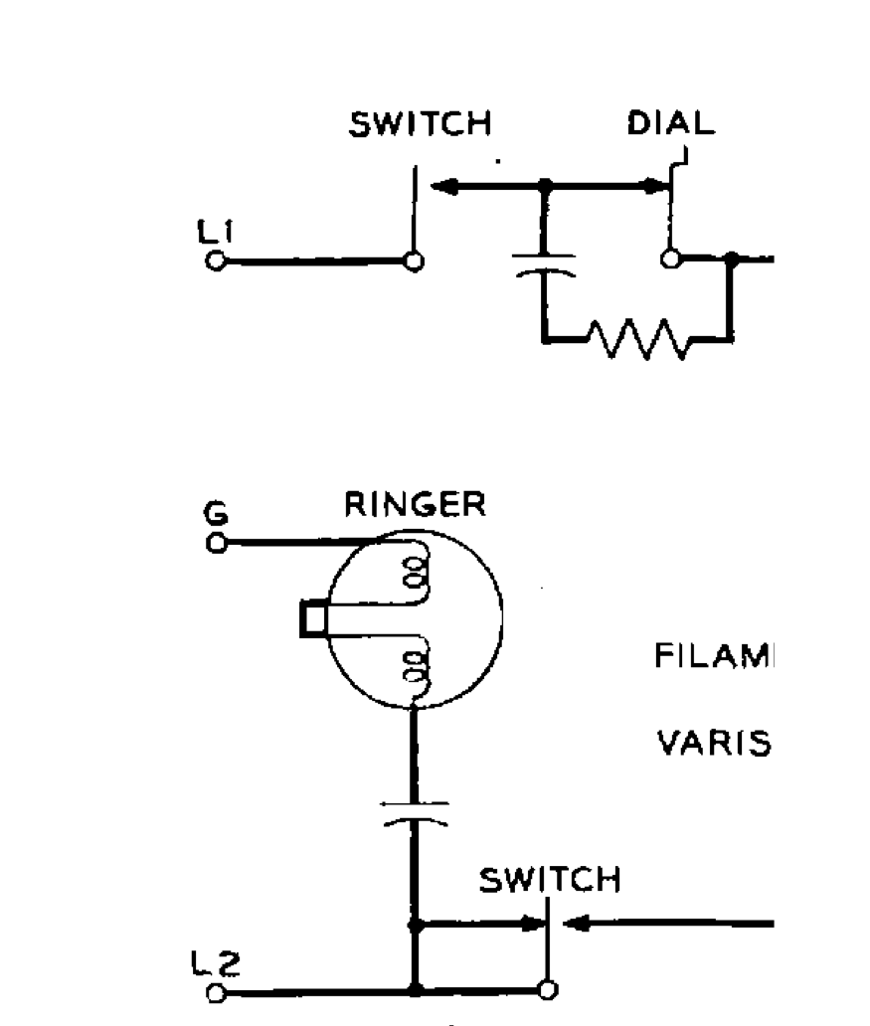
Bugging Phones
On older phones, the microphone was physically disconnected from the phone line when the phone was on-hook
Today, the microphone is controlled by software
Changed software, either in the phone or at the switch, can turn on the mic
(Does your desk phone have a “speakerphone” button? Mine does…)

Slide 56
Software Can Be Buggy
From https://www.epic.org/privacy/carnivore/fisa.html

Slide 57
Location Data
How is location data categorized?
For cell phones, is location third party metadata? The phone company must know where you are, to route calls to you
From Sotomayor’s concurrence in United States v. Jones (615 F. 3d 544 (2012)): “Disclosed in [GPS] data . . . will be trips the indisputably private nature of which takes little imagination to conjure: trips to the psychiatrist, the plastic surgeon, the abortion clinic, the AIDS treatment center, the strip club, the criminal defense attorney, the by-the-hour motel, the union meeting, the mosque, synagogue or church, the gay bar and on and on”
United States v. Carpenter (138 S. Ct. 2206 (2018)): “When Smith was decided in 1979, few could have imagined a society in which a phone goes wherever its owner goes, conveying to the wireless carrier not just dialed digits, but a detailed and comprehensive record of the person’s movements.”

Slide 58
Social Media
People express themselves freely on social media
Should the government be allowed to monitor it?
Sotomayor in Jones: "Awareness that the Government may be watching chills associational and expressive freedoms. And the Government’s unrestrained power to assemble data that reveal private aspects of identity is susceptible to abuse.”
What about abroad, where the Bill of Rights doesn’t apply?

Slide 59
Associational Data
Associational data is very revealing
The phone numbers you dial uniquely identify you
Facebook friend patterns often indicate sexual orientation
But this data is often public—should legal process be required for law enforcement to access it? Does it matter if it’s bulk collection or targeted?
What if it’s non-US data?

Slide 60
Published Text
Use machine learning on published documents
But—must train the algorithms
Is there enough “evil” content?
What about false positives?

Slide 61
International Cooperation
Intelligence: sometimes, there are close ties (NATO) or very close ties (Five Eyes: US, UK, Canada, Australia, New Zealand)
Law enforcement: MLATs—Mutual Legal Assistance Treaties
  Slow process: US DoJ ➝ State Dept ➝ Foreign Ministry ➝ Justice Ministry ➝ Court

Slide 62


