Slide 1

Stealing Credentials

Slide 2
Breaking in Without Bugs
Many attackers steal users’ passwords
This is done for both random and targeted attacks
How is it done?

Slide 3
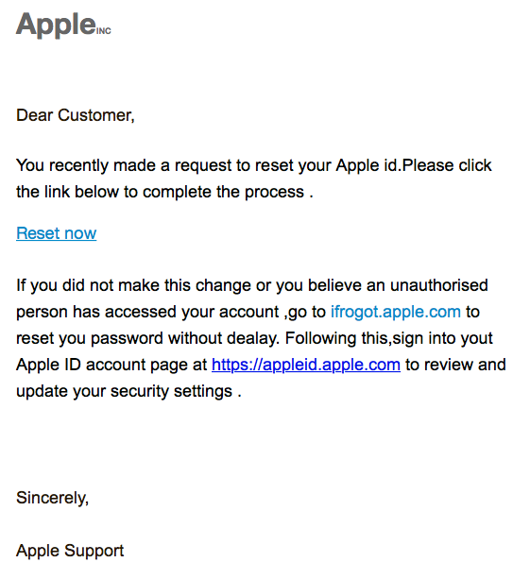
Phishing
Trick the user into going to a bad website
Profit

Slide 4
Spear-Phishing
Send email targeted to particular users
  Do research first to see what useful emails might be
“Jane Doe has asked to be added to your class. Please accept or reject the invitation via SSOL.”
Profit

Slide 5


Phishing versus Spear-Phishing
Phishing
Spear-Phishing

Slide 6
Not a Phishing Attack

Slide 7
Exploiting Browser or Mailer Bugs
Send an email or otherwise lure a target to a malware-bearing site
  Or: compromise a web site that your class of targets will frequent (“watering hole attack”)
  Place a malware-bearing ad on a site your target visits
Exploit a mailer or browser bug to penetrate the victim’s computer and install a keystroke logger
Wait for the victim to log in to a site useful to you

Slide 8
Compromised Servers
Hack a server and steal its password file
Run a password-guessing attack
  Most sites do not store passwords in the clear
With good probability, many users will have guessable passwords
Many users share passwords between sites

