Slide 1

How the Internet Works

Slide 2
What is the Internet Made of?
Computers
  Servers
  Clients
  Phones
  “Things”
Routers—specialized computers that forward “packets”
  Packets are fragments of messages
Links—WiFi, Ethernet, fiber, etc. The Internet was designed to run over anything

Slide 3
Fibers
Each cable has many pairs of strands
Each strand carries many wavelengths (aka “colors” or “lambdas”)
  A new trans-Pacific fiber has six pairs of strands
  Each strand carries 100 wavelengths
  Each wavelength has a bandwidth of 100G bps
  Total capacity: 60 terabits/second
Each wavelength can carry many different circuits
Each Internet circuit carries packets for many different conversations

Slide 4
WiFi
Used in public spaces and private residences
  Some use in business, but wired Ethernet is more common for desktops
Range: about 100 meters
Security: WEP is obsolete and insecure; WPA2 is quite good—and in public, all bets are off.

Slide 5
A Look at Common Applications
Web browsing
Email
The Cloud
Caution: all of this is simplified—and arguably oversimplified

Slide 6



How the Web Appears to Users
Internet
Web Server
Web Browser

Slide 7
The Internet Has Structure: Multiple ISPs that Interconnect at Multiple Points
ISP A
LON
ISP B
NYC

Slide 8
Wiretapping the Internet
Tapping the “backbone” is very difficult—the forward and reverse directions of a conversation generally follow different paths
Consequence: wiretap orders should be served on edge providers

Slide 9
Routing Between ISPs
Sprint
Verizon
IIJ
Big ISPs ‘Peering’
Amazon
GoJ
Sakura
Customers buy ‘Transit’
9

Slide 10


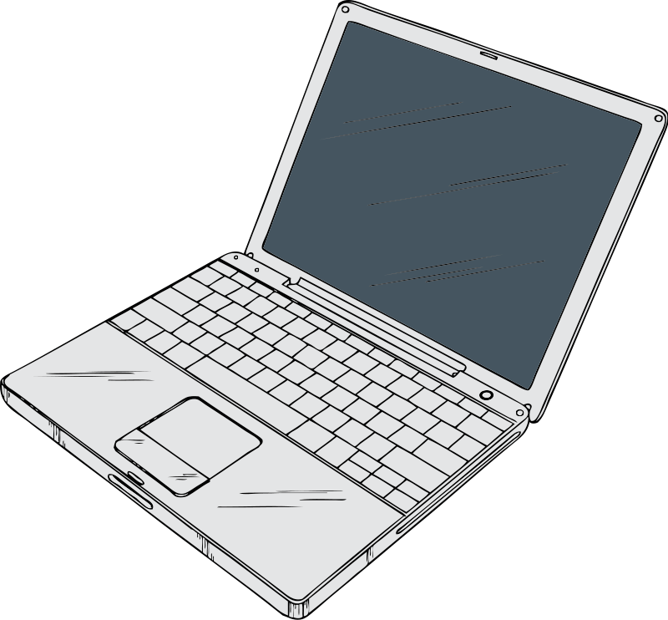

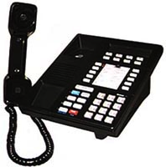
Each ISP Has Structure: Many Routers

Slide 11
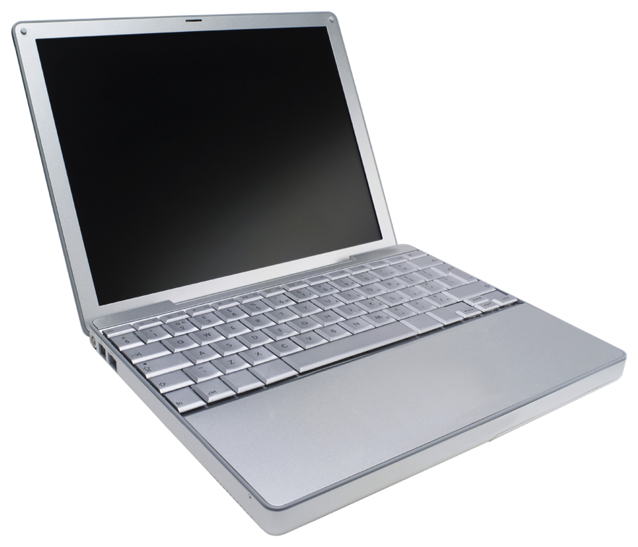
Hosting Services
Company A
Internet
Company B
Company C
Hosting
Company
Web Browser

Slide 12
Content Distribution Network
CDN B
CDN A
CDN C
CDN D
Web
Server

Slide 13
Content Distribution Network
CDN B
CDN A
CDN C
CDN D
Web
Server

Slide 14
Content Distribution Network
CDN B
CDN A
CDN C
CDN D
Web
Server

Slide 15
Content Distribution Network
CDN B
CDN A
CDN C
CDN D
Web
Server

Slide 16
CDN Example: www.supremecourtus.gov
www.supremecourt.gov is an alias for a1042.b.akamai.net; Akamai is
a prominent CDN operator
New York | 24.143.200.48
Ashburn, Va | 23.15.9.144
Atlanta | 208.44.23.57
San Francisco | 216.156.149.106
Boston | 207.86.164.89

Slide 17
Multiple Parties
There are multiple parties involved in most web transactions
Consequently, multiple know who is visiting what pages and hence when is retrieving what content
However, determining who has the information for any given transaction is not always easy

Slide 18
Which is the Browser; Which is the Server?
Internet
Web Server
Web Browser

Slide 19
Architecturally, They’re the Same—What Matters is the Software They Run
Internet
Web Browser
Web Server

Slide 20
“Smart Hosts, Dumb Network”
The phone network was built for dumb phones – nothing else was technically or economically feasible.
All intelligence is in the network: conference calls, call forwarding, even many voice menus
Internet routers are very dumb; all intelligence is in end systems
  Consequence: service providers are not necessarily the same as network providers
  Service provision is decoupled from physical location, and hence from jurisdiction
  A person’s mail provider may be in another country

Slide 21


The Phone Network:
A Few Large Switches, Serving Phones

Slide 22
The Internet:
Many Routers, Very Many Types of Devices

Slide 23
Circuit Switching versus Packet Switching
Circuits: traditional telephony model
Path through the network selected at “call setup time”
  Very small number of call setups; process can be heavyweight
Each “phone switch” needs to know the destination of the call, not the source; return traffic takes the reverse path
Packets: Internet model
Every “packet” – a fragment of a message – is routed independently
  No call setup
  Routing must be very, very fast; it’s done for each packet
Robustness: if a “router” fails, packets can take a different path
Every packet must have a source and destination address, to enable replies
Reply traffic may take a very different path

Slide 24
Many More Parties
On the phone network, the central core knows everything
On the Internet, the core knows little except for the endpoint addresses—and services can be provided anywhere
Service providers can be and often are in different jurisdictions, where you may not have effective legal access (e.g., mail.ru)

Slide 25
IP Addresses
A user types a name such as www.dni.gov.
The Domain Name System (DNS) translates that to an Internet Protocol (IP) Address such as 23.213.38.42
  IP addresses are four bytes long; each of those numbers is in the range 0-255
  www.dni.gov actually uses a CDN, so every querier gets a different answer
  (DNS resolution is complicated and involves many parties_
IP addresses are what appear in packets
Routers talk to each other (via Routing Protocols) to learn where each IP address is

Slide 26
IP Addressing
Roughly 4 billion possible IP addresses today—we’ve essentially run out
  IPv6, a newer version of IP being deployed now, has many more addresses
IP addresses are handed out in blocks to big ISPs. Big ISPs give pieces of their allocations to smaller ISPs or to end customers
Unless you’re a very large enterprise, the only way to get IP addresses is from your ISP – and if you switch ISPs, you have to renumber your computers
There is no analog to “local number portability” on the Internet – and can’t be; there’s no time to do that many lookups

Slide 27
Address Space Assignment
IP addresses are handed out by Regional Internet Registries (RIRs), such as ARIN
They get their addresses from ICANN, an international non-profit which gets its authority from the U.S. Department of Commerce – controversial abroad
Addresses are allocated based on demonstrated short-term need and evidence of efficient use of previously-allocated addresses
Addresses may not be sold, even as part of a bankruptcy, merger, or acquisition, except with ARIN’s approval and in accordance with ARIN’s policies
  This assertion of authority has never been contested in court—and some have been transferred by order of a bankruptcy court
  Some ISPs have (very valuable) pre-ARIN addresses, called “legacy space”. Legacy address holders don’t have to renumber when switching ISPs (among other advantages)

Slide 28
Port Numbers
When one computer contacts another, is it trying to talk to a Web server or trying to send mail?
  Remember that architecturally, all machines on the Internet are alike
  It’s perfectly legal to run a Web server and a mail server on a single computer
Packets contain not just an IP address but a port number
  Port 25 is the mail server, port 80 is the Web server, 443 is encrypted Web, etc.
If an IP address is like a street address, a port number is the room number in the building
  Room 25 is the mail room, room 80 is library, etc.

Slide 29
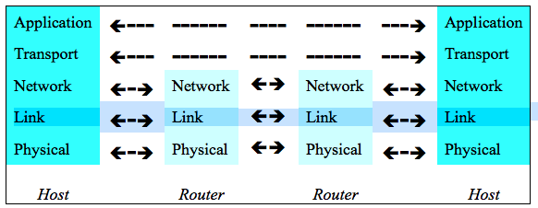
The Network Stack
The Internet uses a layered architecture
Applications—email, web, etc.—are what we care about
TCP (which has port numbers) transports the data; it is end-to-end
IP (the network layer) is processed by every router along the path
The link layer is things like WiFi, Ethernet, etc.

Slide 30
Email

Slide 31
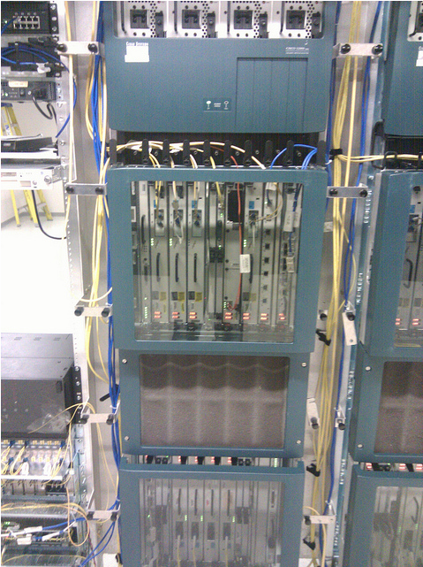
Sending Email
Inbound
Mail Server
ISP
ISP
Outbound
Mail Server
ISP
ISP
Access Links
Notes:
Legal points: ECPA transmission/storage applicability. Email session will address

Slide 32
Sending Myself Email—An SMTP Transcript
220 machshav.com ESMTP Exim 4.82 Tue, 11 Mar 2014 19:43:03 +0000
HELO eloi.cs.columbia.edu
250 machshav.com Hello eloi.cs.columbia.edu [2001:18d8:ffff:16:12dd:b1ff:feef:8868]
MAIL FROM:<smb@eloi.cs.columbia.edu>
250 OK
RCPT TO:<smb@machshav.com>
250 Accepted
DATA
354 Enter message, ending with "." on a line by itself
From: Barack Obama <president@whitehouse.gov>
To: <smb2132@columbia.edu>
Subject: Test
This is a test
.
250 OK id=1WNSaS-0001z5-1d
QUIT
221 machshav.com closing connection
Message

Slide 33
Conversation With A Third Party
220 machshav.com ESMTP Exim 4.82 Tue, 11 Mar 2014 19:43:03 +0000
HELO eloi.cs.columbia.edu
250 machshav.com Hello eloi.cs.columbia.edu [2001:18d8:ffff:16:12dd:b1ff:feef:8868]
MAIL FROM:<smb@eloi.cs.columbia.edu>
250 OK
RCPT TO:<smb@machshav.com>
250 Accepted
DATA
354 Enter message, ending with "." on a line by itself
From: Barack Obama <president@whitehouse.gov>
To: <smb2132@columbia.edu>
Subject: Test
This is a test
.
250 OK id=1WNSaS-0001z5-1d
QUIT
221 machshav.com closing connection
Message

Slide 34
What the Recipient Sees
220 machshav.com ESMTP Exim 4.82 Tue, 11 Mar 2014 19:43:03 +0000
HELO eloi.cs.columbia.edu
250 machshav.com Hello eloi.cs.columbia.edu [2001:18d8:ffff:16:12dd:b1ff:feef:8868]
MAIL FROM:<smb@eloi.cs.columbia.edu>
250 OK
RCPT TO:<smb@machshav.com>
250 Accepted
DATA
354 Enter message, ending with "." on a line by itself
From: Barack Obama <president@whitehouse.gov>
To: <smb2132@columbia.edu>
Subject: Test
This is a test
.
250 OK id=1WNSaS-0001z5-1d
QUIT
221 machshav.com closing connection
Message

Slide 35
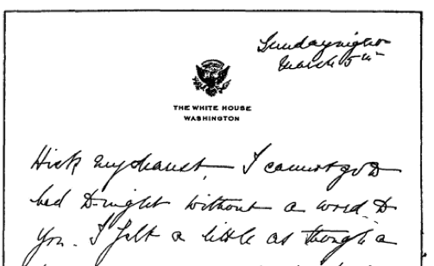
A Letter from Eleanor Roosevelt to Lorena Hickock (March 1933)
(excerpt from Amazon.com)
It begins “Hick my dearest”.

Slide 36
Things to Note re the Third Party Doctrine
The SMTP envelope—that’s the technical term!—can have different information than the message headers
Unlike the phone network, anyone can run their own mail servers
  I personally run two, one personal and one professional
  This complicates third party doctrine analysis
The reality of email is far more complex than I’ve outlined here
  Example: many people read their email via a Web browser—and the NSA has stated that even for them, picking out just the From/To information from a Webmail session is very difficult
I haven’t even begun to address server-resident email, virus scanning, spam filtering, and the like, let alone all of the other metadata that’s present

Slide 37
Encryption on the Internet

Slide 38
Anything Can be Encrypted
Links—though mostly used on WiFi
Virtual Private Networks (VPNs)
Simple connections (Web, email, etc.), generally via Transport Layer Security (TLS)
Data, especially the body of email messages

Slide 39
VPNs
Used by corporate employees for telecommuting or while traveling
  Also used to connect multiple corporate locations
Sometimes used to spoof location
  Cover tracks
  Fool geographic restrictions on content, e.g., streaming movies and music
A recently published academic paper concluded that the NSA could cryptanalyze a lot of VPN sessions

Slide 40
TLS
Used for all secure Web traffic
Widely (and increasingly) used when sending and retrieving email
  But—TLS does not protect email “at rest”, i.e., while on disk on the various servers
Used for many other point-to-point connections, e.g., Dropbox
Older versions of TLS have cryptographic weaknesses; these are (believed to be) fixed in the newest versions
The most common implementations of TLS have a long history of serious security flaws

Slide 41
Email Encryption
Two different standards, S/MIME and PGP
  S/MIME is widely supported—but rarely used
  PGP requires less infrastructure support, and hence is used by enthusiasts
Protects email at rest—but hinders searching
Does not protect email headers or other metadata
Both are generally very hard to use correctly

Slide 42
Tor: The Onion Router
Computer A picks a sequence of Tor relays (C➝E➝D)
  D is the exit node, and passes the traffic to destination host G
  All of these hops are encrypted
B picks relays F➝C➝D
  G can’t tell which is from A and which from B
Neither can anyone else monitoring G’s traffic
Many use Tor for anonymity: police, human rights workers, spies—and criminals (e.g., Ross Ulbricht of Silk Road fame)
Mental model: nested, sealed envelopes

Slide 43
Encryption
Modern encryption algorithms, if used correctly, are extremely hard to break
As a consequence, it is extremely hard to trace Tor connections or figure out the real origin of VPNed traffic
The FBI and other law enforcement agencies have complained that they are “going dark” and want a legislative solution to provide for “exceptional access”
  Most cryptographers think this is a bad idea
  More on this later in the semester

Slide 44
Cloud Computing

Slide 45
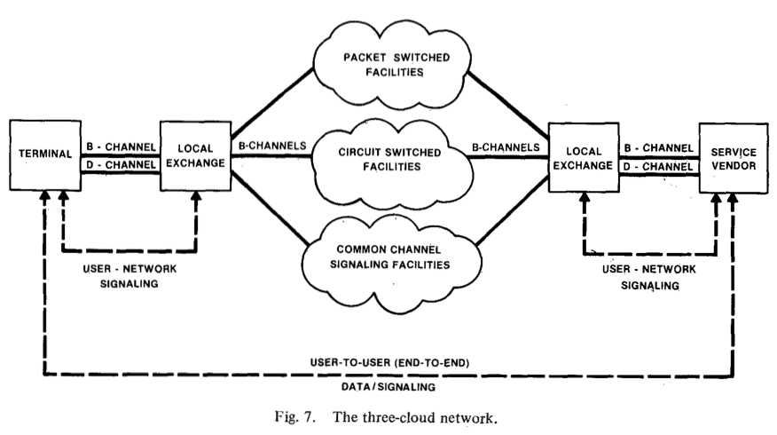
What’s a Cloud?
A cloud is a traditional way to represent a network
This “three-cloud network” picture is from 1982
But—today “cloud” refers to computing services provided via the Internet by an outside party.
(The modern usage seems to date to 1996: http://www.technologyreview.com/news/425970/who-coined-cloud-computing/)

Slide 46
“Via the Internet”
The service is not provided on-premises
An Internet link is necessary
This link provides an opportunity for interception, lawful or otherwise

Slide 47
“Outside Party”
By definition, cloud services are provided by an outside party
  Similar in spirit to the computing and time-sharing service bureaus, which date back to the 1960s
Not the same as a company’s own remote computing facility
  Organizations can have a “private cloud”, but the legal issues may be very different

Slide 48
Computing Services
Many different types of services
  Storage
  Computing
  Applications
  Virtual machines
  More

Slide 49
Storage
Disk space in a remote location
Easily shared (and outside the corporate firewall)
Often replicated for reliability
  Replicas can be on different power grids, earthquake zones, countries, continents, etc.
  Data can be moved—or move “by itself”—to be closer to its users
Expandable
Someone else can worry about disk space, backups, security, and more
Examples: Dropbox, Google Drive, Carbonite (for backups), Amazon S3
Mental model: secure, self-storage warehouse

Slide 50
Computing
Rent computing cycles as you need them
Pay only for what you use
Often used in conjunction with the provider’s cloud storage service
Examples: Amazon EC2, Microsoft Azure, Google Cloud
  Dropbox is a cloud service that uses a different provider’s cloud storage
Mental model: calling up a temp agency for seasonal employees

Slide 51
Applications
Provider runs particular applications for clients
Common types: web sites, email services
Less common types: shared word processing, payrolls
Well-known providers: Google’s Gmail and Docs, Microsoft’s Outlook and Office 365, Dreamhost (web hosting)
Mental model: engaging a contractor for specific tasks

Slide 52
Playing an Active Part: Google Docs
Someone, using a Web browser, creates a document
  Standard formatting buttons: font, italics or bold, copy and paste, etc.
Others who have the proper authorization (sometimes just a special URL) can edit the document via their own Web browsers
The changes made by one user show up in real time in all other users’ browser windows
In other words, Google is not just a passive repository; it is noticing changes and sending them out immediately

Slide 53
Virtual Machines
Normal desktops: an operating system (e.g., Microsoft Windows) runs the computer; applications run on top of the operating system
Virtual machines: a hypervisor running on a single computer emulates multiple real computers. A different operating system can run on each of these emulated computers—and each one is independent of the others and is protected from it
Net effect: many computers that consume the space and power requirements of a single computer
Mental model: rented office space

Slide 54
Location of Cloud Servers
Responsiveness of and effective bandwidth to a server is limited by how far away it is
  The problem is the speed of light—and not even Silicon Valley can overcome that limit!
  It takes a minimum of a quarter-second to set up a secure connection from Washington to Paris, and twice that to New Delhi
For performance reasons—and independent of political and legal considerations—large cloud providers therefore place server complexes in many places around the world
  Also: take advantage of cheap power and cooling

Slide 55
Where is Data Stored?
Modern email: on the server and on one or more devices
  Users can’t easily tell what’s on their device (e.g., phone or laptop) versus what is retrieved from the server on demand
  It differs for different devices at different times, and may depend on the user’s recent activity
  What if the device and server are in different jurisdictions?
(A bad fit for the assumed behavior model of Stored Communications Act)

Slide 56
Security and Privacy Issues
Gmail: Google applications scan email and serve up appropriate ads
Dropbox: uses Amazon S3 for actual storage; encrypts data so that Amazon can’t read it—but Dropbox can
Spider Oak: data is encrypted with the user’s password; Spider Oak can’t read it
Outlook.com: blocks file attachments that frequently contain viruses
Many: check pictures for known child pornography
Many: spam filtering

Slide 57
Web Sites and Ads

Slide 58
Web Pages
Web pages are composed of many separate elements
Images always are loaded from a separate URL
There are also “frames”—web pages embedded in other web pages, again from separate URLs
Many pages download JavaScript (small programs embedded in web pages) libraries from yet other URLs
Web requests (HTTP—hypertext transfer protocol) generally contain the URL of the referring page
In other words, for a typical web page many sites may know of the request

Slide 59
Cookies
Web sites will tell you that cookies are small, harmless text files. That’s true, but…
When you visit a site, it can set a cookie; your browser stores it on disk
When you return to this site, your browser sends back that cookie
Cookies are used for logins, site preferences, shopping carts, etc.
They’re also used to track people around the web
When you visit a page that includes other URLs, each site can set and receive cookies

Slide 60
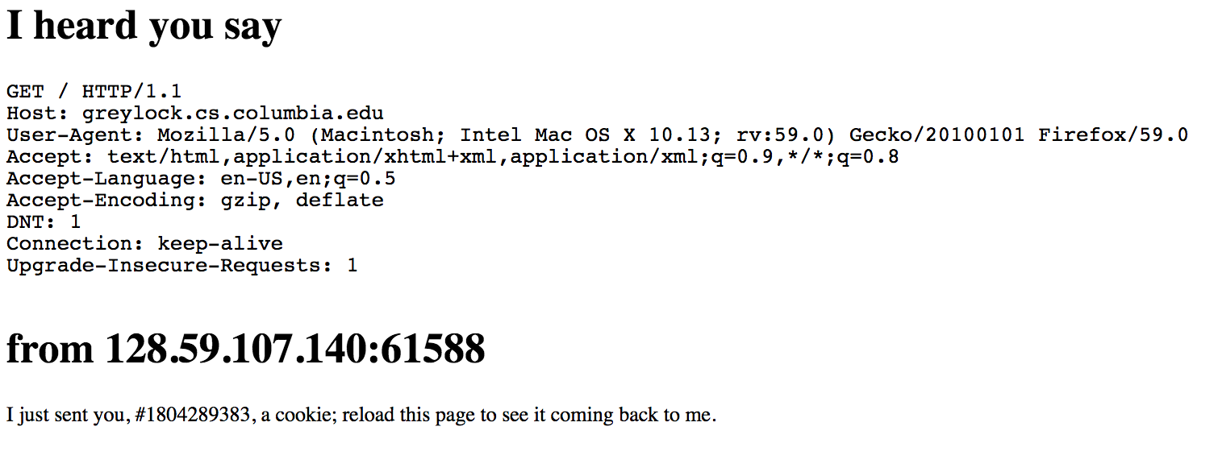
The Initial Request

Slide 61
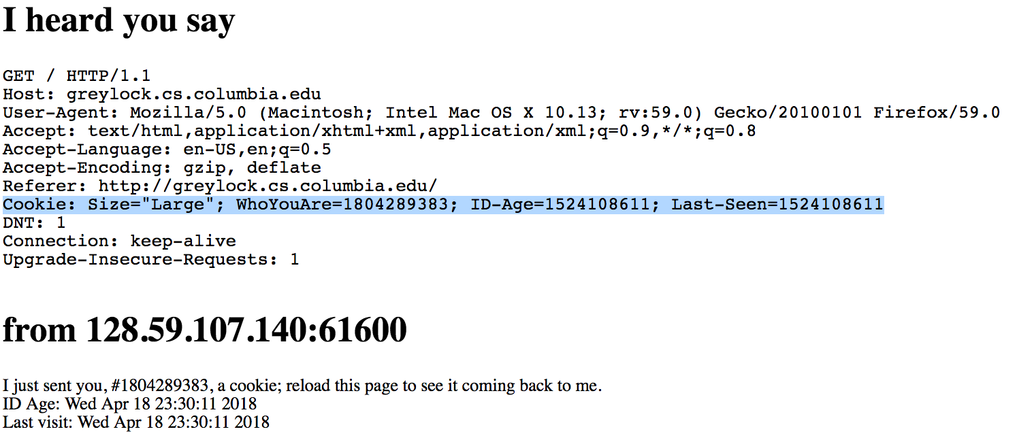
The Return Visit

Slide 62
Ad Networks
Most ads are not served from the web sites you visit
Instead, sites deal with ad brokers
When you download a page, advertising image and frame requests point to ad brokers
  The ad brokers get and set cookies
They then send “redirect” commands, giving the URL of the actual ads for your browser to fetch and display
  Again, the ad sites can get and set cookies

Slide 63
Privacy Implications
You’re tracked around the web
If you visit a site and click on an ad for, say, shoes, a cookie will be set by the ad network saying “this user is interested in shoes”
When you visit a site that uses the same ad network, it will see that cookie—and show you more ads for shoes

Slide 64
Tracking
Many web sites are involved in almost every visit to a web page
Their log files are probably available as business records via the third-party doctrine
Cookies are only accessible via a search warrant—but they (plus browser history) paint a very full picture of online activity
  Note that they can disclose site logins, leading to more evidence
Much of this tracking is dubious under the GDPR—but we’ll have to see how web sites react
These tracking-based ads provide the money that keeps the web operating
  But whether or not tracking works is not that clear—the data is proprietary

Slide 65
Google, Facebook, et al.

Slide 66
Websites?
Google and Facebook are web sites
They’re also ad networks
They collect massive amounts of information
Their mobile apps let them collect even more, including your contacts and location
And Facebook at least will merge information about online behavior with data about offline behavior
They know a tremendous amount about people, and
their machine learning algorithms let them intuit even more

Slide 67
Ad Networks
Together, Facebook and Google reap most of the profits (at least 65%) from online advertising
Virtually all of the revenue growth has gone to these two companies?
Why? Because they use their detailed knowledge about people for very precise targeting

Slide 68
Birds of a Feather
Facebook, Twitter, and other social networks learn the social graph: who interacts with whom
“Birds of a feather flock together” can be very true—and very revelatory
Example: Some MIT undergraduates found that it was possible to predict people’s sexual orientation from whom their Facebook friends were

Slide 69
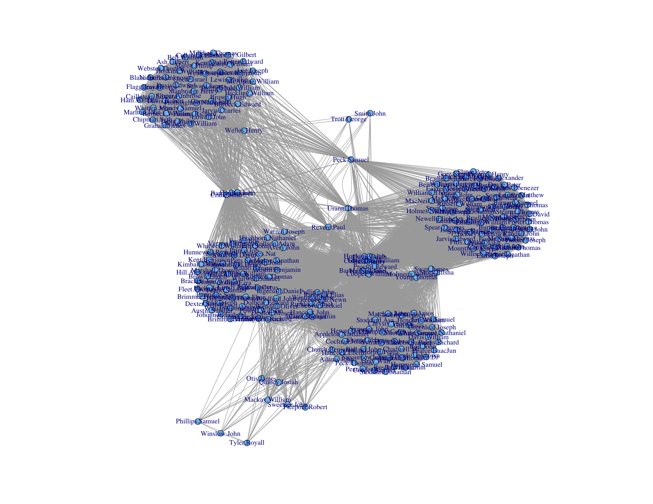
Using Metadata to Find Paul Revere
(https://kieranhealy.org/blog/archives/2013/06/09/using-metadata-to-find-paul-revere/)

Slide 70
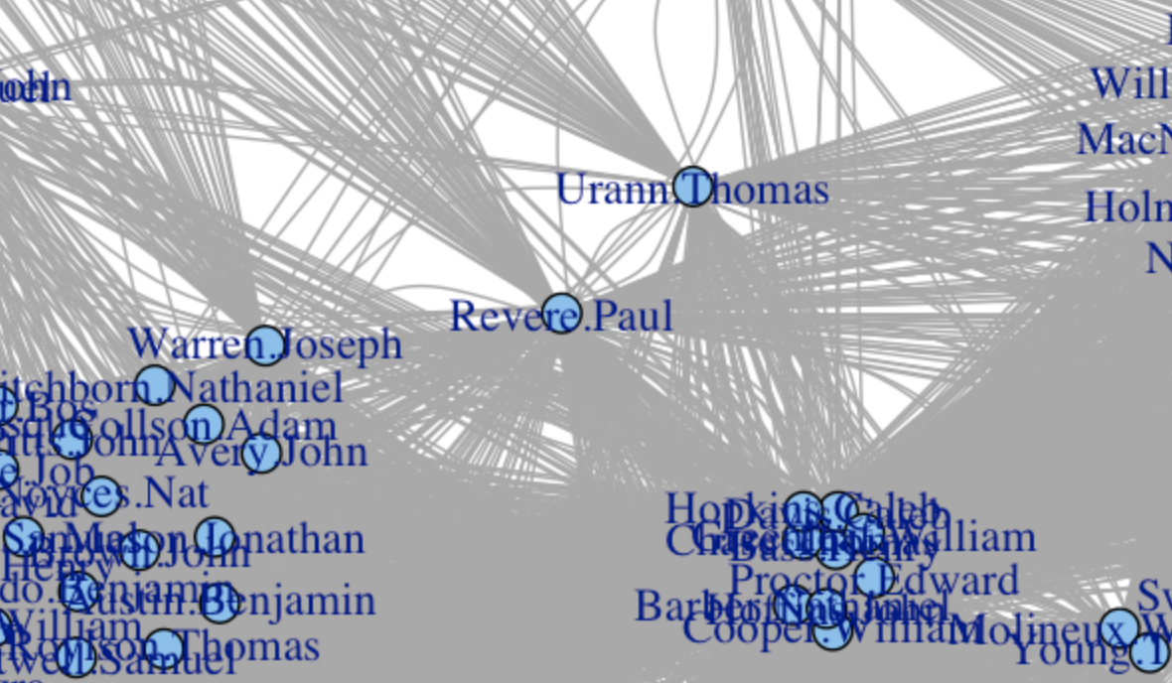
And Right in the Middle…

Slide 71
Evidence
In many cases, it has become routine to seize (often via subpoena) parties’ Google and Facebook records
  Divorce, disability, crimes, and more
  Google records include search history, as well as email (via the Stored Communications Act)
Don’t forget the metadata
  Communications patterns
  Location
  Timing of messages

Slide 72
Weak Spots

Slide 73
Internet Weak Spots
What are the weakest parts of the Internet?
What can an attacker do?
What are the effects and implications?

Slide 74
(Distributed) Denial of Service
Overload some resource: links, servers, etc.
Goal: prevent access by legitimate users
Who?
  Vandals
  Extortionists (sports gambling sites are frequent targets)
  Hacktivists
  Some governments

Slide 75
DNS
Supply incorrect mappings of hostnames to IP addresses
Goal: divert traffic or (sometimes) do denial of service
Who?
  Governments (it’s part of the Great Firewall of China)
  Phishers
  Vandals

Slide 76
Links
Tap or cut links
Cutting links is denial of service
Eavesdropping—but a lot of traffic is encrypted these days
Who?
  Governments—but it’s hard to eavesdrop on backbone cables
  Hackers, on local nets (especially public WiFi hotspots)

Slide 77
Routing
Divert traffic from the legitimate destinations
Why?
  Eavesdrop on traffic
  Intercept sessions
  Denial of service
  Send untraceable messagse
Who?
  Spammers
  Governments
  IP address space thieves

Slide 78
End Systems
Very, very vulnerable
  More next week
Impact depends on the type of end-system
Who?
  More or less everyone…

Slide 79
Users
Many attacks, e.g., phishing, work by tricking users
Almost invariably, the problem is a poorly designed system
Users are not the enemy

Slide 80

Questions?

