Slide 1

The Problem with Exceptional Access
Steven M. Bellovin, Jason Healey, Matt Waxman
Fall 2017

Slide 2
The Problem
True fact: modern algorithms, if correctly implemented and correctly used, are unbreakable
Why do I (and most other cryptographers) oppose exceptional access mechanisms?

Slide 3
The Reason
True fact: modern algorithms, if correctly implemented and correctly used, are unbreakable
Why do I (and most other cryptographers) oppose exceptional access mechanisms?
Cryptography is hard enough as is—adding more complexity has a high probability of breaking things
Security is a systems property

Slide 4
Protocols are Subtle
As noted, to do anything real with encryption you need a protocol
These are harder to get right than the basic algorithms (e.g., AES and RSA)
Algorithms change about once per generation. New protocols are adopted constantly, there are far more of them, and they’re studied less

Slide 5
Examples
Incorrectly padding a short message to match the encryption algorithm’s requirements has resulted in security flaws
Not authenticating every encrypted message has resulted in flaws. (That was the essential flaw recently found in Apple’s iMessage protocol.)
Omitting sequence numbers from encrypted messages has resulted in flaws
The existence of older, “exportable” algorithms in the key and algorithm negotiation protocol has resulted in flaws
Trying to provide an “additional decryption key” for the government has resulted in flaws

Slide 6
A Proposed Compromise:
Additional Decryption Keys
Generic name: “exceptional access”
(Avoids the value judgment implicit in calling it a “back door”, a “front door”, a “golden key”)
One proposal: Any encryption system should provide an additional decryption key, accessible under proper legal safeguards
First instantiated in the Clipper Chip (1993), special hardware that implemented a then-classified encryption algorithm (Skipjack)
  It had an unexpected flaw in the exceptional access mechanism…

Slide 7
System and Policy Problems
How do you protect the secret key necessary to use this feature?
How do you protect it against a major intelligence agency?
How do you protect the process against routinization of access?
  Manhattan alone has hundreds of phones the DA wants to decrypt
  There are undoubtedly thousands more across the country today
  Will people do the right thing when it’s something they do every day, repeatedly? Hint: “rulebook slowdowns” work because normally, people don’t follow every last rule…

Slide 8
Protecting the Infrastructure
We do not have a good track record at protecting crucial secrets
OPM was hacked. Equifax was hacked. The South Korean/US war plans were stolen by North Korean hackers.
Snowden took many documents from the NSA. An employee working on replacement tools was careless and Russia stole them. Martin allegedly took terabytes of data home
  Who did supply “The Shadow Broker” with that NSA code?

Slide 9
Which Countries Can Decrypt?
The country where the device was sold?
The country where the device is now?
  Does a new key get installed at the border? How can that be done securely?
  Twice, I’ve been in one country but my phone was talking to a cell tower in another across the border
The country of the citizenship of the owner? How does the encryption code know?
Will countries trust each other? Not likely…

Slide 10
International Economics
What about foreign-made cryptography?
  The majority of encryption products are developed abroad
  The last time crypto was an issue, in the 1990s, the loss of business to non-US companies was a major factor in loosening export restrictions
What non-US buyers will want American software if the crypto has an exceptional access facility accessible to the FBI and the NSA?
  In 1997, the Swedish parliament was not amused to learn that they’d purchased a system to which the NSA had the keys
What will the State Department say to China when it wants its own access?

Slide 11
The Cost of Compliance
If breaking encryption is too cheap, it is bad for society: “the ordinary checks that constrain abusive law enforcement practices [are]: ‘limited police resources and community hostility.’” (US v. Jones, 615 F. 3d 544 (2012), Sotomayor, concurring)
If it‘s too expensive for the vendor, it inhibits innovation
Code complexity is also a cost and security problem
(As forecast, CALEA compliance indeed led to security problems)

Slide 12
Apple versus the FBI:
San Bernadino
When Syed Farook died in a shootout, the FBI found a county-owned iPhone in his car
The county gave consent to a search, the FBI had a warrant—but the phone was locked (with some data encrypted) and might erase everything if the PIN was entered incorrectly 10 times
Magistrate Judge Pym ordered Apple to produce software that would allow unlimited guesses, with a provision to enter them rapidly
Apple objected

Slide 13
It Wasn’t About This One Phone
There was good reason to believe the FBI would find nothing of interest on this phone
Building the infrastructure to unlock this single phone is time-consuming and expensive—but once the code exists, it becomes easy to unlock others
Apple and the FBI both knew this.
  The FBI wanted a precedent set in what seems like an ideal case
  Apple is afraid of exactly that happening

Slide 14
Cost
Apple estimated that it would take 3-10 person-months to produce the code
  My own, independent estimate was quite compatible with theirs
  All iPhone code must be “digitally signed”, using a cryptographic key possessed by Apple
This, though, is the cost to produce the first copy of the software, for this one phone. Each subsequent version would be very cheap
If the software is not locked to one phone, it will become a target of other governments
If it is locked to one phone, you have the routinization problem

Slide 15
Compelled Speech?
Is computer code “speech” under the First Amendment, or is it purely functional?
  The 2nd, 6th, and 9th Circuits have said code can be speech (9th Circuit opinion withdrawn)
  In all three cases, the code was linked to an political issue
Apple has expressed an opinion that back doors are ethically wrong. Can they be compelled to “say” something they don’t believe?
What about the digital signature?
  Is that merely a functional access control mechanism?
  Or is it Apple’s attestation that the code meets their standards?
  Their app store policies and signed apps have been a major reason why iOS has much better security than Android
Notes:
Junger v Daley (6th), Universal Studios v. Corley (2nd), Bernstein v. US DoJ (9th – opinion withdrawn)

Slide 16
Subpoenaing the Code and Signing Key
The FBI indicated that if Apple won’t help it unlock the phone, it would subpoena the code and signing key
Can the code be subpoenaed? Probably, but producing a usable copy of the code base and build environment is far from easy
The signing key?
  There’s still the compelled speech issue
  Apple may not be able to turn it over—best practices dictate keeping such keys in a “Hardware Security Module” (HSM)
  The whole point of an HSM is to prevent disclosure of a major signing key!

Slide 17
What Happened?
The FBI paid an (unknown) company $900,000 to—somehow!—get into the phone
Nothing was found
Apple never wrote the requested code

Slide 18
It’s Not Privacy, It’s Security
Phones hold a lot of sensitive information (passwords, bank account numbers, email account access, etc.)
The decline of Blackberry and the rise of “Bring Your Own Device” (BYOD) means that corporate data is on phones, too
Phones are are used as authenticators for network login, sometimes in place of hardware tokens
Imagine an American business executive crossing the border into a country with an oppressive government—and that government can unlock the phone…

Slide 19
An Idea: Lawful Hacking
One proposal: hack the endpoints
Plant whatever wiretap software is needed on the target’s machine
Capture plaintext before encryption or after decryption

Slide 20
How to Do It: Wiretaps
Scan the target computer and/or target network
Must allow for multiple devices, home routers (technical term: “NATs”), etc
Figure out the OS and software used, the versions, etc.
Select a vulnerability and built a wiretap package
Install it: drive-by download, infected attachment, phishing, maybe even a black bag job

Slide 21
How to Do It: Devices
It seems really, really hard
After all, everything is encrypted
There doesn’t seem to be room to insert the exploit software

Slide 22

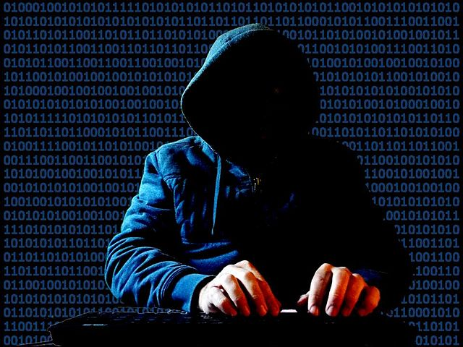
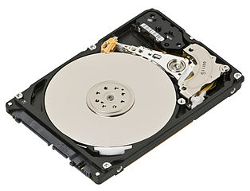
You Don’t Go Through Strong Security,
You Go Around It
Photo: David Whelan
Photo: Evan Amos

Slide 23
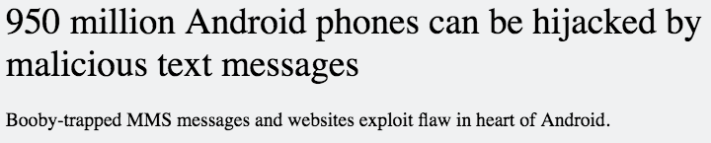
Possible Paths
When you power on a phone, much of it is not encrypted, even if no PIN is entered (though of course some is)
The phone can still receive phone calls and text messages
https://arstechnica.com/information-technology/2015/07/950-million-android-phones-can-be-hijacked-by-malicious-text-messages/

Slide 24
Is This Foolproof?
No, of course not—but nothing is
The choice is not between exceptional access and unsolved crimes; rather, it’s which forms of crime are more serious
Given how much of our infrastructure is online, and given the risks from bad crypto—especially when dealing with unfriendly countries—keeping our crypto simple and strong seems like a better tradeoff

