Slide 1

How to Wiretap
Steven M. Bellovin, Jason Healey, Matt Waxman
Fall 2017

Slide 2
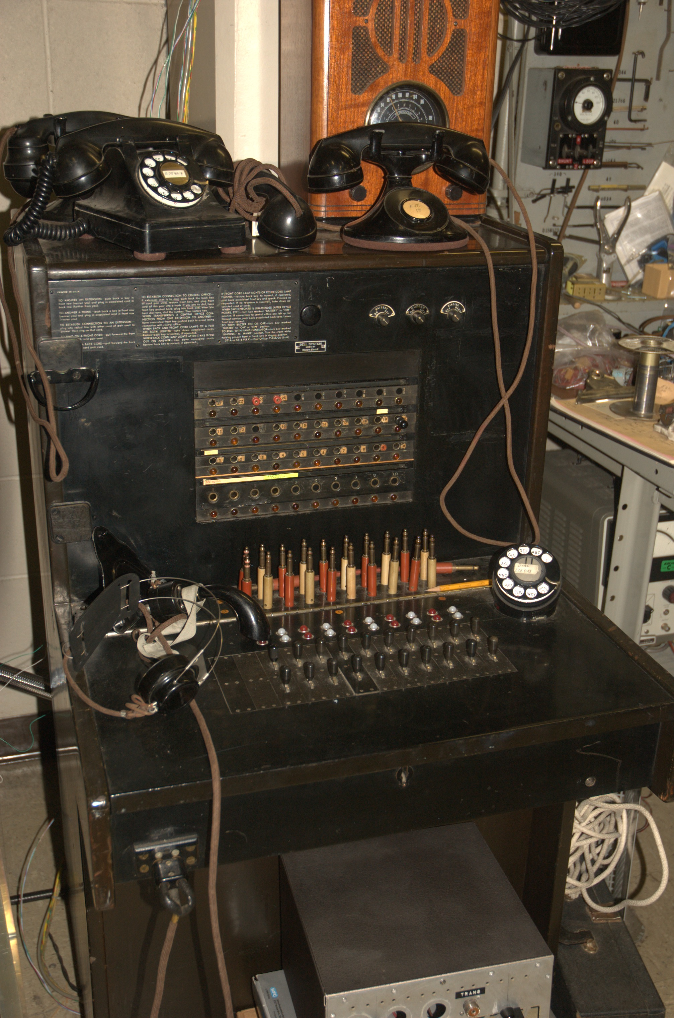
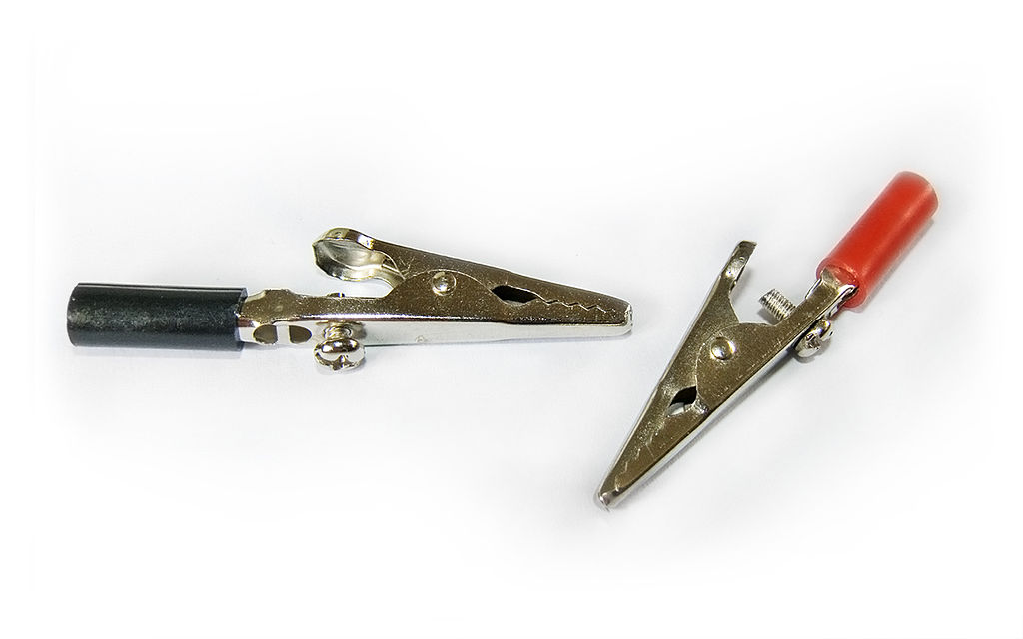
Once, Wiretapping Was Easy
The phone system was simple
Tapping was simple
Very little technology was needed
© Benjamint444:
https://en.wikipedia.org/wiki/File:
Alligator_clips_444.jpg

Slide 3
It Wasn’t Quite that Easy
What pair of wires should be tapped?
  Required cooperation from the phone company
Where is the tap done?
  In Olmstead, it was in the basement of his office building and “in the streets near the houses”.
  “In the streets” sounds wet, cold, and probably noticeable…

Slide 4
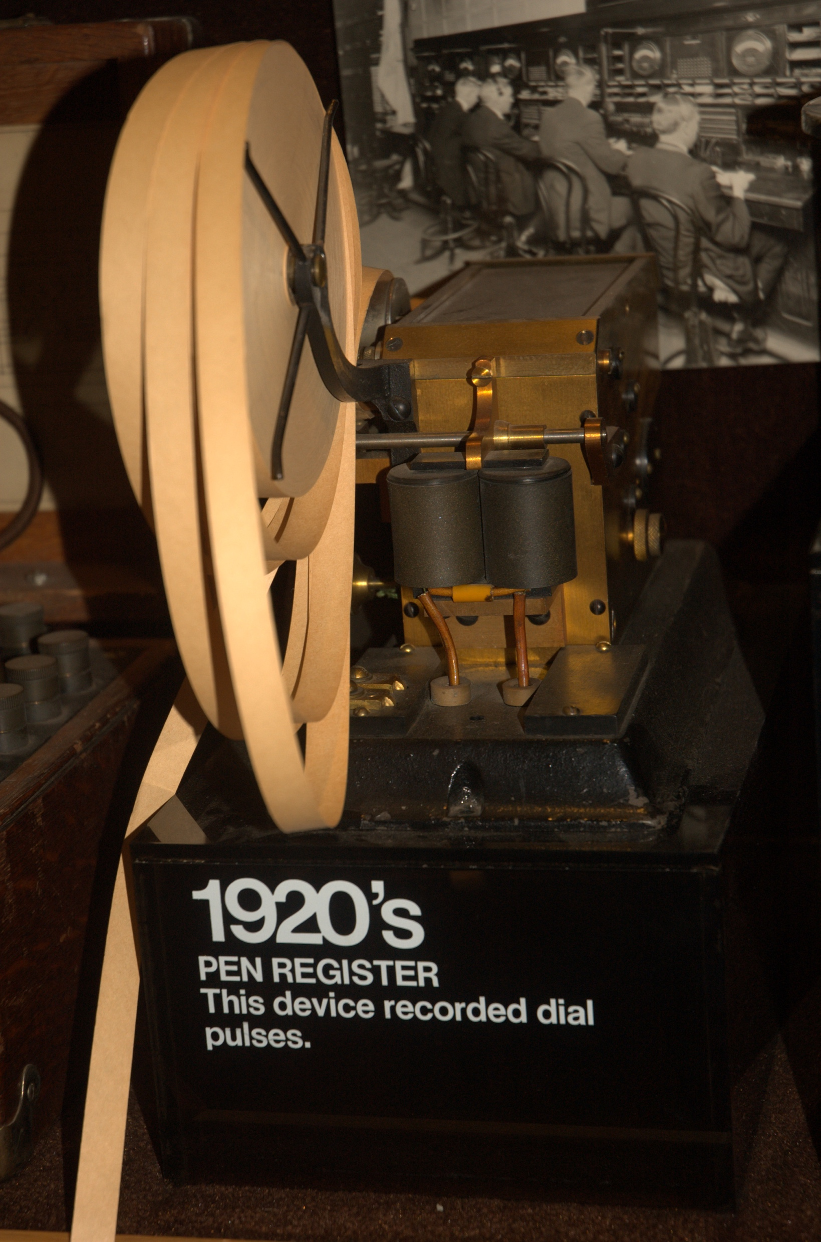
Pen Registers
Pen registers record dialed numbers
Early designs were attached to the wire pair and simply recorded the actual dial pulses

Slide 5
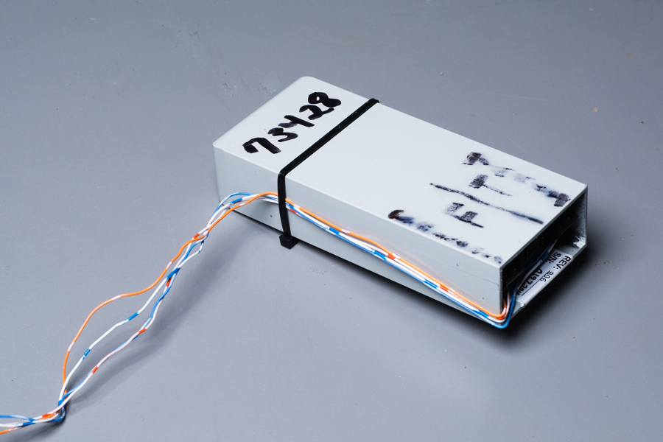
More Modern Approaches
A better idea: loop extenders
Connect the tapped line to a friendly pair of wires that lead back to a nice, warm, dry office
Photo ©Matt Blaze; used by permission

Slide 6
However…
Technology keeps changing
  Mobile phones
  Voice over IP (VoIP)
  Internet games with voice channels
  Skype
Pair of wires? What pair of wires?

Slide 7
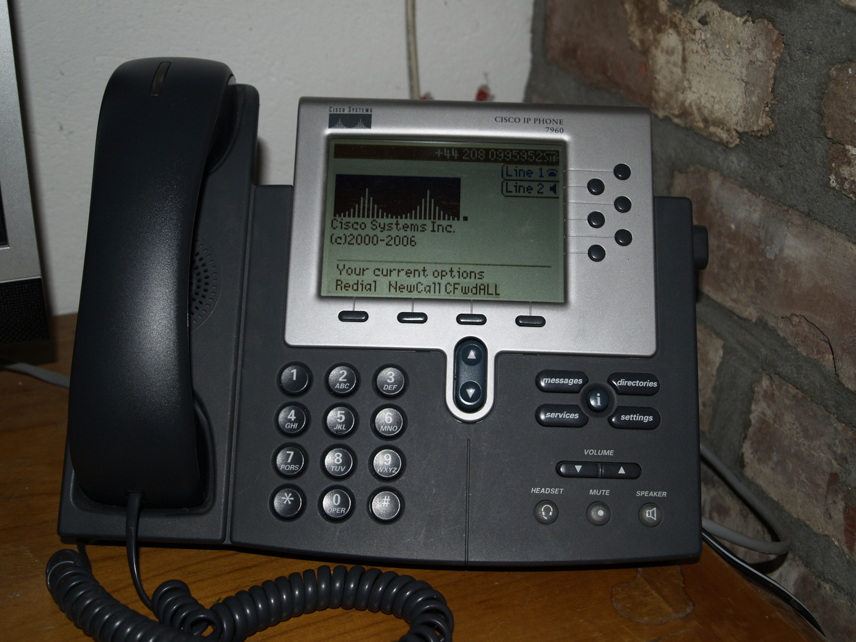
CALEA
All phone switches are required to have a standardized wiretap interface
The technology is irrelevant; the switch handles the details
Remote taps, from your own office
The solution was rapidly copied around the world; the generic term is “lawful intercept”
en.wikipedia.org/wiki/File:Cisco7960G.jpg

Slide 8
Yet More Complexity
What telco handles a given phone number?
  Consult the local number portability database
  Contact that telco
What about mobile phones that have roamed, perhaps to a different network?
  Do you route calls through the home location, for easier tapping?
  Or do you do the tap remotely, which gives better performance but demands comprehensive support for taps throughout the phone network

Slide 9
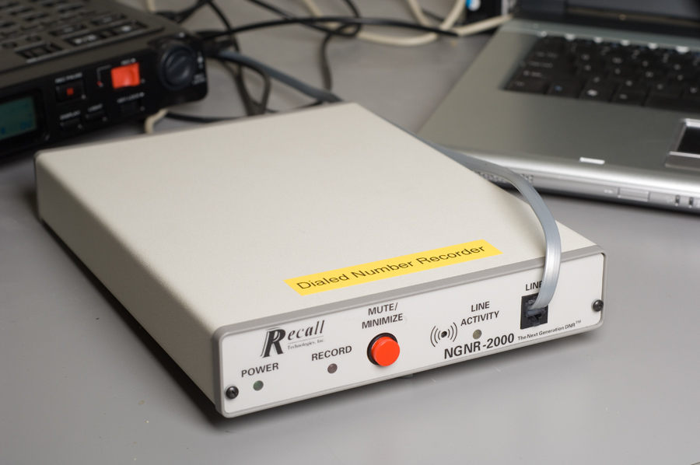
Pen Registers
Once, easy—put a simple device on the line pair
  Modern versions handle touchtone and are easier to use, but are about the same
Again, though—today’s phones don’t use simple wire pairs
Answer: put something in the switch, as per CALEA
Photo ©Matt Blaze; used by permission

Slide 10
How Do We Tap the Internet?

Slide 11
Whom Do We Tap?
A login?
An IP address?
A MAC address?
An email address?
A particular person connecting to a particular web server?

Slide 12
Whom Do We Tap?
A login?
An IP address?
A MAC address?
An email address?
A particular person connecting to a particular web server?
All of the above, plus combinations!
For intelligence taps, tapping many users may be necessary—plus taps by content!

Slide 13
Where Do We Tap?
On the target’s LAN?
On the access link to the customer from the ISP?
On the Internet backbone?

Slide 14
Where Do We Tap?
On the target’s LAN?
  Hard to get access; may be detectable
On the access link to the customer from the ISP?
  Best—but may be a shared medium and carry traffic for many customers
On the Internet backbone?
  Too much volume, and paths are asymmetric
  May be done for intelligence taps

Slide 15
Tapping a Link
Every Mac and Linux computer comes with the tcpdump command; this can tap networks
  (Exercise: what about 18 U.S.C. § 2512—Manufacture, distribution, possession, and advertising of wire, oral, or electronic communication intercepting devices prohibited?)
The tcpdump command even does some protocol analysis

Slide 16
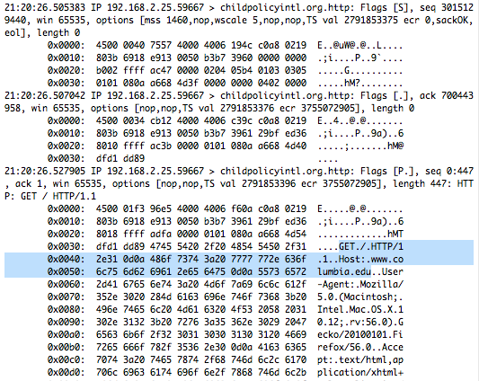

Slide 17
Getting the Right User’s Traffic
We want to tap a person
We may or may not know that person’s email address
IP addresses are dynamically assigned, so we don’t know them a priori
We need smart, protocol-aware filtering

Slide 18
Carnivore
A late 1990s FBI network-tapping device
Very controversial, so there was an external review
As a result, we know much more about it than about other specialized tapping software

Slide 19
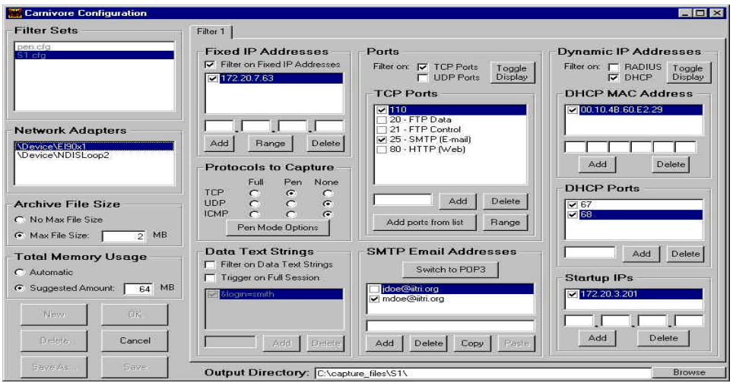
Configuring Carnivore

Slide 20
Configuring IP Address

Slide 21
Filtering on Email Address

Slide 22
Selecting Protocols

Slide 23
Full Content or Pen Register

Slide 24
Filtering on Content

Slide 25
What Does This Tell Us?
Network taps must look at many intermixed sessions
The tapping software must sort the packets into different sessions and evaluate each session for compliance with the warrant
This is hard! (Wire pairs were much easier…)

Slide 26
Software Can Be Buggy
From https://www.epic.org/privacy/carnivore/fisa.html

Slide 27
(When to Encrypt)
Anyone on-LAN can eavesdrop on traffic
Law enforcement can eavesdrop on access links
SIGINT agencies can tap backbones
Law enforcement and SIGINT agencies can compel sites to disclose content, e.g., email
Hackers can penetrate end-systems, including mail and web servers and user computers—and steal their keys
Encrypt things if your usage patterns have one of those scenarios in your threat model

Slide 28
FISA §702
Downstream—compulsory process to ISPs (PRISM)
Upstream collection—look at wires, possibly in the US, for legal foreign intelligence information

Slide 29
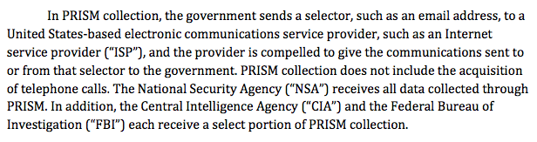
PRISM
(PCLOB §702 report)

Slide 30
Bulk Capture
Intelligence agencies need to capture a lot of traffic, both content and metadata
Often, what is done is to capture a lot of data, but only look at “tasked selectors”
(There are credible reports that this is sometimes done for criminal wiretaps, too.)

Slide 31
Stellar Wind
Stellar Wind is a now-discontinued bulk SIGINT collection system
  The legal arguments permitting it were dubious
It did bulk collection of foreign content and domestic and foreign communications metadata

Slide 32
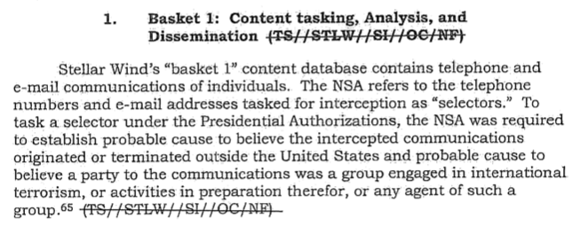
Stellar Wind Content Database
(From a DoJ/DoD/NSA/CIA/ODNI Inspectors General report)

Slide 33
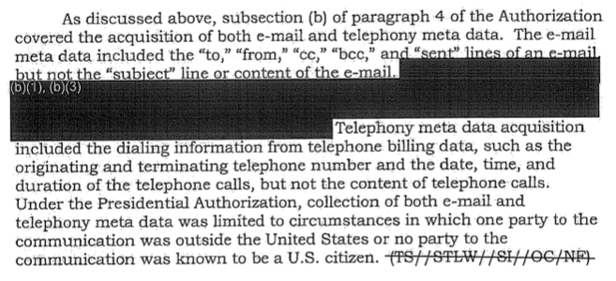
What is Metadata?

Slide 34
Collecting Internet Metadata
You have to collect an entire SMTP or IMAP session
You have to parse the protocol and the email message
  (It’s actually not at all clear that addresses in email header are legally metadata, at least per Smith)
Note the difference from phone calls
  But—what about “post cut-through dialed digits”?
  Hard to tell from content

Slide 35
“About” Collection
Under the §702 program, the NSA can collect messages that mention a selector, i.e., that are “about” that selector
The selector still has to be a valid target
This can sweep up messages to and from US persons
Note: In April 2017, the NSA voluntarily halted “about” collection

Slide 36
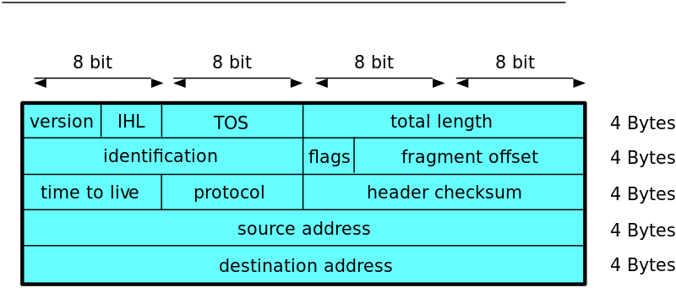
Doing “About” Collection
In the IP header, selectors are at fixed offsets
In email messages, the selectors are near the start of the session
With “about” collection, they can be anywhere—much more expensive!
Image: Bruno Wenk

Slide 37
Multi-Communications Transactions
Sometimes, a single intercept contains permitted and prohibited (i.e., purely domestic) traffic
Picking out just the foreign traffic is technically infeasible

Slide 38
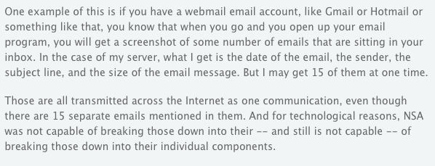
From ODNI
https://www.eff.org/deeplinks/2013/08/intelligence-agency-attorney-explains-how-multi-communication-transactions-allowed

Slide 39
A Gmail Screenshot

Slide 40
SIGINT Isn’t Always Enough
What if the traffic is encrypted?
  (Assuming, of course, that the NSA can’t break the crypto…)
What if Tor is being used?
Both the content and the metadata are hidden
Solution: Network Investigative Techniques

Slide 41
Network Investigative Techniques
Network Investigative Techniques (NITs): lawful hacking
Used by the FBI since at least 2002, per court filings and FOIAed documents
Quite controversial

Slide 42
How NITs are Used
Email a booby-trapped attachment to the user
  Just like illegal spearphishing malware
Plant something on a web site that your target(s) will visit
  Used in the PLAYPEN child pornography case
  Just like watering hole attacks
Use any other mechanism commonly used to install malware on particular targets’ machines

Slide 43
The Purpose of NITs
Most common: find the real IP address, MAC address, perhaps owner information
  Some of that may be (legal) metadata; some of it probably isn’t
Use CIPAV: Computer and Internet Protocol Address Verifier
Possibly do remote search (“Magic Lantern”)

Slide 44
CIPAV
Send a packet to the FBI from the target’s machine
No worries about NATs—the NAT will translate the FBI’s packet’s address
The address, as received, will be the global address, which can be used to find the suspect’s computer
Other FBI tools are apparently classified

Slide 45
Legal Processes Needed
There has been quite a bit of discussion about what legal process is needed for a CIPAV
Eventual consensus: a search warrant to hack into the target’s computer, plus a pen register/trap-and-trace (i.e., metadata) order to obtain the IP address
A remote search would require a search warrant as well as a hacking warrant (though both could be in the same warrant)

Slide 46
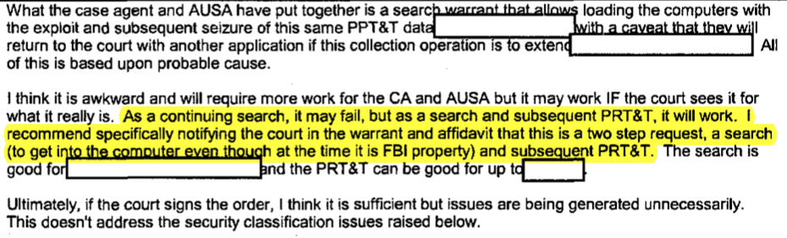
The FBI’s Eventual Answer
https://www.eff.org/files/fbi_cipav-08-p169.pdf

Slide 47
Controversies
Jurisdiction—who can issue a warrant for a target computer in an unknown location?
Is it “particular” enough?
Is it reasonable to use one warrant to search or trace many computers?
Is it acceptable for the FBI to hack computers?

