Slide 1

Software and its Discontents

Slide 2
The Trouble with Software
Software is hard
Correction: software is very hard
Most security problems are due to buggy code

Slide 3
Why is Software Hard?
Computers interpret instructions literally
They do this whether or not those instructions are sensible
Programs today are huge—and any small error can result in a software problem

Slide 4
Why Do Programmers Starve to Death in the Shower?
See the instructions on the shampoo bottle:
Lather
Rinse
Repeat

Slide 5
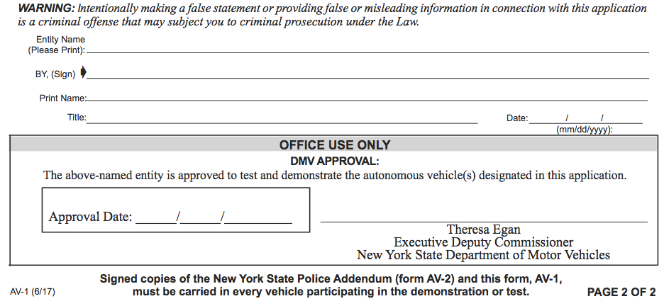
A Common Bug:
Buffer Overflow
What if you fill out the form online and enter a too-long date? It overflows into the “Official Use Only” area…

Slide 6
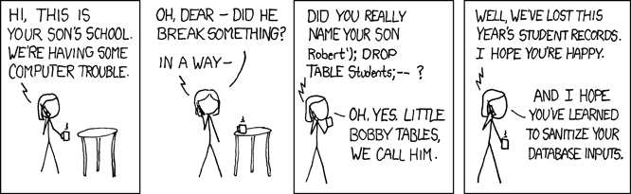
Another Common Bug:
SQL Injection
(https://xkcd.com/327/)
And see https://www.wired.co.uk/article/sweden-election-hack

Slide 7
SQL Injection Example
Consider the SQL command
select where user= "%s" && query= "%s"
where the first %s is the user’s login and the second is a user-entered query. If query is
foo" || user= "target
the resulting SQL command is
select where user="uname" && query = "foo" || user= "target"

Slide 8
It’s the Services That Get You
The more functionality a computer provides over the Internet, the more vulnerable it is
We will never escape this trap completely
Note that everything is a computer: your phone, your car (probably has 60-70 computers), your USB stick, your disk drive, and more
Plus, everything else on the “Internet of Things”: vacuum cleaners, light bulbs, thermostats, toothbrushes, forks, pacemakers, and more

