Slide 1
How the Internet Works

Slide 2
What is the Internet Made of?
Computers
Servers
Clients
Phones
“Things”
Routers—specialized computers that forward “packets”
Packets are fragments of messages
Links—WiFi, Ethernet, fiber, etc. The Internet was designed to run over anything

Slide 3
Fibers
Each cable has many pairs of strands
Each strand carries many wavelengths (aka “colors” or “lambdas”)
A new trans-Pacific fiber has six pairs of strands
Each strand carries 100 wavelengths
Each wavelength has a bandwidth of 100G bps
Total capacity: 60 terabits/second
Each wavelength can carry many different circuits
Each Internet circuit carries packets for many different conversations

Slide 4
WiFi
Used in public spaces and private residences
Some use in business, but wired Ethernet is more common for desktops
Range: about 100 meters
Security: WEP is obsolete and insecure; WPA2 is quite good—and in public, all bets are off.

Slide 5
A Look at Common Applications
Web browsing
Email
The Cloud
Caution: all of this is simplified—and arguably oversimplified

Slide 6
How the Web Appears to Users
Internet
Web Server
Web Browser

Slide 7
The Internet Has Structure: Multiple ISPs
ISP A
LON
ISP B
NYC

Slide 8
Routing Between ISPs
Sprint
Verizon
IIJ
Big ISPs ‘Peering’
Amazon
GoJ
Sakura
Customers buy ‘Transit’
8

Slide 9
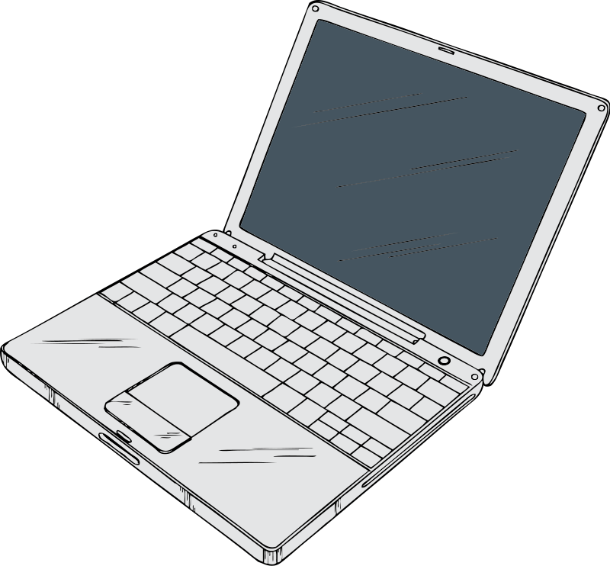
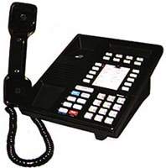
Each ISP Has Structure: Many Routers

Slide 10
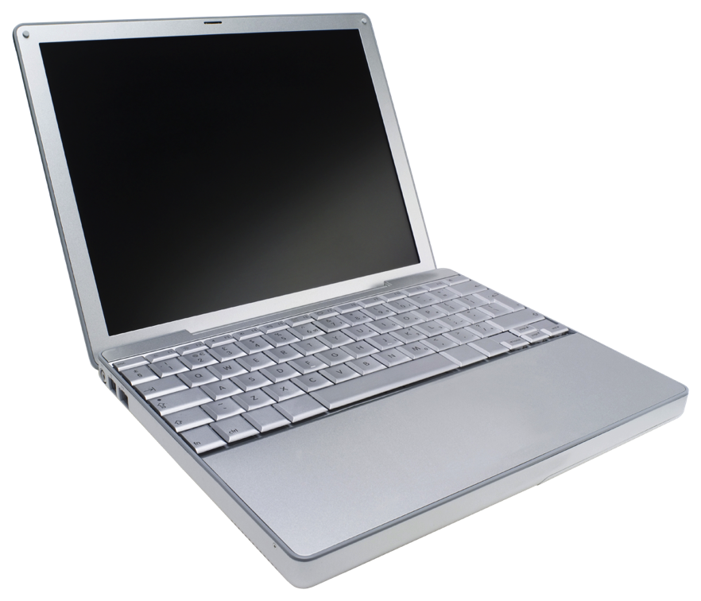
Hosting Services
Company A
Internet
Company B
Company C
Hosting
Company
Web Browser

Slide 11
Content Distribution Network
CDN B
CDN A
CDN C
CDN D
Web
Server

Slide 12
Content Distribution Network
CDN B
CDN A
CDN C
CDN D
Web
Server

Slide 13
Content Distribution Network
CDN B
CDN A
CDN C
CDN D
Web
Server

Slide 14
Content Distribution Network
CDN B
CDN A
CDN C
CDN D
Web
Server

Slide 15
CDN Example: www.supremecourtus.gov
www.supremecourt.gov is an alias for a1042.b.akamai.net; Akamai is
a prominent CDN operator
New York | 24.143.200.48
Ashburn, Va | 23.15.9.144
Atlanta | 208.44.23.57
San Francisco | 216.156.149.106
Boston | 207.86.164.89

Slide 16
Which is the Browser; Which is the Server?
Internet
Web Server
Web Browser

Slide 17
Architecturally, They’re the Same—What Matters is the Software They Run
Internet
Web Browser
Web Server

Slide 18
“Smart Hosts, Dumb Network”
The phone network was built for dumb phones – nothing else was technically or economically feasible.
All intelligence is in the network: conference calls, call forwarding, even many voice menus
Internet routers are very dumb; all intelligence is in end systems
Consequence: service providers are not necessarily the same as network providers
A person’s mail provider may be in another country

Slide 19
The Phone Network: A Few Large Switches, Serving Phones

Slide 20
The Internet: Many Routers, Very Many Types of Devices

Slide 21
Circuit Switching versus Packet Switching
Circuits: traditional telephony model
Path through the network selected at “call setup time”
Very small number of call setups; process can be heavyweight
Each “phone switch” needs to know the destination of the call, not the source; return traffic takes the reverse path
Packets: Internet model
Every “packet” – a fragment of a message – is routed independently
No call setup
Routing must be very, very fast; it’s done for each packet
Robustness: if a “router” fails, packets can take a different path
Every packet must have a source and destination address, to enable replies
Reply traffic may take a very different path

Slide 22
IP Addresses
A user types a name such as www.dni.gov.
The Domain Name System (DNS) translates that to an Internet Protocol (IP) Address such as 23.213.38.42
IP addresses are four bytes long; each of those numbers is in the range 0-255
www.dni.gov actually uses a CDN, so every querier gets a different answer
IP addresses are what appear in packets
Routers talk to each other (via Routing Protocols) to learn where each IP address is

Slide 23
IP Addressing
Roughly 4 billion possible IP addresses today
IPv6, a newer version of IP being deployed now, has many more addresses
IP addresses are handed out in blocks to big ISPs. Big ISPs give pieces of their allocations to smaller ISPs or to end customers
Unless you’re a very large enterprise, the only way to get IP addresses is from your ISP – and if you switch ISPs, you have to renumber your computers
There is no analog to “local number portability” on the Internet – and can’t be; there’s no time to do that many lookups

Slide 24
Address Space Assignment
IP addresses are handed out by Regional Internet Registries (RIRs), such as ARIN
They get their addresses from ICANN, an international non-profit which gets its authority from the U.S. Department of Commerce – controversial abroad
Addresses are allocated based on demonstrated short-term need and evidence of efficient use of previously-allocated addresses
Addresses may not be sold, even as part of a bankruptcy, merger, or acquisition, except with ARIN’s approval and in accordance with ARIN’s policies
This assertion of authority has never been contested in court—and some have been transferred by order of a bankruptcy court
Some ISPs have (very valuable) pre-ARIN addresses, called “legacy space”. Legacy address holders don’t have to renumber when switching ISPs (among other advantages)

Slide 25
Port Numbers
When one computer contacts another, is it trying to talk to a Web server or trying to send mail?
Remember that architecturally, all machines on the Internet are alike
It’s perfectly legal to run a Web server and a mail server on a single computer
Packets contain not just an IP address but a port number
Port 25 is the mail server, port 80 is the Web server, 443 is encrypted Web, etc.
If an IP address is like a street address, a port number is the room number in the building
Room 25 is the mail room, room 80 is library, etc.

Slide 26
The Network Stack
The Internet uses a layered architecture
Applications—email, web, etc.—are what we care about
TCP (which has port numbers) transports the data; it is end-to-end
IP (the network layer) is processed by every router along the path
The link layer is things like WiFi, Ethernet, etc.

Slide 27
Packets and Routing

Slide 28
Packets
When data is to be transmitted, it is broken up into packets
Each packet is sent independently
Every packet has a source and destination IP address
Packets can be dropped, damaged, duplicated, or reordered in transit
Other information in the the packet is used to reconstruct the original data stream despite these errors
An Internet transmission is more like a series of postcards than like a phone call

Slide 29
Forged Packets
Often, a compromised computer can forge the source IP address on packets
This can deceive the recipient—but reply packets won’t make it to the sender
Some ISPs block forged packets from their customers; others do not

Slide 30
Routing
How do packets “know” how to reach their destination?
Routers talk to each other; they thus build up a map of the Internet
What if a router lies?
Translation: what if your map has incorrect data?
Used by spammers—and nation-states…
Note: it’s hard to prevent routers from lying

Slide 31
Email

Slide 32
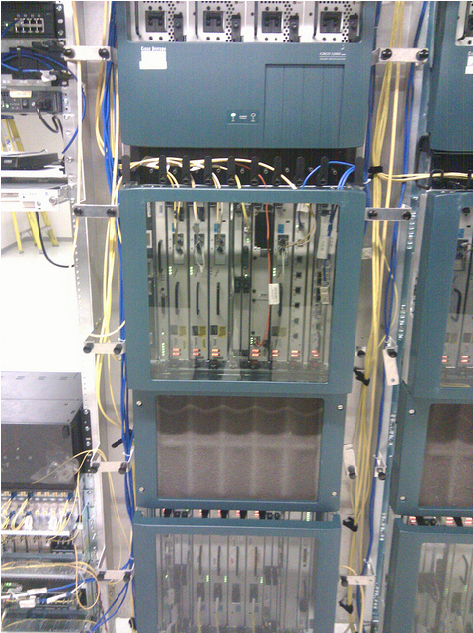
Sending Email
Inbound
Mail Server
ISP
ISP
Outbound
Mail Server
ISP
ISP
Access Links
Notes:
Legal points: ECPA transmission/storage applicability. Email session will address

Slide 33
Multiple Parties!
The sender
The sender’s outbound mail server (often an ISP, an employer, a university, or Google)
The receiver’s inbound mail server (ditto)
The recipient
The sender and/or the recipient may use a mail client or they may use a web browser

Slide 34
Encryption on the Internet

Slide 35
Anything Can be Encrypted
Links—though mostly used on WiFi
Virtual Private Networks (VPNs)
Simple connections (Web, email, etc.), generally via Transport Layer Security (TLS)
Data, especially the body of email messages

Slide 36
VPNs
Used by corporate employees for telecommuting or while traveling
Also used to connect multiple corporate locations
Sometimes used to spoof location
Cover tracks
Fool geographic restrictions on content, e.g., streaming movies and music
A recently published academic paper concluded that the NSA could cryptanalyze a lot of VPN sessions

Slide 37
TLS
Used for all secure Web traffic
Widely (and increasingly) used when sending and retrieving email
But—TLS does not protect email “at rest”, i.e., while on disk on the various servers
Used for many other point-to-point connections, e.g., Dropbox
Older versions of TLS have cryptographic weaknesses; these are (believed to be) fixed in the newest versions
The most common implementations of TLS have a long history of serious security flaws

Slide 38
Email Encryption
Two different standards, S/MIME and PGP
S/MIME is widely supported—but rarely used
PGP requires less infrastructure support, and hence is used by enthusiasts
Protects email at rest—but hinders searching
Does not protect email headers or other metadata

Slide 39
Tor: The Onion Router
Computer A picks a sequence of Tor relays (C➝E➝D)
D is the exit node, and passes the traffic to destination host G
All of these hops are encrypted
B picks relays F➝C➝D
G can’t tell which is from A and which from B
Neither can anyone else monitoring G’s traffic
Many use Tor for anonymity: police, human rights workers, spies—and criminals (e.g., Ross Ulbricht of Silk Road fame)
Mental model: nested, sealed envelopes

Slide 40
Cloud Computing

Slide 41
What’s a Cloud?
A cloud is a traditional way to represent a network
This “three-cloud network” picture is from 1982
But—today “cloud” refers to computing services provided via the Internet by an outside party.
(The modern usage seems to date to 1996: http://www.technologyreview.com/news/425970/who-coined-cloud-computing/)

Slide 42
“Via the Internet”
The service is not provided on-premises
An Internet link is necessary
This link provides an opportunity for interception, lawful or otherwise

Slide 43
“Outside Party”
By definition, cloud services are provided by an outside party
Similar in spirit to the computing and time-sharing service bureaus, which date back to the 1960s
Not the same as a company’s own remote computing facility
Organizations can have a “private cloud”, but the legal issues may be very different

Slide 44
Computing Services
Many different types of services
Storage
Computing
Applications
Virtual machines
More

Slide 45
Storage
Disk space in a remote location
Easily shared (and outside the corporate firewall)
Often replicated for reliability
Replicas can be on different power grids, earthquake zones, countries, continents, etc.
Data can be moved—or move “by itself”—to be closer to its users
Expandable
Someone else can worry about disk space, backups, security, and more
Examples: Dropbox, Google Drive, Carbonite (for backups), Amazon S3
Mental model: secure, self-storage warehouse

Slide 46
Computing
Rent computing cycles as you need them
Pay only for what you use
Often used in conjunction with the provider’s cloud storage service
Examples: Amazon EC2, Microsoft Azure, Google Cloud
Dropbox is a cloud service that uses a different provider’s cloud storage
Mental model: calling up a temp agency for seasonal employees

Slide 47
Applications
Provider runs particular applications for clients
Common types: web sites, email services
Less common types: shared word processing, payrolls
Well-known providers: Google’s Gmail and Docs, Microsoft’s Outlook and Office 360, Dreamhost (web hosting)
Mental model: engaging a contractor for specific tasks

Slide 48
Playing an Active Part: Google Docs
Someone, using a Web browser, creates a document
Standard formatting buttons: font, italics or bold, copy and paste, etc.
Others who have the proper authorization (sometimes just a special URL) can edit the document via their own Web browsers
The changes made by one user show up in real time in all other users’ browser windows
In other words, Google is not just a passive repository; it is noticing changes and sending them out immediately

Slide 49
Virtual Machines
Normal desktops: an operating system (e.g., Microsoft Windows) runs the computer; applications run on top of the operating system
Virtual machines: a hypervisor running on a single computer emulates multiple real computers. A different operating system can run on each of these emulated computers—and each one is independent of the others and is protected from it
Net effect: many computers that consume the space and power requirements of a single computer
Mental model: rented office space

Slide 50
Location of Cloud Servers
Responsiveness of and effective bandwidth to a server is limited by how far away it is
The problem is the speed of light—and not even Silicon Valley can overcome that limit!
It takes a minimum of a quarter-second to set up a secure connection from Washington to Paris, and twice that to New Delhi
For performance reasons—and independent of political and legal considerations—large cloud providers therefore place server complexes in many places around the world
Also: take advantage of cheap power and cooling

Slide 51
Where is Data Stored?
Modern email: on the server and on one or more devices
Users can’t easily tell what’s on their device (e.g., phone or laptop) versus what is retrieved from the server on demand
It differs for different devices at different times, and may depend on the user’s recent activity
What if the device and server are in different jurisdictions?
(A bad fit for the assumed behavior model of Stored Communications Act)

Slide 52
Security and Privacy Issues
Gmail: Google applications scan email and serve up appropriate ads
Dropbox: uses Amazon S3 for actual storage; encrypts data so that Amazon can’t read it—but Dropbox can
Spider Oak: data is encrypted with the user’s password; Spider Oak can’t read it
Outlook.com: blocks file attachments that frequently contain viruses
Many: check pictures for known child pornography
Many: spam filtering

Slide 53
Attacks

Slide 54
Common Attacks
Change the DNS
Packets go to the wrong IP address
Lie about routing
Packets go to the wrong destination
Forge source IP addresses on packets
Packets are hard to trace or filter—used for DDoS attacks
Other infrastructure
CDNs; name, IP address, and routing registries
Distributed Denial of Service (DDoS) attacks—flood your victim with too much traffic

Slide 55
But…
Most attacks are due to buggy software

Slide 56
Questions?

Slide 57
Sending Myself Email—An SMTP Transcript
220 machshav.com ESMTP Exim 4.82 Tue, 11 Mar 2014 19:43:03 +0000
HELO eloi.cs.columbia.edu
250 machshav.com Hello eloi.cs.columbia.edu [2001:18d8:ffff:16:12dd:b1ff:feef:8868]
MAIL FROM:<smb@eloi.cs.columbia.edu>
250 OK
RCPT TO:<smb@machshav.com>
250 Accepted
DATA
354 Enter message, ending with "." on a line by itself
From: Barack Obama <president@whitehouse.gov>
To: <smb2132@columbia.edu>
Subject: Test
This is a test
.
250 OK id=1WNSaS-0001z5-1d
QUIT
221 machshav.com closing connection
Message

Slide 58
Conversation With A Third Party
220 machshav.com ESMTP Exim 4.82 Tue, 11 Mar 2014 19:43:03 +0000
HELO eloi.cs.columbia.edu
250 machshav.com Hello eloi.cs.columbia.edu [2001:18d8:ffff:16:12dd:b1ff:feef:8868]
MAIL FROM:<smb@eloi.cs.columbia.edu>
250 OK
RCPT TO:<smb@machshav.com>
250 Accepted
DATA
354 Enter message, ending with "." on a line by itself
From: Barack Obama <president@whitehouse.gov>
To: <smb2132@columbia.edu>
Subject: Test
This is a test
.
250 OK id=1WNSaS-0001z5-1d
QUIT
221 machshav.com closing connection
Message

Slide 59
What the Recipient Sees
220 machshav.com ESMTP Exim 4.82 Tue, 11 Mar 2014 19:43:03 +0000
HELO eloi.cs.columbia.edu
250 machshav.com Hello eloi.cs.columbia.edu [2001:18d8:ffff:16:12dd:b1ff:feef:8868]
MAIL FROM:<smb@eloi.cs.columbia.edu>
250 OK
RCPT TO:<smb@machshav.com>
250 Accepted
DATA
354 Enter message, ending with "." on a line by itself
From: Barack Obama <president@whitehouse.gov>
To: <smb2132@columbia.edu>
Subject: Test
This is a test
.
250 OK id=1WNSaS-0001z5-1d
QUIT
221 machshav.com closing connection
Message

Slide 60
A Letter from Eleanor Roosevelt to Lorena Hickock (March 1933)
(excerpt from Amazon.com)
It begins “Hick my dearest”.

Slide 61
Things to Note
The SMTP envelope—that’s the technical term!—can have different information than the message headers
Unlike the phone network, anyone can run their own mail servers
I personally run two, one personal and one professional
This complicates third party doctrine analysis
The reality of email is far more complex than I’ve outlined here
Example: many people read their email via a Web browser—and the NSA has stated that even for them, picking out just the From/To information from a Webmail session is very difficult
I haven’t even begun to address server-resident email, virus scanning, spam filtering, and the like, let alone all of the other metadata that’s present

