Slide 1

Introduction to Cryptography
Steven M. Bellovin
https://www.cs.columbia.edu/~smb

Slide 2
What is Cryptography?
Literally: “hidden writing”
(Technical, the entire field is “cryptology”, but almost no one except the NSA and historians uses that word.)
Today, we do much more with cryptography than just encryption, i.e., hiding a message’s contents

Slide 3
History of Cryptography
Arguably, goes back 4,000 years
  Some say there is quasi-cryptography in some Egyptian hieroglyphics and in the Old Testament
  There are Mesopotamian cuneiform inscriptions with substitutions
  The 5th century BCE Spartans used the skytale: wrapping papyrus around the shaft of a spear but writing across
  An Indian treatise from the 4th century BCE speaks of cryptanalysis
Julius Caesar

Slide 4
The Caesar Cipher
A | B | C | D | … | W | X | Y | Z
↓ | ↓ | ↓ | ↓ |  | ↓ | ↓ | ↓ | ↓
D | E | F | G | … | Z | A | B | C
Replace each letter with one three later in the alphabet
The offset need not be 3
3 is the key

Slide 5
Codes and Ciphers
Roughly speaking, ciphers operate at the syntactic level: letters, groups of letters, or bits
Codes operate at the semantic level: words, phrases, sentences
Codes have more or less died out; they’re not as secure and they’re too hard to automate—and you need automation to encrypt today’s traffic volumes

Slide 6
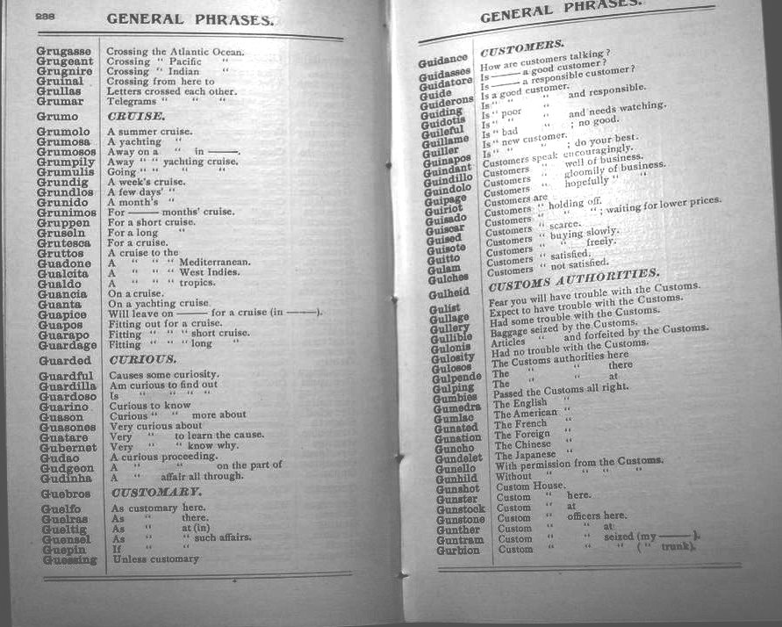
An Old Commercial Code

Slide 7
The Renaissance
Cryptography, especially codes, was heavily used for diplomatic correspondence in Europe
Many countries had “Black Chambers”—organizations that would unseal letters, copy and cryptanalyze the contents, and close them again with forged seals
(King Philip II of Spain complained to the pope that Henry IV of France must be using black magic to read his messages. The pope’s own cryptanalysts were also reading them…)

Slide 8
Cryptanalysis
As noted, evidence for cryptanalysis >2,300 years ago in India
The first written description of a systematic approach to cryptanalysis is by Al-Kindi in Baghdad in the 9th century CE
Sustained use in practice in Europe during the Renaissance
No systematic improvements until Kasiski (Prussia) in 1863
But the real birth of modern systems—and modern attacks—came with World War I

Slide 9
Why World War I?
Large volume of communications
  Hand encryption systems couldn’t really cope with the volume
  Much of the communication was by radio, making it easy to intercept
Technological improvements (and technological mindsets)

Slide 10
Three Major Themes
Mechanization of encryption
  The famous Enigma machine (and other, lesser-known but equally important machines) was developed shortly after the war
Cryptanalysis started to become mathematical (Friedman (US), circa 1920)
  Developed far more by Rejewski’s team (Poland) in the 1930s; their work was expanded at Bletchley Park
The use of metadata, first as an adjunct to cryptanalysis, and then as something useful in its own right

Slide 11
Metadata
Traffic analysis
  Who speaks to whom
  Message size
  Message volume and timing
Other information (including “indicators”) in the message headers
  How you used encryption had become crucial!

Slide 12
Cryptography is Very Hard
The design of ciphers is very hard
Cryptographic protocol design is very hard
Using ciphers correctly is very hard

Slide 13
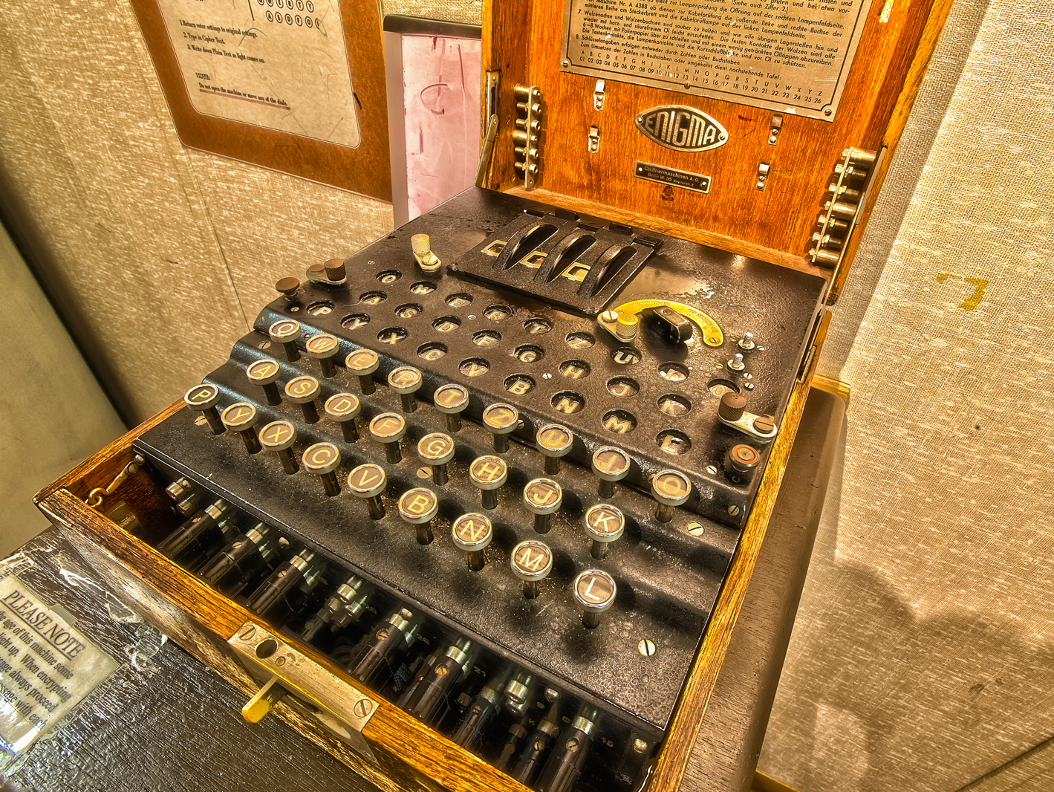
Historical Example: The World War II Enigma Machine
Photo: public domain

Slide 14
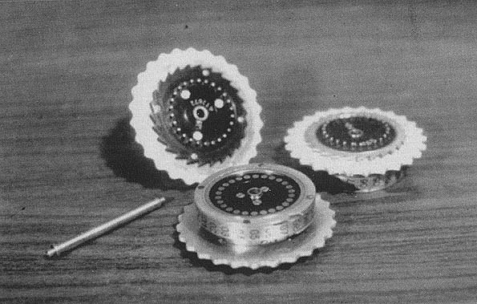
Historical Example: The World War II Enigma Machine
You select the proper rotors
Photo: public domain

Slide 15
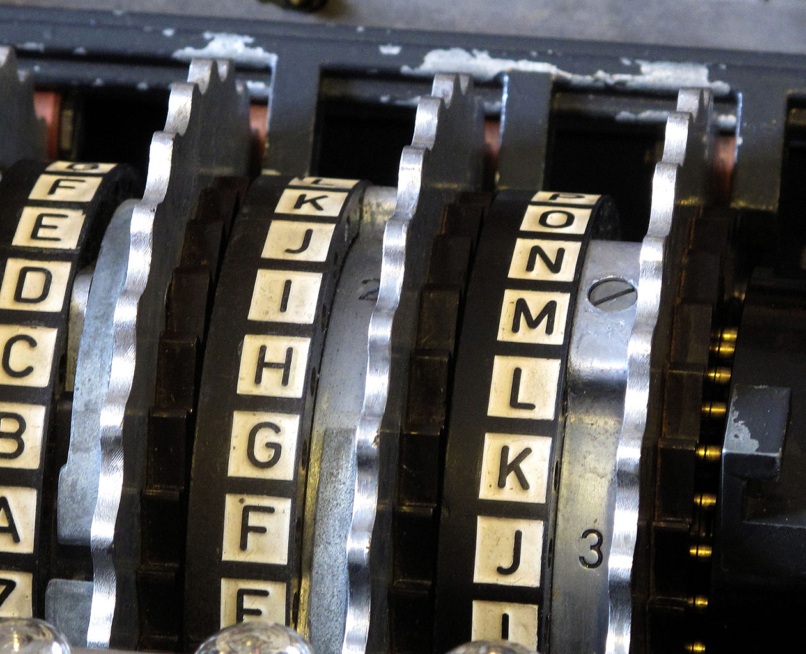
Historical Example: The World War II Enigma Machine
Adjust the rotors to their “ground setting”. (More complex than I’m explaining now.)
Photo: public domain

Slide 16
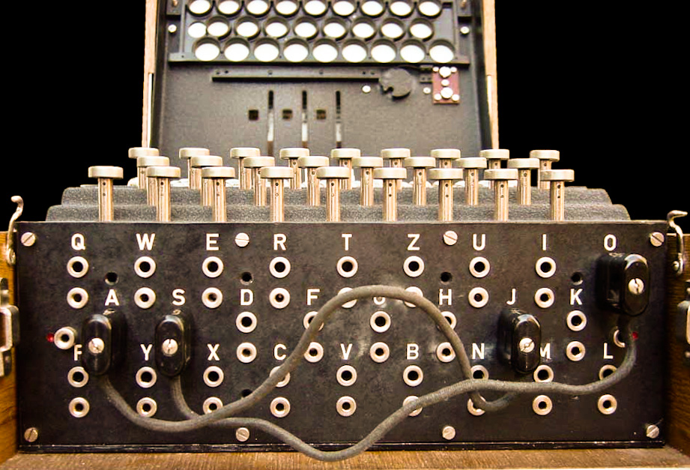
Historical Example: The World War II Enigma Machine
Set the plugboard
Note: in today’s terminology, the rotor selection, initial rotor settings, and plugboard setting were the daily key, which was listed in a book.
Photo: Bob Lord, via WikiMedia Commons

Slide 17
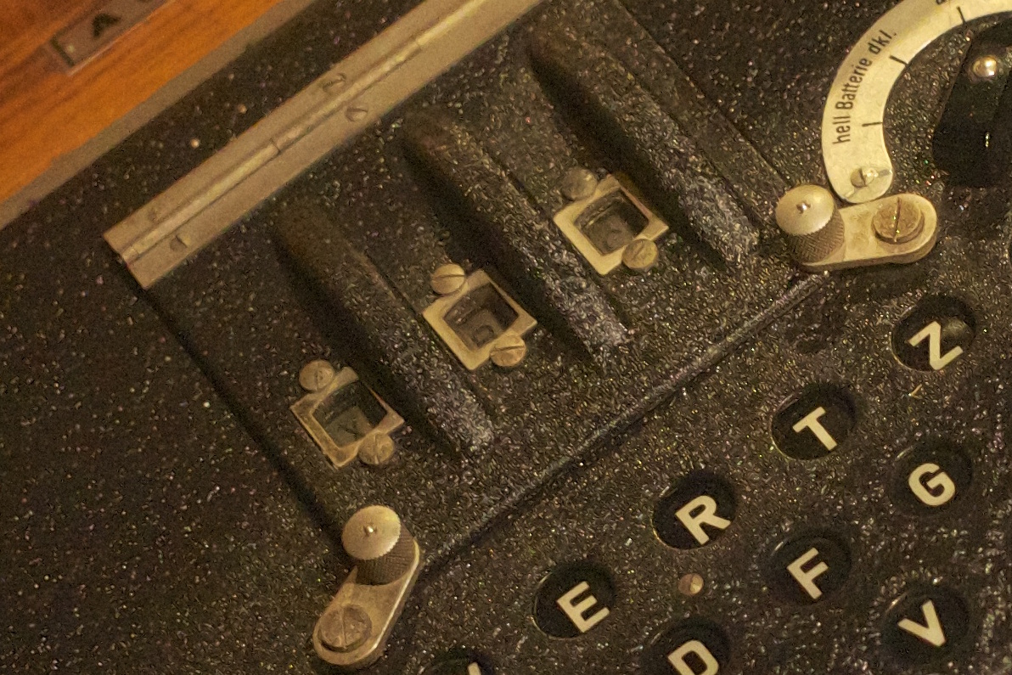
Historical Example: The World War II Enigma Machine
Pick three random letters and encrypt them twice, and send those six letters as the start of the encrypted message
(In modern terminology, these letters are the session key)
Reset the rotors to those three letters
Photo: Paul Hudson, via Flickr

Slide 18
What Could Go Wrong?
Sending the same, simple message every day was a fatal flaw
Picking non-random letters was a fatal flaw
Sending a message consisting of nothing but the letter “L” was a fatal flaw—this is partly usage, and partly a design weakness in the Enigma
Encrypting the three letters twice was a fatal flaw

Slide 19
The Three Letters
Imagine that “XJM” was encrypted to “AMRDTJ”
The cryptanalysts realized that A and D represented the same letter, M and T were the same, and R and J were the same
This gave away valuable clues to the rotor wiring and the rotor order!
Cryptography is very hard…

Slide 20
Modern Cryptography
Algorithms
Keys
Protocols
Hash functions (not covered in this lecture)
Digital signatures (also not covered)
Really arcane math…

Slide 21
Modern Cryptography
An algorithm and a key convert plaintext into ciphertext
A different algorithm and the key convert ciphertext into plaintext
Kerckhoff’s Maxim (1883): “The system must not require secrecy, and it does not matter if it falls into the hands of the enemy.”
  Don’t trust secret designs!

Slide 22
The Data Encryption Standard
In 1974, NBS (now NIST) adopted the Data Encryption Standard (DES) for sensitive but unclassified data
  Some sources claim the need was realized after the Soviets intercepted calls by US private sector grain deal negotiators
DES is a block cipher and encrypts 64 bits (8 bytes) at a time
The key length is 56 bits—72,057,594,037,927,936 possible keys

Slide 23
NSA Limited the Key Length
The original design (from IBM) used 112-bit keys
The commercial design used 64-bit keys
This posed a dilemma for the NSA—protect US communications better, with longer keys, or ease cryptanalysis with shorter keys?
They ended up asking for 48 bits
The compromise with IBM was 56 bits, 256× (i.e., 2⁸×) stronger than 48 bits but 256× weaker than 64 bits

Slide 24
Exhaustive Search
Any cipher can be cracked by trying each possible key
For a Caesar cipher, there are only 26 possible keys—clearly too few!
  In Julius Caesar’s day, there were only 23 possible keys…
If a chip can try one key every microsecond and you have 1 million chips, full search of DES takes ~72,000 seconds—less than a day, on a machine estimated to cost ~$10 million (ballpark figure)
Moore’s Law means the design gets cheaper over time

Slide 25
Using Classical Cryptography
Alice and Bob want to exchange secret messages
First, Alice and Bob have to have a shared key, which they need to keep secret
Alice and Bob can then exchange secret messages
If Carol wants to talk securely with Alice, they need their own key
If Carol also wants to talk to Bob, they need a key, too
With n people, you need approximately n²/2 keys
That’s a lot of keys to issue and protect
  How do these people exchange keys in the first place?

Slide 26
Key Management is Hard
If the Alice-Bob key is ever compromised, all of their past and future traffic is vulnerable
This means they need to change their key periodically
The same is true for all of the other pairs of users
Japanese key distribution difficulties during World War II were very useful to US cryptanalysts—and utterly vital to the US victory in the Battle of Midway

Slide 27
Public Key Cryptography
In 1976, Diffie and Hellman proposed a radically different form of cryptography: public key cryptography
  We now know that GCHQ had invented much of the same concept—but only five years ahead of Diffie and Hellman
  Diffie and Hellman had one idea, digital signatures, that even GCHQ and NSA didn’t have
However, Diffie and Hellman only invented the concept; they did not know an actual way to do it
In 1978, Rivest, Shamir, and Adleman developed the RSA algorithm and made it all work

Slide 28
Public Key Cryptography
In all previous designs, the decryption key is the same as the encryption key
In public key systems, there are two different keys that are related
Furthermore, you cannot calculate the decryption key if all you know is the encryption key
This was revolutionary—and it has enabled today’s e-commerce

Slide 29
Using Public Key Cryptography
Alice generates a key pair—an encryption key k and a decryption key k ⁻¹—and then publishes k
Bob does the same thing
To send Alice a message, Bob looks up her encryption key on the Internet, encrypts the message, and sends it to Alice
Only Alice knows k ⁻¹ and hence only she can decrypt the message

Slide 30
Easier Key Management!
Carol can generate her own key pair, too
So can anyone else
For n people, we now need only n key pairs
Alice can generate and publish a new key pair any time she wants to—she doesn’t have to meet with Bob to exchange keys securely

Slide 31
How Does This Work?
I’m not going to tell you…
  It’s not secret, it’s just math that isn’t relevant for this class
  However, it created very practical uses for a branch of mathematics that had been thought to be of purely academic interest…
The RSA algorithm is being replaced by a new scheme called elliptic curve cryptography, which uses more complex math
If they ever build quantum computers, we’ll need newer algorithms…

Slide 32
Key Sizes
RSA keys (public and private) are much longer than conventional keys—today, about 2048 bits
  Public key systems are often called asymmetric; conventional systems, from Caesar ciphers to today’s, are called symmetric
Symmetric and asymmetric key lengths are not easily comparable—the design and math are very different
Today’s standard cipher (AES) normally uses 128-bit keys, which corresponds to ~3072-bit RSA keys

Slide 33
Problem Solved?
Well, no—using public key crypto is difficult
For one thing, public key operations are computationally expensive
For another, they’re mathematically tricky
  (Don’t ask!)
And we don’t want to use any one key too much
Besides—how do we know this public key we found on the Internet really belongs to Alice?

Slide 34
Cryptographic Protocols
To really use cryptography properly, we need a protocol
A cryptographic protocol is a stylized set of messages between the parties
The usual goal is for the two parties who wish to communicate to end up with a shared session key and to be assured of the other’s identity

Slide 35
Needham-Schroeder (1978)
This is the oldest cryptographic protocol in the open literature
I’ll show the symmetric version—there’s an asymmetric version, but it requires more complex concepts
In addition to Alice and Bob, there is a trusted key server S
  Alice and Bob each share a key (K_{AS} and K_{BS}) with S
  They want to end up with a new session key K_{AB}

Slide 36
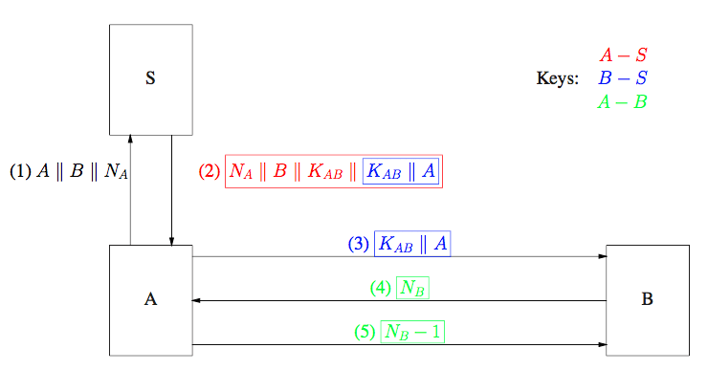
The Needham-Schroeder Protocol

Slide 37
The Messages
Alice sends S her identity, plus a random nonce
S’s response is encrypted in K_{AS}, which guarantees authenticity
  N_{A} guarantees freshness
  K_{AB} is the new session key
  There’s a sealed package for Bob encrypted with K_{BS}
Alice sends the sealed package to Bob
Bob sends a nonce to Alice encrypted with K_{AB}
Alice proves she could read the nonce

Slide 38
You Are Not Expected to Understand This
Yes, it’s complicated
Modern protocols are often more complicated—setting up a TLS connection takes six messages, plus several concepts I haven’t discussed
It’s also not quite correct….

Slide 39
Errors in Needham-Schroeder
Needham-Schroeder was published in 1978
In 1981, Denning and Sacco found some flaws and proposed a fix
In 1987, Needham and Schroeder found a flaw in the fix
In 1996, Lowe found a new, previously unsuspected flaw in all of the older versions
All of these flaws were obvious in retrospect—but one of them took 18 years and automated assistance to find

Slide 40
Don’t Try This at Home!
The basic algorithms are hard
The protocols are hard
Users make mistakes
There’s a lot more I haven’t told you about, stuff that’s utterly vital in the real world
  In particular, while we still need trusted third parties, we don’t need to trust them quite as much as I’ve shown

Slide 41
Today’s Status
We have high confidence that the basic primitive algorithms are correct
Our protocols are very complex—errors have been found in many, including some designed by sophisticated companies
There are often bugs in the code—in one study, 85% of mobile apps got straightforward cryptography wrong
User errors are a major problem

