Slide 1
Artificial Intelligence and National Security
Steven M. Bellovin, Jason Healey, Matt Waxman
Fall 2017

Slide 2
What is Artificial Intelligence?
You know what it is—computer programs that “think” or otherwise act “intelligent”
The Turing test?
What is “machine learning” (ML)?
It’s simply one technique for AI—throw a lot of data at a program and let it figure things out
What are “neural networks”?
A currently popular technique for ML

Slide 3
How Does ML Work?
Lots of complicated math
Not the way human brains with human neurons work
To us, it doesn’t matter—we’ll treat it as a black box with certain properties

Slide 4
How ML Works
You feed the program a lot of training data
From this training data, the ML algorithm builds a model of the input
New inputs are matched against the model
Examples: Google Translate, Amazon and Netflix’s recommendation engines, speech and image recognition
However—machine learning algorithms find correlations, not causation
It’s not always clear why ML makes certain connections

Slide 5
Correlation versus Causation
https://xkcd.com/552/

Slide 6
Training Data
Training data must represent the desired actual input space
Ideally, the training records should be statistically independent
If you get the training data wrong, the output will be biased
To understand or evaluate the behavior of an ML system, you need the code and the data it was trained on
“Algorithm transparency” alone won’t do it

Slide 7
Biased Data
Suppose you want an ML system to evaluate job applications
You train it with data on your current employees
The ML system will find applicants who “resemble” the current work force
If your current workforce is predominantly white males, the ML system will select white male applicants and perpetuate bias

Slide 8
Learning Styles
Supervised
Unsupervised
A human labels the training data according to some criteria, e.g., spam or not spam
The algorithm then “learns” what characteristics make items more like spam or more like non-spam
Finds what items cluster together
Useful for large datasets, where there is no ground truth, or where labels don’t matter
What counts is similarity

Slide 9
Supervised: Image Recognition
Feed it lots of pictures of different things
Label each one: a dog, a plane, a mountain, etc.
Now feed it a new picture—it will find the closest match and output the label

Slide 10
Unsupervised Learning
Feed in lots of data without ground truth
The algorithms find clusters of similar items; they can also find outliers—items that don’t cluster with others
They can also find probabilistic dependencies—if a certain pattern of one set of variables is associated with the values of another set, a prediction can be made about new items’ values for those variables

Slide 11
Watch Out for Biased Training Data!
Google Photos misidentified two African-American men as gorillas
Jacky Alciné—a programmer and one of the people who was misidentified, “I understand HOW this happens; the problem is moreso on the WHY.”
Likely cause: not enough dark-skinned faces in the training dataset

Slide 12
Why Use ML Image Recognition?

Slide 13
Why Use ML Image Recognition?

Slide 14
Why Use ML Image Recognition?

Slide 15
ML Can Spot Features You Miss

Slide 16
Guanajay, Cuba, 1962

Slide 17
Today’s Uses
Machine translation
Speech recognition
Computer vision
Some search engine features
A lot of self-driving car software
In the past, all of these things were attempted by dedicated code, which didn’t work nearly as well

Slide 18
Merging Data Sources
There are many sensors, not just visual light cameras
They differ in resolution, coverage, timing, etc.
Imagine: satellite photo, airborne side-looking radar, ground-level helmet camera, plus weather
ML algorithms can treat these as multiple variables and make inferences without actually merging them

Slide 19
Computer Security
Train your ML system on normal, unhacked data
Have it look, in real-time, for deviations; flag them as possible security incidents
Known as “anomaly detection”; used for network traffic, host behavior, virus detection, etc.

Slide 20
Drone Data
There are many drones flying over Afghanistan, Syria, Iraq, etc.
They send back many hours of video
Most of it is useless—the routes too and from the target area, clouds, etc.
Can machine learning pick out the interesting parts?

Slide 21
Targeting
Can machine learning pick out the right targets?
What about decoys or radar chaff?
Can you train the system properly?

Slide 22
Finding People
Use metadata—calling patterns, location, etc.
Look for people who cluster (in the ML sense) with known targets
At the least, they merit further investigation

Slide 23
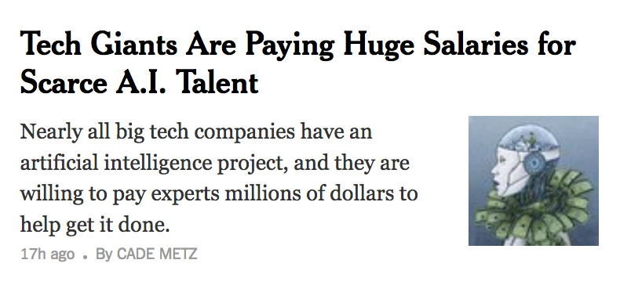
The Good News
ML has made incredible progress in the last very few years
Things that had been very hard research problems are now routine
There is every reason to expect continued rapid progress

Slide 24
Things Change Rapidly!
September 2014
Google Images, Today
https://xkcd.com/1425/

Slide 25
The Full Picture

Slide 26
However…

Slide 27
There Are Issues
Training Data Is Hard
Output is Probabilistic
Adversarial machine learning
There are important “big data” situations where ML cannot help

Slide 28
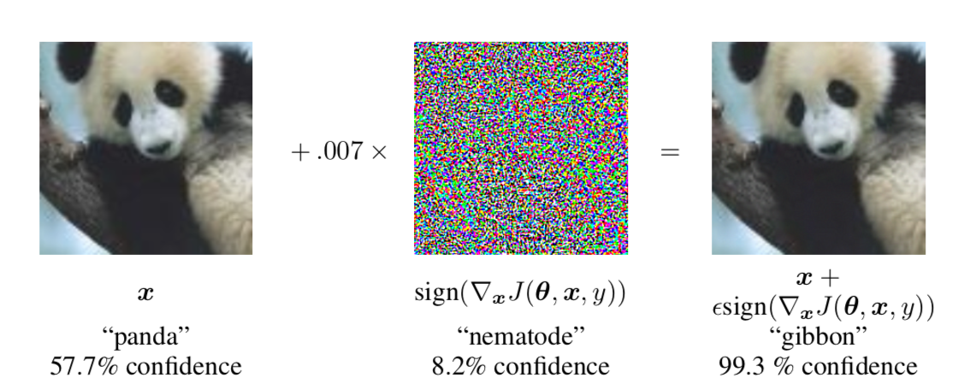
Adversarial Machine Learning
Computers do not “see” the way we do
Imperceptible or irrelevant—to us!—changes to an image can drastically change the results
https://arxiv.org/abs/1412.6572

Slide 29
100% Successful Attack
https://arxiv.org/pdf/1707.08945.pdf

Slide 30
Biased Sources
Training data that doesn’t represent actual data
Cultural biases by the trainers
Mechanical Turk workers are often used for labeling
False positives and false negatives

Slide 31
Alternative Facts
Mostly right…
However, I never went to Duke!
My earliest well-known work was done with people from Duke

Slide 32
Data Points as Proxies
Algorithms can find correlations that are proxies for other values
Example: certain other items correlate with race
Race cannot be used in making certain decisions—can these other fields?

Slide 33
Credit Scores
Credit scores are supposed to indicate how likely you are to repay a loan
They’re used for other things, too, like car insurance

Slide 34
An FTC Study
“This study examines the effect of credit-based insurance scores on the price and availability of automobile insurance and the impact of such scores on racial and ethnic minority groups and on low-income groups. Using a large database of insurance policies, the study shows that scores are effective predictors of risk under automobile policies. At the same time, scores are observed to be distributed differently among racial and ethnic groups, and this difference is likely to have an effect on the insurance premiums that these groups pay, on average. Nonetheless, scores appear to derive a relatively small amount of their predictive power from their correlation with race and ethnicity. Finally, the Commission could not develop an alternative scoring model that would continue to predict risk effectively, yet decrease the differences in scores among racial and ethnic groups.”
https://www.ftc.gov/reports/credit-based-insurance-scores-impacts-consumers-automobile-insurance-report-congress-federal

Slide 35
Decoy Warheads
There’s an incoming missile with a nuclear warhead
The missile has also deployed decoys to fool US anti-missile radars
Can we use ML to pick out the real warhead?
Do we have enough labeled training data on real versus decoy warheads?

Slide 36
Finding Terrorists
There are very, very few terrorists
Where are you going to find enough training data?
Almost certainly, any features the real terrorists have in common will be matched by very many other innocent people
The algorithms can’t distinguish them

Slide 37
Finding Terrorists
There are very, very few terrorists
Where are you going to find enough training data?
Almost certainly, any features the real terrorists have in common will be matched by very many other innocent people
The algorithms can’t distinguish them
When humans do this, we call it profiling

