Slide 1
BOREDGAMES

Slide 2
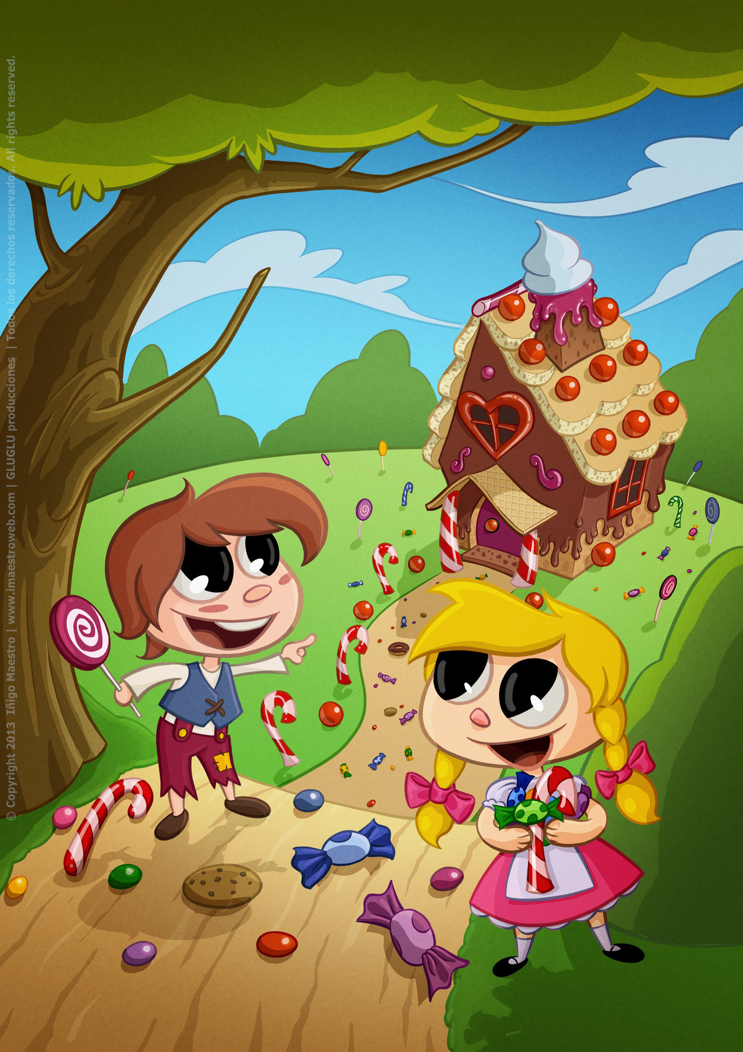
Team
Kristen Wise
Brandon Kessler

Slide 3
Overview
Turn based board games
Board setup, turn changes, game rules
Focus on accessibility, removing base layer of check functions (lessening overall convolution inherent in most game programs)

Slide 4
Types
Int
Float ((Double))
String
Piece
Boolean

Slide 5
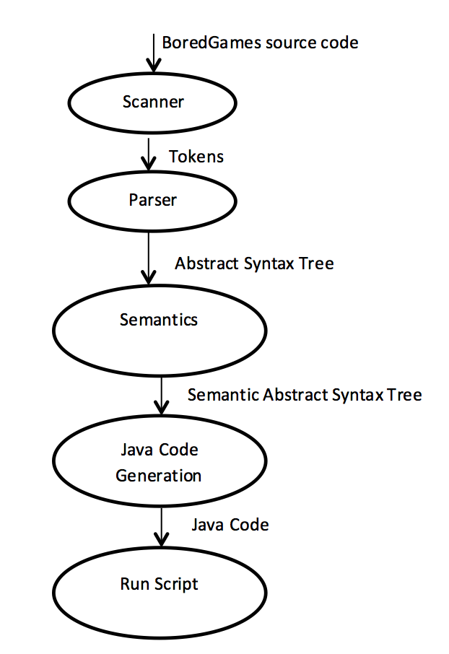
Process

Slide 6
DEMO TIME!!!!

