Slide 1
Watermarks for Generative AI: Constructions
Miranda Christ
Columbia University

Slide 2
Large language models

Slide 3

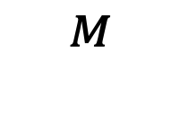
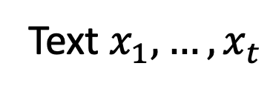
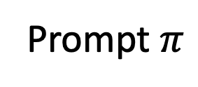
Large language models (LLMs)
Model
Prompt $π$
$$^{M}$$
Neural network
Text $x_{1},…, x_{t}$
“tokens”

Slide 4

Large language models (LLMs)
likelihood of each token
while $x_{t}≠$done:
$p_{t+1}=M\left(π, x_{1},…, x_{t}\right)$
sample $x_{t+1}$ from $p_{t+1}$
$t=t+1$
output $x_{1},…, x_{t}$
Prompt $π$
Neural network
Text $x_{1},…, x_{t}$

Slide 5

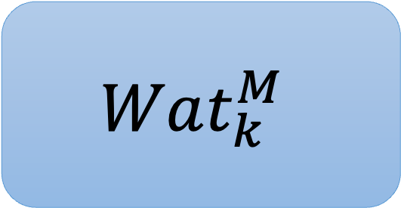
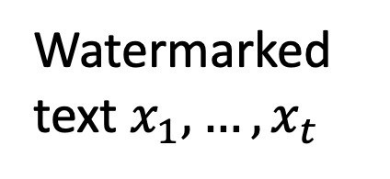
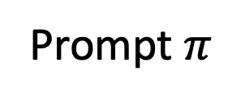
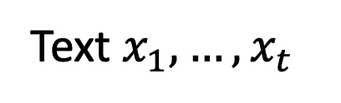
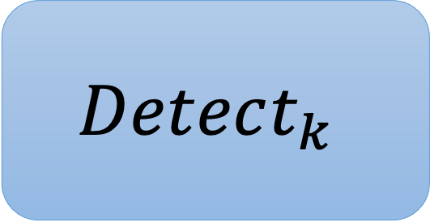
Watermarking LLMs
Prompt $π$
$$Wat_{k}^{M}$$
Watermarked text $x_{1},…, x_{t}$
Secret key
=
Secret rule
Text $x_{1},…, x_{t}$
$$Detect_{k}$$
True/False

Slide 6
Robustness

Slide 7
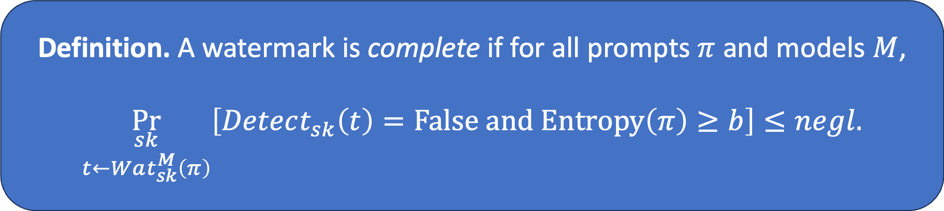
Completeness
Definition. A watermark is complete if for all prompts $π$ and models $M$,
$$\underset{\begin{aligned}sk \\ t←Wat_{sk}^{M}\left(π\right)\end{aligned}}{Pr}\left[Detect_{sk}\left(t\right)=False and Entropy\left(π\right)≥b\right]≤negl.$$

Slide 8
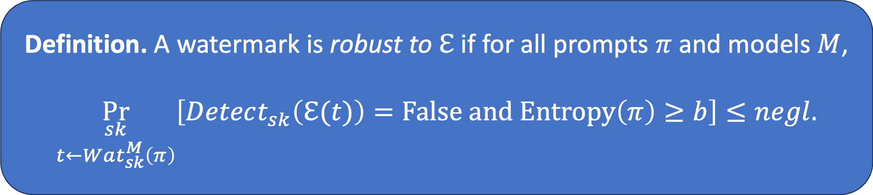
Robustness
An error channel $ℇ\left(⋅\right)→Σ^{∗}$ takes as input text $t$ and outputs $t′$.
Definition. A watermark is robust to $ℇ$ if for all prompts $π$ and models $M$,
$$\underset{\begin{aligned}sk \\ t←Wat_{sk}^{M}\left(π\right)\end{aligned}}{Pr}\left[Detect_{sk}\left(ℇ(t)\right)=False and Entropy\left(π\right)≥b\right]≤negl.$$
Same as completeness,
but error channel is applied

Slide 9
Kinds of robustness
Substitution robustness
Replace some words
Edit robustness
Delete/insert words
Semantic robustness
Paraphrase text
More generally, apply any transformation that preserves meaning

Slide 10
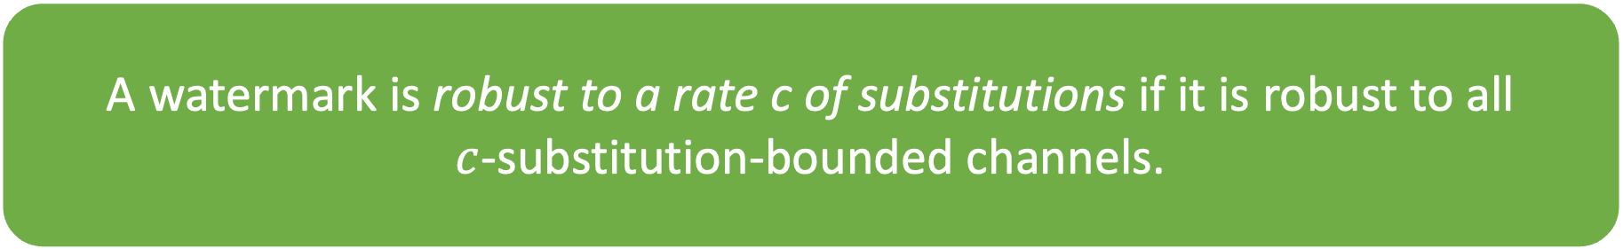
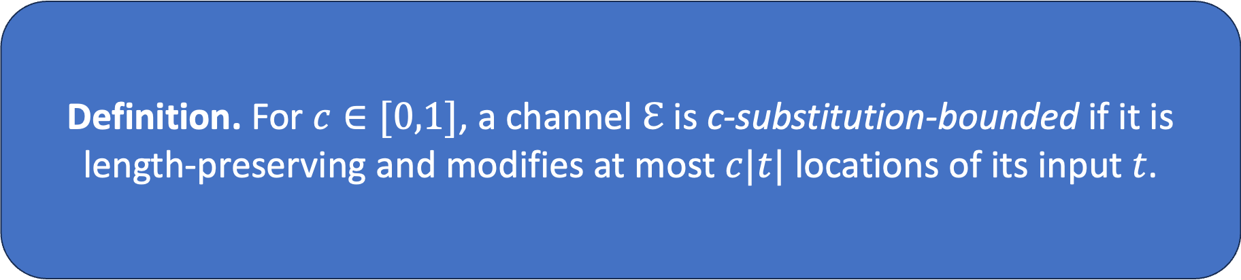
Robustness to substitutions
Definition. For $c∈[0,1]$, a channel $ℇ$ is c-substitution-bounded if it is length-preserving and modifies at most $c|t|$ locations of its input $t$.
A watermark is robust to a rate c of substitutions if it is robust to all
$c$-substitution-bounded channels.

Slide 11
Key technique: unbiased correlated sampling

Slide 12

Watermark template
approximate randomness recovery
randomness
=
randomness
some seed x
content
input/prompt
correlated with x

Slide 13
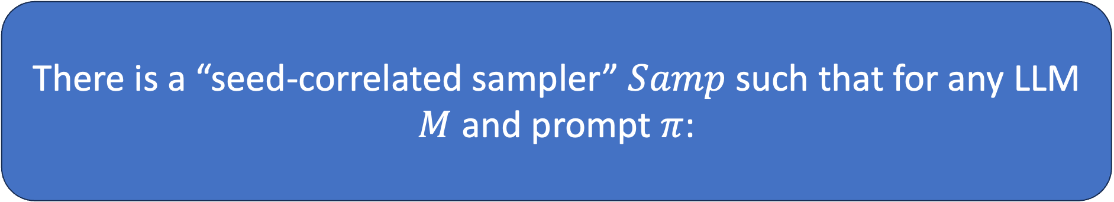
I’ll show:
There is a “seed-correlated sampler” $Samp$ such that for any LLM $M$ and prompt $π$:
$$M\left(π\right)≡Samp\left(M, π, s\right) :s←{\left\{0,1\right\}}^{n}$$
⇨ sampling a response with a random seed yields the same distribution obtained under $M$
$\text{For} t←Samp(M, π, s)\text{, }d(binary\left(t\right), s\text{)} \text{is} \text{small}$ w.h.p.
⇨ the response, when written in binary, is close to the seed in Hamming distance

Slide 14
For simplicity, assume the model outputs its response in binary.
This can be done without loss of generality; see [CGZ24, CG24].

Slide 15

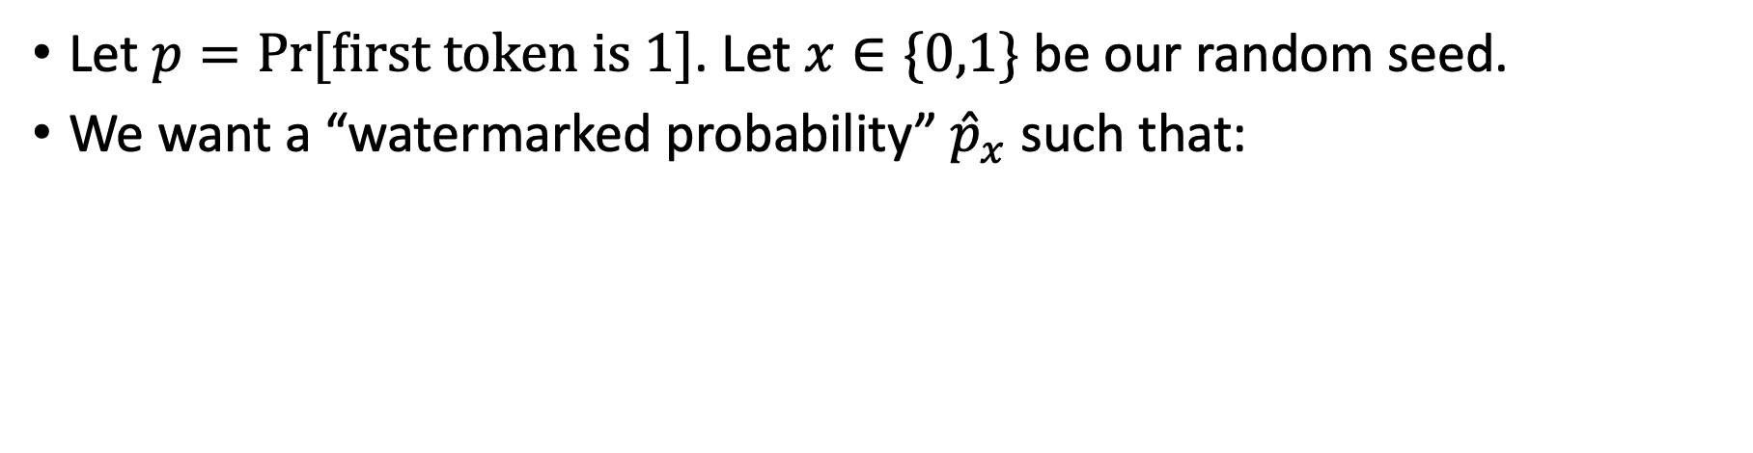


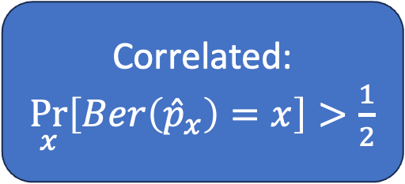
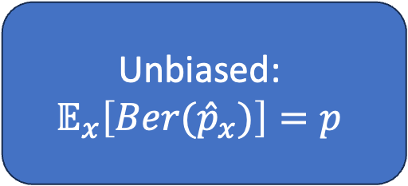

Watermarking one token
Let $p=Pr⁡[first token is 1]$. Let $x∈\{0,1\}$ be our random seed.
We want a “watermarked probability” ${\hat{p}}_{x}$ such that:
Unbiased:
$$𝔼_{x}\left[Ber({\hat{p}}_{x})\right]=p$$
$$1$$
$$p$$
$\frac{1}{2}$
Correlated:
$\underset{x}{Pr}\left[Ber\left({\hat{p}}_{x}\right)=x\right]>\frac{1}{2}$
$$0$$

Slide 16
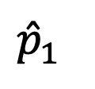


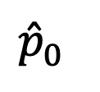






Watermarking one token
when x=1, increase prob of 1 by green bar
when x=0,
decrease similarly
$$1$$
$$1$$
Unbiased:
$$𝔼_{x}\left[Ber({\hat{p}}_{x})\right]=p$$
$$1$$
$${\hat{p}}_{1}$$
$$p$$
$\frac{1}{2}$
$\frac{1}{2}$
$\frac{1}{2}$
Correlated:
$\underset{x}{Pr}\left[Ber\left({\hat{p}}_{x}\right)=x\right]>\frac{1}{2}$
$${\hat{p}}_{0}$$
$$0$$
$$0$$
$$0$$

Slide 17

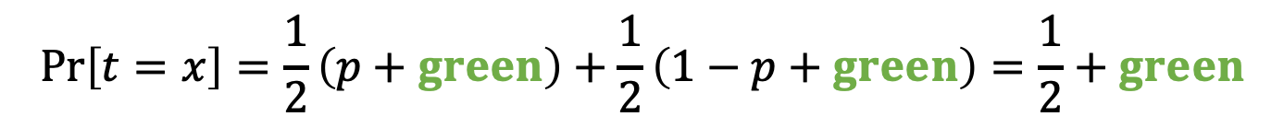
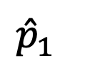
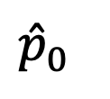


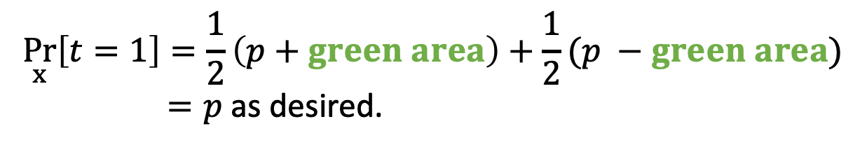



Watermarking one token
Unbiased:
$$1$$
$$1$$
$$\underset{x}{Pr}\left[t=1\right]=\frac{1}{2}\left(p+green area\right)+\frac{1}{2}(p −green area)$$
$=p$ as desired.
$${\hat{p}}_{1}$$
$\frac{1}{2}$
$\frac{1}{2}$
Correlated:
$${\hat{p}}_{0}$$
$$\operatorname{Pr}\left[t=1 | x=1\right]=p+green area$$
$$0$$
$$0$$
$$\operatorname{Pr}\left[t=x\right]=\frac{1}{2}\left(p+green\right)+\frac{1}{2}\left(1−p+green\right)=\frac{1}{2}+green$$

Slide 18
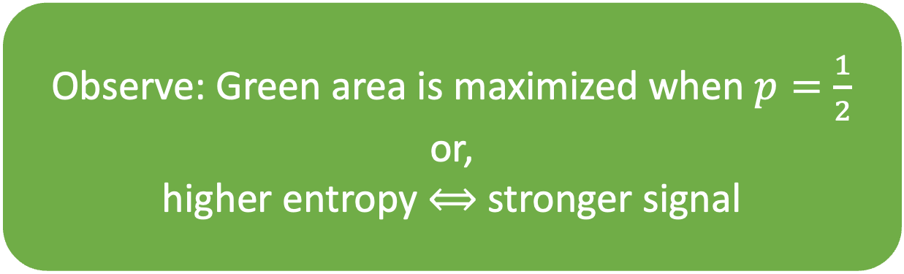
Watermarking one token
Observe: Green area is maximized when $p=\frac{1}{2}$
or,
higher entropy ⟺ stronger signal
$$1$$
$$1$$
$${\hat{p}}_{1}$$
$\frac{1}{2}$
$\frac{1}{2}$
Correlated:
$${\hat{p}}_{0}$$
$$0$$
$$0$$
$$\operatorname{Pr}\left[t=x\right]=\frac{1}{2}\left(p+green\right)+\frac{1}{2}\left(1−p+green\right)=\frac{1}{2}+green$$

Slide 19

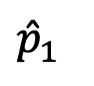
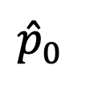






Extend to $n$ tokens!
Generate a long seed $x=x_{1}x_{2}…x_{n}$
Use each $x_{i}$ as we just saw, computing ${\hat{p}}_{x_{i}}$
$$1$$
$$1$$
$$1$$
$${\hat{p}}_{1}$$
$$p$$
$\frac{1}{2}$
$\frac{1}{2}$
$\frac{1}{2}$
$${\hat{p}}_{0}$$
$$0$$
$$0$$
$$0$$

Slide 20

Theorem: If the response $t_{1}t_{2}…t_{n}$ has enough entropy,
then $t_{i}=x_{i}$ for $≫\frac{n}{2}$ values of $i$.

Slide 21
Theorem: If the response $t_{1}t_{2}…t_{n}$ has enough entropy,
then $t_{i}=x_{i}$ for $≫\frac{n}{2}$ values of $i$.
If responses are binary, this is the identity function!
approximate randomness recovery
randomness
=
randomness
some seed x
content
input/prompt
correlated with x

Slide 22
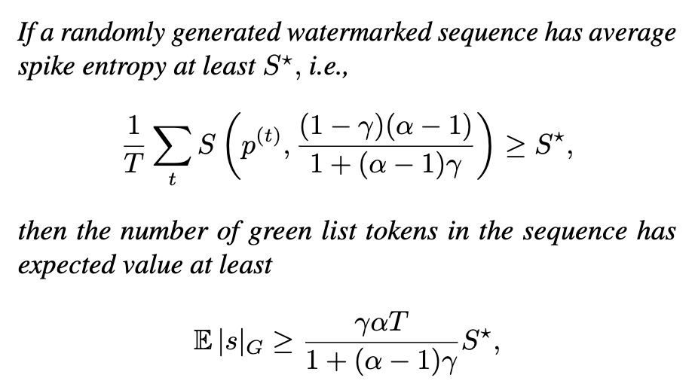
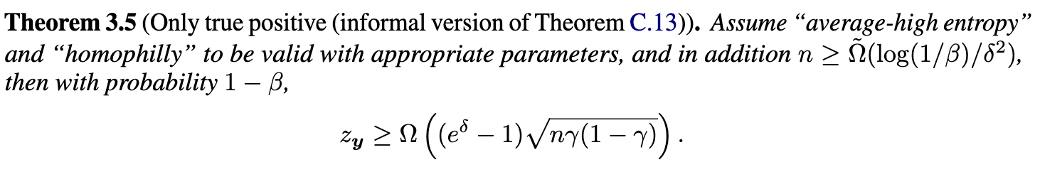


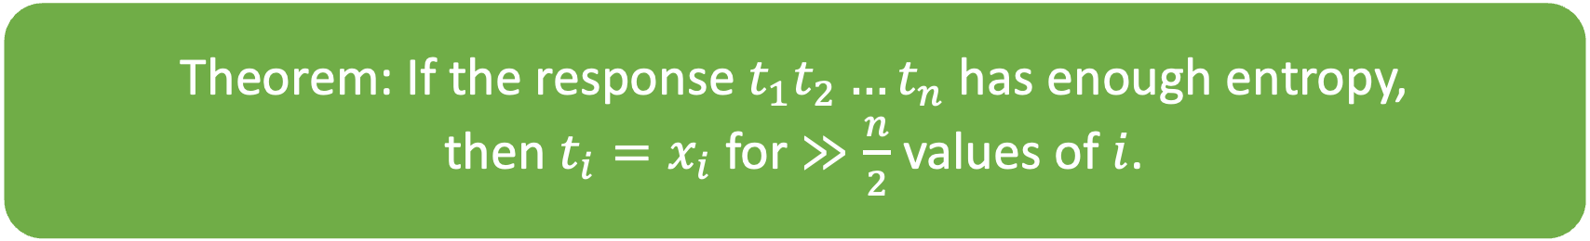

Basically every (theory) watermarking paper (sometimes secretly) uses a theorem like:
Theorem: If the response $t_{1}t_{2}…t_{n}$ has enough entropy,
then $t_{i}=x_{i}$ for $≫\frac{n}{2}$ values of $i$.
A Watermark for Large Language Models.
Provable Robust Watermarking for AI-Generated Text.

Slide 23
Common watermark blueprint
1. Choose seeds from a special structured family.
2. Use an unbiased correlated sampler with seed.
3. To detect, check correlation between response and seed family.

Slide 24
Using correlated unbiased sampling to construct a watermark

Slide 25
 | Seed family | Detection
[Aar22, KGW+23, CGZ24] | Derived from a PRF applied to prev tokens. | Rederive seed by computing PRF.
[ZALW24]
[KTHL24]
[FGJ+24]
[CG24, GM24]
[Aar22]: S. Aaronson, “Leaning Into Uninterpretability for AI Alignment,” 2022.
[KGW+23]: J. Kirchenbauer, J. Geiping, Y. Wen, J. Katz, I. Miers, T. Goldstein, “A Watermark for Language Models,” 2023.
[CGZ24]: M. Christ, S. Gunn, O. Zamir, “Undetectable Watermarks for Language Models,” 2024.

Slide 26
 | Seed family | Detection
[Aar22, KGW+23*, CGZ24] | Derived from a PRF applied to prev tokens. | Rederive seed by computing PRF.
[ZALW24]
[KTHL24]
[FGJ+24]
[CG24, GM24]
Seed can’t be rederived if these tokens are modified.
*Their correlated sampler is not unbiased.

Slide 27
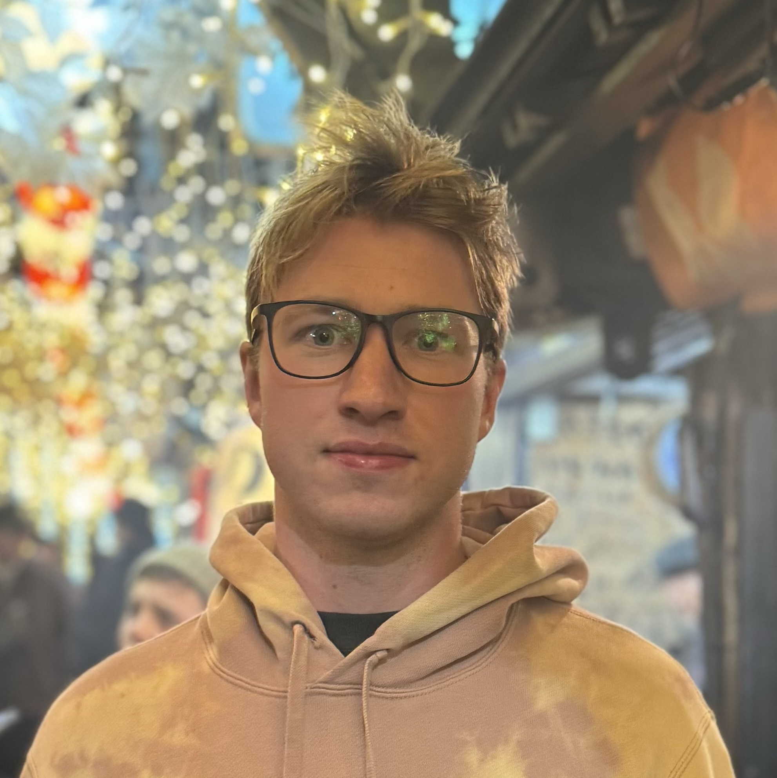
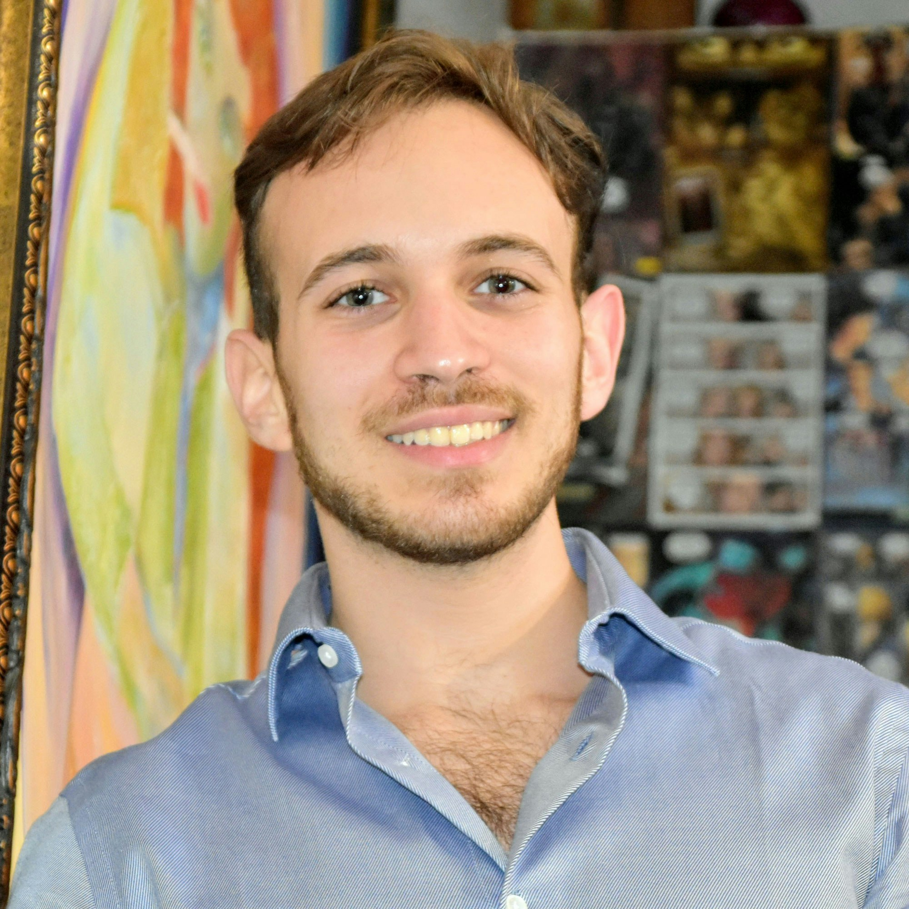
An undetectable watermark [CGZ24]
Sam Gunn
Or Zamir

Slide 28


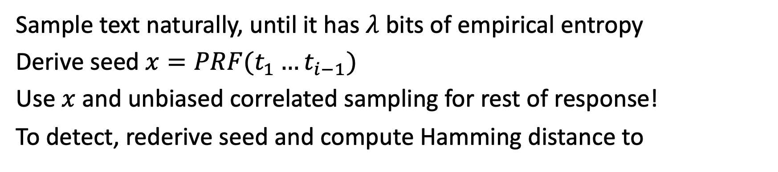

Sample text naturally, until it has $λ$ bits of empirical entropy
Derive seed $x=PRF(t_{1}…t_{i−1})$
Use $x$ and unbiased correlated sampling for rest of response!
To detect, rederive seed and compute Hamming distance to
$$t_{i}, …, t_{j}$$
$$t_{1},t_{2},t_{3},…,t_{i−1}$$
$$t_{i}, …, t_{j}$$
correlated with x
yields seed x
[Aar22, KGW+23] also hash tokens to bias future tokens
(they were first, served as inspiration)
They hash a fixed number of tokens; cannot get undetectability this way

Slide 29
Sample text naturally, until it has $λ$ bits of empirical entropy
Derive seed $x=PRF(t_{1}…t_{i−1})$
Use $x$ and unbiased correlated sampling for rest of response!
To detect, rederive seed and compute Hamming distance to
$$t_{i}, …, t_{j}$$
$$t_{1},t_{2},t_{3},…,t_{i−1}$$
$$t_{i}, …, t_{j}$$
correlated with x
yields seed x
Entropy ensures we never repeat seeds.
Cannot detect watermark if seed block is altered.

Slide 30
Example generated text
Seed (40 bits of empirical entropy)
Changing any word of the seed removes the watermark ☹
Music and mathematics have been intimately intertwined throughout history, and have had a powerful impact on many aspects of culture and society. Mathematics is a fundamental tool in understanding musical structure and composition, and music can help to make mathematics more accessible and interesting.
Music and mathematics are both based upon the same underlying principles of order, structure and rhythm that make them inherently linked. Mathematics is used to analyze musical elements such as pitch, tempo, rhythm, harmony, and form. It is essential to understand the mathematics of music in order to accurately compose or perform music. Music theory, which is the scientific study of music and its structure, is based heavily upon mathematical principles.
Mathematical concepts are also used to explain the physical properties of sound. The frequency of a sound is determined by mathematical equations, as well as the way in which different notes and chords combine and interact. The mathematical principles of harmony and dissonance are also used to create musical compositions.
Music and mathematics can also be used to explore and explain the psychological aspects of music. The mathematical principles of…

Slide 31
 | Seed family | Detection
[Aar22, KGW+23, CGZ24] | Derived from a PRF applied to prev tokens. | Rederive seed by computing PRF.
[ZALW24] (red/green scheme) | Fixed seed = 111…1. | Compute distance to seed.
[KTHL24]
[FGJ+24]
[CG24, GM24]
Equivalently,
count number green tokens
[ZALW24]: X. Zhao, P. Ananth, L. Li, Y. Wang, “Provable Robust Watermarking for AI-Generated Text,” 2024.

Slide 32
 | Seed family | Detection
[Aar22, KGW+23, CGZ24] | Derived from a PRF applied to prev tokens. | Rederive seed by computing PRF.
[ZALW24] | Fixed seed = 111…1. | Compute distance to seed.
[KTHL24] | Fixed random seed. | Compute edit distance to seed.
[FGJ+24]
[CG24, GM24]
[KTHL24]: R. Kuditipudi, J. Thickstun, T. Hashimoto, P. Liang, “Robust Distortion-free Watermarks for Language Models,” 2024.

Slide 33
 | Seed family | Detection
[Aar22, KGW+23, CGZ24] | Derived from a PRF applied to prev tokens. | Rederive seed by computing PRF.
[ZALW24] | Fixed seed = 111…1. | Compute distance to seed.
[KTHL24] | Fixed random seed. | Compute edit distance to seed.
[FGJ+24] | Pseudorandom signatures. | Verify signature.
[CG24, GM24]
[FGJ+24]: J. Fairoze, S. Garg, S. Jha, S. Mahloujifar, M. Mahmoody, M. Wang, “Publicly-Detectable Watermarking for Language Models,” 2024.

Slide 34
 | Seed family | Detection
[Aar22, KGW+23, CGZ24] | Derived from a PRF applied to prev tokens. | Rederive seed by computing PRF.
[ZALW24] | Fixed seed = 111…1. | Compute distance to seed.
[KTHL24] | Fixed random seed. | Compute edit distance to seed.
[FGJ+24]* | Pseudorandom signatures. | Verify signature.
[CG24, GM24]
*Rejection samples $λ$-entropy chunks of text to get exact randomness recovery.

Slide 35
Schemes as of 2023
Robustness
[ZALW24] preferentially uses certain tokens.
[KTHL24] biases text toward a fixed random string.
Undetectable for a single bounded-length response.
[Aar22, KGW+23, CGZ24] all use a similar strategy of applying a PRF to tokens.
[Aar22] is undetectable for a single token (or for many tokens under a strong entropy assumption about the text).
[CGZ24] is undetectable to any polynomial-time user.
Pseudorandom codes!
Quality

Slide 36
 | Seed family | Detection
[Aar22, KGW+23, CGZ24] | Derived from a PRF applied to prev tokens. | Rederive seed by computing PRF.
[ZALW24] | Fixed seed = 111…1. | Compute distance to seed.
[KTHL24] | Fixed random seed. | Compute edit distance to seed.
[FGJ+24] | Pseudorandom signatures. | Verify signature.
[CG24, GM24] | Derived from a pseudorandom code (PRC). | Run PRC decoder.
[CG24]: M. Christ and S. Gunn, “Pseudorandom Error-Correcting Codes,” 2024.
[GM24]: N. Golowich, A. Moitra, “Edit Distance Robust Watermarks via Indexing Pseudorandom Codes,” 2024.

Slide 37
The [CG24] approach: pseudorandom codes
Sam Gunn
[CG24] M. Christ, S. Gunn. Pseudorandom Error-Correcting Codes.

Slide 38
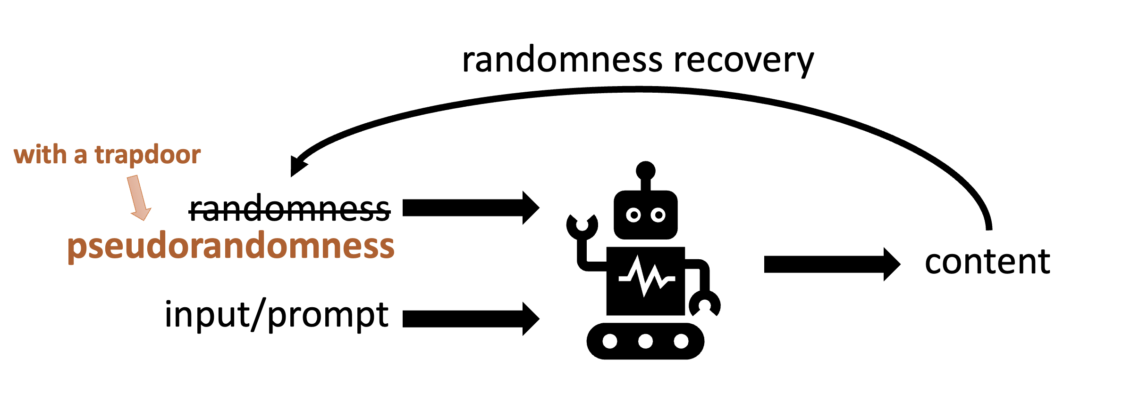
Watermarking template
Recovery is only approximate;
Need a robust trapdoor PRG = PRC
To embed:
For each query, draw a fresh s and output (PRG(s), prompt)
To detect:
Check if RandomnessRecovery(content) is a PRG output (using the trapdoor)

Slide 39
Pseudorandom codes [C-Gunn24]
Pseudorandom encryption
Pseudorandom code (PRC)
+
=
Error-correcting code
Notes:
A PRC consists of an encoding algorithm and a decoding algorithm.
A PRC is pseudorandom in that a distinguisher cannot tell whether it is interacting with an encoding oracle on messages of its choice, or the uniform distribution which outputs a fresh random string on each query.
It also satisfies error correction: if x is the output of encode applied to some message, and you add low weight error to x, Decode still recovers the message with overwhelming probability. In this talk, we’ll focus on binary PRCs, because randomness recovery typically works best for binary randomness. You can think of errors as a constant rate of random bit-flips, though in the paper we consider worst-case errors and deletions as well.
In the paper, we also construct public-key PRCs, analogous to public-key encryption.

Slide 40
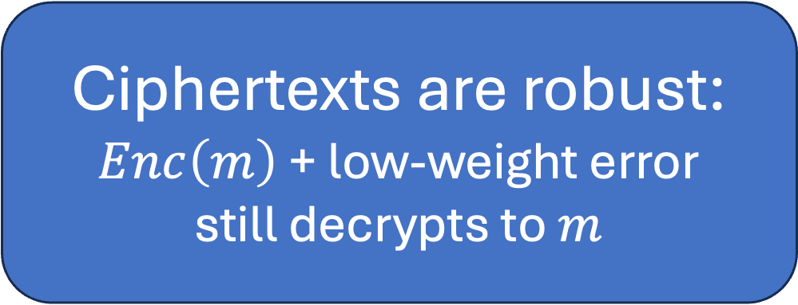
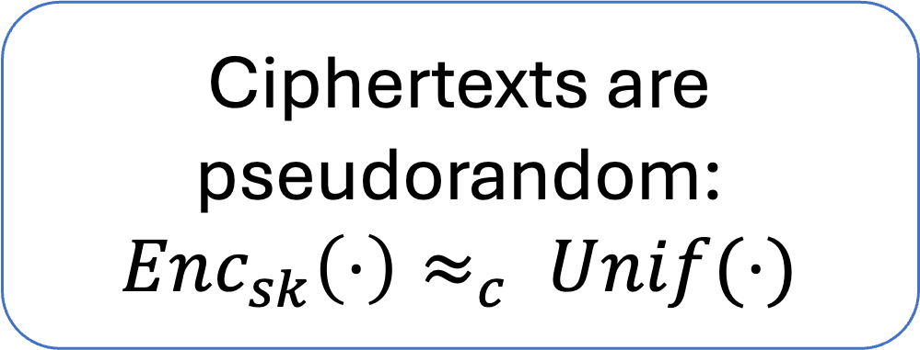
Pseudorandom codes [C-Gunn24]
Ciphertexts are pseudorandom:
$Enc_{sk}\left(⋅\right)≈_{c} Unif(⋅)$
Pseudorandom code (PRC)
+
=
Error-correcting code
Ciphertexts are robust:
$Enc\left(m\right)$ + low-weight error
still decrypts to $m$
Notes:
A PRC consists of an encoding algorithm and a decoding algorithm.
A PRC is pseudorandom in that a distinguisher cannot tell whether it is interacting with an encoding oracle on messages of its choice, or the uniform distribution which outputs a fresh random string on each query.
It also satisfies error correction: if x is the output of encode applied to some message, and you add low weight error to x, Decode still recovers the message with overwhelming probability. In this talk, we’ll focus on binary PRCs, because randomness recovery typically works best for binary randomness. You can think of errors as a constant rate of random bit-flips, though in the paper we consider worst-case errors and deletions as well.
In the paper, we also construct public-key PRCs, analogous to public-key encryption.

Slide 41
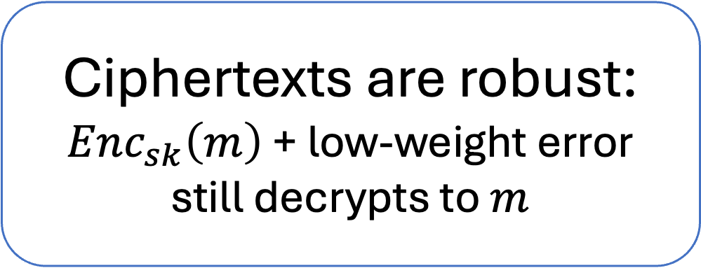
Pseudorandom codes [C-Gunn24]
Ciphertexts are pseudorandom:
$Enc_{sk}\left(⋅\right)≈_{c} Unif(⋅)$
Pseudorandom code (PRC)
+
=
Ciphertexts are robust:
$Enc_{sk}\left(m\right)$ + low-weight error
still decrypts to $m$
Notes:
A PRC consists of an encoding algorithm and a decoding algorithm.
A PRC is pseudorandom in that a distinguisher cannot tell whether it is interacting with an encoding oracle on messages of its choice, or the uniform distribution which outputs a fresh random string on each query.
It also satisfies error correction: if x is the output of encode applied to some message, and you add low weight error to x, Decode still recovers the message with overwhelming probability. In this talk, we’ll focus on binary PRCs, because randomness recovery typically works best for binary randomness. You can think of errors as a constant rate of random bit-flips, though in the paper we consider worst-case errors and deletions as well.
In the paper, we also construct public-key PRCs, analogous to public-key encryption.

Slide 42

Pseudorandom codes [C-Gunn24]
$${\left\{0,1\right\}}^{n}$$
Ciphertexts are pseudorandom:
$Enc_{sk}\left(⋅\right)≈_{c} Unif(⋅)$
Ciphertexts are robust:
$Enc_{sk}\left(m\right)$ + low-weight error
still decrypts to $m$
Encryptions of 1
Notes:
A PRC consists of an encoding algorithm and a decoding algorithm.
A PRC is pseudorandom in that a distinguisher cannot tell whether it is interacting with an encoding oracle on messages of its choice, or the uniform distribution which outputs a fresh random string on each query.
It also satisfies error correction: if x is the output of encode applied to some message, and you add low weight error to x, Decode still recovers the message with overwhelming probability. In this talk, we’ll focus on binary PRCs, because randomness recovery typically works best for binary randomness. You can think of errors as a constant rate of random bit-flips, though in the paper we consider worst-case errors and deletions as well.
In the paper, we also construct public-key PRCs, analogous to public-key encryption.

Slide 43
Pseudorandom codes [C-Gunn24]
Ciphertexts are pseudorandom:
$Enc_{sk}\left(⋅\right)≈_{c} Unif(⋅)$
Ciphertexts are robust:
$Enc_{sk}\left(m\right)$ + low-weight error
still decrypts to $m$
(nearly) all these strings decrypt to 1
Intuition: hard to remove watermark
Notes:
A PRC consists of an encoding algorithm and a decoding algorithm.
A PRC is pseudorandom in that a distinguisher cannot tell whether it is interacting with an encoding oracle on messages of its choice, or the uniform distribution which outputs a fresh random string on each query.
It also satisfies error correction: if x is the output of encode applied to some message, and you add low weight error to x, Decode still recovers the message with overwhelming probability. In this talk, we’ll focus on binary PRCs, because randomness recovery typically works best for binary randomness. You can think of errors as a constant rate of random bit-flips, though in the paper we consider worst-case errors and deletions as well.
In the paper, we also construct public-key PRCs, analogous to public-key encryption.

Slide 44
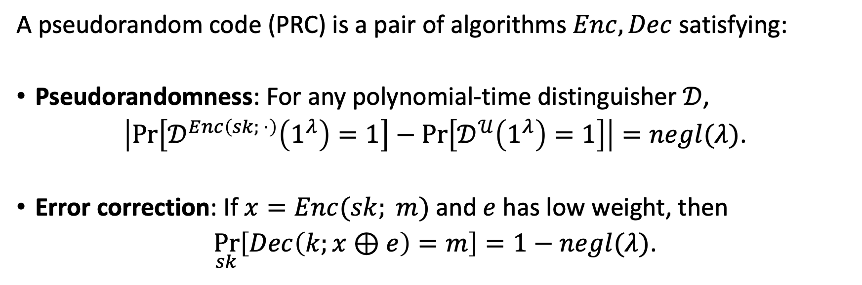
PRC Definition [CG24]
A pseudorandom code (PRC) is a pair of algorithms $Enc,Dec$ satisfying:
Pseudorandomness: For any polynomial-time distinguisher $𝒟$,
$\left|\operatorname{Pr}\left[𝒟^{Enc\left(sk; ⋅\right)}\left(1^{λ}\right)=1\right]−\operatorname{Pr}\left[𝒟^{𝒰}\left(1^{λ}\right)=1\right]\right|=negl(λ)$.
Error correction: If $x=Enc(sk; m)$ and $e$ has low weight, then
$\underset{sk}{Pr}\left[Dec\left(k;x⊕e\right)=m\right]=1−negl(λ)$.

Slide 45
Theorem [CG24]:
Assuming subexponential hardness of LPN, we construct PRCs robust to any constant rate of:
Random* bit flips, and
Random deletions

Slide 46

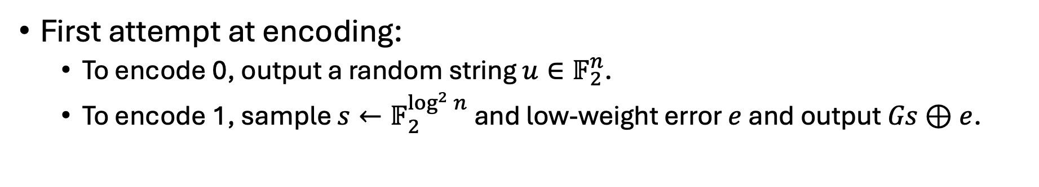

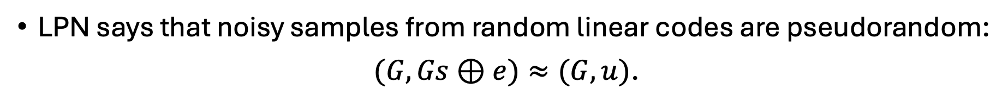
Constructing a PRC for 1 bit
LPN says that noisy samples from random linear codes are pseudorandom:
$(G, Gs⊕e)≈(G, u)$.
First attempt at encoding:
To encode 0, output a random string $u∈𝔽_{2}^{n}$.
To encode 1, sample $s←𝔽_{2}^{\log^{2}{n}}$ and low-weight error $e$ and output $Gs⊕e$.
Sample $G$ with a trapdoor!
Notes:
We take a different approach.
Let’s only try to encode a single bit; we’ll see shortly how to build a high-rate PRC from any 1-bit PRC.
Since we have a question about error-correcting codes, it seems natural to try to see if we can use LPN to build PRCs.
LPN says that noisy samples from a random linear subspace of F2 are pseudorandom.
So are we done? Do we just encode 1-bit messages as either random strings, or noisy samples from a random linear subspace?
No, because LPN says that these samples are pseudorandom even if you know what the subspace is.
But we show that it’s possible to sample small random linear subspaces together with a trapdoor for decoding.
Crucially, this trapdoor will work even if the codeword is subjected to a high rate of errors.
The way we do this is simple.
First we sample a random parity check matrix where the rows have sparsity log(n).
This will serve as the detection key.
Then we sample a random m-dimensional subspace of the kernel of P, with generator matrix A.
The first technical theorem that we prove is that the marginal distribution on A is actually statistically random, as long as m is not too big (like log^2 n).
So by sub-exponential LPN, noisy samples from the image of A are pseudorandom — but if you know P, then you can easily distinguish them.
On the next slide we’ll spell this out a bit more carefully.

Slide 47

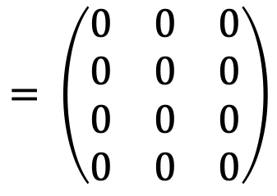
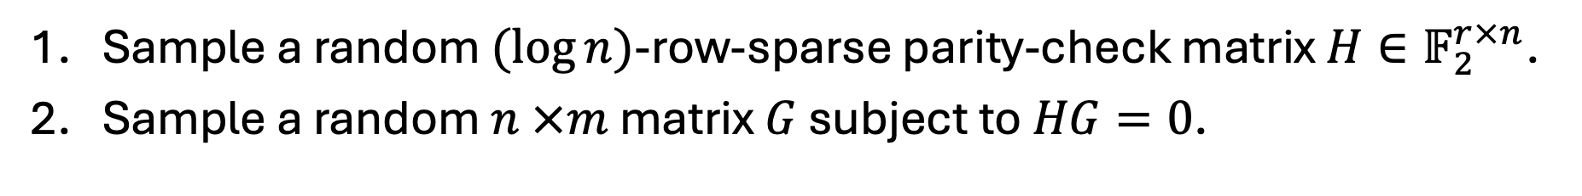

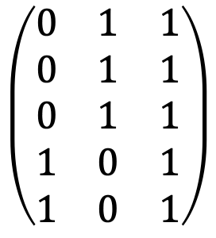

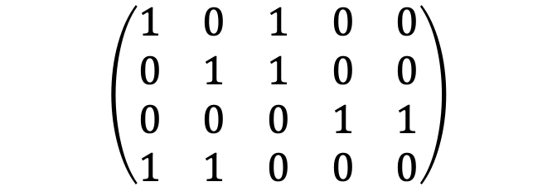
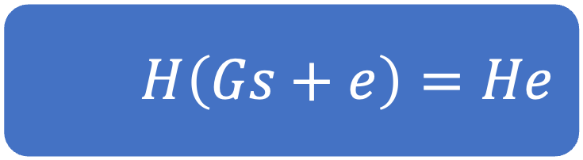
Constructing a PRC for 1 bit
Sample a random $(\log{n})$-row-sparse parity-check matrix $H∈𝔽_{2}^{r×n}$.
Sample a random $n ×m$ matrix $G$ subject to $HG=0$.
$$H$$
$$G$$
$$\left(\begin{matrix}1 & 0 & 1 & 0 & 0 \\ 0 & 1 & 1 & 0 & 0 \\ 0 & 0 & 0 & 1 & 1 \\ 1 & 1 & 0 & 0 & 0\end{matrix}\right)$$
$$\left(\begin{matrix}0 & 1 & 1 \\ 0 & 1 & 1 \\ 0 & 1 & 1 \\ 1 & 0 & 1 \\ 1 & 0 & 1\end{matrix}\right)$$
$$= \left(\begin{matrix}0 & 0 & 0 \\ 0 & 0 & 0 \\ 0 & 0 & 0 \\ 0 & 0 & 0\end{matrix}\right)$$
$$H\left(Gs+e\right)=He$$
Notes:
We take a different approach.
Let’s only try to encode a single bit; we’ll see shortly how to build a high-rate PRC from any 1-bit PRC.
Since we have a question about error-correcting codes, it seems natural to try to see if we can use LPN to build PRCs.
LPN says that noisy samples from a random linear subspace of F2 are pseudorandom.
So are we done? Do we just encode 1-bit messages as either random strings, or noisy samples from a random linear subspace?
No, because LPN says that these samples are pseudorandom even if you know what the subspace is.
But we show that it’s possible to sample small random linear subspaces together with a trapdoor for decoding.
Crucially, this trapdoor will work even if the codeword is subjected to a high rate of errors.
The way we do this is simple.
First we sample a random parity check matrix where the rows have sparsity log(n).
This will serve as the detection key.
Then we sample a random m-dimensional subspace of the kernel of P, with generator matrix A.
The first technical theorem that we prove is that the marginal distribution on A is actually statistically random, as long as m is not too big (like log^2 n).
So by sub-exponential LPN, noisy samples from the image of A are pseudorandom — but if you know P, then you can easily distinguish them.
On the next slide we’ll spell this out a bit more carefully.

Slide 48


Constructing a watermark
approximate randomness recovery
randomness
randomness
pseudorandom codeword:
$$Enc_{sk}(1)$$
content
input/prompt
To detect, output $Dec_{sk}(RandRec\left(content\right))$

Slide 49
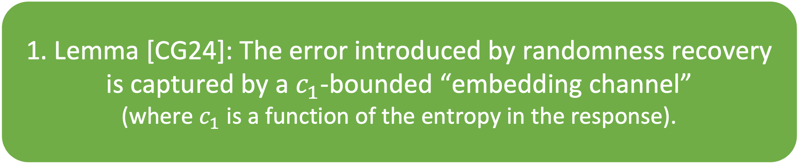
Proving substitution robustness
1. Lemma [CG24]: The error introduced by randomness recovery is captured by a $c_{1}$-bounded “embedding channel”
(where $c_{1}$ is a function of the entropy in the response).
2. The composition of $c_{1}$- and $c_{2}$- bounded channels is $(c_{1}+c_{2})$-bounded.
3. The PRC used tolerates $(c_{1}+c_{2})$-bounded error channels.
⇨ the watermark is robust to $c_{2}$-bounded error channels!

Slide 50
Watermarking template: LLMs
Theorem [CG24]:
We construct the first undetectable LLM watermark with robustness to any constant rate of:
Random word substitutions, and
Random word deletions

Slide 51
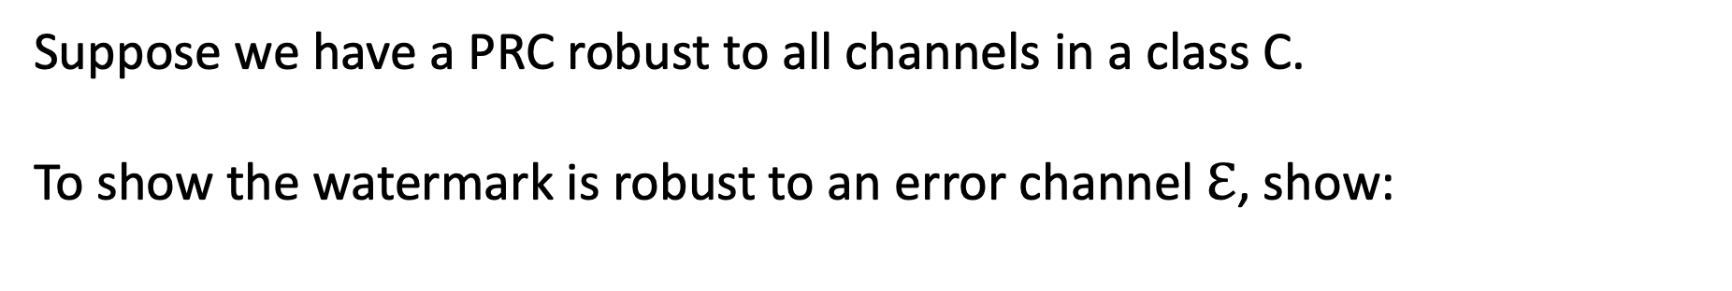

Proving robustness, more generally
Suppose we have a PRC robust to all channels in a class C.
To show the watermark is robust to an error channel $ℇ$, show:
$$ℇ∘\left(embedding channel\right)∈C$$
Equivalently, using [CG24] lemma from last slide:
$$ℇ∘\left(c_{1}bounded channel\right)∈C$$
⇨ more robust PRCs yield more robust watermarks!

Slide 52
Golowich-Moitra (NeurIPS ’24) and Christ-Golowich-Gunn-Moitra-Wichs (STOC ’26):
construct PRCs robust to worst-case edits (insertions/deletions/substitutions)
watermarks robust to worst-case edits

Slide 53
More pseudorandom codes

Slide 54
More pseudorandom codes
Ghentiyala & Guruswami (RANDOM ‘25):
pseudorandom codes from other assumptions, some with pseudorandomness against weaker adversaries
Alrabiah, Ananth, Christ, Dodis, Gunn (STOC ‘25):
pseudorandom codes with robustness in the presence of encoding and decoding oracles
Garg, Gunn, Wang (TCC ‘25); Döttling, Müller, Rajasree (TCC ‘25):
there are no black-box constructions of PRCs from essentially any crypto (OWF, VBB, PKE, …)

Slide 55
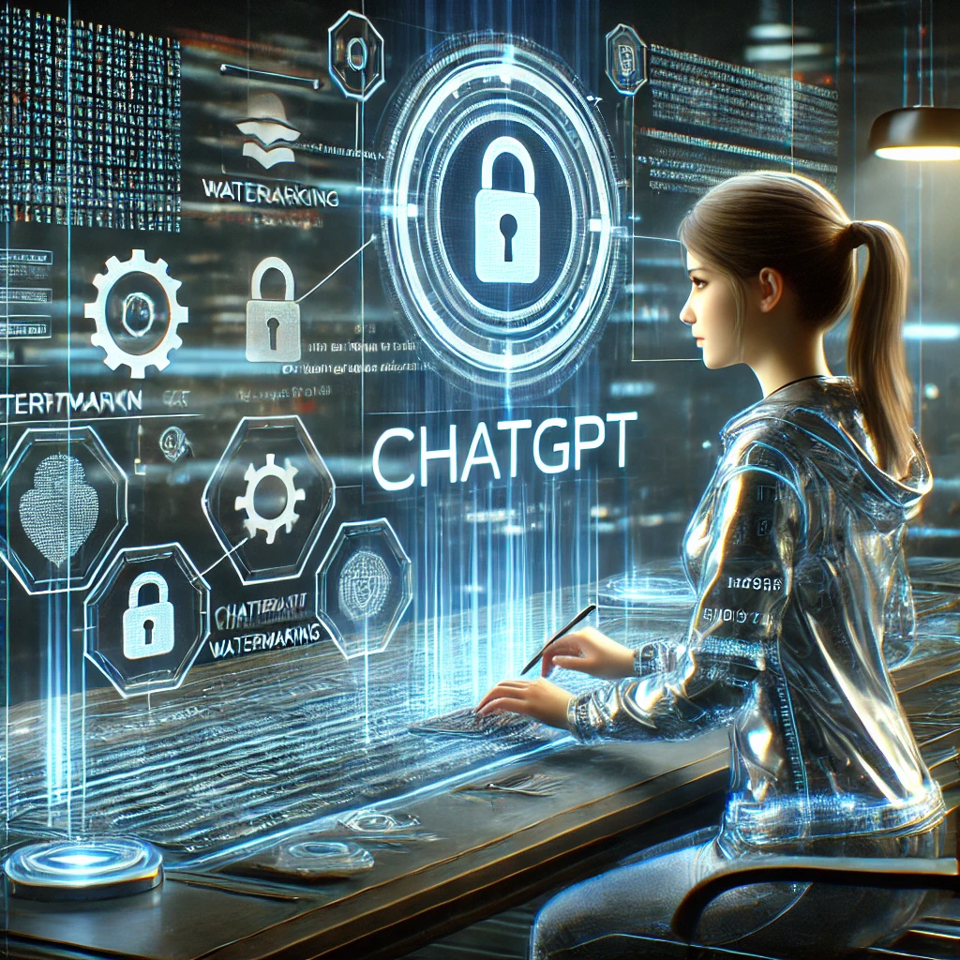
An Undetectable Watermark for Generative Image Models Sam Gunn, Xuandong Zhao, Dawn Song. ICLR ‘25
watermarked
image
latents with signs from a PRC codeword
latents with random signs

Slide 56
watermarked
image
latents with signs from a PRC codeword
latents with random signs
To detect, compute latents and decode signs

Slide 57
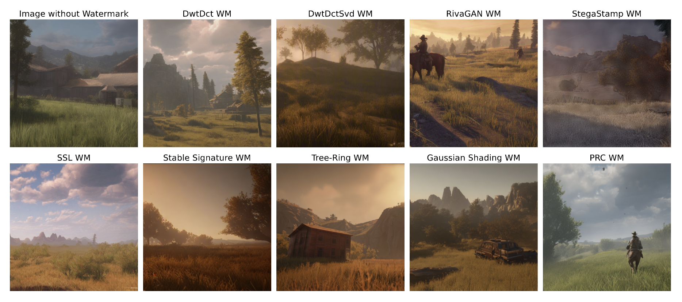
An Undetectable Watermark for Generative Image Models Sam Gunn, Xuandong Zhao, Dawn Song. ICLR ‘25

Slide 58
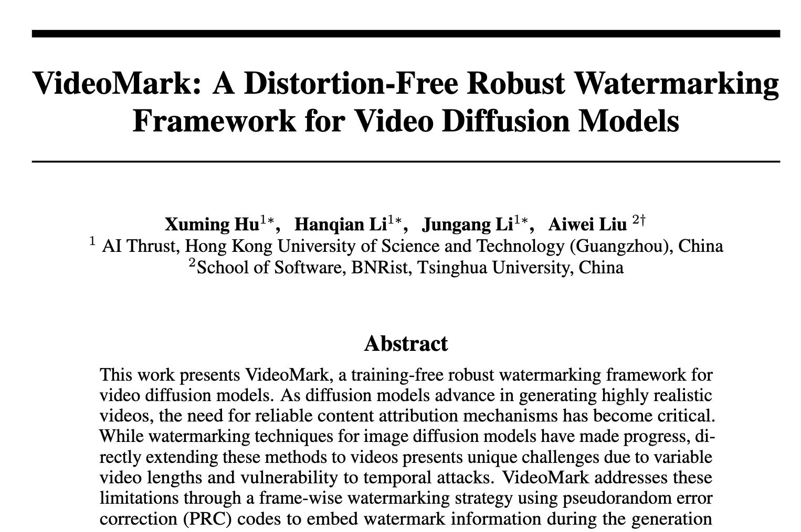
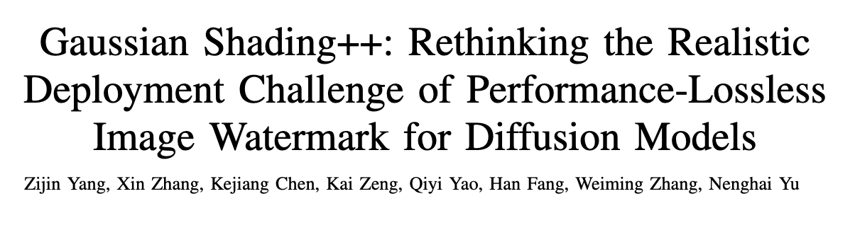


Slide 59
Future directions

Slide 60
LLM watermarks with semantic robustness
Can we embed a watermark in the semantic space of text?
Should be possible, but in my (limited) experience it’s been hard to reliably manipulate semantics

Slide 61
Practical bottleneck: information rate of PRCs
Can we construct PRCs with concretely shorter codewords?
⇨ for the level of error in LLMs, need 1000s of words to embed a watermark
⇨ image models have far lower error, so embedding is already feasible. But a better information rate would let us embed more metadata
Can we improve randomness recovery for LLMs?

Slide 62
Watermarks for open models
Can we watermark content generated by open models, in a way that is not trivially removable?
Partial answer:
Christ, Gunn, Raykova, Malkin ‘23: Provably Robust Watermarks for Open-Source Language Models

Slide 63
“Secure” detection, whatever that means
Who do we give detector access? And how?
API? Detection key?
for some schemes, secret key can be learned from a detection API or even just watermarked responses
How do we allow detection without compromising other properties?
Unforgeable public detection: [FGJ+23, CG24]
Require an infeasibly large amount of text to detect
Robustness: [CHS25, AAC+25]
What properties do we even want to preserve?

Slide 64
References: papers
[Aar22]: S. Aaronson, “Leaning Into Uninterpretability for AI Alignment,” 2022.
[KGW+23]: J. Kirchenbauer, J. Geiping, Y. Wen, J. Katz, I. Miers, T. Goldstein, “A Watermark for Language Models,” 2023.
[CGZ24]: M. Christ, S. Gunn, O. Zamir, “Undetectable Watermarks for Language Models,” 2024.
[ZALW24]: X. Zhao, P. Ananth, L. Li, Y. Wang, “Provable Robust Watermarking for AI-Generated Text,” 2024.
[KTHL24]: R. Kuditipudi, J. Thickstun, T. Hashimoto, P. Liang, “Robust Distortion-free Watermarks for Language Models,” 2024.
[FGJ+24]: J. Fairoze, S. Garg, S. Jha, S. Mahloujifar, M. Mahmoody, M. Wang, “Publicly-Detectable Watermarking for Language Models,” 2024.
[CGRM23]: M. Christ, S. Gunn, M. Raykova, T. Malkin, “Provably Robust Watermarks for Open-Source Language Models,” 2023.
[CG24]: M. Christ and S. Gunn, “Pseudorandom Error-Correcting Codes,” 2024.
[GM24]: N. Golowich, A. Moitra, “Edit Distance Robust Watermarks via Indexing Pseudorandom Codes,” 2024.
[GG24]: S. Ghentiyala, V. Guruswami, “New Constructions of Pseudorandom Codes,” 2024.
[GZS25]: S. Gunn, X. Zhao, D. Song, “An Undetectable Watermark for Generative Image Models,” 2025.
[CHS25]: A. Cohen, A. Hoover, G. Schoenbach, “Watermarking Language Models for Many Adaptive Users,” 2025.
[AAC+25]: O. Alrabiah, P. Ananth, M. Christ, Y. Dodis, S. Gunn, “Ideal Pseudorandom Codes,” 2025.
[GGW25]: S. Garg, S. Gunn, M. Wang, “Black-Box Crypto is Useless for Pseudorandom Codes,” 2025.
[DMR25]: N. Döttling, A. Müller, M. Rajasree, “Separating Pseudorandom Codes from Local Oracles,” 2025.
[ZGC+25]: X. Zhao, S. Gunn, M. Christ, J. Fairoze, A. Fabrega, N. Carlini, S. Garg, S. Hong, M. Nasr, F. Tramer, S. Jha, L. Li, Y. Wang, D. Song, “SoK: Watermarking for AI-Generated Content,” 2025.

Slide 65
Thanks!

