Slide 1
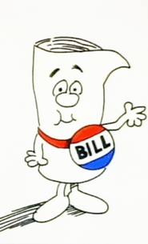
From Bill to Reg:
Tales from the Sausage Factory
Robert Cannon
Senior Counsel Internet Stuff
FCC OSP
Robert.cannon@fcc.gov

Slide 2
Objective: Process Show-and-Tell in order to encourage Engagement

Slide 3
Standard Disclaimer: Not the views of anyone at all

Slide 4
 | Executive | Legislative | Judicial
 | President + Agencies | Congress | Courts
Vote | 1 (4 years) | 3 (House: every 2 years; Senate: Every 6 years) | None
Not Elected | Agency Heads nominated by President, Confirmed my Congress, Serve at pleasure of President* |  | Judges nominated by President, Confirmed by Congress, Appointed for life
Right to heard | Yes (APA) | M’eh | Only litigants
Accountability | Court review (APA, Statutory, Constitution) | Election, Court review | Appeal
* Independent Agency leadership serves term and can only be removed for cause

Slide 5
Administrative Procedure Act
Agency “Decision”
Initiate
  New Statute
  Petition of stakeholder
  Agency own motion
Notice of Propose Rulemaking
  Draft decision
Comment
  Anyone can comment
Decision
  Reasoned; must consider all arguments
    Low standard
    Chevron Doctrine: Expert Agency (BrandX)
  Not arbitrary or capricious
Appeal
  Administrative Procedure Act (Broadband Principles Enforcement)
  Statutory Authority (Open Internet 2010)
  Constitution (Communications Decency Act)

Slide 6
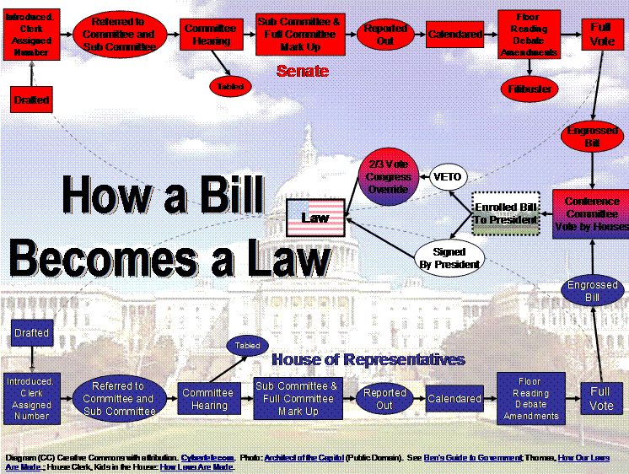

Slide 7

Judicial
Appeal
Court
Order
Supreme
Court
APA
Affirmed
Statute
Reversed
Remanded
Constitution
Executive
Report
Notice
Inquiry
Enforce
Order
Decision
Comments
Notice
Proposed
Rule
Petition
Optional
Administrative Procedure Act
Legislative
Bill
Hearings
Law
Warning: Not Drawn to Scale

Slide 8
Judicial
Amicus Briefs
Appeal
Court
Order
Supreme
Court
APA
Affirmed
Statute
Reversed
Remanded
Constitution
Opportunities for Influence
Executive
Comments
Report
Notice
Inquiry
Enforce
Order
Decision
Comments
Notice
Proposed
Rule
Advisory Committees
Petition
Optional
Administrative Procedure Act
Legislative
Lobbying
Bill
Hearings
Law
Warning: Not Drawn to Scale

Slide 9
Judicial
Appeal
Court
Order
Supreme
Court
APA
Affirmed
Statute
Reversed
Remanded
Constitution
End Points?
Executive
Report
Notice
Inquiry
Enforce
Order
Decision
Comments
Notice
Proposed
Rule
Petition
Optional
Administrative Procedure Act
Legislative
Bill
Hearings
Law
Warning: Not Drawn to Scale

Slide 10
Communications Decency Act

Slide 11
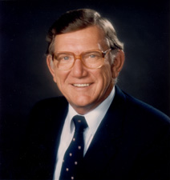
Bill
Senator James Exon
Communications Decency Act 1995

Slide 12

Hearings

Slide 13
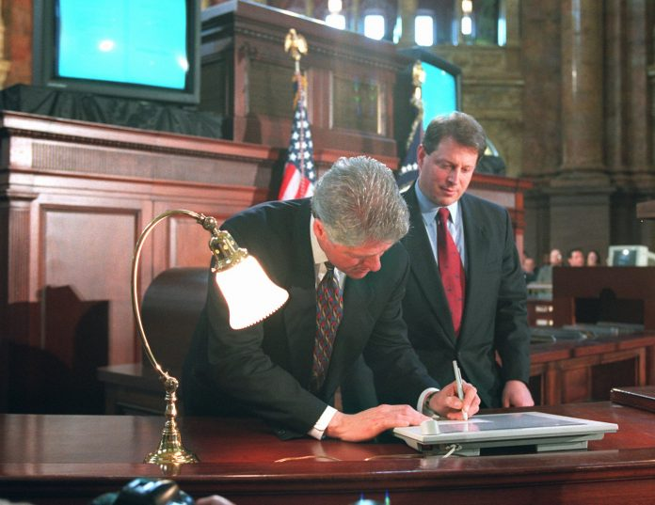
Law
Telecommunications Act of 1996
Only mention of Internet in Telecom Act

Slide 14
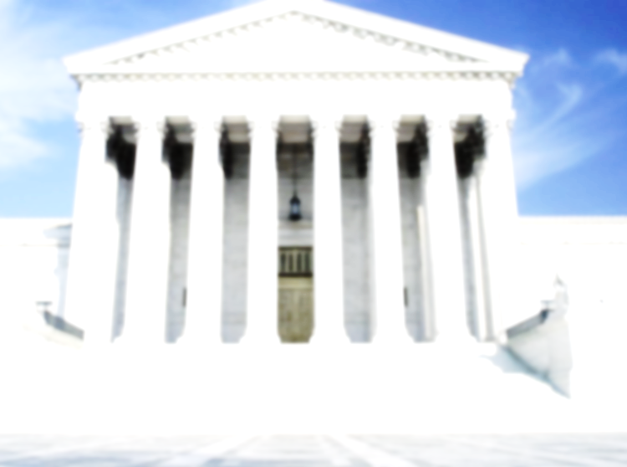
Appeal
ACLU v Reno
Constitutional Challenge :: First Amendment
Analysis
  Unanimous Supreme Court
  Strick scrutiny :: Compelling Govt Interest; Narrowly Tailored
  Vague :: “Indecency” undefined
    Community Standards
      Reduce acceptable content down to level of most sensitive community
      Not acceptable to reduce acceptable discourse in the mailbox down to what is acceptable discourse in the sandbox
  Overbreath :: Chilled legitimate speech
    UCR/California Museum of Photography, whose new exhibit announcements contain nudes by Edward Weston and Robert Mapplethorpe; Critical Path, for its safer sex instructions; Stop Prison Rape, for its on-line content; parents who send birth control information to their minor children at college, and arguably the Carnegie library for its card catalogue
  Less Restrictive Alternatives Available :: Parental filtering software
  1st Amendment Analysis Unique to Medium :: Internet is not newspaper or radio (7 Dirty Words)
Observation
  Ironically pornographers loved the CDA
  Emergence of the Cyberlibertarian Era
    “Hands off the Internet”
  Left Standing :: 47 USC 230 (Internet service not liable for third-party content)

Slide 15
It is no exaggeration to conclude that the Internet has achieved, and continues to achieve, the most participatory marketplace of mass speech that this country -- and indeed the world -- has yet seen. The plaintiffs in these actions correctly describe the "democratizing” effects of Internet communication: individual citizens of limited means can speak to a worldwide audience on issues of concern to them. Federalists and Anti-Federalists may debate the structure of their government nightly, but these debates occur in newsgroups or chat rooms rather than in pamphlets. Modern-day Luthers still post their theses, but to electronic bulletin boards rather than the door of the Wittenberg Schlosskirche. More mundane (but from a constitutional perspective, equally important) dialogue occurs between aspiring artists, or French cooks, or dog lovers, or fly fishermen. . . . [T]he Internet may fairly be regarded as a never-ending worldwide conversation. The Government may not, through the CDA, interrupt that conversation. As the most participatory form of mass speech yet developed, the Internet deserves the highest protection from governmental intrusion.

Slide 16
Judicial
Amicus Briefs
Appeal
Court
Order
Supreme
Court
APA
Affirmed
Statute
Reversed
Constitution
Executive
Report
Notice
Inquiry
Enforce
Order
Decision
Comments
Notice
Proposed
Rule
Petition
Optional
Administrative Procedure Act
Legislative
Child Safe Viewing Act
Protect Act
Truth in Domain Names Act
Dot Kids Act
Children’s Internet Protection Act
Child Online Protection Act
Bill
Hearings
Law
Warning: Not Drawn to Scale

Slide 17
Computer Inquiries

Slide 18





Computer Inquiries II
Basic v Enhanced Dichotomy
Content
Any Content
Unregulated
Enhanced
Service
Applications
Any App
ISP
Computer Network
Common Carriage
No discrimination
Any destination
Any device (modems)
Any content
Support computer networks / unbundle
Telephone
Regulated
Common Carrier
X
Telco

Slide 19
Computer Inquiries II
Basic v Enhanced Dichotomy
Telecom Act ‘96
Codify CI
Content
Any Content
Unregulated
Enhanced
Service
Applications
Info Service
Any App
ISP
Computer Network
Common Carriage
No discrimination
Any destination
Any device (modems)
Any content
Support computer networks / unbundle
Telephone
Telecom
Service
Regulated
Common Carrier
X
Telco

Slide 20
Internet over Broadband
2000s
BrandX
Internet over Cable
Content
Any Content
Applications
Info Service
Any App
Unregulated
Information
Service
Internet
Common Carriage
No discrimination
Any destination
Any device (modems)
Any content
Support computer networks / unbundle
BIAS
Broadband
B
X
B

Slide 21



Chevron Doctrine
National Cable & Television Ass’n v. BrandX, S.Ct. 2005
Expert Agency given deference
Chevron Analysis
  Is the statute ambiguous?
  Is the agency’s interpretation reasonable?
    Low standard
Duck test? If it quacks like a duck….
  Agency deference

Slide 22
Judicial
Amicus Briefs
NCTA v BrandX
Appeal
Court
Order
Supreme
Court
APA
Affirmed
Statute
Reversed
Remanded
Constitution
Executive
Comments
Report
Notice
Inquiry
Enforce
Internet over Cable
Comments
Notice
Proposed
Rule
Order
Decision
Petition
Computer Inquiries
Optional
Administrative Procedure Act
Legislative
Lobbying
Bill
Hearings
Telecom Act 96
Law
Warning: Not Drawn to Scale

Slide 23
Internet over Wireline (DSL) 2005
Information Service (unregulated)
Broadband Policy Statement
  Access content of choice
  Run applications and use services of choice
  Connect devices of choice
  Information regarding service plans
  Competition
First Network Neutrality Proceeding

Slide 24


Comcast / Bittorrent
As reported / alleged in the media
Internet
 Reset (I’m from Fred)
 Reset (I’m from Jane)
① Request File
② Send
File
Fred
Jane
Allegation: Researchers tested the use of BitTorrent where Comcast was the ISP for both subscribers, sending the King James Bible via BitTorrent. Research found that Comcast at both ends sent a “Reset” command to both subscribers, terminating the P2P transmission – both “Reset” commands were spoofed so as to appear as if they were from the other subscriber and not from Comcast. Comcast blocking competing application: video.

Slide 25
Comcast For Degrading P2P
2008 FCC Orders Comcast to End Discriminatory Practices (Enforcement)
Comcast Appealed
  Argued enforcement action procedurally flawed
  Circumvented the APA
  Cannot have a decision without notice and comment
Court: FCC lacks jurisdiction
  If Title I :: Unregulated
  If Title II :: Common Carriage

Slide 26
Judicial
Amicus Briefs
Appeal
Court
Order
Supreme
Court
APA
Affirmed
Statute
Reversed
Remanded
Constitution
Executive
Report
Notice
Inquiry
Enforce
Comments
Open Internet NPRM
Order
Decision
Notice
Proposed
Rule
Petition
Optional
Administrative Procedure Act
Legislative
Bill
Hearings
Law
Warning: Not Drawn to Scale

Slide 27
Internet over Broadband
2000s
Open Internet
2010
Content
Any Content
Applications
“Third Way”
Any App
Unregulated
Information
Service
Internet
Common Carriage
No discrimination
Any destination
Any device (modems)
Any content
Support computer networks / unbundle
BIAS
Broadband
B
X
B

Slide 28

Communications Act
Verizon v. FCC, D.C. Cir. 2014
  FCC may not impose common carrier obligations on non common carriers
  FCC has classified Internet over Broadband as an unregulated information service
  No Blocking and Non Discrim constitute common carrier obligations
  Agency has discretion to classify as common carrier or not
  But agency cannot muddle
  Reversed

Slide 29
Judicial
Amicus Briefs
Appeal
Court
Order
Supreme
Court
APA
OI 2015
Affirmed
Affirmed
Statute
Reversed
Remanded
Constitution
Executive
Comments
Report
Notice
Inquiry
Enforce
Order
Decision
Comments
Notice
Proposed
Rule
Election 2017
OI
2015
OI
2015
RIF 2017
Petition
Optional
Administrative Procedure Act
Legislative
Bill
Hearings
Law
Warning: Not Drawn to Scale

Slide 30
Open Internet 2015
Content
Any Content
Unregulated
Information
Service
Applications
Any App
Internet
Telecom
Service
BIAS
Broadband
B
X
B

Slide 31
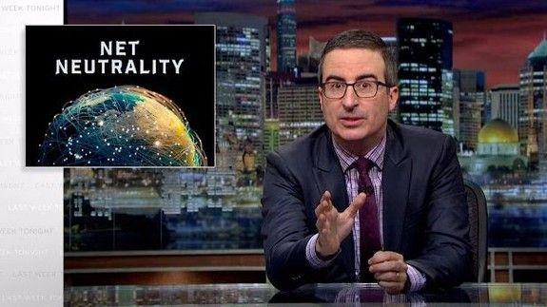

Slide 32
Restoring Internet Freedom
Notice of Proposed Rulemaking
2017
Content
Any Content
Applications
Any App
Unregulated
Information
Service
Internet
BIAS
Broadband
B
X
B

Slide 33
Influence
Responsive to the NPRM
  Know where you are on the board game
    Agency cannot change the statute
    FCC cant do anything about DOJ
How does this impact your business plan?
Facts Data Research
Consensus
Large number of comments
Not so much
Speculation, allegation, innuendo
Astroturf
All comments will be read and summarized
  Make your comments clear and readable
  Accompany your comments with a visit

Slide 34
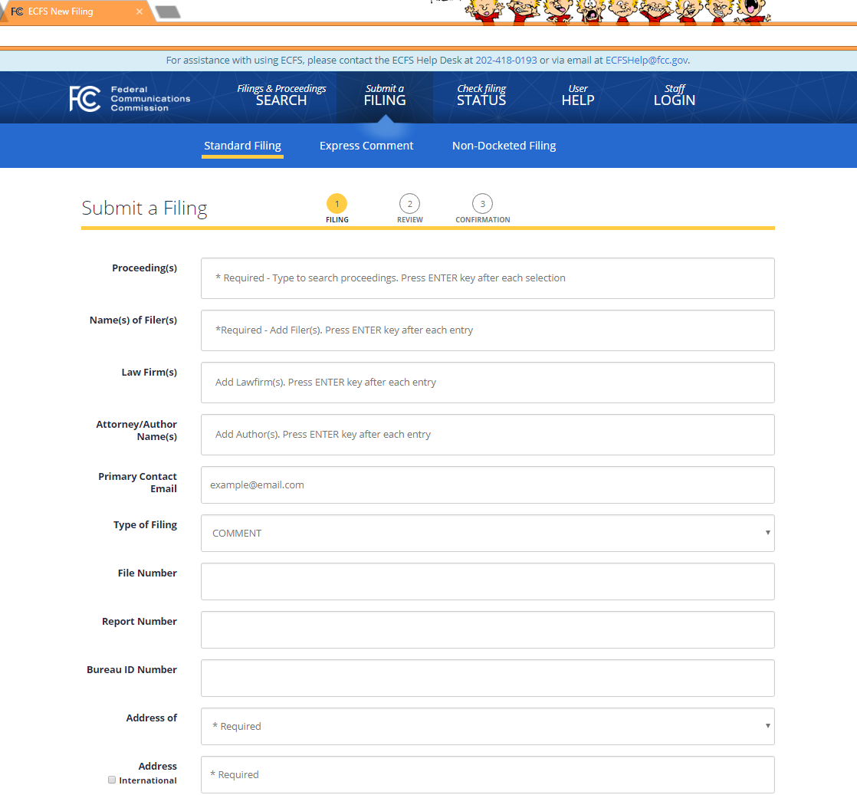
OI / Restoring Internet Freedom: 22 m comments

Slide 35
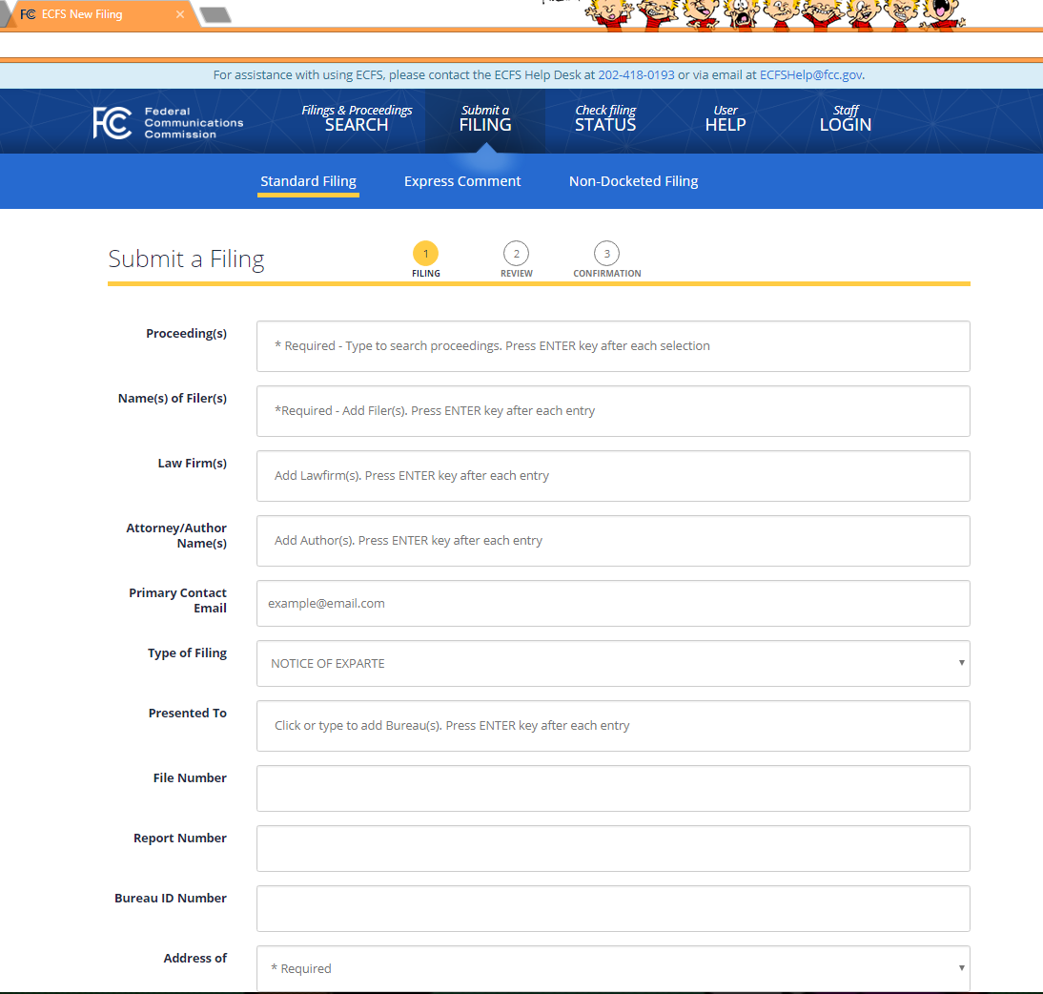
Summarize presentation and who met with

Slide 36
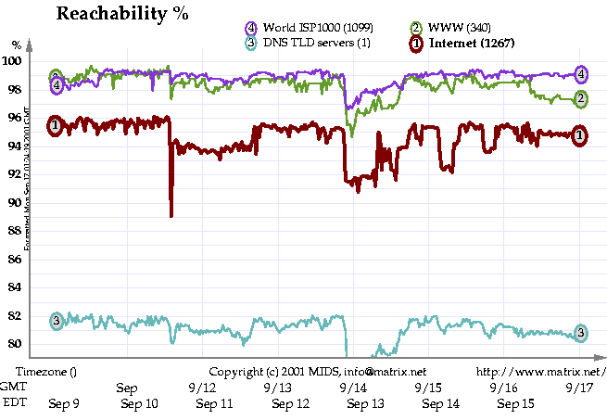
September 11, 2001
Internet Performance
Planes Hit
Towers
50 Hudson Street
Sean Donelan, What Worked, What Didn’t, NANOG
Source: Matrix
Notes:
On Sept 11 it appeared that Internet routing and traffic loads were normal for the start of a workday. That normalcy would be shattered for the Internet, as for so many other operations, when American Airlines Flight 11 crashed into the WTC’s north tower at 8:46 am. Within minutes, major online news sites were struggling to serve between 3 and 10 times their normal load as Internet users sought details. One news web site estimated that traffic to its web servers was doubling every 7 minutes, beginning around 8:50 am until 9:30 am.
By just after 9 am, when united airlines flight 175 crashed into the WTC south tower, the web sites CNN, MSNBC, and the NYT, Yahoo! News and otherw were observed to be slowing significantly. The cause would later be reported to have been the loads on these sites servers, not connectivity problems in reaching servers across the Internet. Then the south tower collapsed, damaging equipment and circuits in the Trade center complex. The subsequent collapse of the North tower, the collapse of the WTC building 7 (a 47 story structure) damage to the neighboring Verizon CO and power cuts in lower manhattan all had disruptive effects on the Internet and other communications systems.
Matrix recorded a brief 8 percent decrease in the ability to reach a select number of sites on the Internet in the minutes following the collapse of the first tower. Internet routing and reachability measurements returned nearly to normal within 15 miinutes of the collapase of the south tower. However, Matrix data show on Sept 11, about a 1 to 2 percent decrease in reachability for the Internet.

Slide 37
Judicial
Appeal
Court
Order
Supreme
Court
APA
Affirmed
Statute
Reversed
Remanded
Constitution
Executive
Report
Notice
Inquiry
Enforce
Order
Decision
Comments
Notice
Proposed
Rule
Advisory Committees
Petition
Optional
Administrative Procedure Act
Legislative
Bill
Hearings
Law
Warning: Not Drawn to Scale

Slide 38
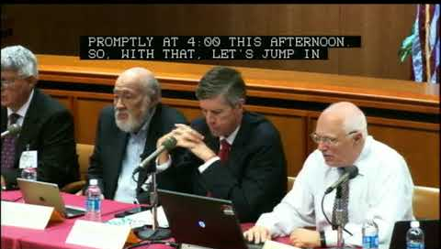
Federal Advisory
Committees
Provide advice to executive branch
  Answer questions from the agency
  Composed of industry, academics, public interest…
  Consensus based
FCC
  Technology Advisory Committee
  Communications Security Reliability and Interoperability Council
  Broadband Deployment Advisory Committee
  Consumer Advisory Committee
  Disability Advisory Committee
  Diversity and Digital Empowerment
  North American Numbering Council
  Open Internet Advisory Committee
Broadband Internet Technology
Advisory Group

Slide 39

Thank you
Robert Cannon
Senior Counsel Internet Stuff
FCC OSP
Robert.cannon@fcc.gov
202 418 2421

