Slide 1
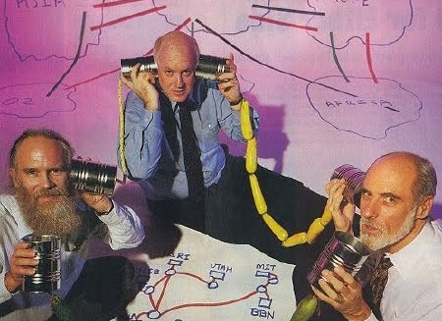
Interconnection
Robert Cannon
Office of Strategic Planning and Policy Analysis
Robert.cannon@fcc.gov
Disclaimer: Views expressed are no one at all’s

Slide 2
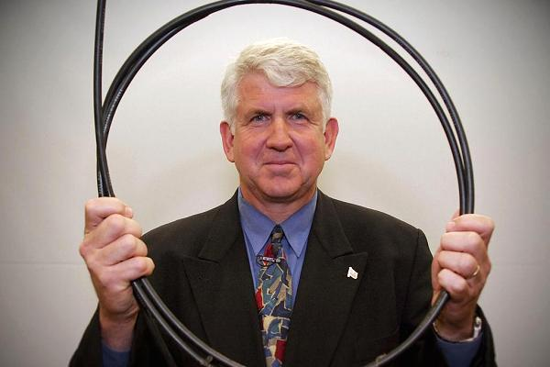
Network Effect
“A network effect (also known as a network externality) exists when a product’s value to the user increases as the number of users of the product grows.” – Financial Times
Metcalfe’s Law: v = n²
v = value
n = number of users

Slide 3
Network Effect
Network
Network
v = 2n²

Slide 4
Network Effect
Network
Network
v = 9n²
v = 1.2n²
Notes:
Both networks increase in value through interconnection
One network benefits much more than the other
With disproportionate benefit, orange may (a) call blue a free rider (b) demand compensation for interconnection to balance the value
This is about pursuing business plans
Blue may not be able to pursue its business plan without interconnecting to orange
Orange may want to sell the full network – but it might be able to still pursue its business plan if blue is small

Slide 5
Revenue
Network
Network
$
Interconnection
Interconnection
Access
Revenue $$
Revenue $$
Access
Notes:
Revenue from access exceeds revenue from interconnection
Therefore networks have an incentive to interconnection – to resolve interconnection disputes – in order to increase the value of their networks and increase their access revenue
If value of interconnection with orange is great enough
If it helps to generate revenue
Then blue is probably willing to pay for interconnection

Slide 6
Incentives
•
Network
•
Network
Increase network effect :: Pursue Business Plan
Extract rent (vertical firm making lots of money)
Reduce costs
Barrier to market entry (horizontal or vertical competing firm)
Raise costs
Refuse interconnection
Notes:
Both networks increase in value through interconnection
One network benefits much more than the other
With disproportionate benefit, orange may (a) call blue a free rider (b) demand compensation for interconnection to balance the value
This is about pursuing business plans
Blue may not be able to pursue its business plan without interconnecting to orange
Orange may want to sell the full network – but it might be able to still pursue its business plan if blue is small

Slide 7
Ability
Network
•
Network
Large value (lots of end users)
End users = substantial increase network effect
End users = substantial portion customer base
Control of interconnection (block or degrade)
Notes:
Both networks increase in value through interconnection
One network benefits much more than the other
With disproportionate benefit, orange may (a) call blue a free rider (b) demand compensation for interconnection to balance the value
This is about pursuing business plans
Blue may not be able to pursue its business plan without interconnecting to orange
Orange may want to sell the full network – but it might be able to still pursue its business plan if blue is small

Slide 8
The Era of Telephone Competition 1894 - 1921

Slide 9
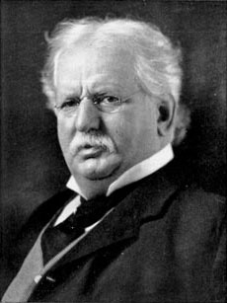
Markets could have “dual service” ~ Did not interconnect ~ businesses had two phones; two numbers
6000 Independent telcos
Only AT&T had “Long Lines” – AT&T has largest network effect
Refuse interconnection with long distance (and refuse to sell Western Electric equipment; JP Morgan financing)
Independent Telephone Cos
Theodore Vail, President AT&T
1907-1919
Notes:
Gateway
Network Effect
Crush Competitors
Acquire Market Share
One competitive strategy could be to hurt or destroy your competitor
Another strategy could be to extract rent. Here you want your target to be relatively healthy as possible so that you can extract as much blood as possible.
In the 1980s, the local telephone companies imposed access charges on long distance companies, imposing monopoly rents on those long distance providers – leading to telecommunications liberalization and the reduction of access charges to cost.
We have seen these strategies used by railroad carriers and telegraph companies

Slide 10
Independents go bankrupt; AT&T acquired them / market share
Kingsbury Commitment 1913
AT&T Divest Western Electric
AT&T would not acquire Indies
AT&T Long Distance would interconnect with Indies (impose access fee)
Theodore Vail, President AT&T
1907-1919
Notes:
"Two exchange systems in the same community, each serving the same members, cannot be conceived of as a permancy, nor can the service in either be furnished at any material reduction because of competition, if return on investment and proper maintenance be taken into account. Duplication of plant is a waste to the investor. Duplication of charges is a waste to the user." Theodore Vail, 1907
Indies were going bankrupt and wanted to be acquired by AT&T
AT&T agreeing to interconnect its long distance network to indies removed any incentive to build a separate long distance network
One explanation for the Kingsbury commitment was a threat at that time to nationalize AT&T – which happened during a brief period during WWI
Competition is inefficient
Marvelous like 1970s AT&T video that talks about how competition is inefficient. AT&T history posted it on youtube and it was pulled down in days and unfortunately I did not get a copy of it.

Slide 11
“One Network, One Service: Universal Service”
Theodore Vail, President AT&T
1910
Notes:
"Two exchange systems in the same community, each serving the same members, cannot be conceived of as a permancy, nor can the service in either be furnished at any material reduction because of competition, if return on investment and proper maintenance be taken into account. Duplication of plant is a waste to the investor. Duplication of charges is a waste to the user." Theodore Vail, 1907
Competition is inefficient
Marvelous like 1970s AT&T video that talks about how competition is inefficient. AT&T history posted it on youtube and it was pulled down in days and unfortunately I did not get a copy of it.

Slide 12
Interconnection Disputes
1866 :: Post Roads Act :: Telegraph must interconnect
MCI :: AT&T fights interconnection :: ends with break up of AT&T
Hush a Phone / Carterfone :: AT&T must interconnect with devices (customer premises equipment)
Computer Inquires :: AT&T / WU refuse to provide lines to interconnect computer networks because competitive service :: AT&T must provide lines
Mobile phones
Telecom Act of 1996
Telecom liberalization drives interconnection fees to cost (to zero)
iVoIP :: ILECs refuse interconnection with PSTN and 911

Slide 13
Internet Interconnection

Slide 14
Internet Interconnection
Tier 1 Backbone
Tier 1 Backbone
Settlement
Free Peering
Academic Networks historically SFP
Transaction costs exceeds revenue gain :: SFP very efficient
Revenue derived from selling downstream access
v = ~2n²

Slide 15
Internet Interconnection
Tier 1 Backbone
Tier 1 Backbone
Settlement
Free Peering
1998 UUNET depeering; ISPs complained to FCC; FCC conclude no reason to intervene (Sec. 706; Digital Handshake). But DOJ blocks MCI / Sprint merger
One Pipe brings full Internet
Download
Download
Upload
Transit $
Upload
Transit $
Access
ISP
Access
ISP

Slide 16
1990s Hierarchical Ecosystem
Backbone
IXP
IXP
Tier 1
Backbone
Peering
Peering
Transit $$
Transit $$
Regional
Regional
Tier 2
Transit $$
Transit $$
Transit $$
Transit $$
Transit $$
Transit $$
Edge
Edge
Edge
Edge
Edge
Edge
Tier 3
$
$
$
•

$
$
$
✵



Arrangement | Access to
Peering | Peer + Peer’s Customers
Transit | Vendor + Vendor’s Customers + Vendor’s Transit Vendor + Vendor’s Peer
Notes:
If we are going to ask whether peering policies reflect how things have changed, we have to know where we have been
Back in ancient days
Peering occurred between the big backbones
Everyone else is a customer
All money flows up-
everyone downstream paid upstream for transit
It was very hierarchical
It was good to be king of this ecosystem
There were nice discrete business plans – you knew who you were then
identifying peer networks was not too hard, relatively speaking

Slide 17
Routing Around Transit Fees
Backbone

IXP
IXP
Tier 1
Backbone
Peering
Peering
Backbone
③
Transit $$
Transit $$
Content Delivery Networks
Move Content Closer to End Users
①
Donut
Peering
Regional
Regional
Tier 2
Transit $$
Transit $$
Transit $$
Transit $$
Transit $$
Transit $$
Edge
Tier 3
Edge
Edge
Edge
Edge
Edge
Edge
$
$
$
•

$
$
$
✵



②
Acquire own backbone :: Increase # end users / network effect value :: Renegotiate / directly interconnect with backbones / Content / CDNs
Notes:
If we are going to ask whether peering policies reflect how things have changed, we have to know where we have been
Back in ancient days
Peering occurred between the big backbones
Everyone else is a customer
All money flows up-
everyone downstream paid upstream for transit
It was very hierarchical
It was good to be king of this ecosystem
There were nice discrete business plans – you knew who you were then
identifying peer networks was not too hard, relatively speaking

Slide 18
Flat Earth
Backbones have become CDN feeder networks

IXP
IXP
CDN
✵

Access
✵
Edge
CDN


CDN

Backbone
Access

Backbone
25%
Market
•
Edge
•
CDN
CDN


CDN
Access
San Jose IXP
New York City IXP
Paid Transit
Settlement Free Peering
Notes:
And we add into the model the interconnection relationships and incentives
Green is paid interconnection
Yellow is SFP
And in this version
the CDN has the incentive to sell content delivery to content customers- here the bicycle network – and deliver quality content to end users
And the ISP has an incentive to avoid transit costs and improve content delivery
Thus the CDN’s offer of SFP is attractive to the ISP

Slide 19
A Plethora of Peering
Hierarchical
Flat Earth


✵

•

Backbones

✵
•
IXP
Backbones
Access



Congestion Negotiation Can Work
Access
Congestion Negotiation Wont Work
Notes:
The evolution from the hierarchical model to the flat model changes interconnection
In the old world, one (or a few) transit connections would get you the full Internet
In the flat world, an access network negotiates a plethora of peering arrangements
In the old world, the access network did not negotiate interconnection with the other ends of the network
In the flat world, the access network negotiates directly with the content sources and edge providers. There is one connection with amazon, and another with Netflix, and another with google, and so on
In the old world, if the interconnection from the access network has a failure – for whatever cause – it impacts that ISPs entire internet connectivity
In the flat world, when the interconnection from the access network with one edge provider fails – say the telephone application – it only impacts the telephone application and does not impact connectivity to the other services

Slide 20
Flat Earth

IXP
IXP
CDN
Pay me for transit!
✵

Access
✵
CDN
Pay me for access!
Edge


CDN

Backbone
Access

Backbone
25%
Market
•
Edge
•
CDN
CDN


CDN
Access
Business Plans
Backbone :: Sell full internet as transit service to edge networks and enterprises
ISP :: Sell full internet as Internet access and access to end users
Conflict :: Both wants to charge the other / Need each other for business plan
ISP only uses backbone for peering :: ISP congests interconnection access to end users until backbone agrees to SFP
Resolution :: Settlement free peering with restrained capacity
ISP does not want backbone to be substitute for paid peering from CDNs
San Jose IXP
New York City IXP
Notes:
And we add into the model the interconnection relationships and incentives
Green is paid interconnection
Yellow is SFP
And in this version
the CDN has the incentive to sell content delivery to content customers- here the bicycle network – and deliver quality content to end users
And the ISP has an incentive to avoid transit costs and improve content delivery
Thus the CDN’s offer of SFP is attractive to the ISP

Slide 21
Flat Earth
Dispute is over cross connect between two boxes on collocation floor costing $$$ per month

IXP
IXP
CDN
✵

Access
✵
If I start paying, nothing will discipline price
CDN
Pay me for access!
Edge


CDN

Backbone
•
Access

Backbone
25%
Market
•
Edge
•
CDN
CDN


CDN
Access
San Jose IXP
New York City IXP
Content :: Sell quality content to end users (minimize costs)
Wants to limit costs with SFP to Access ISP :: If start paying, no market force can discipline the price :: ISP is a terminating monopoly
ISP is raising costs on video rivals – increasing barrier to entry
First uses backbone SFP capacity, but that becomes exhausted and congested
ISP :: Sell full internet as Internet access and access to end users
Content should pay for data delivery :: $$ can be passed through and reduce price to end user
Content can use alternative route into ISP :: If we congest, customers will switch
Notes:
And we add into the model the interconnection relationships and incentives
Green is paid interconnection
Yellow is SFP
And in this version
the CDN has the incentive to sell content delivery to content customers- here the bicycle network – and deliver quality content to end users
And the ISP has an incentive to avoid transit costs and improve content delivery
Thus the CDN’s offer of SFP is attractive to the ISP

Slide 22
As utilization increases, SFP Backbones ask ISPs for more SFP capacity; ISPs say no, only paid peering
Direct Interconnection
Backbones

Slide 23
Flat Earth

IXP
IXP
CDN
✵

Access
✵
Edge
CDN


CDN

Backbone
•
Access

Backbone
25%
Market
•
Edge
•
CDN
CDN


CDN
Access
San Jose IXP
New York City IXP
Business Plans
Content :: Sell quality content to end users (minimize costs)
Wants to limit costs with SFP to Access ISP :: If start paying, no market force can discipline the price
ISP :: Sell full internet as Internet access and access to end users
Resolution :: Content agrees to Access Paid Peering
ISP has reversed the flow of interconnection fees
Notes:
And we add into the model the interconnection relationships and incentives
Green is paid interconnection
Yellow is SFP
And in this version
the CDN has the incentive to sell content delivery to content customers- here the bicycle network – and deliver quality content to end users
And the ISP has an incentive to avoid transit costs and improve content delivery
Thus the CDN’s offer of SFP is attractive to the ISP

Slide 24
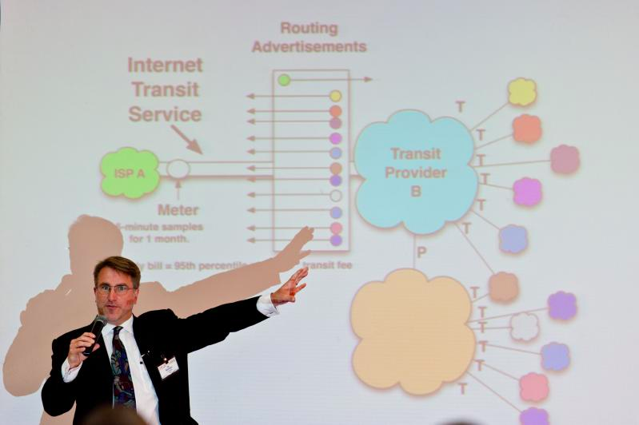
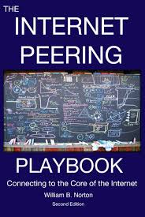
"From a practical perspective, if you are paid to deliver video to Comcast customers, there is no choice but to purchase Paid Peering from Comcast. This is a potentially huge shift in power in the ecosystem." – Bill Norton

Slide 25
Thank you
Robert Cannon
Senior Counsel Internet Stuff
FCC OSP
Robert.cannon@fcc.gov
202 418 2421

Slide 26
End Game


Backbone
Backbone
Limelight
•

✵

⬅$ Paid Peering
⬅$ Paid Peering
⬅$ Paid Peering
⬅$ Paid Peering
⬅$ Paid Peering
⬅$ Paid Peering
Access
Incumbent
Notes:
This is never a peering relationship by the proxy
Not like networks
Not balanced traffic

Slide 27
Computer Inquiries

Slide 28
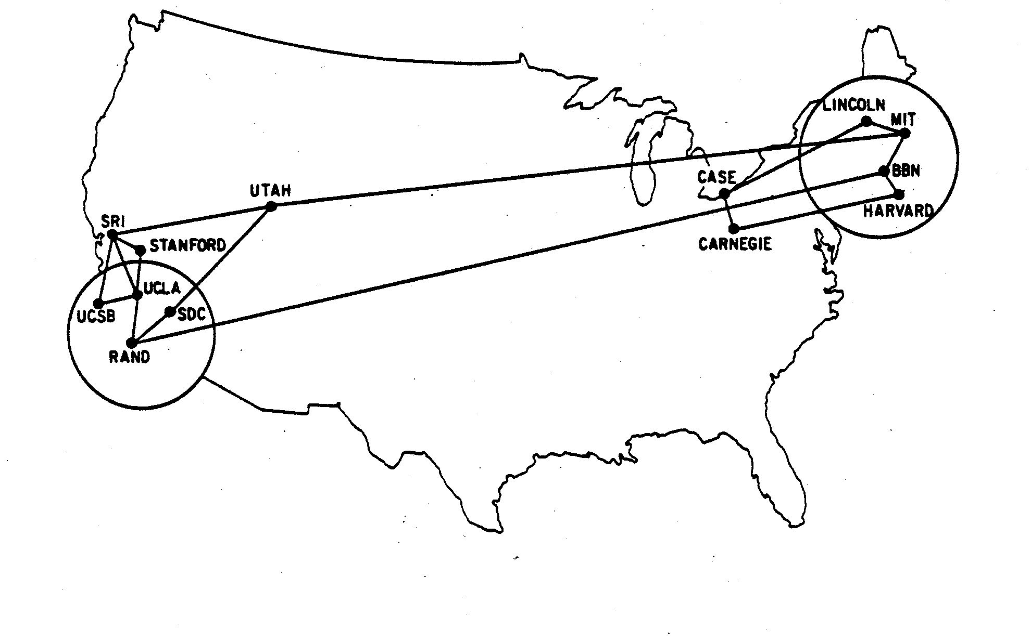
AT&T 56 kbps
You are providing a messaging service in direct competition with us
AT&T (1956 Consent Decree prohibited from info services)
Western Union (building data network)
Bunker Ramo (financial service)
SABRE (airlines)
DOD, SAGE network, ARPANET, Vietnam
Academic networks
USG / Apollo
1970
Refuse to provide lines to interconnect computer networks :: Barrier Market Entry

Slide 29
Computer Inquiries II
Basic v Enhanced Dichotomy
Policy: Recognize economic promise of computer industry – Common carriers must provide service to support computer industry
Implementation:
Telcos are regulated common carriers; must unbundle network, provide service to enhanced services
Computer networks (a.k.a. enhanced services, information services) unregulated – beneficiary of policy
Content
Any Content
Unregulated
Enhanced
Service
Applications
Any App
ISP
Computer Network
Telephone
Regulated
Common Carrier
X
Telco

Slide 30
MCI

Slide 31
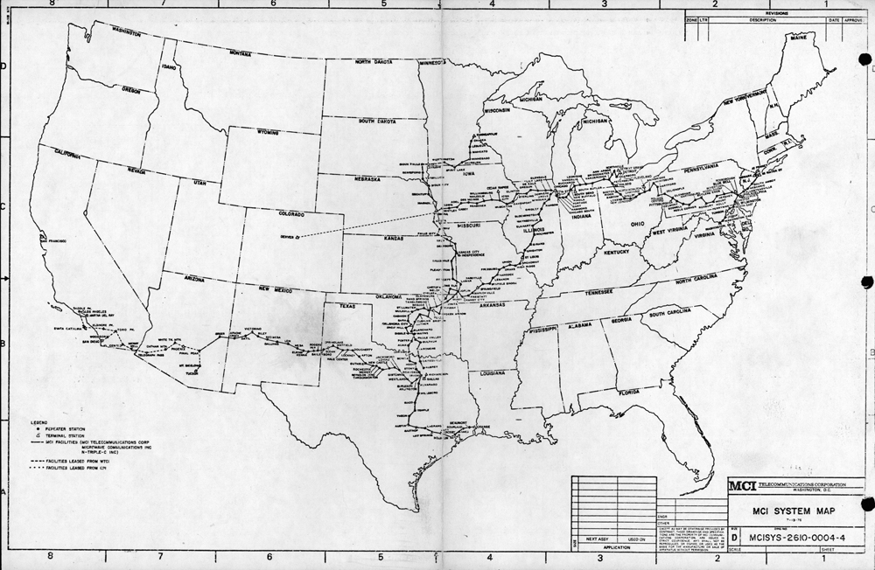
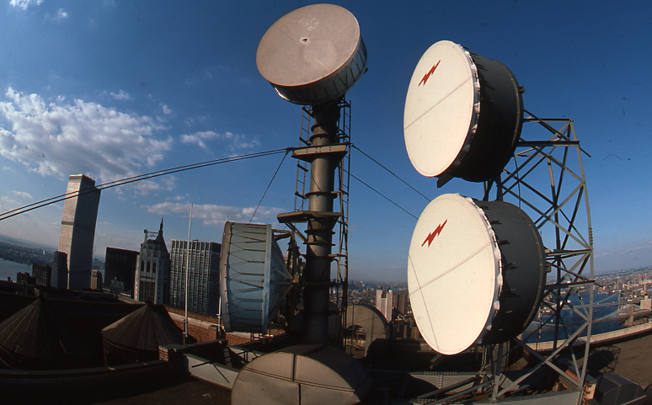

Slide 32
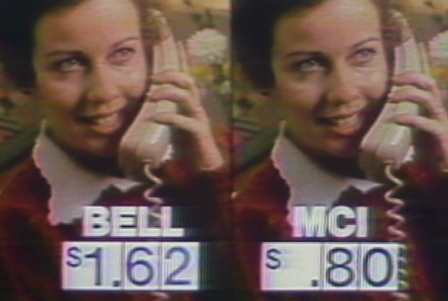
MCI v AT&T
1969: MCI approved to provide service – interconnect with AT&T
1972: MCI initiates service – AT&T fights interconnection
Barrier to Market Entry
1973: AT&T files 49 interconnection tariffs in states – Courts and FCC order AT&T to interconnect
1974
MCI and DOJ file antitrust lawsuit
AT&T disconnects MCI
1982: AT&T Modified Final Judgment
AT&T would be broken up into BOCs and AT&T LD
1984: Divestiture

