Slide 1
Sublinear Algorithmic Tools
Alex Andoni

Slide 2
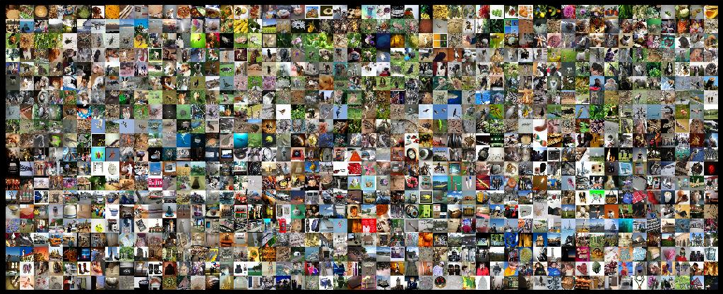
Find similar pairs

Slide 3
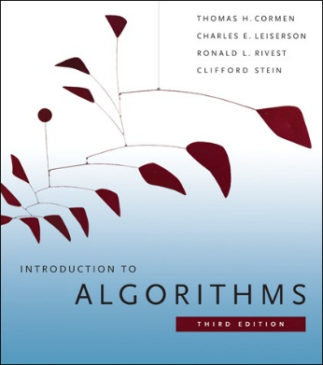
Algorithm Design
Happy when your algorithm is efficient
Golden standard: polynomial time
$O\left(n^{2}\right)$ time
CSOR 4231
Ask not what runtime is achievable for your problem,
but what you can solve in small runtime

Slide 4
Algorithm Design
Modern
New goal: linear, or sublinear time
How?
approximation
randomization
resources
also space: working memory << all data
communication,…
$$≈$$
Algorithm( )
$O\left(n\right)$ time
Ask not what runtime is achievable for your problem,
but what you can solve in small runtime

Slide 5
Methodology ?
Succinct
data representations
Efficient
Algorithms
000000
011100
010100
000100
010100
011111
000000
011100
010100
000100
010100
011111
dimension
reduction
Sketching (streaming)
Sampling
Metric embeddings
…
$$≈$$
lossy
good for specific task
000000
001100
000100
000100
110100
111111
000000
001100
000100
000100
110100
111111
$$≈$$

Slide 6
Plan
Dimension reduction
Application: Numerical Linear Algebra
Sketching
Application: Streaming
Application: Nearest Neighbor Search
and more…

Slide 7
Dimension Reduction: Johnson-Lindenstrauss Lemma [JL84]
Preserves distances between $N$ points for $k=O\left(\frac{\log{N}}{ε^{2}}\right)$ with probability at least $1−1/N$
For $δ=1/N^{3}$
Dimension reduction: linear map $S:ℝ^{n}→ℝ^{k}$ s.t:
for any points $p,q∈ℝ^{n}$:
$\underset{S}{Pr}\left[\frac{||S\left(p\right)−S(q)||}{||p−q||}∈\left(1±ε\right)\right]≥1−δ$
[Johnson-Lindenstrauss’84]:
$$k=O\left(\frac{1}{ε^{2}}\log{\frac{1}{δ}}\right)$$

Slide 8
Idea:
Project onto a random subspace of dimension $k$!
In general, $S$ linear:
$S(p)−S(q)=S(p−q)$
Ok to prove that for $x=p−q$
$||S\left(x\right)||^{2}=\left(1±ε\right)⋅||x||^{2}$

Slide 9
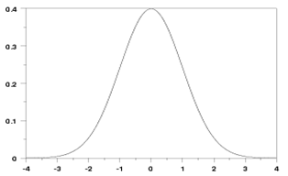
JL Construction
pdf = ${\frac{1}{\sqrt{2π}}e}^{−g^{2}/2}$
$$E[g]=0$$
$$E[g^{2}]=1$$
Take $S\left(x\right)=G⋅x$,
where each entry $G_{ij}$ is gaussian,
then $||Gx||^{2}=\left(1±ε\right)||x||^{2}$ with probability $1−e^{−O(kε^{2})}$
Why Gaussian?
Stability property: $G_{i}x=\sum_{j}{G_{ij}x_{j}}$ is distributed as $|\left|x|\right|⋅g$, where $g$ is also Gaussian
Equivalently: $G_{i}$ is centrally distributed, i.e., has random direction, and projection on random direction depends only on length of $x$
$$k=O\left(\frac{1}{ε^{2}}\log{\frac{1}{δ}}\right)$$
$$P\left(a\right)∙P\left(b\right)=$$
$$= \frac{1}{\sqrt{2π}}e^{−a^{2}/2}\frac{1}{\sqrt{2π}}e^{−b^{2}/2}$$
$$=\frac{1}{2π}e^{−{(a}^{2}+b^{2})/2}$$

Slide 10
Proof: JL
pdf = ${\frac{1}{\sqrt{2π}}e}^{−g^{2}/2}$
$$E[g]=0$$
$$E[g^{2}]=1$$
$Gx$is distributed as
$\frac{1}{\sqrt{k}}\left(||x||{⋅g}_{1}, …,||x||⋅g_{k}\right)$
where each $g_{i}$ is distributed as 1D Gaussian
Hence: $||Gx||^{2}=||x||^{2}⋅\frac{1}{k}\sum_{i}{g_{i}^{2}}$
$\frac{1}{k}\sum_{i}{g_{i}^{2}}$ is called chi-squared distribution with $k$ degrees
Expectation is =1 since $\left[g_{i}^{2}\right]=1$
Fact: chi-squared very well concentrated:
Equal to $1+ε$ with probability ${1−e}^{−Ω(ε^{2}k)}$
Akin to central limit theorem

Slide 11
Numerical Linear Algebra
$$A$$
$$x$$
$$b$$
$$−$$
Problem: Least Square Regression
$x^{∗}=argmin_{x}||Ax−b||$
where $A$ is $n×d$ matrix
$n≫d$
$1+ε$ approximation
Usual (exact) solution:
Perform SVD (singular value decomposition)
Takes $O\left(nd^{ω−1}\right)≈O(nd^{1.373})$ time
Faster?

Slide 12
Numerical Linear Algebra
$$A$$
$$x$$
$$b$$
$$S$$
$$−$$
$$S$$
Problem: Least Square Regression
$x^{∗}=argmin_{x}||Ax−b||$
Idea: Reduce-Dimension & Solve
solve $x^{′}=argmin_{x}||S⋅\left(Ax−b\right)||=argmin_{x}||SAx−Sb||$
where $S:ℝ^{n}→ℝ^{k}$ is a dimension-reducing matrix
reduces to much smaller $k×d$ problem
Hope: $||Ax^{′}−b||≈||Ax^{∗}−b||$
Dimension reduction $S$ satisfies:
$||Ax−b||≈||S(Ax−b)||$ with high probability
Issue:
There’s an infinite number of $x$’s -- can’t apply union bound
$$SA$$
$$x$$
$$Sb$$
$$−$$

Slide 13
NLA: Reduce-Dimension & Solve
[S’06, CW’13, NN’13, MM’13, C’16]
Why enough?
Need $||Ax−b||≈||S(Ax−b)||$ only for $P=\{Ax−b, x∈R^{d}\}$
Overall algorithm:
Compute $SA$ and $Sb$
Solve $argmin_{x}||SAx−Sb||$
Issue: time to compute $SA$
When $S$=Gaussian $⇒$ computing $SA$ takes $O(n⋅d^{2})$ time
Idea: structured $S$ s.t. $SA$ can be computed faster
Overall result: $O\left(nnz\left(A\right)+{\left(\frac{d}{ε}\right)}^{O\left(1\right)}\right)$ time
Oblivious Subspace Embedding: linear map $S:ℝ^{n}→ℝ^{k}$s.t.
for any linear subspace $P⊂ℝ^{n}$ of dimension $d$:
$\underset{S}{Pr}\left[∀p∈P :\frac{||S\left(p\right)||}{||p||}∈\left(1±ε\right)\right]≥1−δ$
$$k=O\left(\frac{d}{ε^{2}}\log{\frac{1}{δ}}\right)$$
$S$ = Gaussian matrix
slower than the original problem !

Slide 14
Structured Dimension Reduction
JL: For $y∈ℝ^{n}$
$S\left(y\right)=\frac{1}{\sqrt{k}}Gy=\frac{1}{\sqrt{k}}(g_{1}⋅||y||, g_{2}⋅||y||, …g_{k}⋅||y||)$
Time to compute $Gy$:
$O(nk)$
Faster:
Ideal: $O\left(nnz\left(y\right)+k^{O\left(1\right)}\right)$
Will see: $O(n\log{n}+k^{3})$ time [Ailon-Chazelle’06]

Slide 15
Fast JL Transform
$$n$$
$$G$$
$$G$$
$$y$$
$z=Gy$
Costly because $G$ is dense
Meta-approach: use $sparse$matrix $G$ ?
Suppose sample $s$ entries per row
Analysis of one row:
$h:\left[n\right]→\{0,1\}$ s.t. $h(i)=1$ with probability $s/n$
$z_{1}=η⋅$ $\sum_{i=1}^{d}{h(i)}⋅g_{i}y_{i}$
Expectation of $z_{1}^{2}$:
$E\left[z_{1}^{2}\right]=η^{2} E\left[\sum_{i}{h\left(i\right)g_{i}^{2} y_{i}^{2}}\right]=η^{2}⋅\frac{s}{n}⋅{\left|\left|y\right|\right|}^{2}$
What about concentration?
$$k$$
Set $η=\sqrt{n/s}$
normalization constant

Slide 16
Fast JLT: sparse projection
$$n$$
$z_{1}$ doesn’t concentrate ☹
Bad case: $y$ is sparse
think: $y=e_{1}−e_{2}$
Even for $s≈n/k$ (each coordinate of $y$ goes somewhere)
two coordinates collide (bad) with probability ~$1/k$
want exponential in $k$ failure probability
really would need $s≈n$
But, take away: may work if $y$ is “spread around”
New plan:
“spread around” $y$
then use sparse $G$
$$G$$
$$y$$
$$k$$

Slide 17
FJLT: construction
$$z=PHD⋅y$$
$D$ = matrix with random $±1$ on diagonal
$H$= Hadamard matrix (Fourier transform)
a non-trivial rotation
$Hy$ can be computed in time $O(n⋅log n)$ -- Fast Fourier Transform
$P$ = projection matrix:
sparse matrix as before, with size $k^{′}×n$, with $k^{′}≈k^{2}$ (ie, a little worse)
Main idea: uncertainty principle of the Hadamard/Fourier Transform:
If the original $y$ is sparse, then the transform is dense!
“spreading around”
Projection:
sparse matrix
Hadamard
(Fourier Transform)
Diagonal

Slide 18
Plan
Dimension reduction
Application: Numerical Linear Algebra
Sketching
Application: Streaming
Application: Nearest Neighbor Search
and more…

