Slide 1
Advanced Algorithms (4995-2) Nearest Neighbor Search (part 2)
Alex Andoni
4/28/20

Slide 2
Approximate Near Neighbor Search
$r$-near neighbor: given a query point $q$, report a point $p^{′}∈P$ s.t. $\left\|p′−q\right\|≤r$
as long as there is some point within distance $r$
Remarks:
In practice: used as a filter
Randomized algorithms: each point reported with 90% probability
Can use to solve nearest neighbor too
[HarPeled-Indyk-Motwani’12]
$c$-approximate
similar
$$cr$$
not similar
$$r$$
$$p^{∗}$$
$$cr$$
$$q$$
$$p^{′}$$
kind of…
either way
$n$: number of points
$d$: dimension

Slide 3
LSH Algorithms
Hash: project on
random bits!
Space | Time | Exponent | $$c=2$$ | Reference
Hamming
space
$$n^{1+ρ}$$ | $$n^{ρ}$$ | $$ρ=1/c$$ | $$ρ=1/2$$ | [IM’98]
 |  | $$ρ≥1/c$$ |  | [MNP’06, OWZ’11]
Euclidean
space
$$n^{1+ρ}$$ | $$n^{ρ}$$ | $$ρ=1/c$$ | $$ρ=1/2$$ | [IM’98, DIIM’04]
 |  | $$ρ≈1/c^{2}$$ | $$ρ=1/4$$ | [AI’06]
 |  | $$ρ≥1/c^{2}$$ |  | [MNP’06, OWZ’11]
$$Pr⁡[g(q)=g(p)]$$
$$ρ=\frac{\log{1/P_{1}}}{\log{1/P_{2}}}$$
1
$$P1$$
$$P2$$
$$\left\|q−p\right\|$$
$$r$$
$$cr$$
Notes:
Other ways to use LSH

Slide 4
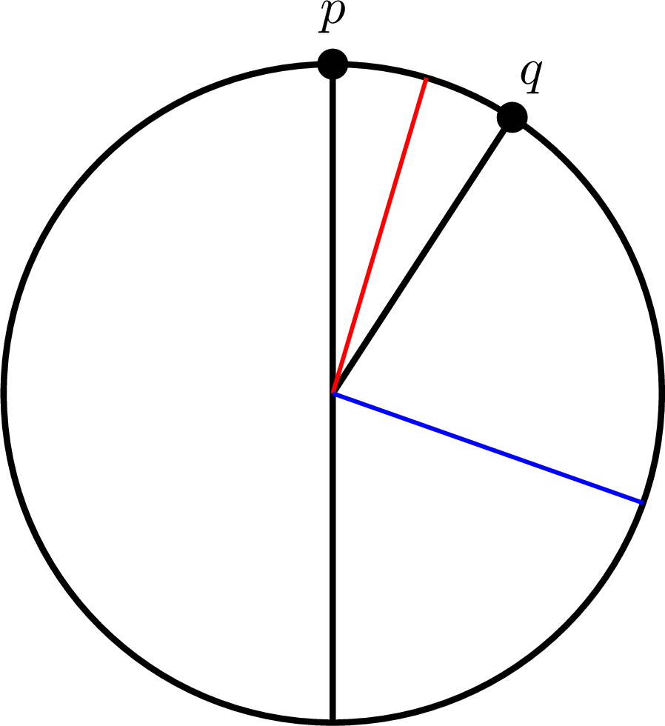
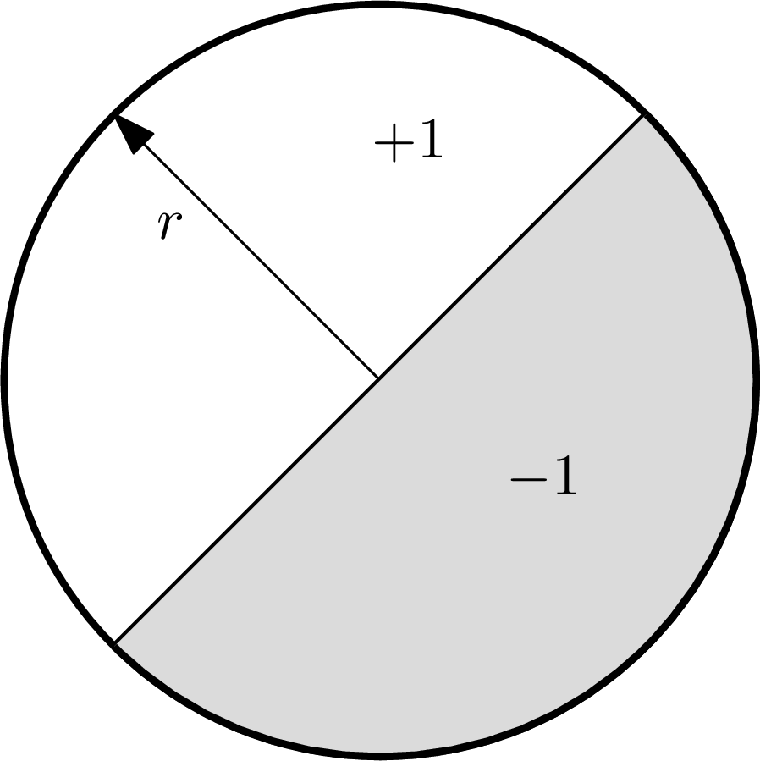
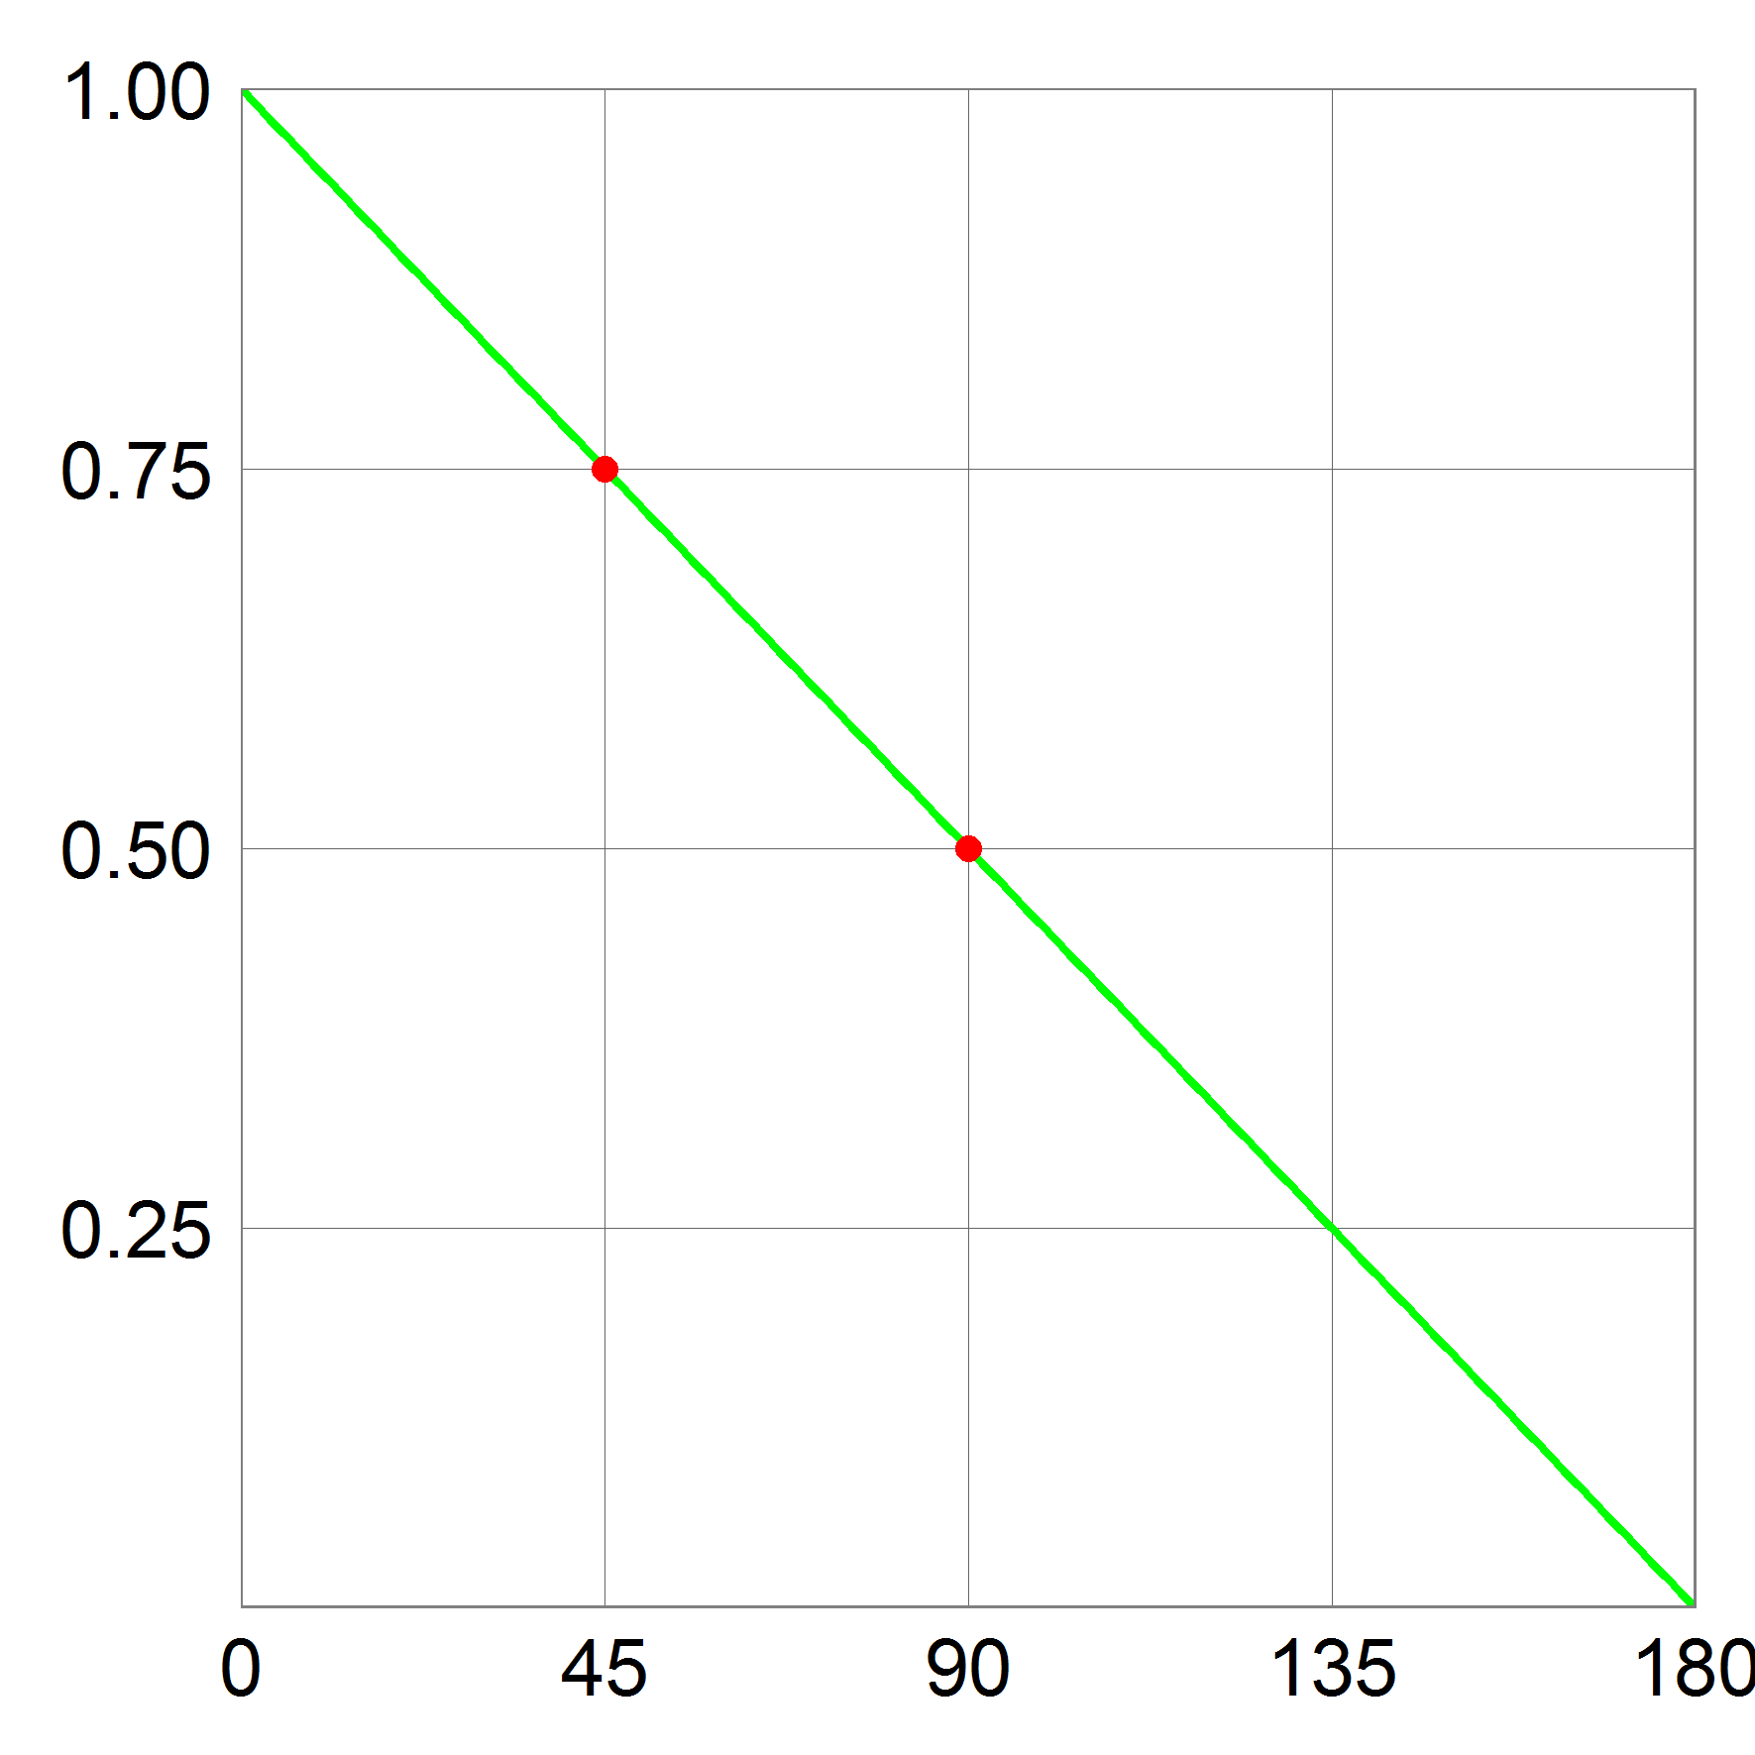
Euclidean LSH: Hyperplane ($ρ=1/c$)
Assume unit-norm vectors
Sample unit $r$ uniformly, hash $p$ into $h\left(p\right)=sgn〈r, p〉$
$Pr[h(p) = h(q)]$ ?
$= 1 – α / π$
where $α$ is the angle between $p$ and $q$
$P_{1}=3/4$
$P_{2}=1/2$
$ρ≈0.42$
Recall: hash function $g=(h_{1},h_{2},…h_{k})$
Ie, we perform $k$ such projections
[Charikar’02]

Slide 5
LSH $≈$ random dimension reduction
000000
011100
010100
000100
010100
011111
000000
011100
010100
000100
010100
011111
Hamming space: bit-sampling
In Euclidean space:
[Johnson-Lindenstrauss’84]
$S\left(p\right)=\left(R_{1}p, R_{2}p,…R_{k}p\right)=Rp$
each $R_{i}$ is (scaled) d-dimensional Gaussian vector
Then:
$||S(p)−S(q)||=\left(1±ε\right)⋅||p−q||,$
with probability $1−e^{−kε^{2}/c}$
For NNS: enough to reduce to dimension $k=Θ(\log{n})$
$$≈$$
000000
001100
000100
000100
110100
111111
000000
001100
000100
000100
110100
111111
$$≈$$
$$d$$
$$\text{R}$$
$$p$$
$$k$$
LSH (prev slide):
Sign($S(p)$)=Sign($S(q)$)

Slide 6
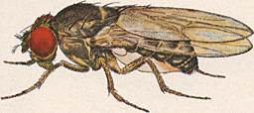
Detour: Fruit Fly Olfactory System
all but top 5%
strongest
are inhibited
[Dasgupta-Stevens-Navlakha’18]
random, sparse
connections (6/50)
$$p$$
normalization
0
0
0
0
Random dimension reduction?
Seems like dimension “increasing”
0
0
0
0.7
DSN: akin to Locality-Sensitive Hashing?
0
0
0
0
0
Winner-Take-All (WTA):
why useful?
0
0
0
0
odorant
receptors
~50 types
projection
neurons
~50
0
0
0
Kenyon cells
~2000

Slide 7
Back to LSH: Better NNS possible!
[A.-Indyk-Nguyen-Razenshteyn’14, A.-Razenshteyn’15,
A-Indyk-Laarhoven-Razenshteyn-Schmidt’15]
Two components:
Space | Time | Exponent | $$c=2$$
Euclidean
space
$$n^{1+ρ}$$ | $$n^{ρ}$$ | $$ρ=1/c$$ | $$ρ=1/2$$
 |  | $$ρ≈1/c^{2}$$ | $$ρ=1/4$$
 |  | $$ρ≥1/c^{2}$$
data-dependent !
 |  | $$ρ≈\frac{1}{2c^{2}−1}$$ | $$ρ=1/7$$
1) if data is “pseudorandom” => better LSH partitions!
2) can always reduce any worst-case dataset to the “pseudorandom” case

Slide 8
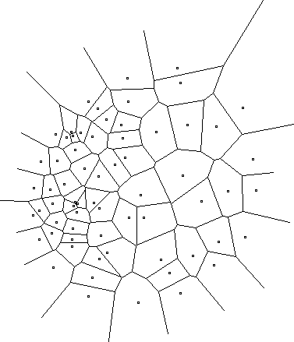
Data-dependent hashing
A random hash function, chosen after seeing the given dataset
Efficiently computable
Notes:
Example: Voronoi diagram
but expensive to compute the hash function

Slide 9
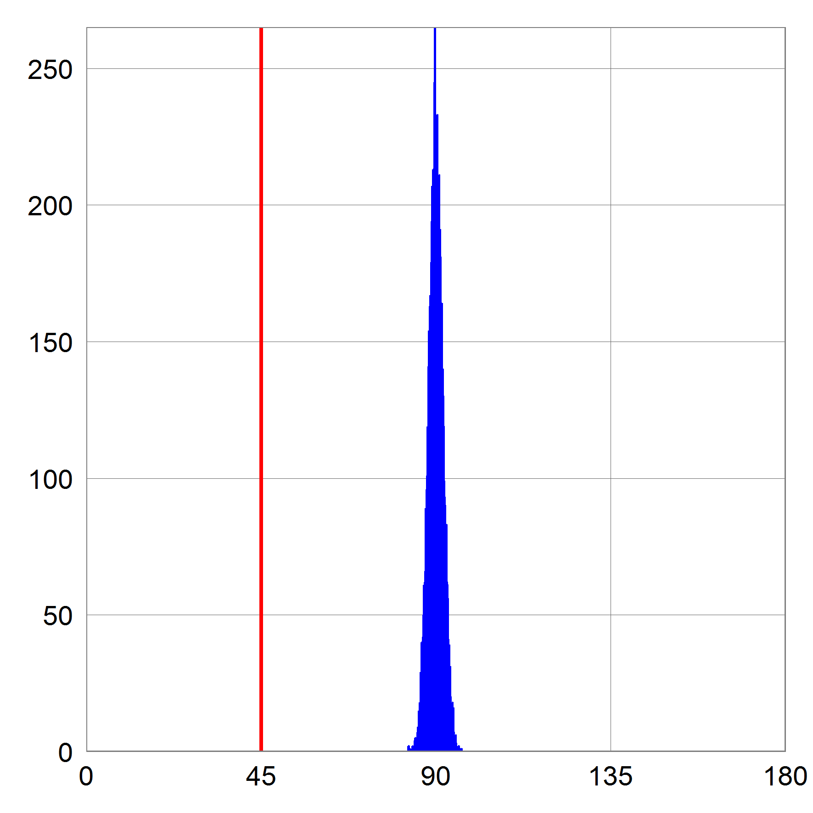
“Pseudo-random” case (isotropic)
Isotropic case:
Far pair is (near) orthogonal (@distance $cr$)
equivalent to when dataset is random on the sphere
close pair (distance $r$)
Lemma: exists LSH with $ρ=\frac{1}{2c^{2}−1}$
best possible (also isoperimetry)!
$$cr$$

Slide 10
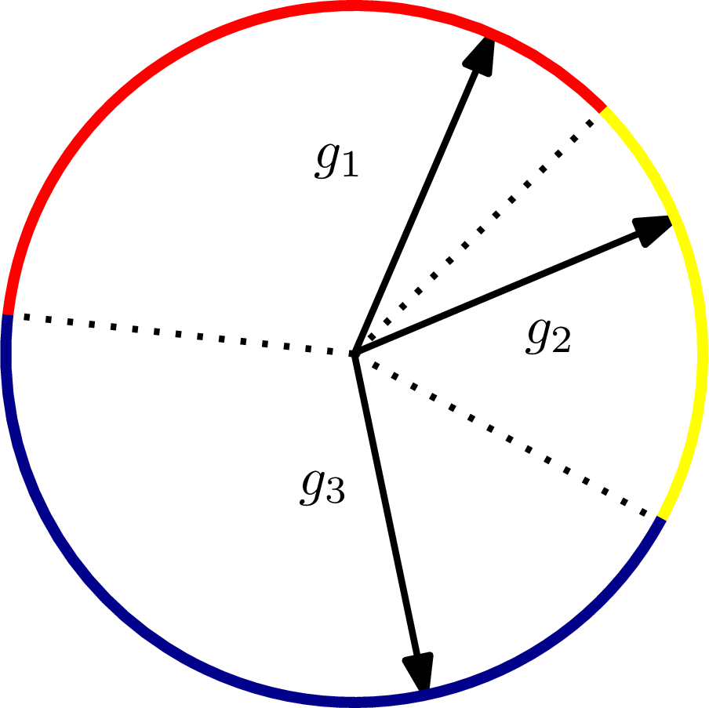
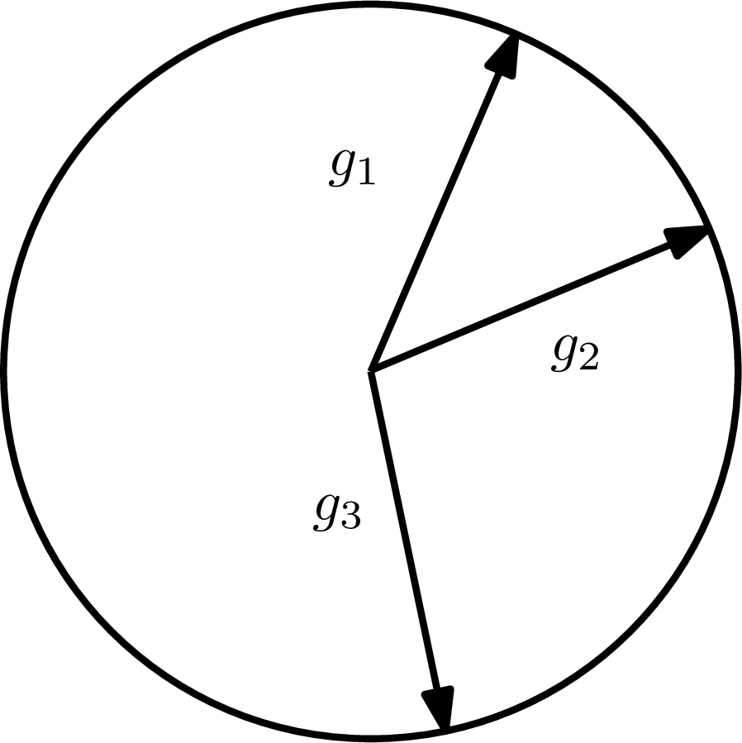
Better LSH for isotropic case
Lemma: LSH with $ρ=\frac{1}{2c^{2}−1}$
Sample $T$ i.i.d. standard $d$-dimensional Gaussians
$$r_{1}, r_{2}, …, r_{T}$$
Hash $p$ into
$g\left(p\right)= argmax_{1≤i≤T}〈p, {\text{r}}_{i}〉$
$T=2$ is simply Hyperplane LSH
Works* even if:
$p,q$ are Gaussian vectors (vs worst-case),
$r_{i}$’s are sparse
Winner-Take-All!
$$r_{1}$$
$$r_{2}$$
$$r_{3}$$

Slide 11
WTA LSH for isotropic case
$$r_{1}$$
$$r_{2}$$
Hash $p$ into
$g\left(p\right)= argmax_{1≤i≤T}〈p, r_{i}〉$
$$r_{3}$$
Issues:
Fruit fly uses more than 1 “winner”
LSH has somewhat small $P_{1}$ (close prob.)
Kind of using just one hash function/table
+another NNS idea: Multi-probe LSH
[Lv-Josephson-Wang-Charikar-Li’07]
Classic LSH collision: $g\left(q\right)=g(p)$
$P_{1}$ is very small, $≈n^{−ρ}$, hence build $n^{ρ}$ iid hash tables
New idea: look up also other buckets $g_{1}\left(q\right),…g_{k}(q)$
“guess” the value of $g(p)$
Multi-probe algo:
Preprocessing: as before, with 1 hash table using $g(p)$
Query: check all of $g\left(q\right),g_{1}\left(q\right),…g_{L}(q)$ whether collide with $g(p)$
Oftentimes: $L=n^{O\left(ρ\right)}$ enough
In WTA LSH: $g\left(q\right),g_{1}\left(q\right),…g_{k}(q)$ are top $k$ max’s!
0
0
0
0
0
0
0
0.7
0
0
0
0
0
0
0
0
0
0
0
0

Slide 12
Back to LSH: the data-dependent part
2) can reduce any worst-case dataset to the “pseudorandom” case
Lemma: any pointset $P∈R^{d}$ can be decomposed into clusters, where one cluster is pseudo-random and the rest have smaller diameter
a form of “regularity lemma”

Slide 13
A data-dependent LSH
[A.-Razenshteyn-Shekel-Nosatzki’17]
Hamming space
$n^{ρ}$ random decision trees, of height $k$
in each node sample a random coordinate
LSH Forest++:
LSH Forest [Bawa-Condie-Ganesan’05]
In a tree, split until $O(1)$bucket size
++: store $t$ points closest to
the mean of P
query compared against the $t$ points
Theorem: obtains $ρ≈\frac{0.72}{c}$
for $t,c$ large enough
$$n^{1+ρ}$$ | $$n^{ρ}$$ | $$ρ=1/c$$ | [Indyk-Motwani’98]
$$x=00110110$$
coor 3
coor 2
coor 5
coor 7

Slide 14
NNS for other distances?
Earth Mover Distance (Wasserstein):
Given two sets A, B of points in a metric space
EMD(A,B) = min cost bipartite matching between A and B
Applications in image vision
$$S$$
010110
$EMD(A,B)$ small or large?
$$S$$
010101

Slide 15
Tool: metric embeddings
Metric Embedding:
Map sets into vectors in $ℓ_{1}$ preserving the distance (approximately)
Then use algorithms for $ℓ_{1}$ !
Say, EMD over ${\left[s\right]}^{2}$
Theorem [Cha02, IT03]: Exists a map $f$ mapping all $A⊂{\left[s\right]}^{2}$ into $ℓ_{1}$ with approximation $O(log⁡s)$:
i.e., for any $A,B⊂{\left[s\right]}^{2}$ we have:
$$EMD\left(A,B\right)≤||f\left(A\right)−f\left(B\right)||_{1}≤O(\log{s})⋅EMD(A,B)$$
Implies NNS: $O\left(\log{s}\right)$-approximation

Slide 16
Embeddability into $ℓ_{1}$
edit( banana ,
ananas ) = 2
Metric | Upper bound
Earth-mover distance ($s$-sized sets in 2D plane) | $$O\left(\log{s}\right)$$ [Cha02, IT03]
Earth-mover distance ($s$-sized sets in ${\left\{0,1\right\}}^{d}$) | $$O(\log{s}⋅\log{d})$$ [AIK08]
Edit distance over ${\left\{0,1\right\}}^{d}$ (#indels to transform x->y) | $$2^{\tilde{O}\left(\sqrt{\log{d}}\right)}$$ [OR05]
Ulam (edit distance between permutations) | $$O\left(\log{d}\right)$$ [CK06]
Block edit distance | $$\tilde{O}\left(\log{d}\right)$$ [MS00, CM07]
edit(1234567,
7123456) = 2

Slide 17
Non-embeddability into $ℓ_{1}$
Metric | Upper bound
Earth-mover distance ($s$-sized sets in 2D plane) | $$O\left(\log{s}\right)$$ [Cha02, IT03]
Earth-mover distance ($s$-sized sets in ${\left\{0,1\right\}}^{d}$) | $$O(\log{s}⋅\log{d})$$ [AIK08]
Edit distance over ${\left\{0,1\right\}}^{d}$ (#indels to transform x->y) | $$2^{\tilde{O}\left(\sqrt{\log{d}}\right)}$$ [OR05]
Ulam (edit distance between permutations) | $$O\left(\log{d}\right)$$ [CK06]
Block edit distance | $$\tilde{O}\left(\log{d}\right)$$ [MS00, CM07]
Lower bounds
$$Ω\left(\sqrt{\log{s}}\right)$$ [NS07]
$$Ω\left(\log{s}\right)$$ [KN05]
$$Ω\left(\log{d}\right)$$ [KN05,KR06]
$$\tilde{Ω}\left(\log{d}\right)$$ [AK07]
4/3 [Cor03]

