Slide 1
rxKinFu: Moving Volume KinectFusion for 3D Perception and Robotics.
Dimitrios Kanoulas, Nikos G. Tsagarakis, Marsette Vona
By Hrisheekesh Patil (hpp2105)

Slide 2
3D Perception Tools
Autonomous locomotion and manipulation require an accurate knowledge of the surroundings.
There are sensors for various specialized purposes.
For 3D data common modes used are LiDAR scanners, stereo, depth, RGB-D, monocular and event cameras.

Slide 3
Non – Kinect Algorithms
Sparse reconstruction : Visual SLAM and SFM methods have been used.
Dense reconstruction method : DTAM
PTAM

Slide 4
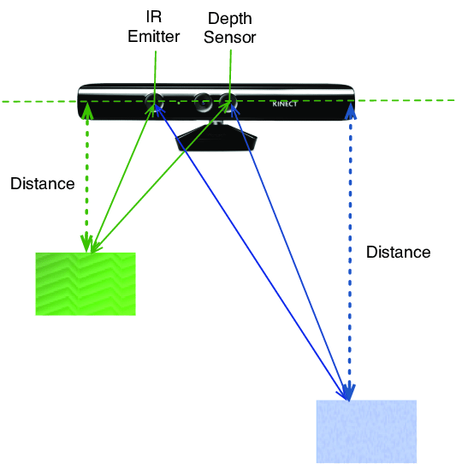
Kinect Camera
RGB CMOS sensor
Illuminant (Infrared Laser + diffuser)
Monochrome Infrared CMOS Sensor
GPU implementation
Processing at 30 fps

Slide 5
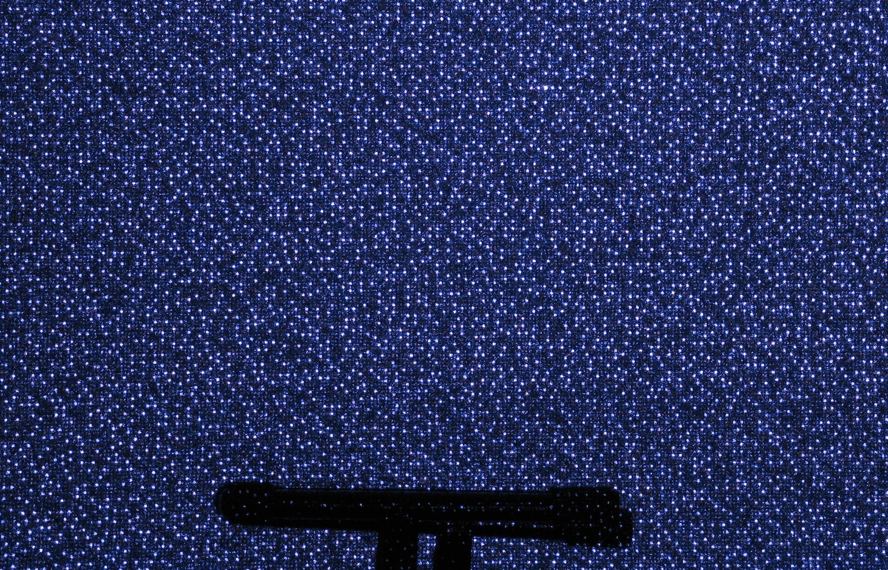
Projected dots

Slide 6
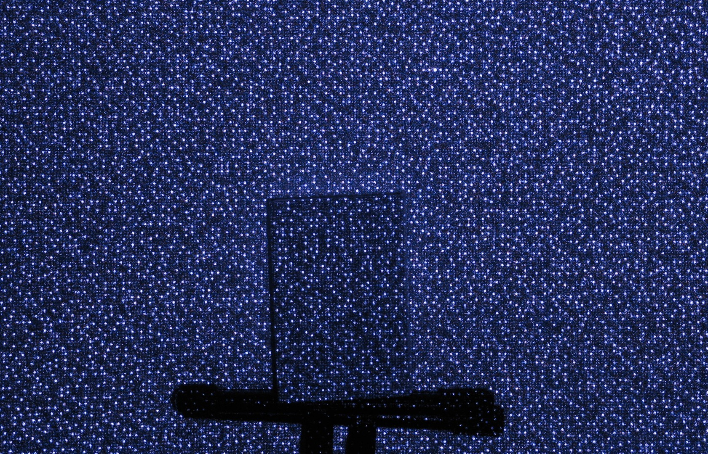
Projected dots

Slide 7
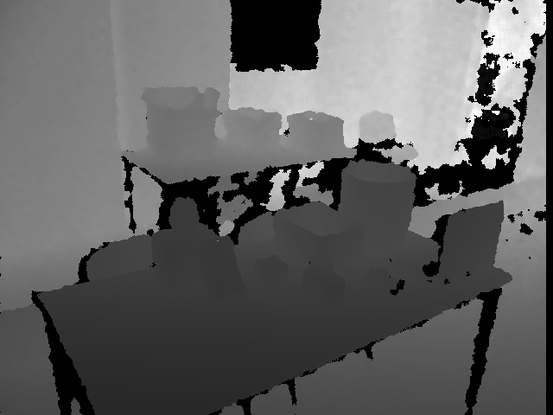
Raw depth image

Slide 8
Reference Papers and algorithms
KinectFusion : Real-Time Dense Surface Mapping and Tracking
Moving Volume KinectFusion
rxKinfu: Moving Volume KinectFusion for 3D perception and Robotics

Slide 9
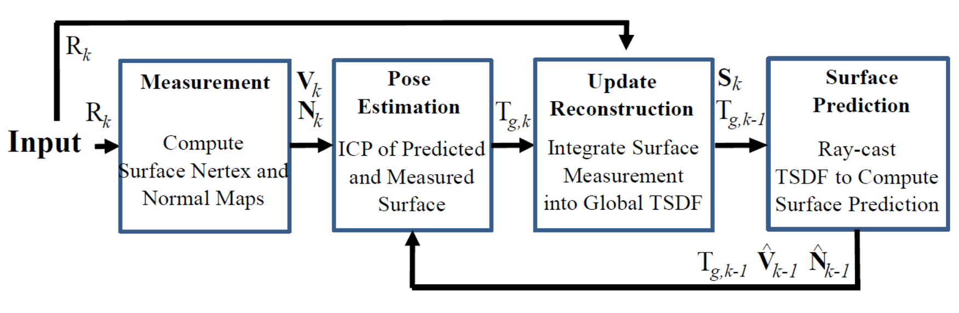
Process flow for localisation and mapping

Slide 10
Measurement

Slide 11
Process flow for localisation and mapping

Slide 12
Pose Estimation(Iterative Closest Point)

Slide 13
Process flow for localisation and mapping

Slide 14
Volume Integration
Model is built within a volumetric reconstruction of Global Space.
The space is uniformly divided into a 3D grid of 512³ voxels.
It is represented using Truncated Signed Distance Function.

Slide 15
Truncated signed Distance Function
The whole volume splits into 512³ voxels of 3 cubic meters of physical volume.
For each Voxel v, it is represented by d and w where d is distance to nearest surface and w is weight representing confidence in measurement.
To increasing speed / space efficiency cells close to surfaces (-T < d < T, T = 3cm) are stored and others are 0 or uninitialized.

Slide 16
Process flow for localisation and mapping

Slide 17
Raycasting
Raycasting is used for rendering of the voxel grid data given position of the camera and direction of ray
0 crossings in the grid represent a surface which acts as a stopping point for the ray.
Once implicit surface is discovered the vertex and normal maps are recalculated using interpolation of neighbouring element.

Slide 18
Reference Papers and algorithms
KinectFusion : Real-Time Dense Surface Mapping and Tracking
Moving Volume KinectFusion
rxKinfu: Moving Volume KinectFusion for 3D perception and Robotics

Slide 19

Moving Volume KinectFusion
This implementation used for using Kinect with moving volumes.
The main difference over original KinectFusion being is that, new depth images are not merged to the global model of the scene but are remapped using TSDF interpolation if required.
Each volume is saved as a rigid transform to track camera movement in time.
There are some criteria for remapping/ shifting of volume.

Slide 20
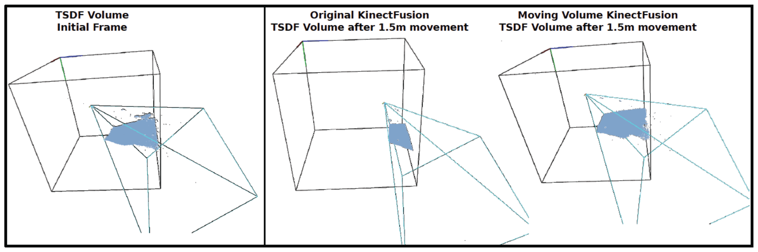
Moving Volume KinectFusion

Slide 21
Reference Papers and algorithms
KinectFusion : Real-Time Dense Surface Mapping and Tracking
Moving Volume KinectFusion
rxKinfu: Moving Volume KinectFusion for 3D perception and Robotics

Slide 22
rxKinFu
Developed a free roaming method specifically for Robotic Applications such as locomotion and manipulation.
Raycasting methods to extract point clouds based on virtual cameras placed in moving volume.
Use of IMU sensor mounted on the camera or robot to fuse gravity information into the volume.
Use of a colormap into reconstruction which can be helpful in methods that require RGB data.
Integration of rxKinFu into three robots:
          RPBP : the mini-bipedal robot
          CENTAURO : full sized wheeled/legged robot
          COMAN : full-sized humanoid robot

Slide 23
Implementation of Algorithm
A. Task Based - Remapping strategies
    Fix Volume (fv)
    Fix Camera in Volume (fcv)
    Fix Down and then Forward in the Volume (fdv)
    Fix Forward and then Down in the Volume (ffv)
B. Raycasting based on Virtual Bubble Cameras

Slide 24
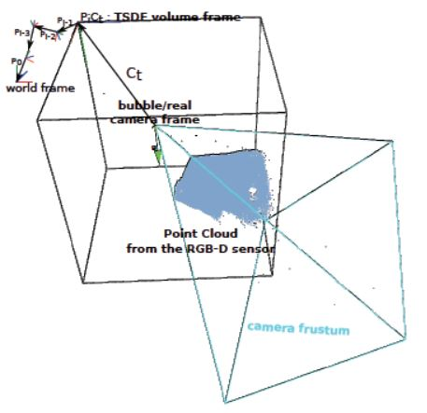
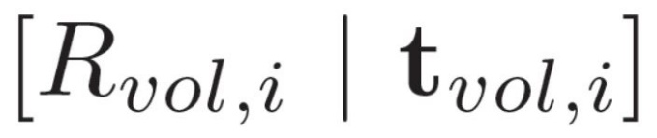
Task-based Remapping Strategies
Volume Frame : upper – left – back corner
: from volume i to i -1
X : right
Y : down
Z : forward
vd : down vector
vf : forward vector

Slide 25
Implementation of Algorithm
A. Task Based - Remapping strategies
    Fix Volume (fv)
    Fix Camera in Volume (fcv)
    Fix Down and then Forward in the Volume (fdv)
    Fix Forward and then Down in the Volume (ffv)
B. Raycasting based on Virtual Bubble Cameras

Slide 26
Implementation of Algorithm
A. Task Based - Remapping strategies
    Fix Volume (fv)
    Fix Camera in Volume (fcv)
    Fix Down and then Forward in the Volume (fdv)
    Fix Forward and then Down in the Volume (ffv)
B. Raycasting based on Virtual Bubble Cameras

Slide 27
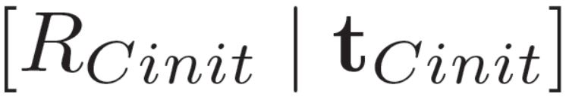

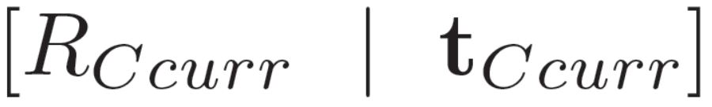
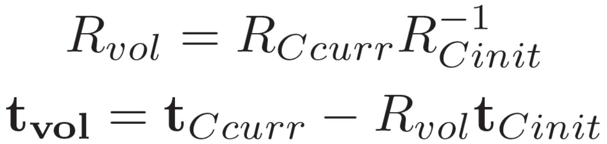
Fix Camera in Volume (fcv)
Factoring the current camera pose into initial camera transform and a volume transform
`
Initial Camera transform
Volume transform
Current Camera Pose

Slide 28
Implementation of Algorithm
A. Task Based - Remapping strategies
    Fix Volume (fv)
    Fix Camera in Volume (fcv)
    Fix Down and then Forward in the Volume (fdv)
    Fix Forward and then Down in the Volume (ffv)
B. Raycasting based on Virtual Bubble Cameras

Slide 29
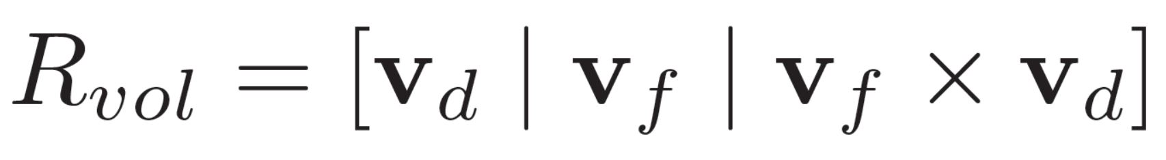
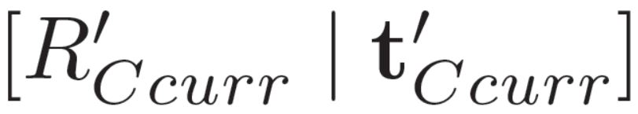
Fix Down and Forward in Volume (fdv)
STEPS:
Rotate the volume to keep +y – direction parallel to specified down vector
Orient +z – axis as close as possible to a specified forward vector

Slide 30
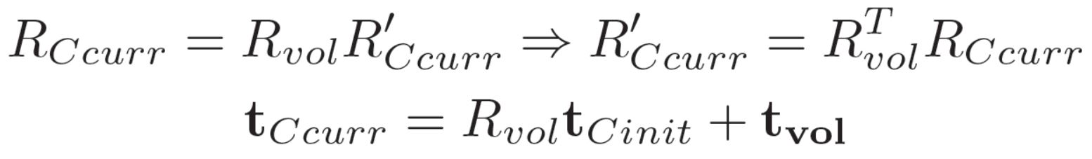
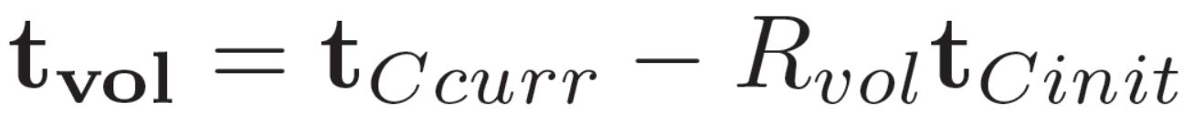
Fix Down and Forward in Volume (fdv)

Slide 31
Fix Down and Forward in Volume (fdv)

Slide 32
Fix Down and Forward in Volume (fdv)

Slide 33
Implementation of Algorithm
A. Task Based - Remapping strategies
    Fix Volume (fv)
    Fix Camera in Volume (fcv)
    Fix Down and then Forward in the Volume (fdv)
    Fix Forward and then Down in the Volume (ffv)
B. Raycasting based on Virtual Bubble Cameras

Slide 34
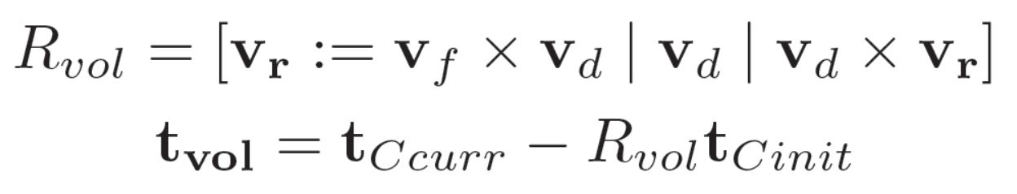
Fix Forward and Down in Volume (ffv)
STEPS:
Rotate the volume to keep +z – direction parallel to specified forward vector
Orient +y – axis as close as possible to a specified down vector

Slide 35
Remapping strategies extensions.
Extension :
Moving volume down and forward vectors to default +y (mvfd) and +z (mvff) of starting configuration
Use of IMU for implementation :
downgrav : It sets moving volume down vector equal to gravity vector obtained from IMU
headvel : recent camera velocity is used as forward vector
headcam : current camera +z axis pose

Slide 36
IMU integration
Systems such as Multisense-SL visual/range sensors can be used which are already calibrated
In some cases where sensors need to be separated of re-calibration is required.
Depth data and gravity vector from IMU is used to get transformation between both

Slide 37
Implementation of Algorithm
A. Task Based - Remapping strategies
    Fix Volume (fv)
    Fix Camera in Volume (fcv)
    Fix Down and then Forward in the Volume (fdv)
    Fix Forward and then Down in the Volume (ffv)
B. Raycasting based on Virtual Bubble Cameras

Slide 38
Raycasting based on virtual bubble cameras
Method for point cloud raycasting from the TSDF volume over the default option of only camera view-point.
It is a sort of integration of jobs done by KinectFusion and Moving Volume KinectFusion algorithms.
Specially applicable in cases of Robotic manipulation tasks, locomotion tasks.
It helps robot plan its motion even in the presence of obstructions in the local view point using data from a birds eye view with obstructions.
An option of 6 virtual bubble cameras is available that covers the full-space.
Limitation is that the TSDF data for the complete view point is already obtained from previous frames.

Slide 39
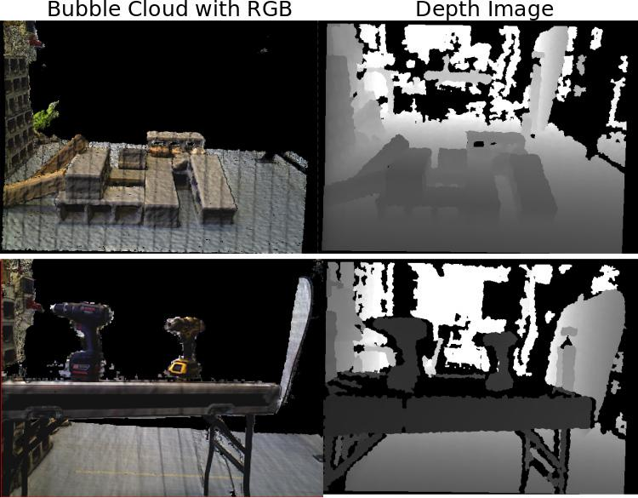
Raycasting based on virtual bubble cameras
Left : Raycasted RGB point cloud from bubble virtual camera
Right: the depth image of the scene from real camera
Color is also integrated unlike original version.

Slide 40
Construction of virtual bubble camera
Rules of construction :
It’s reference frame is axis-aligned with the frame of TSDF volume with z-axis in the downward direction.
Centre of projection be at a fixed offset of bo above the location of real camera.
Variation in camera width/height dimension bd is allowed.
Resolution is dependent upon the task to be done.
Graphical rectangular prism “bubble” is represented by two values size(bs) and resolution(br) representing a frustum.
There are 6 frustums in 6 direction with center of projection at bubble reference point If resolution is positive.

Slide 41
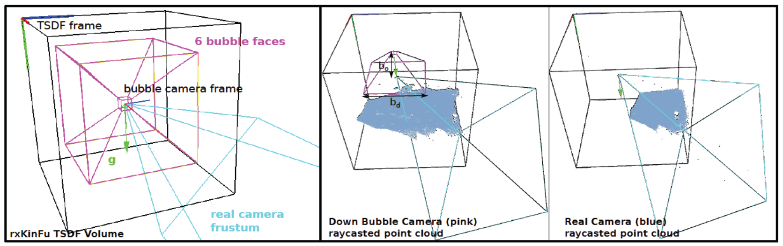
Construction of virtual bubble camera

Slide 42
Robotic Application
Primesense Carmine
Kinect V1
ASUS Xtion PRO

Slide 43
RBPB Mini - Robot
Process followed :
Robot bends over to look down the ground to create a map.
Robot moves to place its for on the ground to place its foot.
Specifications and Method used:
Down Vector is gravity vector obtained from IMU
bo (Distance between real camera and bubble frustum) is twice the robot’s height.
Fix Down and then Forward in the Volume (fdv) method is used.
Down face of virtual bubble camera acquires 200px^{2.}

Slide 44
RBPB Mini - Robot

Slide 45
CENTAURO
Experiment 1
Two drill machines are kept on the table and the robot is manually driven linearly and with some small CoM movements.
Fix Forward and then Down in the Volume (ffv) method is used with front face of camera acquiring a dense 400px²
Experiment 2
Some bricks are set on the ground with similar movements with bubble frustum higher and behind to extract point cloud from down face of the camera.
Fix Forward and then Down in the Volume (ffv) method is used using IMU gravity vector as down vector with down face of camera acquiring a dense 400px²

Slide 46
CENTAURO

Slide 47
CENTAURO
Experiment 3
Two drill machines are kept on the table and bricks lying before the table.
Fix Down and then Forward in the Volume (fdv) method is used.
Down face of camera acquiring a dense 400px²
The robot moves and stops before the bricks.

Slide 48
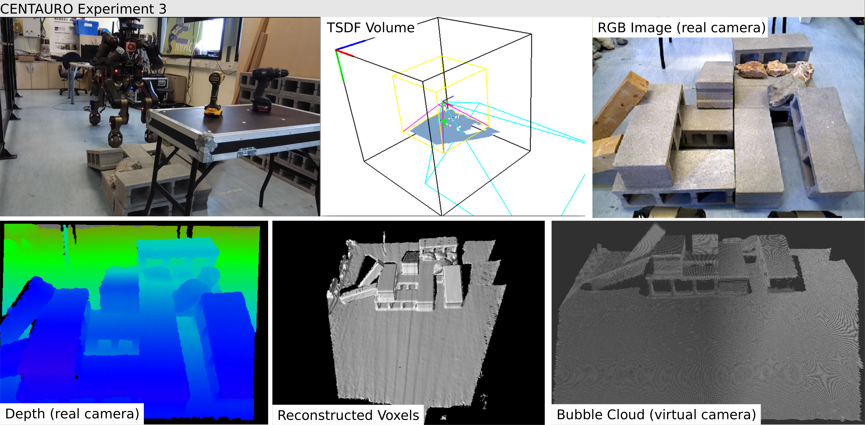
CENTAURO

Slide 49
CogIMon
https://www.youtube.com/watch?v=FozLfHGv1D0

Slide 50
Conclusions and Future Works
Conclusions
Different strategies for remapping the moving volume over time were shown.
Virtual Camera based raycasting technique was demonstrated.
The algorithm was implemented on legged/wheeled robot.
Future Works
Extension of the method to other EKF – based IMU/Kinematics state estimators.
Application on more complicated robotic tasks like rock hiking or tool manipulation
Extension of this algorithm to sensors other that RGB-D ones used here.

Slide 51
Thank You
All data has been taken from following references:
KinectFusion: Real-Time Dense Surface Mapping and Tracking, Richard Newcombe, Shahram Izadi et all.
Moving Volume KinectFusion, Henry Roth, Marsetta Rona.
rxKinFu: Moving Volume KinectFusion for 3D Perception and Robotics, Dimitrios Kanoulas, Nikos G. Tsagarakis, and Marsette Vona.
Open Fusion Real-time 3D Surface Reconstruction Out of Depth Images, Nurit Schwabsky Vered Cohen
Realtime Dense 3D reconstruction, Visual Computing Systems CMU 15-769, Fall 2016.

