Slide 1
Lab 4 overview + tips
- Aalhad Patankar, Bryan Li, David Watkins

Slide 2
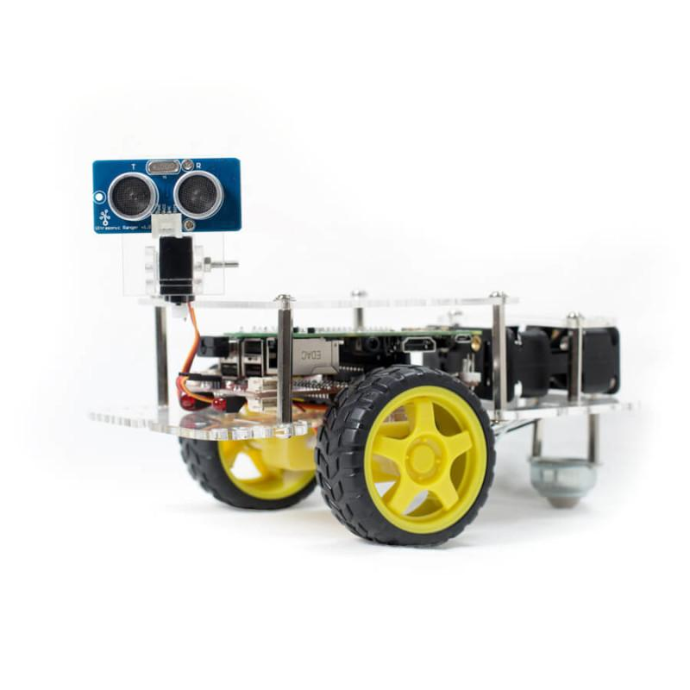
Lab overview
Goals:
Follow a yellow line using computer vision
Correct yourself when veering off course
U-turn when orange stop line is encountered (at a certain distance)
Extra credit: Achieve a turn

Slide 3
One possible architecture
Find position
Stop sign
Capture Image
Detect Stop Sign
Apply Homography
Controller
Determine angle/distance
Move robot to center line
Filter colors
Move forward
Find hough lines
U-turn

Slide 4
Additional helpful modules
GPG2 control module wrapper to easily move and turn robot
Camera module to control camera settings/config
Homography module or script to obtain the correct transform and session parameters you will need
Testing module to automatically iterate through testbed
Try not to write it all in one long script -- think about good coding practices

Slide 5
Tips and hints
Start early!!!
Purchase tape that we linked to in lab spec to be able to test anywhere on the go
Or use the image set we gave you to do the same
Separate assignment into logical modules, and work in parallel to build + test modules. Mock up where appropriate
E.g. To test position + pose estimation code, mock up valid hough line + robot position
Assign team roles. There are several components to this lab
The core algorithms, software design + testing, integration, testing, etc.

Slide 6
Tips and hints
Develop good debugging tools early, will help you in the long run
Save good images so you can use them as mock data for modules
raspistill command
Be careful when working in homography transformed space to make sure all the data points you're working with have also been transformed (if doing pose or position estimation)
Post on Piazza and help out teammates
This will be updated as new hints come up

