Slide 1
Towards Natural Clarification Questions in Dialogue Systems
Svetlana Stoyanchev, Alex Liu,
and Julia Hirschberg
AISB 2014 Convention at Goldsmiths, University of London
April 3, 2014
Notes:
1

Slide 2
Outline
Motivation
Previous work: a corpus of human clarification questions
Automatic method for generating targeted clarification questions
Evaluate automatically generated questions with human subjects
Comparison two evaluation groups

Slide 3


Speech Translation
3
Speech-to-Speech translation system
Translation
System
L1 Speaker
L2 Speaker
Speech
Question
(L1)
Translated Question (L2)
lation
Answer (L2)
Translated
Answer (L1))
Notes:
3

Slide 4
Speech Translation
4
Translation may be impaired by:
  Speech recognition errors
    Word Error rate in English side of Transtac is 9%
    Word Error rate in Let’s Go bus information is 50%
  A speaker may use ambiguous language
  A speech recognition error may be caused by use of out-of-vocabulary words
Notes:
4

Slide 5
Speech Translation
5
Speech-to-Speech translation system
Introduce a clarification component
Translation
System
L1 Speaker
L2 Speaker
Dialogue Manager
Dialogue Manager
Speech
Question
(L1)
Translated Question (L2)
Clarification
sub-dialogue
Answer (L2)
Clarification
sub-dialogue
Translated
Answer (L1))
Notes:
5

Slide 6
Most Common Clarification Strategies in Dialogue Systems
6
“Please repeat”
“Please rephrase”
System repeats the previous question
Notes:
6

Slide 7
What Clarification Questions Do Human Speakers Ask?
7
Targeted reprise questions (M. Purver)
  Ask a targeted question about the part of an utterance that was misheard or misunderstood, including understood portions of the utterance
    Speaker: Do you have anything other than these XXX plans?
      Non-Reprise: What did you say?/Please repeat.
      Reprise: What kind of plans?
88% of human clarification questions are reprise
12% non-reprise
Goal: Introduce targeted questions into a spoken system
Notes:
7

Slide 8
Advantages of Targeted Clarifications
8
More natural
User does not have to repeat the whole utterance/command
Provides grounding and implicit confirmation
  Speech-to-speech translation
  Useful in systems that handle natural language user responses/commands/queries and a wide range of topics and vocabulary
  Tutoring system
  Virtual assistants (in car, in home): a user command may contain ASR error due to noise, background speech, etc.
Notes:
8

Slide 9
Corpus of Human Clarification Questions
Collect a corpus of targeted clarification questions
Understand user’s reasons for choosing
  Whether to ask a question
  Whether it is possible to ask a targeted question
When can users infer missing information

Slide 10
Corpus of Human Clarification Questions
Gave a participant a sentence with a missing segment (from Transtac system output)
  how many XXX doors does this garage have
Asked the participant to
  Guess the word
  Guess the word type (POS)
  Would you ask a question if you heard this in a dialogue?
  What question would you ask? (encourage targeted)

Slide 11
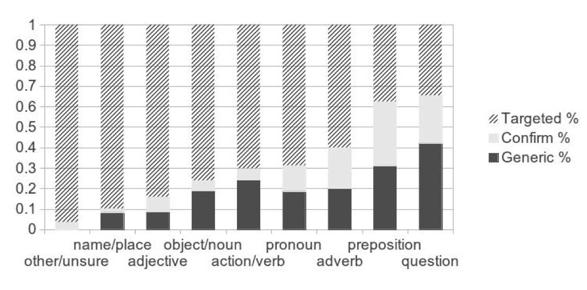
Corpus of Human Clarification Questions
Collected 794 Targeted clarification questions
72% of all clarification questions asked

Slide 12
Rules for Constructing Questions
Construct rules for question generation based on analysis of human-generated questions
The algorithm relies on detection of an error segment
Use context around the error word <context before>, <context after> to create a targeted clarification question
  R_WH Generic (reprise)
  Syntactic R_VB (reprise)
  Syntactic R_NMOD
  R_START
  R_NE – Named Entity-specific question

Slide 13
Rules for Constructing Questions
R_WH Generic: <context before > + WHAT?
  The doctor will most likely prescribe XXX.
    R_WH: The doctor will most likely prescribe WHAT?

Slide 14
Rules for Constructing Questions
R_WH Generic: <context before > + WHAT?
  The doctor will most likely prescribe XXX.
    R_WH: The doctor will most likely prescribe WHAT?
In some cases using <context after> error word is desirable
  When was the XXX contacted?
    R_WH* When was the WHAT?
    R_VB1: When was the WHAT contacted?

Slide 15
Rules for Constructing Questions
Context <after error> can not be used indiscriminately
  As long as everyone stays XXX we will win.
    R_VB1* As long as everyone stays WHAT we will win?
    R_WH As long as everyone stays WHAT?
R_VB1: applies when verb and error word share a syntactic parent

Slide 16
Rules for Constructing Questions
R_VB2: applies when an infinitival verb follows an error word
We need to have XXX to use this medication.
  R_WH We need to have WHAT?
  R_VB2 We need to have WHAT to use this medication?

Slide 17
Rules for Constructing Questions
R_NMOD: Error word is a noun modifier
  Do you have anything other than these XXX plans
    R_WH: Do you have anything other than these WHAT?
    R_NMOD: Which plans?
NMOD
Parent NN/NNS
XXX

Slide 18
Rules for Constructing Questions
If an error occurs in the beginning of a sentence (or there are no content words before the error), there is no <context before>.
R_START: what about <context after error>
  XXX arrives tomorrow.
    R_START: What about “arrives tomorrow”?

Slide 19
Rules for Constructing Questions
If an error word is a name or location, use WHERE and WHO instead of WHAT
  Not present in this data set

Slide 20
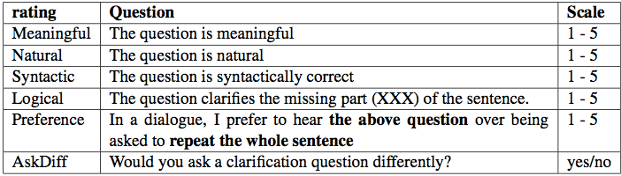
Evaluation Questionnaire
2 Experimental conditions:
COMPUTER: Generated questions automatically using the rules for a set of 84 sentences
HUMAN: Asked humans (mturk) to create a clarification questions for the same sentences

Slide 21
Experiment
Two groups of participants
  Mturk experiment
  Recruited 6 participants from the lab
Each participant scored 84 clarification questions (CQ)
Each CQ was scored by 3 participants from each group

Slide 22
Survey Results
*
*

Slide 23
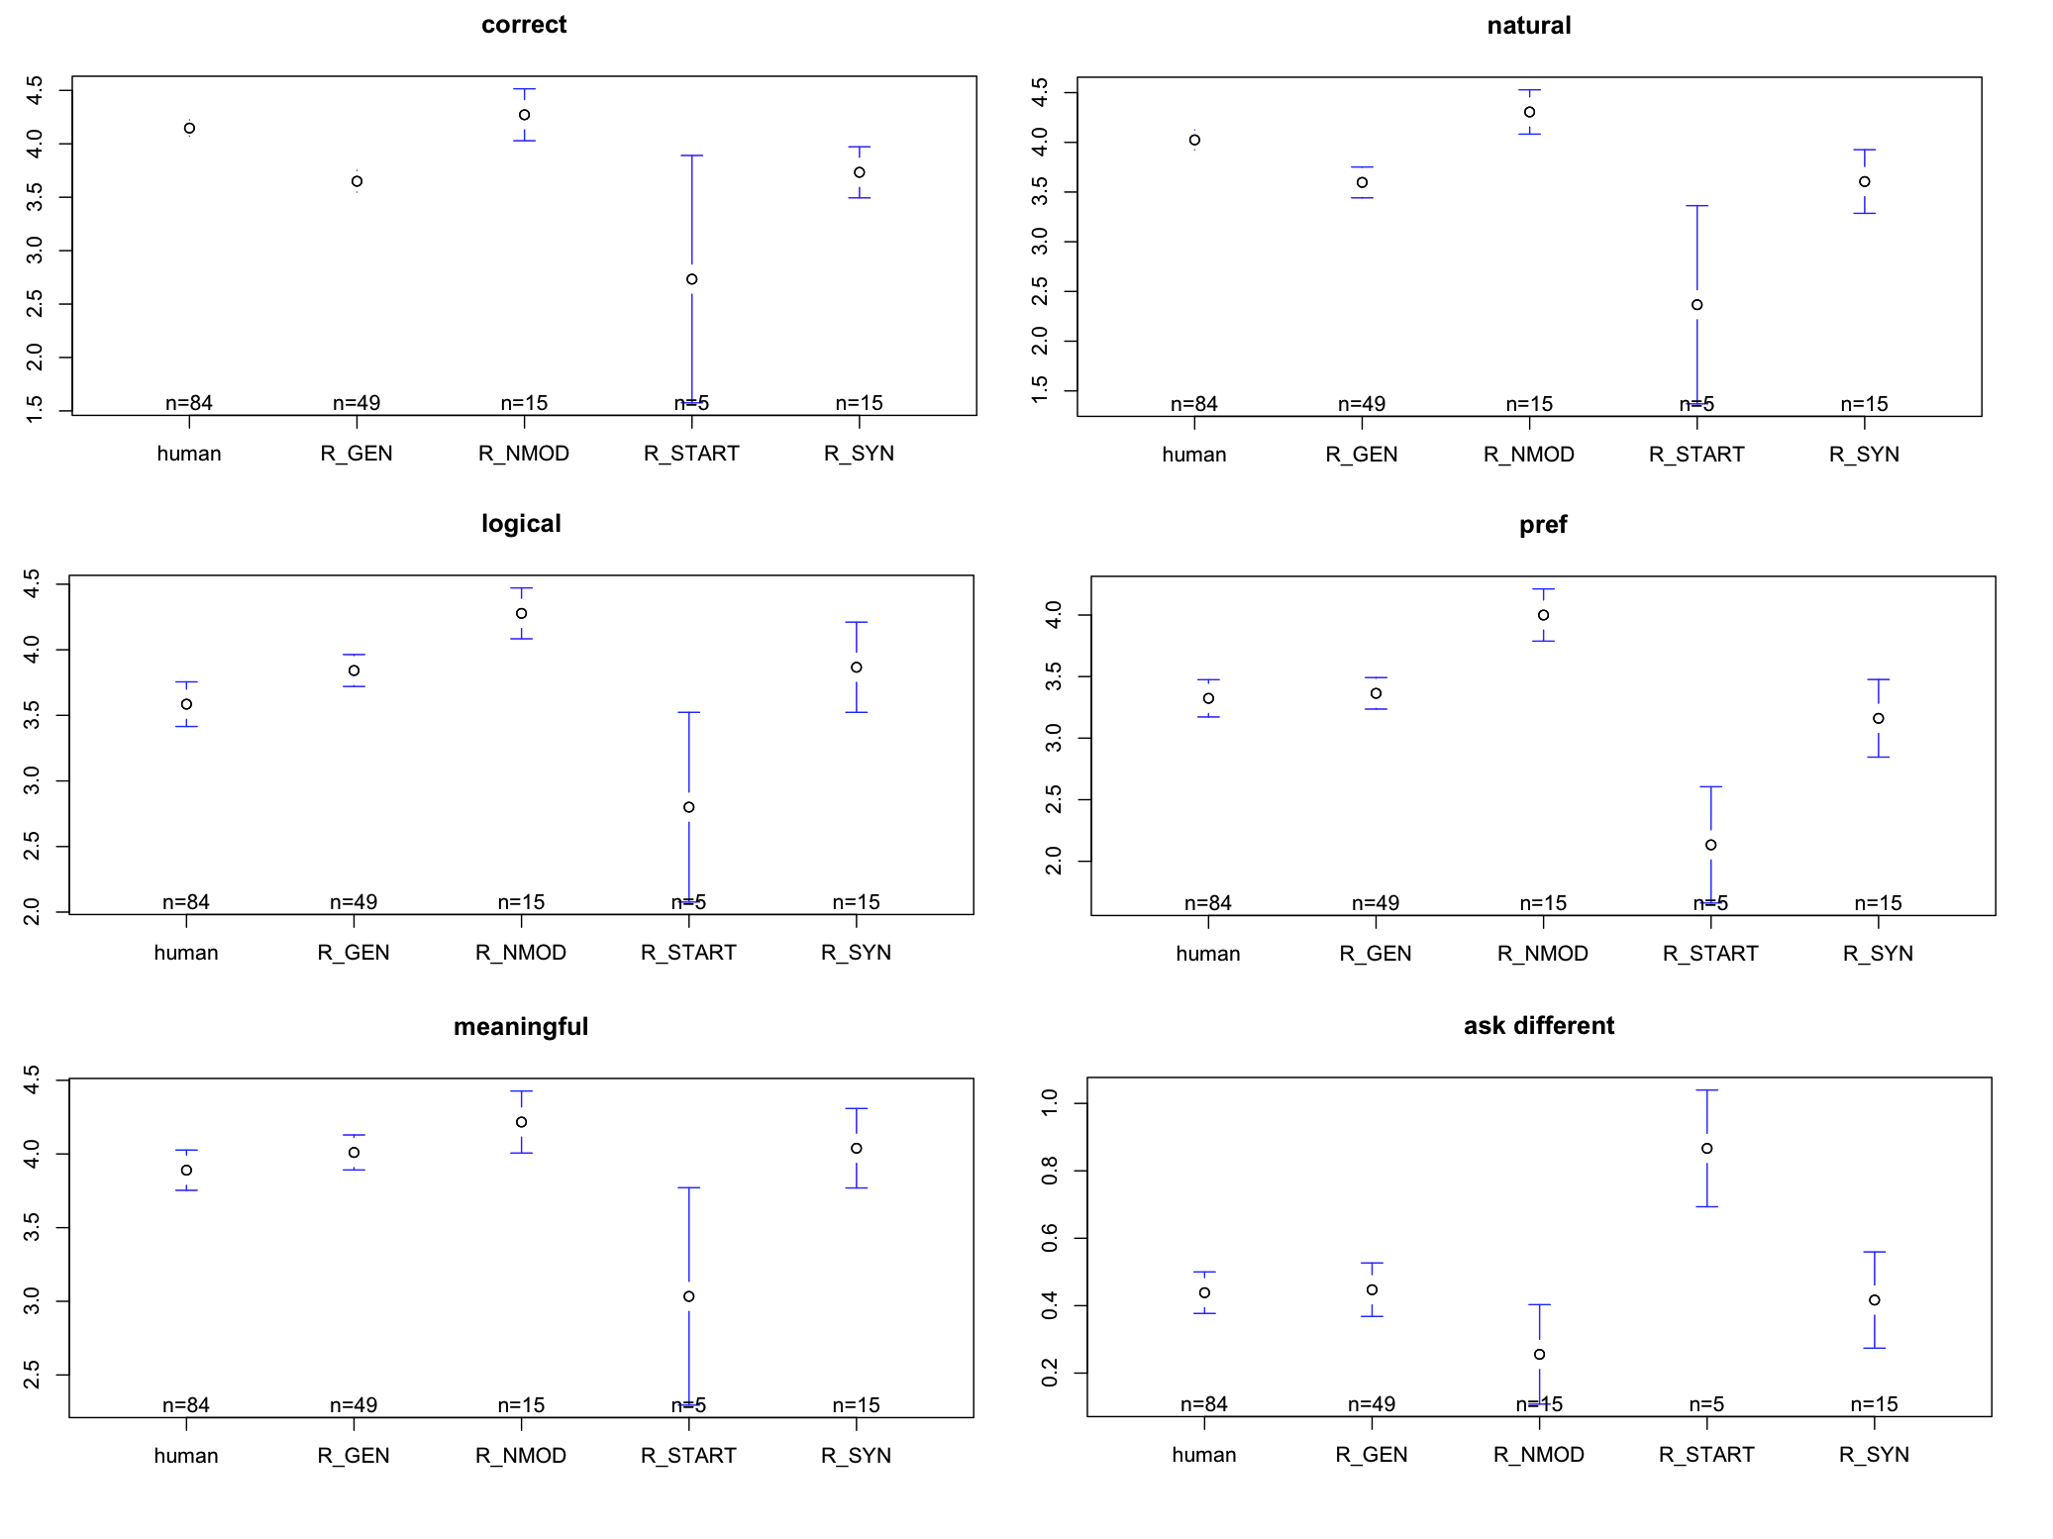
Results

Slide 24
Discussion
R_WH and R_VB performance is comparable to human-generated questions
R_NMOD (which …?) outperforms all other question types including human-generated questions
R_START rule did not work

Slide 25
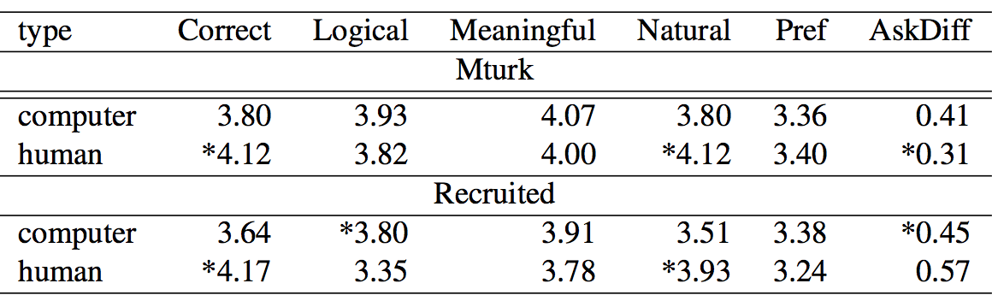
Comparing Mturk and Recruited Subjects

Slide 26
Recruited Subjects
Disliked more human-generated questions than computer-generated questions.
Examples of answers to the survey question “How would you ask this clarification question differently?”
  The set up is obviously XXX by a professional
    Human-Gen: what type of set up is this?
    Recruited-subjects chose to change this to:
      The set up is WHAT by a professional?
      The set up is obviously WHAT by a professional?
      it’s obviously WHAT?

Slide 27
Mturk Subjects
Disliked more computer-generated questions than human-generated questions.
Examples of answers to the survey question “How would you ask this clarification question differently?”
  Do your XXX have suspicious contacts
    Human-Gen: what type of set up is this?
    Recruited-subjects chose to change this to:
      My WHAT?
      What was suspicious contacts?
      Who?

Slide 28
Discussion
Desirable properties of clarification questions
  Conciseness
  Specificity
Goal of a generator is to maximize conciseness and specificity
  Future work: identify properties of an optimal clarification question from the data
    Classify syntactic constituents whether they should be present in question

Slide 29
Summary
Presented a set of simple transformation rules for creating targeted clarification questions
  Simplicity of the rules makes the method more robust to incorrect error segment detection
Evaluation with human subjects shows that subjects score generated questions comparably to human-generated questions
The user preference is subjective and may differ across subject groups

Slide 30
Related Work
30
A system's clarification question may not be appropriate because
  An error segment may not be detected correctly
  An error type is not identified correctly
Automatically detect user responses to “inappropriate” clarification questions
Notes:
30

Slide 31
Thank you
31
Questions?
Notes:
31

Slide 32
Requirement for a Targeted Question
Constructing an appropriate question requires correct error detection
  Error segment boundaries
  Error type
    Does the error contain a proper name?
    Does the error contain an out-of-vocabulary (OOV) word?

