Slide 1
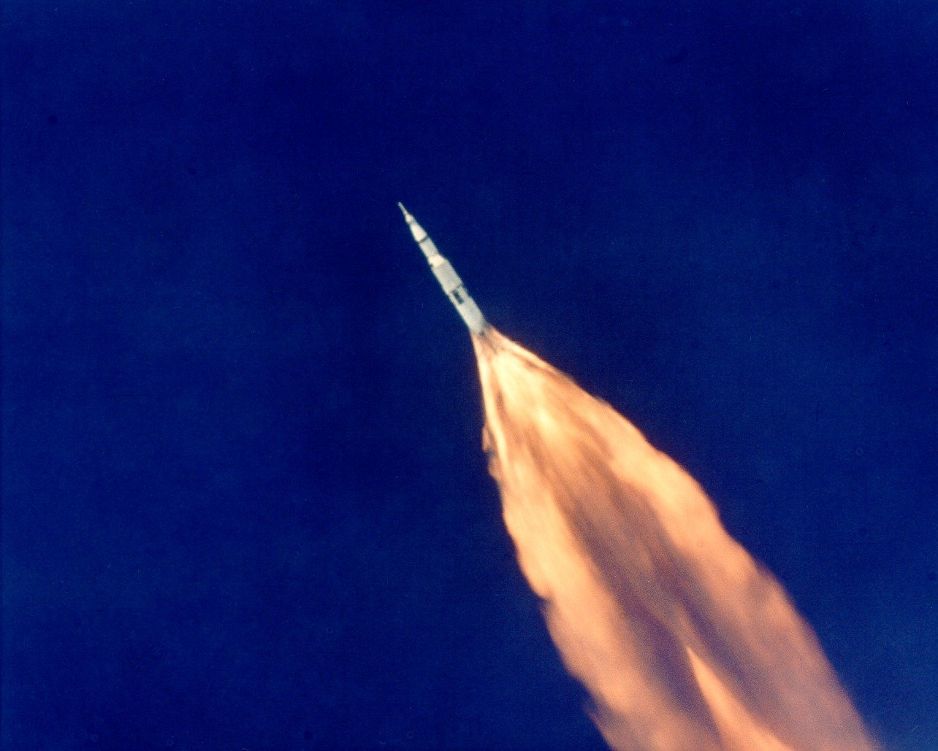
Biomedical Engineering and Informatics Applications in
Critical Care
J. Michael Schmidt, PhD, MSc
Assistant Professor of Neuropsychology in Neurology
Informatics Director, Neurocritical Care
Columbia University Medical Center

Slide 2
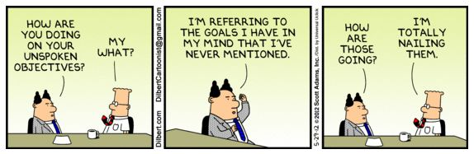
Presentation Outline
What is Clinical Informatics
An Overview of the Current Reality in Critical Care
How Did We Get Here
This is Inadequate – A Deeper Dive into the Data
Where Do We Go From Here – Building Towards Enhanced Situational Awareness
What Difference Does it Make
Extra Slides

Slide 3
Biomedical Informatics in Perspective
Basic Research
Biomedical Informatics Methods, Techniques, and Theories
Biomedical Informatics ≠ Bioinformatics
Bioinformatics
Imaging Informatics
Clinical
Informatics
Public Health Informatics
Applied Research
And Practice
© AMIA 2011

Slide 4
Biomedical Informatics in Perspective
Basic Research
Biomedical Informatics Methods, Techniques, and Theories
Biomedical Informatics ≠ Health Informatics
Health Informatics
Bioinformatics
Imaging Informatics
Clinical Informatics
Public Health Informatics
Applied Research
And Practice
Molecular and
Cellular
Processes
Tissues and
Organs
Individuals
(Patients)
Populations
And Society
© AMIA 2011

Slide 5
Biomedical Informatics in Perspective
Biomedical Informatics Methods, Techniques, and Theories
Clinical Informatics
Deals with biomedical information, data and knowledge storage, retrieval, and optimal use for problem solving and decision making
…as applied to problems in clinical care.
Basic Research
Biomedical Informatics ≠ Health Informatics
Health Informatics
Bioinformatics
Imaging Informatics
Clinical Informatics
Public Health Informatics
Applied Research
And Practice
Molecular and
Cellular
Processes
Tissues and
Organs
Individuals
(Patients)
Populations
And Society
© AMIA 2011

Slide 6
Interdisciplinary Nature of Biomedical Informatics
Computer Science (hardware)
Computer Science (software)
Cognitive Science
& Decision Making
Bioengineering
Biomedical
Informatics
Management
Sciences
Epidemiology
And Statistics
Clinical
Sciences
Basic Biomedical
Sciences

Slide 7


Slide 8


Slide 9
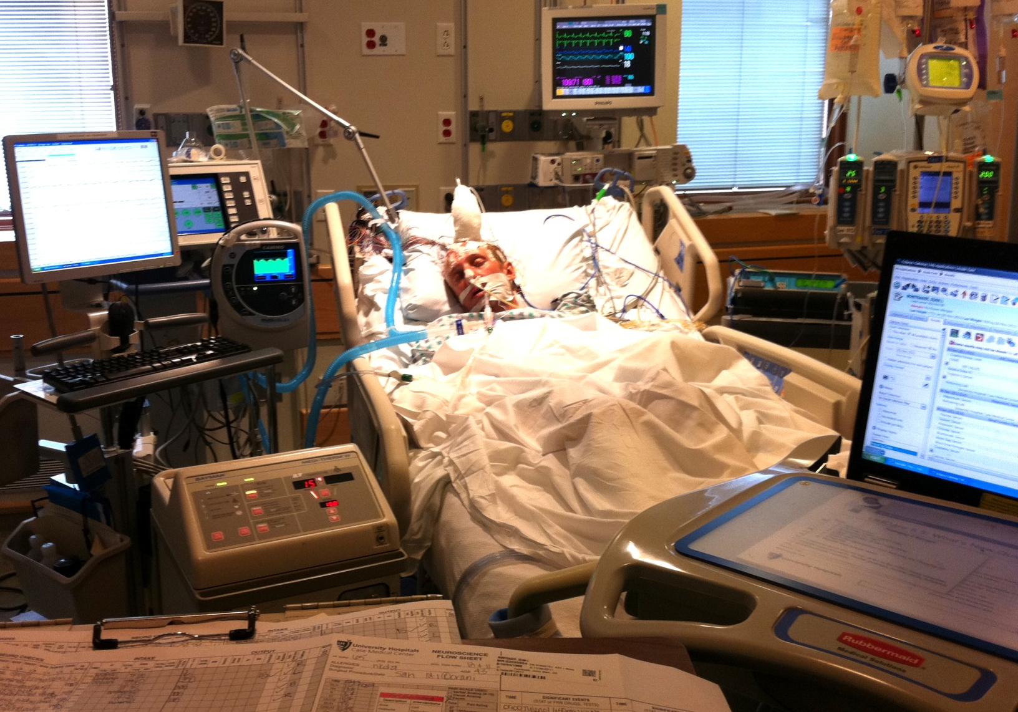
More than 5 million Americans with life-threatening conditions are admitted to Intensive Care Units each year. Critical care saves lives but it is complex, error prone, and very expensive.

Slide 10
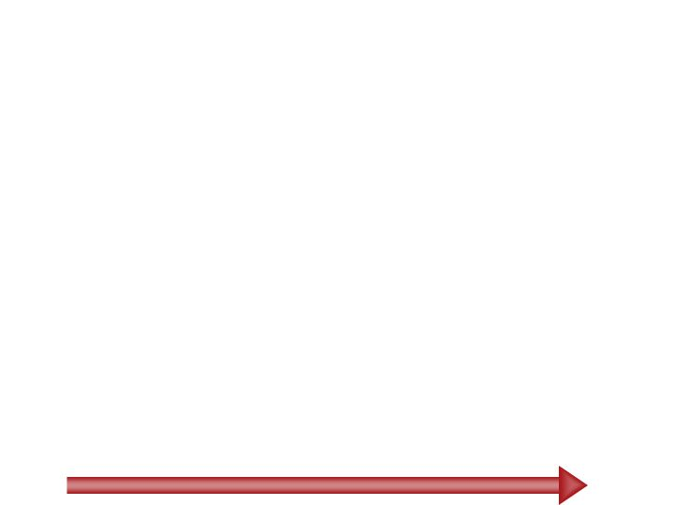
Critical Care is One of the Most Expensive Components of Health Care
17% to 39% of hospital dollars are spent in the ICU
Average of $11,000 per mechanically ventilated patient day
Annual cost estimate of $263 billion (1-2% of GDP)
$65 billion dollars of Medicare’s costs
80
77.2
Costs are rising because of the aging U.S. population.
Drivers of ICU Demand
Elderly Patients
US Population >65, Millions
70.3
60
53.7
39.7
40
31.2
34.8
25.5
20.1
20
16.6
Future Needs of Critical Care Medicine 1998
1960
1970
1980
1990
2000
2010
2020
2030
2040
Coopersmith et al., Crit Care Med 2012; 40:1072-1079
Halpern et al. Crit Care Med 2010;38:65-71
Milbrandt et al. Crit Care Med 2008;36:2504-2510
Notes:
2010 Medicare budget = $504 billion.
27% is inpatient care = $136 billion
50% of that is ICU = $68 billion

Slide 11
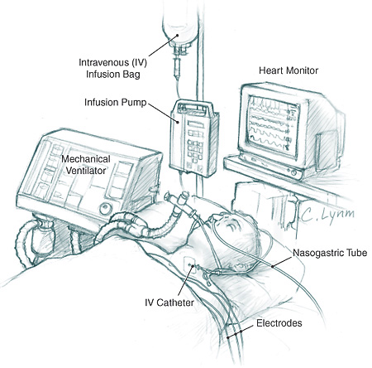
Processing limited conceptually
Pharmacy
Clinicians may be confronted with 200 time-related variables, yet human beings can only determine the relationship between two variables unassisted.
Blood bank
Intracranial Pressure
Cerebral Perfusion Pressure
Brain Tissue Oxygenation
Intracerebral Microdialysis
Cerebral Blood Flow
Cerebral Blood Flow
EEG
Cardiopulmonary
Laboratory Data
Imaging
We think univariate in a multivariate world
Medical Record

Slide 12
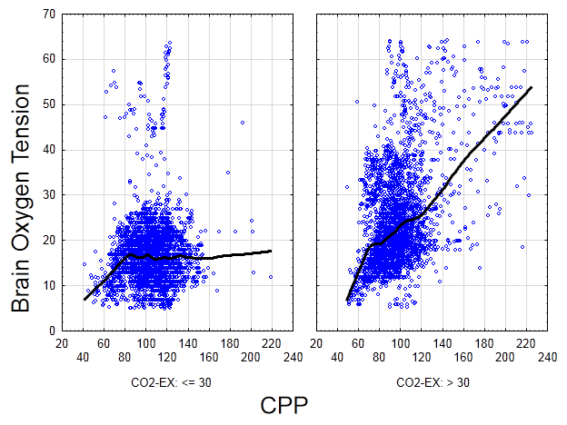
High Dimensional Nonlinear Data
Notes:
Other metrics that are likely impacting this plot:
CPP is composed of MAP and ICP, FiO2, cardiac output, MAP, ICP,

Slide 13
Processing limited conceptually
Pharmacy
Conceptually, analysis has been restricted to
linear and univariate statistical models. Alarm limits are based on arbitrary thresholds without regard for dynamic interactions between variables.
Blood bank
Intracranial Pressure
Cerebral Perfusion Pressure
Electronic Order Set
Notify physician:
HR < 60 or > 125 bpm
SBP < 90 or > 180 mm Hg
Respirations < 10 or > 30 per minute
Pulse oximetry < 90% SaO₂
Temperature < 35.0 or >38.8° Celsius
Urine Output < 50 mL per hour
Blood Glucose < 60 or > 130 mg/dL
Cardiac Index < 2 L/min/m²
Brain Tissue Oxygenation
Intracerebral Microdialysis
Cerebral Blood Flow
Cerebral Blood Flow
EEG
Laboratory Data
Imaging
Medical Record
Notes:
in the absence of any understanding of what is happening we are relegated to very simple interventions based only the most extreme limits of organ system

Slide 14
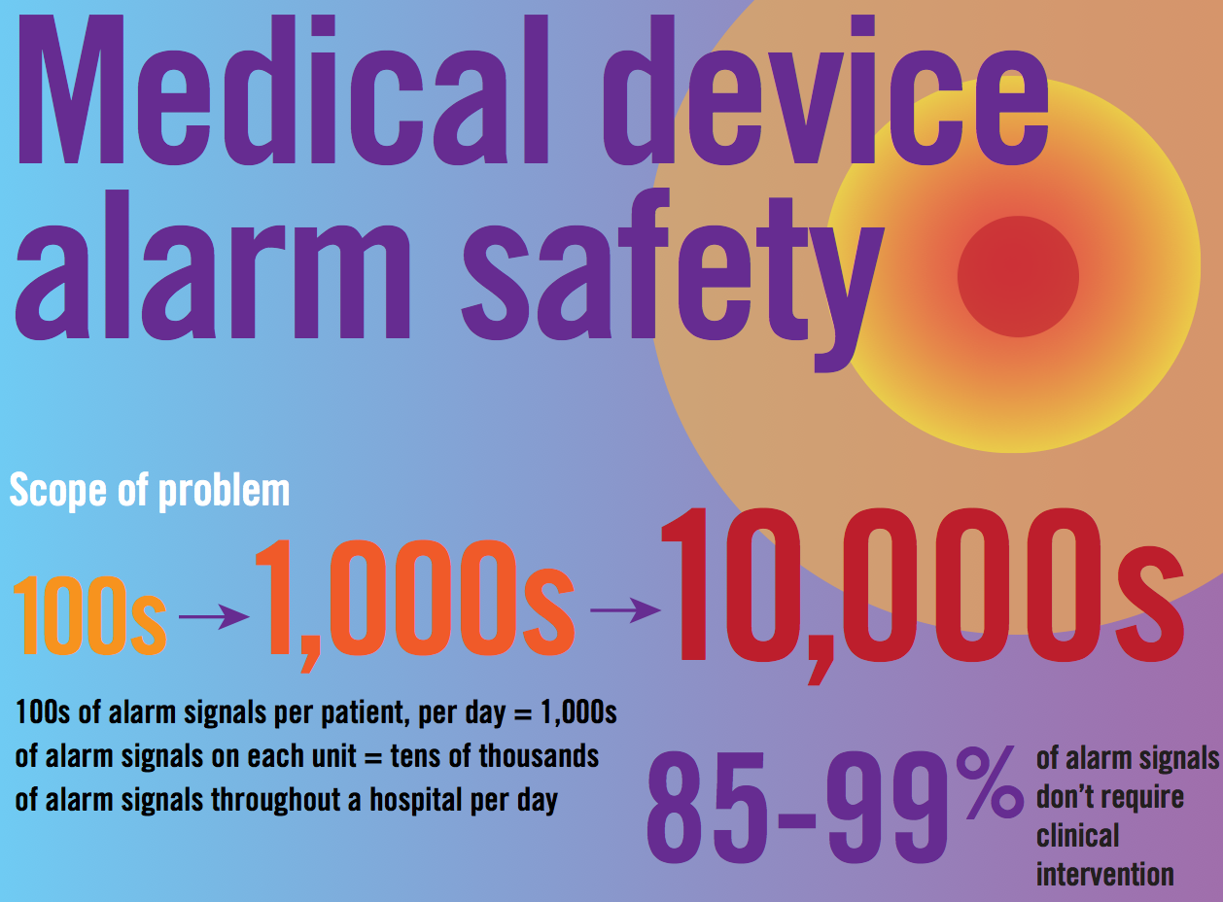

Slide 15
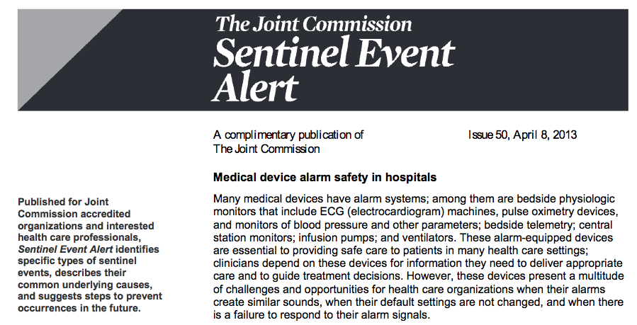

Slide 16

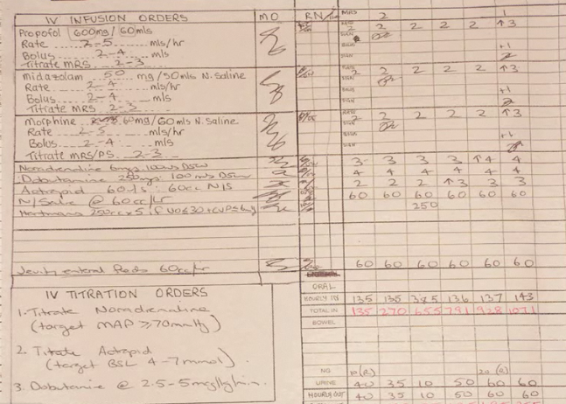
Focus on Electronic Health Record Adoption

Slide 17
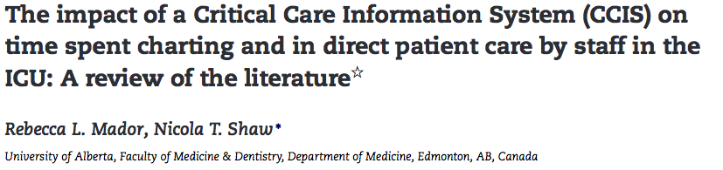
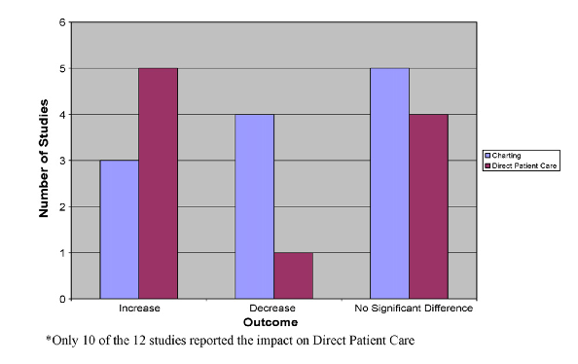
A recent review found that 8 out of 12 studies report that instituting a clinical information system did not significantly reduce patient charting times and in many cases actually increased it.

Slide 18
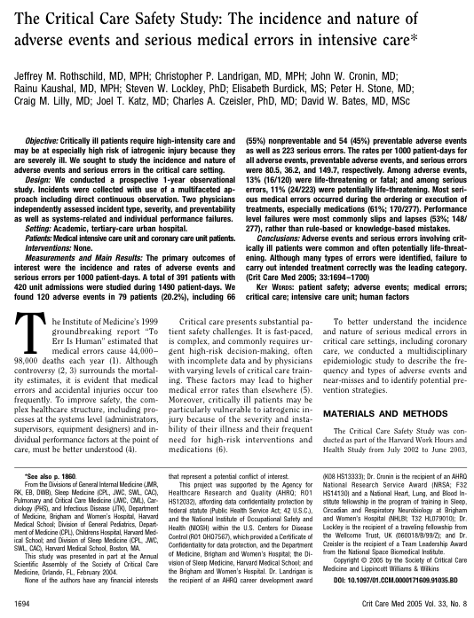
Critical Care is Error Prone
Clinical Activity | % of Errors*
Treatment and Procedure Errors | 74.8
Medication error | 61.4
Failure to follow protocol | 7.9
Prevention and Diagnostic Errors | 24.2
Failure to follow protocol | 10.8
Avoidable delays in diagnosis | 4.7
Monitoring and Reporting Errors | 19.9
Inadequate reporting / communication | 13.7
Inadequate monitoring system | 6.1
*More than one factor may be associated with a serious medical error, with the total exceeding 100%
“Critical care settings provide life-saving care for the sickest patients but are also associated with significant risks for adverse events and serious errors. It will be especially important to ‘engineer out’ slips and lapses, to improve the likelihood that treatment in the ICUs is implemented as intended.”
Rothschild JM et al. Crit Care Med 2005;33:1694
Notes:
a prospective 1-year observational study. Incidents were collected with use of a multifaceted approach including direct continuous observation. The primary outcomes were the incidence and rates of adverse events and serious errors per 1000 patient-days. A total of 391 patients with 420 unit admissions were studied during 1490 patient-days. We found 120 adverse events in 79 patients (20.2%), including 66 (55%) nonpreventable and 54 (45%) preventable adverse events.

Slide 19
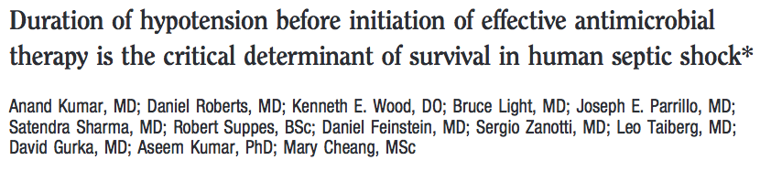
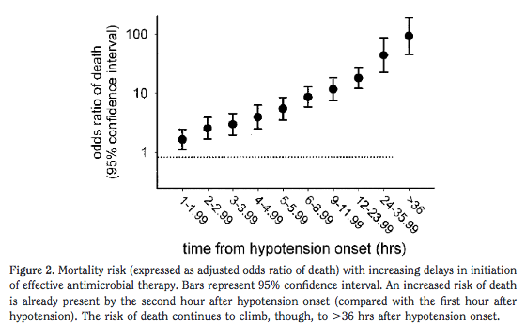
Each hour delay in antibiotic administration to septic patients
result in a 7.6% increased mortality risk.

Slide 20



Slide 21
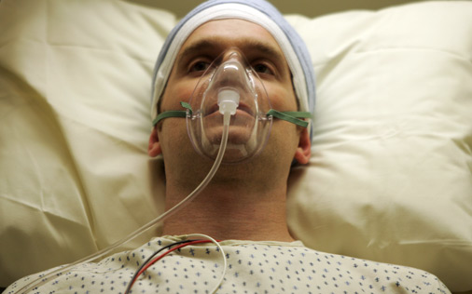
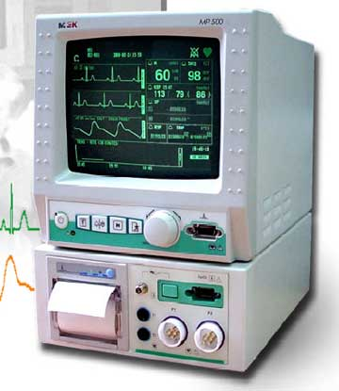
Reactive Medicine: Phases of Monitoring
Phase 1: Clinical neuromonitoring
1960-1980
React to clinical events paired with clinical treatment protocol followed blindly.

Slide 22
Clinical examination
Backbone of neurological diagnosis and crucial in the acute brain injury assessment but clear limitations
Good Kappa btw different MDs, RNs vs. MDs,
Validated in Neuro ICU, ER, MICU
Prognosticates mortality and functional outcome in mixed ICU populations
Purpose: facilitate rapid communication between first responders and specialized brain injury units to triage TBI patients
Problems:
Recording the best responses only
Developed on TBI patients only
Variability between experienced vs. inexperienced users Rowley Lancet 1991
Variable predictive accuracy for outcome Balestreri JNNP 2004

Slide 23
Sternal Rub

Slide 24
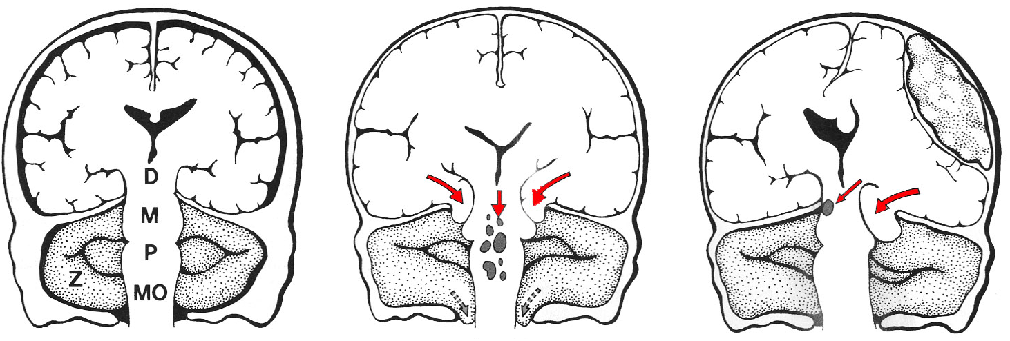
Intracranial Mass Effect

Slide 25
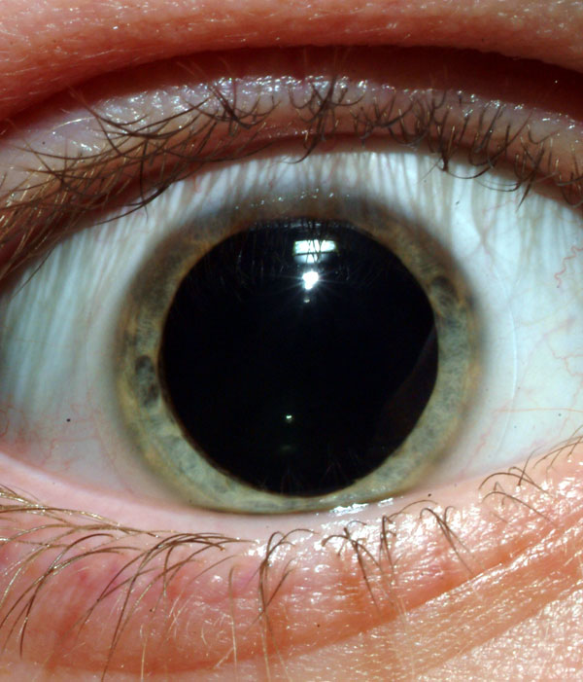

Slide 26


Slide 27
Reactive Medicine: Phases of Neuromonitoring
Phase 1: Clinical neuromonitoring
1960-1980
React to clinical events
Phase 2: Physiological neuromonitoring
1980-2000
React to pathophysiological events

Slide 28

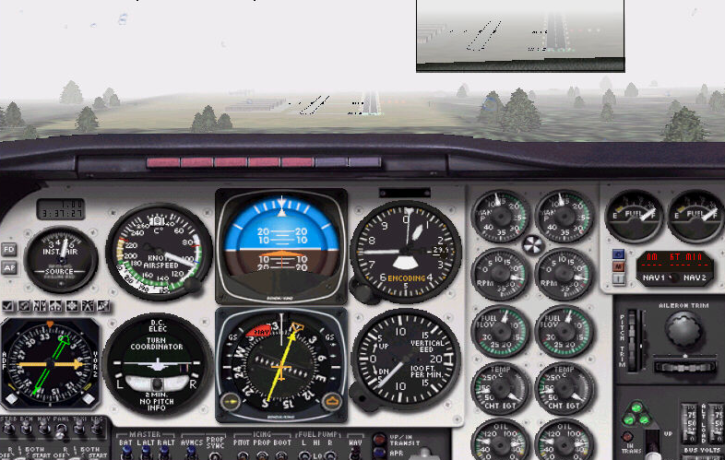
Stable patient - fly by sight

Slide 29
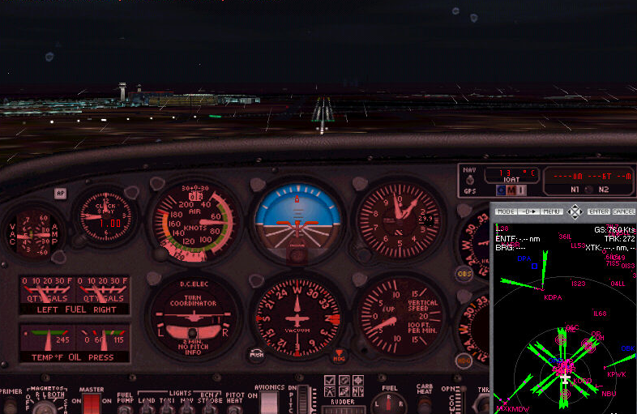
Critically ill patient - fly by gauges

Slide 30
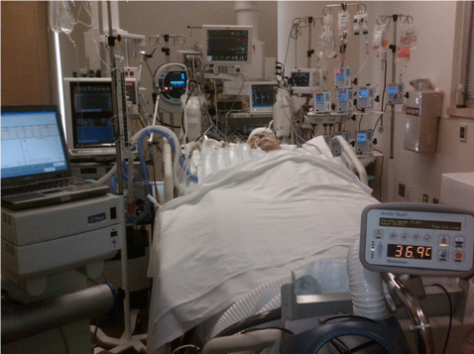
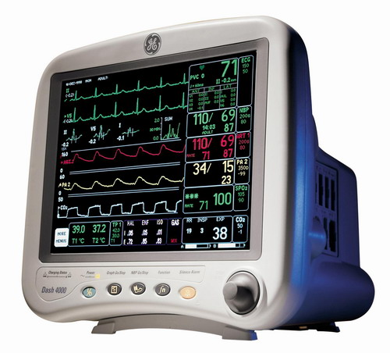
Reactive Medicine: Physiologic Neuromonitoring

Slide 31


Monitoring in the ICU
CV: ECG, MAP, CVP, PAD, CO, Echo, troponin
Pulmonary: O₂ sat, ABGs, CXR
ID: Cultures, WBC, Temperature
Renal: Fluid balance, lytes
Nutrition: REE, VO2, Nitrogen balance
Heme: CBC, coagulation cascade
Neuro: Exam, ICP, EEG, neuroimaging

Slide 32
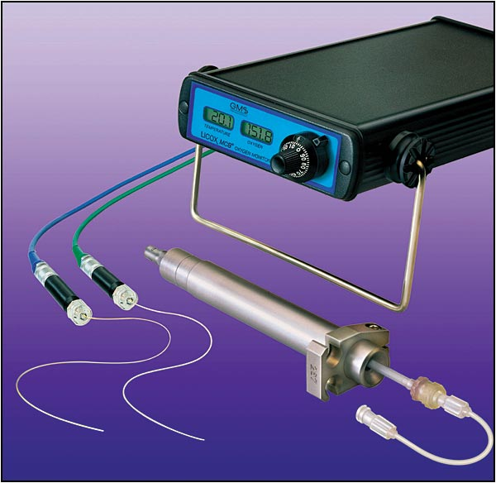
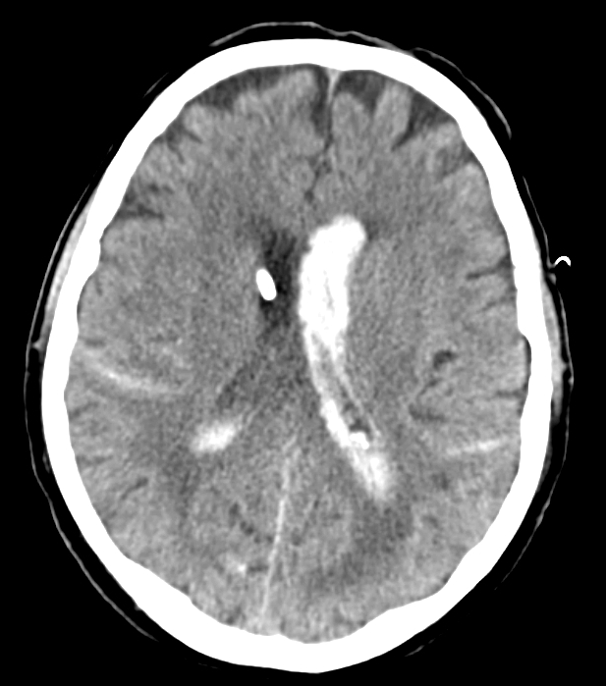
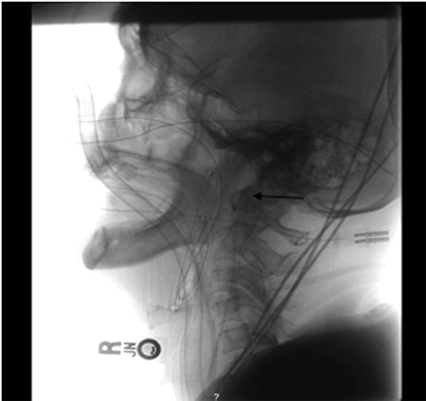
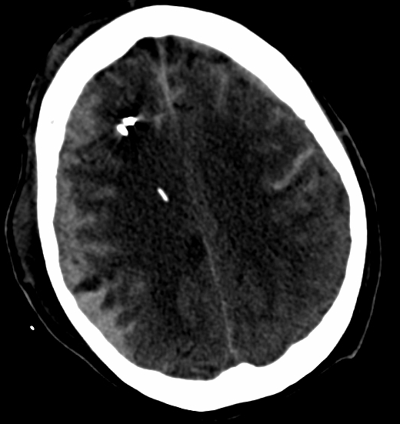
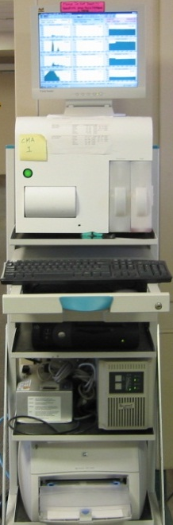
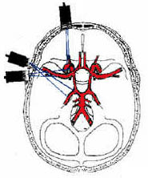
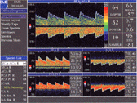
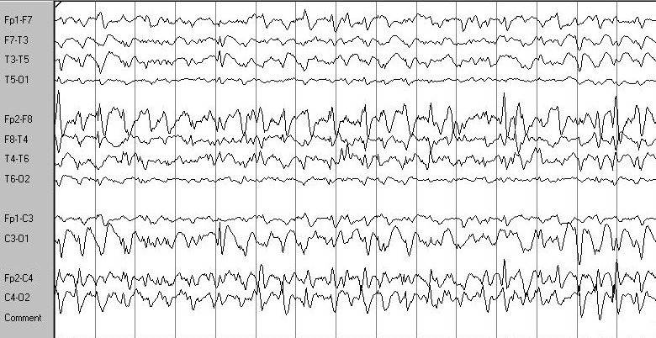
Invasive neuromonitoring: What’s the Rationale?
CBF
pbtO_{2,} pbCO₂, pH,
brain temp
Microdialysis
ICP/CPP
SjvO₂
cEEG
TCD

Slide 33
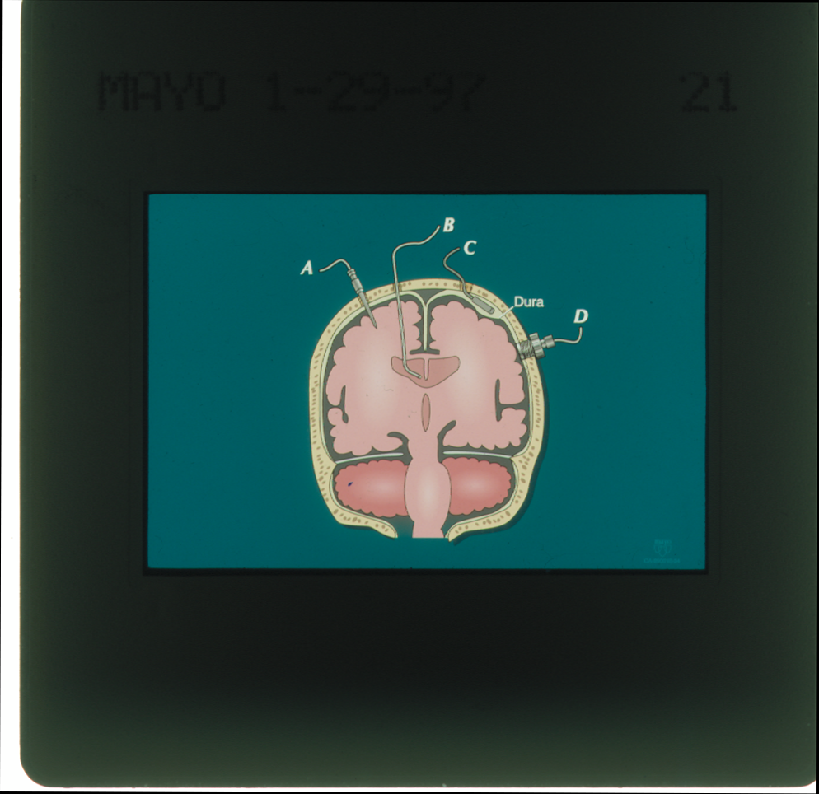
Ventricular catheter
Epidural Monitor
Parenchymal Micosensor
Richmond Bolt

Slide 34
ICP
MANNITOL
40g
20g
20g
CPP

Slide 35
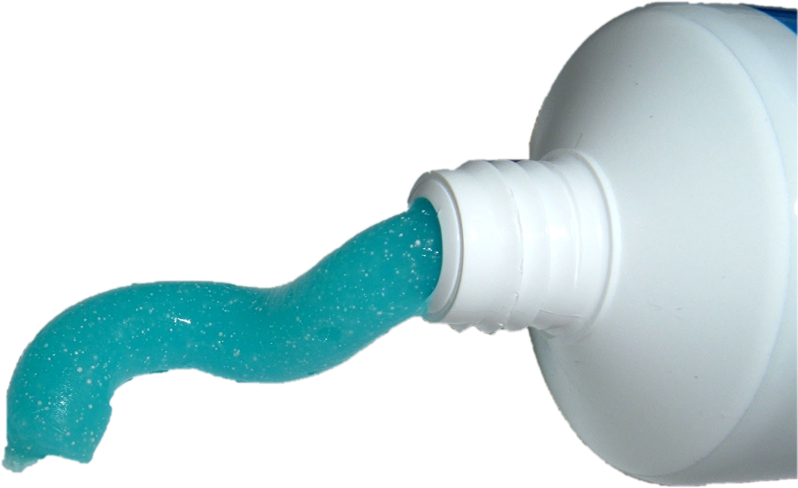

Slide 36
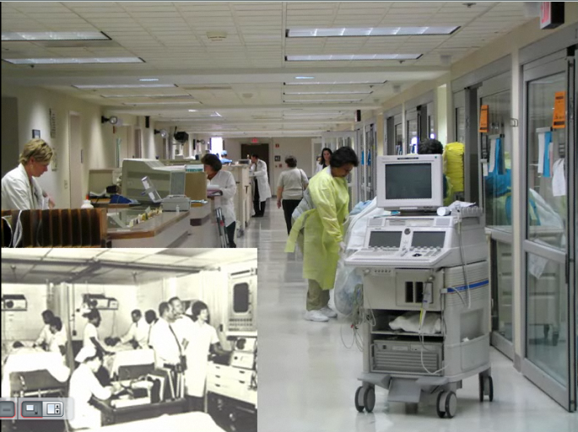

Slide 37


Slide 38
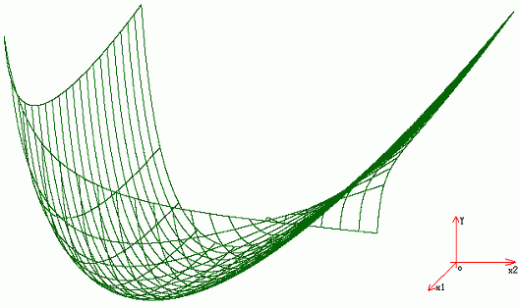
Relationships are not linear
Notes:
Methods of linear analysis are not able to elucidate physiology

Slide 39
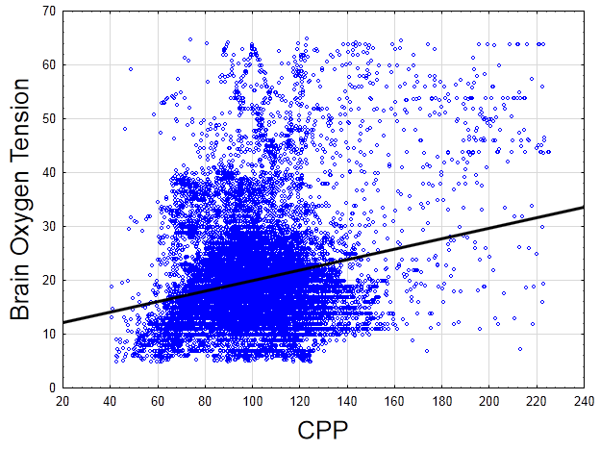

Slide 40
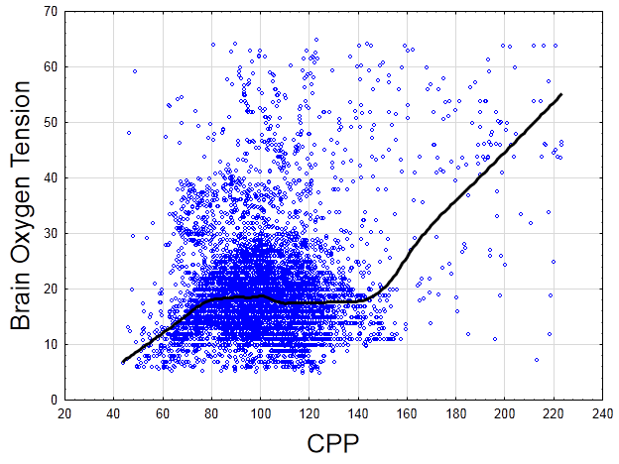

Slide 41
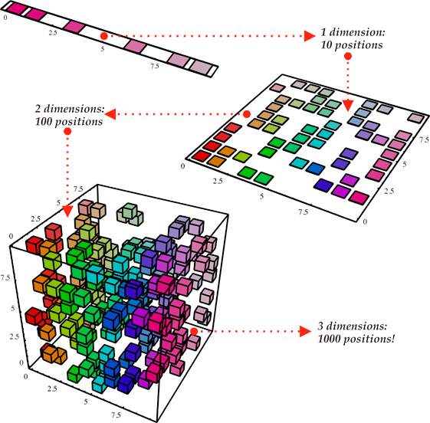
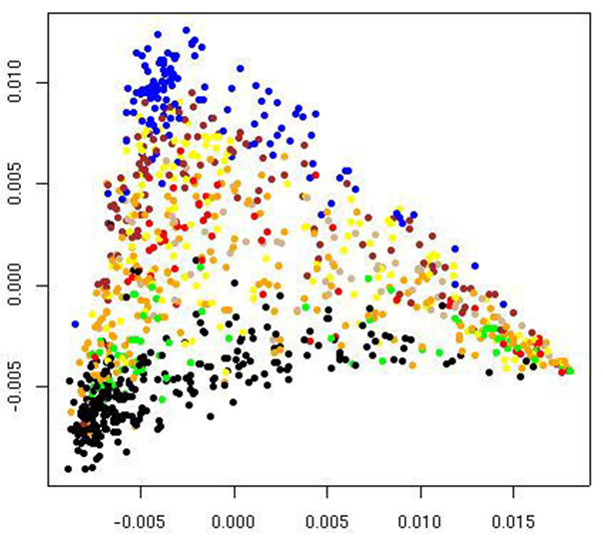
High Dimensionality in Physiology
Notes:
Physiology is not limited by our inability to understand multiple dimensions
As the number of dimensions increases the number of possible dimensions increases factorially.

Slide 42
Notes:
Other metrics that are likely impacting this plot:
CPP is composed of MAP and ICP, FiO2, cardiac output, MAP, ICP,

Slide 43
Critical Care Medicine
OFFICIAL JOURNAL OF THE SOCIETY OF CRITICAL CARE MEDICINE
Volume 24 (7) July 1996 pp 1107-1116
Uncoupling of biologic oscillators: A complimentary hypothesis concerning the pathogenesis of multiple organ dysfunction syndrome
Godin, Paul J. MD; Buchman, Timothy G., PhD, MD, FCCM
Multiple organ dysfunction syndrome
May represent disruption of ‘initial conditions’ resulting in ‘uncoupling’ of organ systems.
Eliminating the infection is necessary but not sufficient to restore coupling.
Healthy organs behave as biologic oscillators, coupled
and maintained by a communications network that
includes neural, humoral and cytokine components
Heart rate variability is a reflection of the degree of
coupling between organ systems

Slide 44
Complex Systems Analysis
Information about variability more important than information of a single value, or trend of values
Heart
CNS
Information about interactions between systems may be more important than variability within a system
Immune
Information about the emergent order of the entire system may be even more important than individual interactions and may provide a more accurate model of physiology
Coupling

Slide 45
Conventional Linear Statistics
80
60
Heart Rate (bpm)
40
20
0
Patient A
Patient B
Goldberger Proc Am Thor Soc 2006;3:467-472

Slide 46
Visual Inspection of Raw Time Series
100
Patient A: Healthy
Mean = 64.98 SD = 4.79
90
80
Heart Rate (bpm)
70
60
50
0
5
10
15
Time (minutes)
100
Patient B: Obstructive Sleep Apnea
Mean = 64.95 SD = 4.68
90
80
Heart Rate (bpm)
70
60
50
0
5
10
15
Time (minutes)
Goldberger Proc Am Thor Soc 2006;3:467-472

Slide 47
Approximate Entropy
1.0
0.8
0.6
ApEn minimum
0.4
Nonsurvivors had lower ApEn (greater periodicity in their signals)
compared to survivors.
Less critically ill patients (SOFA < 7) had higher variance and ApEn (more variable, less periodic signals).
Loss of variability and increase in periodicity in heart rate of critically ill patients are linked with parallel deterioration of organ dysfunction and high mortality.
0.2
0.0
survivors
non-survivors
Mortality
1.6
1.4
1.2
1.0
ApEn mean
0.8
0.6
0.4
0.2
0.0
2
3
4
5
6
7
8
9
10
11
12
13
15
SOFA score
Papaioannou et al. Journal of Critical Care 2006;21: 95– 104

Slide 48
Detrended Fluctuation Analysis
8
Young patient
6
IBI (sec)
4
2
0
0
200
400
600
800
1000
8
Elderly patient
6
IBI (sec)
4
2
0
0
200
400
600
800
1000
Breathing cycle
Goldberger Proc Am Thor Soc 2006;3:467-472

Slide 49
Detrended Fluctuation Analysis
Detrended Fluctuation Analysis
8
Young patient
Young patient
6
10
Elderly patient
IBI (sec)
4
2
0
α = 0.69
0
200
400
600
800
1000
Fluctuation
8
Elderly patient
α = 0.58
6
1
IBI (sec)
4
2
0
0
200
400
600
800
1000
10
100
Breathing cycle
Time Scale (breathing cycle)
Goldberger Proc Am Thor Soc 2006;3:467-472

Slide 50
Notes:
Multivariate physiologic and ventilator data
Surgical ICU

Slide 51
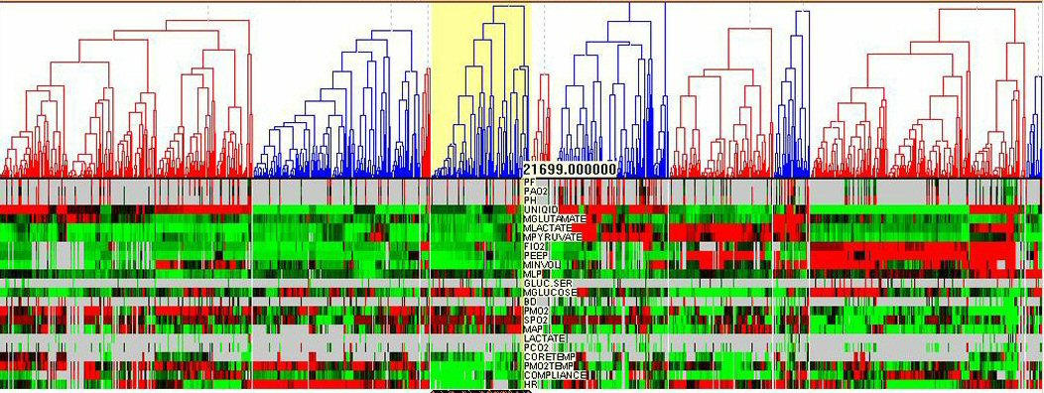
Hierarchical Cluster Analysis
State 1
State 2
State 3
State 4
States 5,6
State 7
Development of “Patient States” based on complex multivariate relationships of changing physiology not otherwise discernable to clinician.
Courtesy of J. Claude Hemphill, MD
Notes:
Able to identify different clusters composed of different relationship structures among the data
Presented these states to intensivits who were not able to give each cluster an obvious clinical diagnosis
Therefore found relationships not discernable to clinician

Slide 52
0.2
0.18
0.16
0.14
0.12
Probability of Death
0.1
0.08
0.06
0.04
0.02
1
2
3
4
5
6
7
8
9
10
Cluster Group
Notes:
These clusters were clinically meaningful

Slide 53
6 16 1 8
Probability of death = 0.13
4 6 1
Probability of death = 0.025
Notes:
Also able to display which cluster specific patients were in over time

Slide 54


Slide 55
Processing limited conceptually
Pharmacy
Clinicians may be confronted with 200 related variables, yet human beings can only determine the relationship between two variables unassisted.
Blood bank
Intracranial Pressure
Cerebral Perfusion Pressure
Brain Tissue Oxygenation
Intracerebral Microdialysis
Cerebral Blood Flow
Cerebral Blood Flow
EEG
Laboratory Data
Imaging
We think univariate in a multivariate world
Medical Record
Multiple Slides Courtesy of Michael De Georgia, MD

Slide 56
None of this data is processed
Pharmacy
Some monitors display raw trends but even basic analyses (mean, median, standard deviations) are nearly impossible to perform.
Standard biostatistical methods are not sufficient.
Blood bank
Intracranial Pressure
Cerebral Perfusion Pressure
Brain Tissue Oxygenation
Intracerebral Microdialysis
Cerebral Blood Flow
Cerebral Blood Flow
EEG
Laboratory Data
Imaging
Medical Record
Notes:
Currently state of the ICU.
Properties data that can not be adequately handled by biostatistical methods.
Biostatistics we are familiar with are not going to be sufficient to provide true situational awareness

Slide 57

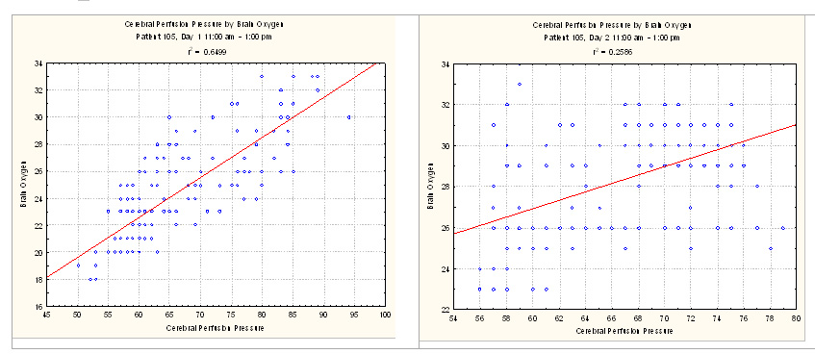

Slide 58


Slide 59
Processing limited conceptually
Pharmacy
Conceptually, analysis has been restricted to
linear and univariate statistical models. Alarm limits are based on arbitrary thresholds without regard for dynamic interactions between variables.
Blood bank
Intracranial Pressure
Cerebral Perfusion Pressure
Electronic Order Set
Notify physician:
HR < 60 or > 125 bpm
SBP < 90 or > 180 mm Hg
Respirations < 10 or > 30 per minute
Pulse oximetry < 90% SaO₂
Temperature < 35.0 or >38.8° Celsius
Urine Output < 50 mL per hour
Blood Glucose < 60 or > 130 mg/dL
Cardiac Index < 2 L/min/m²
Brain Tissue Oxygenation
Intracerebral Microdialysis
Cerebral Blood Flow
Cerebral Blood Flow
EEG
Laboratory Data
Imaging
Medical Record
Notes:
in the absence of any understanding of what is happening we are relegated to very simple interventions based only the most extreme limits of organ system

Slide 61
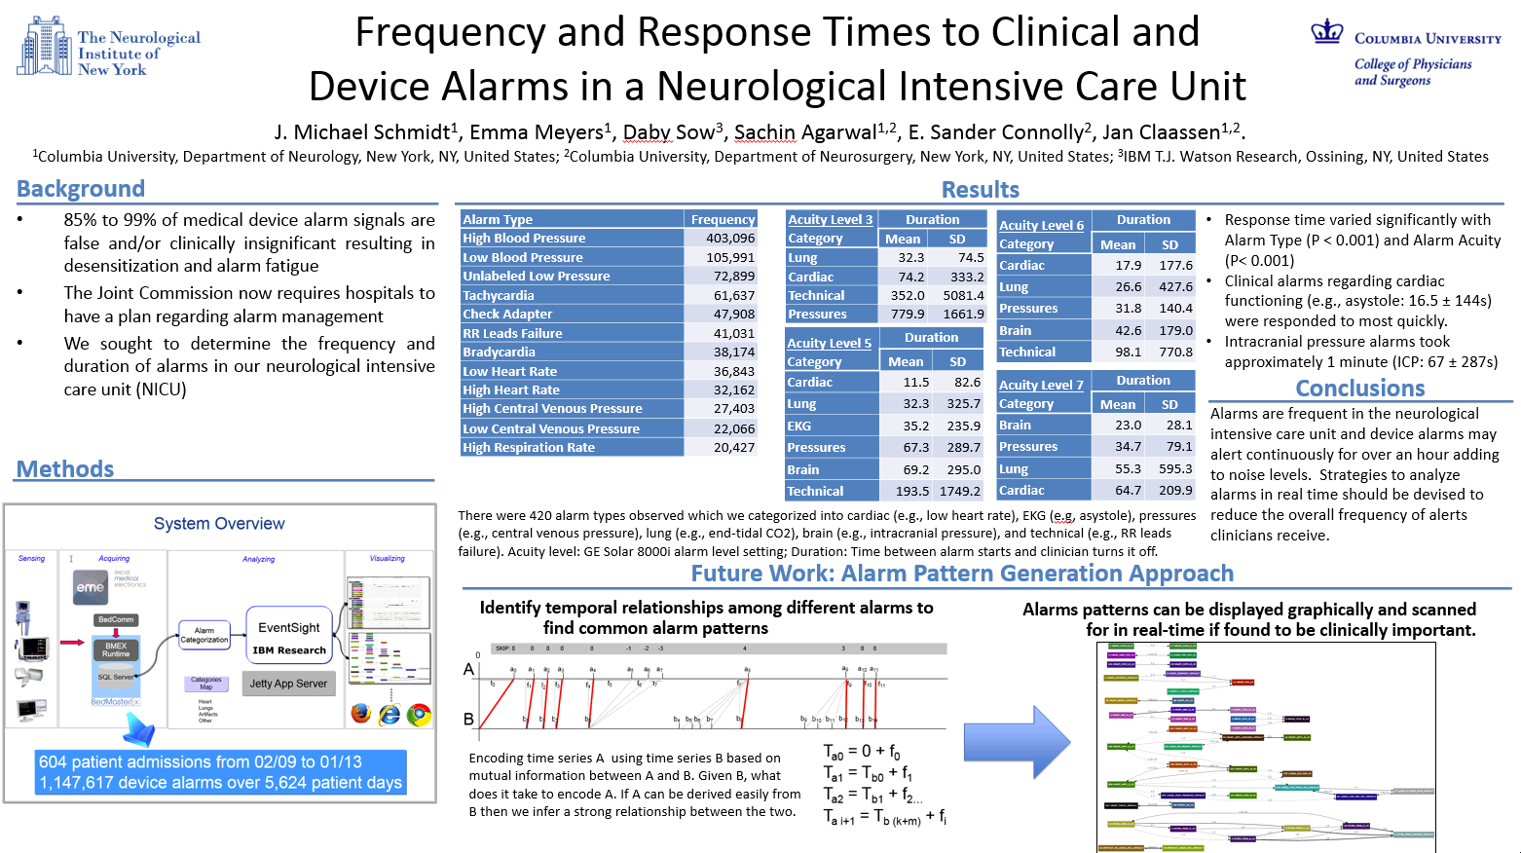
604 patients generated 1,147,617 medical device alarms over 6,624 patient days,
not including ventilator and infusion pump alarms.

Slide 62
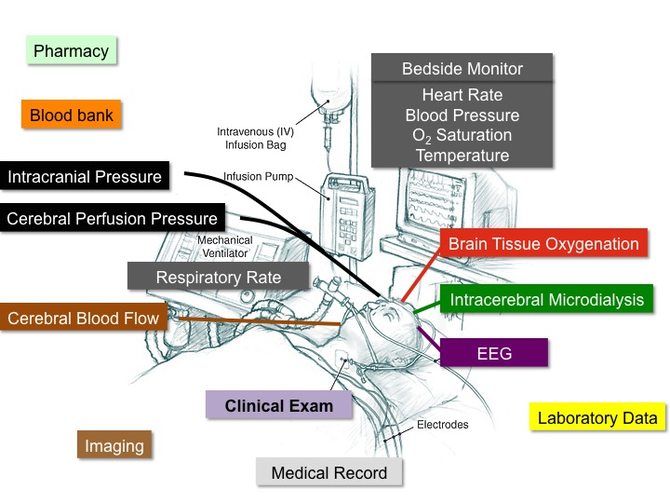
Too Much Data. Not Enough Information.
Data Overload. There are staggering amounts of data, beyond the capability of any person to absorb, integrate and act upon reliably.
Lack of Integration. Device interoperability is limited.
Lack of Processing. Basic statistical analyses are elusive. More sophisticated analyses and correlations are unavailable at the bedside.
Inability to Search. It is difficult for data to be indexed, searched, and assembled to provide accurate information to treat patients, because the original context of the data is lost.
“Computational Technology for Effective Health Care:
Immediate Steps and Strategic Directions,” NRC, 2009

Slide 63

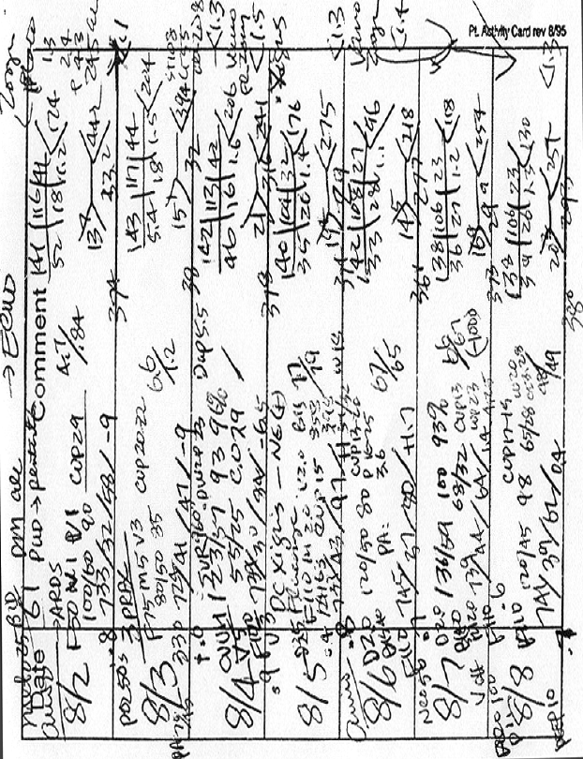
ICU Data Integration Today
Notes:
63

Slide 64


Slide 65
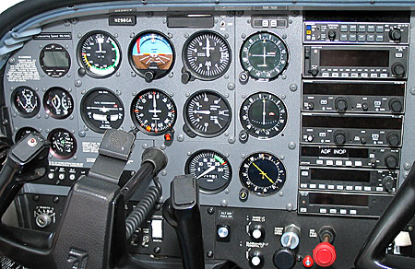
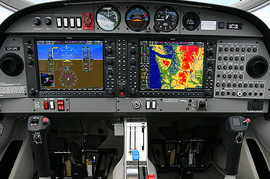
The Need for Enhanced Situational Awareness
Translating Raw Data into Actionable Information
Traditional Cockpit
Data-Integrated Glass Cockpit
"The success of the NASA-led glass cockpit work is reflected in the total acceptance of electronic flight displays... Safety and efficiency of flight have been increased with improved pilot understanding of the airplane's situation relative to its environment. The cost of air travel is less than it would be with the old technology and more flights arrive on time.”
www.nasa.gov/centers/langley

Slide 66

The Need for Improved Information
Applying Systems Engineering in the ICU to Reduce Errors
“A systems-integration approach that incorporates the fundamental building blocks of health care, from equipment and technology to clinical insight and workflow processes, is needed to take the next major leap in improving quality and safety.”
Mathews & Pronovost The Need for Systems
Integration in Health Care JAMA 2011;305
In aviation, a systems engineering approach mitigated cognitive errors and reduced crashes 65%.
Wald, New York Times, October 1, 2007

Slide 67
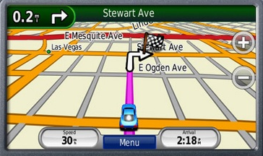
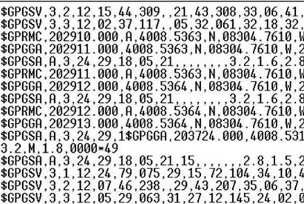
The Need for Enhanced Situational Awareness
Translating Raw Data into Actionable Information
Notes:
all information in readily interpretable form, much as a PS receiver takes data from satellites and creates situational awareness to provide a map back to health for
each patient

Slide 68
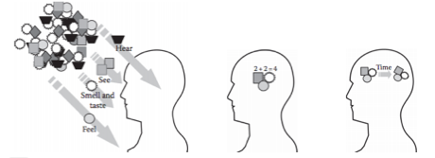
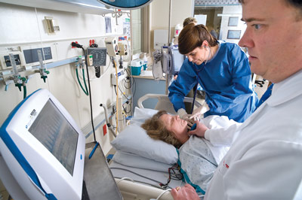
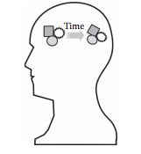
The Need for Enhanced Situational Awareness
Translating Raw Data into Actionable Information
Traditional Cockpit
Data-Integrated Glass Cockpit
Perceive
Comprehend
Project
Action

Slide 69



Enhanced Situational Awareness
Analytic Monitoring: The Future
No Clinical Symptoms
Clinical Symptoms
Crashing Patient
Prediction
Physiologic Monitoring
Clinical Monitoring
Analytic Monitoring
Nothing
Complication Time

Slide 70





Slide 71
Patient Bedside
Multimodal Monitoring Data Acquisition
Streaming Data Interface
Bedside Visualization
Real-Time Analytics
Real-Time GUI Interface
Bedside Decision Support
Bedside Decision Support Loop

Slide 72
Patient Bedside
Multimodal Monitoring Data Acquisition
Streaming Data Interface
Bedside Visualization
Real-Time Analytics
Real-Time GUI Interface
Bedside Decision Support
Bedside-to-Bench-to-Bedside
(Two-Way) Translational Research
Clinical Data Repository
Advanced Decision Support Tools
Knowledge Discovery
Patient-Oriented Translational Research

Slide 73
Patient Bedside
Multimodal Monitoring Data Acquisition
Streaming Data Interface
Bedside Visualization
Real-Time Analytics
Real-Time GUI Interface
Bedside Decision Support
Bedside-to-Bench-to-Bedside
(Two-Way) Translational Research
Save Data
Retrieve Data
Clinical Data Repository
Advanced Decision Support Tools
Knowledge Discovery
Patient-Oriented Translational Research

Slide 74
Even just acquiring data is hard
Pharmacy
Proprietary limitations from industry, glaring absence of standard data formatting, and lack of interoperability make seamless data acquisition and data integration nearly impossible.
Blood bank
Phillips Monitors
Intracranial Pressure
Cerebral Perfusion Pressure
Brain Tissue Oxygenation
Respiratory Rate
Intracerebral Microdialysis
Cerebral Blood Flow
EEG
Laboratory Data
Imaging
Medical Record
Notes:
74

Slide 75
Interoperability:
Ability of two or more systems or components to exchange information and to use the information that has been exchanged
Semantic interoperability:
Shared Data types, Terminology (“ontology”), Coding
Functional interoperability:
Shared Architectures, Methods, Frameworks

Slide 76






Semantic Interoperability
Data Coming Out of the Box
Institute of Electrical and Electronics Engineers
Data & waveforms
Health Level 7
v2 waveforms v2 data v3 data CDA data
Comité Européen de Normalisation
Technical Committee 251
Open EHR / 13606 data ECG files Sleep-lab files
Data & waveforms Waveform in web ‘Lab’ data
DICOM
National Electrical Manufacturers Association
Digital Imaging and Communication in Medicine
Cathlab waveforms

Slide 77



Semantic Interoperability
Data Coming Out of the Box
Proprietary Data Format
Proprietary Data Format
Proprietary Data Format

Slide 78
Third Party (Software) Solutions
Bedmaster (www.Excel-Medical.com)
Comprehensive acquisition and storage system for trend and waveform data, designed around GE/Marquette monitors. Working on future support for Philips Intellivue monitors.
RugLoop (www.Demed.be)
Designed as data acquisition system for OR. Captures waveform data from multiple monitors, including Philips Intellivue, and trend data from many other monitors (GE/Marquette, Philips, HP/Agilent/Philips, Siemens, Draeger, Apsect, …)
Dataplore/Trendface (www.ixellence.com)
Support for trends and waveforms from the new and old Philips monitors
Mobius (www.integra-ls.com)
Provides waveform and trend data from new and old Philips monitors, support for various other monitors including their Licox brain tissue oxygen and Camino ICP monitors.
ICUPilot (www.microdialysis.se)
Trends only, with interfaces to many different monitors

Slide 79
None of this data is processed
Pharmacy
Some monitors display raw trends but even basic analyses (mean, median, standard deviations) are nearly impossible to perform.
Blood bank
Intracranial Pressure
Cerebral Perfusion Pressure
Brain Tissue Oxygenation
Intracerebral Microdialysis
Cerebral Blood Flow
Cerebral Blood Flow
EEG
Laboratory Data
Imaging
Medical Record

Slide 80
Critical Care Bioinformatics
Suite of Complex Systems Analysis Tools
Distributional
Variance
Linear
Properties
Nonlinear
Properties
Attractor
Properties
Predictability
There is no universal equation for “complex systems”. There is no single tool.
We need high resolution data acquisition and a suite of tools for physiologic signal processing and analysis, using both classical techniques and novel methods based on statistical physics and nonlinear dynamics.

Slide 81
Critical Care Bioinformatics
Suite of Complex Systems Analysis Tools
Distributional
Variance
Linear
Properties
Nonlinear
Properties
Attractor
Properties
Predictability
Mean
Autocorrelation
Multiorder
Histograms
Correlation
Dimension
Mutual
Information
Standard
Deviation
Multiorder
Histograms
Poincaré
Analysis
Lyapunov
Exponent
Sample
Entropy
Coefficient
of Variation
Hierarchical
Clustering
Surrogate
Comparisons
Visual
Reconstruction
Approximate
Entropy
Shannon
Entropy
Poincaré
Analysis
Mutual
Information
Jacono FJ, De Georgia MA, Wilson CG, Dick TE, Loparo KA. Data Acquisition and Complex Systems Analysis in Critical Care: Developing the Intensive Care Unit of the Future. Healthcare Engineering. 2010.
Frequency
Analysis
Sample
Entropy

Slide 82



Slide 84






Bedside-to-Bench-to-Bedside (Two-Way) Translational Research
Real-time Visualization
Patient Bedside
Multimodal Data Acquisition
Streaming Data Interface
Bedside Visualization
Real-Time Analytics
Real-Time GUI Interface
Bedside Decision Support
Bedmaster EX w/ Bedcomm
Real-time GUI Interface
Streaming data Analytics
High Resolution Clinical Data Repository
Hadoop & SQL
t
Advanced Decision Support Tools
Knowledge Discovery
t
InfoSphere Streams
Patient-Oriented Translational Research

Slide 85
Situational Awareness
Patients with Intracranial Hypertension

Slide 86


Slide 87



Slide 88
Improved Situational Awareness
Did not dictate to clinicians a specific response treatment protocol.
22% mortality reduction from neonatal sepsis

Slide 89



Slide 90


Slide 91
Projected Benefits of Big Data in Critical Care
For Patient Shorter stay, fewer tests, fewer complications = safer, more individualized and predictable care
Over 750,000 patients suffer adverse drug events annually in the U.S. Cutting this in half will improve the outcomes to over 375,000 patients
For Clinician Increased efficiency = less time needed to diagnose, reduced errors
Direct and immediate access to latest clinical information will reduce time to respond to infectious diseases from 16 hours to just a few hours
For Hospital Increased patient throughput
Reduced length of stay and cutting readmissions in half to 5-10% (from 10-20% today) will save hospitals over $600 million
For Payer Reduced expenses
Reducing all preventable adverse events by 50% will save Medicare $2 billion a year
For Vendors Increased device interoperability
Eliminates vendors from being locked out of opportunities
For Society Increased productivity
Potential to save 3 million “workdays”
Adverse Events in Hospitals: National Incidence Among Medicare Beneficiaries; DHHS; November 2010; OEI-06-09-00090

Slide 92


Slide 93


Slide 94

Reactive medicine is obsolete
Treat physiologic states before thresholds broken
Treat complications before clinical symptoms observed
Must be able to acquire all the data into single integrated system
Enable clinicians to interrogate and model complex clinical data in relationship to clinical events and outcome.
Models must be able to be evaluated in live ICU environments using clinical protocols.
Evaluate effectiveness of treatment interventions
Identify patient specific physiologic targets
Identify physiologic states (healthy or not)
Identify secondary complications before they cause damage
Establish early intervention is beneficial (Key Step)
Provide better prognostic information
Use informatics based suite of translational tools to Analyze data
Present information to clinicians to help decision making

Slide 95
Notes:
This should be a standard that is readily available yet takes a ton of work. Demand and be angry that you can’t see this for all your patients.

Slide 96
Critical Care Bioinformatics
Suite of Complex Systems Analysis Tools
Distributional
Variance
Linear
Properties
Nonlinear
Properties
Attractor
Properties
Predictability
There is no universal equation for “complex systems”. There is no single tool.
We need high resolution data acquisition and a suite of tools for physiologic signal processing and analysis, using both classical techniques and novel methods based on statistical physics and nonlinear dynamics.

Slide 97


Slide 98


Slide 99


Slide 100

Each minute of EEG was classified after visual inspection by a blinded experienced electroencephalographer as ictal, ictal-interictal continuum or nonictal.
Two key problems in working with high resolution data:
Data was acquired then converted by a human as opposed to computer into clinical information.
Data reduction from 200 Hz to 1 minute resolution.
New onset seizures were defined as lasting at least 5 minutes and preceded by 30 minutes without any seizure activity and then combined with physiological data.
Series of SQL queries to automatically identify new onset seizures meeting both criteria
Then linking physiological data stored in a different database by the defined time window.
Physiologic signals were preprocessed through several steps of filtration and missing data were extrapolated.
Significance was assessed by constructing a permutation test where investigators resampled by patient and evaluated a Monte Carlo estimate of the significance level.

Slide 101




Slide 102


Slide 103
Example of bedside-to-bench translational research
Study was truly a multidisciplinary effort:
Department of Neurology, Division of Critical Care Neurology
Department of Neurology, Comprehensive Epilepsy Center
Department of Neurosurgery
Department of Biomedical Informatics.
Required considerable clinical, data management, and analysis expertise.
BUT, no clear pathway back to the bedside.
Relies on a human to classify seizures
No clinical system to send real-time analysis results back to the bedside

Slide 104


Slide 106


Slide 107


Slide 108
Future
The bedside monitor displays present state, reached from many trajectories.
To predict future trajectory, we have looked backwards to identify trend.
What we really want to know is if patient will move from condition 1 (good) to 2 (bad)
With “velocity” (“speed” and “direction” at which patient is moving) and probability density “space”, we can forecast trajectory.
Time
Condition
1
Condition
2
Physiologic Space

Slide 109


Slide 111



Slide 112


Slide 113


Slide 114
Video

Slide 115

Intracranial pressure management
Goal: to determine an ‘ideal’ target for cerebral perfusion pressure that will maintain adequate perfusion of the brain.
Challenges:
Difficult to understand patient monitoring data without visualization due to multidimensional nature of physiology.
For example the relationship between cerebral perfusion pressure (CPP) and brain oxygen tension is dependent on end tidal CO₂ concentrations.
3. Notice that when end tidal CO₂ is below 30 the patient appears to regulate cerebral blood flow properly when CPP is greater than 80 mmHg (normal), but when end tidal CO₂ is above 30 brain oxygen tension increases as cerebral perfusion pressure increases (abnormal).

Slide 116

Cerebral Autoregulation after Acute Brain Injury

Slide 117
PRx based optimal CPP
Validated in various disease conditions

Slide 118


Slide 119


Slide 120


Slide 123
Video

Slide 124



PREDICT: Pattern Representation and Evaluation of Data through Integration, Correlation, and Transformation
PI: J. Michael Schmidt, PhD, MSc Org: Columbia University
Study/Product Aim(s) Develop interactive visualization to support earlier prediction of conditions that require integration across multiple dimensions and detection of subtle trends. Propose initial use cases of sepsis and acute brain injury. Transform the underlying physiological processes (learned in school and through years of training) into an intuitive display, where current and future patient state can be instantly integrated into the decision process. Perform an experiment with experienced clinicians to quantitatively evaluate the benefits of the visualization technique against current methods in faster detection of emerging events.
Approach and Military Relevance Earlier detection of emerging events such as intracranial hypertension in severe brain injury and sepsis are critical and important problems for military medicine.
Timeline and Cost
Projected Goals/Milestones
Month 3 Goal – Visualization prototype development complete
After 3 months, we will have a prototype of the system that will be ready for development.
Prototype development includes conducting a cognitive work analysis and multiple iterations of the visualization.
Month 9 Goal – Data integration and Interactive Visualization
The backend system with actual historical data will be connected with the interactive visual interface
A working interactive visual interface will be complete and ready for demonstration
Month 12 Goal – Experiment
An experiment will be conducted with clinical staff to quantitatively validate the effectiveness of the visualization over current methods.
A final report on the results of the study will be delivered.
Activities CY 10/12 10/13
Combined
3 months
Prototype Visualization 1 and 2 (Sepsis, MPP-ICP)
Columbia
6 months
Data Collection and Integration
Draper
6 months
Interactive visualization (Working interactive visualization with data)
Combined
3 months
Experiment (Conduct, Analyze, Publish)
Estimated Budget ($260K) $65K $125k $65K
Notes:
Quad charts should be submitted with the original proposals and then updated quarterly with the quarterly reports. The measurable goals are placed on the chart at that time. These are put in the lower right quadrant for each year of execution. Sample goals are put above.
Each quarter do the following:
Once you start a study on your timeline chart, place a bar on the timeline bar where you are in the study. Each quarter, move the bars to represent the current location in the study.
Check off your goals and milestones as you complete them. Here are some checked bars and empty bars   to use
If your timelines change, modify the timeline bar’s length and position but if you change them, make sure and comment on the change under Comments/Challenges/Issues/Concerns
Make sure and place a new accomplishment in the upper right quadrant.

Slide 125
Sepsis Identification
Goal: To help clinicians identify patients that are in early stages of sepsis
Challenges:
Well-defined criteria to recognize if a patient is in septic shock. Generally, if two or more criteria are met, there is a suspected infection.
temperature >38ºC or lower than 36ºC;
heart rate > 90 beats/min;
respiratory rate > 20 breaths/min; and
white blood cell count > 12,000/mm3 or < 4,000/mm3 which more than 10% immature forms.
Monitor 6 variables (4 SIRS criteria, and 2 additional):
temperature
heart rate;
respiratory rate
white blood cell count
heart rate variability
blood pressure

Slide 126
Sepsis Identification
Challenges (cont):
The challenge is that once these criteria are met, it is often the case that the patient is severely ill.
It is possible that we can help to detect the early emergence of SIRS through supporting clinicians in seeing early trends in SIRS-related variables.
Clinicians need help seeing subtle trending of multiple variables at one time.
For clinicians, the challenge is the monitoring for these slight trends in multiple variables are multifaceted:
Monitoring for the emergence semi-rare events with weak evidence is challenging.
The variables that the clinicians are monitoring are not all located in the same place.
It is easy to see many of the variables on the patient monitor (HR, RR, Temp), however that monitor only provides the last 10 seconds of data. Longer trends are not shown here.
Rate of change of individual variables is not easily found
Rate of change of multiple variables requires integration in the clinician or nurses head.

Slide 127
Sepsis Identification
Solution
Individual Variables
Present all 6 variables in a single location
Present longer trends of all variables
Show their individual values at time steps of 15-minutes.
Color code the individual values to indicate how close they are to normal or alarm stages
Integrated Display
The goal is to detect slight trending of the 6 variables over time.
Present the 6-variables in a spider-plot.
Normalize the variables so that the larger the circle the higher the likelihood that SIRS trends are being observed.
The x-axis is time in 15-minute intervals
The y-axis is likelihood of SIRS.
Redundant coding for position on the y-axis and size of the circle.
Color of the circle as a whole could be used to indicate rate of change. This could be redundant to the jump along the y-axis between two time points.
POSSIBLE: We could color code individual dots on the circle to indicate how close the individual values are to alarm state.

Slide 128

SEPSIS Detection: Version 1
Design concerns:
1. The presentation of the individual variables and numbers would not reduce clinician cognitive load.
2. Clinicians would have to trend many hours of data to determine if changes were occurring.
3. We wanted to maximize the ability to make single comparison between the current status and past status.

Slide 129


Slide 130
Identifying Priority Patients
Goal: Identify patient state changes and identifying patients that need clinician attention
Challenges:
Clinicians may be confronted by more than 200 variables for critically-ill patients.
In contrast people are not able to judge the degree of relatedness between more than two variables.
The most difficult task for clinicians is not determining which patients are doing poorly – this is usually self-evident – it is determining which patients are changing and require intervention.
We hypothesize that an interactive visualization can be designed to support clinicians in more quickly recognizing changes to patient state, situation awareness, and faster ability to pinpoint emerging situations.
Solution:
To apply a multivariate temporal analysis technique, specifically empirical orthogonal functions, to patient monitoring data.
This analysis will identify the sources of variance in patient data and what physiological parameters vary together.

Slide 131

Identifying Priority Patients Update and Challenges
Outlier Removal
Physiological data collected in the Neurological ICU is not collected in a controlled environment
Frequent outliers represent spurious data from the perspective of patient care.
For example, catheters measuring body temperature are often removed prior to the termination of data collection.
Have temperature readings from in the body and room temperature.
Solution
We have implemented a variational Bayesian mixture model for the detection and removal of such spurious states – the results of which applied to the same variable (temperature) can be seen in the figure below.
Unfiltered versus Filtered Temperature Values

Slide 132

Identifying Priority Patients Update and Challenges
Missing Data
Empirical orthogonal function (EOF) can help visualize the patient's state over time and identify points of significant change.
Physiological variables are not always recorded at all times.
We had to address the issue of missingness.
Solution
We experimented with several approaches.
The combination of outlier removal as described above and constant interpolation was determined to be the most accurate approach.
Displayed is the application of this method showing a period of significant change when temperature is one of the variables involved in the change.
EOF analysis (above) and Temperature (below) corresponding to variable 'TMP-2'

Slide 133
Identifying Priority Patients Update and Challenges
Method 1 to assess change
EOFs that account for the most variance for each time period
Choose the top K EOFs and create a set from the variables that are significant contributors to those EOFs.
Evaluate the Jaccard Index and establish a threshold for alerting significant changes across time periods.
Method 2 to assess change
…for a given patient
…for a set of time bins prior to the current time bin
Build a multivariate normal or multivariate t distribution.
Evaluate the likelihood that a significant change has occurred in the current time bin (negative logarithmic scale, inverted likelihood scale)
Alerts can be designed sudden changes in state.
EOF analysis (above) and Temperature (below) corresponding to variable 'TMP-2'

Slide 134


