Slide 1
Measuring emotion through keystrokes in behavioral experiments
Matt Sisco
5/3/2016

Slide 2
Introduction
Objectively measuring emotion is relevant to many behavioral research programs
Some use physiological measurements
Expensive
Require specific training and expertise
A free, non-invasive method could be very appealing thousands of behavioral researchers

Slide 3
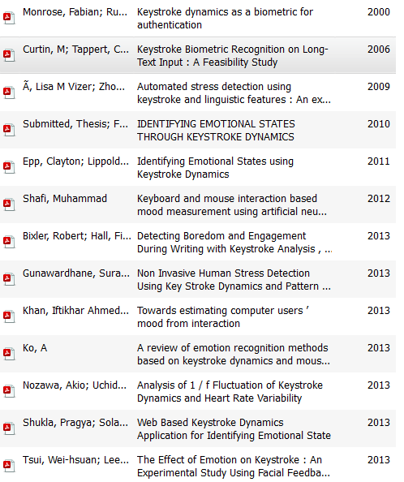
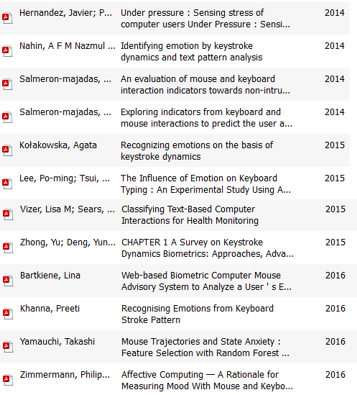

Slide 4
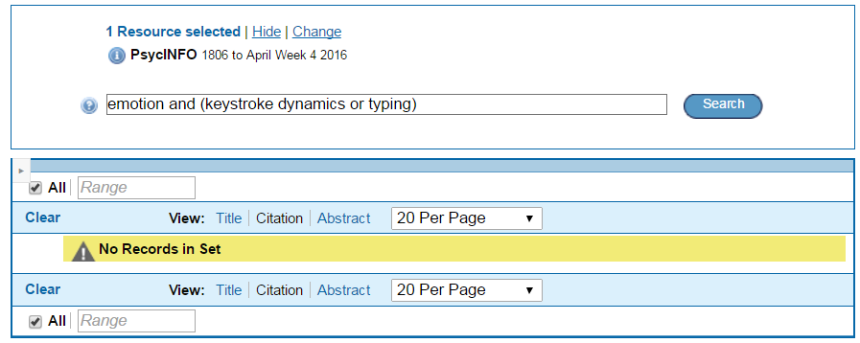

Slide 5
Goals
Develop a model meant for detecting arousal in behavioral experiments
Tuned to physiological changes
Create JavaScript tool for measuring arousal in experiments
Using individual-specific models

Slide 6
Past research
Many features have been explored
Which are most predictive depends on task, measured state, and the individuals [1]
Substantial individual differences in how keystroke patterns change with arousal [2]

Slide 7
Study 1
Online pilot study
test and develop the basic framework
proof of concept
explore boundaries
fixed vs free text?
how much text is really needed?
how small of an effect can we detect?

Slide 8
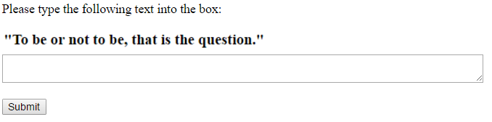
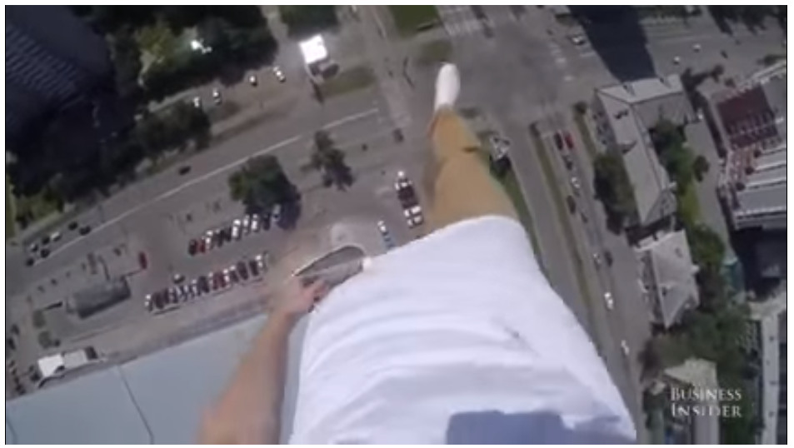
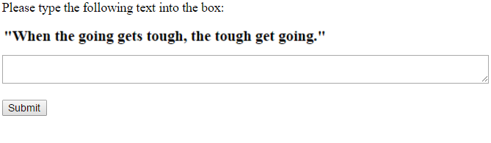
Video

Slide 9
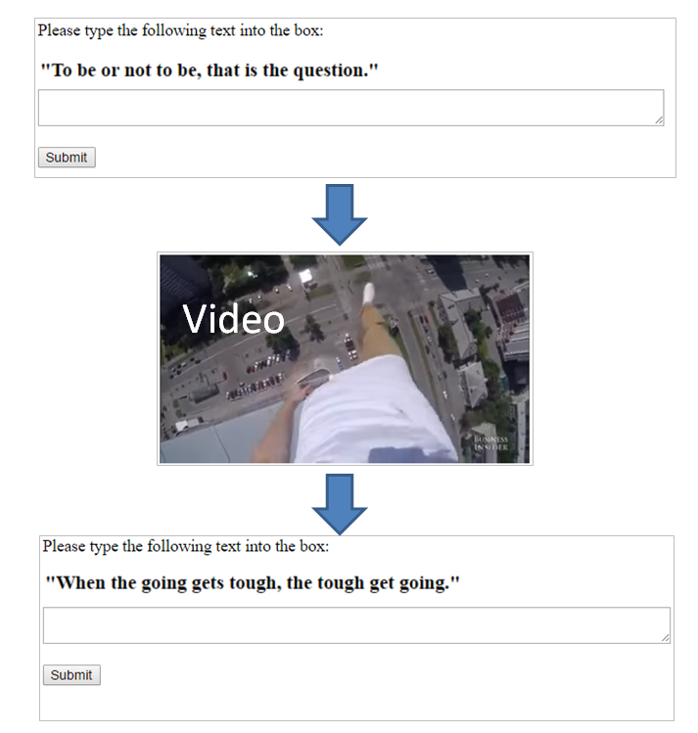
Preliminary results
N=48
Mturk sample
One iteration each
http://portal.cred.columbia.edu/epsilon/input.php?taskcode=0&SubjectID=3

Slide 10
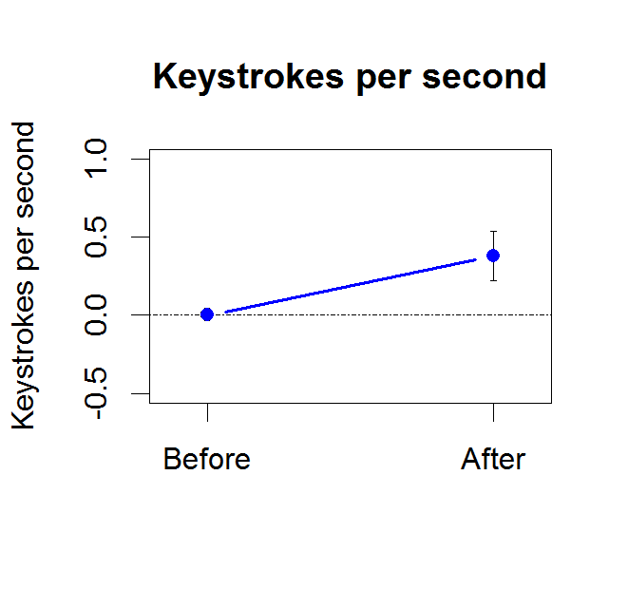
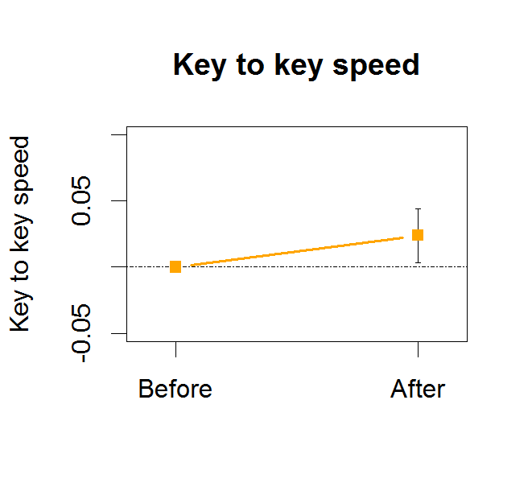
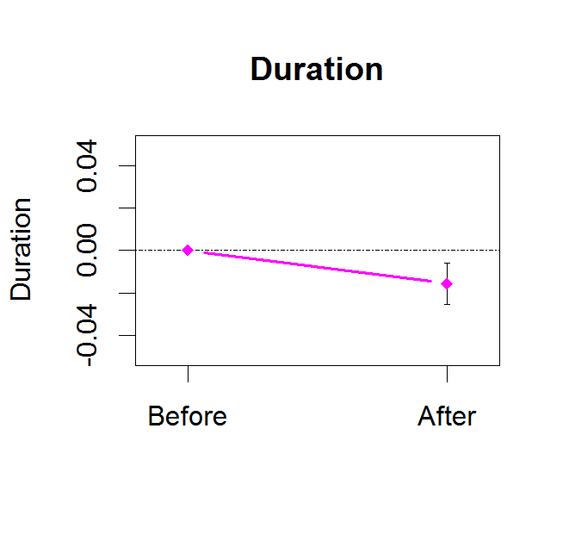
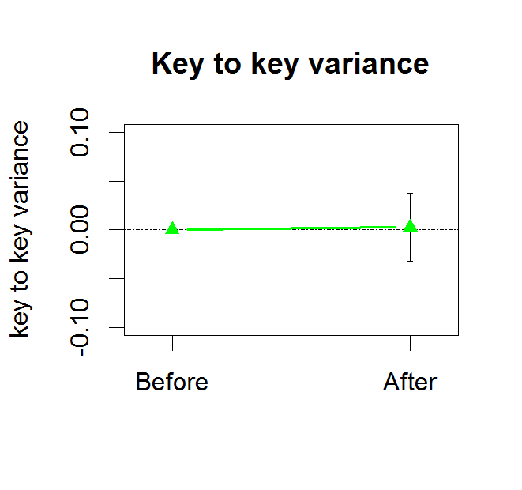

Slide 11
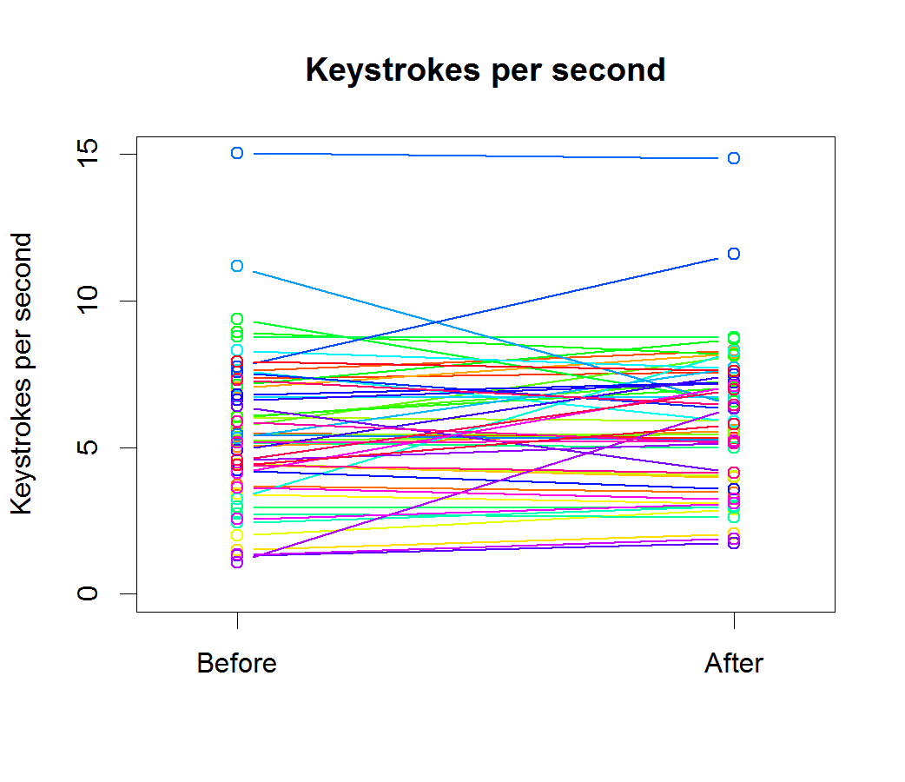

Slide 12

Arousing stimulus

Slide 13


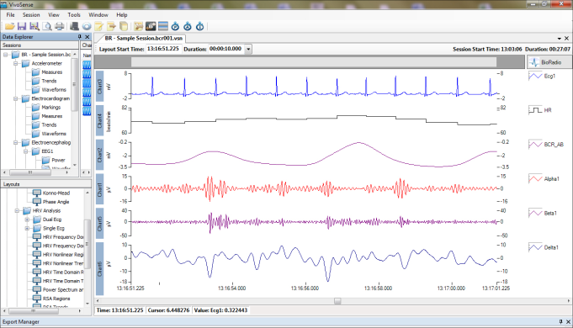
Study 2
In-person study in collab with Prof. Bolger
Changes in psychophysiological variables will be measured before and after a highly arousing stimulus
galvanic skin response, heart rate variability, vascular constriction
Used to develop estimation model

Slide 14
Individual-specific Modeling
Are there consistent clusters that people predictably fall into?
How well would “in-experiment tuning” work?
A short series of typing tasks around standard stimuli known to evoke certain states, to train individual-specific models that can be used for evaluating how participants react to other stimuli

Slide 15
Evaluation
Accuracy compared to past studies (~75%)
Extent tool is used by researchers
Ability to predict real world outcomes

Slide 16


Future Direction – Evaluate Stimuli

Slide 17


Future Direction – Evaluate Stimuli

Slide 18
Thank you!

Slide 19
References
[1] Ko, A. (2013). A review of emotion recognition methods based on keystroke dynamics and mouse movements, HSI 2013.
[2] Kołakowska, A. (2015). Recognizing emotions on the basis of keystroke dynamics, IEEE 2015.

Slide 20
