Slide 1

Analysis of Privacy Expectations on Google Play Store
Dan Rosenthal

Slide 2
Motivation
68% of American adults now own a smartphone.
People are incredibly unprepared to make informed privacy and security decisions around applications [1].
Applications often overreach when requesting permissions.
Dr. Bellovin’s talk showed us just how few data points are needed to start building a full picture.
Plus, its just creepy!
[1] Kelly, P. A Conundrum of Permissions: Installing Applications on an Android Smartphone (2012). Financial Cryptography and Data Security.

Slide 3
“…it may be necessary to reconsider the premise that an individual has no reasonable expectations of privacy in information voluntarily disclosed to third parties.”
- S.C. Justice Sonia Sotomayor

Slide 4
Prior Work
A recent (Nov. 2015) study by the Pew Research Center performed a comprehensive study
which analyzed data from the Google Play Store and surveyed Android users
Data Collected
Data Scraped from Application Marketplace
1,041,336 apps – (June – Sept. 2014)
235 Distinct Permission Types
41 Categories of Apps
Survey Data
461 respondents
Adults ages 18 or older
Notable Findings
70/235 unique permission types could be used to access user information
The average app required five permissions before a user could install it
60% of users had opted not to install an app after they discovered how much personal information was required
90% of downloaders said how their personal data will be used is “very” or “somewhat” important to them

Slide 5
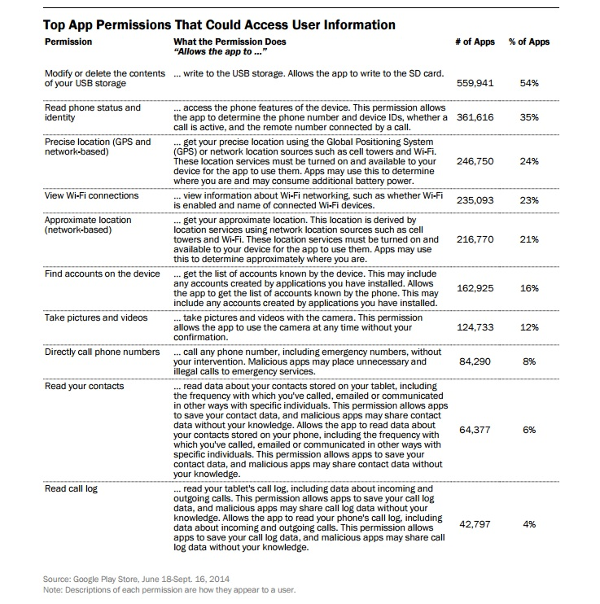

Slide 6
Project Goals
Make Sense of How Different Users Interact with Application Permissions
Can we find patterns in user data which may give us an understanding of privacy expectations?
Develop a Transparency Tool that Educates Users
Users often have limited understanding of how permissions effect their levels of privacy [2].
[2] Robinson, N. (2016) Cognitive Disconnect: Understanding Facebook Login Permissions, Unpublished

Slide 7
Experimental Design
Creation of mobile platform.
Data collection.
Apply learning techniques to evaluate user behavior, both supervised (alongside in-application survey data) and unsupervised.
Evaluate Results.

Slide 8
Visualize and allow manipulation of application permissions (enabled by Android 6.0)
Provide users with more detailed, granular information about the unique permission types and what they allow.
Periodically survey users about privacy expectations and comprehension
(Ironically) – Track user behavior, privacy settings and engagement

Slide 9
Data & Methodology
Large dataset of application permissions and behavioral data across all of users
Can treat as a Collaborative Filtering problem, with each privacy permission as a “rating”
Pew study found the app store also exhibited the “long tail” phenomenon.
Start with simple questions –
Is there a correlation between user engagement in the app and data conscientiousness?
Can we apply some clustering model to make sense of the data?

Slide 10
Project Evaluation
Statistical
Cross-validation for regression analysis.
Unsupervised models harder to evaluate. Can we even achieve seperation between user types?
Social
Do users see a value add from the use of the application? (User rating)
How do users opinions change over the course of use?
Legal
Are results meaningful? (In a legal sense)
Is the data collected useful to companies?

Slide 11
Thanks!

