Slide 1
Toward improved document classification and retrieval
Richard Muñoz
EECS 6898
May 5, 2016

Slide 2
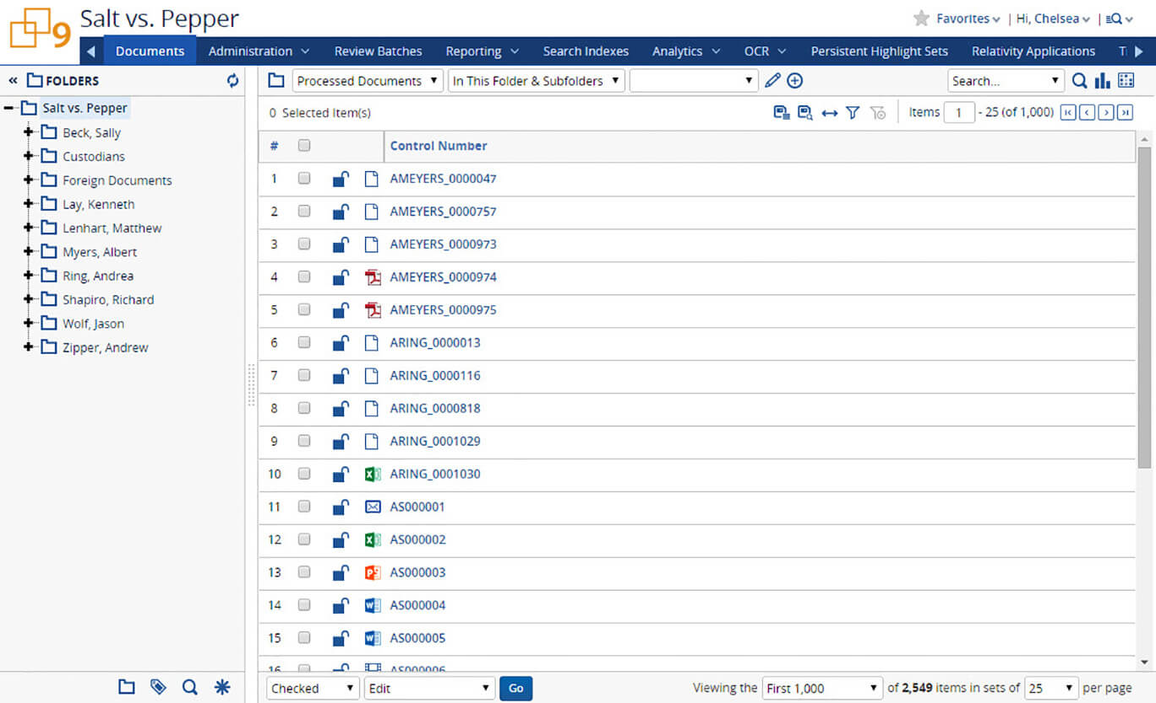
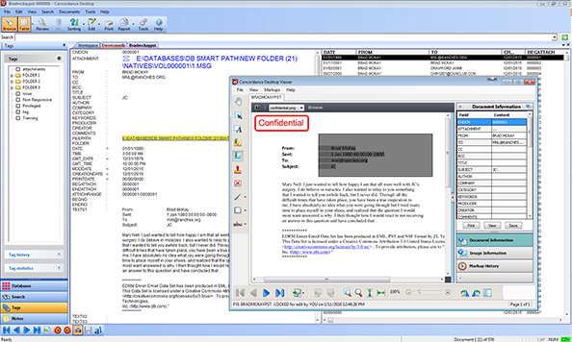
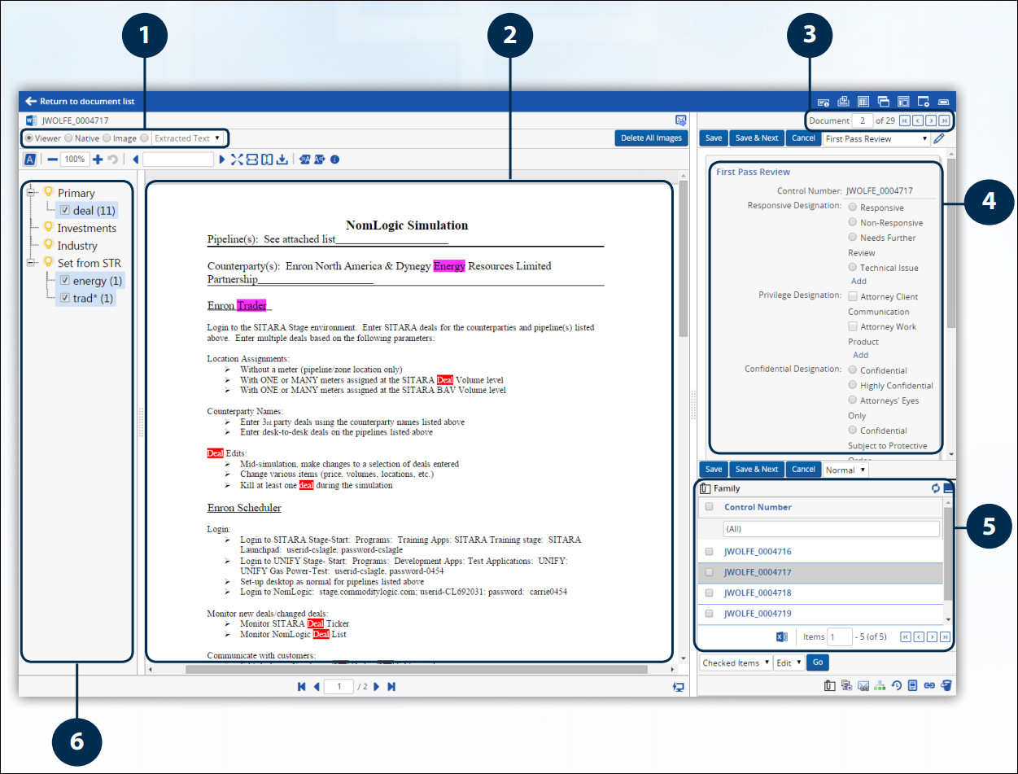
Document Classification/Retrieval
Images from LexisNexis and kCura

Slide 3
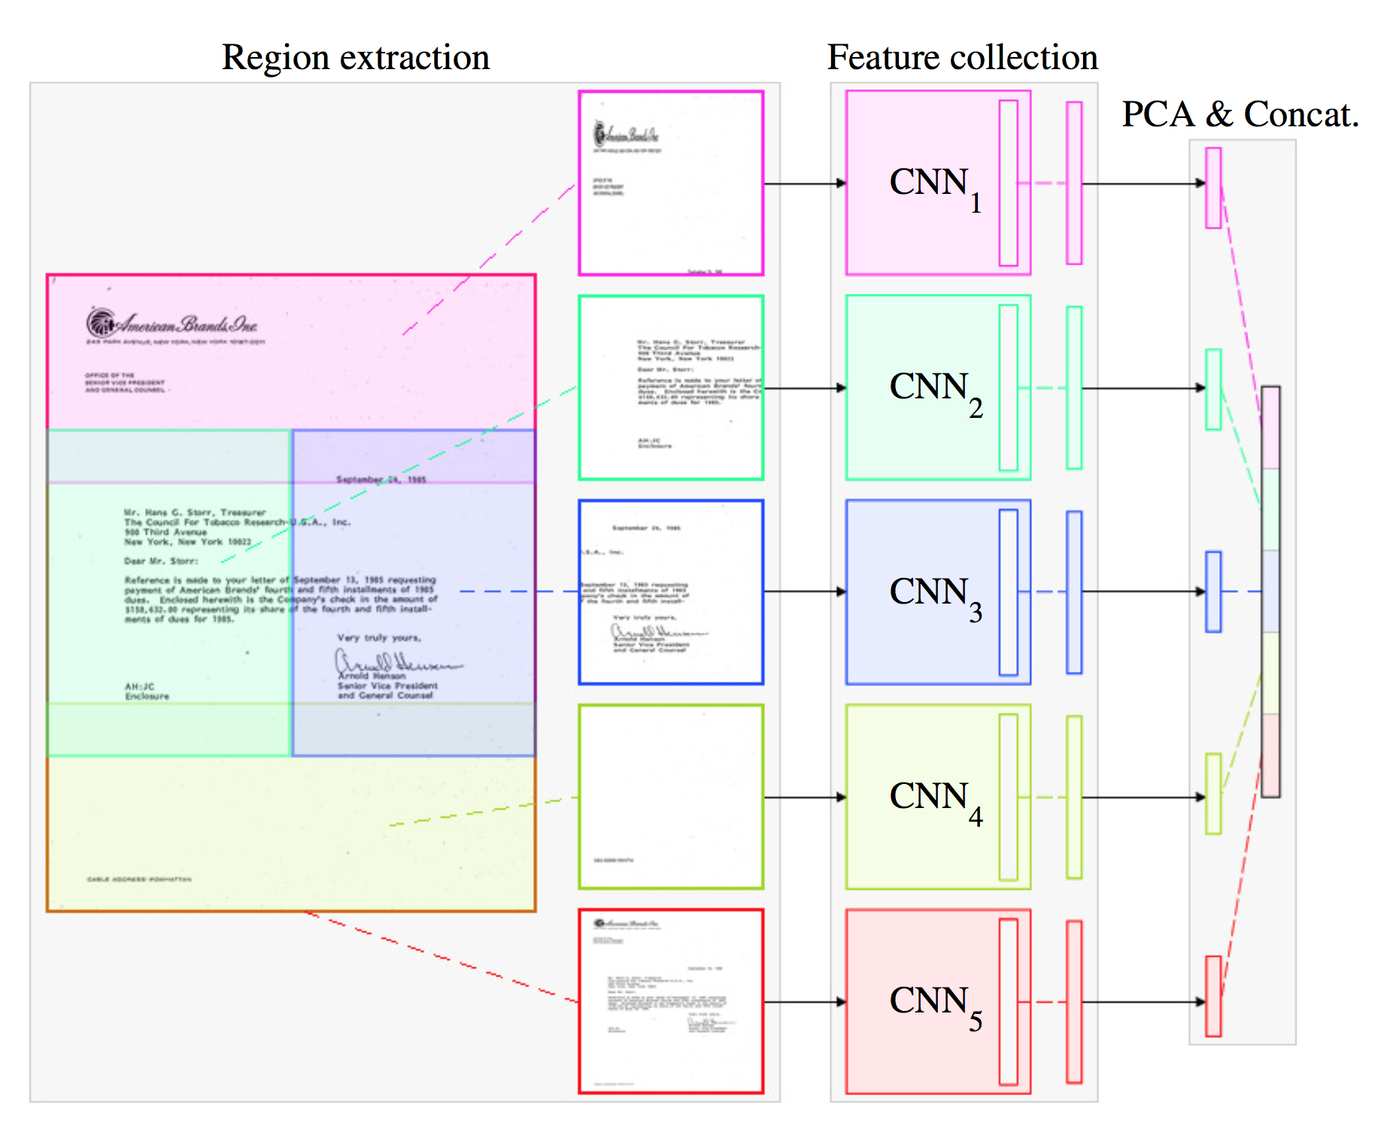
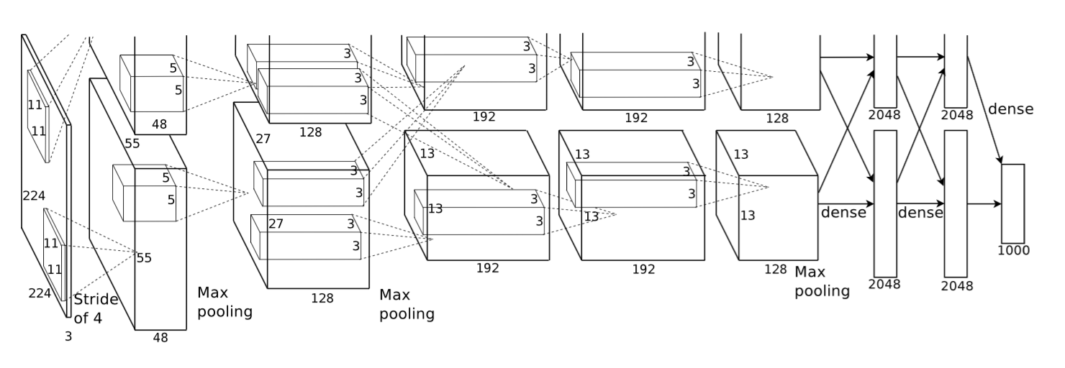
CNNs to the Rescue?
Images from:
Krizhevsky et al. (2012). Imagenet classification with deep convolutional neural networks. In Advances in neural information processing systems.
Harley et al. (2015, August). Evaluation of deep convolutional nets for document image classification and retrieval. In ICDAR.

Slide 4
Can we do better?
Build Decision Trees that consider document structure
Crop out region and send to CNN denoted by leaf
Predict classification or relevance score
Inspired by context-dependent selection of GMMs (and later NNs) in speech recognition
Difficult layout segmentation or unknown layouts:
Back off to single CNN model

Slide 5
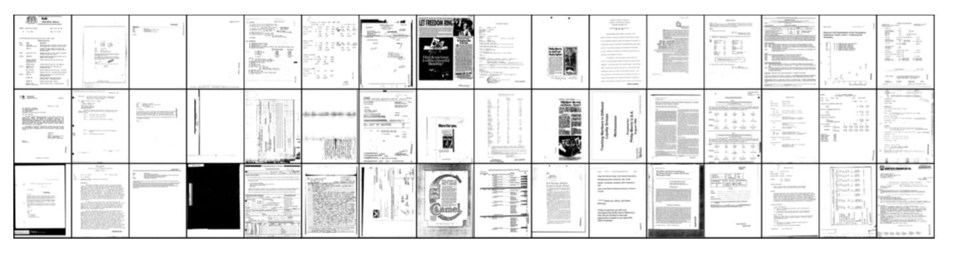
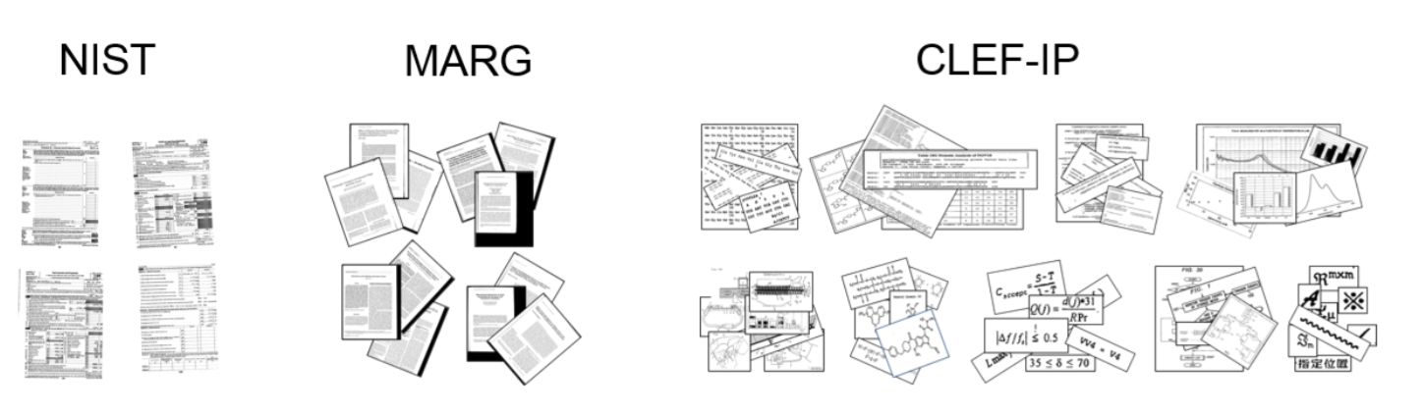
Data Sources
Tobacco litigation files
NIST tax forms
Potentially:
FOIA requests
Collaborations
Medical journal articles
Patent figures
Images from:
- Csurka et al. (2016). What is the right way to represent document images?. arXiv preprint arXiv:1603.01076.

Slide 6
Evaluation
Classification Accuracy
Mean average precision
Performance on poorly OCR’d documents given higher weight
Scalability with respect to
Labeling datasets
Computational time for CNNs

Slide 7
Thank you

