Slide 1
Customer-centric and Real-time Parking Recommendation
By Mei Mei

Slide 2
What is Customer-centric and Real-time Parking Recommendation?

Slide 3
Motivation

Slide 4
Hypothesis

Slide 5
Real-time parking recommendation
Location tracking pattern

Slide 6
Hypothesis support
Customer location pattern analysis:
Mosaic theory
Machine learning
Real-time street parking recommendation:
object detectors
Video analysis
Algorythm

Slide 7
How?
Hardware
Software
Camera Installation
Intel Edison
Mobile phone sensor
AWS for cloud storage
NYC Camera feed fetching + Image Processing
Cloud based computing for behavioral analysis
Machine Learning algorithm
App development

Slide 8
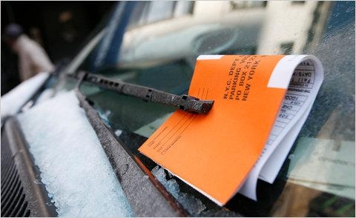
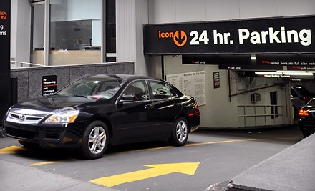
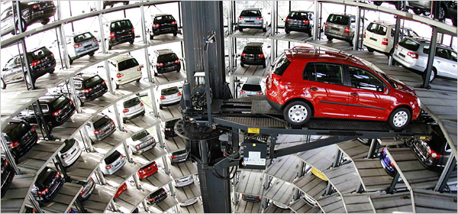
Procedure
Install Camera on CS Lounge: Install camera and guarantee data quality
Install GPS tracking sensor on cars: collect user location data via mobile phone on car.
Cloud upload: Upload data onto AWS
Pattern Recognition: Garage Recognition
Get NYC Data feed: Get data from website
Recommendation Algorithm: Parking recommendation based on garage data

Slide 9
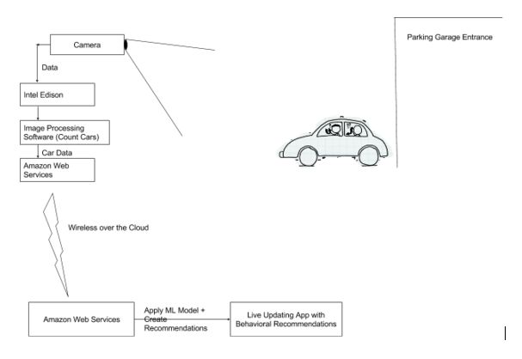
Initial experiment

Slide 10
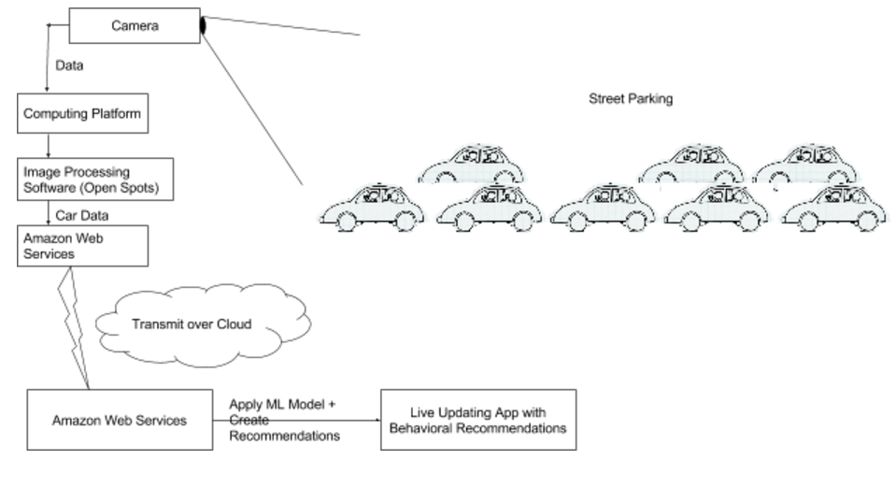
Street

Slide 11
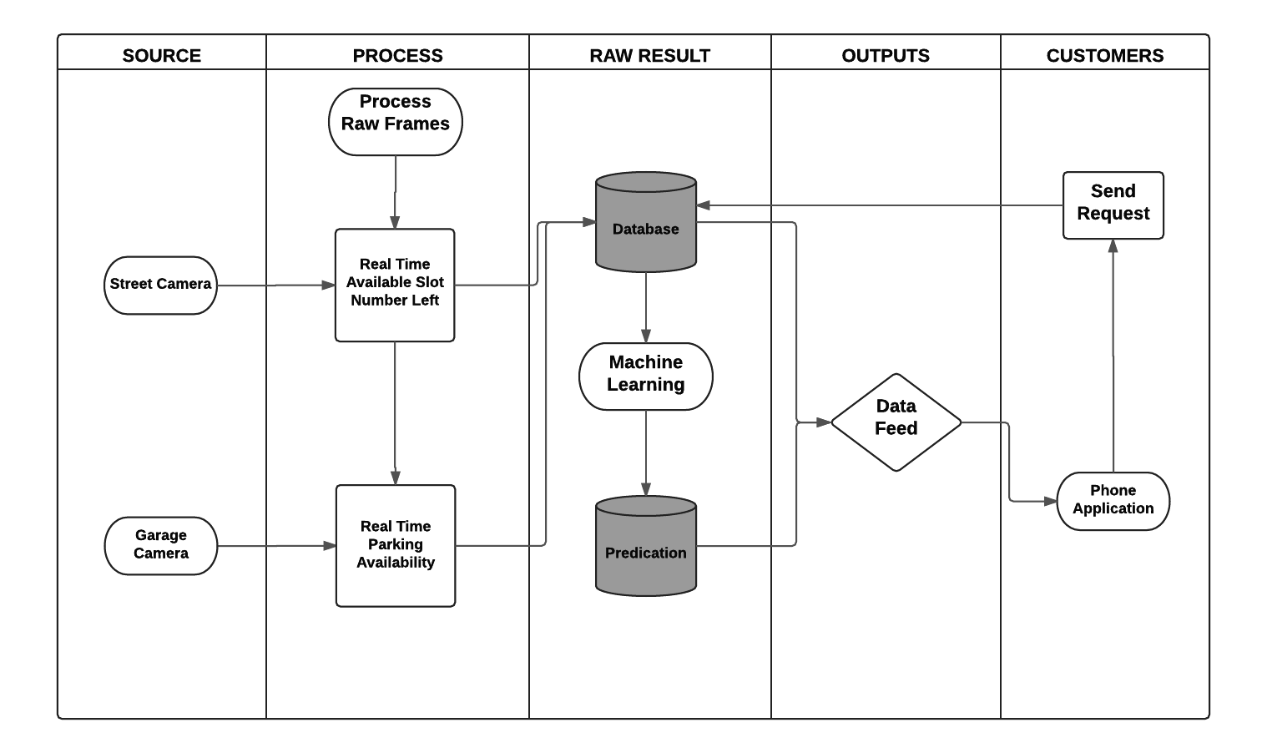
Functional Flowchart

Slide 12
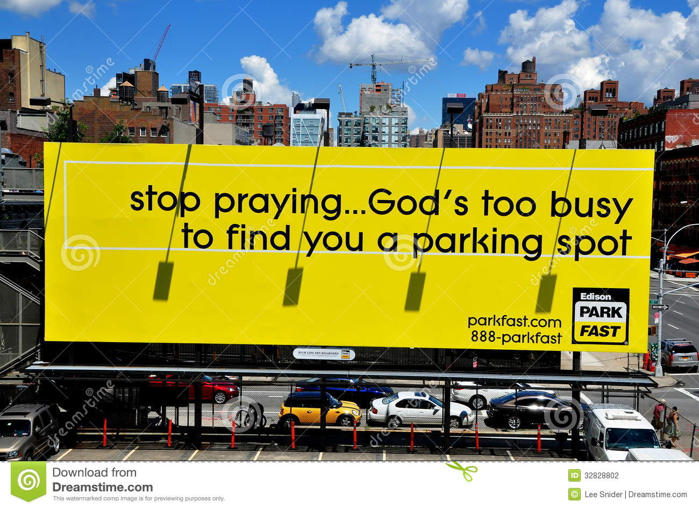
The experiment

