Slide 1

mHealth for Chronic Disease:
Using a Tracking Application for Management and Research of Endometriosis

Slide 2
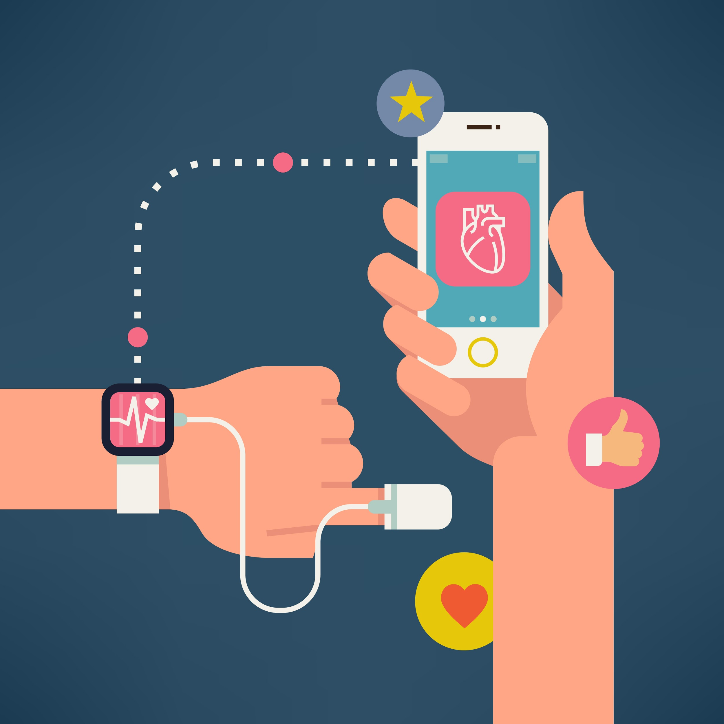
HELLO!
My name is
Mollie McKillop
I am a PhD student in the Department of Biomedical Informatics at Columbia University. I like health, technology, and science.

Slide 3
1.
Background and Introduction

Slide 4
CHRONIC DISEASES
Chronic diseases responsible for 7 out of 10 deaths each year in the U.S.
Chronic diseases account for 86% of the nation’s healthcare costs
Our healthcare system not designed for these kinds of diseases
Requires new approaches to treatment, care, even medical research!
Notes:
Chronic diseases require sustained patient engagement with health and healthcare

Slide 5
CURRENT TRENDS
mHealth
Quantified Self
Patient centered care
Precision medicine
BD2K initiative
... are pushing towards new models of medical care and research
Notes:
Good news is there are trends which are pushing us in the right direction. All of these trends are coalescing into a new field, digital health.

Slide 6
DIGITAL HEALTH
empowering people to better track, manage, and improve their own health and live better through digital tools
Notes:
How shoudl we use digital health to improve the lives of patients with chronic disease? I think we should focus on prevalent diseases where patients are really suffering. So people usually think of diabetes, obesity, etc. when thinking of chronic disease. What is the prevalence of diabetes?

Slide 7
~8%
Percentage of U.S. adults with diabetes

Slide 8
~10%
Percentage of women with endometriosis of reproductive age
Notes:
How many people have heard of endometriosis? In endometriosis, endometrial tissues grows outside of the uterus. It is a chronic condition with no cure

Slide 9
Endometriosis Symptoms
Pain during period, during ovulation, during or after intercourse, low back pain, when passing urine or opening bowels
Abnormal bleeding, heavy menstruation, irregular bleeding, premenstrual spotting
Bowel or urinary symptoms, cyclical painful bowel or bladder movements, constipation or diarrhoea, urinary frequency, urgency, haematuria, abdominal bloating
Infertility, chronic fatigue, anxiety, depression
Notes:
High disease morbidity, on average women lose 10.8 hours of productivity weekly

Slide 10
Questions Remain
Despite high morbidity of the disease, important aspects of endometriosis remain unknown
Symptomology of endometriosis and changes through time not well understood
Important for understanding mechanism of disease
Notes:
10.8 hours of productivity weekly. signs as symptoms of the disease vary greatly across women and over time

Slide 11
2.
Project Proposal

Slide 12
Project Goal
Phenotype endometriosis and help women manage their symptoms through a mobile app
Notes:
10.8 hours of productivity weekly. signs as symptoms of the disease vary greatly across women and over time. Plan to use a user-centered design process to develop the app.

Slide 13
App Design and Development
User-centered, iterative approach
~7 focus groups and individuals interviews with 30 participants
Theoretically ground design choices in Self- Determination Theory

Slide 14
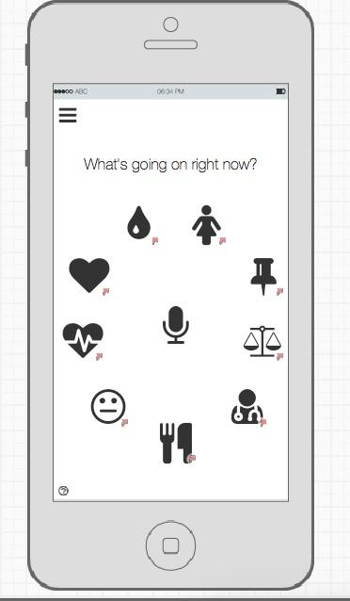
iPHONE MOCKUP
Tracking functionalities as well as engagement functionalities

Slide 15
Phenotyping
Data from static questionnaire and app
Structured in Open mHealth framework
Use dynamic topic modeling to generate phenotypes and changes in time

Slide 16
Sample Phenotypes
Severe upper pelvic-pain during late menstruation phase with heavy exhaustion during late ovulation phase
2. Severe GI problems throughout ovulation and menstruation with co-occurring dairy intolerance

Slide 17
3.
Evaluation

Slide 18
Engagement Evaluation
Measure engagement with randomized control trial of engagement features
Data quality measured through number of log-ins/time
Measure how well users needs being met with Self-Determination Theory Scale

Slide 19
Phenotyping Evaluation
Compare learned phenotypes to survey data
Test phenotype algorithm on simulated data that has known signals in input data
Determine phenotype quality by employing patients and medical experts

Slide 20
Implications
Tests a new approach to medical research
Could be adopted to study other chronic diseases
Engagement and tracking functionalities could be useful to patients in other chronic diseases

Slide 21
THANKS!
Any questions?
You can find me at
mm4234@cumc.columbia.edu

