Slide 1
Hyperscanning Deception: EEG Analysis of the Lying Game
Laura Long
Data to Solutions
05/04/16

Slide 2
Detecting Deception
Posture
Microexpressions
Physiology
Speech analysis
Brain signals

Slide 3
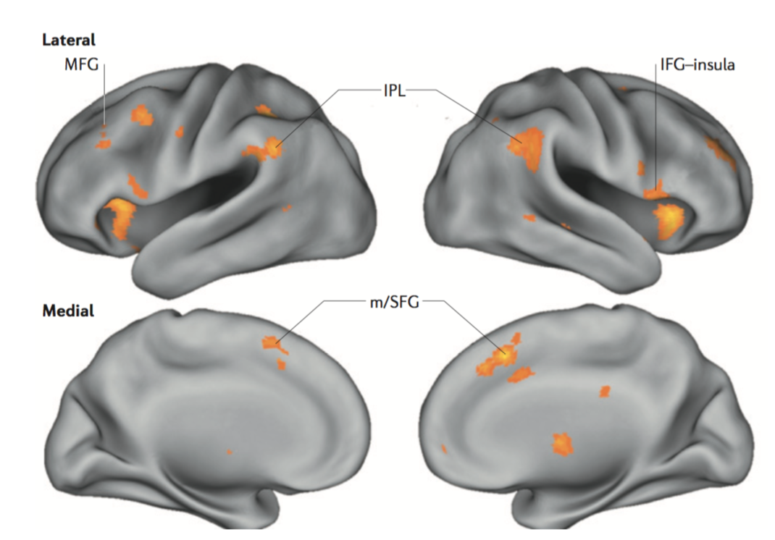
Neural correlates of deception
EEG
fMRI
Farah et al, 2014

Slide 4
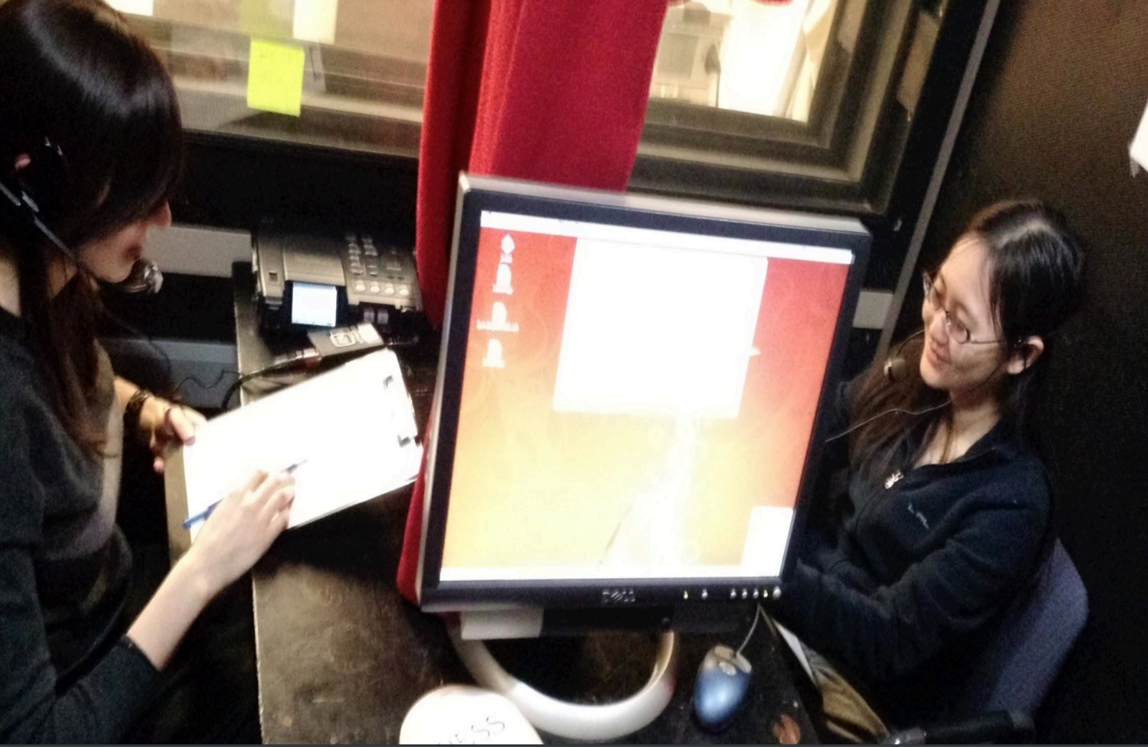
Lying Game
Levitan et al, 2015

Slide 5
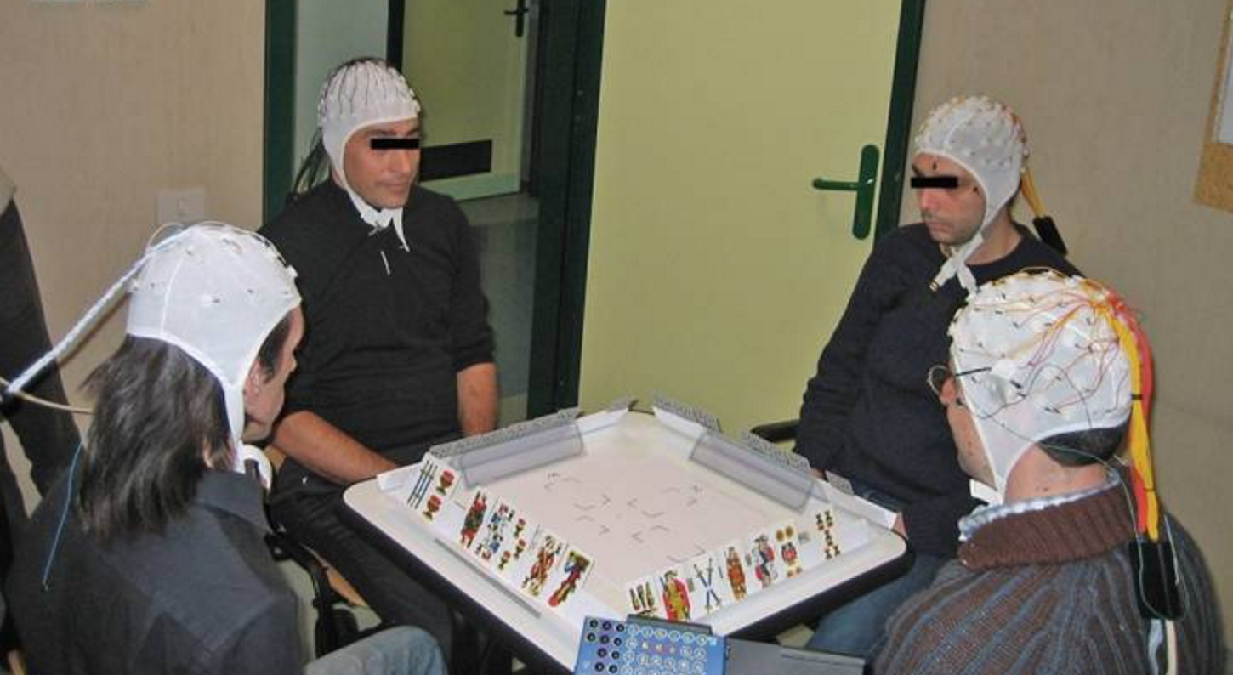
Hyperscanning
Astolfi et al, 2011

Slide 6
Experimental Design
Hyperscanning EEG during lying game
Equipment:
Simultaneous EEG system (Mesgarani)
Soundproof booth and speech recording equipment (Hirschberg)
Analyze neural oscillations in biologically relevant frequency bands
Measure of cognitive load

Slide 7
Evaluating Results
Analyze oscillatory power as measure of cognitive load
Deceiver: deception vs truth-telling
Detector: confidence
Analyze synchrony between deceiver and detector
Coherence, phase locking value, mutual information, circular correlation coefficient
Compare deception and truth-telling, including across confidence levels

