Slide 1
Quantifying the stereotype
Melody Ju

Slide 2
Mass media today
Latinos play secondary characters or extras. ~45% of Latino-coded TV characters are uncredited or unnamed.
When Latinos are visible, they appear as stereotypes: criminals, law enforcers, cheap labor, sexual objects…

Slide 3
Stereotypes on the big screen
Stereotypes are maintained for their narrative economy. A stereotyped character requires little to no introduction or development, and is quickly and completely comprehended.
Most of us do not resemble the protagonist, yet we must identify with him for the story to work. Stereotypes deflect viewer identification. On-screen marginalization is enhanced by cinematic techniques that focus the narrative on the unmistakable hero.

Slide 4
Cinematic techniques
I will focus on shot-making: framing & composition, camera angles, shot duration, etc.
Examples credited to film theorist David Bordwell and media studies professor Charles Ramirez Berg.

Slide 5
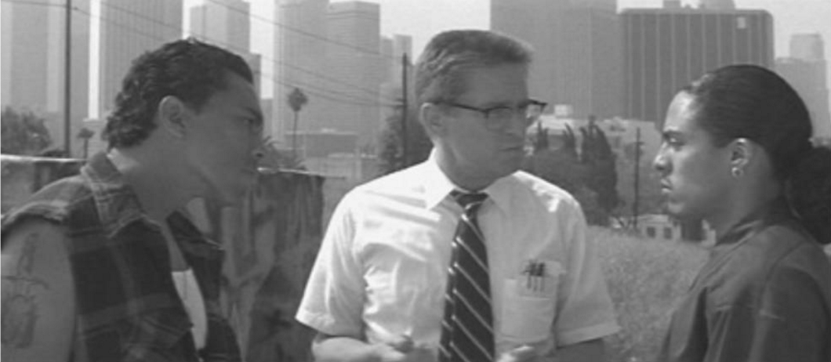
Framing

Slide 6
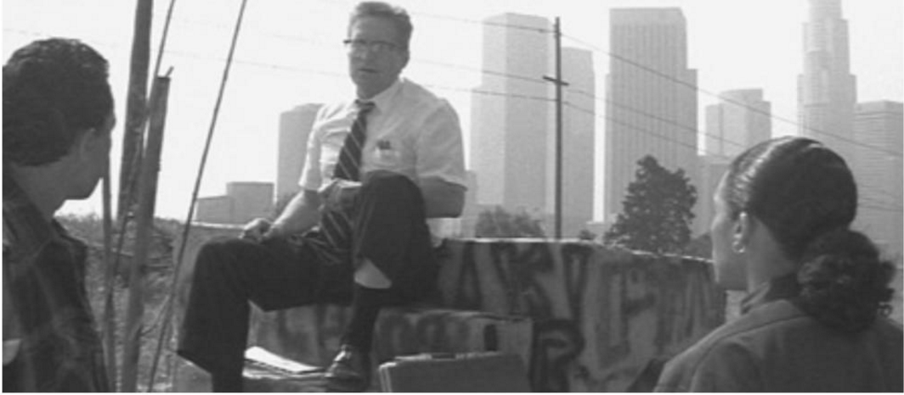
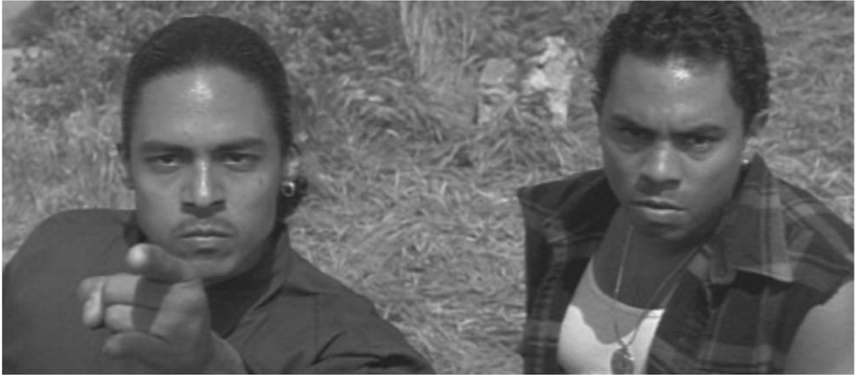
Camera angles

Slide 7
Camera movement
If a character is moving on screen, is the camera following him/her or staying still?

Slide 8
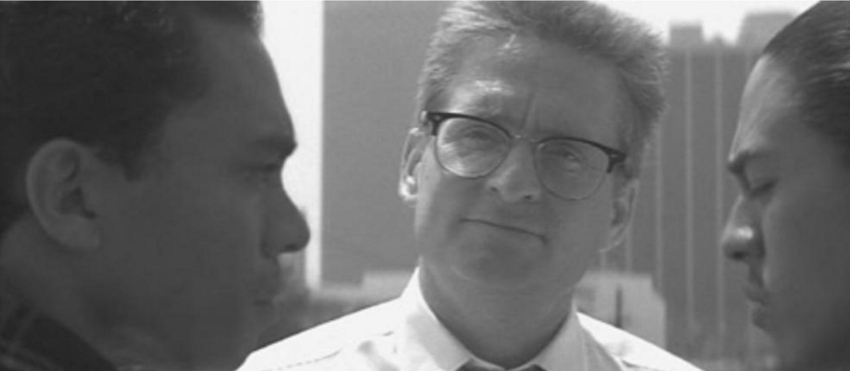
Editing

Slide 9
Stereotypes on the big screen
The human image is the most obvious part of the stereotype, but it does not act alone. Hollywood filmmakers use cinematic conventions to tell visual stories clearly and effectively. These devices work together with the character to complete the stereotypical image.

Slide 10
My goal
Move beyond superficial content analysis (spotting & counting the stereotype).
Investigate how standardized cinematic techniques contribute to the totality of the image of the stereotype.

Slide 11
Benefits of this approach
Breaking down the stereotypical image into its technical, quantifiable components may pave the way for automated content analysis and stereotype detection.
Understanding how technical decisions create the stereotypical image may help us provide filmmakers with specific, actionable criticisms.

Slide 12
Requirements
Data: Hollywood films. Datasets: Hollywood, Hollywood-2, MSR-VV.
Computer vision capabilities. Face recognition, pose estimation, shape recognition.

Slide 13
Evaluating results
Based on film theory, create a “Bechdel-like” metric to score films on the active presence of minorities.
Calculate scores for films and TV shows by extracting and automatically analyzing frames.
Compare automatically induced scores with expert viewer opinions.

