Slide 1
RGB-D Image for Scene Recognition by Jiaqi Guo

Slide 2
Outline
Introduction
Dataset & Related Works
Method & Metrics
Future Direction

Slide 3
Outline
Introduction
Dataset & Related Works
Method & Metrics
Future Direction

Slide 4
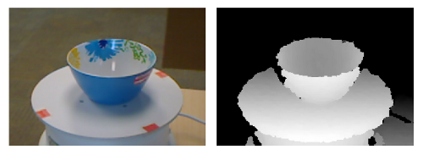
What is RGB-D?
Monocular vs. Binocular
Missing Information in Monocular Systems -- Depth
RGB Image Depth Image

Slide 5
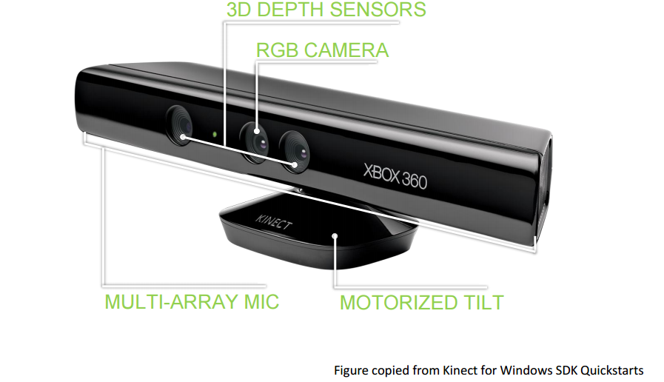
Depth Sensors
Distance between Camera and Object
Using Structured Light or ToL

Slide 6
Goal: Explore how depth information would help in scene recognition

Slide 7
Outline
Introduction
Dataset & Related Works
Method & Metrics
Future Direction

Slide 8
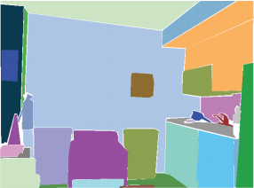
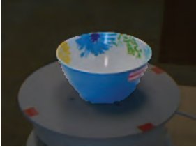
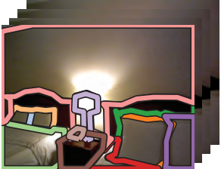
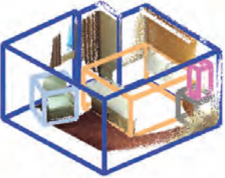
RGB-D Scene Dataset

Slide 9
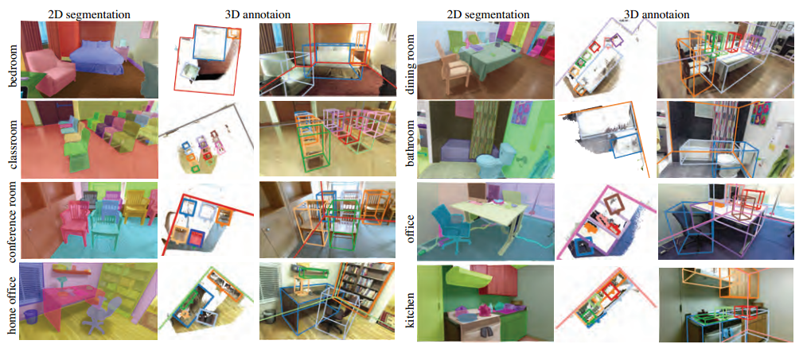
SUN RGB-D
3D Bounding Boxes, 2D Polygons & Room Layout

Slide 10
Related Works on RGB Scene
Feature Selection
Manually
Scale Invariant Feature Transform (SIFT)
Shape, Illumination and Reflectance from Shading (SIRFS)
Semantic Classes detected by Object Recognition
Automatically
Using Places convolutional neural network (Places-CNN)
Features are automatically selected in different trained layers

Slide 11
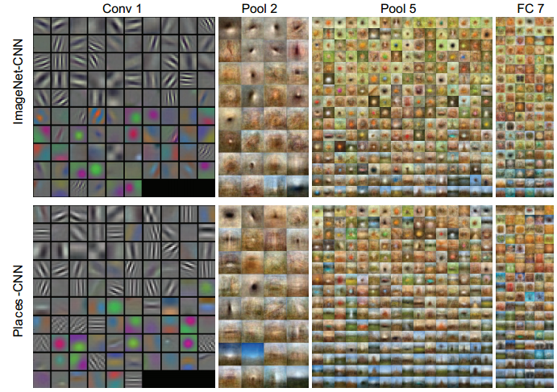
Features Selected by Places-CNN

Slide 12
Outline
Introduction
Dataset & Related Works
Method & Metrics
Future Direction

Slide 13
Explore How Depth Information Fits In
Better Segmentation Algorithms for Object Detection
Complementary Information for Other Scene Features Such as Texture, Illumination and Shading

Slide 14
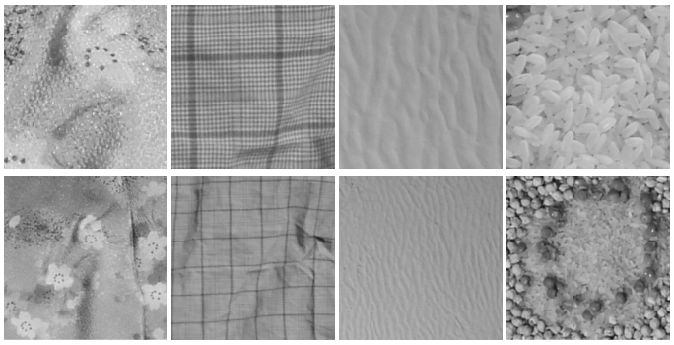
Explore How Depth Information Fits In
Same ROI, Same Texture, Different Distance (Depth)

Slide 15
Method & Metrics
Add depth information into labels when training, this would further divide the original classes into sub-groups
For each pixel, classifiers are decided according to its depth value
Separate dataset into halves and conduct controlled experiment
Control Group: Desired feature extracted from original object classes
Experimental Group: Desired feature extracted from subdivided objects groups
Evaluation would be conducted on test set for each group

Slide 16
Outline
Introduction
Dataset & Related Works
Method & Metrics
Future Direction

Slide 17
Future Direction
Whether color information is redundant
Need to determine the best range when subdividing depth
Depth map improvement: Denoise and fill gaps
Depth map improvement: Improve resolution and depth limit

Slide 18
Thank you for listening !

