Slide 1
EECS6898 Final Project Mortality Predictions in ICU
Yijing Feng
yf2375

Slide 2
Outline
Motivation
Methods
Compare(Novelty)
Database
Evaluation

Slide 3
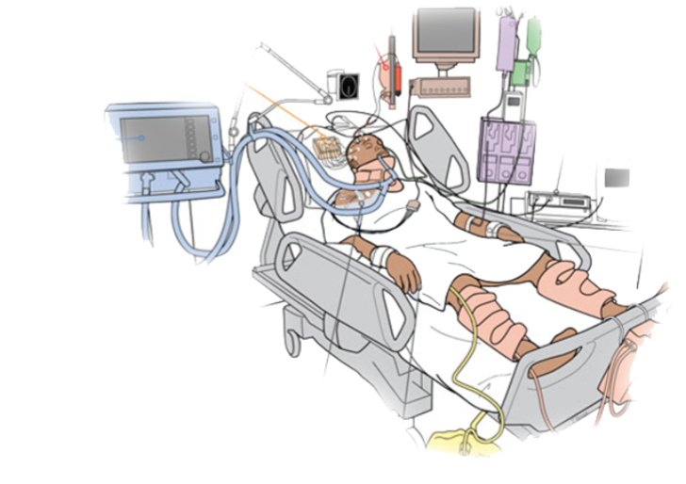
Motivation
ICUs are busy
Inadequate care staff
Conflicting even false alarms
Who needs what?

Slide 4
Severity of Illness Evaluation
 | Neurological | Vital | Respiration | Chemistry | Renal | Hematology | Coagulation | Liver
Age | Glasgow Coma Score | Temperature | CPAP | Sodium | Urine Output | Hematocrit | Platelets | Bilirubin
 |  | MAP | PaO₂ | Potassium | BUN | WBC
 |  | Heart Rate | Mechanical ventilation | Creatinine | Creatinine
 |  | Systolic BP | FiO₂ | Bicarbonate
 |  |  | Arterial pH
SAPS II : Simplified Acute Physiology Score
APACHE II: Acute Physiology and Chronic Health Evaluation Score
SOFA: Sequential Organ Failure Assessment

Slide 5
Prior Work
Numeric Data
Combination of SOIs
Decision Tree
PSM (Patient Similarity Metric)
RBF SVM
Hierarchical Dirichlet Processes
LDA topic model
Text Based Data

Slide 6
Challenges
Dynamic Data
Multivariate Data
Recovery of missing or false data
Detection of Unobserved Clinical and Demographic Features

Slide 7
Pipeline
Data Recovery & DeNoise
Time series graph
Feature Group Discovery
Mortality
Prediction

Slide 8
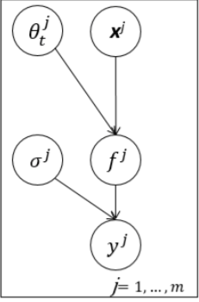
Multi-Task Gaussian Processing
Function | Advantages
DeNoise | Consider the correlation between and within multiple time-series to estimate parameters
Missing Data Recovery

Slide 9
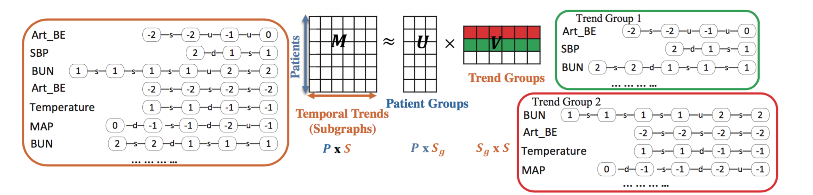
Feature Group Discovery

Slide 10
Feature Group Discovery ----Subgraph Augmented NMF
Frequent Subgraph Miner MoSS
Use NMF to group time series subgraphs by factorizing the patient-by-subgraph count matrix, (SANMF).

Slide 11
Feature Group Discovery
Subtypes of diseases
progression patterns of physiologic variables
Focus on the top subgraph groups associated with high mortality risk.
Retaining the temporal trend details
Identify some subgraph groups
Detect

Slide 12
Prediction Method
Machine Learning Method | Deep Learning Method
SVM | RNN
Regression | MLP

Slide 13
Evaluation
Recovery Quality
Mortality Prediction
Generating artificial gaps randomly
Calculate the error between prediction value of the recovered signals and reference values.
The accuracy of the mortality prediction
Compare with SAPS score

Slide 14
MIMIC-II Dataset Multi-parameter Intelligent Monitoring in Intensive Care
Bedside monitor waveforms and associated numeric trends derived from the raw signals
Clinical data derived from Philips’ CareVue system,
Data from hospital electronic archive
In and out-of-hospital mortality
Daily SAPS and SOFA score
Noise and artifact examples in the database.

Slide 15
Future Work
Combined with Text Based Notes

Slide 16
THANK YOU!

