Slide 1
Physiological Data Analysis of Neuro-Critical Patients Using Markov Models
By
Shashwat Bhoop
sb3758

Slide 2
Goal
Main goal is to enhance the way data is visualized in the neuro-critical section of the ICU concerned with patient states.
To provide better prediction estimates using a different method for data driven analysis.
To simplify the way patient state information is presented to medical staff.

Slide 3
Some background information
Patient state – A patient undergoes many states during their stay at the ICU which can be as simple as ‘dead’ and ‘alive’ to 100’s of states depending on multiple parameters like blood pressure, ICP, etc.
Data decision analysis has the following steps- choosing a model, assigning probabilities, assigning costs, developing the model, and finally, use of the model for prediction.

Slide 4
The Current Situation
For data driven analysis in the neuro-critical section of the ICU, decision trees are commonly used.
Data consists of parameters like blood pressure, heart beat rate among others.
States of the patients are represented by decision trees.
Representation is in a sequential manner.

Slide 5
What decision trees do well
They help depict patient states along with probabilities of state transitions.
This data is displayed in a visual model resembling a flow chart.
They help calculate variables like estimated costs and health outcomes.

Slide 6
The problems with decision trees
They have a hard time modelling diseases which are chronic in nature and have a lot of repeated patient states.
Thus, they are not as well suited for neuro-critical patients which may have state changes for long periods between common states.
They are less indicative of the amount of time spent in a particular state thus giving less accurate overall estimates.

Slide 7
My proposal
Use Markov models instead of decision trees for data driven analysis.
Benefits -
Can represent more than simple sequences.
Simplify data visualization as well as reduce overall number of states.

Slide 8
Benefits Continued...
Allow transitions from one state to itself to support recursion.
Provide us the amount of time spent in a state by giving the number of cycles.
Provide better cost estimate as each state has individualized average cost and time is more accurately represented.

Slide 9
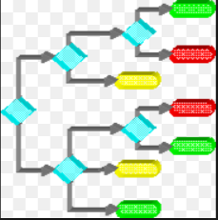
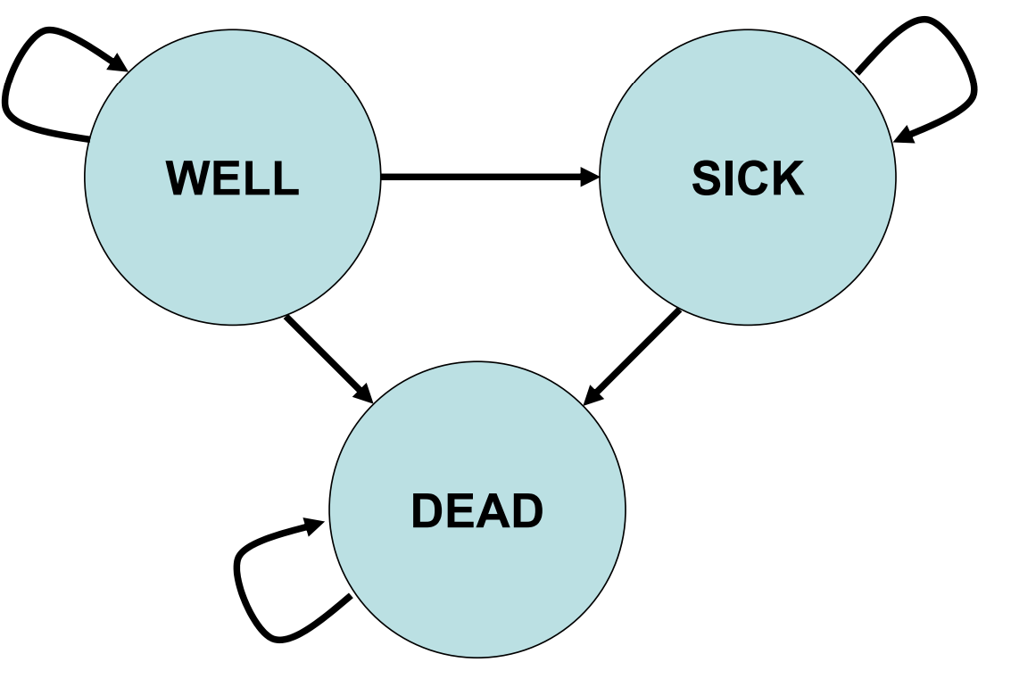
Example of Markov VS Decision Trees
State A
State B
State C

Slide 10
The Experiment
Data Required : MIMIC-III (Medical Information Mart for Intensive Care III) is a large, freely-available database comprising deidentified health-related data associated with over forty thousand patients who stayed in critical care units of the Beth Israel Deaconess Medical Center between 2001 and 2012.
The database includes information such as demographics, vital sign measurements made at the bedside,procedures, medications, caregiver notes, and imaging reports.

Slide 11
The Experiment
The first step would be to extract the desired neuro-critical ICU data from MIMIC through querying – (We need to gather the records consisting of the variation of multiple parameters related to brain injuries along with any significant changes of state of the patient such as a type of secondary brain injury.
Then perform data driven modelling of the patient data from different states to other states based on amount and type of medication as decision parameters which were given to the patients at different times according to the data.
Thus, we have to perform the data driven analysis steps mentioned earlier for both decision trees and markov models.
At this step, we have obtained both decision trees and markov models corresponding to the same patient data.
Then we implement both the models at the same hospital. We make both the models available to medical staff and allow them to use what feels better.

Slide 12
Steps to evaluate results
6. We predict cost and state based on both decision trees and markov models for incoming patients.
7. We get the actual cost, the time taken for prediction, and states which the patient went through and record these.
8. We now compare the prediction accuracy for the two different models, the average time taken for the prediction, and the prediction accuracy for the costs.
9. One more thing step the experiment takes is the recording of feedback from the doctors and medical staff after a suitable time period like 4 months, which basically tells us which method was simpler to use, which was easier to understand, which they preferred using and so on.

Slide 13
Concluding Comments
1. The success can be checked through the graphical representation of the prediction accuracy for cost and patient states, and the time taken for prediction for both of the models. We could do these accuracy checks for different time periods as the models mature like for different months.
2. Also, the feedback from the medical staff would need to be incorporated with a high weight percentage because it represents the user feedback from direct implementation.
3. Depending on the type of values we obtain in the comparison, we may attempt to come to a conclusion on the success of markov models.
4. An example graph for prediction accuracy by month is –

Slide 14
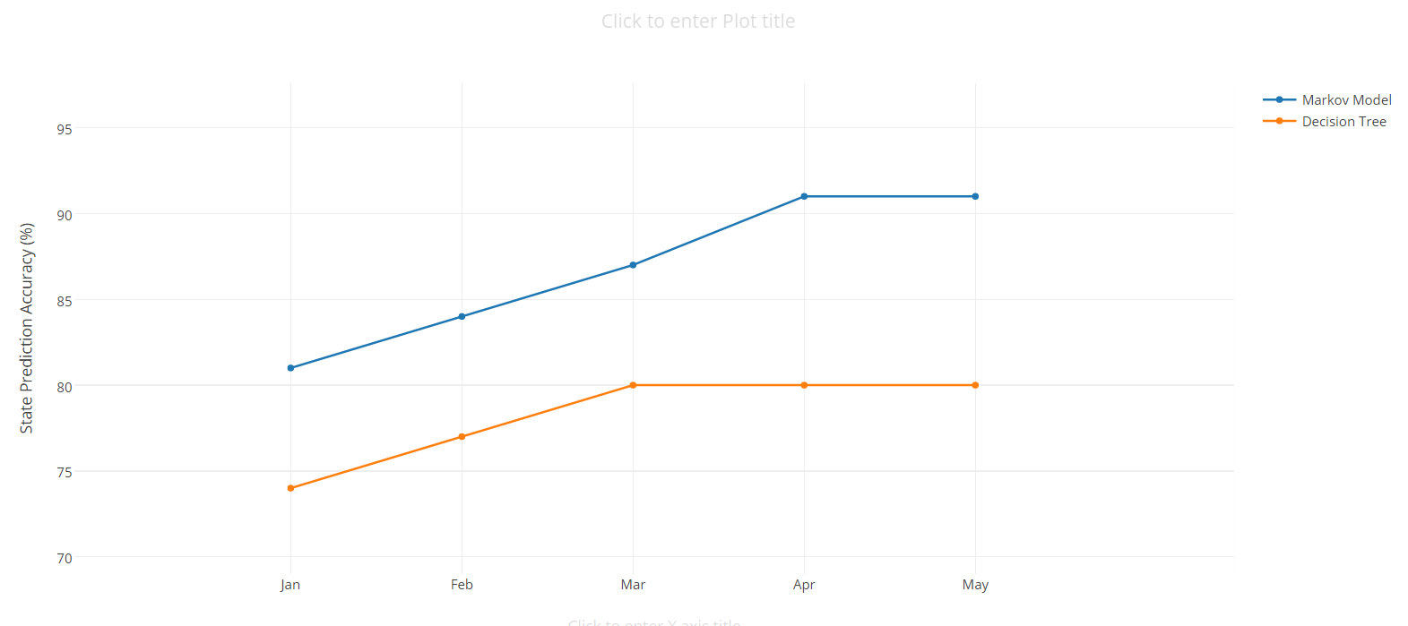
An example graph for prediction accuracy by month is –

Slide 15
Thank You

