Slide 1
The Emerging Scholars Program COMS 1404
www.cs.columbia.edu/esp

Slide 2
About ESP
Weekly workshops: 75 minutes on Fridays
Discussion and group problem solving
Wide variety of CS topics
Small peer groups (~12 students per group or fewer)
Led by an undergraduate peer leader
No homework; No programming
Not extra help for your intro CS class

Slide 3
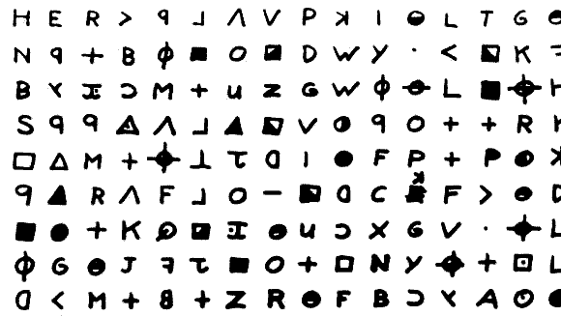
Topics
Natural Language Processing: How do computers speak, listen, read, summarize, and analyze tone?
Computational Linguistics: Using computers to model, analyse and decode language

Slide 4
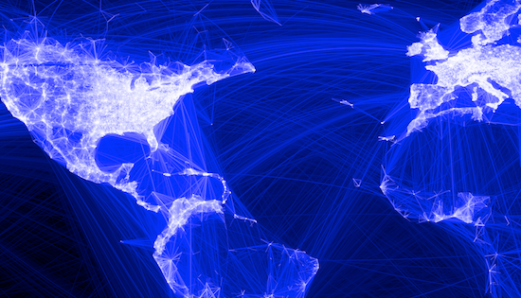
Topics
Graphs and Social Networks
What can we learn about a person from their friend feed? How do advertisers use influencers to maximize their brand exposure?

Slide 5
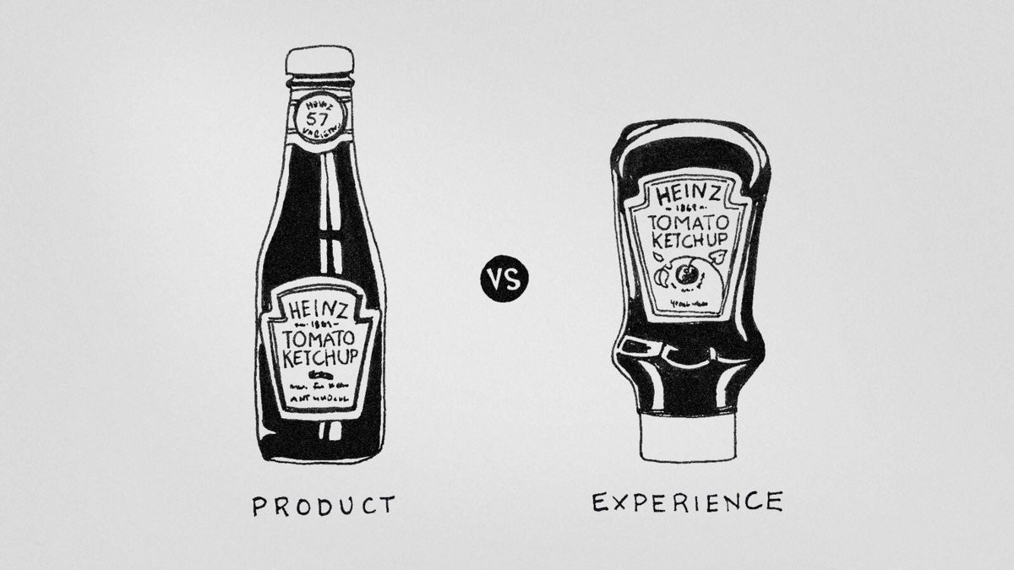
Topics
Usability and Human-Computer Interaction
Designing technology that works for people

Slide 6
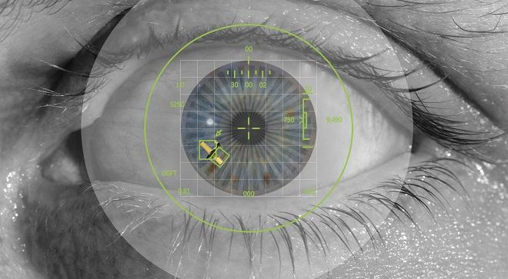
Topics
Computer Vision
How do machines see?

Slide 7
Topics
Cryptography
Hacking and protecting data

Slide 8
Topics
Machine learning
Teaching machines to classify and predict

Slide 9
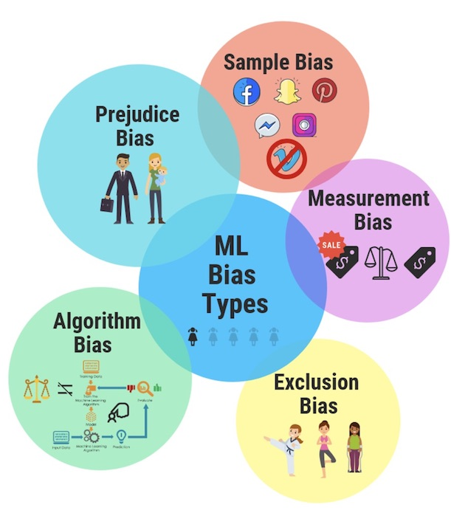
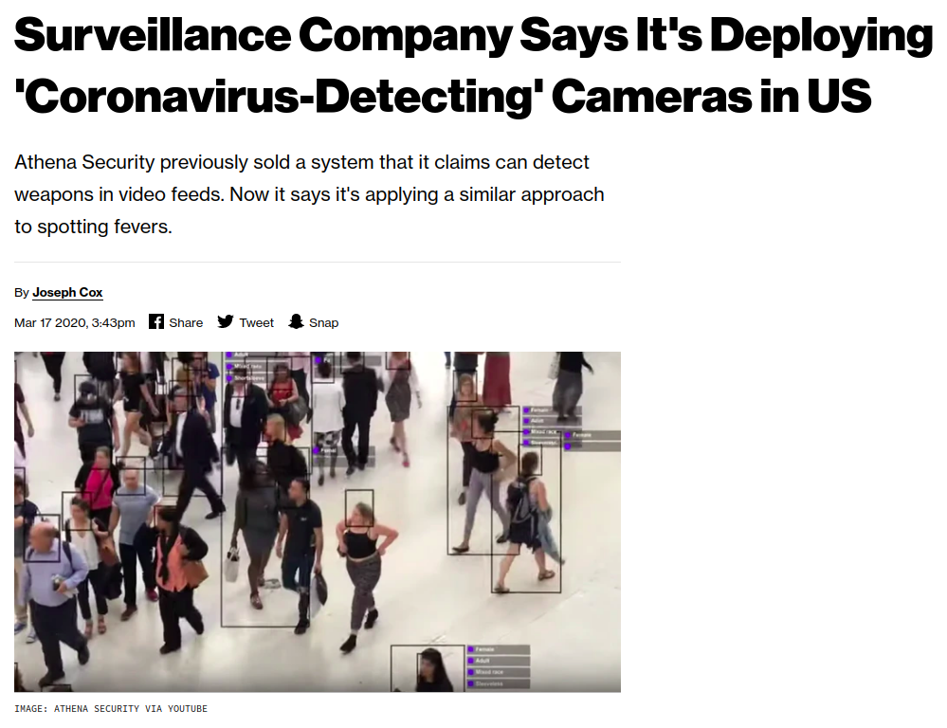
Topics
Computer Science and Society
Unraveling the ways in which computer science affects the world

Slide 10
Why join ESP?
Learn about upper-level CS topics and applications and discover your CS interests
Build a CS peer group
Peer leader “office hours”
Final research symposium
Free snacks every Friday
Easy application: quick to fill out, targeted at first and second year students, no previous computer science background assumed.

Slide 11
Apply today!
Find the application at www.cs.columbia.edu/esp or linked in an upcoming email.
Due Monday, 1/23 at 11:59 PM EST.
Sometimes more applications than slots.

