Slide 1
Technology and the COVID-19 Pandemic
A Case Study in Society and Computer Science Ethics
Notes:
Some of the examples are very March 2020 - feel free to skip through them to the ones that seem most interesting to you; there’s plenty of material here!

Slide 2
How is technology being used?
The Good

Slide 3
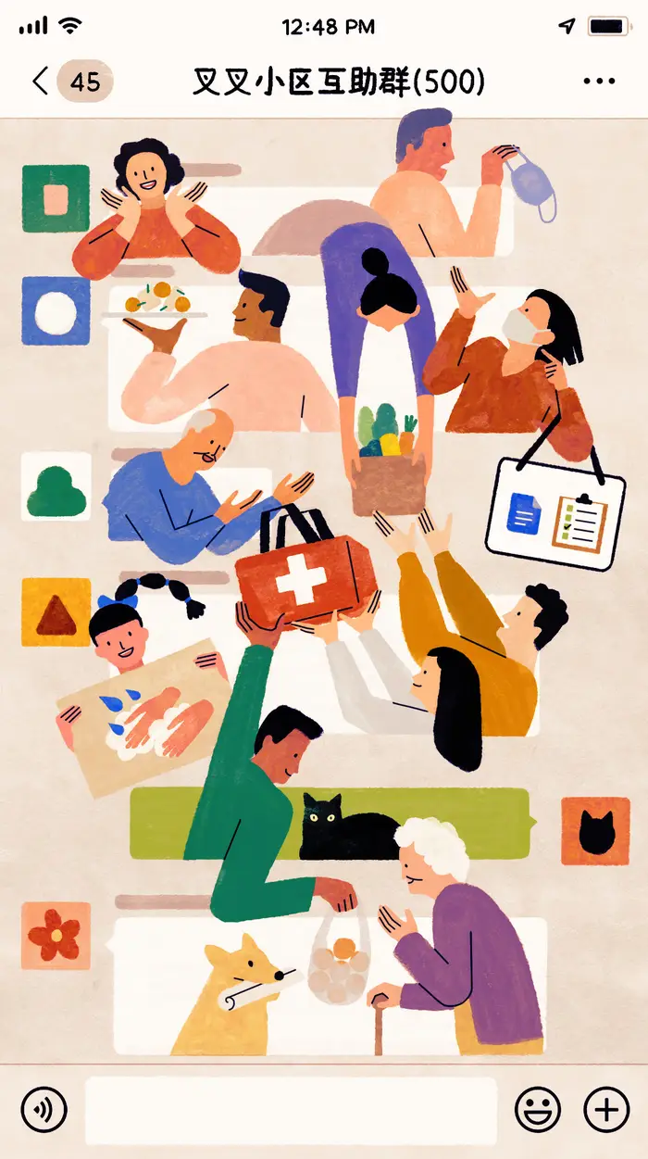
Connecting People
Telecommunications technology has become critical societal infrastructure.
The world wide web is allowing us to stay in touch with our family and friends, form hyperlocal groups to cope with the crisis, virtualize school, work, and other institutions, provide entertainment, coordinate charity and emergency response, and much much more.
Yifan Wu for BuzzFeed News
Notes:
Discussion: Mental exercise of stepping backward in steps of 10yrs- imagine pandemic in 2020 then 2010-...-1990. (The real change is in technical infrastructure, which varies by region.)
Mexico school broadcasted on tv
The coronavirus pandemic has highlighted how telecommunications technology, and in particular the internet and world wide web, have become critical societal infrastructure. The world wide web is allowing us to maintain our traditional friends-and-family connections, allowing hyperlocal groups to form to respond to the crisis together, allowing our institutions to virtualize school and work, providing needed entertainment under all our pressure, allowing the coordination of charity, emergency response, and much more. And all the while responding admirably to the sudden demand changes.
What has changed socially?

Slide 4
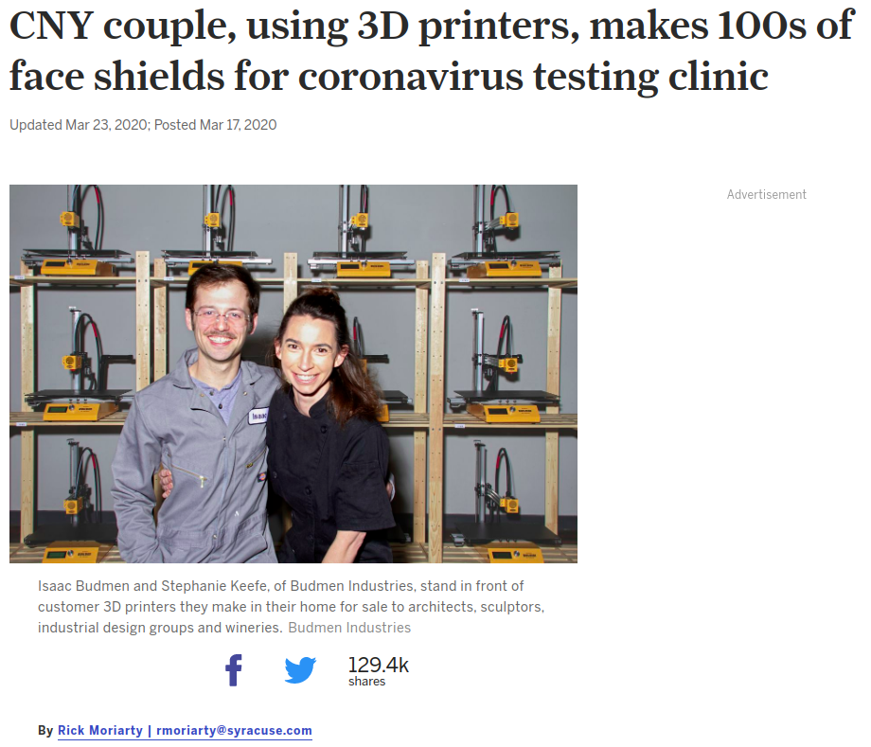
Emergency 3D Printing
3D printing enthusiasts worldwide are helping to fill some of the emergency demand for products.
A couple in Liverpool, New York designed a printable face shield and posted the design online.
Notes:
Foreshadows the future of manufacturing economy- reduced turnover time coz of flexible economy
CNY==NYC’
Columbia makerspace (may have) done this

Slide 5
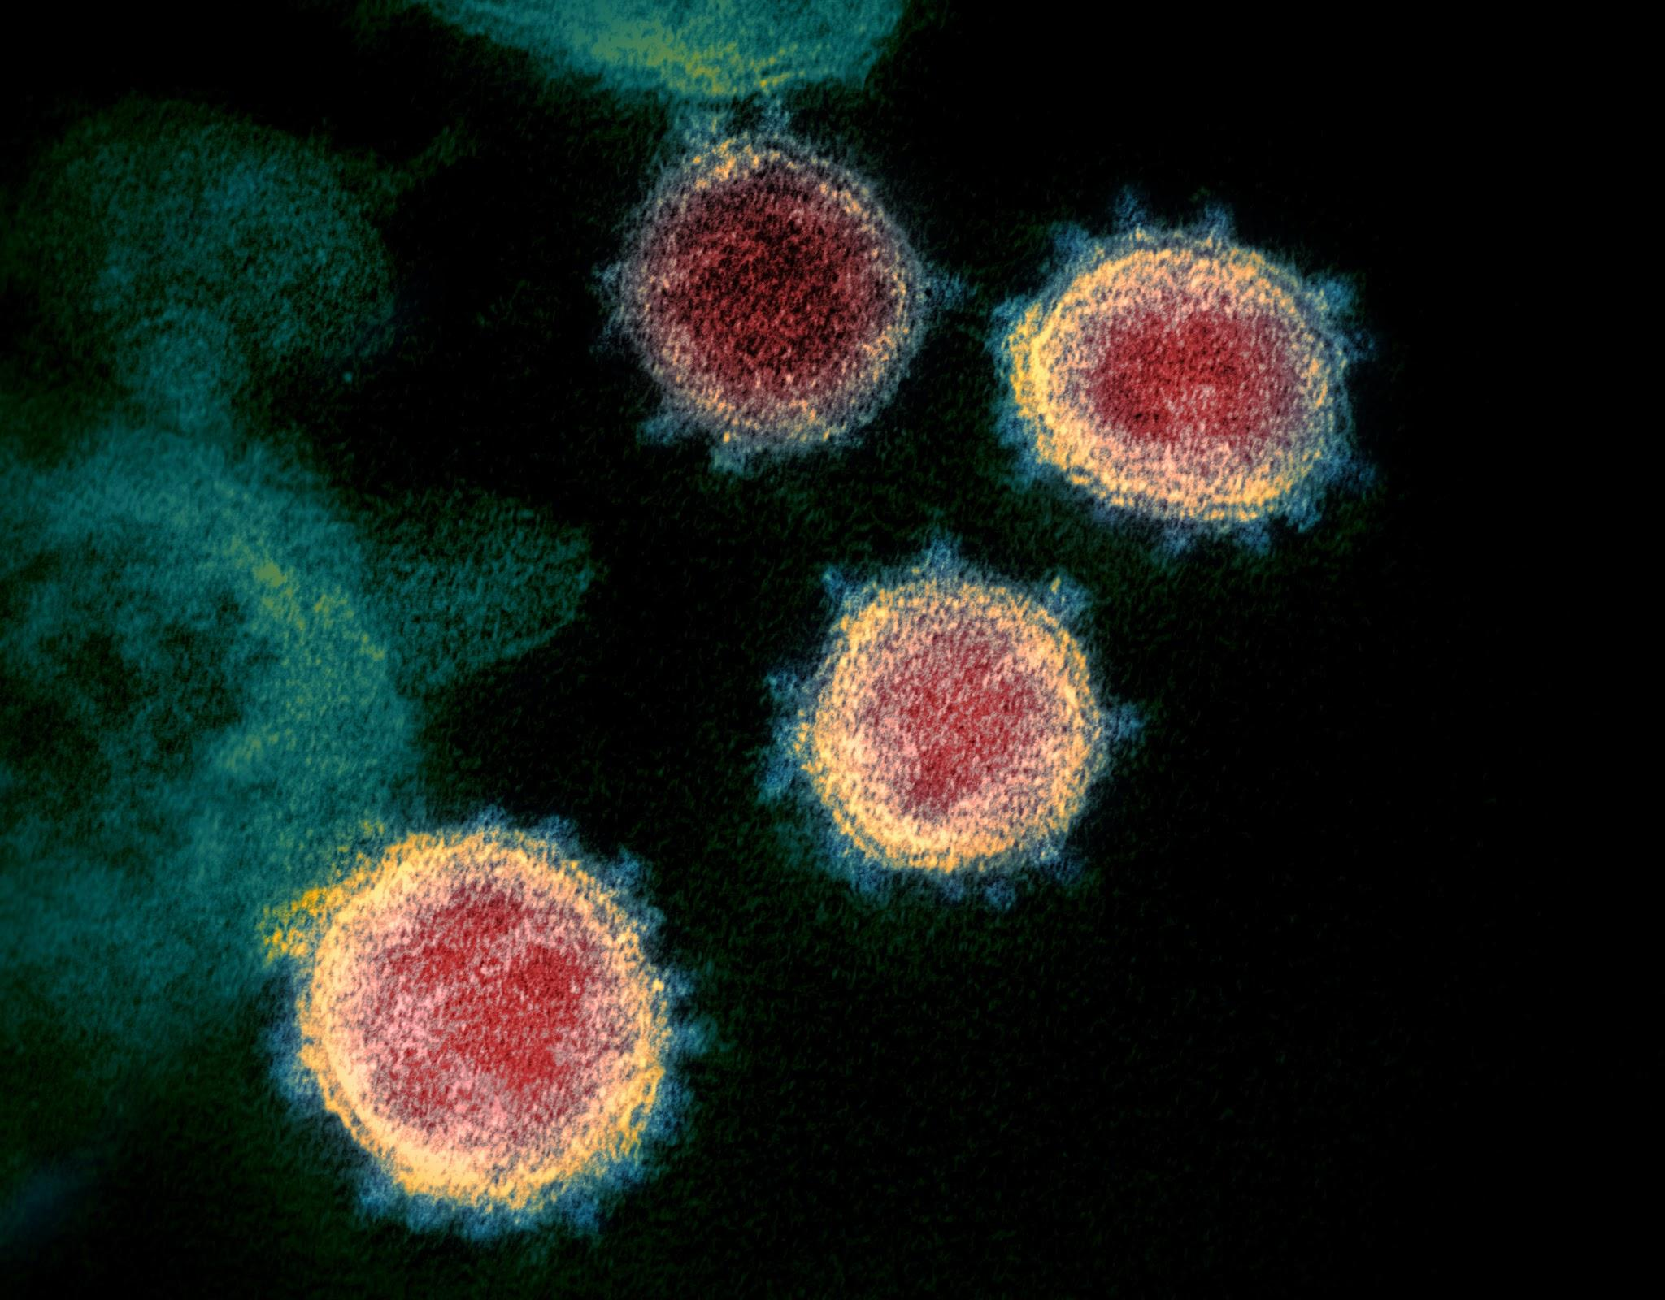
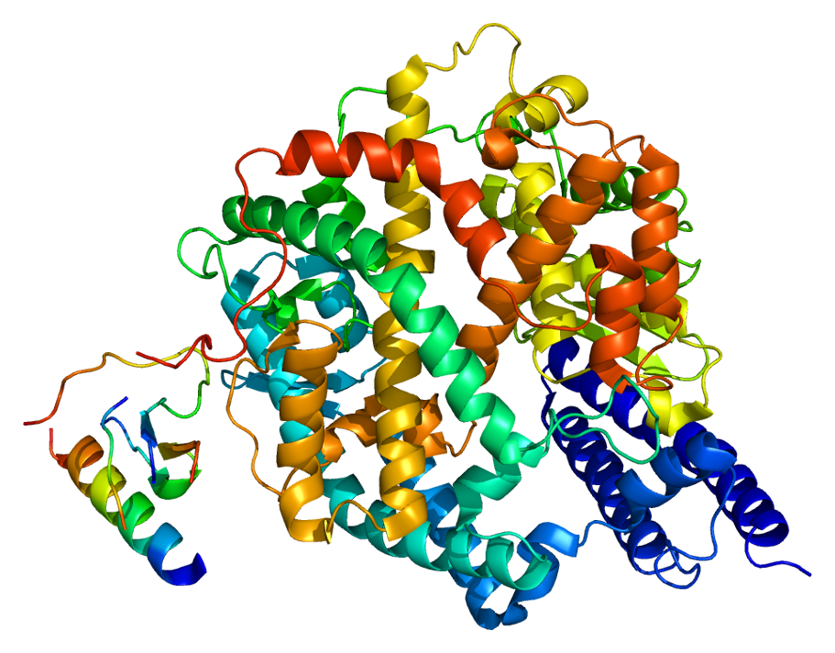
Citizen Science
Fold@home is a project that allows individuals to volunteer their computing power to study protein dynamics through simulation.
Fold@home is running simulations to understand COVID-19 and potentially develop therapeutics.
Top: coronavirus. Bottom: An enzyme ACE2 associated with coronavirus uptake.
NIAID / CC BY (https://creativecommons.org/licenses/by/2.0)
EMW / CC BY-SA (https://creativecommons.org/licenses/by-sa/3.0/deed.en)
Notes:
Top Photo Description: This transmission electron microscope image shows SARS-CoV-2—also known as 2019-nCoV, the virus that causes COVID-19—isolated from a patient in the U.S. Virus particles are shown emerging from the surface of cells cultured in the lab. The spikes on the outer edge of the virus particles give coronaviruses their name, crown-like. Credit: NIAID-RML
Bottom Photo Description: Structure of the ACE2 protein. Based on PyMOL rendering of PDB 1r42.

Slide 6
How is technology being used?
The Bad

Slide 7
Zoom Bombing
Exploiting security issues in software.
Bombers, who can be as young as preteenagers, have raided everything from kindergarten classes to substance-abuse support group meetings.
Beyond Zoom, how do you plan for a pandemic security scenario?
CS 1004 was Zoom-bombed Spring ‘20.
Notes:
Discussion: ask for zoom bomb experiences
Security mindset: likely problem points for zoom security-> seal up access points for inc security
Essential tools/infrastructure for pandemic
What are attack factors
Security expert balances public uses tools while being secure/have a fall back
Has this happened to you? (Similar to doxxing on Twitter or elsewhere)

Slide 8
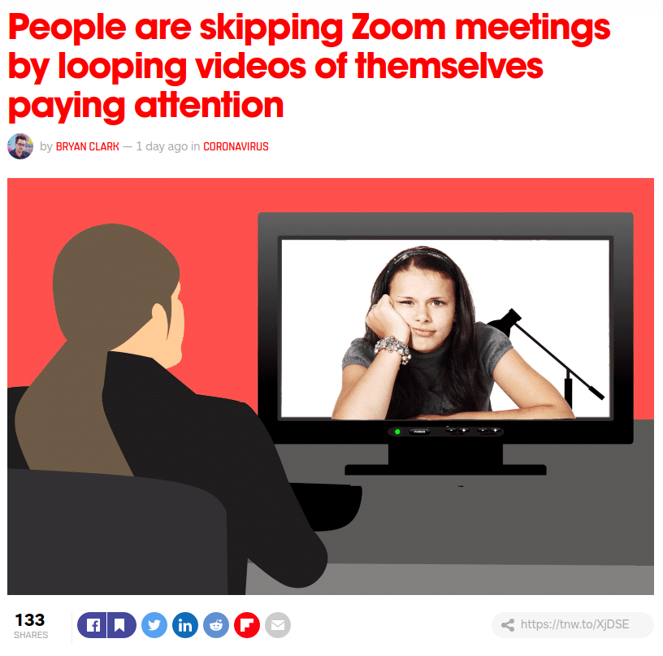
Avoiding Commitments
Are you there???
Did we make these slides for nothing?
Are you there???
Notes:
Or just turning your camera off… hint hint

Slide 9
How is technology being used?
And the Fuzzy

Slide 10
Privacy

Slide 11
Telling A Cautionary Tale
A young man died of the coronavirus. His passing was shared on Twitter to caution other young people against dismissing the dangers of the virus to them.
The tweet sharing his story revealed his sex, age, employer, approximate time of death, and alleged the cause of death.
Do you think this is enough to identify him?
Notes:
Presenters: You can discuss with the students here whether they feel this is appropriate or not: Is it okay to share this information at all? Is Twitter an appropriate venue for the dissemination of this news? Is it okay to reveal the young man’s identity?

Slide 12
Re-identification in the Information Age
Linking an anonymized data record to an individual is called a re-identification attack.
Often public records and a few pieces of information are enough.
In 1998 Latanya Sweeney famously re-identified then-Massachusetts Governor William Weld from anonymized health records which released his date-of-birth, sex, and zip code.
Notes:
https://en.wikipedia.org/wiki/Latanya_Sweeney

Slide 13
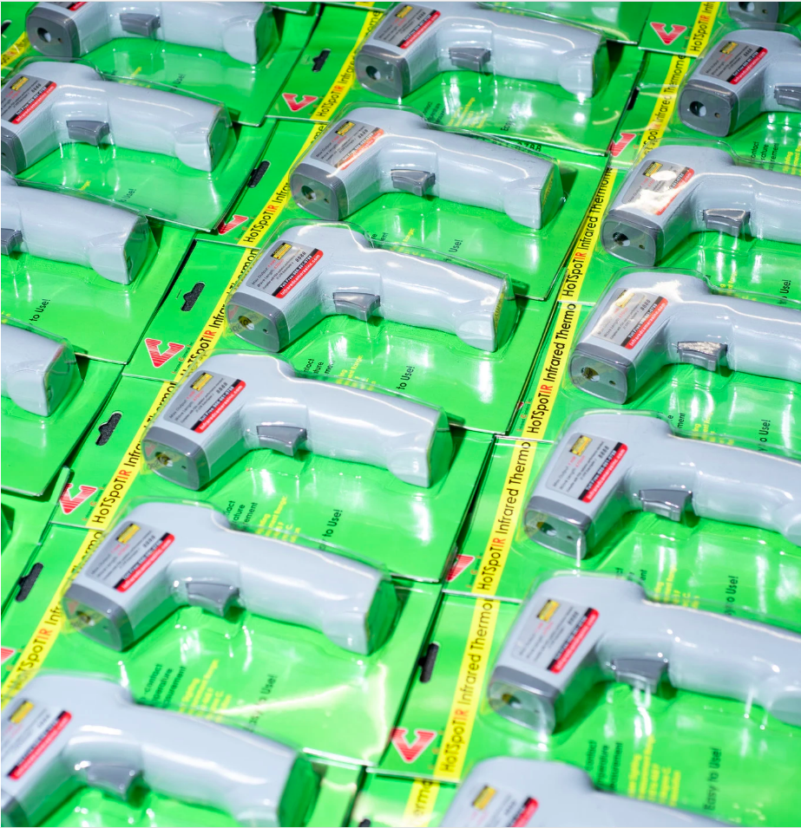
DeTechting the Coronavirus
Fever presents in 87.9% of symptomatic cases.
Thermometer guns are being widely deployed worldwide to check the temperature of citizens.
What are the privacy implications?
What if the guns are inaccurate? How accurate is good enough?
Notes:
Many restaurants now require your name and phone number for contact tracing. This poses a similar privacy/health security tradeoffs.

Slide 14
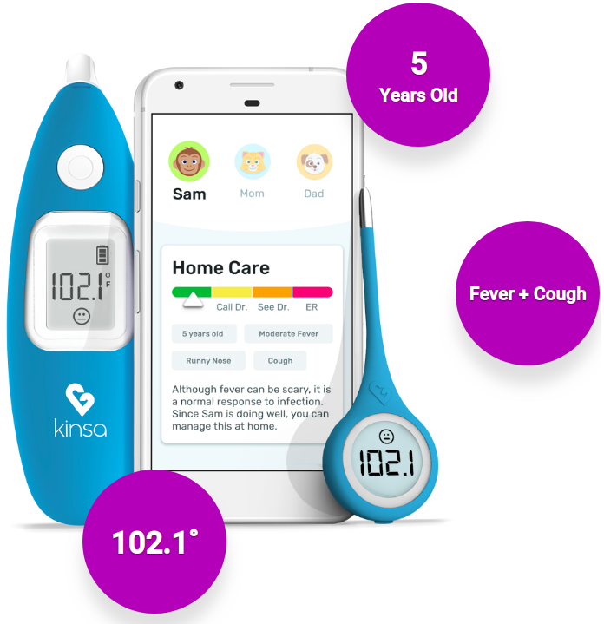
Surveillance-Capitalism Style: “Smart” Thermometers
Kinsa Smart Thermometers require an app to use. Readings are transmitted back to Kinsa.
For COVID-19 Kinsa used the data to build a tool to “guide public health first-responders to the areas needing further investigation and resources, because something outside of the ordinary is happening.”
Notes:
Potential benefit: early awareness of COVID spread in a community. Potential downside: private health data could leak.

Slide 15
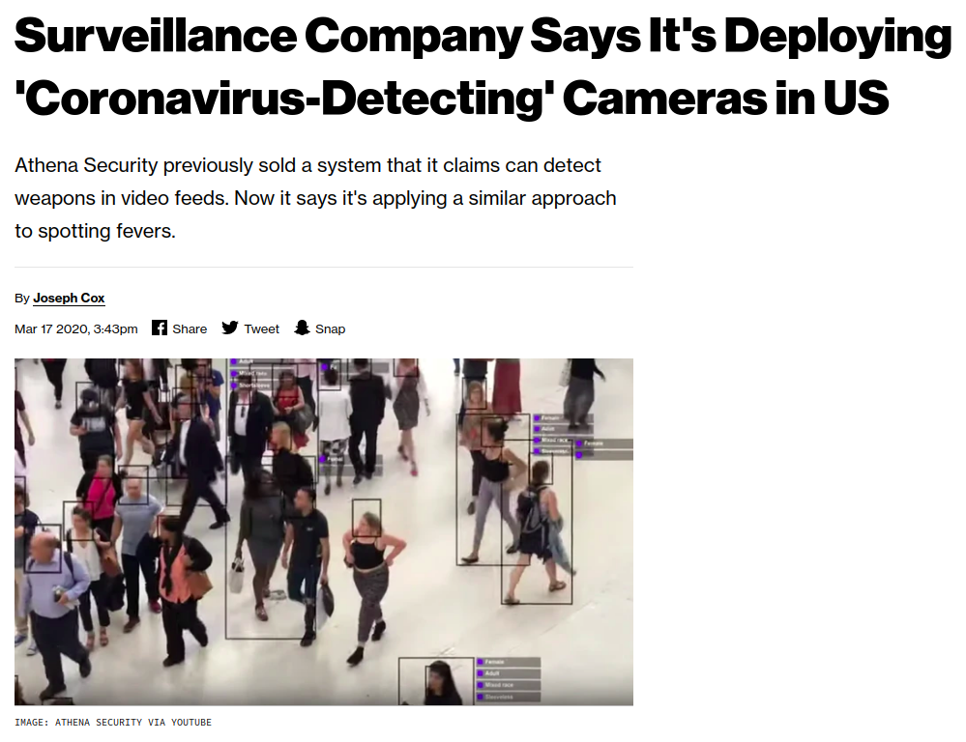
Detection via Computer Vision
What if infrared cameras and computer vision are used to screen individuals for fevers? How does your privacy analysis change?
Notes:
Google search history can be used to detect outbreak in communities, ‘temperature’ went up in
US Government using facial recognition technology to identify capital rioters https://statescoop.com/facial-recognition-capitol-riot-charlie-baker/
Cellphone tech to track rioters: https://theconversation.com/how-law-enforcement-is-using-technology-to-track-down-people-who-attacked-the-us-capitol-building-153282
https://www.washingtonpost.com/technology/2021/01/08/trump-mob-tech-arrests/

Slide 16
Facial-Recognition Contact Tracing
What about determining who has been in proximity to an infected person by identifying them in video?
Does it make a difference if the computer vision system actually identifies people or merely predicts whether they have a fever?
Notes:
Is this more or less okay in the workplace vs. in public?

Slide 17
Facial Recognition (Continued)
What if the facial recognition software produces too many false positives? Or false negatives?
What if it is biased in racial, gendered, socioeconomic or other similarly problematic ways?

Slide 18
Collaborative Contact Tracing
Remember the crypto session?
Private Kit: Safe Paths is an app that once fully developed can allow fully private contact tracing.
Individual’s location data is stored locally on their device.
Broadcasts of infected individuals’ location trails can be locally and cryptographically compared against the user’s location trail, and notify the user if they have been in close proximity to someone who tested positive.
Notes:
What do students think of this? Practically: To be effective requires widespread use, and users have to opt to share the fact that they have tested positive with the app. Equity and inclusion concerns: What about populations without smartphones? Zooming out from the application: What are the consequences of building potentially indispensable healthcare infrastructure on commercial platforms of surveillance?
is the NYC Covid App actually secure?

Slide 19
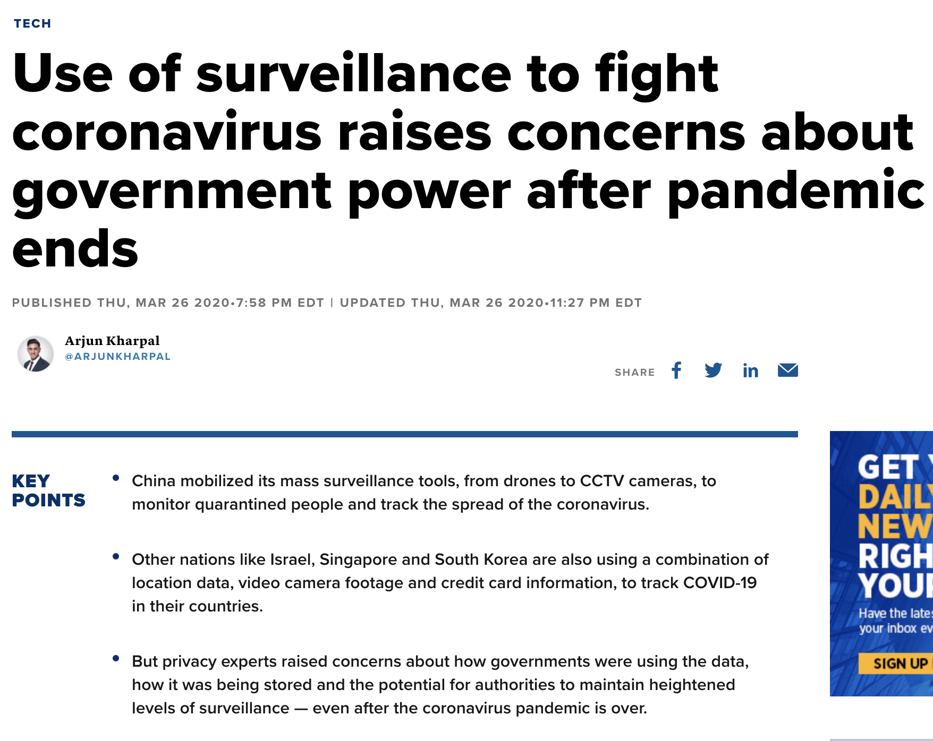
Notes:
https://www.cnbc.com/2020/03/27/coronavirus-surveillance-used-by-governments-to-fight-pandemic-privacy-concerns.html
similar to patriot act

Slide 20
Tech Democratization

Slide 21
To Viz or Not to Viz?
High quality tools, massive compute, and large amounts of publicly available and privately accumulated data have led to a tsunami of COVID-19 related visualizations.
How is this good? How is this bad? When is this fuzzy? How do we navigate the fuzz?
Professor Evan Peck, an HCI researcher at Bucknell University has a great tweet thread on this.
Notes:
A good way to think about this problem is a world map, i.e a sphere is hard to represent, and how some maps make countries seem bigger than what they are; likewise covid is a complex problem and it is hard to represent accurately
twitter thread - > comments on how different visualizations each have their tradeoffs, i.e COVID data has a certain uncertainty/error margin that a lot of viz. may not include
raw numbers may easily mislead the public, because covid grows exponentially(100 confirmed cases is probably not far from actually being 1000 cases) -> relying on raw numbers means we're accurately portraying the values, but inaccurately portraying the situation.
People believe story of the vis they see; different portrayals tell different stories
Last problem is that COVID data is outdated quickly

Slide 22
Access to Online Learning
Many schools and universities worldwide (can you name one?) have transitioned to online classes.
On 3/26/20, the New York times ran a story on a girl who couldn’t access virtual education because the homeless shelter in which she lives had no Wi-Fi. Many others face barriers to working or learning from home because they don’t have the right technology.
Notes:
How have Professors adapted to online learning? Testing strategies, homeworks, camera policies, cheating…
How much are we actually learning?

Slide 23
Free Speech, Content Moderation, and Censorship

Slide 24
Freedom of (Mis)information
Apple, Google, and Twitter, among others, are censoring content related to COVID-19. On Twitter:
Content that may be removed includes “denial of global or local health authority recommendations” (such as discouraging people from engaging in “social distancing”); descriptions of “ineffective” treatment or prevention methods, “even if made in jest”; “denial of established scientific facts” from “global and local health authorities”; urging people to go out to local businesses in defiance of government mandates; statements such as “ignore news about COVID-19, it’s just an attempt to destroy capitalism by crashing the stock market”; “unverified” claims that could “incite people to action and cause widespread panic”; impersonation of official government bodies, including parody accounts; and more.
Supporters argue that these measures will save lives. When is it appropriate to curtail speech? Can we make principled distinctions here?
Notes:
More recently (than these slides) many right-wing conspiracy accounts (including the former president) have been banned on Twitter, FB, and YouTube. How do you decide the boundaries of political speech? Live fact-checking and automatically flagged content is now a thing. (Parler, etc.)

Slide 25
Whose Voices are Amplified?
Politicians? Public health experts? Celebrities? Public figures?

Slide 26
Data: Its Limitations, Biases, and Rhetorical Forcefulness

Slide 27
What is the case fatality rate?
Country-level differences lead to different estimated case fatality rates.
Yet there is a tension in plausibly explaining large differences.
Different modeling assumptions lead to different estimates for disease parameters.
Large amounts of uncertainty, and a high velocity of data generation and dissemination complicate estimation and communication.
How to do all this responsibly?
Notes:
Science done quickly in pandemic- leads to misinfo and confusion. This is also related to vaccine development and rollout. How do you balance safety (and the blowback from a potentially unsafe health advice/vaccine) with wanting to make progress as quickly as possible?

Slide 28
You Visualized What?
Remember Kinsa with it’s smart thermometers?
Their data is temperature readings of thermometer applications.
Who has these thermometers? Whose temperatures are being taken?
One of the maps their tool produces is a heat map of the “7 Day Trend in Illness Levels.” Here it is updated for March 25.

Slide 29
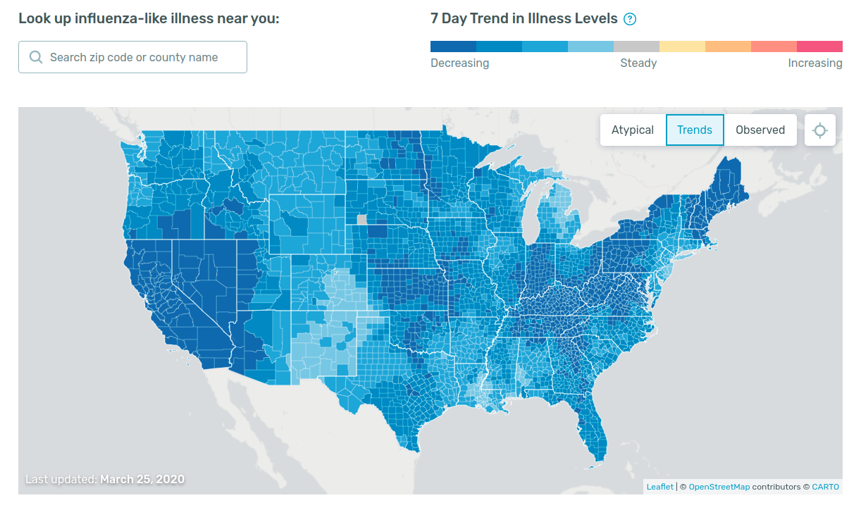
Visualizing Trends in “Illness”
What story does this map tell?
How does that story change as you take into account your background knowledge about the pandemic?
Note that this is 3/25/2020.
Notes:
blue= decreasing
red= increasing
Doesn’t give relevant info abt pandemic- blue areas not necessarily doing best.

Slide 30
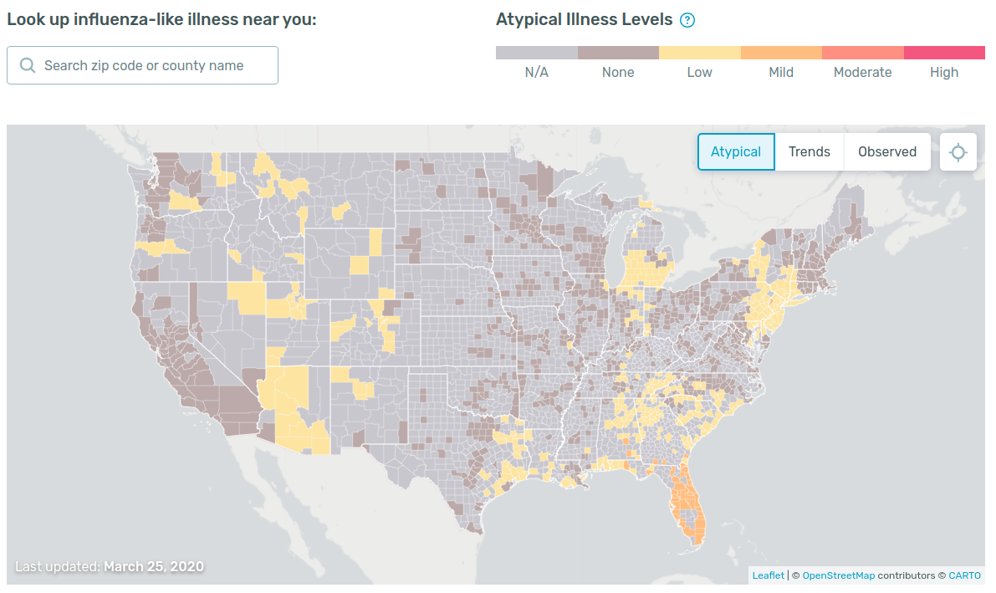
Mapping (In)Equity in Data Collection
Kinsa also publishes a map of “Atypical Illness Levels.”
Remember those equity issues we mentioned?
Large swaths of the map are labeled N/A because they do not have enough data to apply their model.
Notes:
equity issues-data more relevant in certain areas where counties have the thermometers

Slide 31
A Final Thought:
Are these problems of the tech? Or problems exposed by the tech?

Slide 32
Technological Solutionism versus Luddism
Notes:
Luddism -> Luddites that reject advanced tech; means people that reject technology because they do not think its useful

Slide 33
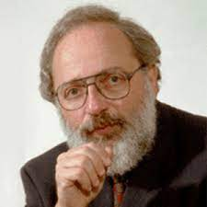
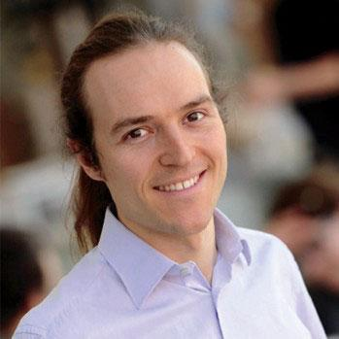
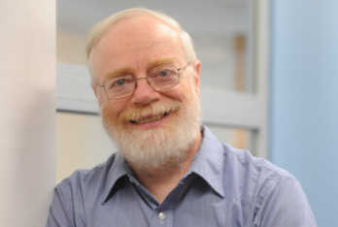
CS, Ethics, and Society at Columbia
Ron Baecker Augustin Chaintreau Steve Bellovin
Notes:
equity issues-data more relevant in certain areas where counties have the thermometers

Slide 34
DNS Abuse
Using technologies to exploit people.

