Slide 1
Computer Vision

Slide 2
What is vision?
A general definition with two components:
Sensing device:
Captures as much details from an image as possible
Interpreting device:
Process the information and extract meaning from it

Slide 3
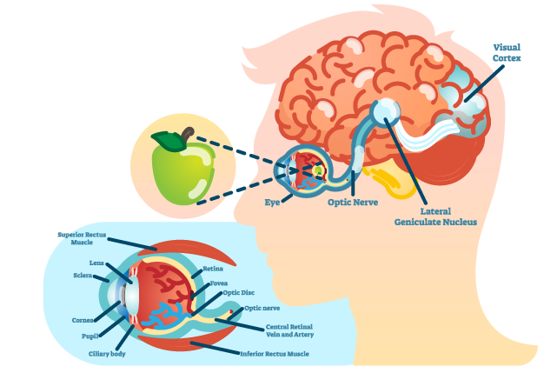
What is vision for humans?
Notes:
Light rays reflect off an object and enter the eyes through the pupil
Your cornea and lens bends and refracts the light rays
The retina has cells called rods and cones which convert the light into electrical signals
These pass along the optic nerve to your brain which then process them to create an image

Slide 4
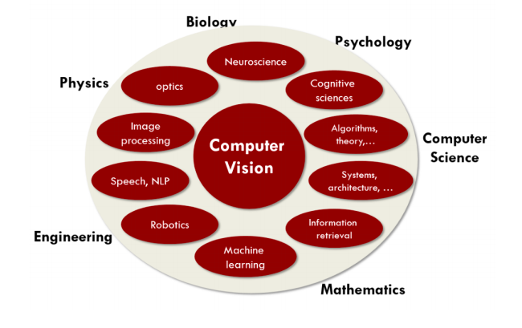
What is vision for computers?
Computer vision is building algorithms that can understand the content of images and use it for other applications
Interdisciplinary field:
Neuroscience can help computer vision by first understanding human vision
Need physics to understand the nature of color, light
Math: all images are inherently treated as large matrices
The challenge of CV can be described in terms of building a signal-to-symbol converter.
The world presents itself as physical signals, we try to make sense of these signals and convert them into symbolic, representations of the world

Slide 5
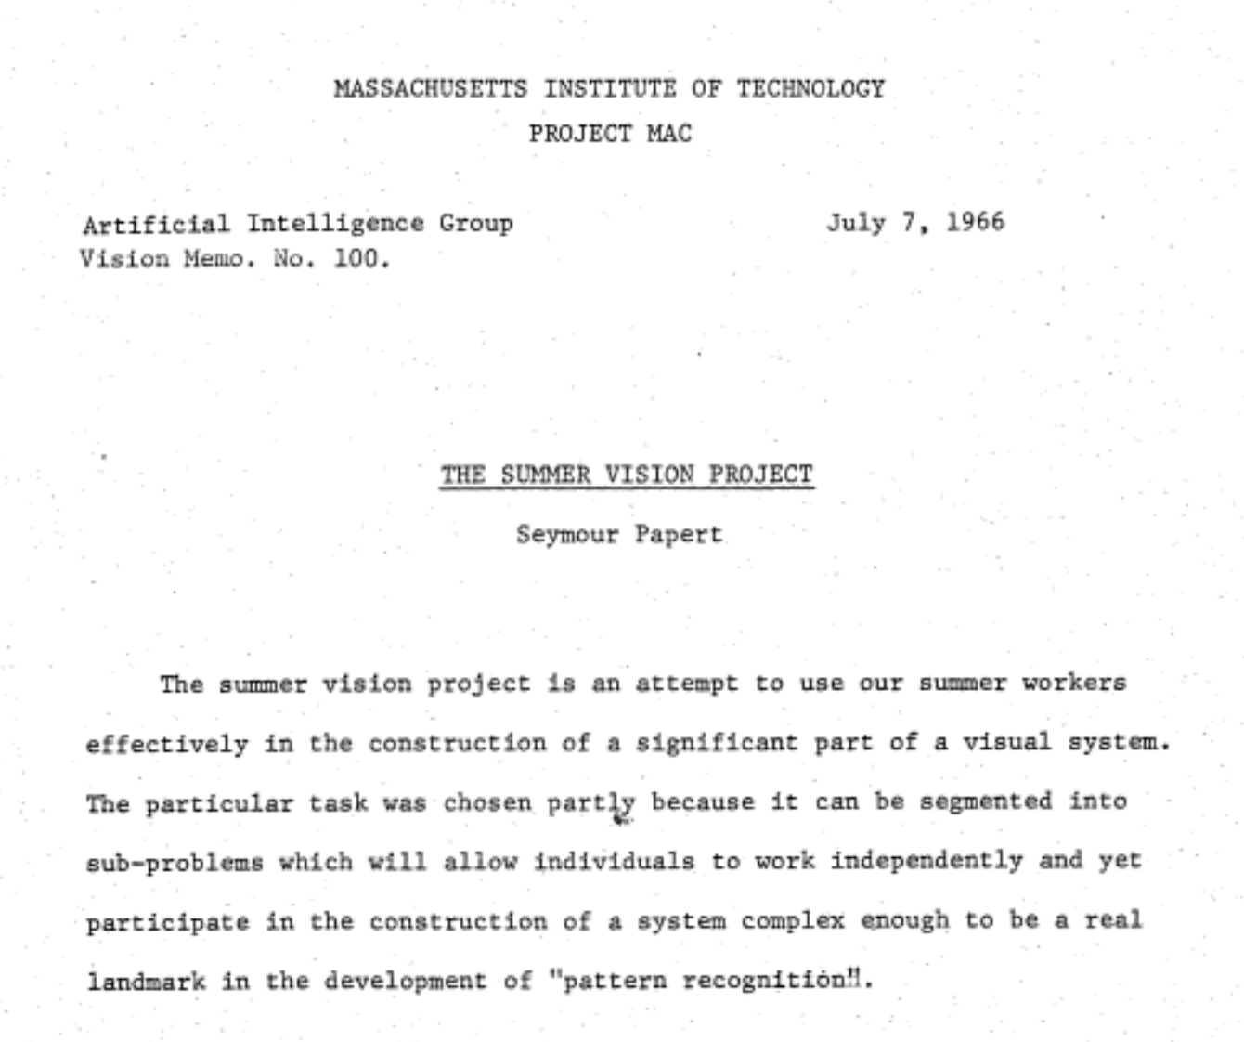
Notes:
Summer Vision Project 1960s paper: assumed they could solve the CV problem over a single Summer
Shows how challenging CV is- some fundamental problems still unsolved
Signals undetected by human eye could be captured by CV: spinach for detecting landmines

Slide 6
Why is vision so hard?
Huge gap between pixels and meaning
Notes:
In 1966

Slide 7
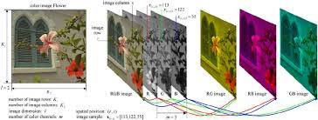
Representation of Images
Images are represented as rectangular arrays of numbers representing image intensities at particular locations.
Each element of such an array is called a pixel (for picture element)
A color image may be represented in 3 separate such arrays called color planes containing red, green and blue components

Slide 8
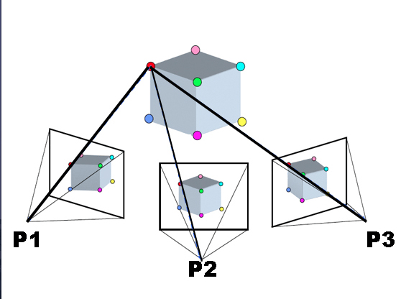
Computer vision is an inverse problem
An image is a two-dimensional optical projection, but the world we wish to make sense of visually is 3D
Vision is “inverse optics, inverse graphics”
2D → 3D

Slide 9
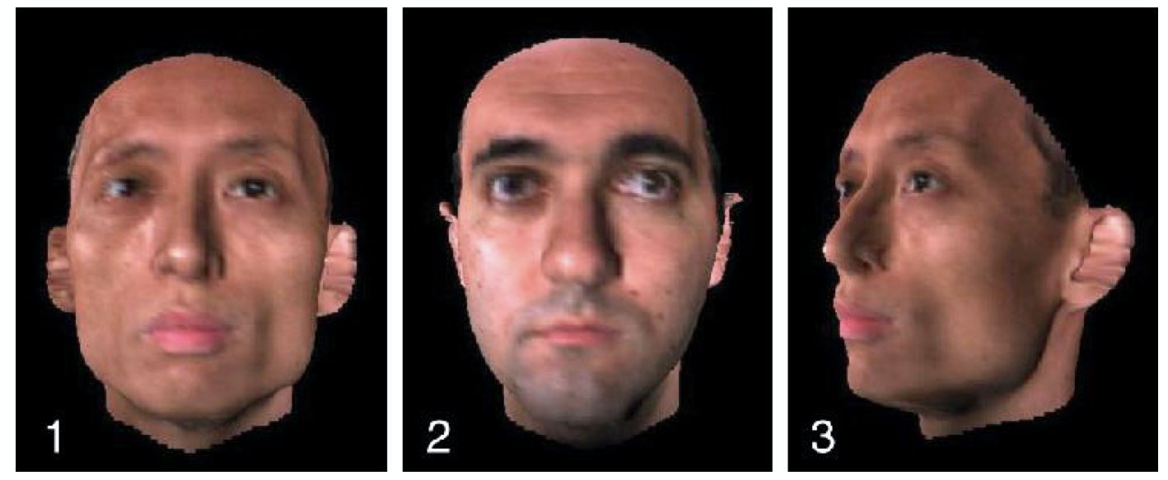
Which two pictures show the same person?
Notes:
Most algorithms for computer vision select 1 and 2 since those images (think about representation as pixels/matrix) are more similar than 1 and 3

Slide 10
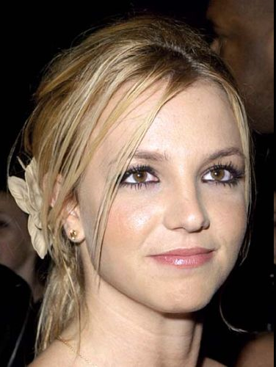
Recognize that face?
Notes:
Brittany Spears

Slide 11
How about this one?

Slide 12
Activity: Try to label these emotions in groups. Think about how a computer could do this.

Slide 13
Notes:
labels from a computer or survey?

Slide 14
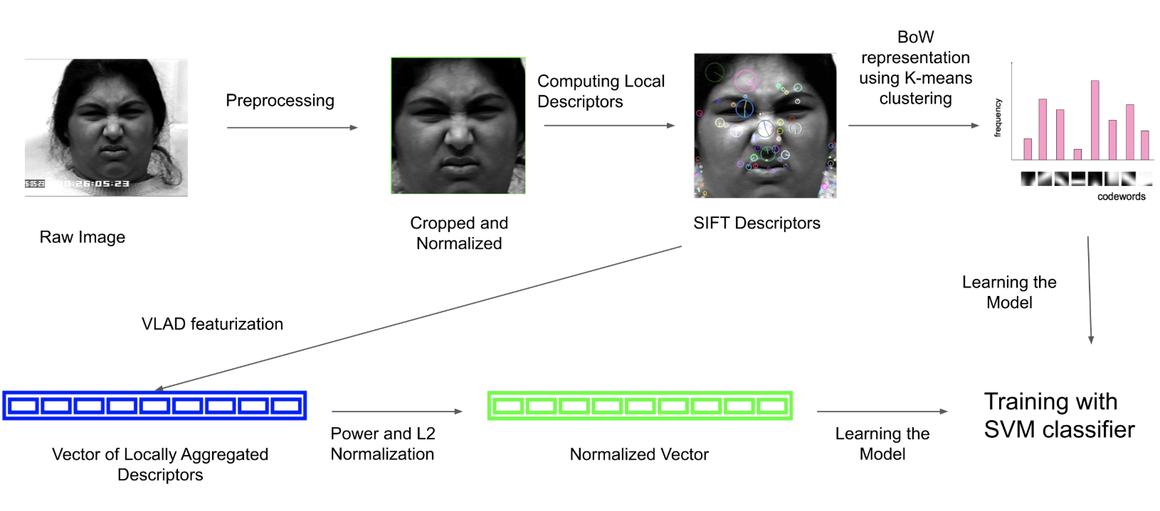
Notes:
https://towardsdatascience.com/classifying-facial-emotions-via-machine-learning-5aac111932d3
One approach to recognize emotions from images
Way of representing images for computers
CV pipeline for emo classification: descriptor gives features- unsupervised gives labels
Top right bar chart=cnn unit
svm=ml model

Slide 15
Recognizing a person
B
A

Slide 16
A or B?
Notes:
This task is trivially easy for humans, but might be hard (at least, with a slightly changed picture) for computers.

Slide 17
Recognizing QR codes
B
A

Slide 18
A or B?
Notes:
This task is trivial for computers, but might be hard for humans (at least, without careful study.)

Slide 19
Applications of Computer vision
Self-driving cars to recognize objects
http://moralmachine.mit.edu/
Should a self-driving car sacrifice its passenger to save others?
Should we switch to self-driving cars when they’re safer? Even if they’ll sometimes crash / injure people?
Structure-from-motion (3D reconstruction from multiple views, stereo reconstruction)
Tracking
Object recognition
Object extraction
Notes:
Links for ethics of self-driving cars:
https://www.theverge.com/2018/10/24/18013392/self-driving-car-ethics-dilemma-mit-study-moral-machine-results
https://www.nytimes.com/2016/09/21/technology/the-15-point-federal-checklist-for-self-driving-cars.html
http://moralmachine.mit.edu/

Slide 20
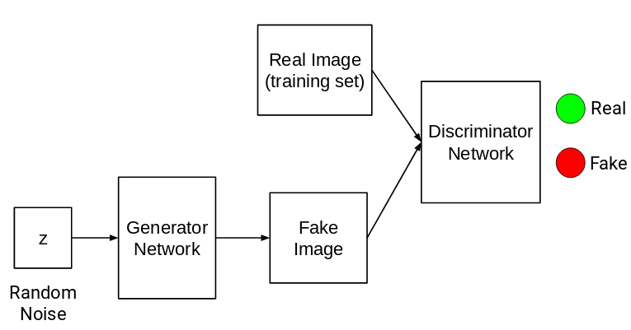
GANs in Computer Vision
GANs are composed of two different networks:
Generator network
Generates images given some random noise as input
Counterfeiter
Discriminator network
Identifies if the input is real or fake
Cop
Notes:
Generative Adversarial Network (GAN) - Deep fakes

Slide 21
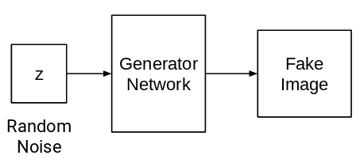
Training GANs, step-by-step
Think of this as the Generator and Discriminator playing a game:
Round 1:
The generator generates images given some random noise and puts these fake images in a pile with real images (from the training set)
The discriminator takes an image from the pile and answers the question: Real or Fake? (binary classification)

Slide 22
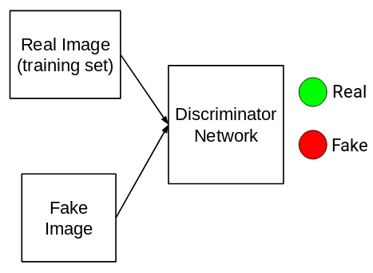
Training GANs, step-by-step
If the discriminator guesses the answer correctly, it wins! Otherwise the generator wins.
After the round, the loser will tweak itself to improve its performance.
If the discriminator loses, it adjusts itself to become better at detecting fakes.
If the generator loses, it becomes better at generating fakes that look real.

Slide 23
GANs in Computer Vision
After many rounds, the generator becomes better and better at generating fakes, and the discriminator becomes better at spotting fakes.
Once the game is done, we ask the generator to generate an image.
Notes:
Technique for generating synthetic images: so once training is complete, Generator w spit out real-looking images

Slide 24
Activity: GANs and Fictionary
Moderator: Select an unusual word from phrontistery.info. Share the word (not the definition!) with the group.
Generators: Send a fake definition to the moderator (without looking it up!)
Discriminators: Can you tell which definition is real?
Idea: through repeated trials, both the generators and discriminators learn about the category (English word definitions.) In this case, you already have a lot of category knowledge...
Notes:
https://thispersondoesnotexist.com/

Slide 25
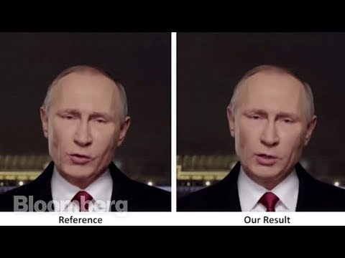
Deep Fakes
Notes:
Stop for discussion, GANs make fakes! @jojobiden46 in tiktok makes deep fakes :
https://www.tiktok.com/@jojobiden46/video/6909519851325279493?sender_device=pc&sender_web_id=6891433687549642245&is_from_webapp=v2&is_copy_url=0
https://www.tiktok.com/@jojobiden46/video/6888445134149668101?sender_device=pc&sender_web_id=6891433687549642245&is_from_webapp=v2&is_copy_url=0

Slide 26
Ethical Considerations for Deep Fakes
Use cases:
“Fake news on steroids”
Ransomfakes, smear campaigns etc.
Cere Proc: a firm that creates personalized synthetic voices for people who lose theirs from disease
DeepEmpathy: creates synthetic images that show what cities such as London and Tokyo would look like if they were bombed, with the aim of fostering empathy with those fleeing from war.
Synthetic resurrection

Slide 27
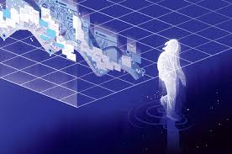
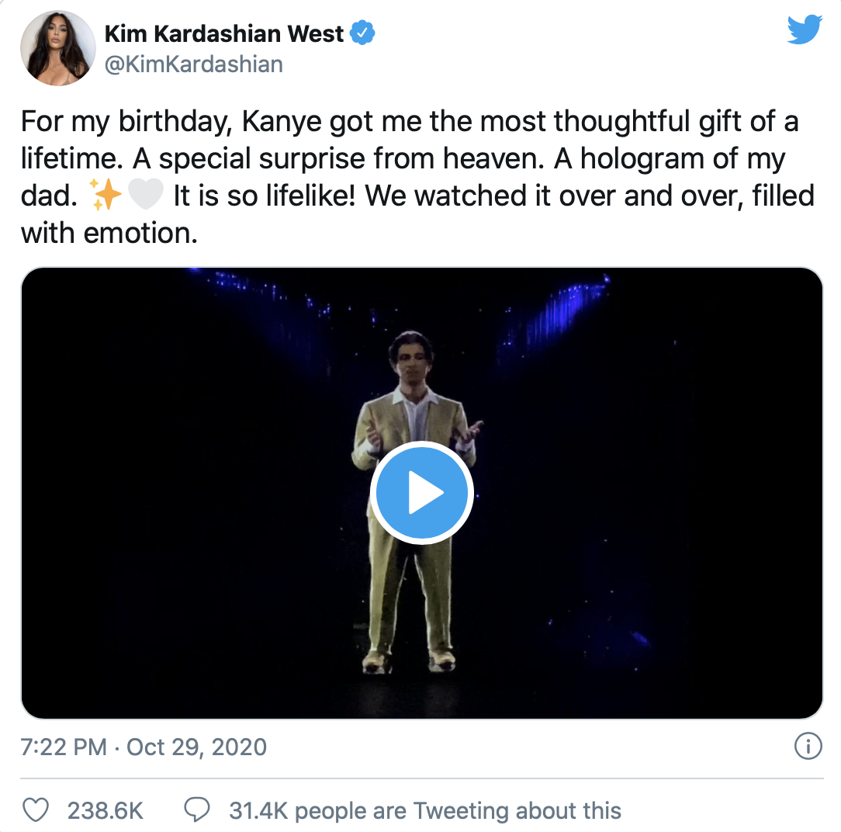
Deep Fakes, Synthetic Media - Questions
Control over our “digital afterlife”
the possibility of a synthetic afterlife for celebrities could see figures such as JFK becoming puppets for companies, recreated to advertise products or brands
Recreating the voices of dead loved ones:
Potentially, this could form part of a new kind of bereavement therapy, or help people feel better connected with the deceased. Alternatively, it could cause significant psychological damage, stunting people’s recovery from loss and creating a dependence on synthetic copies of the dead.
Notes:
https://www.youtube.com/watch?v=jwnR8FlH9e8

Slide 29
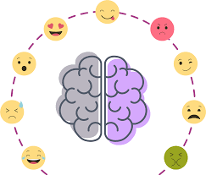
Computer Vision and Emotional Privacy
The system detects micro movements of the face, and particularly identifies whether it is likely that they are produced by the cortical pyramidal motor system, which enables humans to simulate facial expressions of emotions not actually experienced.
Applications:
Students’ expressions of attention and comprehension
Detecting sleepiness for drivers (excessive paternalism, individual differences)
Job interviews (real vs faked enthusiasm, anxiety)
Notes:
http://www.iaacblog.com/projects/end-emotional-privacy-2/

Slide 30
Computer Vision and Emotional Privacy
The main worry about the use of emotion recognition technology is likely to be that our private emotions are made public
Humans can be trained to recognize micro expressions so why is a machine different?
High dimensional data → noise if going to create spurious connections, how will our conclusions be biased?
Notes:
High dimensional data causes more noise which is going to create spurious connections which have nothing to do with the actual prediction task. How do we know these correlations are useful?
Naive eg. : # of shark attack proportional to nick cage movies but this doesn’t help(?)
Correlation vs causation can’t necessarily be separated
http://blog.practicalethics.ox.ac.uk/2014/03/computer-vision-and-emotional-privacy/
https://ucsdnews.ucsd.edu/feature/computers_spot_false_faces_better_than_people

Slide 31
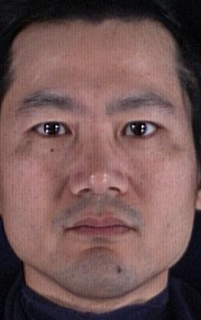
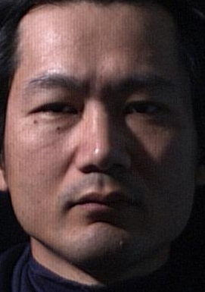
Same person? Different people?

Slide 32
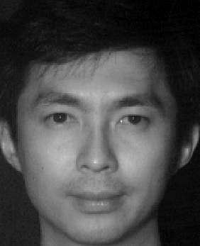
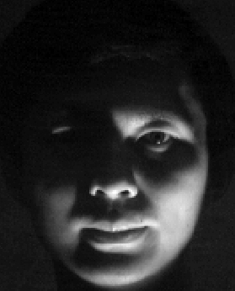
Same person? Different people?

Slide 33
Speech Recognition
Speaker Identification is a widely sought after biometric
But just getting accurate transcripts is still an open research question

Slide 34
Why is it hard?
How are these words pronounced: colonel, pterodactyl, pale/pail, blue/blew…

Slide 35
Why is it hard?
How are these words pronounced: colonel, pterodactyl, pale/pail, blue/blew…
When do humans have trouble understanding?
What are these people saying?
What does each example tell us about difficulties in automatic speech recognition?

Slide 36
What information could help?
This example is hard to understand, but we can still figure out what she’s saying. How?
What is Barack Obama’s next word?
Which of the following words are the most likely to come next and why? Are any of the others possible?
Mary went to the…
(answer: )
Stare
Star
Store
Sitar

Slide 37
One Word
We have a single word in isolation. What could it be?
Another hint. ASR thinks that the word has the following sounds:
Which words are possible?
Which words are most likely?
How can we calculate which words are most likely?
p / b
ah /aa /eh
k
s

Slide 38
Word Frequencies
Some words are much more common than others. We can estimate how frequently words are used by looking at lots of examples of people talking or writing.
For instance, Google tells us that these are the (approximate) frequencies of the following words:
Given these numbers, which word seems the most likely for the example?

Slide 39
More information…
We now know that the speaker is from Boston. Does that change our guess as to which word it is?
Here is the whole sentence.
Now do you know what the word is?
Why was it so hard before, and so easy now?
How does the rest of the sentence help us figure out what word it was?
http://www.youtube.com/watch?v=RbK4cL3QSc0

Slide 40
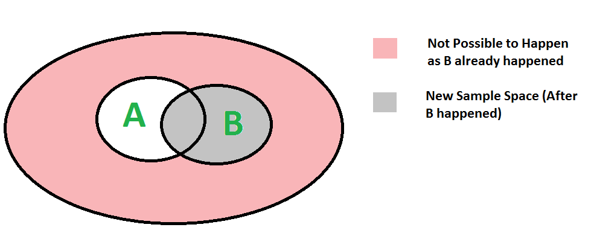
Review: Probability
P(A and B) = P(A | B) P(B)

Slide 41
Help the ASR System
The system has a few hypotheses for a word. Which word is most likely?
The system has different hypotheses for the previous word. Which word is most likely?
What is the problem with treating each word separately? How could we fix this?
P(shark) | 0.009
P(shirk) | 0.005
P(shirt) | 0.05
P(scary) | 0.02
P(hairy) | 0.03
P(wary) | 0.009

Slide 42
Bigrams: looking at 2 words at a time
There are two words the system can’t figure out. The first is either “green” or “mean”. The second is either “plant” or “cat.”
Which phrase has the highest probability?
P(green) | 0.1
P(plant | green) | 0.5
P(cat | green) | 0.05
P(mean) | 0.05
P(plant | mean) | 0.01
P(cat | mean) | 0.2
green
mean
plant
cat

Slide 43
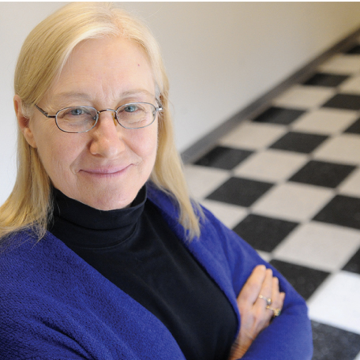
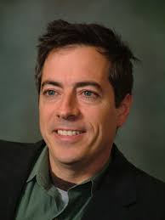
Computer Vision at Columbia
Prof. Carl Vondrick
Prof. Julia Hirschberg
Prof. Peter Belhumeur

