Slide 1
Machine Learning
Notes:
Notes for next semester: machine learning has a natural ethics component, so let’s add that! (e.g. if your data is biased, your output will be biased.)

Slide 2
Supervised Machine Learning - Classification
So far, we have discussed programming computers to do certain tasks.
However, some tasks may be too complex for us to program directly. We may not even be able to complete those tasks on our own, or if we are able to, we have no idea how we do it. How do you recognize someone’s face, for example?
Humans learn from past experiences. We can provide this for the computer, in the form of labeled data.
How can we use labeled data to make predictions?

Slide 3
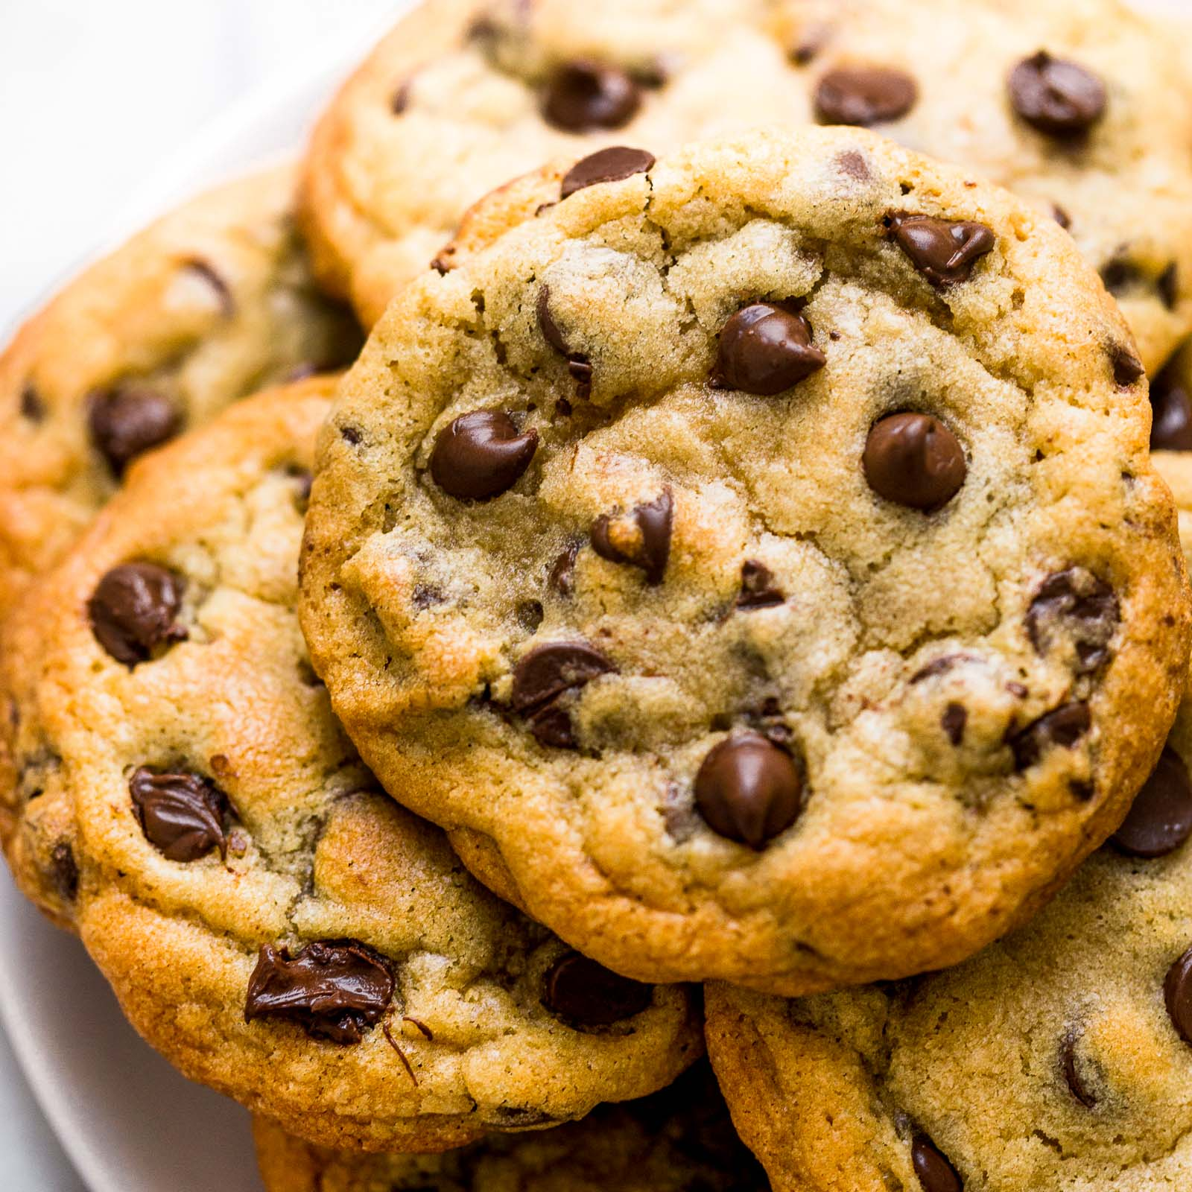
What kind of cookies does Sophie like?
Cookie 1: XL 1 chocolate chip LIKE
Cookie 2: M 3 chocolate chips DISLIKE
Cookie 3: L 1 chocolate chip LIKE
Cookie 4: XS 4 chocolate chips DISLIKE
Cookie 5: S 1 chocolate chip DISLIKE
Cookie 6: XL 5 chocolate chips DISLIKE
Notes:
Ask students the pattern for cookies liked- ans= bigger cookies w fewer chocolate chips -- how could we make a decision tree?
Inspired by “Why Are We Not Teaching Machine Learning at High School? A Proposal” (Evangelista, et al.), ask them to come up w a tree that leads into decision tree

Slide 4
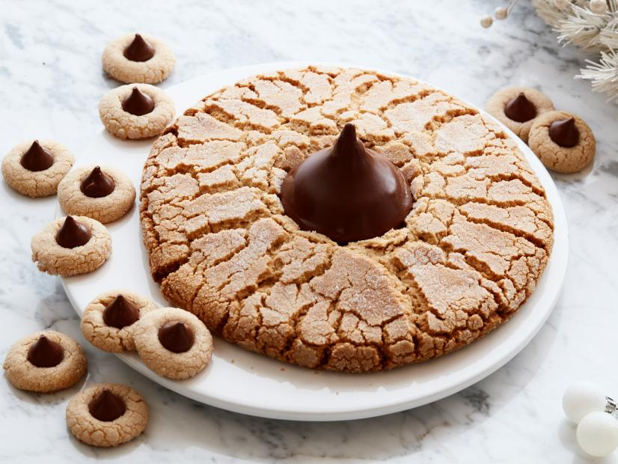
Decision Tree
size > M?
chocolate chips < 2?
LIKE DISLIKE DISLIKE
the type of cookie Sophie likes? we may never know
convention: taking the left arrow means answering ‘yes’
Notes:
recall that these were introduced on the first day, in algorithms
this is one potential decision tree, from the 6 data points provided
edges = yes or no
vertices = cookie features

Slide 5
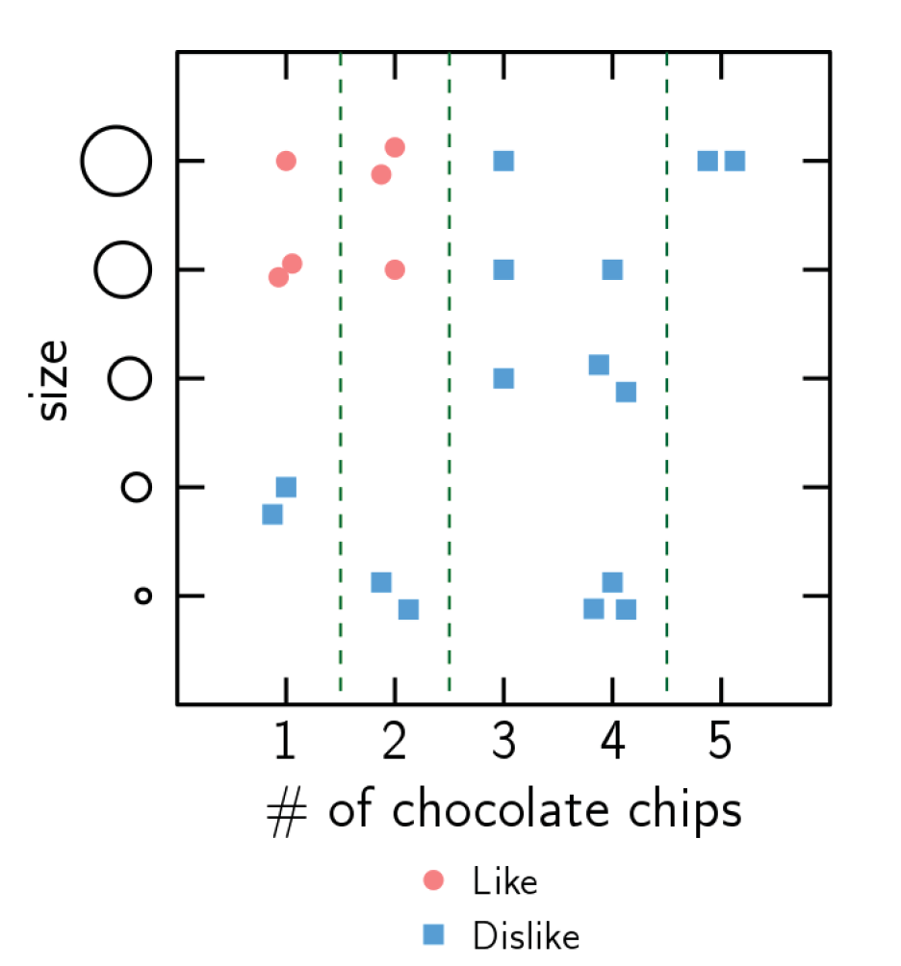
What kind of cookies does Sophie like?
Does receiving more data alter your decision rule?
More data helps us make more accurate decisions.
Here, our decision was how to divide the data into two classes - like and dislike.
We can use this to make predictions about future data points: would Sophie like a cookie of medium size, with 2 chocolate chips?
However, 2 classes are rarely so cleanly separable..

Slide 6
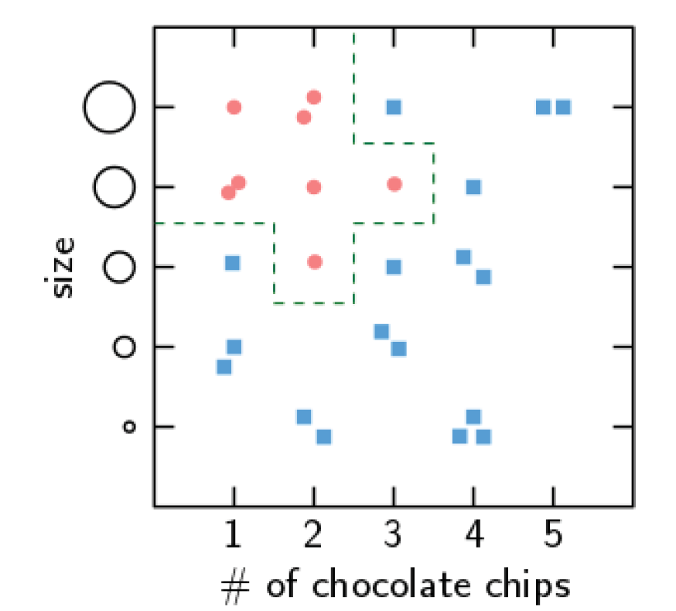
How would you make a decision rule for this data?
Excluding some data points could result in misclassification, or error.
Including all of the data points can lead to overfitting. What if those points don’t reflect Sophie’s true likes? Kids are capricious.
We want our model to be as general as possible, while being as accurate as possible. Our goal is to increase accuracy on unseen data, not the training data.
Notes:
“Overfitting is like preparing for an exam by memorizing all the examples and thus being unable to generalize to unseen problems”
Data measuring correlation not causation- so not necessarily representative of facts

Slide 7
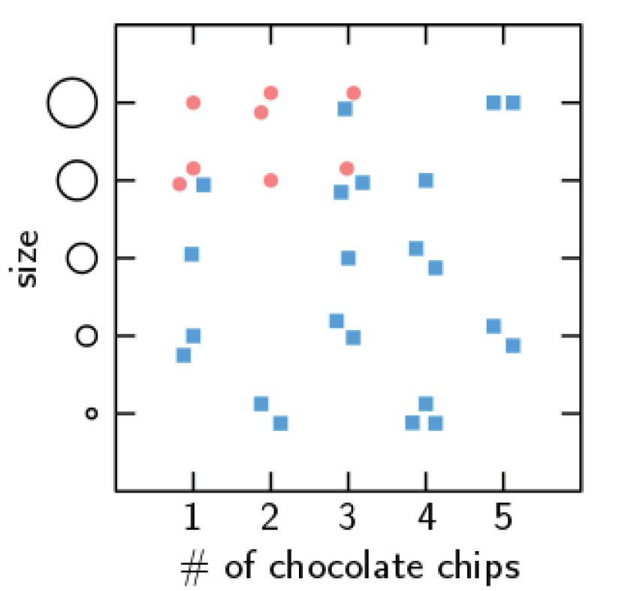
Sometimes, class separation is not achievable, even with a complex model.
Your choice of a decision rule can take into account what kind of error you want to disfavor- is it worse to give Sophie a cookie she won’t like (false positive), or not to give her a cookie she would like (false negative)?
 | Predicted Sophie would like | Predicted Sophie won’t like
Sophie liked | true positive | false negative
Sophie didn’t like | false positive | true negative

Slide 8
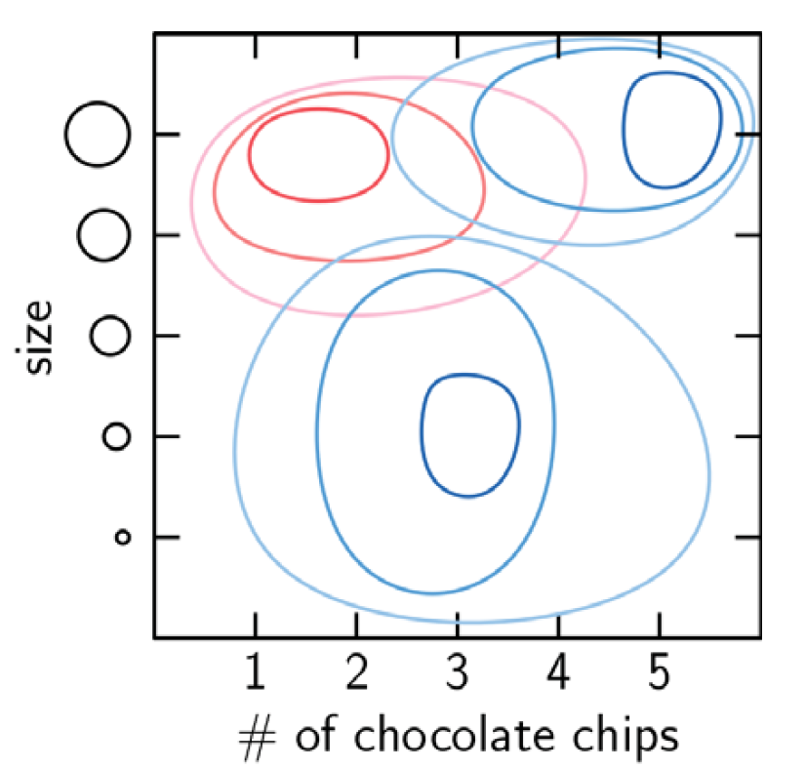
In this activity, you were acting as the machine learning algorithm, and it was easy to see how to divide the data. Imagine if we had more features, e.g. butter content and crispiness. Already, it’s impossible to visualize the data ourselves.
You wouldn’t explicitly program the decision tree, the computer would learn it from the data.
We assume the data is samples drawn from an underlying probability distribution. There is a degree of noise and randomness in our sample.
Our model approximates the underlying distribution.
Notes:
The model can be a huge variety of things, not just a decision tree.
Topographical map drawn can be imagined as heaps of cookies. Cookies from blue ones are the not liked ones and red are liked ones.
explain what a probability distribution is just in case

Slide 9
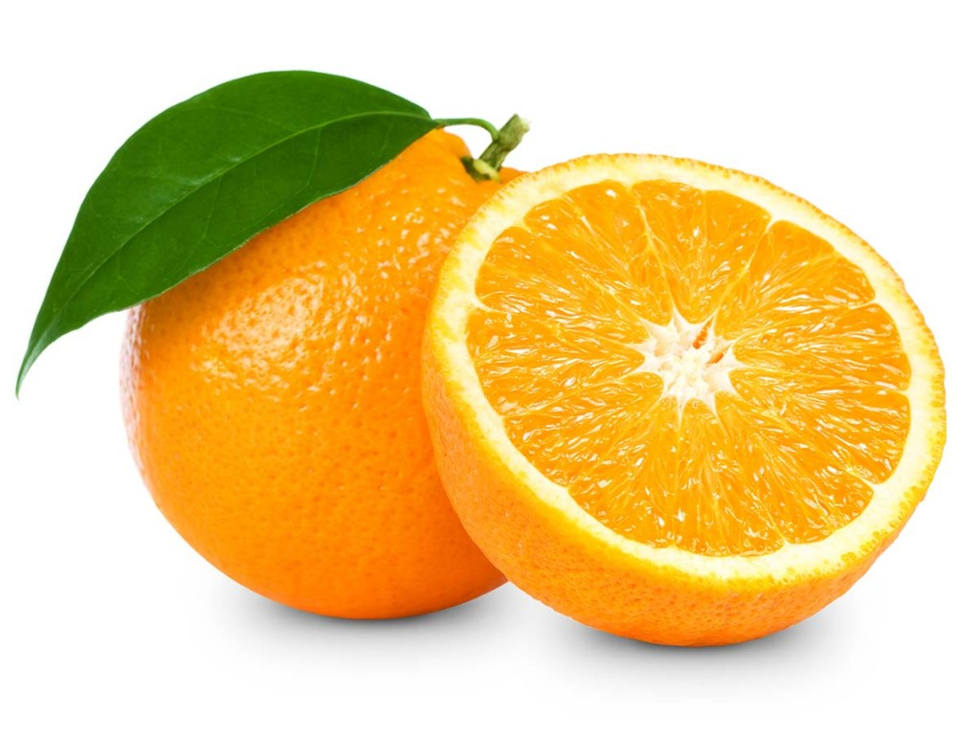
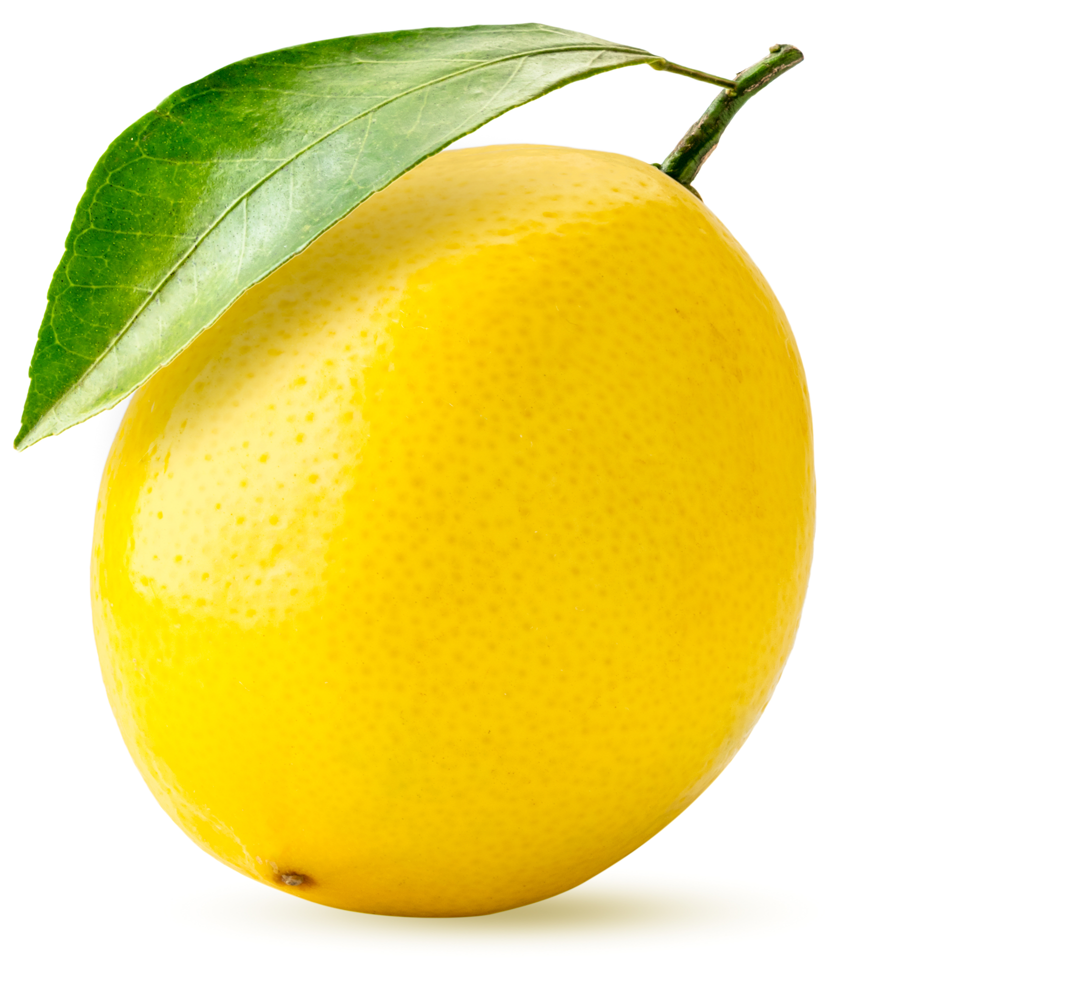
Unsupervised Machine Learning - Clustering
Sometimes, we don’t have labels for our data. Machine learning is all about finding patterns in data- we can still try to do that, even if we aren’t sure what those patterns mean.
Say we had the dimensions of different citrus fruits, but we had no way to tell which are oranges, and which are lemons. How can we find clusters in this data?

Slide 10
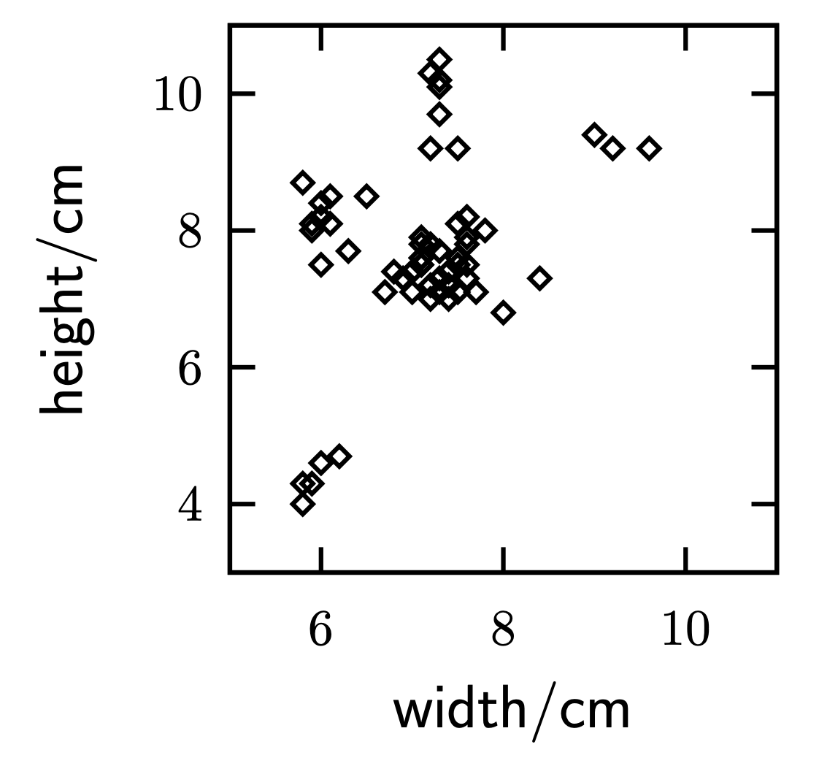
k-means clustering
Our goal is to assign each data point to a cluster. The number of clusters we choose to form is known as k.
Just as adding more features to the cookie task made it impossible to visualize, the same is true here. Deciding on a value for k can therefore be difficult.
How many clusters do you see?

Slide 11
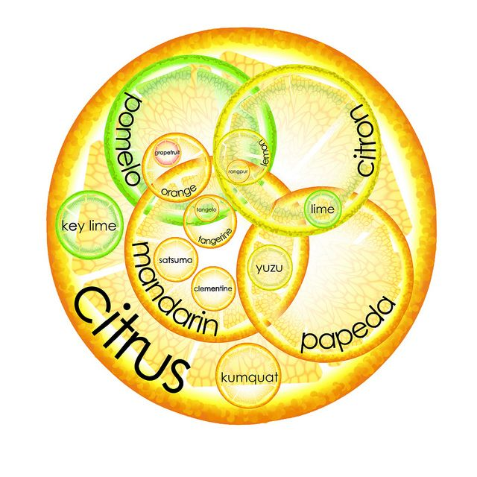
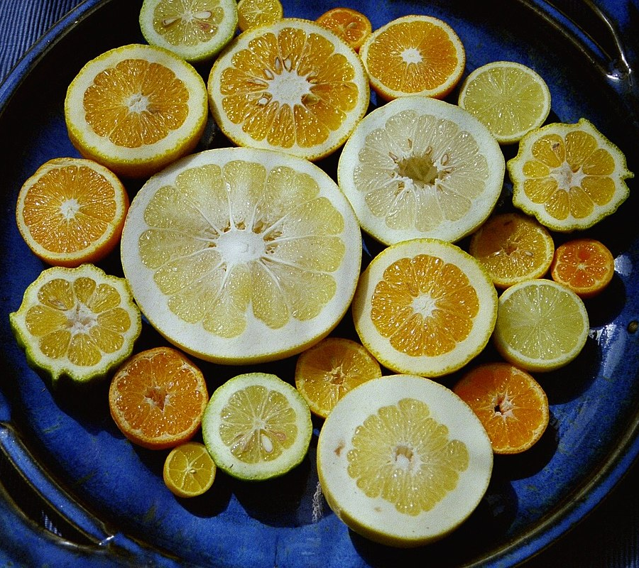
there are many different citrus varieties, which may be why we see more than the two clusters we expectǃ
Notes:
.

Slide 12
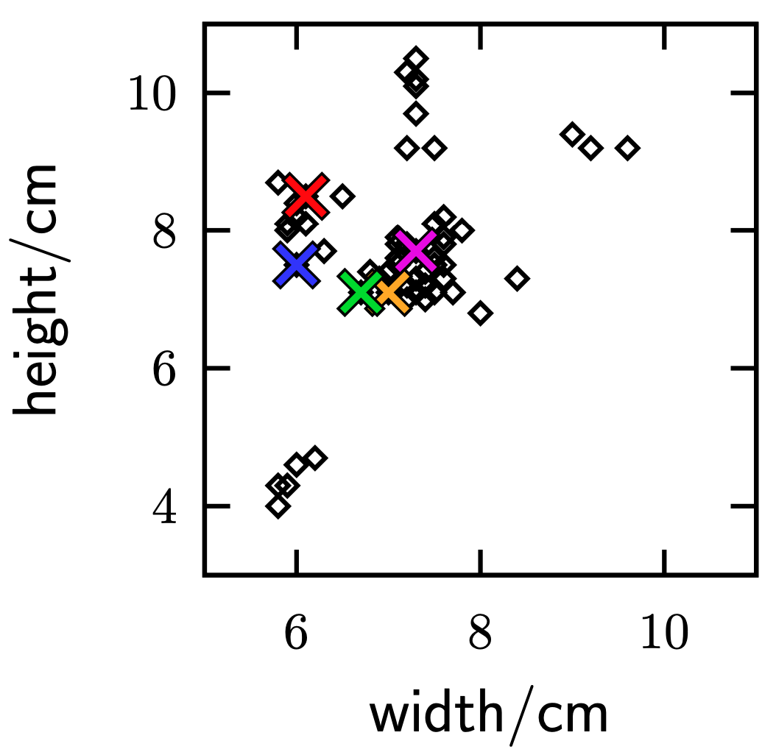
k-means clustering
step 1
Say we choose k=5.
The first step is to randomly choose 5 points to assign to be the center of each cluster. They are marked in the diagram with an X, each color denoting a different cluster.
Notes:
Coming up w easy algo for machine to come up w clusters w/o human interaction

Slide 13
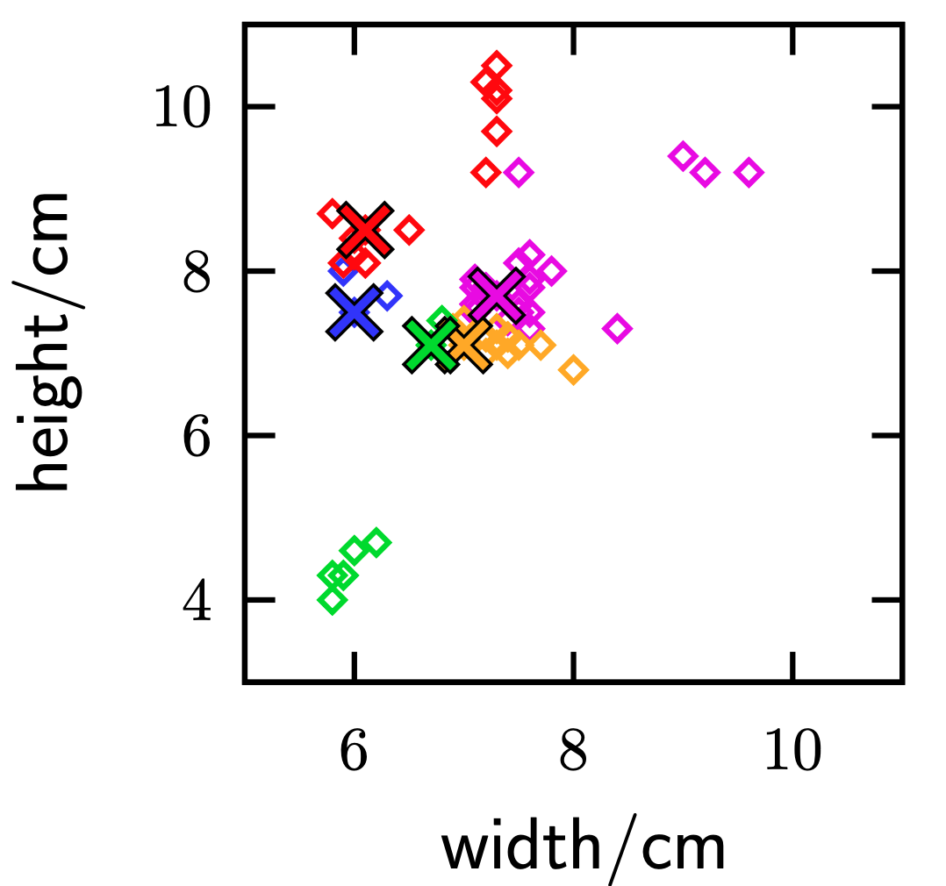
k-means clustering
step 2
Choose a point, and calculate its distance to each of the cluster centers.
Assign that point to the cluster whose center it’s closest to.
Repeat for all points that haven’t yet been assigned in this iteration.

Slide 14
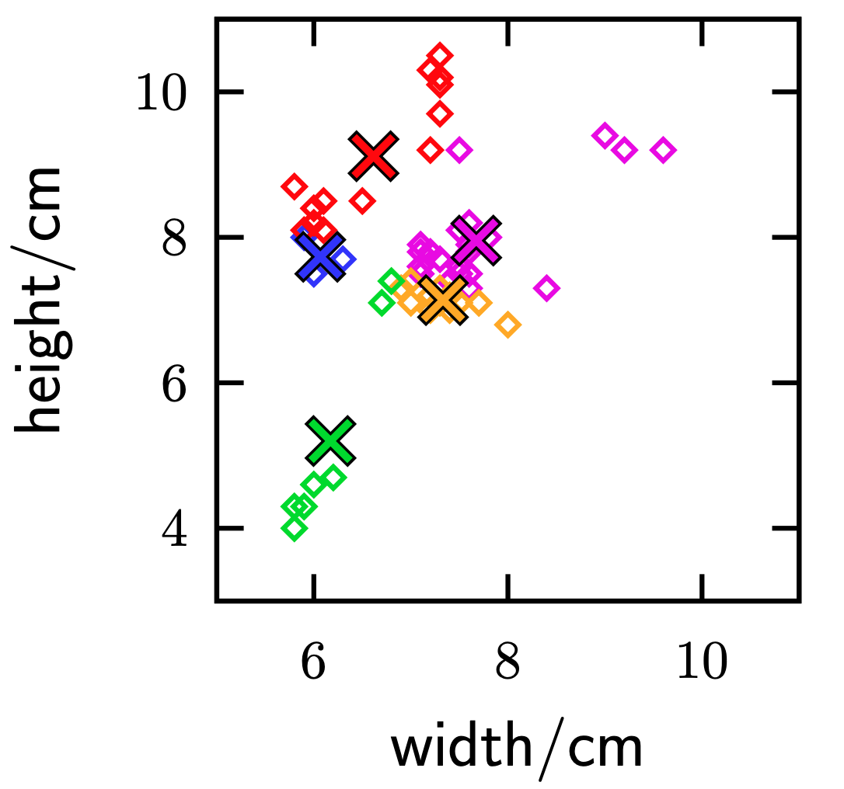
k-means clustering
step 3
For each cluster, recalculate the center point by averaging all points in the cluster.
Adjust the center (denoted with an X).

Slide 15
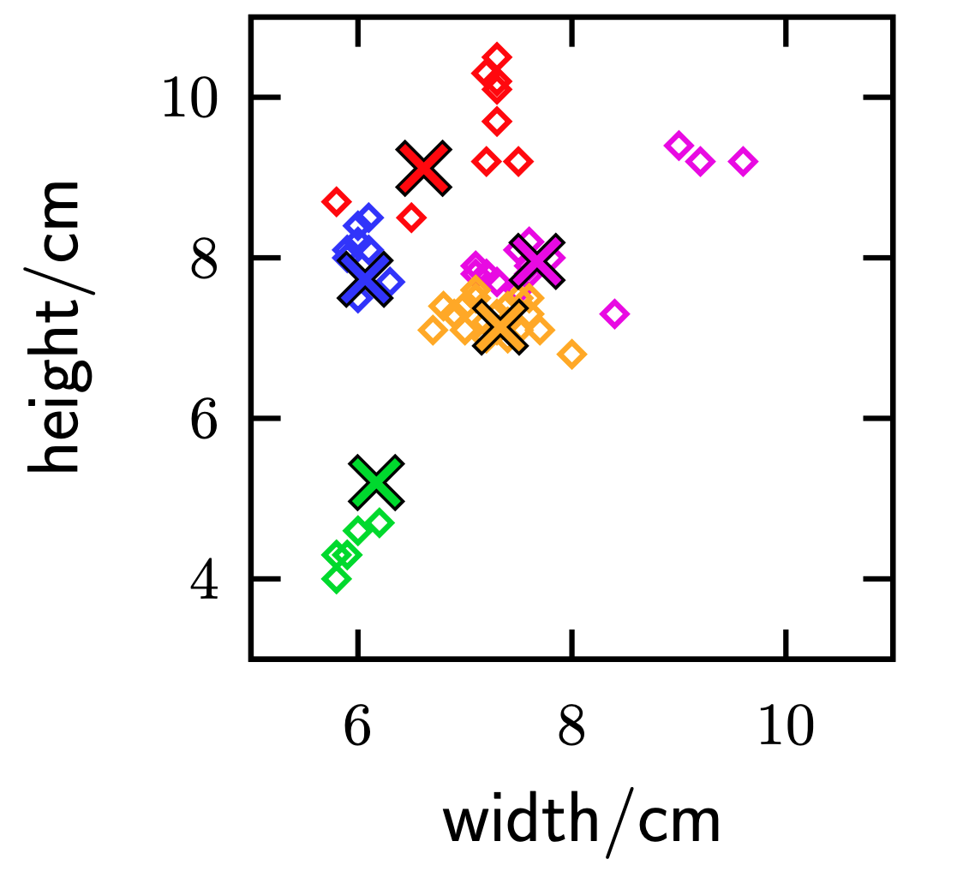
k-means clustering
Repeat step 2 (assigning each point to the cluster it’s closest to).
You can note that some points have changed clusters, especially the green ones. Before, the cluster had a huge gap, which isn’t something we want. Now, those are part of the orange cluster.

Slide 16
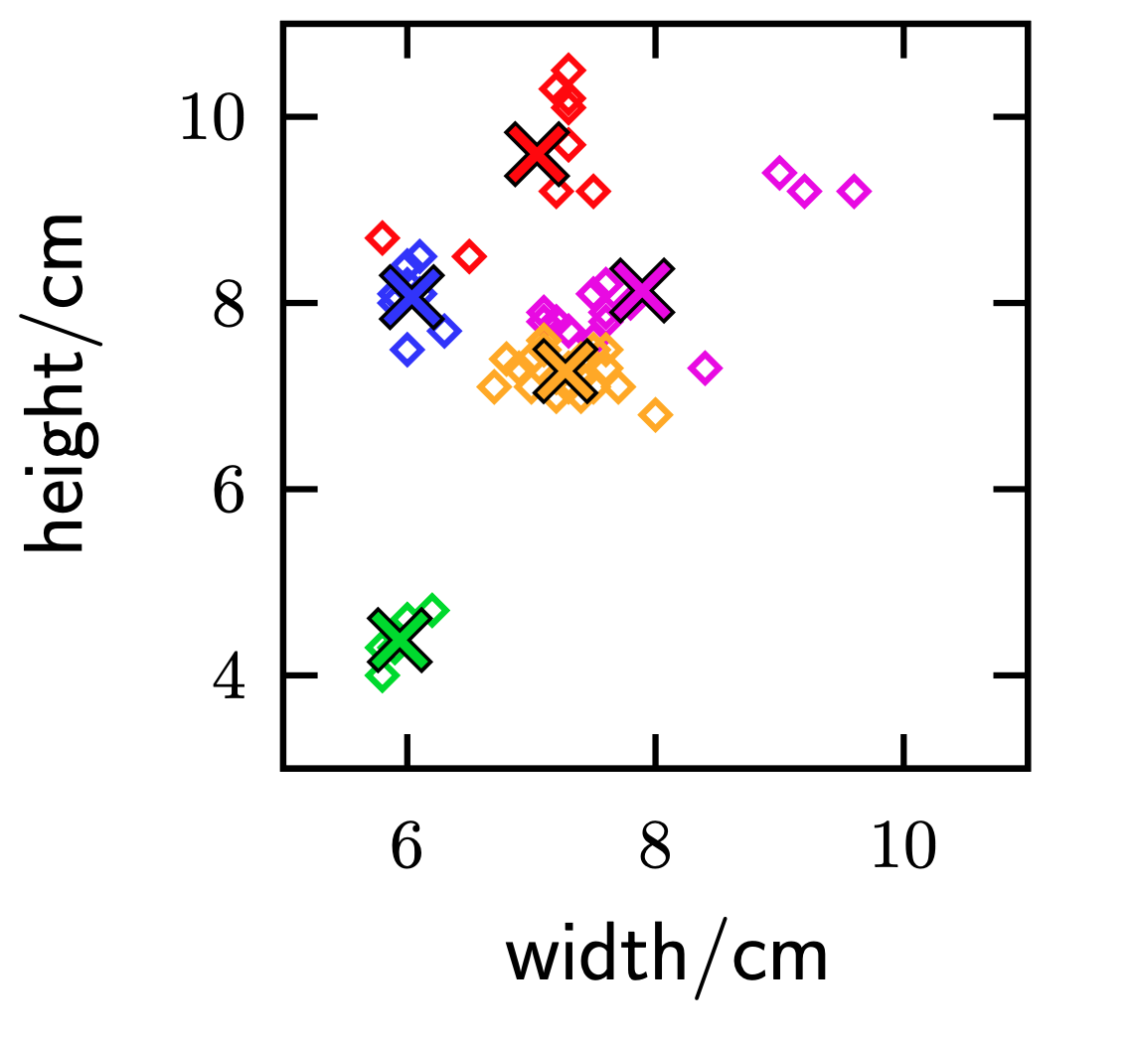
k-means clustering
Repeat step 3 (adjusting the center of each cluster).
Next, we will repeat step 2 again (assigning each point to the clusters they are closest to).
Can you predict what will happen to the red points highlighted in the diagram?

Slide 17
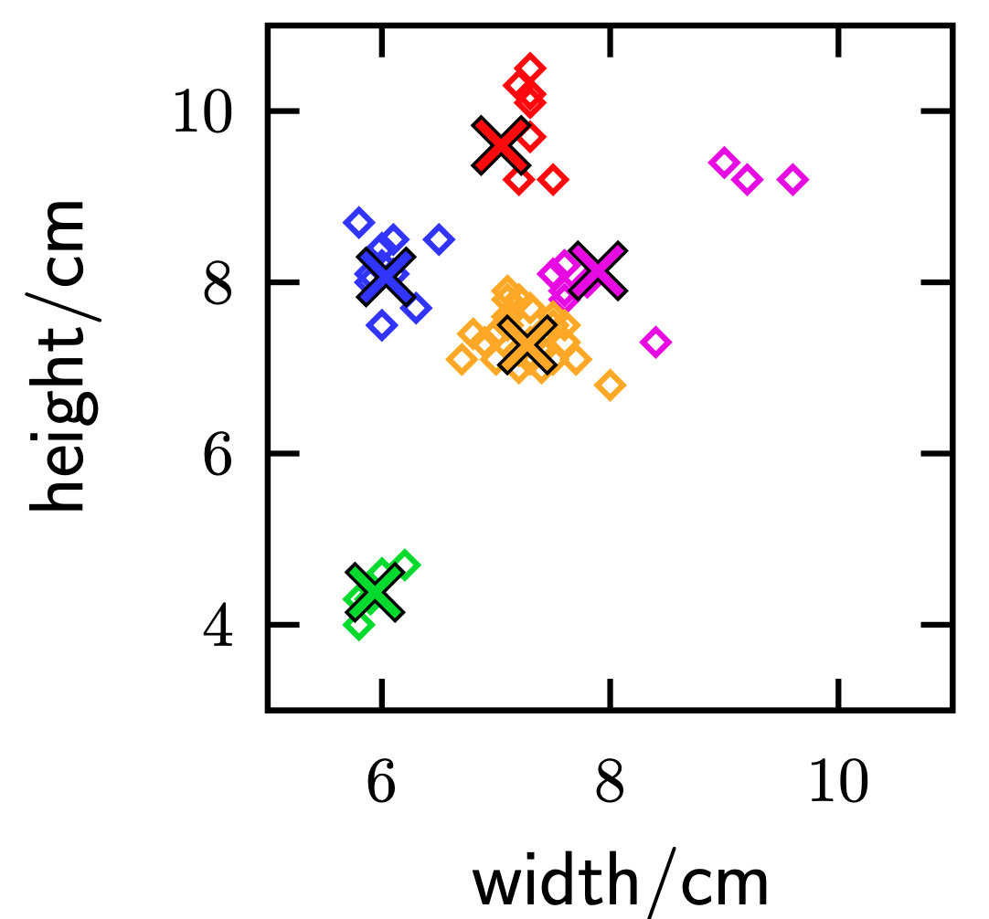
k-means clustering
The red points became part of the blue cluster.
Next, we continue repeating steps 3 (adjusting the center of each cluster), and step 2 (assigning each point to the clusters they are closest to).
What do you predict will happen to the pink points?

Slide 18
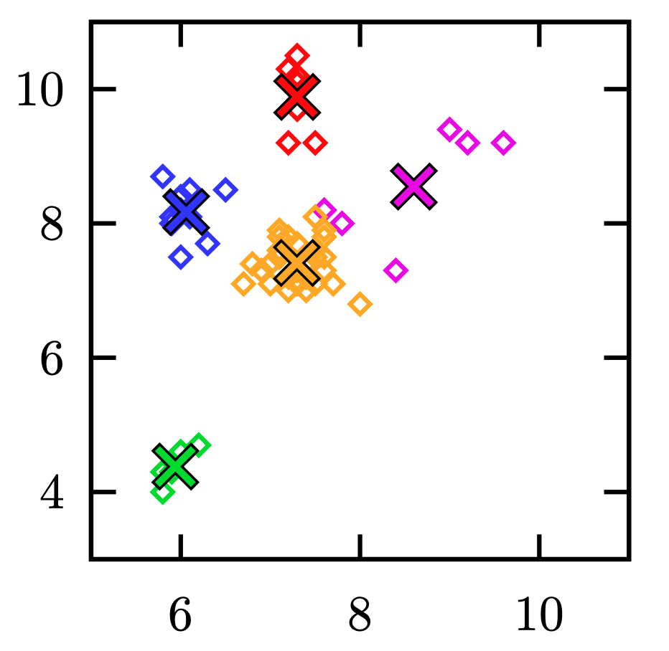
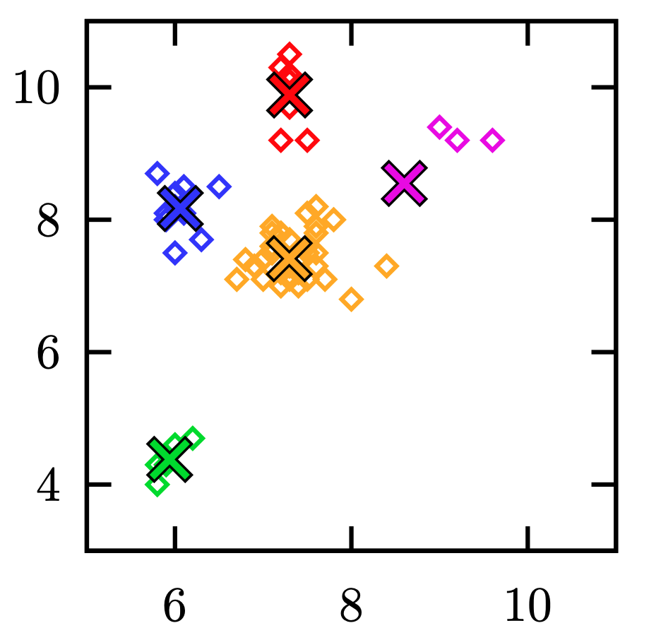
moving the centers
reassigning the clusters

Slide 19
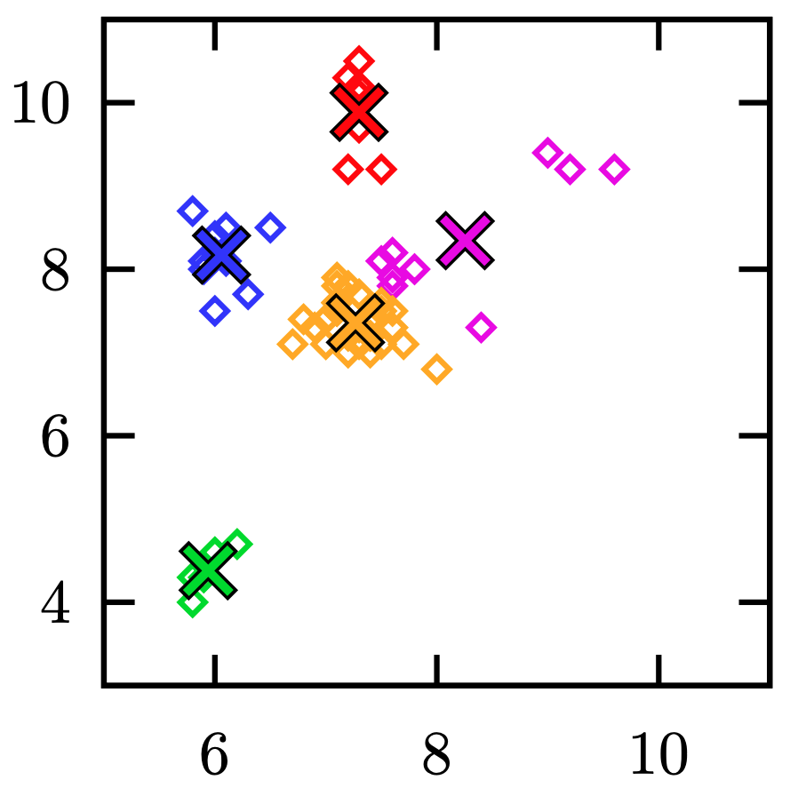
moving the centers
reassigning the clusters

Slide 20
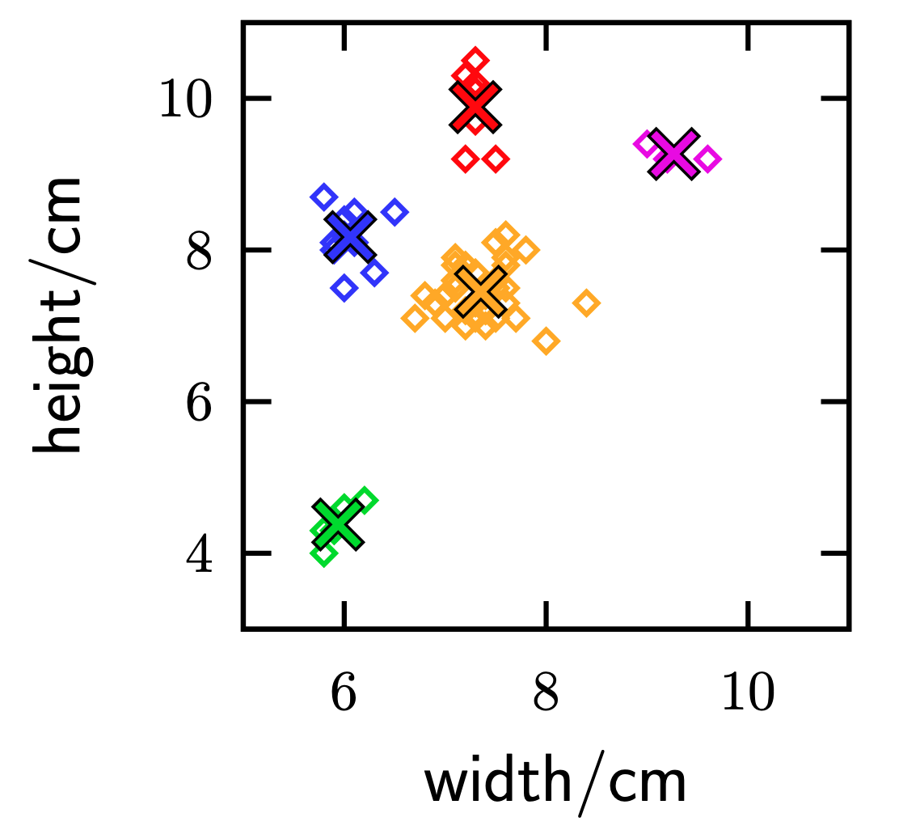
k-means clustering
Ultimately, we have 5 distinct clusters, and we can stop.
If we couldn’t see the data (as is usually the case), how do you think we could decide when to stop?
How representative do you think this is of oranges and lemons?
Notes:
How do we know when to stop?
changes<threshold movement/ finite time horizon...more dependent on the data set

Slide 21
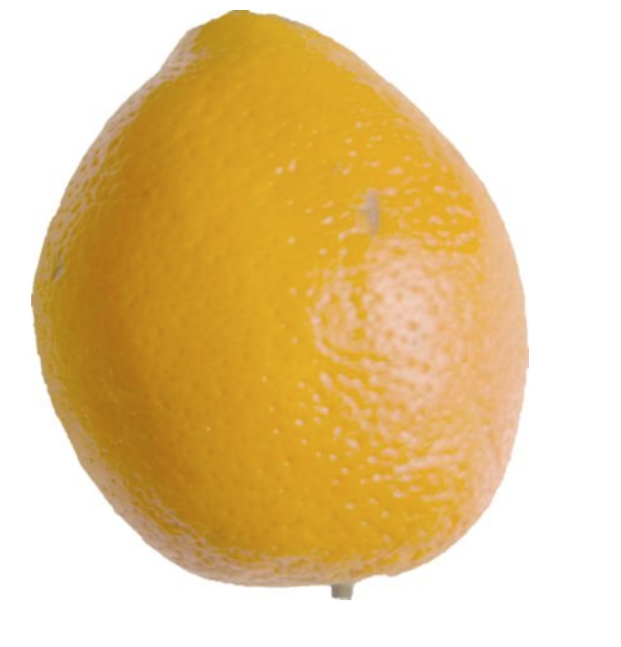
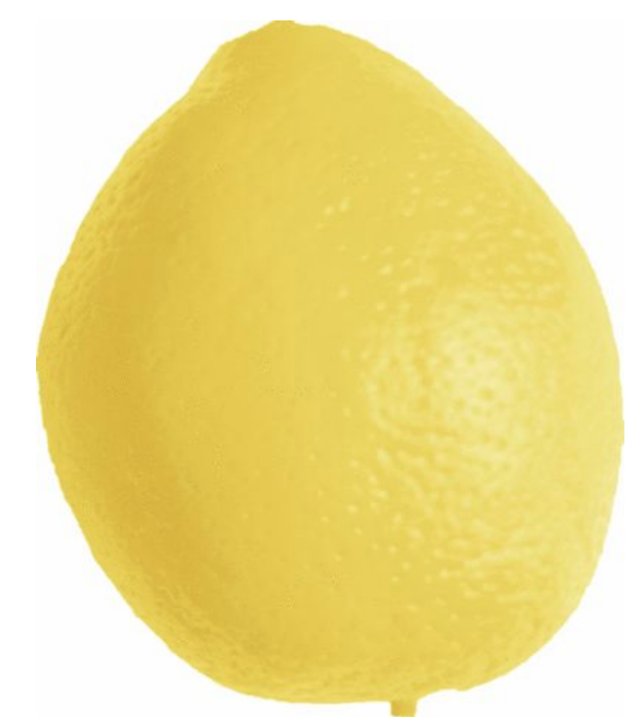
What about potential misclassifications? (oranges shaped as lemons, or vice versa)?
Notes:
More factors we have, more accurate result will be
ML successful when it is better than human

Slide 22
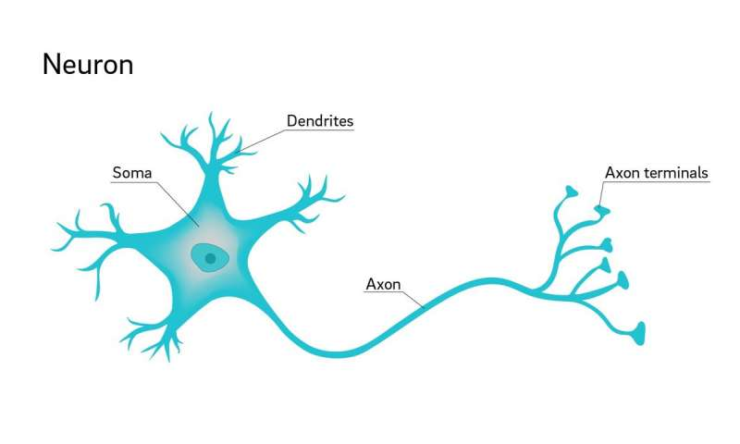
“Machine” Learning in the Brain
There are 86 billion neurons in the human brain.
Neurons receive signals (inhibitory or excitatory) using dendrites connected to the cell body.
If the input signal exceeds a threshold, the neuron “fires,” and sends its own signal down the axon to other neurons.
In nature, networks of neurons allow animals to perform complex tasks like eating, sleeping, and learning computer science.
Notes:
For this slide, the goal is to get students to realize that we already have a “computational” architecture that learns functions, and while we can’t imitate it directly (there are literally trillions of synapses in the brain, and multiple types of neurons arranged in puzzling and intricate structures), maybe we can learn a thing or two. Importantly, neurons are functionally uniform at a high level: they take weighted inputs, and if a threshold is exceeded, they send a signal to other neurons.

Slide 23
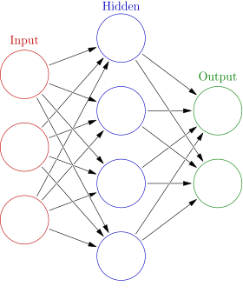
Neural Nets
Neural networks are composed of nodes in layers. Each node assigns a weight (measure of importance) to the nodes in the previous layer.
If the weighted input signals exceed a threshold, the node fires and sends a signal to the next node. (We can also use a continuous model, where a node’s output is some increasing function of its input.)
Neural networks can compute functions! (Encode an object as input, and interpret the output as a classification.)
Notes:
Traditional neural nets look like the picture on the left, with one hidden layer. We can take an input (a vector of features), encode it as 0’s and 1’s, and pass these 0’s and 1’s to the input layer. We then decide on a way to interpret the signal from the output layer as a category. Like neurons, nodes take weighted input and fire if the signal exceeds a threshold. We can evaluate in layers from left to right (although things are a little more complicated for recursive neural nets and some other models.)

Slide 24
How to train a neural net: Backpropagation
Begin with random weights.
Pick a labeled example (like {🍪, YES}.) Input “🍪” and observe output.
Notes:
The following sequence of slides are intended to give a very high-level idea of the process of backpropagation, with no math. When we begin, weights are initialized randomly. Our neural network does compute a function on our input, but it’s a totally arbitrary one. Our goal is to gradually massage this function until it turns into something that works for us by repeatedly trying inputs and updating the weights inside the network. There are many explanations online that go into a little more detail, but they’re probably too notation-heavy for ESP, e.g.: https://medium.com/datathings/neural-networks-and-backpropagation-explained-in-a-simple-way-f540a3611f5e

Slide 25
How to train a neural net: Backpropagation
Begin with random weights.
Pick a labeled example (like {🍪, YES}.) Input “🍪” and observe output.
🍪
“NO”

Slide 26
How to train a neural net: Backpropagation
Begin with random weights.
Pick a labeled example (like {🍪, YES}.) Input “🍪” and observe output.
🍪

Slide 27
How to train a neural net: Backpropagation
Begin with random weights.
Pick a labeled example (like {🍪, YES}.) Input “🍪” and observe output.
If the output is wrong (NO):
Update weights to last layer.
Assign ‘blame’ to the nodes in the second-to-last layer.
Update weights to second to last layer.
Continue backwards until all weights are updated.
🍪
“NO”

Slide 28
How to train a neural net: Backpropagation
Begin with random weights.
Pick a labeled example (like {🍪, YES}.) Input “🍪” and observe output.
If the output is wrong (NO):
Update weights to last layer.
Assign ‘blame’ to the nodes in the second-to-last layer.
Update weights to second to last layer.
Continue backwards until all weights are updated.
🍪
“NO”

Slide 29
How to train a neural net: Backpropagation
Begin with random weights.
Pick a labeled example (like {🍪, YES}.) Input “🍪” and observe output.
If the output is wrong (NO):
Update weights to last layer.
Assign ‘blame’ to the nodes in the second-to-last layer.
Update weights to second to last layer.
Continue backwards until all weights are updated.
🍪
“NO”

Slide 30
How to train a neural net: Backpropagation
Begin with random weights.
Pick a labeled example (like {🍪, YES}.) Input “🍪” and observe output.
If the output is wrong (NO):
Update weights to last layer.
Assign ‘blame’ to the nodes in the second-to-last layer.
Update weights to second to last layer.
Continue backwards until all weights are updated.

Slide 31
How to train a neural net: Backpropagation
Begin with random weights.
Pick a labeled example (like {🍪, YES}.) Input “🍪” and observe output.
If the output is wrong (NO):
Update weights to last layer.
Assign ‘blame’ to the nodes in the second-to-last layer.
Update weights to second to last layer.
Continue backwards until all weights are updated.
Pick a new labeled example ({🧁, NO}). Repeat until the neural net is accurate or until you run out of patience.

Slide 32
How to train a neural net: Backpropagation
Begin with random weights.
Pick a labeled example (like {🍪, YES}.) Input “🍪” and observe output.
If the output is wrong (NO):
Update weights to last layer.
Assign ‘blame’ to the nodes in the second-to-last layer.
Update weights to second to last layer.
Continue backwards until all weights are updated.
🧁
Pick a new labeled example ({🧁, NO}). Repeat until the neural net is accurate or until you run out of patience.

Slide 33
How to train a neural net: Backpropagation
Begin with random weights.
Pick a labeled example (like {🍪, YES}.) Input “🍪” and observe output.
If the output is wrong (NO):
Update weights to last layer.
Assign ‘blame’ to the nodes in the second-to-last layer.
Update weights to second to last layer.
Continue backwards until all weights are updated.
🧁
“YES”
Pick a new labeled example ({🧁, NO}). Repeat until the neural net is accurate or until you run out of patience.

Slide 34
How to train a neural net: Backpropagation
Begin with random weights.
Pick a labeled example (like {🍪, YES}.) Input “🍪” and observe output.
If the output is wrong (NO):
Update weights to last layer.
Assign ‘blame’ to the nodes in the second-to-last layer.
Update weights to second to last layer.
Continue backwards until all weights are updated.
🧁
“YES”
Pick a new labeled example ({🧁, NO}). Repeat until the neural net is accurate or until you run out of patience.

Slide 35
How to train a neural net: Backpropagation
Begin with random weights.
Pick a labeled example (like {🍪, YES}.) Input “🍪” and observe output.
If the output is wrong (NO):
Update weights to last layer.
Assign ‘blame’ to the nodes in the second-to-last layer.
Update weights to second to last layer.
Continue backwards until all weights are updated.
🧁
“YES”
Pick a new labeled example ({🧁, NO}). Repeat until the neural net is accurate or until you run out of patience.

Slide 36
How to train a neural net: Backpropagation
Begin with random weights.
Pick a labeled example (like {🍪, YES}.) Input “🍪” and observe output.
If the output is wrong (NO):
Update weights to last layer.
Assign ‘blame’ to the nodes in the second-to-last layer.
Update weights to second to last layer.
Continue backwards until all weights are updated.
Pick a new labeled example ({🧁, NO}). Repeat until the neural net is accurate or until you run out of patience.

Slide 37
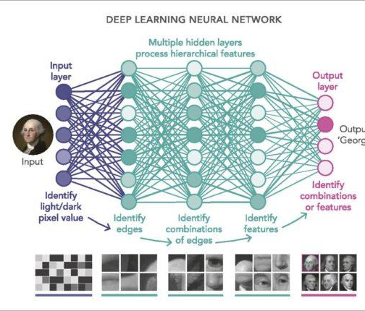
Deep Learning
Deep learning refers to machine learning using neural nets with many layers, many nodes, and (often) complicated internal structure.
Pros: immense flexibility and power.
Cons: requires lots of data. Often hard for humans to interpret what’s going on (Why might this be an issue?)
Open question: Why isn’t overfitting a bigger problem?
Notes:
Deep learning networks may have many, many layers. They may also use certain neural net structures as ‘sub-networks’ or components and combine them together. Generally, it’s really hard to look at a trained neural network (in the form of nodes and many, many weights) and describe what’s going on at any level in between the table of weights and the overall error rate. The open question comes from the fact that neural networks are so powerful that they should be able to overfit with ease (e.g., say “yes” on only a certain set of “yes” examples, and nothing else). Yet in practice, they often generalize well. People are generally stumped as to why.

Slide 38
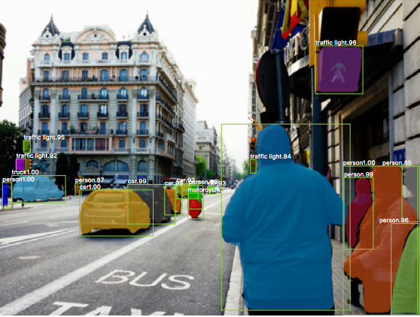
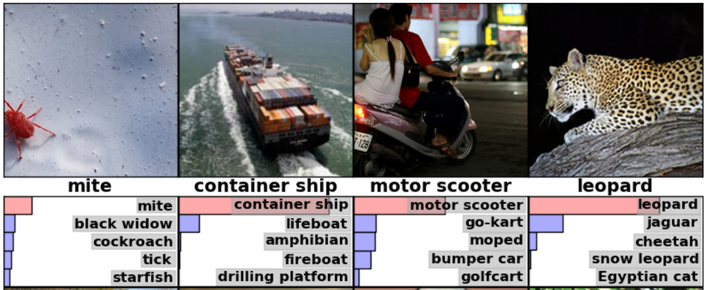
The Deep Learning Boom
The last decade has been marked by startling advances in deep learning capabilities, including image recognition:
Notes:
Examples: recognize the subject of a picture, with confidence bars (note how even the second and third guesses are closely related!), and identify many entities in one picture.

Slide 39
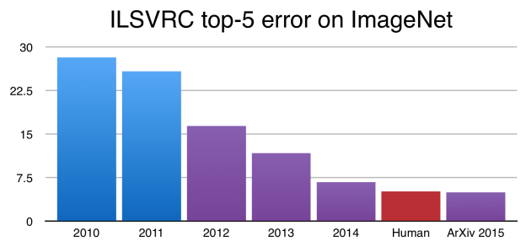
The Deep Learning Boom
The last decade has been marked by startling advances in deep learning capabilities.
Notes:
ImageNet is perhaps the most frequently used database of annotated images. Over the course of 5 years, the best neural networks went from 28% error to marginally beating humans at image labeling on this set!

Slide 40
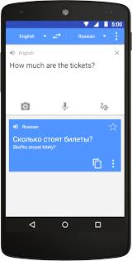
The Deep Learning Boom
The last decade has been marked by startling advances in deep learning capabilities, including language tasks:
Recurrent Neural Nets (RNNs) are a type of deep learning architecture in which the neural net feeds back into itself
A type of RNN architecture called an LSTM (Long Short Term Memory) network is now used for many natural language processing problems including:
Speech recognition
Language modeling
Translation
Image captioning

Slide 41
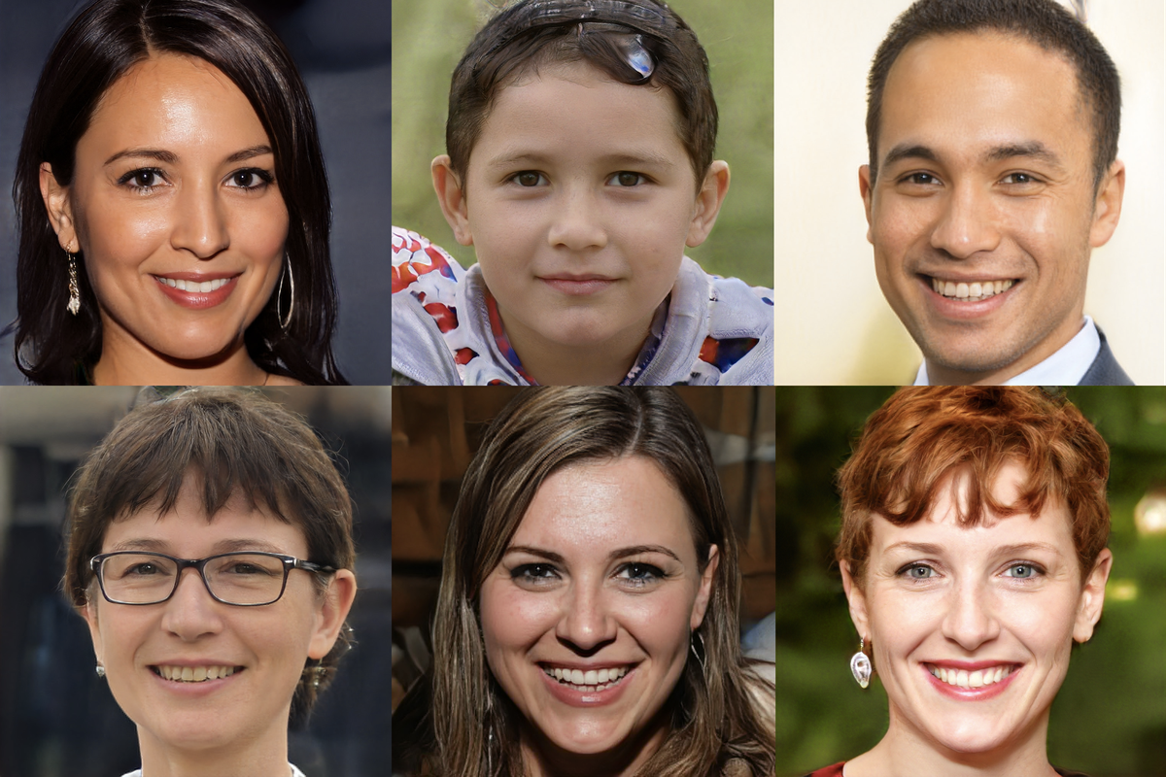
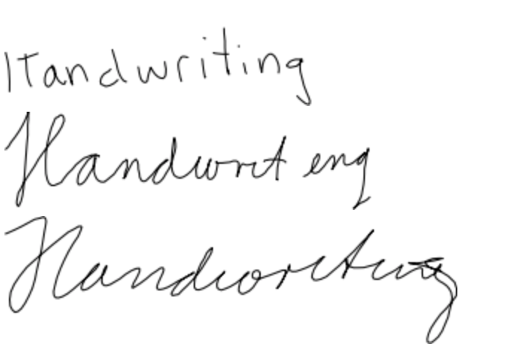
The Deep Learning Boom
The last decade has been marked by startling advances in deep learning capabilities, including image generation.
A type of deep neural net called a GAN (generative adversarial network) pits a generator network (whose goal is to generate a convincing member of a set) against a discriminator (whose goal is to detect fake members of the set.) The generator learns from competition until it can generate realistic fakes.
ThisPersonDoesNotExist.com
Notes:
Both the handwriting sample and the pictures on the right aren’t real - they’re generated by GANs. ThisPersonDoesNotExist will show you a different photorealistic picture of a nonexistent person every time you refresh.

Slide 42
Activity: GANs and Fictionary
Moderator: Select an unusual word from phrontistery.info. Share the word (not the definition!) with the group.
Generators: Send a fake definition to the moderator (without looking it up!)
Discriminators: Can you tell which definition is real?
Idea: through repeated trials, both the generators and discriminators learn about the category (English word definitions.) In this case, you already have a lot of category knowledge...

Slide 43
A Note of Caution
Although neural networks have achieved amazing successes, like other machine learning architectures, they are trained to succeed at very specific tasks. General intelligence remains elusive.
For fun: https://imgflip.com/ai-meme

Slide 44
Machine Learning at Columbia CS
COMS W4252
Computational Learning Theory
COMS W4771 Machine Learning
COMS W4772 Advanced Machine Learning
COMS E6253 Advanced Topics in Computational Learning Theory
David Blei
Shih-Fu Chang
Daniel Hsu
Tony Jebara
Ansaf Salleb-Aouissi
Carl Vondrick

Slide 45
Data Bias
Notes:
Notes for next semester: machine learning has a natural ethics component, so let’s add that! (e.g. if your data is biased, your output will be biased.)

