Slide 1
Graph Theory and Social Networks
Notes:
Facebook, social media, ...

Slide 2
What is a Graph?
Can you draw one?
How does your graph represent:
the whole data set?
an individual data point?
the relation between two points?
What do all graphs attempt to convey?
RELATIONSHIPS
Notes:
Distinction between ‘charts’ and the mathematical objects we call graphs.

Slide 3
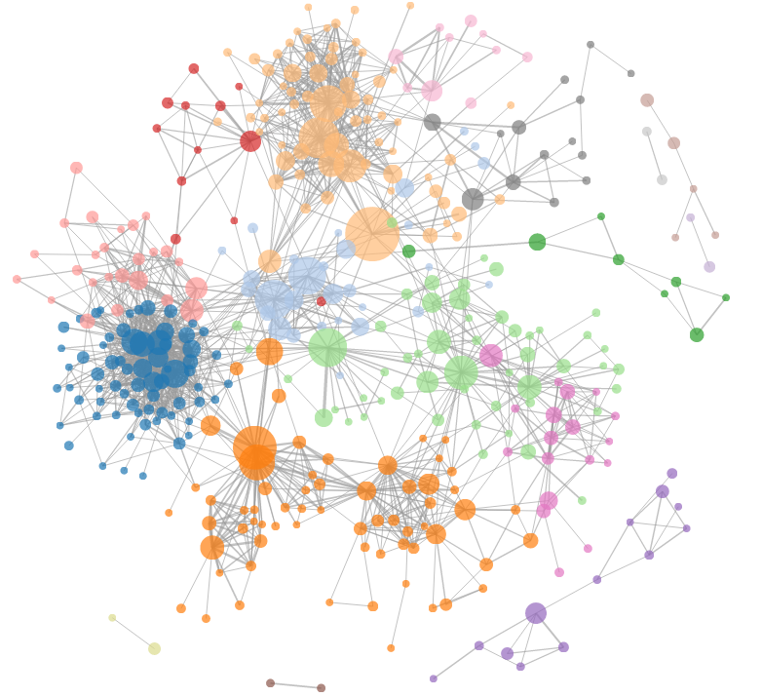
Notes:
Questions: size of nodes? Arrangement? Note that these aren’t inherent properties of the graph

Slide 4
Graph Basics
In its most basic form, a graph is an ordered pair
is a set of vertices (or nodes or points)
is a set of edges (or arcs or lines), a 2-element subset of
Can you draw this graph ?
This graph is both undirected and simple
Note: A graph doesn’t specify any particular visual representation
Notes:
Diana’s example: two separate edges are the same graph (whether or not they cross in a drawing)
Worth talking about notation of sets, tuples, building mathematical objects etc.
Simple because only 1 edge between 2 vertices and no loops

Slide 5
Simple Graph and Multigraph
Notes:
Simple graphs don’t allow multiple edges or self loops

Slide 6
Undirected and Directed Graphs

Slide 7
Graph Basics (Cont'd)
The order of a graph G = (V, E) is the number of vertices it has |V|.
The degree of a vertex u is the number of edges connected to u.
A path from a node u to v is a sequence of nodes (u,s₁,s₂,...,v) such that there is an edge between each pair of adjacent nodes.
The length of a path p is the number of nodes in the sequence.
A graph G is connected if there is a path between every pair of nodes u and v.
Notes:
Mention notation: |V| is cardinality or ‘size’ of a set V
Two unconnected components can still be one graph. So is the graph with no edges.

Slide 8
clusters
components
bridges
Notes:
Try and get the students to explain how the “importance” of each of these structural elements changes depending on our measure of centrality
Cluster: many internal connections. Components: connected subgraphs. Bridges: edges that would separate two components if removed

Slide 9
Social Network Analysis
What is a Social Network?
Can you draw one of yours?
Activity #1: Noticing and Drawing Social Networks
Try to brainstorm 10 different relationships.
Using the graph theory tools you have just learned, draw one of these social networks.
Notes:
apartment, apartment building, friend groups, (hypothetical?) dorm floor, contact tracing. Can draw ESP section as a graph, with connections between those who have shared a breakout room
If you need an example, try drawing a tree of disease spread based on this article: https://www.nytimes.com/interactive/2020/10/02/us/politics/trump-contact-tracing-covid.html
https://www.vox.com/2020/10/2/21498870/white-house-cluster-tested-positive-covid-19-coronavirus

Slide 10
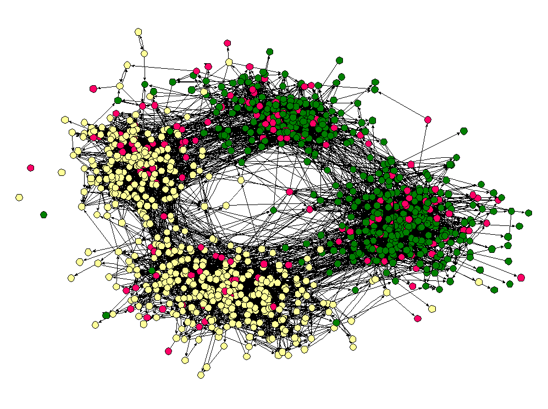
Are our lives structured?
Notes:
Figure Source: "Race, school integration, and friendship segregation in America. James Moody. American Journal of Sociology.

Slide 11
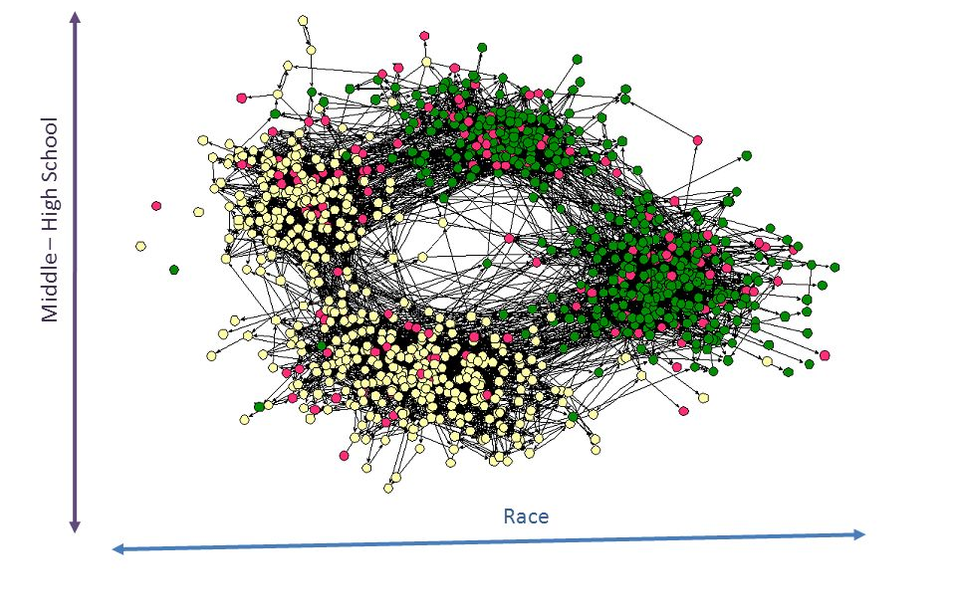
Notes:
Suppose you’re given a new node with race / age unknown. Could you guess? How accurate would your guess be?

Slide 12
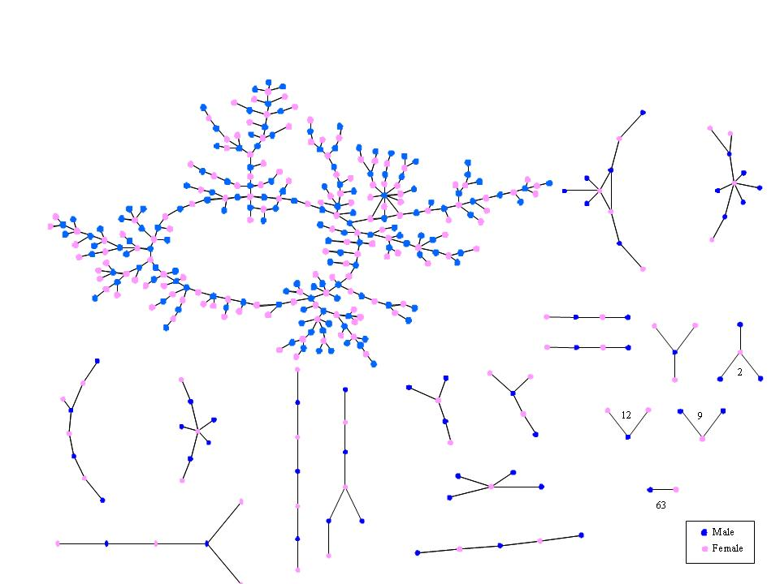
Are our lives structured?
Notes:
Make sure to explain the concept of triadic closure-- ie. people tend to close off most of their relations into triangles… why don’t we see that behavior here? What can the frequency of certain structures, centrality measures, and node attributes (ie gender) tell us about behavior?

Slide 13
Why does it matter?
Which came first– social identity/behavior or the structures that allow them to occur?
Social networks inscribe everyone
And their structure results in unintuitive findings!
Kevin Bacon number
🎶 It’s a small world after all… 🎶
Erdos number

Slide 14
From Structure to Algorithms
Activity #2: Computing on Social Networks
Brainstorm at least 3 questions someone might ask about a social network.
How can you use structure to answer these questions? Is structure enough to answer each of these questions? Why or why not? If not, what else is needed?
Prompts:
What are some examples of social networks? That you are part of? That you know of? What are the nodes in these networks? People, families, businesses, advocacy groups, states, countries? How does the social network matter to them? How do they interact with the social network? What are they trying to accomplish? What useful information does the social network contain?
Notes:
Notes: this is a hard activity to run. How can we streamline it? Prompts enough for a group discussion.

Slide 15
Algorithmic Influence Propagation
Networks capture the structure of human relations and interactions. Ideas, diseases, products, and more propagate through these connections.
In industry, marketing divisions often turn to network analysts for recommendations on how to ensure the widespread of a product
Ever heard of FitTea?
Note: this is related to the problem of vaccine prioritization!
Notes:
Vaccines given to ppl who make networks more highly connected

Slide 16
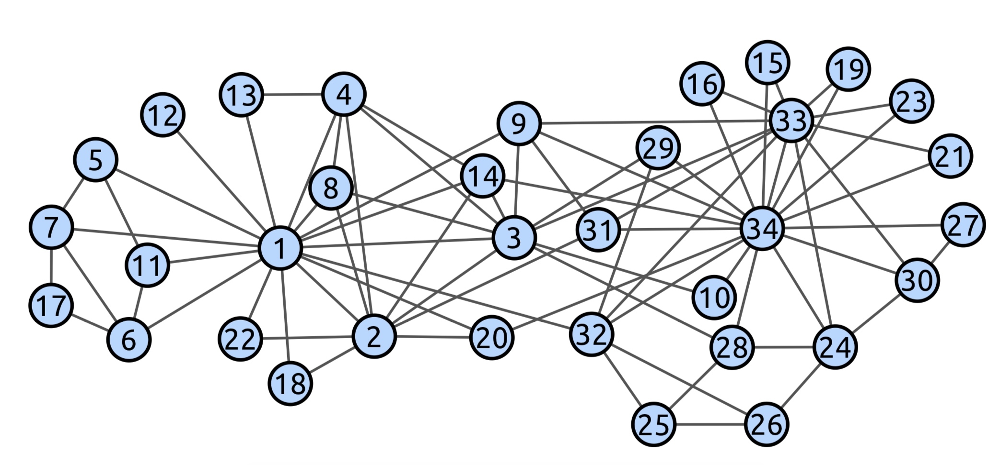
Algorithmic Influence Propagation
Can we approach this question from an algorithmic perspective?
Notes:
Who would you give a COVID vaccine to first? (Who’s intuitively most central?)

Slide 17
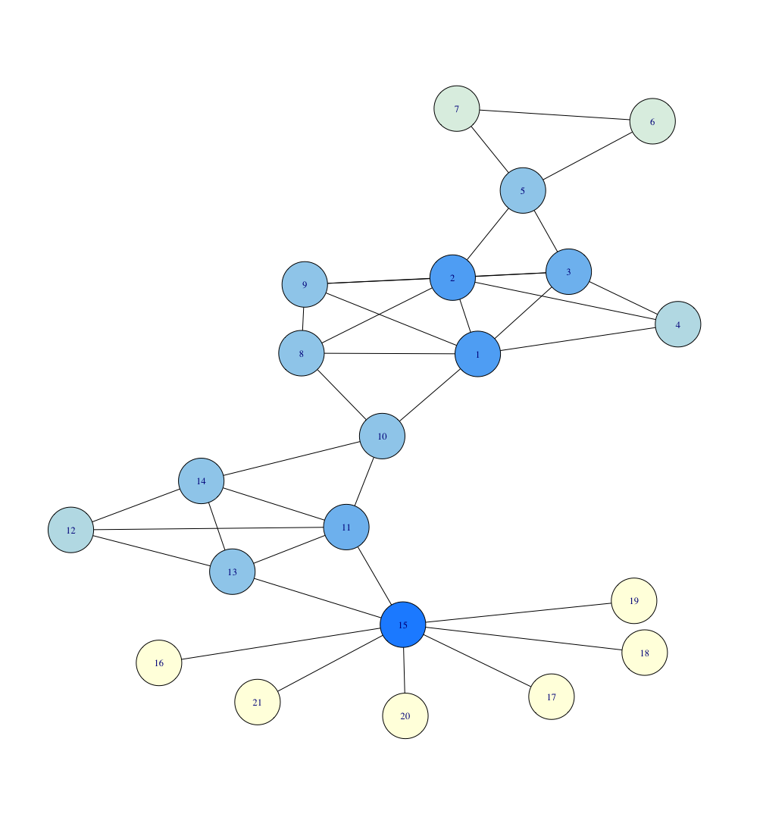
Graph Centrality
Degree Centrality: Your connections are what matter.

Slide 18
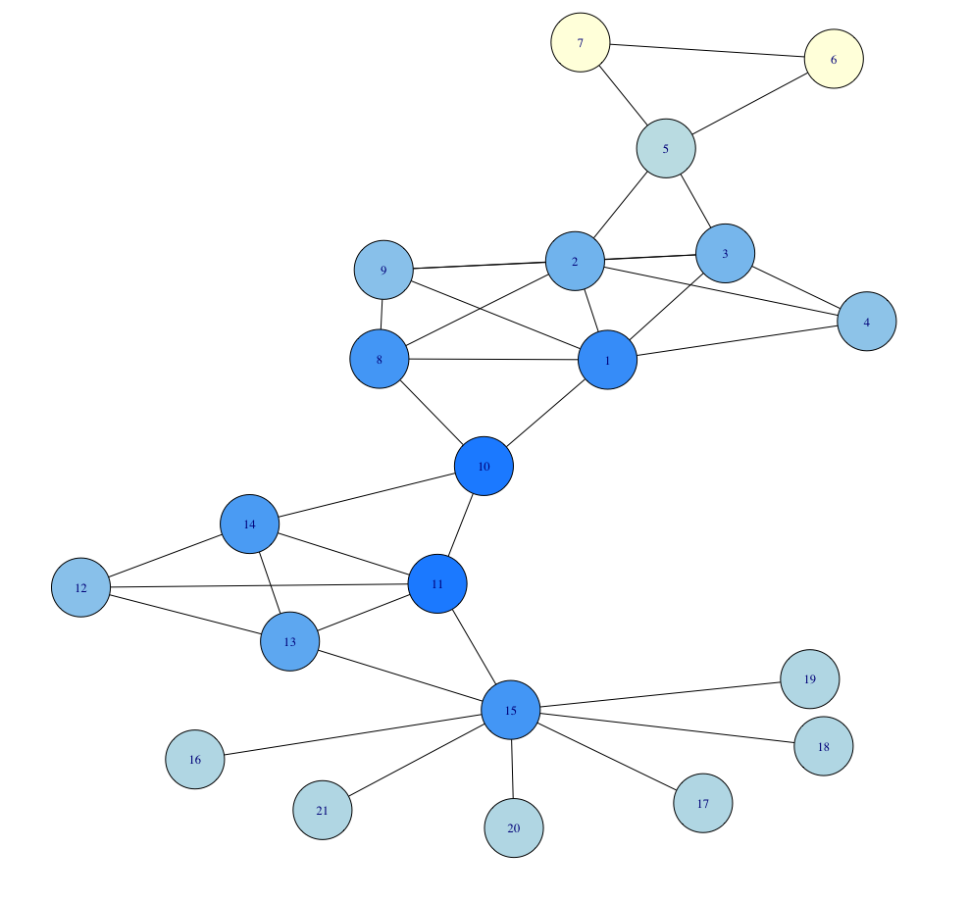
Graph Centrality
Degree Centrality: Your connections are what matter.
Closeness Centrality: Your distance from everyone else in the network is what matters.
Notes:
Note that for closeness centrality, the ‘most central’ nodes have shifted toward the visual ‘middle’ of the graph

Slide 19
Graph Centrality
Degree Centrality: Your connections are what matter.
Closeness Centrality: Your distance from everyone else in the network is what matters.
Betweenness Centrality: Your position as an intermediary in the network is what matters.
Notes:
denominator= Sigma(s,t)= total # of shortest paths from node s to node t
numerator= all the shortest paths that pass thru v
Closeness vs betweeness: middle nodes most blue coz north to south paths have to pass thru it

Slide 20
Algorithmic Influence Propagation
Activity #3: Influence Maximization
Design an algorithm for selecting k nodes that have the most "influence" on the network.
Things to consider:
What makes a node "influential"?
How might influence propagate?
Might there be interaction between the selected nodes?
Notes:
Note that this is also dorm data, but generated using a different understanding of an edge, I believe in response to a question like “Name all the people on your floor who you have talked to in the past 5 days”

Slide 21
Social Influence: Ethics and Law
Influencers have the potential to affect many people through their actions and words.
Influencers are often compensated to promote companies, services, and products.
What do you think are the ethics here?
How should the law protect people?
Frank Schwichtenberg. Creative Commons Attribute-Share Alike 4.0 International License. https://en.wikipedia.org/wiki/File:Cardi_B_-_Openair_Frauenfeld_2019_02.jpg
Notes:
Cardi B scandal: failure to disclose

Slide 22
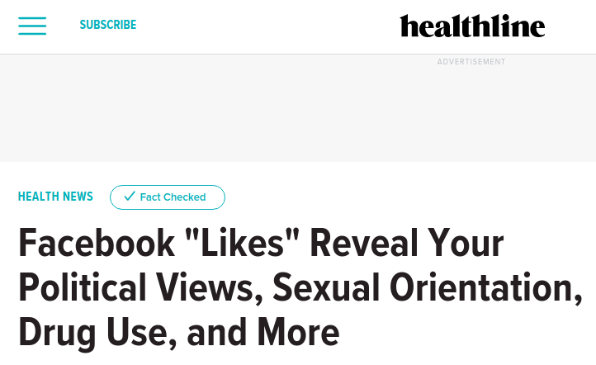
Reconciliation
A social network contains a lot of information about the people in it.
People often participate in multiple social networks that overlap substantially: Twitter, Facebook, TikTok, non-digital, etc.
How easy is it to link individuals across their social networks?

Slide 23
Reconciliation
Given a set of individuals U, and two social networks over U the individuals, and possibly overlapping and different edges: G₁ = (V₁, E₁) and G₂ = (V₂, E₂).
Suppose you don't know the correspondence between the nodes in V₁ and V₂.
Problem: Match the individuals between the networks.
Notes:
https://icerm.brown.edu/materials/Slides/sp-s14-w2/An_Efficient_reconciliation_algorithm_for_social_networks_]_Silvio_Lattanzi,_Google_Inc..pdf

Slide 24
Reconciliation
Consider the ESP Group Interactions social network G = (U, E):
U is the set of ESP students in your section.
There is an edge (a, b) in E if student a has interacted with student b in any of the group activities this semester.
What constitutes an interaction?

Slide 25
Reconciliation
Activity #4: ESP Reconciliation
Part 1: In individual groups, draw the ESP Group Interactions social network.
Use the whiteboard app.
Label the nodes numerically.
Keep a separate key for the nodes.
Part 2: Exchange your ESP Group Interactions social network with another group. Reconcile your two social networks.
Notes:
Other notes: what ELSE can you do with graphs?

Slide 26
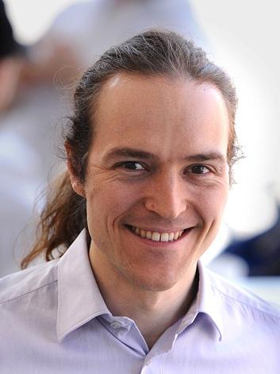
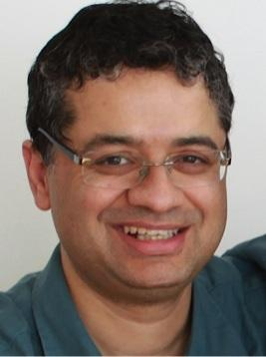
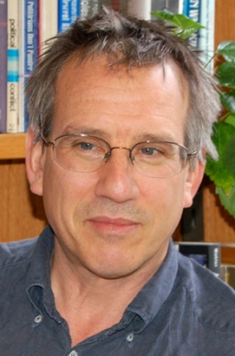
At Columbia
Courses to Consider:
COMS W4995 -- Networks and Crowds
COMS W6998 -- Social Networks
COMS W6998 -- Internet Economies
SOCI C4701 -- Social Network Analysis
SOCI C3998 -- Organizing Innovation
SOCI C3108 -- Demographic Homophilies
David Stark
Vishal Mishra
Peter Bearman
Augustin
Chaintreau
Notes:
Chaintrau -- CS Department focus on Social Networks and Data Transparency, Mishra-- CS Department focuses on Internet Infrastructure and intersections with Economic Networks, Stark-- Sociology focuses on Institutional Structures in relation to post-colonialism and neoliberalism, Bearman-- Sociology focuses on Theoretical Networks (essentially trying to discover new places where there are networked relations)
I would stress that you need a strong background in graph theory, linear algebra, and Analytical Theory (a kind of logic used in quantitative Sociology), but especially important for Social Network Analysis is a strong interest in a specific social space (ie. I’m writing my thesis on rural societies, more popular spaces would be international migration, american racial identities, or low-skill labor markets)

