Slide 1
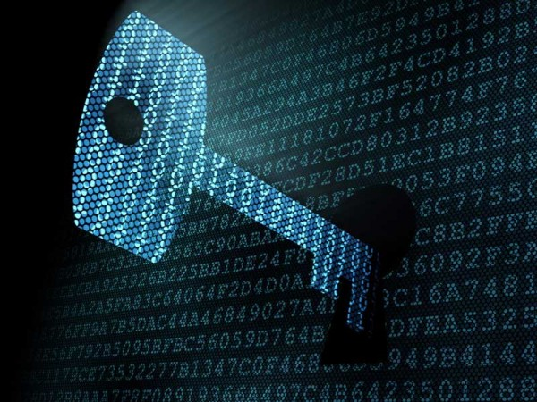
Cryptography
Notes:
https://en.wikipedia.org/wiki/Kryptos (Couple of fun crypto-related things - Kryptos sculpture, Zodiac cypher broken December 2020)
https://www.sfchronicle.com/crime/article/Zodiac-340-cypher-cracked-by-code-expert-51-years-15794943.php

Slide 2
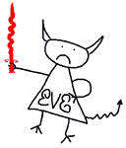
What is Cryptography?
Cryptography is the practice and study of techniques for secure communication in the presence of adversaries.
Eve
Alice
Bob
Notes:
Alice and Bob - from original RSA paper [RSA78] and used ever since RSA is a public-key cryptosystem that is widely used for secure data transmission. It is also one of the oldest. The acronym RSA comes from the surnames of Ron Rivest, Adi Shamir, and Leonard Adleman, who publicly described the algorithm in 1977.

Slide 3
Secure Communication:
Say Alice wants to send Bob a message. However, an adversary, Eve, is listening to their conversation. How can Alice make sure that only Bob receives her message?
Alice
Bob

Slide 4
Secure Communication:
Alice and Bob can share a secret, which enables them to send encrypted messages to each other.
Shared Secret
Alice
Bob

Slide 5
Secure Communication:
Hopefully, without the secret, Eve will not be able to read the contents of the encrypted message.
?
Alice
Bob

Slide 6
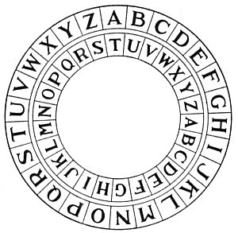
Pre-modern Cryptography
Before the 1950s, messages were encrypted using essentially heuristics.
“Scramble” the message in some complicated way making it hard to tell the original contents.

Slide 7
Pre-modern Cryptography
Typical Cycle:
New “scrambling” method created, often claimed “unbreakable”
Used for critical communications by governments, spies, kings, etc.
Eventually broken by enemy. Replaced with new scheme.
Notes:
Explain Caesar cipher

Slide 8
Can You Read This?
N fgngr, juvpu qjnesf vgf crbcyr, va beqre gung gurl znl or zber qbpvyr vafgehzragf va vgf unaqf rira sbe orarsvpvny checbfrf, jvyy svaq gung jvgu fznyy crbcyr ab terng guvat pna ernyyl or nppbzcyvfurq; naq gung gur cresrpgvba bs znpuvarel gb juvpu vg unf fnpevsvprq rirelguvat, jvyy va gur raq ninvy vg abguvat, sbe jnag bs gur ivgny cbjre juvpu, va beqre gung gur znpuvar zvtug jbex zber fzbbguyl, vg unf cersreerq gb onavfu.
Notes:
Ask - how would you start to crack this? Double-letters, short words.
n==a

Slide 9
Can You Read This?
“A state, which dwarfs its men, in order that they may be more docile instruments in its hands even for beneficial purposes--will find that with small men no great thing can really be accomplished. ...” - J. S. Mill, On Liberty

Slide 10
Example: Substitution Cipher
In a substitution cipher, each character of the message is replaced by a different character.
The mapping from message characters to ciphertext characters is the shared secret that both Alice and Bob have.
Example secret mapping:
A
B
C
D
…
D
X
Z
E
…
Here, the message “CAB” would be encrypted as “ZDX”
Notes:
Unlike caeser cipher- ans to 1 =/= ans to all

Slide 11
Can You Read This? (2)
Tzwwg! Otyf yf l cqzfzko iqgn l fnlww ayfolko sgqwa, l ogrzk gi geq fgekaf, geq fmyzkmz, geq ynlpzf, geq nefym, geq otgeptof lka geq izzwykpf. Sz lqz loozncoykp og feqdydz geq oynz fg sz nlu wydz ykog ugeqf. Sz tgcz fgnzalu, tldykp fgwdza otz cqgxwznf sz ilmz, og bgyk l mgnnekyou gi plwlmoym mydywyhloygkf. Otyf qzmgqa qzcqzfzkof geq tgcz lka geq azozqnykloygk, lka geq pgga syww yk l dlfo lka lszfgnz ekydzqfz.
Notes:
What words can be a single word at the beginning of a sentence? What do the double-letters tell us?

Slide 12
Can You Read This? (2)
“Hello! This is a present from a small distant world, a token of our sounds, our science, our images, our music, our thoughts and our feelings. We are attempting to survive our time so we may live into yours. We hope someday, having solved the problems we face, to join a community of galactic civilizations. This record represents our hope and our determination, and our good will in a vast and awesome universe.” - Voyager spacecraft

Slide 13
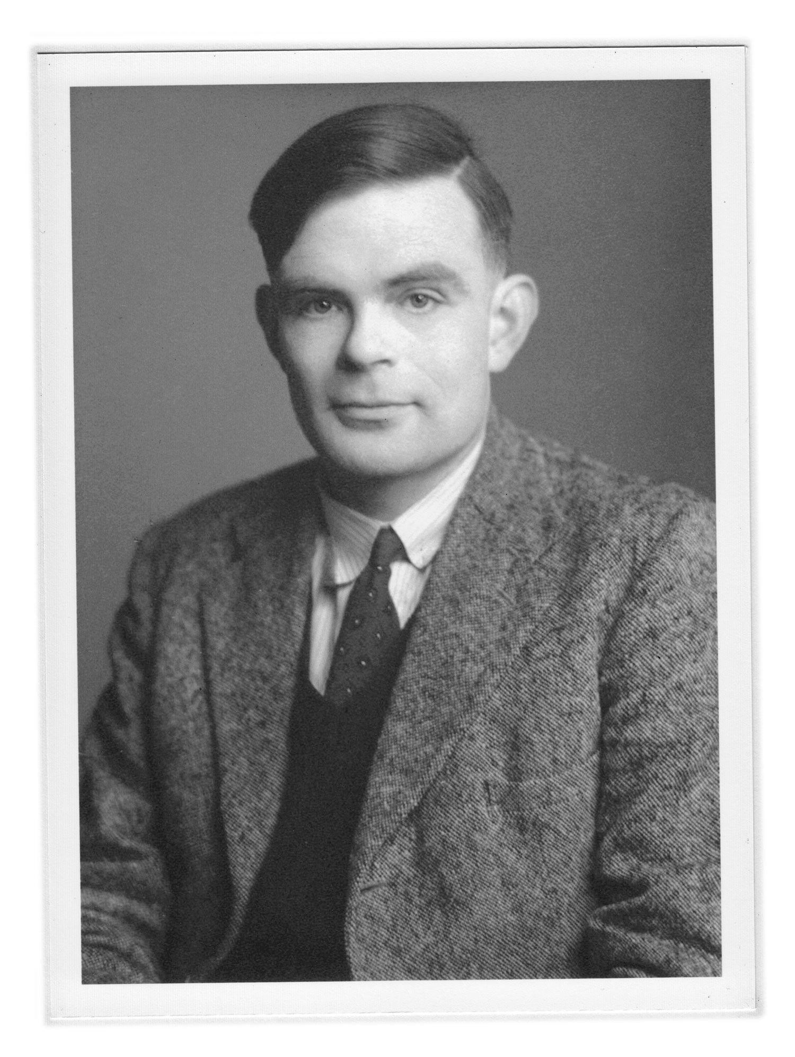
Example: Substitution Cipher
Although messages encrypted this way appear scrambled, this method of encryption is not very secure. Why?
Suppose I see the ciphertext: “ASXVF”. I then know that each of the letters in the plaintext (message) are different. So, for example, I know that the plaintext could not have been: “HELLO”
More generally: I can learn some information about the message just from observing the ciphertext. Small weaknesses like these can have enormous real-world consequences! (Imitation Game: https://www.youtube.com/watch?v=_C25CwNlVjA)
Notes:
Word length= problem
Explain the movie problem where all messages ended w ‘heil hitler’ which helped decode it turing machine

Slide 14
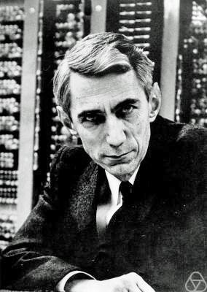
A New Approach?
To avoid the problems we saw with the substitution cipher, we’d like our encryptions to have the property that: without the secret, an adversary cannot obtain any information about the message.
This notion is called perfect security and was made possible by Claude Shannon, who developed the field of information theory in the 1950s.

Slide 15
Perfect Security – One Time Pad
Represent a message as a string of bits (0/1)
Secret is a random string of bits
To encrypt: XOR message with secret
To decrypt: XOR ciphertext with secret
Message: 00001111
Secret:
Ciphertext:
x | y | x XOR y
0 | 0 | 0
0 | 1 | 1
1 | 0 | 1
1 | 1 | 0
10110010
10111101
Notes:
XOR:
Diff values so (0, 1)= 1
Same value= 0
Worth drawing out the table on the board and going through it in some depth, because XOR may not be familiar. Also: if you XOR the ciphertext and secret, you get the message back.
XOR smth w same string twice, you get the original str

Slide 16
Perfect Security – One Time Pad
Note that this scheme avoids the problem we noted about the substitution cipher.
Given a ciphertext, we can no longer rule out some messages (like we did with “HELLO” for the substitution cipher).
For any message, there is some secret that might have been used to create a given ciphertext.
x | y | x XOR y
0 | 0 | 0
0 | 1 | 1
1 | 0 | 1
1 | 1 | 0
Message: 00001111
Secret:
Ciphertext:
10110010
10111101
Notes:
Discuss some XOR examples on whiteboard before next slide- chk out understanding by asking in chat
11 XOR 10-->01
01 XOR 10-->11

Slide 17
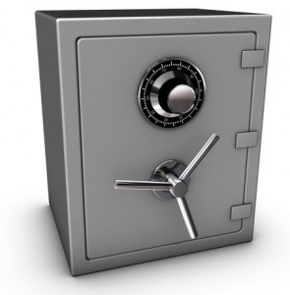
Secret Sharing
Suppose you are a large bank owner and you have a secret code to open your vault.
You’d like to delegate this ability to your five top managers.
The password is “money”
Notes:
Password is “money” is a joke, not important to the activity. :)

Slide 18
Secret Sharing
Can you make it so that the vault can only be opened if all your managers authorize it?
Hint: use one-time pad

Slide 19
Secret Sharing
Solution:
Notes:
Look at it like m cancels out the not answer parts of r1,r2,r3,r4 and you finally get the key
Start by explaining w 2 ppl and writing out a simple example

Slide 20
Modern Cryptography
Modern Cryptography is characterized by its emphasis on provable security.
This involves establishing rigorous definitions of security (like “perfect security”) and providing mathematical proofs that given schemes satisfy the definition.

Slide 21
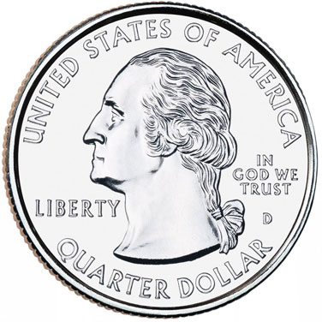
Beyond Message Encryption
Say Alice and Bob are playing a game:
Alice guesses “heads” or “tails.”
Bob flips a coin.
If Alice was right, she wins. If not, Bob wins.
“heads”
I win!
Alice
Bob

Slide 22
Bob and Alice had so much fun playing this game, they want to continue to play once they get home over the telephone:
Alice starts to get suspicious… How can she know if Bob is playing fairly?
No, it was Heads, you lose.
Heads!
No, it was Tails, you lose.
Tails!
Hmm...
Mad.
Notes:
Best game ever

Slide 23
One-Way Functions
Function that is easy to do, but hard to undo.
Used as a tool to help construct many cryptographic protocols.

Slide 24
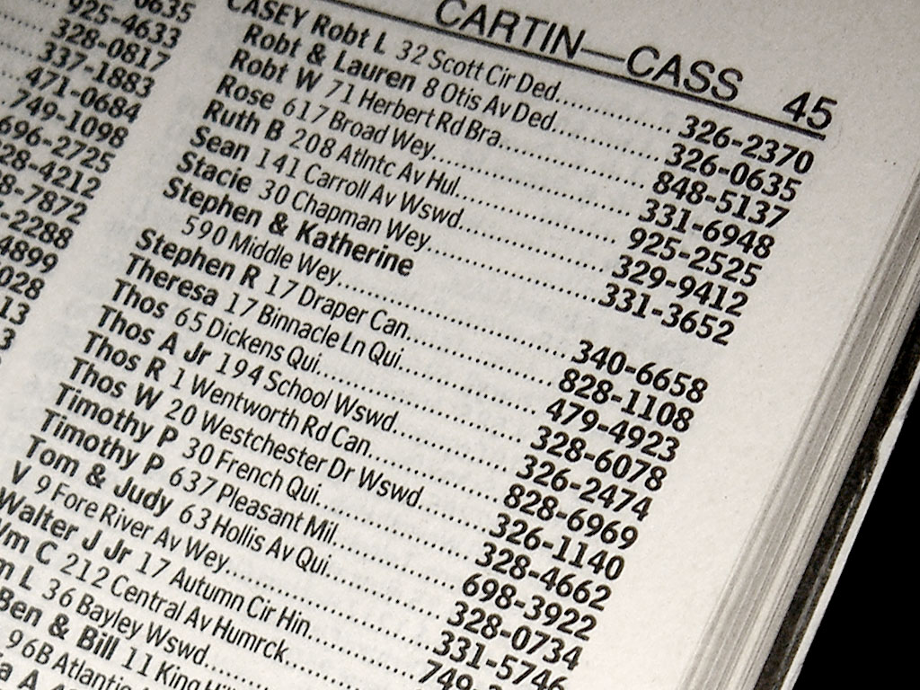
One-Way Functions
For an example, consider a phone book:
Given a name, it is easy to find a phone number
Notes:
As phone books fade from relevance, what other real-world examples are useful? UNIs/ID numbers?

Slide 25
One-Way Functions
For an example, consider a phone book:
However, given a phone number, it is much harder to find the associated name.

Slide 26
Suppose Alice and Bob each had a phonebook so large that given just a phone number, it is impossible for either to find the associated name (but it is still easy to find the number for a given name).
Notes:
Break out rooms. This is a hard activity, but usually at least one group gets it.

Slide 27
Activity: design a protocol that will allow Alice and Bob to play the coin flipping game over the telephone such that Bob cannot cheat Alice (make sure Alice has a ½ chance of winning).

Slide 28
Answer:

Slide 29
Answer: Bob flips the coin first. If heads, he selects a name in the first half of the phone book. If tails, he selects a name in the second half of the phone book.
He sends the corresponding phone number of the name to Alice.
I got heads! Let me look up a name in the first half…
212-555-9812
Bob Borchers

Slide 30
Alice can’t look up the name corresponding to Bob’s phone number, so she doesn’t know anything about what Bob chose.
She chooses heads or tails.
You’re wrong again, but this time I can prove it!
Ah, I see!
Tails!
212-555-9812
Look up “Bob Borchers”

Slide 31
One-Way Functions in Real Life
For real protocols, cryptographers use one-way functions that are based on mathematics.
Example: factoring – easy to compute product of two large primes, hard to compute factors p, q of some given n = pq.

Slide 32
One-Way Functions in Real Life
Example: hash functions. Computing h(x) is easy. (You can compute SHA-1 hashes on your computer)
Given the output, it is practically impossible to find the input.
Given the input, you can verify on your own computer that the result equals the hash.
Notes:
Do the coin flip activity using the hash function!!!!!!

Slide 33
Coin Flipping Protocol: True Story
Suppose Luke and Kui are two ESP Graduate Student Coordinators who have to decide to hire one of two equally qualified assistants.
They want to decide using a random coin flip, but want to do so via email in a way that prevents cheating/bias.
How might they use the coin flipping protocol with the SHA-1 hash function installed on their MacBooks to solve their problem?
Notes:
Break out room one
Hashing names is a easy function. (To make it hard to just test both names, hash “Assistant 1 is heads + <some random garbage>” - the garbage ensures the there’s no cheating by checking both names

Slide 34
New Problem: Zero Knowledge
A zero-knowledge protocol is a method by which one party (the prover) can prove to another party (the verifier) that a given statement is true without conveying any information apart from the fact that the statement is true.
When might this be useful?
Notes:
Useful in Hw answers
Applications:
Ethical behavior: One of the uses of zero-knowledge proofs within cryptographic protocols is to enforce honest behavior while maintaining privacy. Roughly, the idea is to force a user to prove, using a zero-knowledge proof, that its behavior is correct according to the protocol.
Also: Blockchains, Nuclear disarmament (!)

Slide 35
Colorblind Card Difference
Suppose Bob is colorblind and Alice has two colored cards.
Notes:
Prove to bob that A has 2 diff colors

Slide 36
Colorblind Card Difference
Activity: construct a protocol that allows Bob to be convinced that Alice’s two cards are indeed different colors despite his inability to see the colors of the cards himself.

Slide 37
Colorblind Card Difference
Answer:

Slide 38
Colorblind Card Difference
Answer: Alice gives the cards to Bob. Bob holds them up, turns around, then either swaps the cards or not (each with probability ½), then turns back and asks Alice if he swapped or not.

Slide 39
Colorblind Card Difference
If the cards are indeed different, Alice will be able to answer correctly every time.
If Alice was lying, she will only have a ½ chance of guessing correctly (since the cards will look the same either way)

Slide 40
Colorblind Card Difference
Alice and Bob can repeat this as many times as Bob desires until he is convinced that Alice is not simply “getting lucky” with her guesses.

Slide 41
Colorblind Card Difference
How is this Zero-Knowledge? Alice is able to convince Bob of her statement without giving away any extra information (like the color of the cards – Bob can’t see this).

Slide 42
Notes:
Cryptocurrency has exploded in popularity over the last decade, earning endorsements from celebrities as well as tech boosters. What reasons might Elon Musk have to post this tweet?

Slide 43
Notes:
Imagine this scenario:
We have a castle in the middle
The lieutenants have surrounded the castle. They plan to launch an attack.
The only way that the castle could be defeated is if the Byzantine army launches a planned and synchronized attack. If there is any miscommunication, the offense will fail. Speaking of communication, the only way that the generals can synchronize a strike is by sending messages via messengers. Now, this leads to several failure scenarios: Imagine that the messengers are traitors, and they convey information that is contrary to the army’s strategy? Presume that one messenger out of four is a traitor, and he passes along the message of “RETREAT” to some when the actual strategy is to “ATTACK”? What if the messenger gets captured by the enemy, and their message is tampered with? Ponder whether some of the Byzantine lieutenants are traitors and plan on betraying the army? What if the general himself is corrupt and looking to spread discord among the lieutenants?
With context to blockchains, each lieutenant is a node (computer; ‘person’) in the network, and these nodes need to reach a consensus to determine the current state of the protocol. For anything to happen, a supermajority (>2/3rd) of the network in a distributed system will need to come to a consensus. What this also means is that if a majority of the network is malicious (like in the case of a 51% attack), the system is vulnerable to failures.

Slide 44
What is Blockchain Technology?
It is a decentralized, distributed ledger that records the origin and the history of a digital asset.
Let’s break it down:
1. Decentralized/distributed: no central authority (like a bank or government.) Who owns/does what is determined by consensus.
2. Ledger: a database of transactions or records.
3. Digital asset: E.g., Bitcoin (who owns what? List of all prior transactions), medical test results.
Notes:
-It started as a CS term for how to structure and share data and has become so much more!
-Ledger=a book or other collection of financial accounts of a particular type

Slide 45
An Analogy: Google Docs
What happens when you share a Google Doc with many people?
Gives everyone has access to the same document (as opposed to making a copy or passing the original around.) Any changes to the Google doc are being recorded in real-time (everything is transparent.) Everyone with access can view it, make comments or suggest changes, and even the revision history is visible to all guests. What’s seen and entered cannot be denied by anyone, and one person can’t make a change without everyone seeing the change.
Notes:
That being said the difference between a blockchain and a google doc is that if two people make a change at the same time google doc technically is the middle person and does decided whose change goes first. But analogy shows how a distributed ledger works overall. What if you wanted to remove Google from the equation?

Slide 46
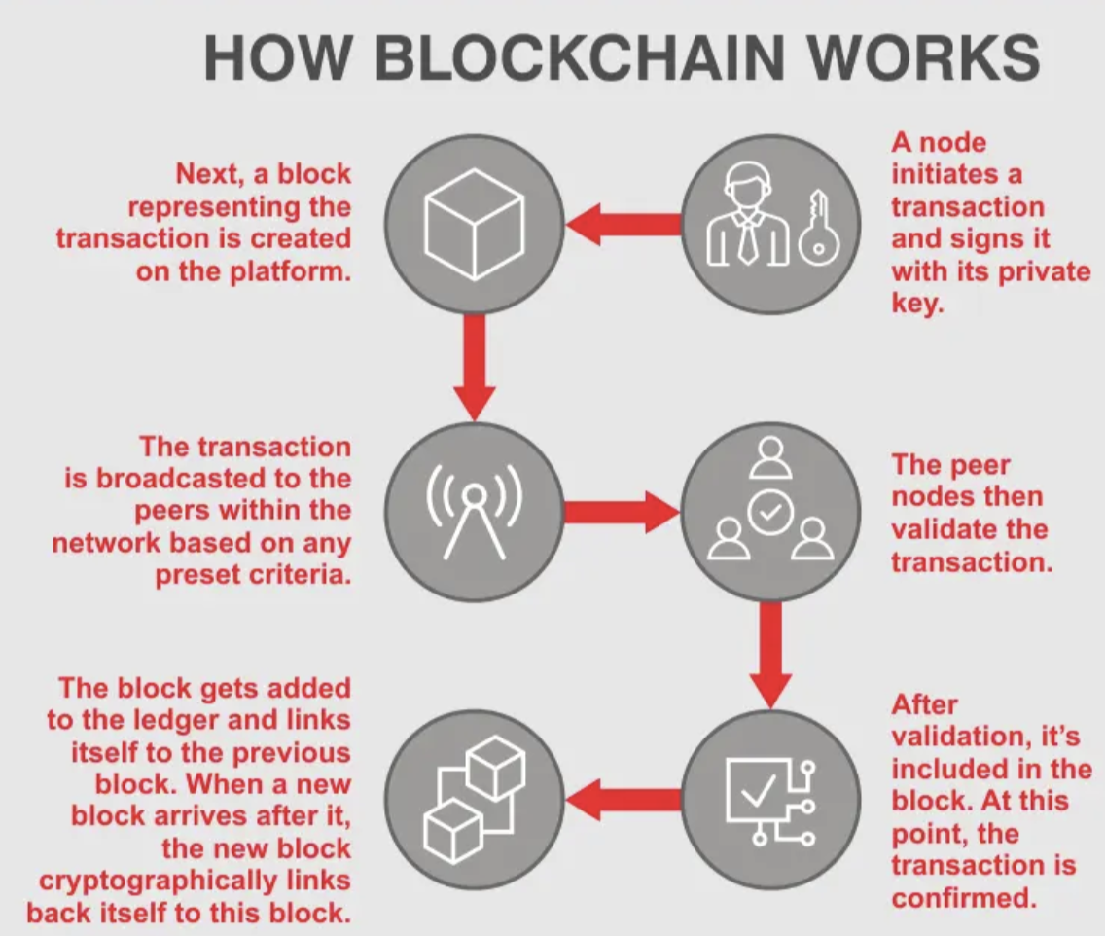
Notes:
Transaction-an instance of buying or selling something; a business deal.
- miners=auditors
- No advanced math or computation is involved. You may have heard that miners are solving difficult mathematical problems. What they're actually doing is trying to be the first miner to come up with a 64-digit hexadecimal number (a "hash") that is less than or equal to the target hash. It's basically guesswork.(hash puzzles)

Slide 47
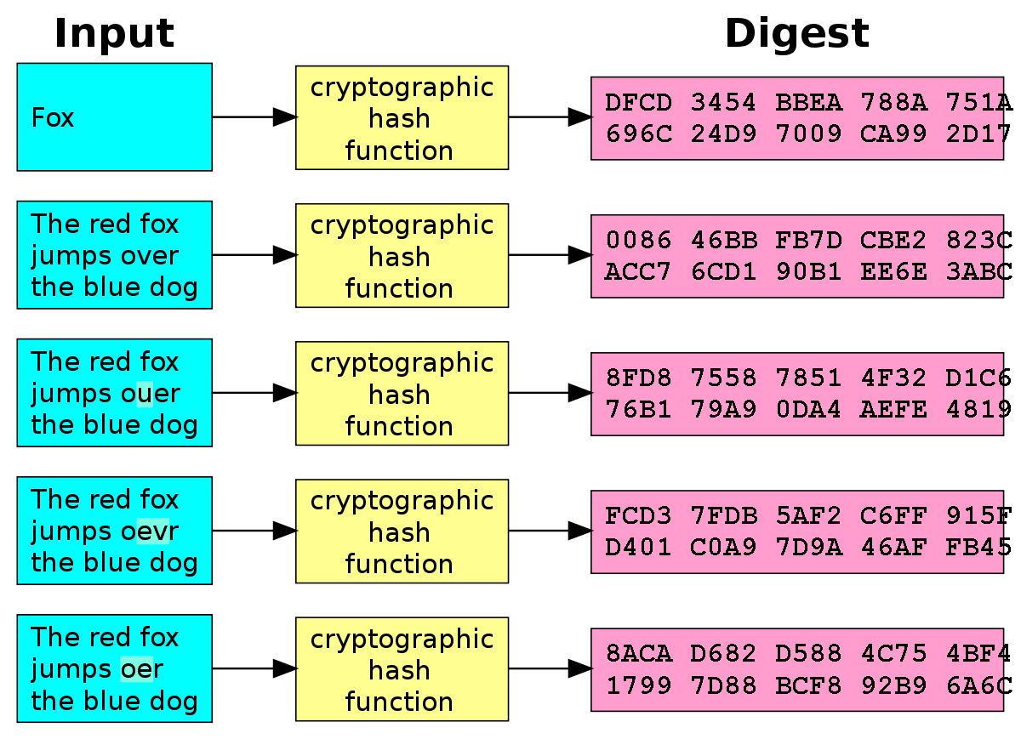
Connections to Cryptography
Part of the appeal of blockchain is built-in security:
1. asymmetric-key algorithms
2. hash functions.
The hash function used in blockchain is SHA-256.
Each ‘block’ in the chain is authenticated by a value that results in a special hash when plugged into SHA-256. Bitcoin miners provide a “proof of work” by discovering these values.
Notes:
-Reminder: Cryptography is the practice and study of techniques for secure communication(distributed computing)
-Asymmetric-key algorithms combine plaintext with a key, input to an algorithm, and outputs ciphertext. The keys used for the encryption and decryption portions are different which is why it is called asymmetric---> opposite of one-time pad as mentioned in the slides
-Hash functions’ purpose is to be able to provide the functionality of a single view of blockchain to every participant. The hash function used in blockchains is the SHA-256 hashing.
-Hash functions link the blocks to one another. They also maintain the integrity of the data stored inside each of the blocks. If there is some kind of alteration in the block it can lead to inconsistency and breaking of the “chain”(so the block becomes invalid).
-This is possible because of a special property of the hash function called the ‘avalanche effect’. -if we make even a slight change, we end up with a totally unrelated output as compared to the original output.

Slide 48
What is Its application in the world?
Transactions and banking
Healthcare
Real Estate
Academia
Gaming

Slide 49
Implementation of Blockchain in Healthcare
Estonia is one of the first countries to start using blockchain technology in health care(today 95% is blockchain)
For the past 10 years more than 176 million patient records were exposed in data breaches (stolen credit card and banking information, as well as health and genomic testing records)
Storing personal data of Patients (Electronic Health Records)
Maintains a record of origin and protects patient identity.
Notes:
Blockchain is transparent it is also private, concealing the identity of any individual with complex and secure codes that can protect the sensitivity of medical data→ can’t steal information nor change them. In more detail:
-It can be used to store the personal data of patients (Electronic health records). Blockchain technology works on a distributed basis. Thus, the database is not stored in one place, but on computers hundreds, thousands of users. There is a duplication of the entire chain of information and storage in encrypted form for each participant, like a backup, eliminating the substitution of original data.This eliminates the possibility of DDoS attacks. Hackers simply cannot destroy or replace data. If the transaction was conducted with the participation of 10 people, then this chain will always remain available, even when 9 out of 10 computers fail. Each link becomes a full backup for all transactions. A high level of encryption based on secret private keys excludes the possibility of stealing any information.

Slide 50
Implementation of Blockchain in Real Estate and Stock Market
Tokenization: division of a property or company ownership into tradable shares (digital assets) on a blockchain network
Why tokenize and digitize assets?
More liquidity opportunities, better market transparency, enabling real-time investing processes, reliable tracking of ownership
A liquidity opportunity for clarification is an acquisition, merger, or other action that allows early investors in a company/asset to cash out some of their ownership shares or in this scenarios tokens
Notes:
Wall street-bitcoin exchange, why is it good? Manipulation of market can no longer be done, many security issues go away, much faster cause again no middle person...
Why tokenization of assets? More liquidity opportunities, better market transparency, enabling real-time investing processes, reliable tracking of ownership
“The use of blockchain gives investors more opportunities to ‘cash out’ their tokens into real-world money.”
“Traditionally, investing requires access to lots of capital and information. The use of blockchain can help democratize investment by lowering these barriers.”

Slide 51
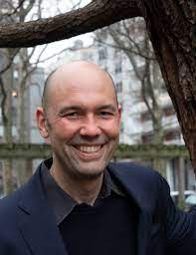
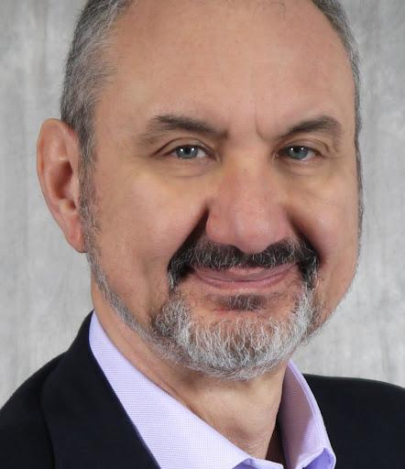
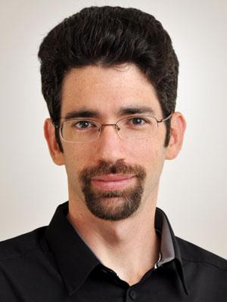
Where at Columbia are there blockchain opportunities?
Columbia blockchain club
Classes open to undergrads:
Prof. Tim Roughgarden: Foundations of Blockchain
Profs. Alexandros Biliris and Eran Tromer: Blockchains and their applications
Notes:
https://cu-ibm-blockchain-data.columbia.edu/content/education-track/courses

Slide 52
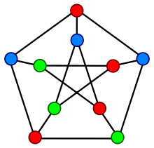
Zero-Knowledge Graph Coloring
Suppose you have a graph that you have found a 3-coloring for. (a labeling of each vertex to one of three colors such that no two adjacent vertices have the same color)
Notes:
Explain adj. (Sometimes this activity is skipped for time, but sometimes it proves really enjoyable!)

Slide 53
Zero-Knowledge Graph Coloring
Suppose your friend really wants to know a 3-coloring and is willing to buy your solution from you. However, he wants to make sure you really have it first.
Notes:
No breakout, just discuss

Slide 54
Zero-Knowledge Graph Coloring
Can you design a protocol that will allow you to convince him you know a coloring without giving it away?
(hint: use a one-way function like SHA-1 hash)

Slide 55
Zero-Knowledge Graph Coloring
Answer:

Slide 56
Zero-Knowledge Graph Coloring
Answer: Let numbers 1-1000, 1001-2000, and 2001-3000 represent “red”, “blue”, and “green respectively.
Then, randomly permute the colors in your coloring.
Notes:
Note: It doesn’t matter what the colors actually are - just that all pairs are different. So permuting the colors doesn’t really change anything about the solution!

Slide 57
Zero-Knowledge Graph Coloring
Let numbers 1-1000, 1001-2000, and 2001-3000 represent “red”, “blue”, and “green” respectively.
For each node, randomly choose a number for that node’s color and compute its hash.
etc.
h( )
733
h( )
2499
h( )
1455
Notes:
Hash doesnt give out number info, so answer is safe
But still you for each edge you can show you have different colors

Slide 58
Zero-Knowledge Graph Coloring
Note that given the uncolored graph with these labels, it is practically impossible to learn the original coloring.
However, if I identify a random edge, you could provide me with the original numbers used, so I could verify that they indeed represent different colors.
etc.
h( )
1382
h( )
723
2988
h( )

Slide 59
Zero-Knowledge Graph Coloring
This does not give me any information about the coloring, since if you were telling the truth, I would expect to see two different (random) colors anyway (and I see no information about the rest of the colors).
etc.
h( )
1382
h( )
723
2988
h( )

Slide 60
Zero-Knowledge Graph Coloring
However, if you were cheating, there would be at least two adjacent vertices colored the same. If there are X edges, then I have a 1/X chance of catching this each time.
We can repeat this procedure multiple times until I am satisfied that you are not cheating.
etc.
h( )
1382
h( )
723
2988
h( )

Slide 61
Just the tip of the iceberg…
The field of cryptography is vast and full of problems like the ones that you’ve seen – problems which require security guarantees in the presence of adversaries.
Today one of the biggest applications of cryptography is in blockchain technology which is what we discussed
It is developing quickly and is bound to change the future as we know it

Slide 62
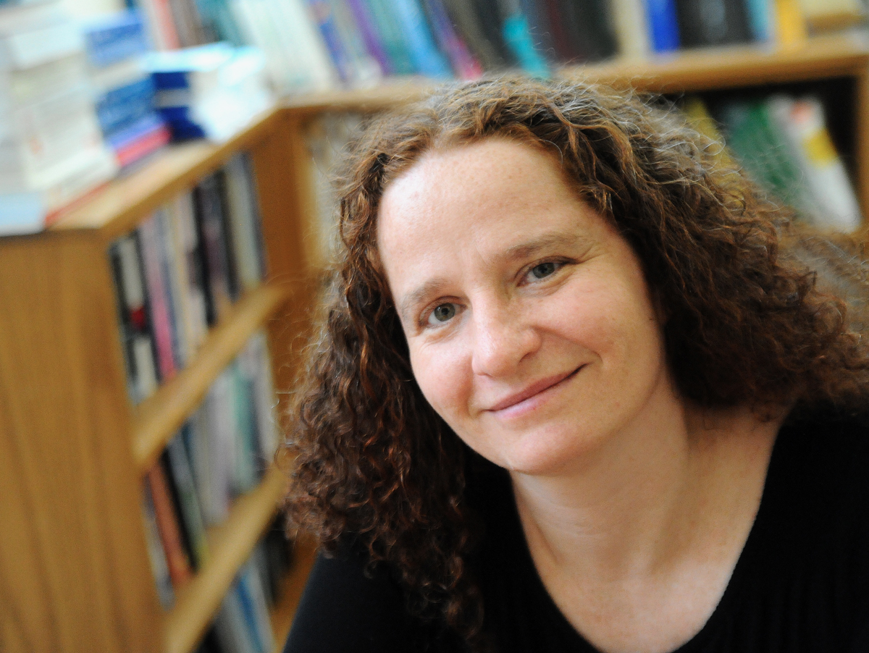
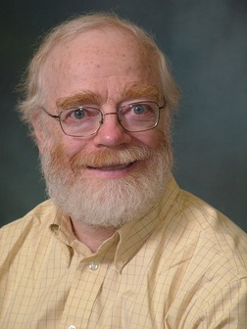
Cryptography At Columbia:
Several professors conduct research on cryptography and security:
Prof. Allison Bishop
Prof. Tal Malkin
Prof. Steven Bellovin

