Slide 1

Usability, Accessibility,
Human Computer Interaction, and User Interface Design
Notes:
‹#›
What do you think about when you hear these terms? UI design is more familiar. Web design, etc… The field is bigger than what xyou might think!

Slide 2


What is a User Interface (UI)?
the space where interaction between humans and machines occurs
01011 10100
01010 01011
01011 10100
01010 01011
Notes:
‹#›

Slide 3
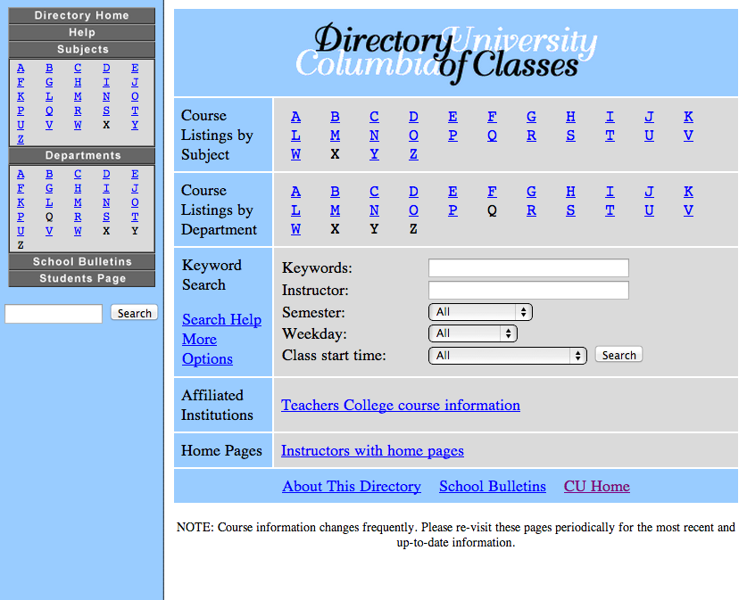
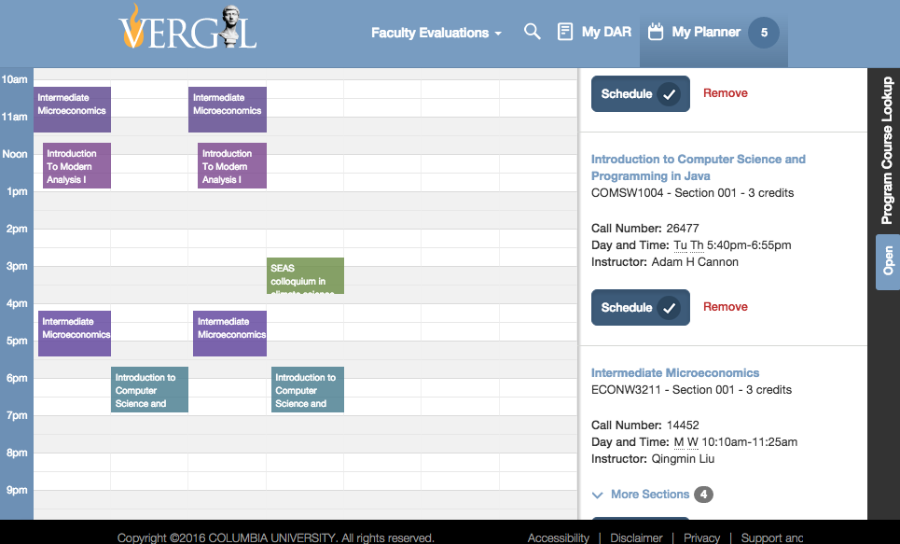
Similar backend, different UI:
Notes:
‹#›
‹#›
How usable are the following interfaces?
Look at fine-grained UI details
Note - add a screenshot of Barnard website; others?
Ease of search
Ease of document organization
-Clarity- extra info with email number and file size
Who are the target users?
- Columbia University students and faculty, possibly with little CS background
What kinds of users would have trouble navigating the interfaces?
- elderly (small font), small children- lot of text

Slide 4
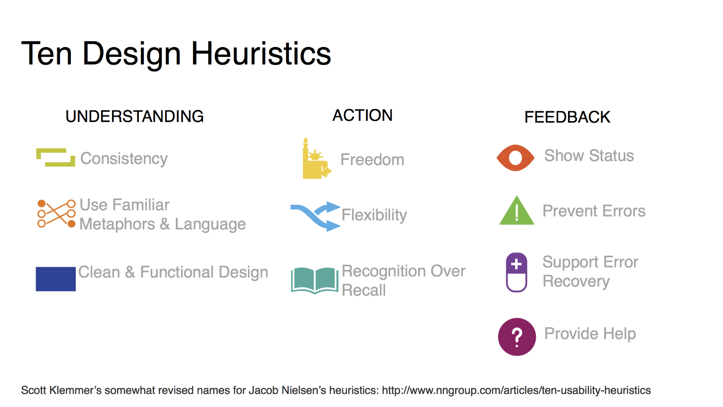
What makes a good UI?
Jakob Nielson’s Usability heuristics
Notes:
‹#›

Slide 5
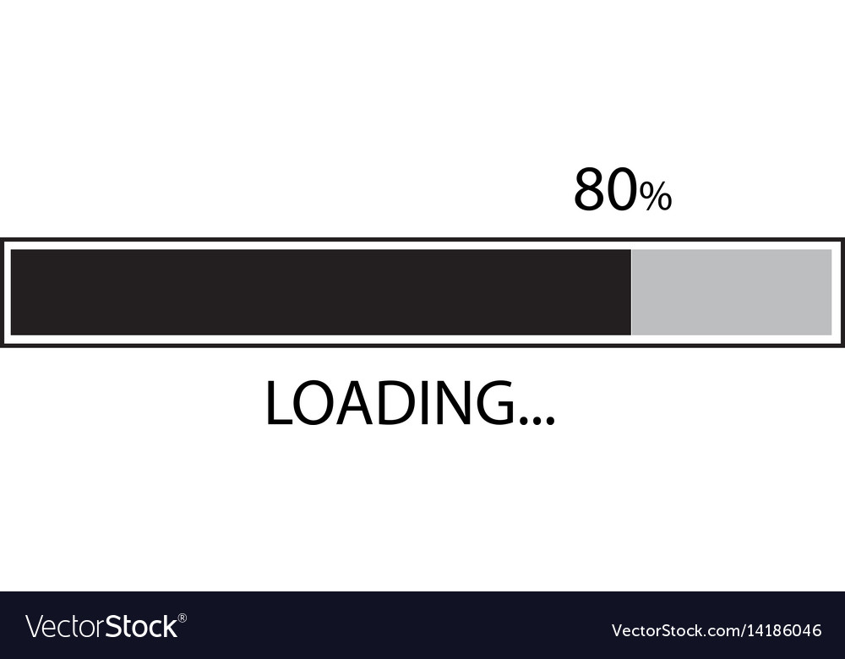
What makes a good UI?
Visibility of system status
Notes:
‹#›
The system should always keep users informed about what is going on, through appropriate feedback within reasonable time.
‹#›

Slide 6
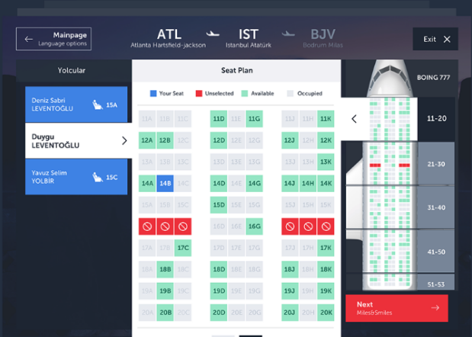
What makes a good UI?
2. Match between system and the real world
Notes:
‹#›
The system should speak the users' language, with words, phrases and concepts familiar to the user, rather than system-oriented terms. Follow real-world conventions, making information appear in a natural and logical order.
‹#›

Slide 7
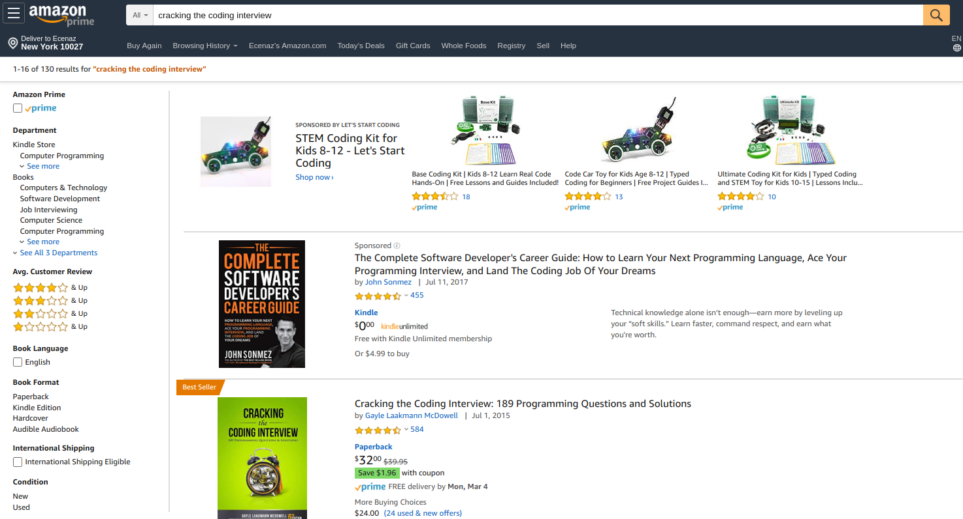
What makes a good UI?
3. User control and freedom
Notes:
‹#›
(?) Users often choose system functions by mistake and will need a clearly marked "emergency exit" to leave the unwanted state without having to go through an extended dialogue. Support undo and redo (toggling search options, for example)
.
‹#›

Slide 8
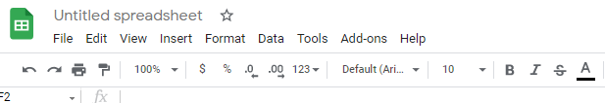
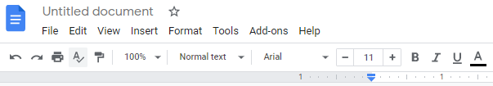
What makes a good UI?
4. Consistency and standards
Notes:
‹#›
Users should not have to wonder whether different words, situations, or actions mean the same thing. Follow platform conventions.
‹#›

Slide 9
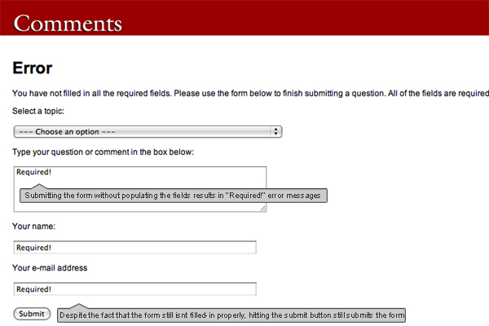
What makes a good UI?
5. Error prevention
Notes:
‹#›
Even better than good error messages is a careful design which prevents a problem from occurring in the first place. Either eliminate error-prone conditions or check for them and present users with a confirmation option before they commit to the action.
‹#›

Slide 10
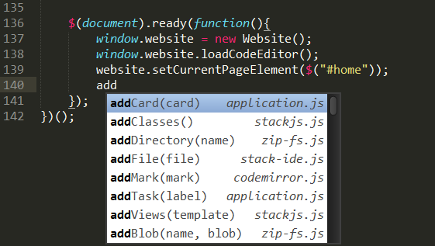
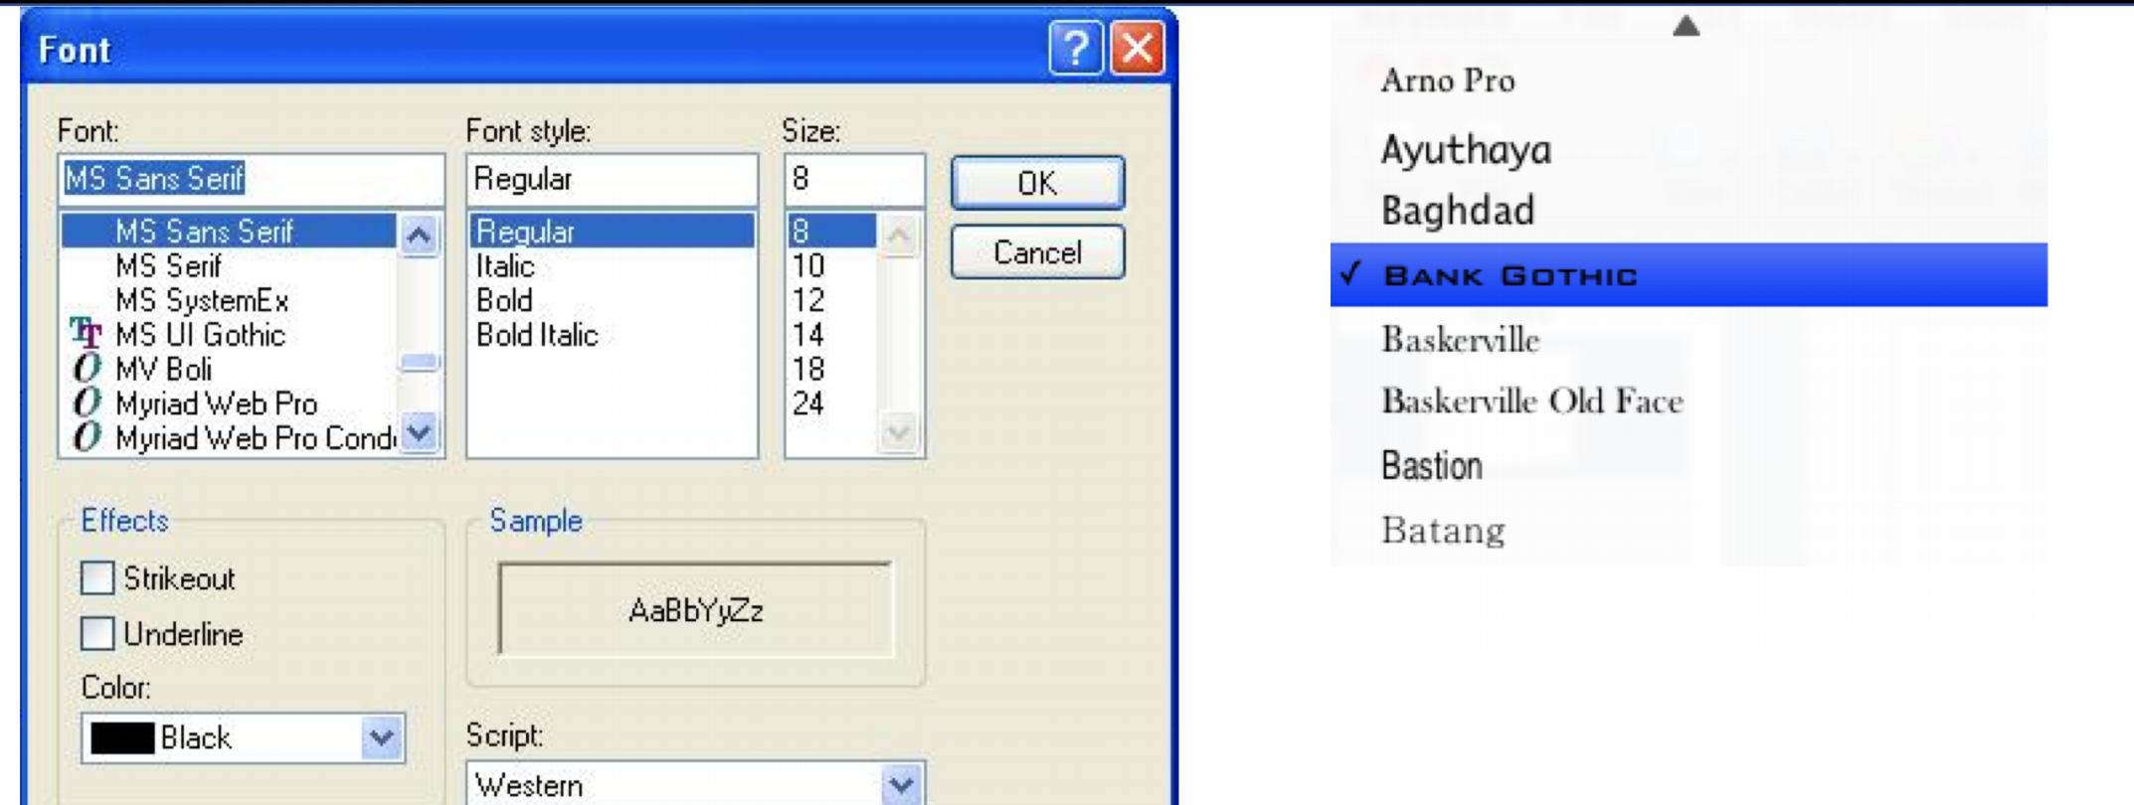
What makes a good UI?
6.Recognition rather than recall
Notes:
‹#›
Minimize the user's memory load by making objects, actions, and options visible. The user should not have to remember information from one part of the dialogue to another. Instructions for use of the system should be visible or easily retrievable whenever appropriate.
‹#›

Slide 11
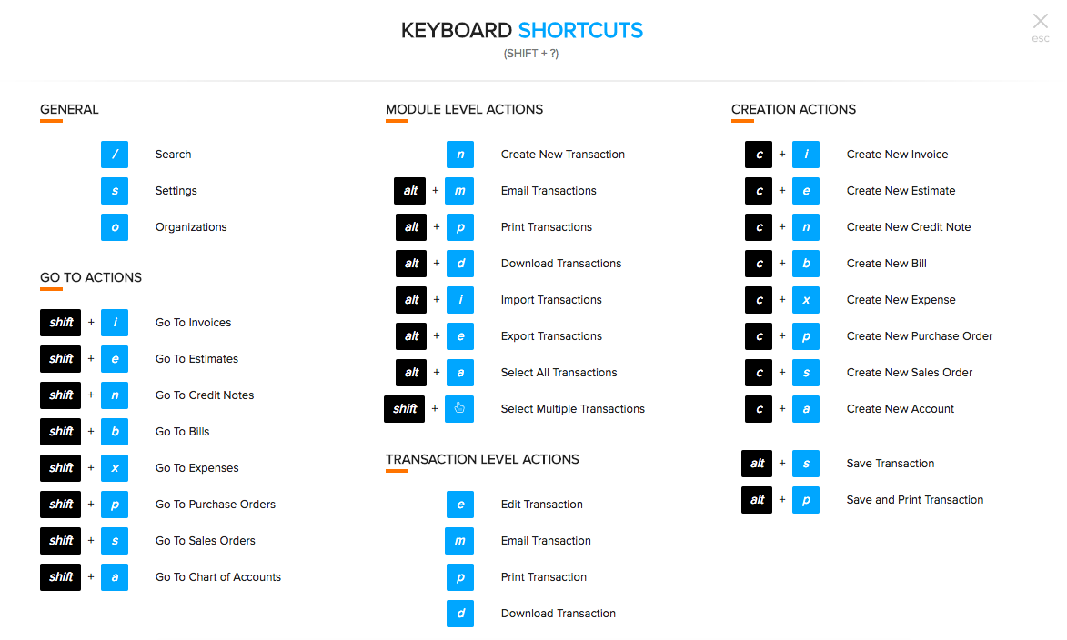
What makes a good UI?
7. Flexibility and efficiency of use
  - Accelerators for expert users, allowing users to tailor frequent actions
Notes:
‹#›
Accelerators -- unseen by the novice user -- may often speed up the interaction for the expert user such that the system can cater to both inexperienced and experienced users. Allow users to tailor frequent actions.
‹#›

Slide 12
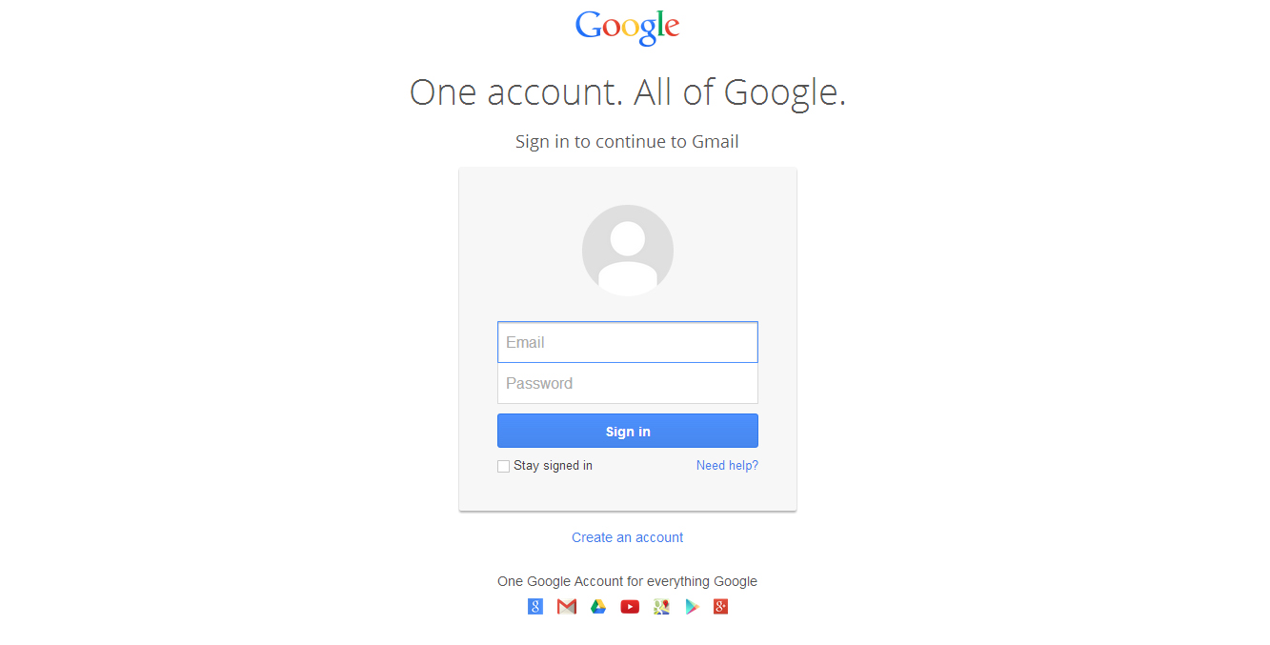
What makes a good UI?
8. A e s t h e t i c and minimalist design
Notes:
‹#›
Dialogues should not contain information which is irrelevant or rarely needed. Every extra unit of information in a dialogue competes with the relevant units of information and diminishes their relative visibility.
‹#›

Slide 13
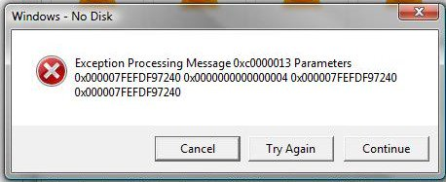
What makes a good UI?
9. Help users recognize, diagnose, and recover from errors
Violation:
Notes:
‹#›
Error messages should be expressed in plain language (no codes), precisely indicate the problem, and constructively suggest a solution.
‹#›

Slide 14
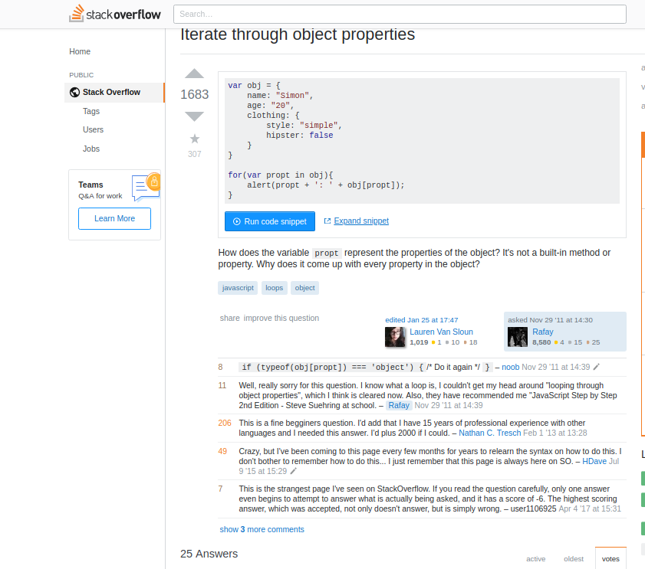
What makes a good UI?
10. Help and documentation
Violation:
https://www.youtube.com/watch?v=b71rpN1iJKA
Notes:
‹#›
video from 1:45pm
Even though it is better if the system can be used without documentation, it may be necessary to provide help and documentation. Any such information should be easy to search, focused on the user's task, list concrete steps to be carried out, and not be too large.
StackOverflow is an example of how aggregators for help/forums have superceded traditional product-specific documentation. Now, it’s more likely for people to google search errors isntead of going through documentation.
‹#›

Slide 15
What makes a good UI?
Visibility of system status
Match between system and the real world
User control and freedom
Consistency and standards
Error prevention
Recognition rather than recall
Flexibility and efficiency of use
Aesthetic and minimalist design
Help users recognize, diagnose, and recover from errors
Help and documentation
Notes:
‹#›
The system should always keep users informed about what is going on, through appropriate feedback within reasonable time.
The system should speak the users' language, with words, phrases and concepts familiar to the user, rather than system-oriented terms. Follow real-world conventions, making information appear in a natural and logical order.
Users often choose system functions by mistake and will need a clearly marked "emergency exit" to leave the unwanted state without having to go through an extended dialogue. Support undo and redo
Users should not have to wonder whether different words, situations, or actions mean the same thing. Follow platform conventions.
Even better than good error messages is a careful design which prevents a problem from occurring in the first place. Either eliminate error-prone conditions or check for them and present users with a confirmation option before they commit to the action.
Minimize the user's memory load by making objects, actions, and options visible. The user should not have to remember information from one part of the dialogue to another. Instructions for use of the system should be visible or easily retrievable whenever appropriate.
Accelerators -- unseen by the novice user -- may often speed up the interaction for the expert user such that the system can cater to both inexperienced and experienced users. Allow users to tailor frequent actions.
Dialogues should not contain information which is irrelevant or rarely needed. Every extra unit of information in a dialogue competes with the relevant units of information and diminishes their relative visibility.
Error messages should be expressed in plain language (no codes), precisely indicate the problem, and constructively suggest a solution.
Even though it is better if the system can be used without documentation, it may be necessary to provide help and documentation. Any such information should be easy to search, focused on the user's task, list concrete steps to be carried out, and not be too large.
‹#›

Slide 16

Activity: Product Design
McDonald’s now uses touchscreen table surfaces to take your order. Once you order and pay at your table, a waiter will bring your food. Design the table interface.
Please consider:
-product users
-product features
-how to encourage orders
Notes:
‹#›
Virtual whiteboard app: https://awwapp.com/#
How does your design make use of the ten principles?

Slide 17
Why are good UIs important?
Prevent confusion and mistakes
Get user to do what you want them to do!
Products must be usable for people to use them
Users work harder to find information when sites are more aesthetically pleasing.
Notes:
‹#›
-three-mile island
-Ticketmaster won’t let you set shipping address for mail-only tickets (defaults to billing address)
‹#›

Slide 18
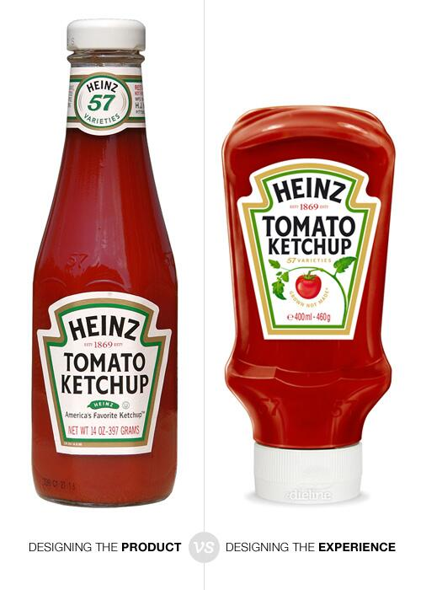
Notes:
‹#›

Slide 19
Challenges in Design
People differ
People don’t know what they want
  Think they want every feature, but then suffer from “feature fatigue”
You don’t always know your user
Cultures differ
  Right sidebar for right-to-left languages
Notes:
‹#›
Exercise: propose designs, and then try to poke holes in them. One solution rarely fits all!

Slide 20
Challenges in Design
http://en.wikipedia.org/wiki/Amal_Alamuddin
http://ar.wikipedia.org/wiki/%D8%AC%D9%88%D8%B1%D8%AC_%D9%83%D9%84%D9%88%D9%86%D9%8A
Notes:
‹#›

Slide 21
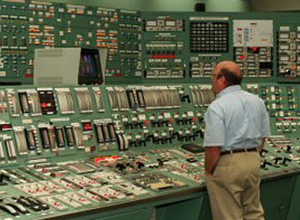
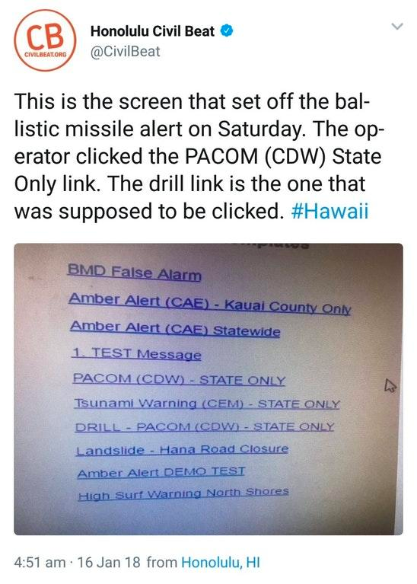
Can you name examples of UI problems?
- Three Mile Island - False Missile Alert
Notes:
In 1979 a nuclear reactor at Three Mile Island failed. It became the biggest accident in US nuclear power plant history. One of the key reasons behind the scale of the failure was to do with a problem with the control room user interface which workers believed was indicating something it wasn't. “Despite the critical valve being stuck open, a status indicator on the control panel seemed to indicate that the valve was closed. In fact, the status light did not even indicate whether the valve was open or closed, but only whether it was powered or not! The status indicator thus gave false evidence of a closed valve, and when the control room operators were unable to interpret the meaning of the light correctly, they could not correctly diagnose the problem for several hours. By this time, major damage had occurred.”

Slide 22
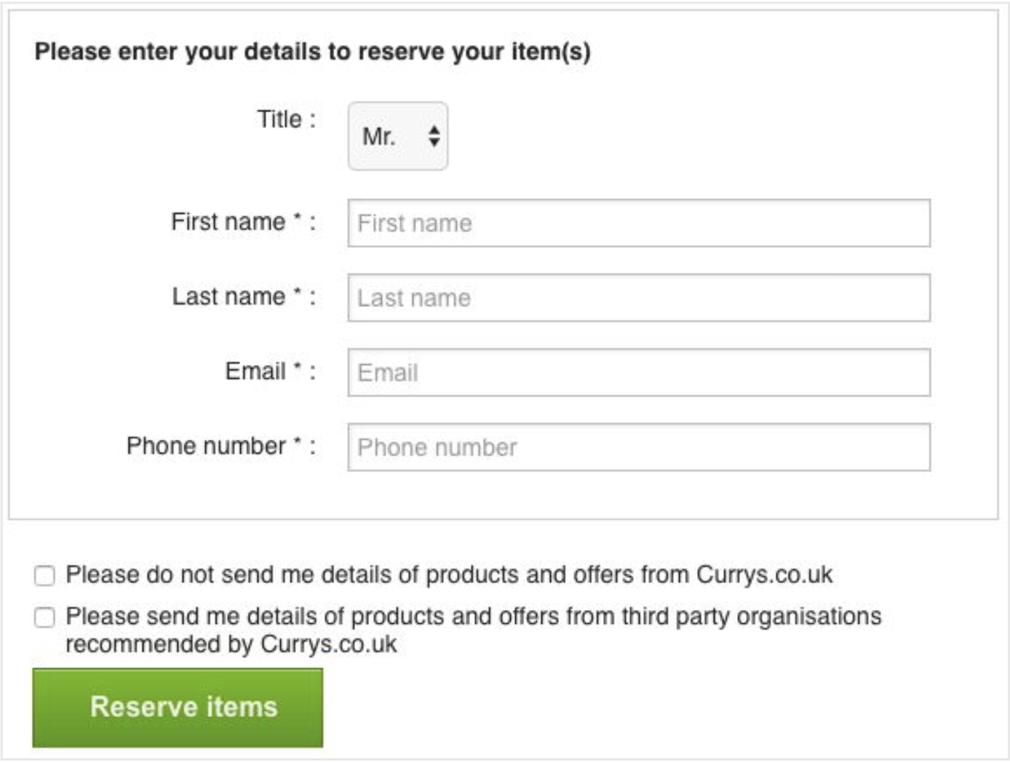
Problems with UI Design
The designer has a lot of responsibility and power in directing the user’s attention.
https://www.darkpatterns.org/
Notes:
Dark pattern: if you read the first one but not the second, you’ll check both! Extra confusing.

Slide 23
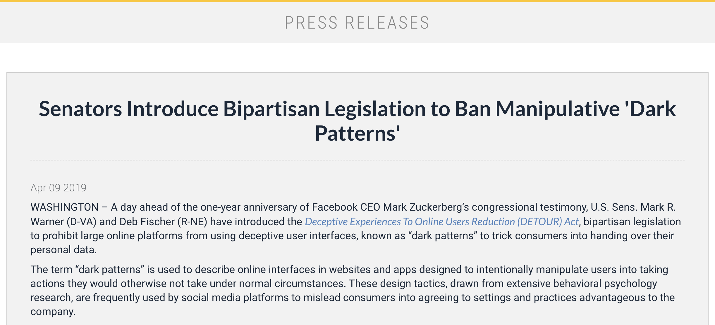
https://www.warner.senate.gov/public/index.cfm/2019/4/senators-introduce-bipartisan-legislation-to-ban-manipulative-dark-patterns
Notes:
As of Feb 2021, this legislation hasn’t gone anywhere yet.

Slide 24
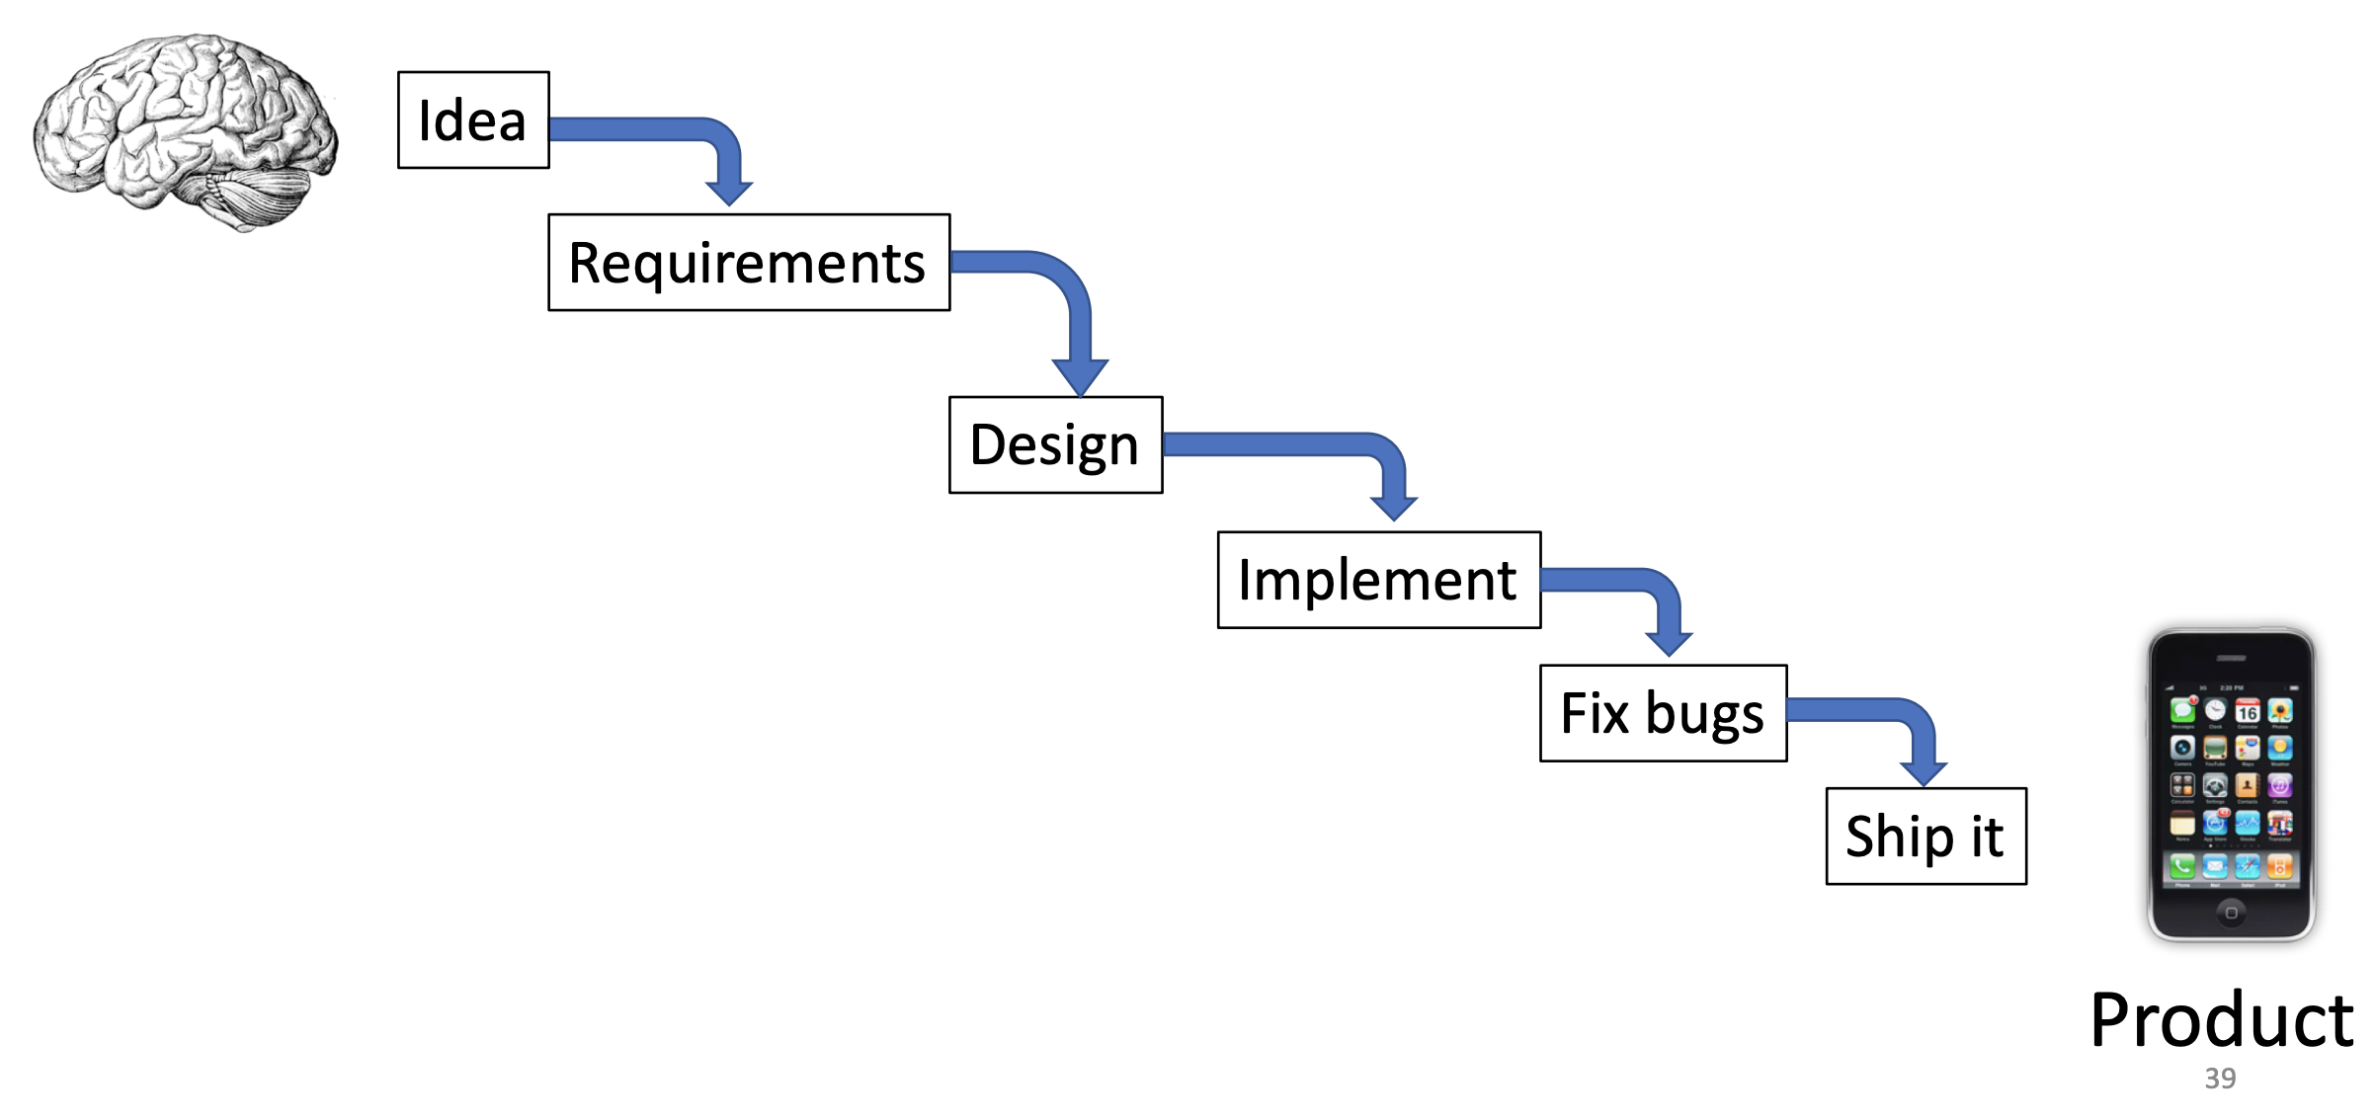
Different Models of the Design Process
The waterfall model
What’s good about this model?
What can go wrong?
Source : Prof. Lydia Chilton COMS 4170
Notes:
‹#›
What’s good about it?
It’s simple, linear, clean
What can go wrong?
There are many unknowns – if. Something goes wrong in the last step, you have to go back

Slide 25
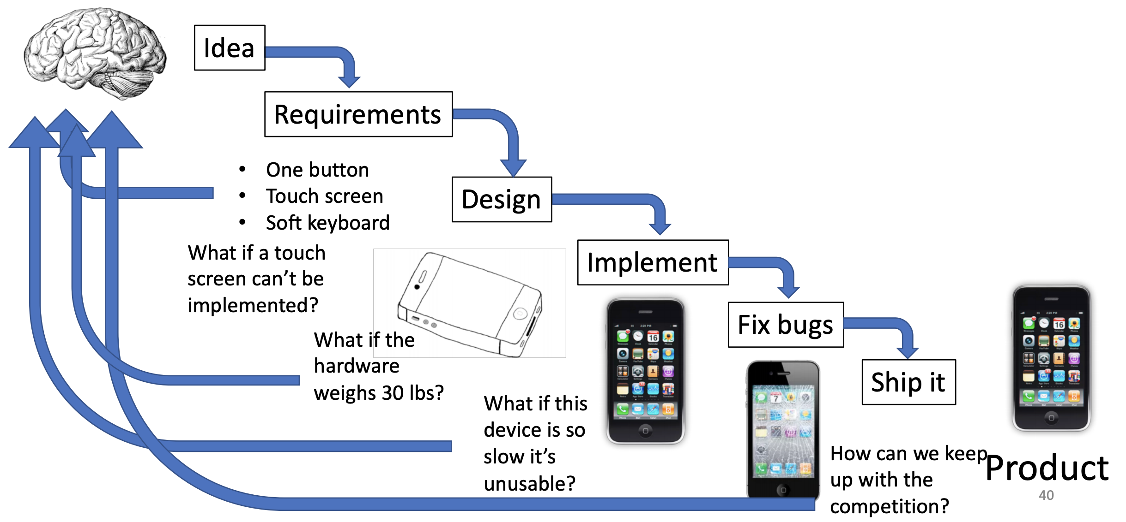
The waterfall model is clear and linear, but it breaks when there are risks.
Source : Prof. Lydia Chilton COMS 4170

Slide 26
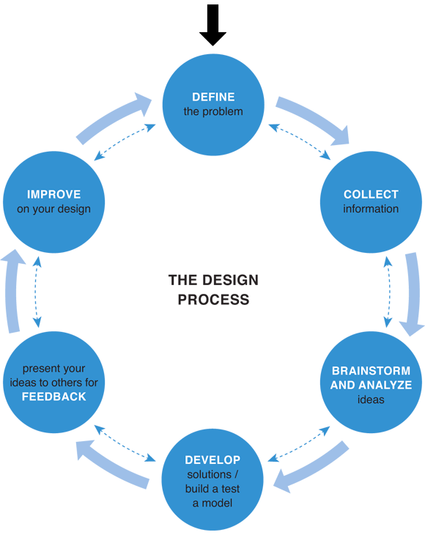
Different Models of the Design Process
Iterative and incremental model
Notes:
‹#›
Iterative design is good because it minimizes risk
What’s hard about it?
Steps aren’t clear from the start

Slide 27
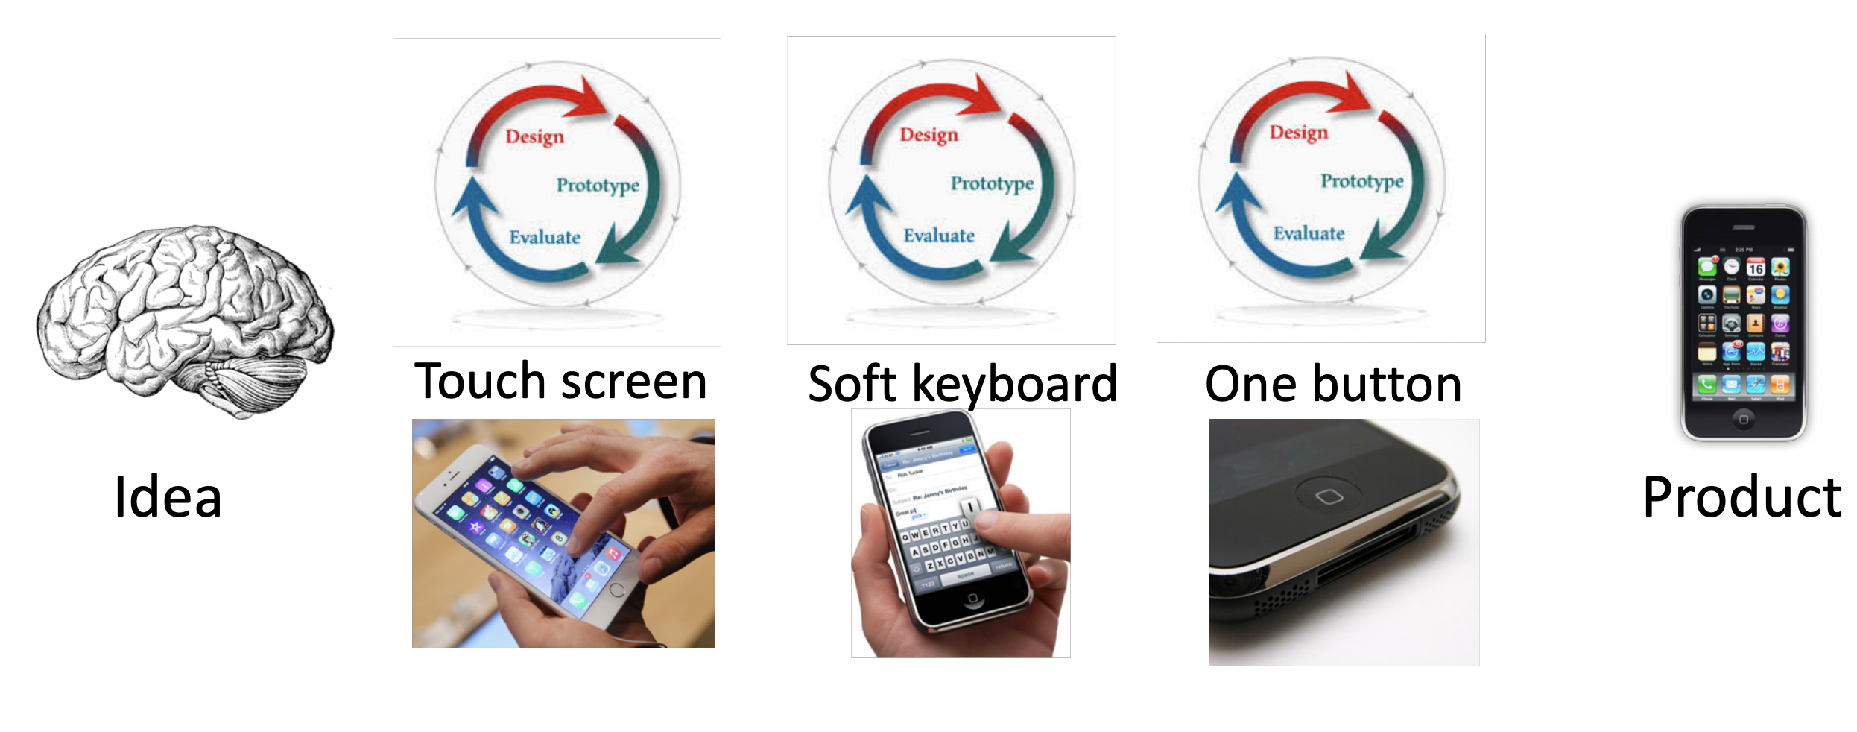
Iterative design minimizes risk by prototyping and getting feedback at each risky step.

Slide 28
Steps of Product design
User research (surveys, observation)
Prototyping (“mockups”)
Beta
Usability testing
Iteration (experiment and improve)
Notes:
‹#›

Slide 29
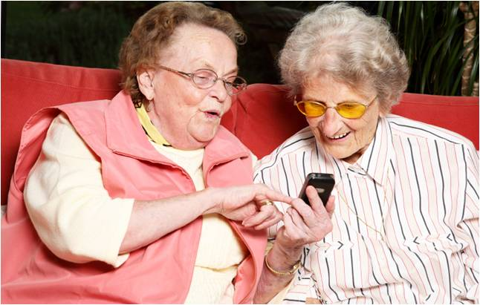
User Research
For effective, people-centered design:
Consider user demographics
Consider scenario of product use
  GPS app should require little sustained attention
Consider physical limitations
Notes:
‹#›

Slide 30
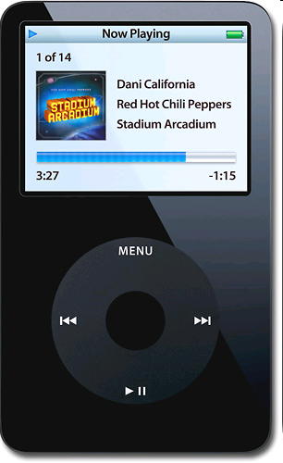
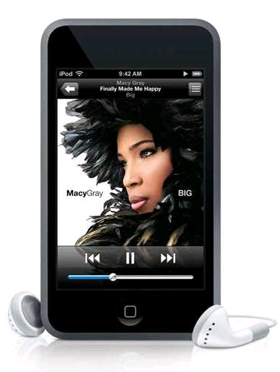
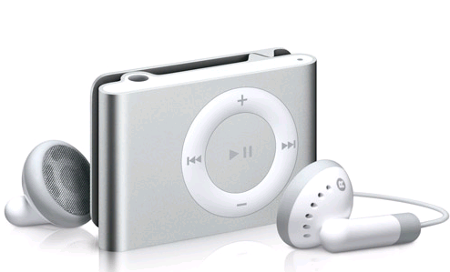
Example
These are all mp3 players, but serve different user needs.
What are some pros and cons of these mp3 player UIs?
What can we infer about the users from their design?
Notes:
‹#›
‹#›
So now that you all are familiar with the concept of critiquing interfaces, let’s critique another type of interface: MP3 players.
What features make the Classic iPod and iPod touch more usable?
Classic: wheel and 4 buttons. Very clean interface, but user doesn’t have much control beyond scrolling through menus
This limited user control makes the device more usable for a wider audience (ex: children)
What sacrifices were made as a result of these interface choices?
User has much more control with the touch- might be slightly harder to use for some people- more options
Extremely simple interface- one home button, on/off switch, volume control
- More expensive to include a touch interface than a scroll bar, but user has subjectively better experience

Slide 31
A/B Testing
Real-time experiments where users see slightly different versions of your site
  E.G. will a larger search bar increase percentage of visitors who search?
Data collected from the experiments is used for improvements
Google is famous for constantly doing A/B testing
Notes:
‹#›
Instagram & Google do this a lot

Slide 32
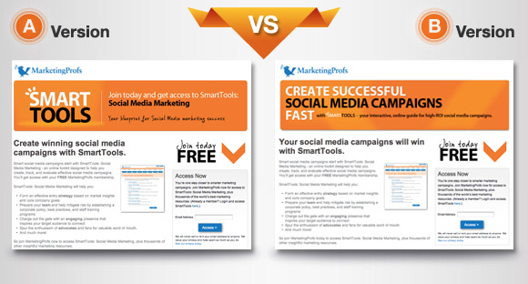
Notes:
‹#›

Slide 33
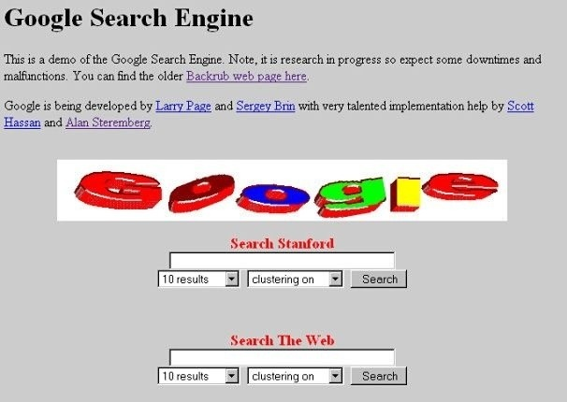
1996
Notes:
‹#›

Slide 34
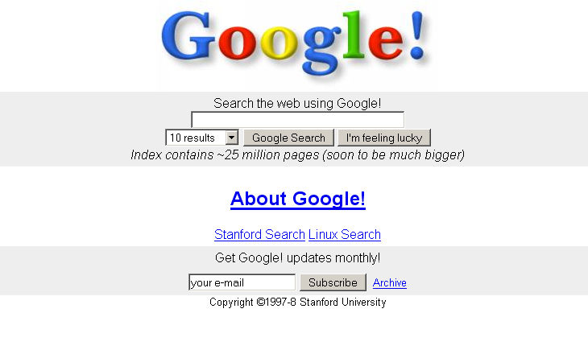
1997
Notes:
‹#›

Slide 35
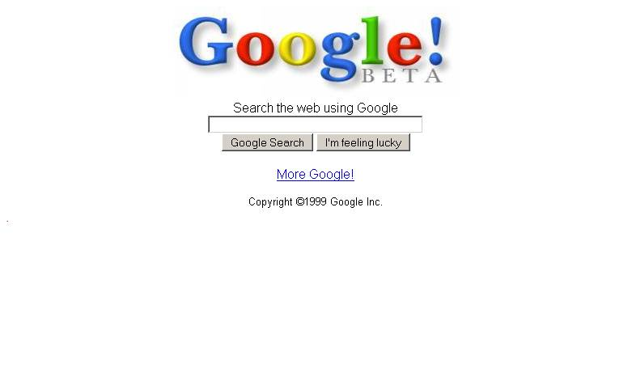
1999
Notes:
‹#›

Slide 36
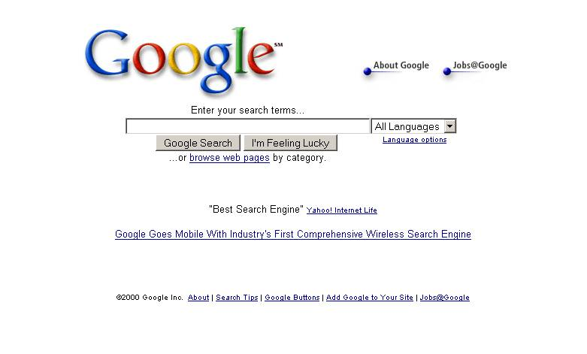
2000
Notes:
‹#›

Slide 37
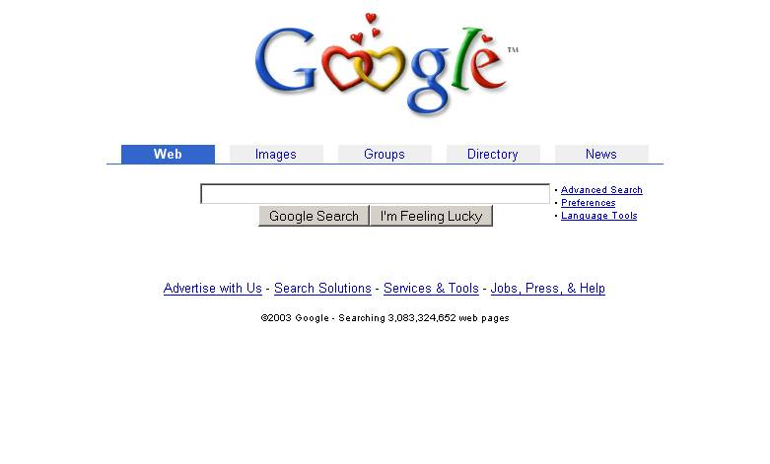
2003
Notes:
‹#›

Slide 38
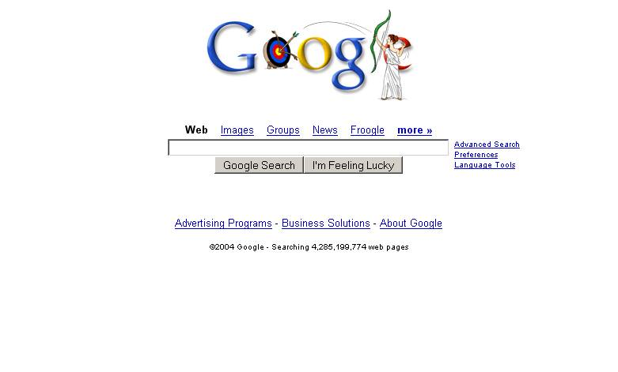
2004
Notes:
‹#›

Slide 39
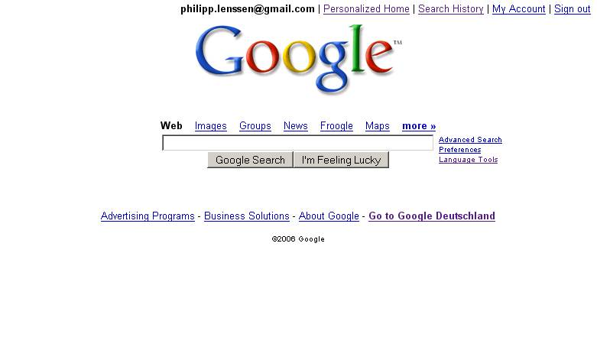
2006
Notes:
‹#›

Slide 40
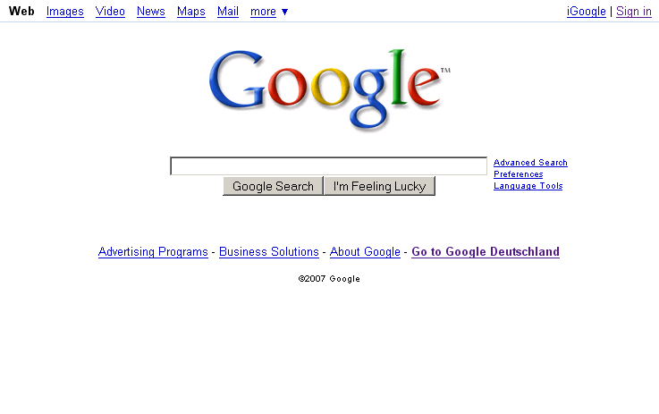
2007
Notes:
‹#›

Slide 41
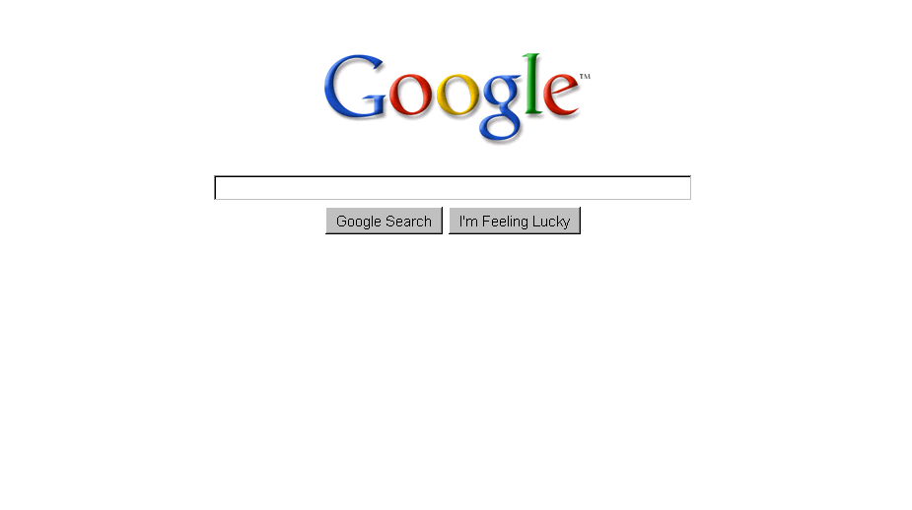
2009
Notes:
‹#›

Slide 42
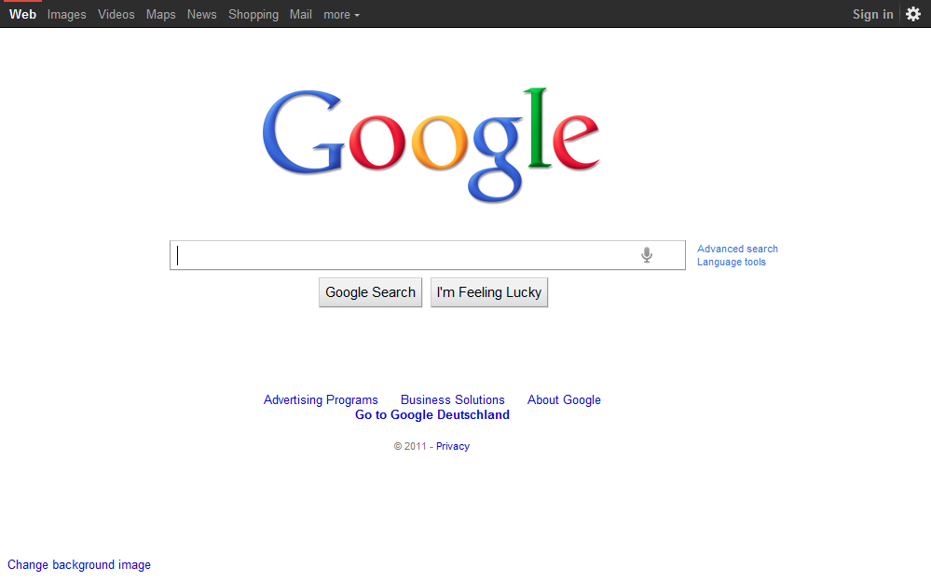
2011
Notes:
‹#›

Slide 43
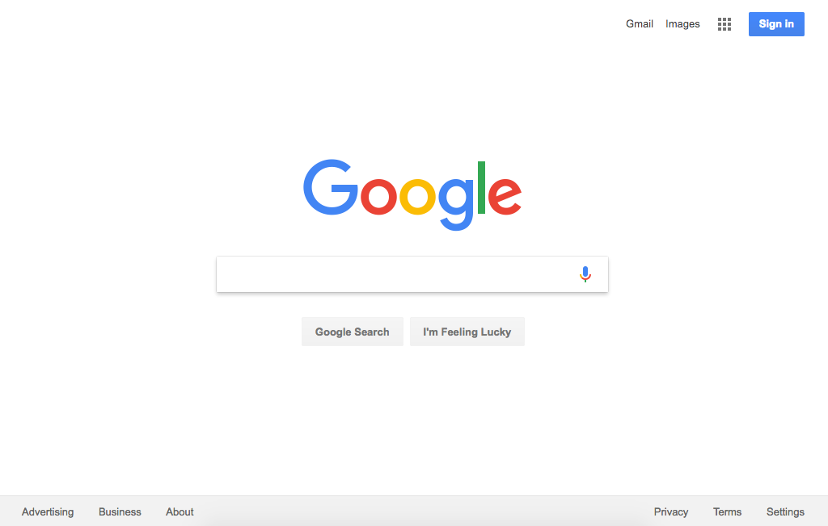
2015
Notes:
‹#›

Slide 44
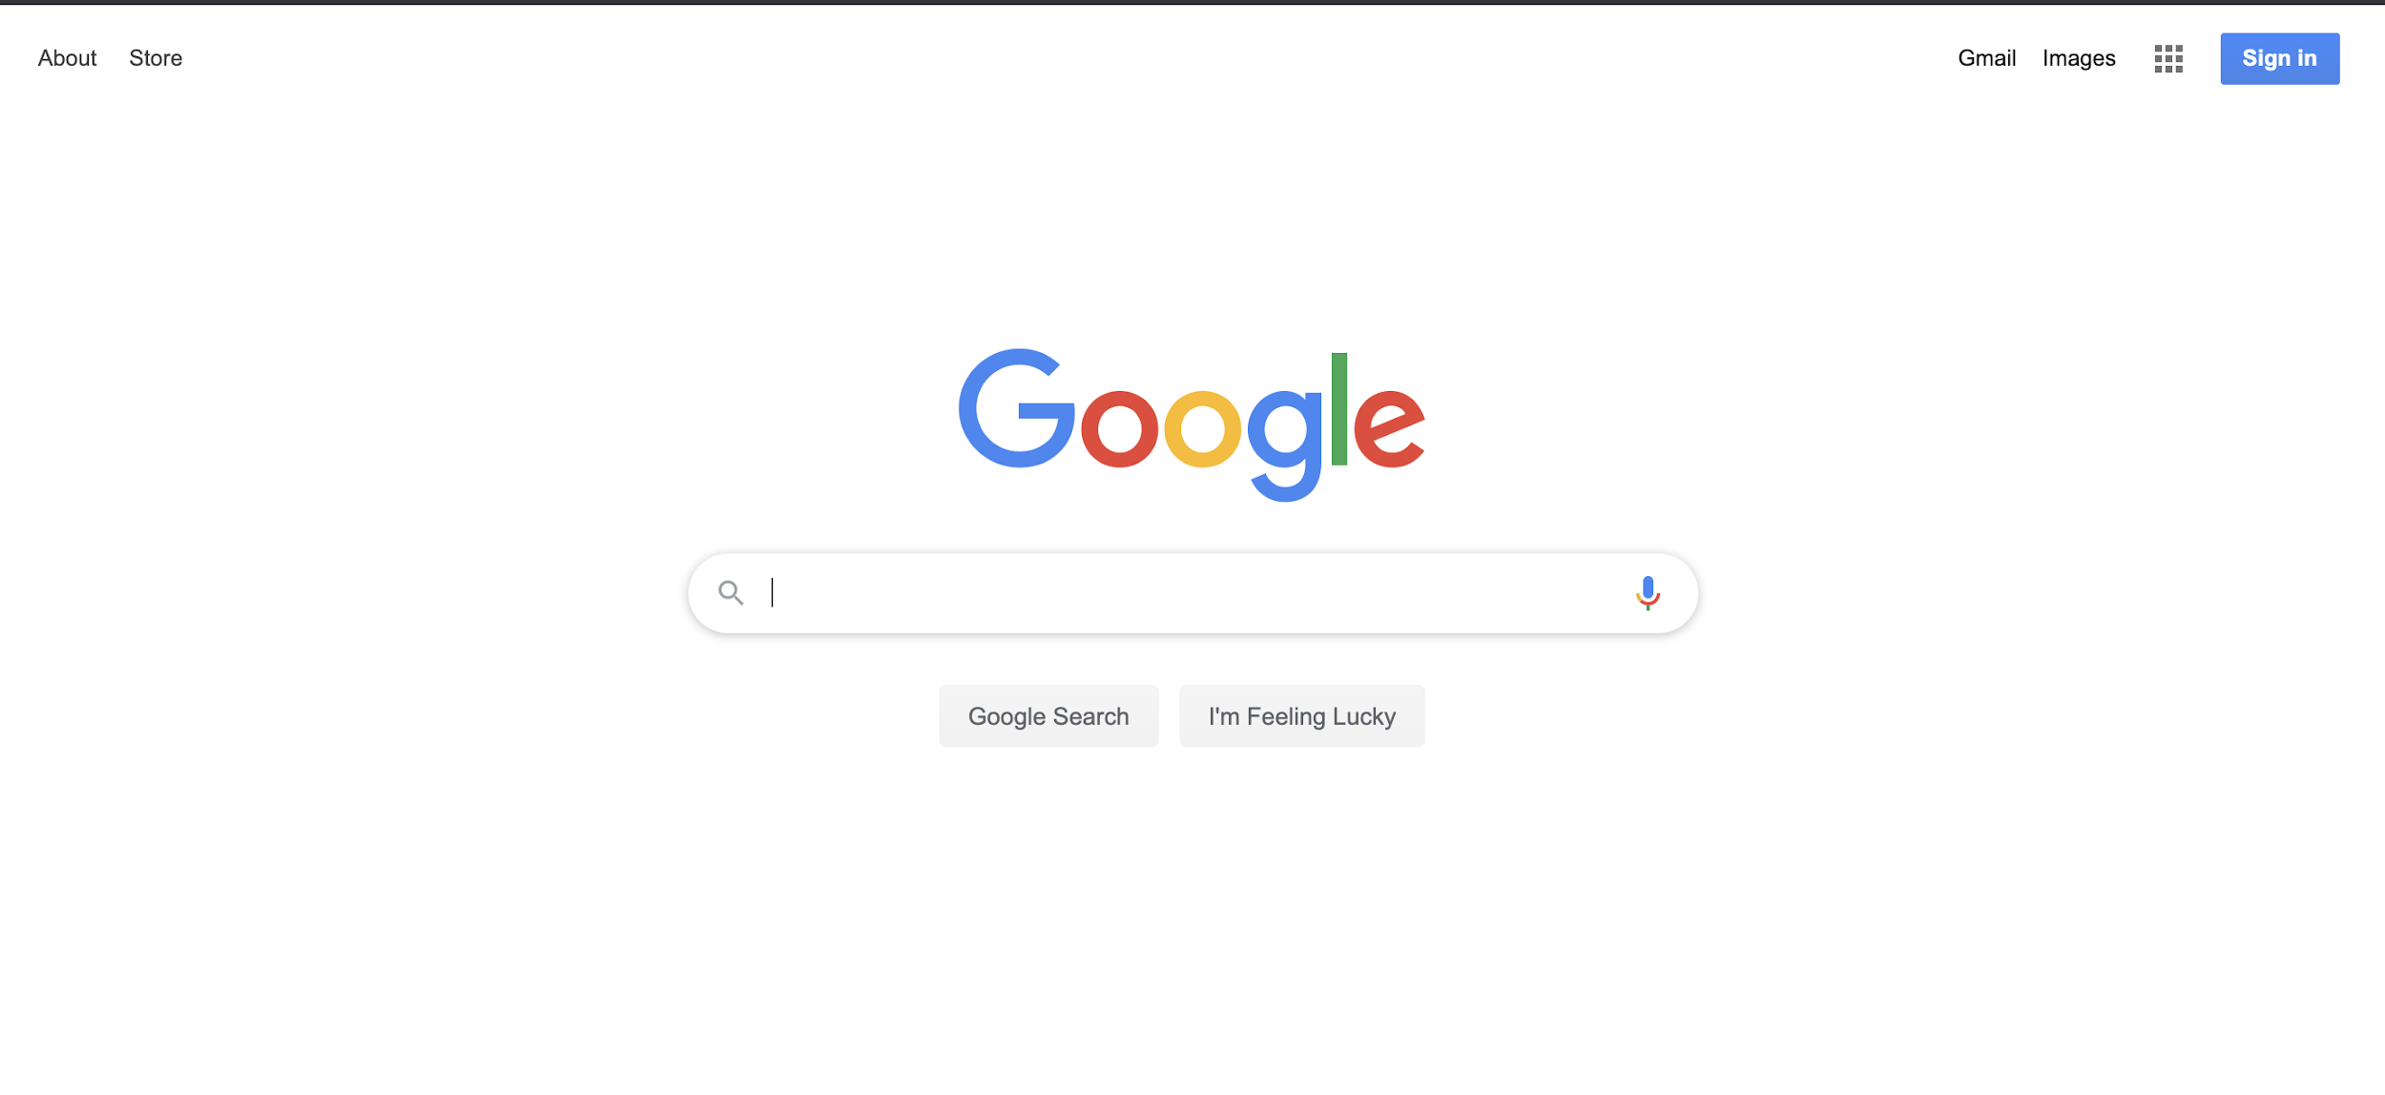
2020
Notes:
‹#›

Slide 45

Web Accessibility
Giving users with disabilities or impairments alternative ways to access our content
WCAG (Web Content Accessibility Guidelines) 1.0 compiled by Gregg Vanderheiden in January 1995
Today: Up to WCAG 2.1
4 organizing principles:
Perceivable: Can all users see, hear or otherwise
perceive content?
Operable: Can all users interact with content?
Understandable: Do users understand content
and how to interact with it?
Robust: Can content be interpreted by a variety of user types, including assistive technology?
Notes:
‹#›
Link to the full guidelines: https://www.w3.org/TR/WCAG21/

Slide 46
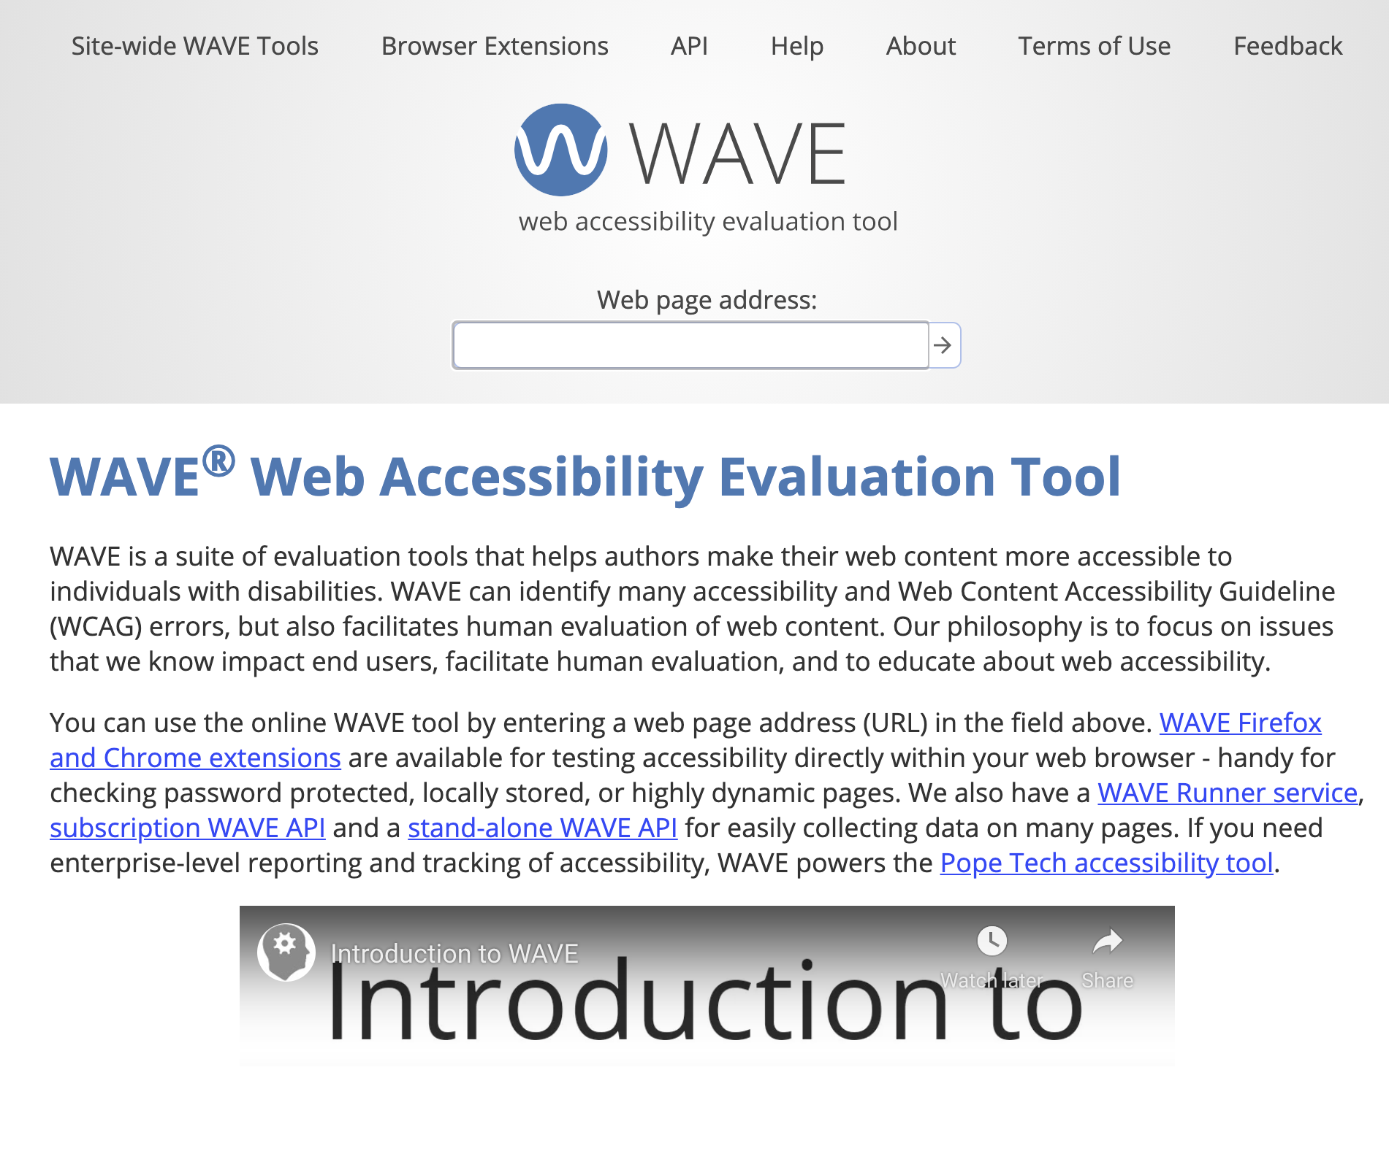

Tools for Assessing Accessibility
WCAG checklist https://webaim.org/standards/wcag/checklist
Wave http://wave.webaim.org/
What other ways can you
ensure that websites are
accessible?
Notes:
‹#›
Whose responsibility is it to make sure the web is accessible?•Web developers? Browsers? W3C?
Bad websites: Fox News, Burger King, Nike, CVS pharmacy,Harvard, MIT, Barnard,
Beyoncé Was Sued Over Her Website Violating the Americans With Disabilities Act
Can open up WAVE and test it on bad websites (e.g. Barnard and Columbia)

Slide 47
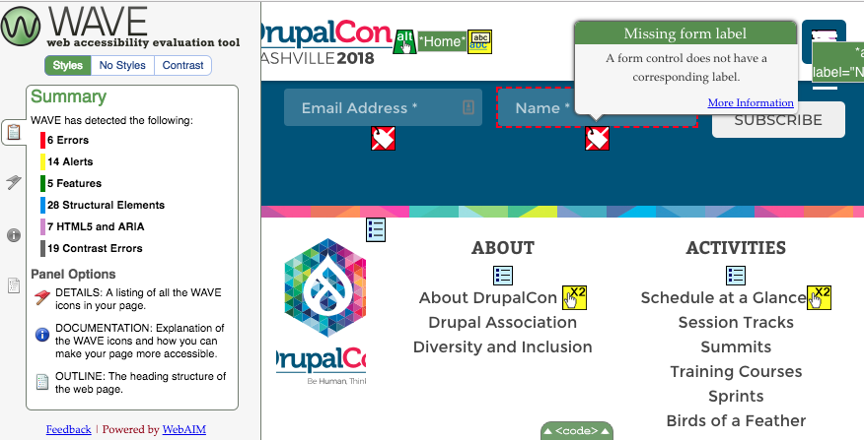
Notes:
Go to barnard page and put it in wave to see how bad it is
Most companies now hire specialist just for this!
WCAG itself is not a law!
It was never intended for legislative policy...however it is being used to inform laws anyway notably in:USA, Canada, EU, UK, Australia
Does art need to be accessible?

Slide 48
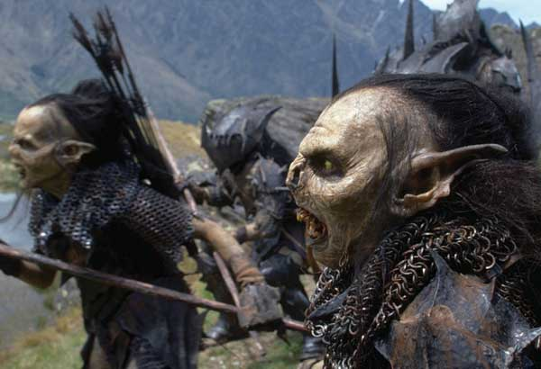
3D User Interfaces and Virtual Reality:
Notes:
‹#›

Slide 49
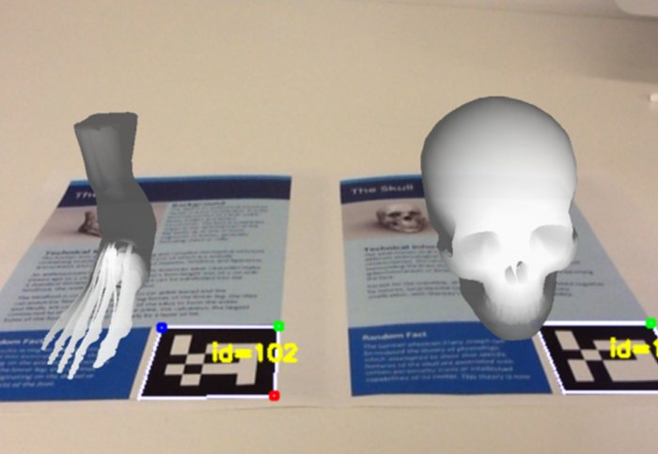
Augmented Reality
Direct or indirect interaction with reality that is augmented by computer generated sensory input
Use computers to interact with world in entirely new way
Notes:
‹#›

Slide 50
Applications
What are some potential applications of augmented reality?
Translation
Medical Models
3D model demonstration
Advertisements
Notes:
‹#›

Slide 51
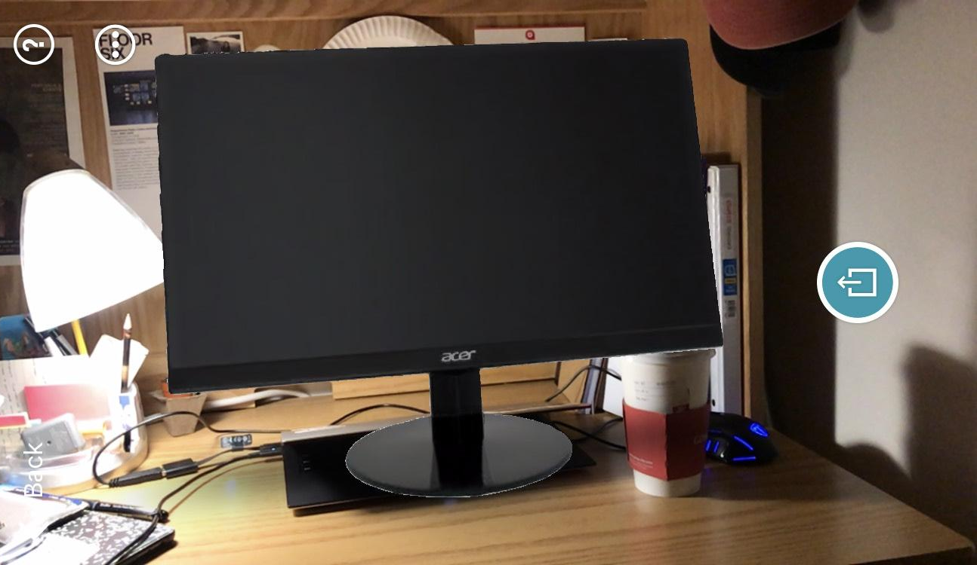

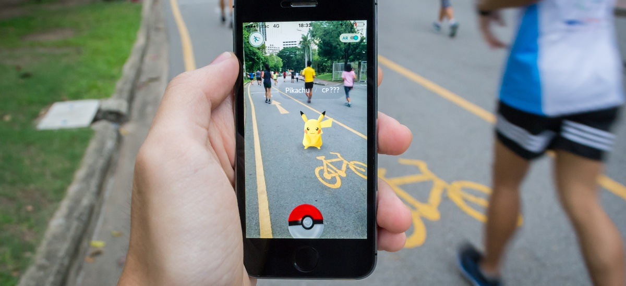

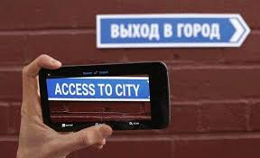
Notes:
‹#›

Slide 52

Virtual Reality
Immersive interaction with a computer generated world
Notes:
‹#›

Slide 53





Research at Columbia
Steven Feiner
Lydia Chilton
Michael Reed
Brian Smith
Sarah Morrison-Smith
Notes:
‹#›

