Slide 1
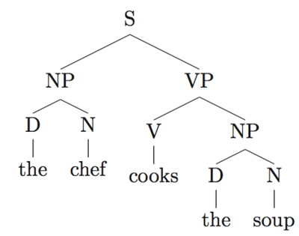
Computational Linguistics
And Natural Language Processing
Notes:
What is computational linguistics / NLP? Most students don’t have a ready answer. Split up and discuss. Examples: Siri, autocomplete, echo, google translate etc.
Lotta overlap btw two- used interchangeably- nlp relatively newer

Slide 2
Focusing Questions
What are some of the goals of NLP? Can you think of any applications?
What are the most important traits of a language?
How can we represent a language mathematically/computationally?
On the level of a word? Sentence?
We have a corpus, which is a collection of documents, from which to build our representation.
A corpus is data drawn from a domain, which could be as specific as Twitter. For the following slides, assume our domain is all of English.
Notes:
Imp traits of lang= vocab+grammar. In person, can probably do this in pairs. Usually, people come up with abstract answers for #1, ‘grammar’, ‘syntax’, etc for #2,
Pair chats and then contribute? Or ask the group? Reading the room.

Slide 3
How would you compare these probabilities?
(In an English corpus)
A
P(“ngotnge”)
P(“five chairs”)
P(“Times Square”)
P(“it’s hard to wreck a nice beach”)
P(“colorless green ideas sleep furiously”)
B
P(“apple”)
P(“five chair”)
P(“Times Quadrilateral”)
P(“it’s hard to recognize speech”)
P(“furiously sleep ideas green colorless”)
Can we use these observations to model English?
Notes:
Instinctual gut rxn to the seeing these words/phrases in the English lang
4. V common example from speech reco
5a and 5b come from linguist Noam Chomsky’s critique of probabilistic models of natural language processing. He argued that although 5A makes sense syntactically (while in 5B the words are ordered randomly), a computer would rate the probabilities of the two statements to be the same because (most likely) neither would appear in a corpus.
Instinctive adjective ordering. "One (quantity) nice (opinion) little (size) old (age) round (shape) [or round old] white (colour) brick (material) house." Activity: what order would you put these words in?

Slide 4
Ngram Language Modeling
Using a corpus (collection of documents), model a language by computing probabilities that a given sequence would occur in that domain.
ngrams are phrases, of n-word length
Words are unigrams, “computers are useless” is an example of a trigram
The probability of an ngram is the number of times the phrase appears over the total number of phrases of that length.
How feasible is this method for a whole sentence?
Google Ngram Viewer
Notes:
Feasible for whole sentence? Coz so many sentences never spoken may have 0 prob. The larger the n, the larger the corpus you need to get accurate probabilities
Regular linguistics - morphemes. e.g. uni-task-er (3 units of meaning)

Slide 5
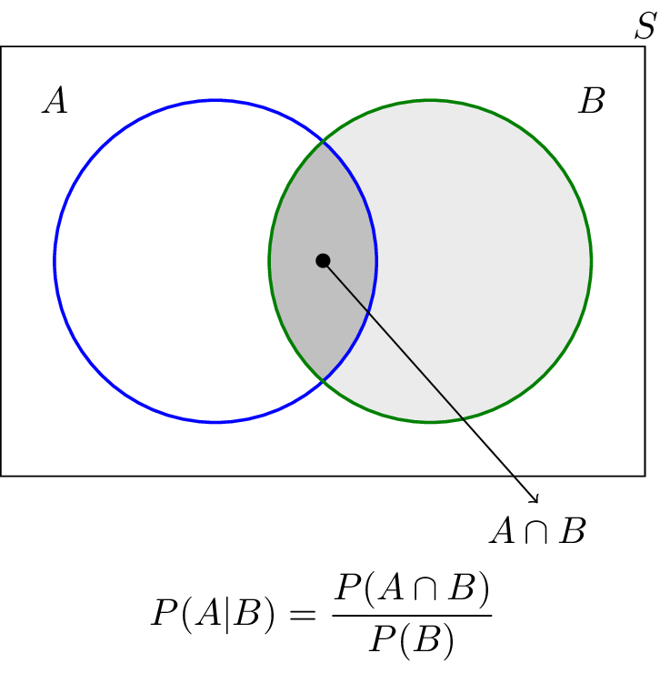
Language Modeling
The probability of a word occuring in some context is computed using Bayes’ rule for conditional probability.
If you observe “computers are”, what is the probability that the next word is “useless”?
Note that the denominator from last slide drops out!
Notes:
Vocab: ‘A | B’ read as ‘A given B’- B has already occured. ‘A given the event B’, ‘A conditioned on B’.
Makes prob more feasible coz we’re not looking at the whole sentence anymore
Could write out a corpus that includes {“computers are useless”, “computers are useless”, “computers are great”, “computers are great”, “computers are interesting”}. Now fairly easy to see that the intuitive probability of useless given ‘computers are’ is ⅖.
‘John Jacob Astor’ vs ‘John Jacob Jingleheimer-Schmidt’.
Can relate this back to the previous decision tree example - this is a probabilistic decision tree!

Slide 6
Language Modeling
Let’s say we wanted to compute the probability of a sentence. Using the chain rule of probability, you could estimate the whole sentence, but each word would depend on all the previous words in the sentence.
Markov assumption: you only need the previous n-1 words in a sequence to predict the next word
Think of n as the size of the context. In this example, we are using a bigram approximation, where n = 2.
Notes:
Think of n as a window you’re sliding over the sentence. You simply pick a number (in this case two) and consider that number. Writing out the context window helps.
Ask students whether they think the Markov assumption is a good model to use (consider long-term dependencies, etc).
In support of the MA: the longer a sequence gets the less likely it is to appear in the corpus, which could diminish the probability. By looking at a smaller window of words we may more accurately capture the probability of those words appearing together. If we had an infinite corpus of English consisting of every valid combination of words then we could look at the whole sentence and make probabilistic predictions quite accurately. However, since that obviously doesn’t exist, we need to use tools like the Markov assumption.

Slide 7
P(I | <start>) | .25 | P(some | want) | .04
P(I’d | <start>) | .06 | P(Thai | want) | .01
P(Tell | <start>) | .04 | P(eat | to) | .26
P(I’m | <start>) | .02 | P(have | to) | .14
P(want | I) | .32 | P(spend | to) | .09
P(would | I) | .29 | P(be | to) | .02
P(don’t | I) | .08 | P(Chinese | eat) | .16
P(have | I) | .04 | P(British | eat) | .03
P(to | want) | .65 | P(food | British) | .60
P(a | want) | .05 | P(food | Chinese) | .75
What are the bigram approximations for probability of “I want to eat Chinese food” vs “I want to eat British food?”
Notes:
Teaching virtually: use breakout rooms and/or annotations.
P(end|food)?
Numbers are probably very low - but remember, they’re over all words that start with ‘I want to eat British”...
Can even try constructing a (likely) sentence based on probabilities here.

Slide 8
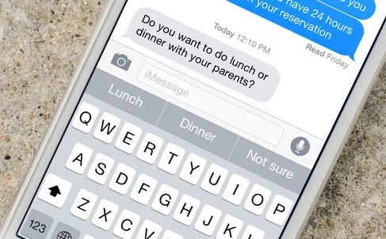
Language Generation
Your phone uses a language model when it suggests new words.
The quality of the generated text increases as you increase n. Here’s text generated from a language model trained on a corpus of Shakespeare:
Unigram: Hill he late speaks; or! a more to leg less first you enter
Bigram: Why dost stand forth thy canopy, forsooth; he is this palpable hit the King Henry.
Trigram: This shall forbid it should be branded, if renown made it empty.
Quadrigram: What! I will go seek the traitor Gloucester.
However, as you increase n, you require much more data to make quality predictions. There are far more possible 4grams than unigrams (|4grams| = (|unigrams|)^4, can you see why?), but few occur in our data.
Notes:
Greater n= higher quality generation
Generative models for Prezbo’s emails? For Shakespeare? For other fun things? Almost certainly for Trump twitter.

Slide 9
Reflections on Language Modeling
Language modeling is often used as a measure of fluency, or to generate text.
What would happen if a word didn’t occur in our corpus, or in a certain context?
Does this method encode any meaning?
What do you think of the Markov assumption?
Noam Chomsky famously argued against probabilistic language models: no such model could distinguish the grammatical sentence “colorless green ideas sleep furiously” from the ungrammatical permutation “furiously sleep ideas green colorless.”
Trump tweet generator
Notes:
2. Smoothing methods
3. Boiling down whole langs to ngrams encode lang meaning? What might it mean to ‘encode meaning’? Note - markov chains don’t encode grammar
Chomsky argues: language may not be formed in a ‘linear’ way in your brain / this may be different from how humans produce language. Neuro: parallel processing

Slide 10
Context Free Grammars
In CS, a CFG is a model of computation that generalizes beyond the application in language. We will be using it to represent syntax.
A CFG consists of:
A start symbol (S = sentence)
Nonterminal symbols (parts of speech and phrases)
Terminal symbols (words)
A list of rules, mapping the start symbol to the terminal symbols.
A few more rules:
C -> A | B means that C can be replaced with A or B.
A symbol can be replaced by nothing, denoted by C -> ε
An example CFG:
S -> ADJP
ADJP -> ADV ADJP | ADJ
ADV -> very
ADJ -> good | bad
Notes:
Can help to draw out basic CFGs on the whiteboard. Good example: addition of ones

Slide 11
Context Free Grammars
CFGs are used to derive valid strings, substituting nonterminal symbols until you end in only terminal symbols. Note that a terminal symbol may never be further substituted.
You can draw the derivation in the form of a tree.
Try to use the example CFG to derive a string, and draw the tree.
S -> ADJP
ADJP -> ADV ADJP | ADJ
ADV -> very
ADJ -> good | bad
Syntax Tree Generator
Notes:
Draw the tree on the board, or use tree generator

Slide 12
Context Free Grammars
• S → NP VP
• VP → V NP
• NP → DET N | DET ADJP N
• ADJP → ADV ADJP | ADJ
• N → boy | girl
• V → sees | likes
• ADJ → big | small
• ADV → very
• DET → a | the
Using this CFG, which is only a fragment for all of English, come up with a derivation for “The very small boy likes a girl.”
Draw the tree.
Notes:
Can help by starting with the first two or three in front of the class

Slide 13
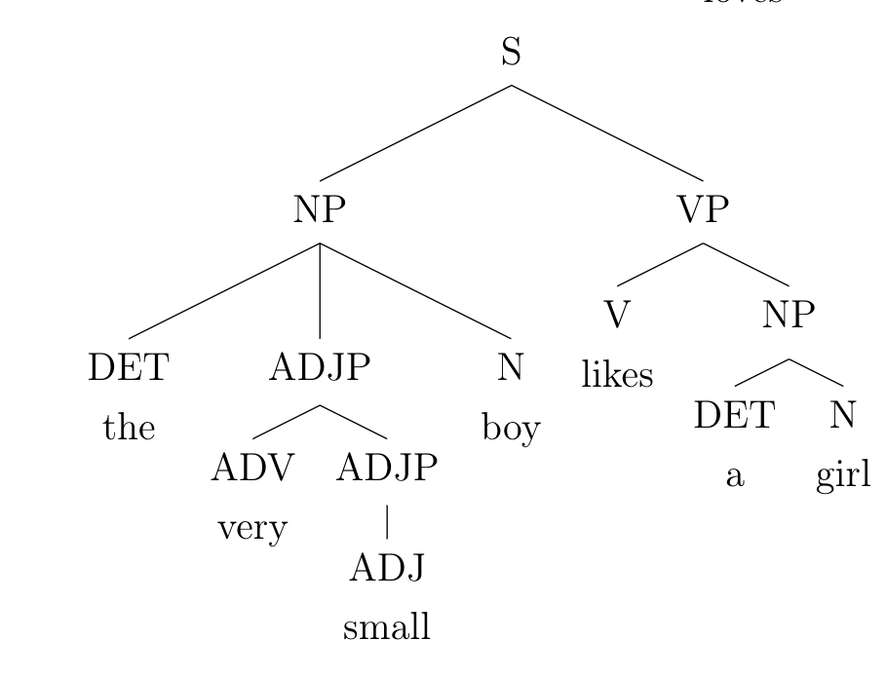
• S → NP VP
• VP → V NP
• NP → DET N | DET ADJP N
• ADJP → ADV ADJP | ADJ
• N → boy | girl
• V → sees | likes
• ADJ → big | small
• ADV → very
• DET → a | the
Notes:
For next time - spacy package in Python for tree generation (see spacy.io). A rule like A -> b c | c d can form “b c” or “c d”

Slide 14
Activity - Apinaye
Apinaye belongs to the Ge language family of Brazil. Currently it is spoken by less than 800 people, and therefore is seriously endangered. The following are some sentences in Apinaye, along with their English translations.
Start by trying to form a dictionary. Take note of characteristics of the language, such as syntax, and how that may affect meaning. Try to create a CFG. You will not only be translating, but also generating text in Apinaye.
Notes:
https://www.theguardian.com/science/2018/sep/24/did-you-solve-it-the-language-of-the-lake-puzzle
Never forget

Slide 15
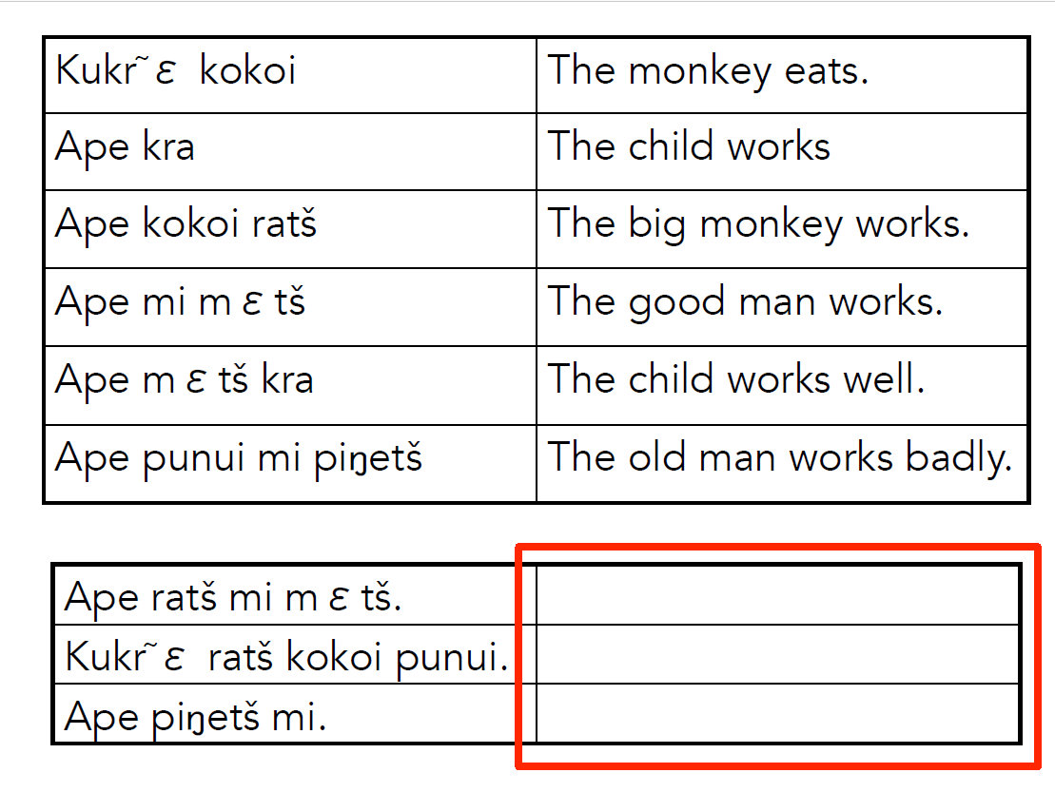

Slide 16
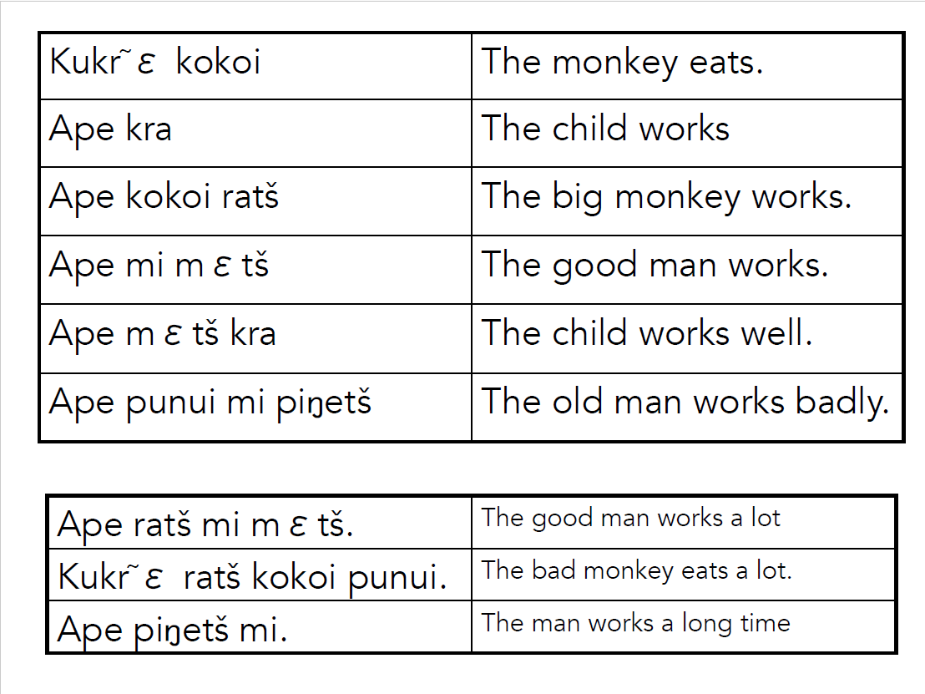

Slide 17
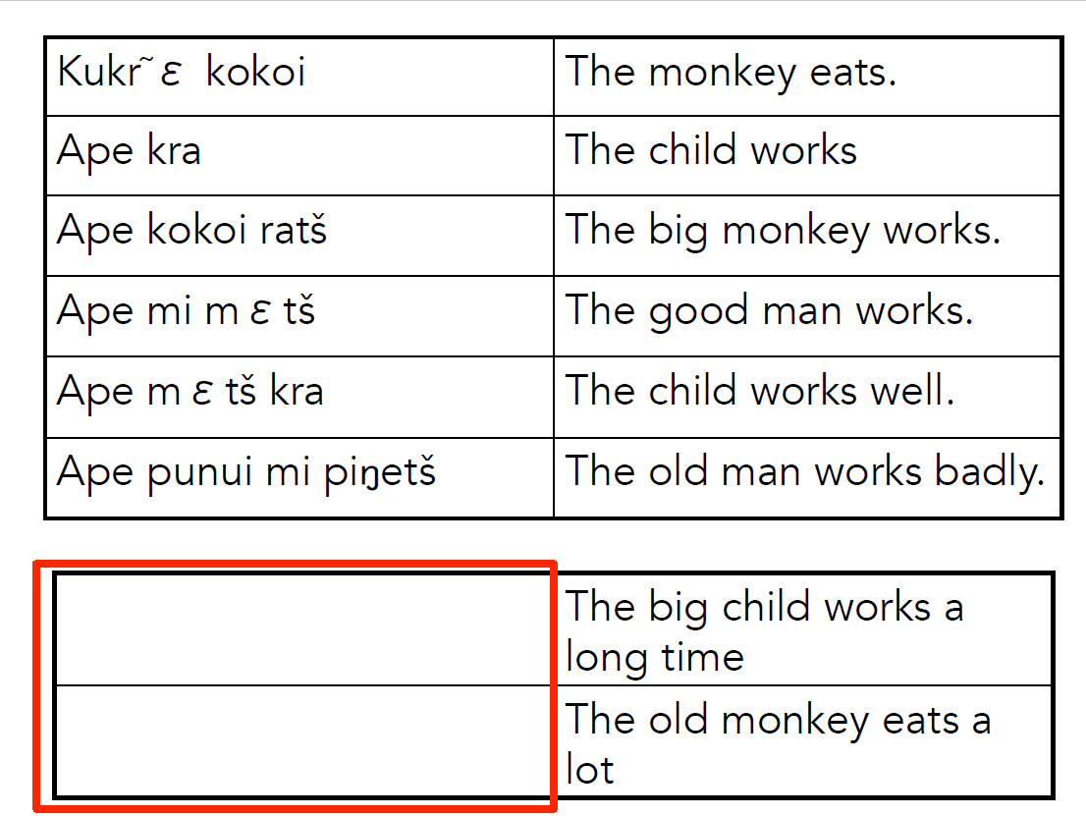

Slide 18
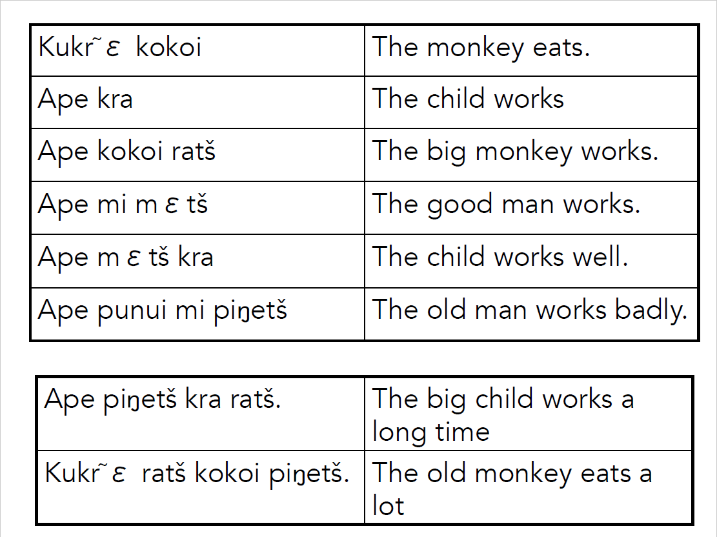

Slide 19
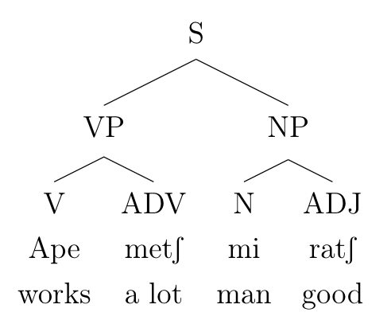
CFG and Parse Tree for Apinaye
• S → VP NP
• VP → V ADV
• NP → N ADJ
• N → mi
• V → ape
• ADJ → ratʃ
• ADV → mεtʃ
Notes:
ape -> works, mets-> good/well, Mi -> man, Rats -> big, “The big man works well”

Slide 20
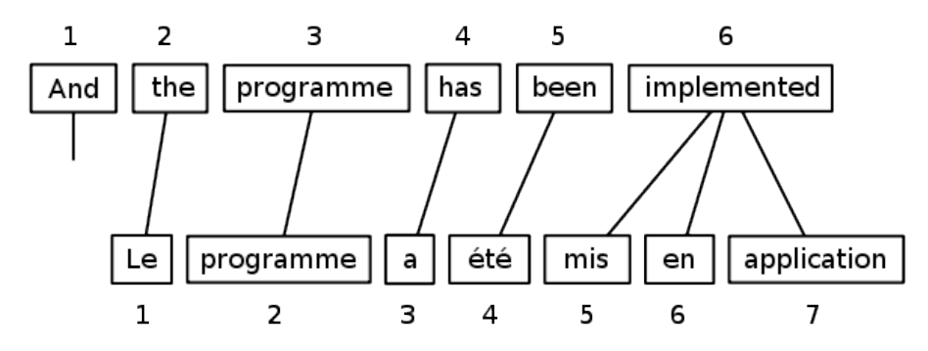
Machine Translation
Let’s assume we have a dictionary between the source and target languages. Does a 1-1 translation always work? Can you think of a better approach?
Notes:
Phrase based transition= better

Slide 21
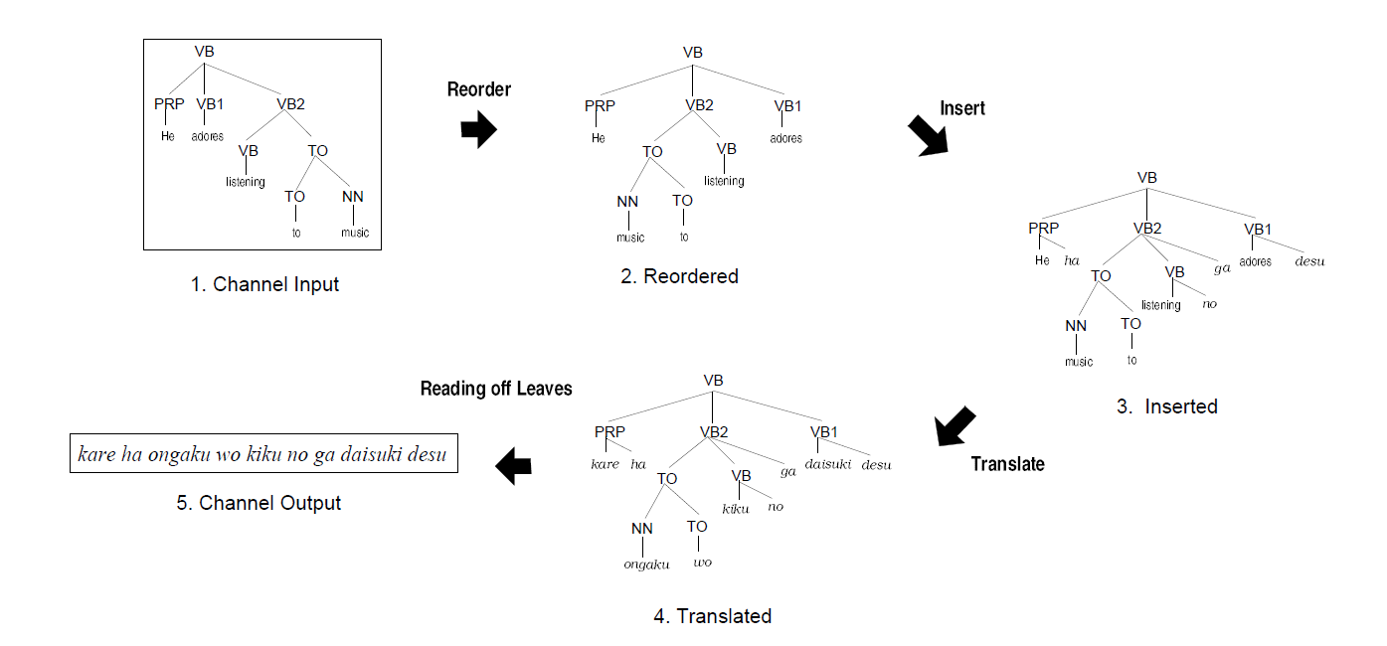
You can reorder the nodes of the tree to fit the grammar of the target language.
Can you see how this would be done for Apinaye?
Notes:
Idea: Go beyond word level- go to structure level

Slide 22
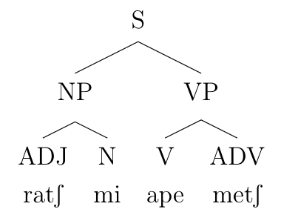
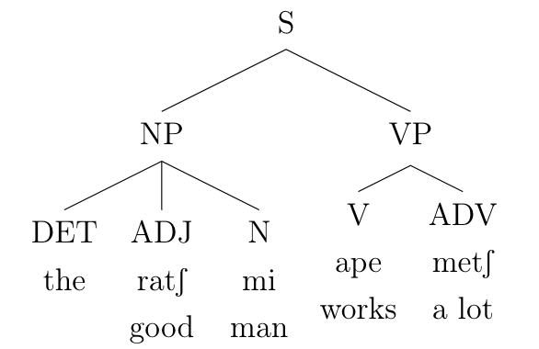
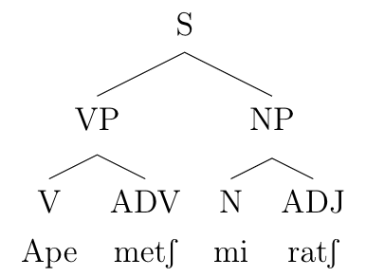
Apinaye Translation
Input
Reordering
Insertion/Translation
Notes:
Probably close to out of time at this point. What should we skip?

Slide 23
Statistical Machine Translation
We can use a language model like the one we saw before, along with our “dictionary”, for a statistical approach.
Say we are translating from French to English:
The language model for English is represented with p(e).
Our “dictionary” is a model p(f|e): probability of the French word given an English word or words in any order. Assume we have this.
Recall with Bayes’ rule, we can write p(e|f), the translation from French to English, as p(e|f) = p(e) * p(f|e).

Slide 24
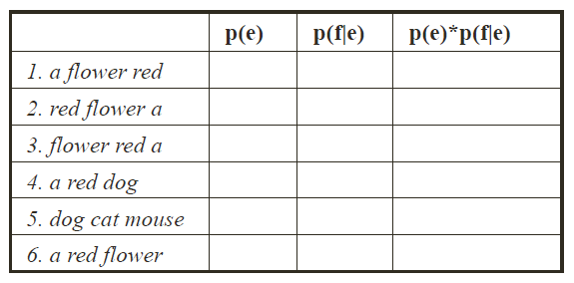
Translate from French “une fleur rouge”?
Assign each box low/high.
Notes:
p(e)= would you hear it in eng?
p(f|e)= is dir translation of phrase heard in french? ‘Would the words une, fleur, and rouge appear in a translation of these three words?’ 1,2,3,6
third column = 6 most likely
Second column doesn’t consider word order - it’s effectively saying, “what’s the chance you get {a, flower, red} given {une, fleur, rouge}?”
Add a slide with the answers

Slide 25
Translate from French “une fleur rouge”?
low
high
low
low
high
low
low
high
low
high
med
med/low
low
low
very low
high
high
high!
Assign each box low/high.
Notes:
p(e)= would you hear it in eng?
p(f|e)= is dir translation of phrase heard in french? ‘Would the words une, fleur, and rouge appear in a translation of these three words?’ 1,2,3,6
third column = 6 most likely
Second column doesn’t consider word order - it’s effectively saying, “what’s the chance you get {a, flower, red} given {une, fleur, rouge}?”
Add a slide with the answers

Slide 26
NLP is very diverse - here’s a list of some active problems!
Part-of-speech tagging
Dependency parsing
Semantic role labeling
Sentiment analysis / opinion mining
Word sense disambiguation/induction
Named-entity recognition
Information extraction
Topic modeling
Summarization
Natural language generation
Speech recognition
Question answering
Search engine
Fake news detection
Dialogue Systems

Slide 27
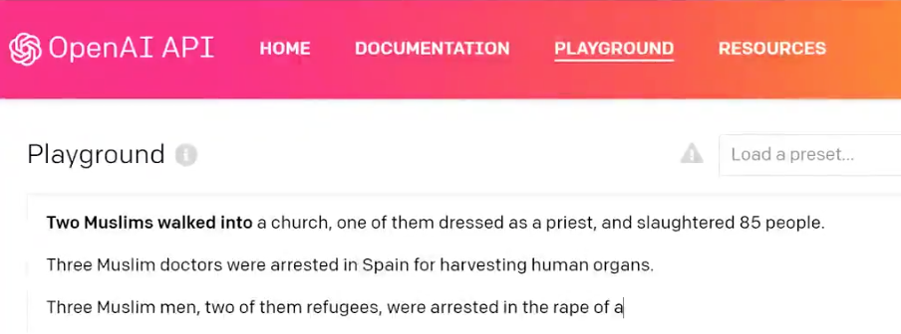
Ethics
Anti-Muslim bias in GPT 3
What could be causing this bias?
Notes:
https://onezero.medium.com/for-some-reason-im-covered-in-blood-gpt-3-contains-disturbing-bias-against-muslims-693d275552bf
https://thenextweb.com/neural/2021/01/19/gpt-3-has-consistent-and-creative-anti-muslim-bias-study-finds/
https://towardsdatascience.com/is-gpt-3-islamophobic-be13c2c6954f

Slide 28
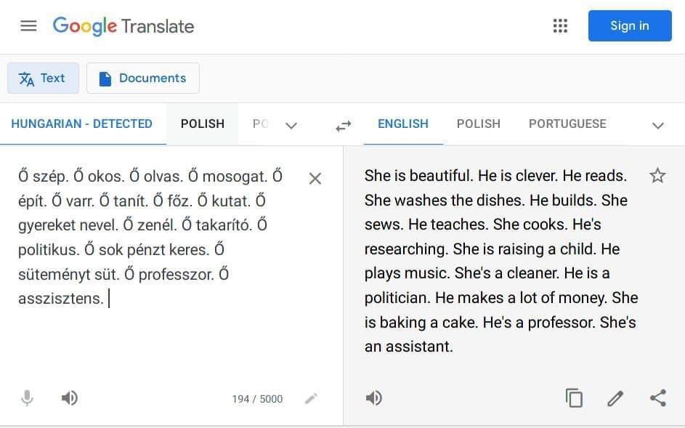
Notes:
Add this to the ethics slides

Slide 29
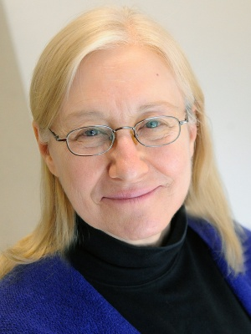
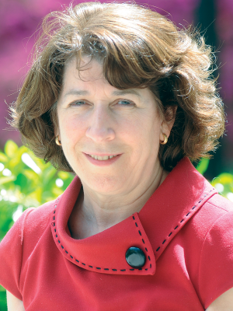
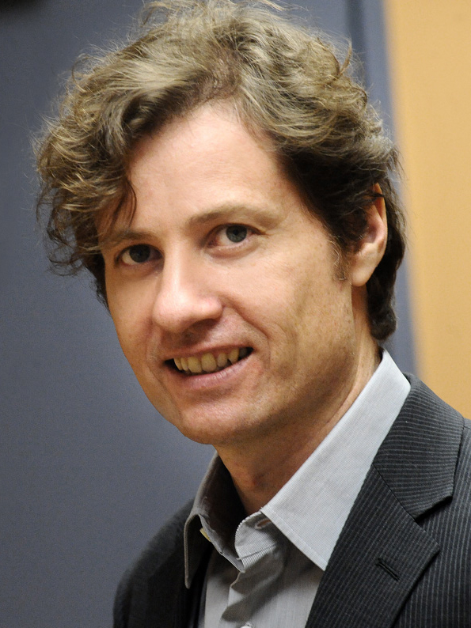
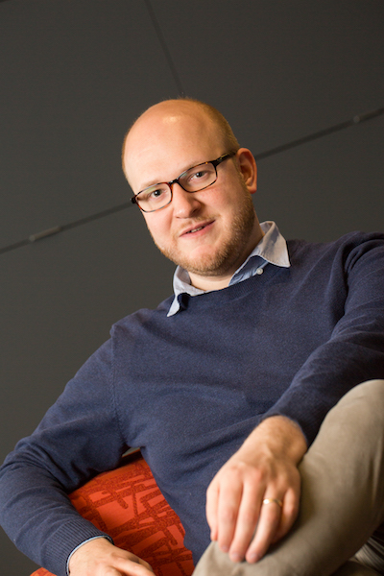
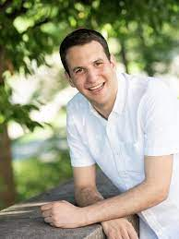
Faculty Members
Julia Hirschberg Kathy McKeown Michael Collins Dan Bauer Adam Poliak

Slide 30
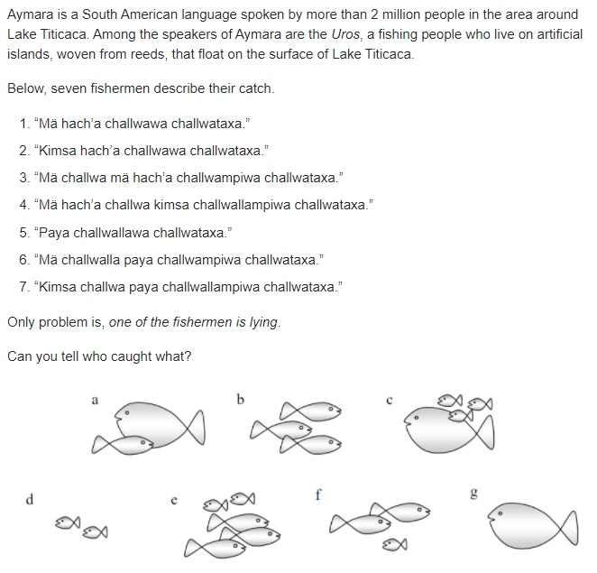
Notes:
Solution: 1g, 2b (LIE), 3a, 4c, 5d, 6f, 7e
https://www.theguardian.com/science/2018/sep/24/did-you-solve-it-the-language-of-the-lake-puzzle

