Slide 1
Logic Puzzles
and Algorithms
Notes:
‹#›
Intro- admin stuff: show syllabus, community expectations(mics/camera/engagement), grab snacks!
Ice breaker: pick your favorite from the first meeting. Adjective with same first letter of your name, for example
ask what is an algorithm? Cannon’s definition (A well-ordered collection of unambiguous and effectively computable operations that when executed produces a result and halts in a finite amount of time.)

Slide 2
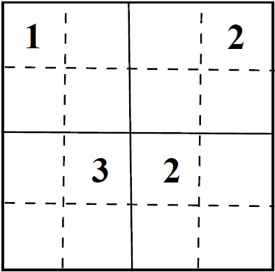
Sudoku
Notes:
‹#›
Ask to define Sudoku- Cannon’s class
Ask what Sudoku is, how you solve it (think of/talk thru steps)

Slide 3
Sudoku
Rule: can’t have the same number appear twice in any column, row, or box.
Notes:
‹#›

Slide 4
Sudoku
4
3,4
Rule: can’t have the same number appear twice in any column, row, or box.
Notes:
‹#›

Slide 5
Sudoku
4
3
Rule: can’t have the same number appear twice in any column, row, or box.
Notes:
‹#›

Slide 6
Sudoku
4
3
4
Rule: can’t have the same number appear twice in any column, row, or box.
Notes:
‹#›

Slide 7
Sudoku
4
3
4
1
Rule: can’t have the same number appear twice in any column, row, or box.
Notes:
‹#›

Slide 8
Sudoku
4
3
2, 3
4
1
2
Rule: can’t have the same number appear twice in any column, row, or box.
Notes:
‹#›

Slide 9
Sudoku
4
3
3
4
1
2
Rule: can’t have the same number appear twice in any column, row, or box.
Notes:
‹#›

Slide 10
Sudoku
4
3
3
2
4
1
2
1
Rule: can’t have the same number appear twice in any column, row, or box.
Notes:
‹#›

Slide 11
Sudoku
4
3
3
2
1
4
4
1
2
1
4
3
Rule: can’t have the same number appear twice in any column, row, or box.
Notes:
‹#›

Slide 12
Sudoku
What about a bigger puzzle?
Notes:
‹#›

Slide 13
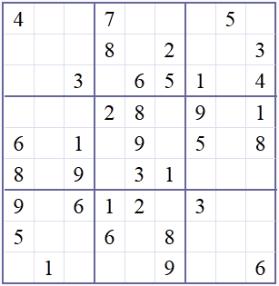
Sudoku
Try to write an algorithm for solving this 3x3 puzzle
Notes:
Ask them to discuss with people around them

Slide 14
Sudoku
Solution:
Step 1: Go row by row, cell by cell – pencil in all numbers 1 to 9
Step 2: Check row, column and box, eliminate all numbers
that are same
Step 3: Once you finish filling in all cells, go back and repeat
Steps 1 and 2 until all boxes are filled in
Notes:
‹#›

Slide 15
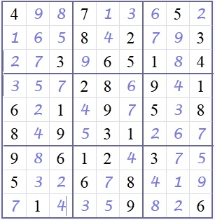
Sudoku
Solution
Notes:
‹#›

Slide 16
Nim's Game
Initially, there is a pile of stones (or Hershey’s kisses) in the middle of the table. Players sit in a circle around the pile. Each player must pick up 1, 2 or 3 stones as they take their turn. The loser is the person who picks up the last stone.
Variants: Stones arranged in multiple rows, and you can take from only one row at a time.
(This was actually played as an immunity challenge in Survivor: Thailand.) [Slide deck]
Notes:
‹#›
Online versions of Nim:
https://www.transum.org/Software/Nim/ . So retro. And what music.
https://education.jlab.org/nim/c_gamepage.html Simplest version.
http://benpyle.com/nim/ Person who takes the last stone loses version.
Breakout rooms of 2?

Slide 17
Nim's Game
5
Decision Tree for 5 Stones:
(you are player 2!)
P1 takes 3
2
Notes:
‹#›
Use tree language: node, edge
Ask what nodes and edges represent

Slide 18
Nim's Game
5
Decision Tree for 5 Stones:
P1 takes 3
2
You take 2
You take 1
1
LOSE
Notes:
‹#›

Slide 19
Nim's Game
Decision Tree for 5 Stones:
5
P1 takes 3
2
You take 2
You take 1
1
LOSE
P1 takes 1
WIN
Notes:
‹#›

Slide 20
Nim's Game
5
Decision Tree for 5 Stones:
P1 takes 2
3
2
1
L
W
Notes:
‹#›

Slide 21
Nim's Game
5
Decision Tree for 5 Stones:
P1 takes 2
3
2
You take 1
You take 3
2
1
LOSE
1
L
W
Notes:
‹#›

Slide 22
Nim's Game
Decision Tree for 5 Stones:
5
P1 takes 2
3
2
You take 1
You take 3
2
1
LOSE
1
L
P1 takes 1
P1 takes 2
P1 takes 1
1
WIN
WIN
W
Notes:
‹#›

Slide 23
Nim's Game
Decision Tree for 5 Stones:
5
P1 takes 2
3
2
You take 1
You take 3
2
1
LOSE
1
L
P1 takes 1
P1 takes 2
P1 takes 1
1
WIN
WIN
W
You take 1
LOSE
Notes:
‹#›

Slide 24
Nim's Game
5
Decision Tree for 5 Stones:
P1 takes 1
4
3
2
2
1
L
1
L
1
W
W
W
L
Notes:
‹#›

Slide 25
Nim's Game
5
Decision Tree for 5 Stones:
P1 takes 1
4
3
2
You take 1
You take 3
You take 2
3
2
1
2
1
L
1
L
1
W
W
W
L
Notes:
‹#›

Slide 26
Nim's Game
Decision Tree for 5 Stones:
5
P1 takes 1
4
3
2
You take 1
You take 3
You take 2
3
2
1
2
1
L
1
L
P1 takes 1
P1 takes 3
P1 takes 1
P1 takes 2
P1 takes 1
P1 takes 2
2
1
WIN
1
WIN
WIN
1
W
W
W
L
Notes:
‹#›

Slide 27
Nim's Game
5
Decision Tree for 5 Stones:
P1 takes 1
4
3
2
You take 1
You take 3
You take 2
3
2
1
2
1
L
1
L
P1 takes 1
P1 takes 3
P1 takes 1
P1 takes 2
P1 takes 1
P1 takes 2
2
1
W
1
W
W
1
W
W
W
You take 1
You take 2
You take 1
You take 1
L
1
L
L
L
Notes:
‹#›

Slide 28
Nim's Game
5
Decision Tree for 5 Stones:
P1 takes 1
4
3
2
You take 1
You take 3
You take 2
3
2
1
2
1
L
1
L
P1 takes 1
P1 takes 3
P1 takes 1
P1 takes 2
P1 takes 1
P1 takes 2
2
1
W
1
W
W
1
W
W
W
You take 1
You take 1
You take 2
You take 1
L
L
1
L
L
P1 takes 1
W
Notes:
‹#›
Not as complicated as it looks coz it is recursive
Trees to represent any deterministic/probabilistic games

Slide 29
Nim's Game
Winning Strategy for 5 Stones:

Slide 30
Nim's Game
5
Winning Strategy for 5 Stones:
takes 3
take 1
take 2
3
4
2
take 3
take 2
take 1
3
2
1
2
1
L
1
L
take 1
take 1
take 1
2
1
W
1
W
W
1
W
W
W
1
L
L
L
L
W
Notes:
Winning actions of player 2= blue arrow
If other person starts, you can always win
Bolded arrows are shortest and surest ways to win

Slide 32
Coin Game
Assume that you have 4 coins, and you know that 3 are OK but
one is bad. You know that the bad coin has a different weight
than the good coins, but you don’t know whether it’s heavier or
lighter. Figure out how, using only a balance scale, you can find
out which is the bad coin using just 2 weightings.
Notes:
‹#›
Breakouts with same people

Slide 33
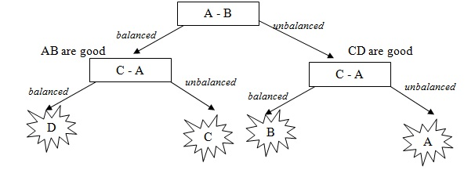
Coin Game
Decision Tree: 4 coins (ABCD)
Notes:
‹#›
Use graph terms- tree, node, edge

Slide 34
Tower of Hanoi
Setup:
Goal: move all disks from starting point to end point
Rules: you can only move one disk at a time
AND a disk cannot rest on top of a smaller disk
https://www.mathsisfun.com/games/towerofhanoi.html
Notes:
‹#›

Slide 35
Tower of Hanoi
Try writing an algorithm to solve the Tower of Hanoi
problem

Slide 36
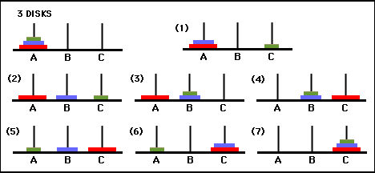
Tower of Hanoi
Solution:

Slide 37
Tower of Hanoi
Iterative Algorithm:
For an even number of disks:
move between pegs A and B
move between pegs A and C
move between pegs B and C
repeat until complete
For an odd number of disks:
move between pegs A and C
move between pegs A and B
move between pegs B and C
repeat until complete

Slide 38
Tower of Hanoi
Solution:
Recursive Algorithm:
number of discs = n
move n−1 discs from A to B. This leaves disc n alone on peg A
move disc n from A to C
move n−1 discs from B to C so they sit on disc n
Notes:
Intro recursion by nim games trees and repeating subtrees for more stones than 5
Solving tower of hanoi=2^n moves

Slide 39
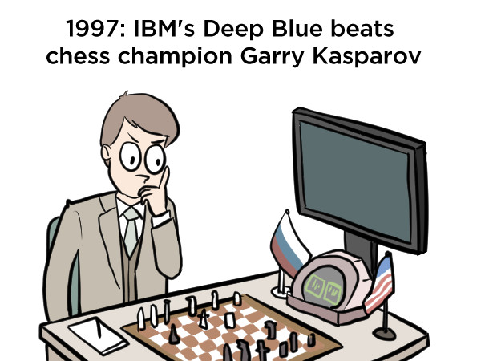
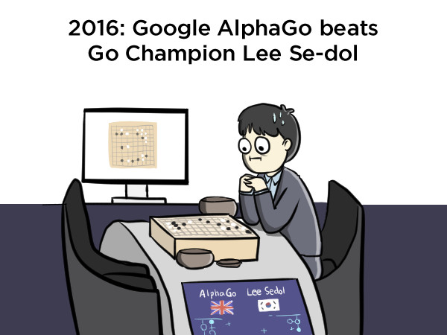
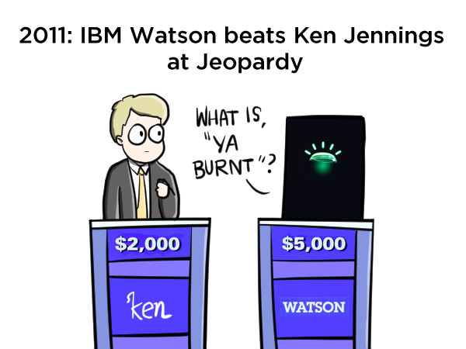
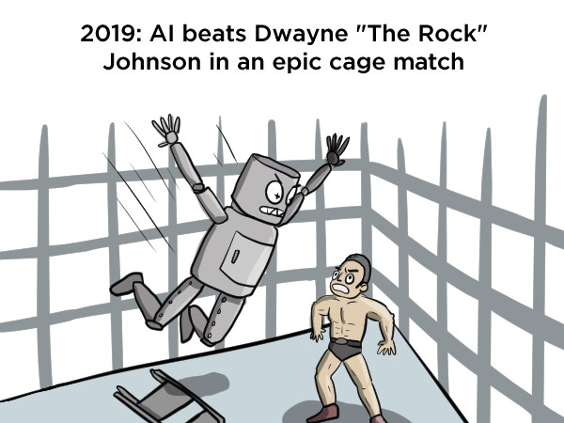
Applications
Algorithms play all sorts of games
2022
Notes:
Not all algorithms for solving games are based on decision trees, i.e chess, go, jeopardy

Slide 40
At Columbia
Algorithms classes at CU:
CSCI 3261: Computer Science Theory
CSOR 4231: Analysis of Algorithms
CSCI 4236: Introduction to Computational Complexity
...and more at advanced levels.

Slide 41
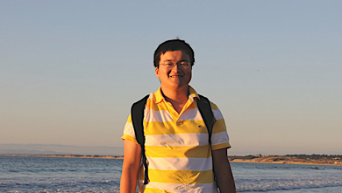
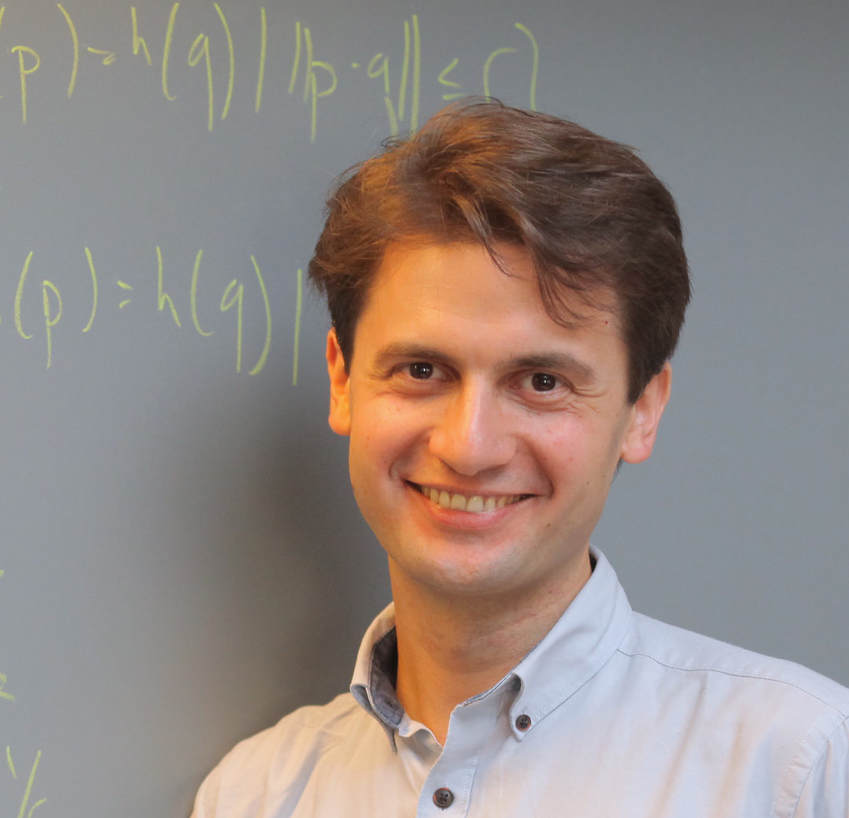
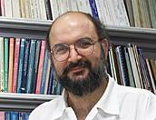
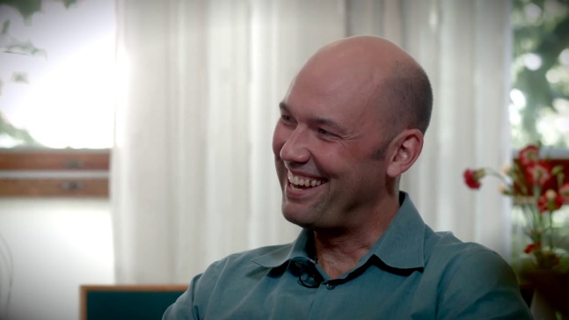
At Columbia
Many professors conduct research on algorithms
Cliff Stein
Xi Chen
Alex Andoni
Mihalis Yannakakis
Tim Roughgarden
Rocco Servedio
Omri Weinstein
Christos Papadimitriou
Notes:
Attendance link!
Office hrs for 15 mins!
Themed office hours(?)

