Slide 1
The Minimalist Camera
Parita Pooj
Columbia University
parita@cs.columbia.edu
Michael Grossberg
City University of New York
grossberg@cs.ccny.cuny.edu
Peter Belhumeur
Columbia University
belhumeur@cs.columbia.edu
Shree Nayar
Columbia University
nayar@cs.columbia.edu
[Pooj et al. 2017]
Notes:
Hi, I am Parita and I am here to talk about my project – the Minimalist Camera. To understand this project, let’s first take a look at a traditional Camera

Slide 2
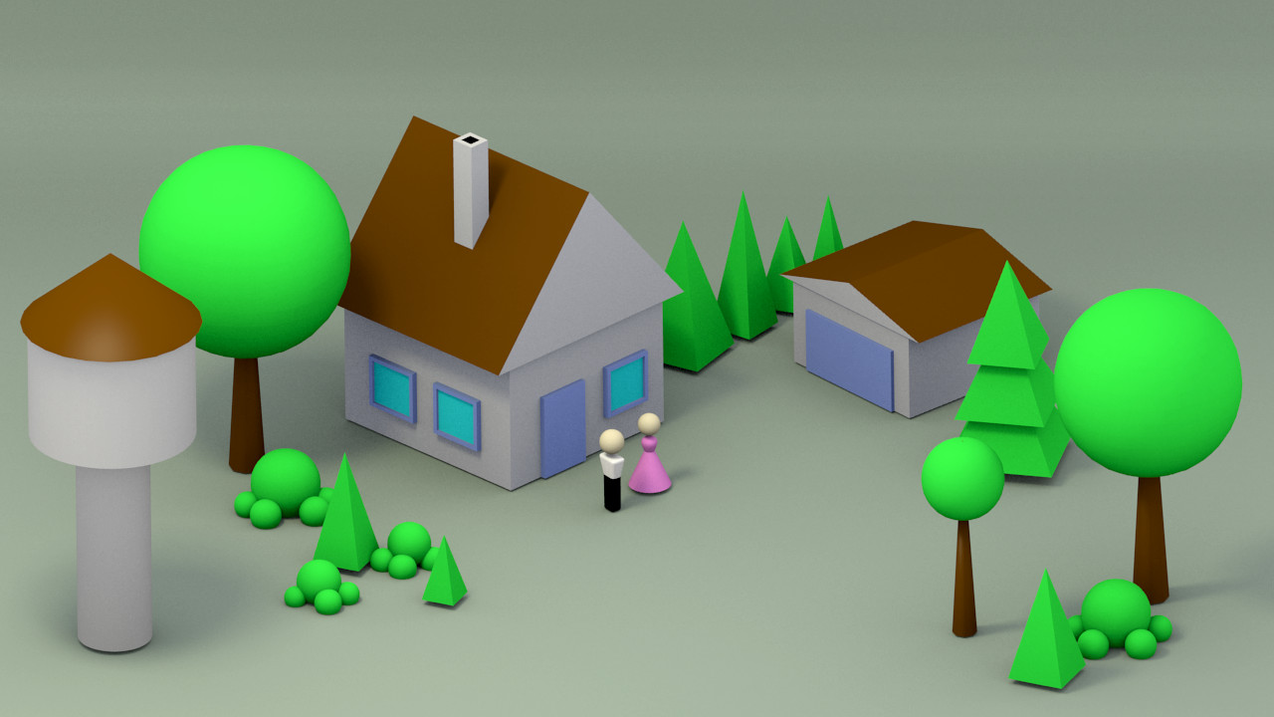
Traditional Camera
Camera Sensor Array
Lens
Scene
A Lens captures a 3D Scene as an Image to the Sensor Array
Notes:
Change this illustration and make it vertical

Slide 3
Traditional Camera
Image
Camera System
Scene
A Lens captures a 3D Scene as an Image to the Sensor Array
Notes:
Change this illustration and make it vertical

Slide 4
What if we didn’t care about capturing the image?
Notes:
Change this illustration and make it vertical

Slide 5
Our Camera
Information
Camera System
Scene
Design a System to capture Information directly
Notes:
Change this illustration and make it vertical

Slide 6
Our Camera
Information
Design this using minimal resources
Camera System
Scene
Design a System to capture Information directly
Notes:
Change this illustration and make it vertical

Slide 7
Traditional Camera
Camera Sensor Array
Lens
Scene
A Lens captures a 3D Scene as an Image to the Sensor Array
Notes:
Change this illustration and make it vertical

Slide 8
Single Pixel Camera
Single Pixel
No Lens
Scene
[Duarte et al. 2008]
Notes:
Change this illustration and make it vertical

Slide 9
Single Pixel Camera
Single Pixel
No Lens
Coded Aperture
Scene
[Duarte et al. 2008]
Notes:
Change this illustration and make it vertical

Slide 10
Single Pixel Camera
Single Pixel
Measurements
No Lens
Coded Aperture
Recovery
Scene
Recovered Image
[Duarte et al. 2008]
Notes:
Change this illustration and make it vertical

Slide 11
Single Pixel Camera
Single Pixel
No Lens
Make Static
Static Aperture
Scene
[Duarte et al. 2008]
Notes:
Change this illustration and make it vertical

Slide 12
A Mixel: Mask and Pixel
Mixel
Pixel
$$P\left(t\right)$$
$$d_{f}$$
Smallest Unit of a Minimalist Camera
Mask
$$P\left(t\right)=\int{\int{I_{t}\left(x, y\right)M\left(x, y\right)ⅆxⅆy}}$$
Scene, $I_{t}\left(x, y\right)$
Notes:
Which we call .. A mixel. All the light from the scene is modulated by the mask and then integrated to a single measurement by the mixel.

Slide 13
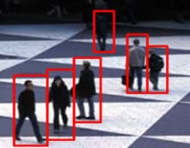
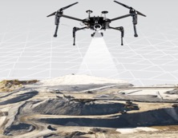
A Minimalist Camera - MinCam
Mixel 3
$$P_{2}\left(t\right)$$
$$P_{3}\left(t\right)$$
Mixel 2
Mixel 1
$$M_{2}\left(x, y\right)$$
$$P_{1}\left(t\right)$$
$$M_{3}\left(x, y\right)$$
$$M_{1}\left(x, y\right)$$
Detect people
Estimate Depth
A Minimalist Camera combines multiple pixels with their masks to solve a task without recovering an image
Notes:
Thus a minimalist camera tries to solve a problem without aiming to recover an image. How do we design such a camera?

Slide 14
Designing a MinCam
Pixel
$$P\left(t\right)$$
Pixel
$$P\left(t\right)$$
Pixel
$$P\left(t\right)$$
Pixel
$$P\left(t\right)$$
Mask
Mask
Mask
Mask
Find appropriate
mask design
2. Solve the task in
minimum number of pixels
Find masks such that you need minimum pixels
Hence, “Minimalist Camera”
Notes:
Illustrate the design questions.
Which masks to pick?
Such that ….
We need minimum number of mixels

Slide 15
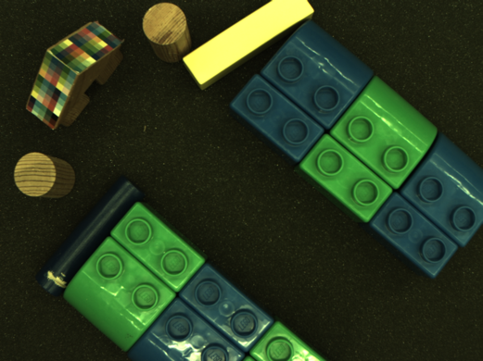
Application: Naïve Object Tracking
Notes:
Let’s talk about one such application where given a scene

Slide 16
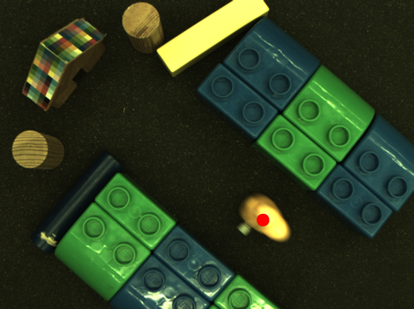
Application: Naïve Object Tracking
How many mixels do you need to detect and track a new object?
Notes:
To detect the object, we need to find the centroid or the coordinate of this point. Scene -> Camera System -> (x, y)
|
V
Design this component

Slide 17
Application: Naïve Object Tracking
Pixel
$$P\left(t\right)$$
Pixel
$$P\left(t\right)$$
Centroid
$$d_{f}$$
$$d_{f}$$
$$\overline{x}= \frac{\int{\int{x D\left(x, y\right) dx}dy}}{\int{\int{D\left(x, y\right) dx}dy}}$$
$$\overline{y}=\frac{\int{\int{y D\left(x, y\right) dx}dy}}{∫\int{D\left(x, y\right) dx}dy}$$
$$D\left(x, y\right)$$
Mask
Mask
Scene, $I_{t}\left(x, y\right)$
Scene, $I_{t}\left(x, y\right)$
$$P\left(t_{0}\right)=\int{\int{I_{t}\left(x, y\right)M\left(x, y\right)ⅆxⅆy}}$$
$$P\left(t_{1}\right)=\int{\int{\left(I_{t}\left(x, y\right)+D\left(x, y\right)\right) M\left(x, y\right)ⅆxⅆy}}$$
Notes:
Consider a single unit of measurement – before and after an object appears Place the two images side by side and show that we want to find the “centroid” of D(x, y) with formula

Slide 18
Application: Naïve Object Tracking
Pixel
$$P\left(t\right)$$
Pixel
$$P\left(t\right)$$
Centroid
$$d_{f}$$
$$d_{f}$$
$$\overline{x}= \frac{\int{\int{x D\left(x, y\right) dx}dy}}{\int{\int{D\left(x, y\right) dx}dy}}$$
$$\overline{y}=\frac{\int{\int{y D\left(x, y\right) dx}dy}}{∫\int{D\left(x, y\right) dx}dy}$$
$$D\left(x, y\right)$$
Mask
Mask
Scene, $I_{t}\left(x, y\right)$
Scene, $I_{t}\left(x, y\right)$
$$P\left(t_{1}\right)−P\left(t_{0}\right)=\int{\int{D\left(x, y\right) M\left(x, y\right)ⅆxⅆy}}$$
Notes:
Consider a single unit of measurement – before and after an object appears Place the two images side by side and show that we want to find the “centroid” of D(x, y) with formula

Slide 19
Application: Naïve Object Tracking
Pixel
$$P\left(t\right)$$
Pixel
$$P\left(t\right)$$
Centroid
$$d_{f}$$
$$d_{f}$$
$$\overline{x}= \frac{\int{\int{x D\left(x, y\right) dx}dy}}{\int{\int{D\left(x, y\right) dx}dy}}$$
$$\overline{y}=\frac{\int{\int{y D\left(x, y\right) dx}dy}}{∫\int{D\left(x, y\right) dx}dy}$$
$$D\left(x, y\right)$$
Mask
Mask
Scene, $I_{t}\left(x, y\right)$
Scene, $I_{t}\left(x, y\right)$
$$P\left(t_{1}\right)−P\left(t_{0}\right)=\int{\int{D\left(x, y\right) M\left(x, y\right)ⅆxⅆy}}$$
Notes:
Consider a single unit of measurement – before and after an object appears Place the two images side by side and show that we want to find the “centroid” of D(x, y) with formula

Slide 20
Application: Naïve Object Tracking
Mixel 1
$M_{1}\left(x, y\right)=x$
Centroid
$$\overline{x}= \frac{\int{\int{x D\left(x, y\right) dx}dy}}{\int{\int{D\left(x, y\right) dx}dy}}$$
$$\overline{y}=\frac{\int{\int{y D\left(x, y\right) dx}dy}}{∫\int{D\left(x, y\right) dx}dy}$$
$$D\left(x, y\right)$$
Scene, $I_{t}\left(x, y\right)$
$$P\left(t_{1}\right)−P\left(t_{0}\right)=\int{\int{D\left(x, y\right) xⅆxⅆy}}$$
Notes:
Consider a single unit of measurement – before and after an object appears Place the two images side by side and show that we want to find the “centroid” of D(x, y) with formula

Slide 21
Application: Naïve Object Tracking
Mixel 1
Mixel 2
$M_{1}\left(x, y\right)=x$
$M_{2}\left(x, y\right)=1 −x$
Centroid
$$\overline{x}= \frac{\int{\int{x D\left(x, y\right) dx}dy}}{\int{\int{D\left(x, y\right) dx}dy}}$$
$$\overline{y}=\frac{\int{\int{y D\left(x, y\right) dx}dy}}{∫\int{D\left(x, y\right) dx}dy}$$
$$D\left(x, y\right)$$
Mixel 3
Mixel 4
$M_{3}\left(x, y\right)=y$
$M_{4}\left(x, y\right)=1 −y$
Scene, $I_{t}\left(x, y\right)$
$$P\left(t_{1}\right)−P\left(t_{0}\right)=\int{\int{D\left(x, y\right) M\left(x, y\right)ⅆxⅆy}}$$
Notes:
Consider a single unit of measurement – before and after an object appears Place the two images side by side and show that we want to find the “centroid” of D(x, y) with formula

Slide 22
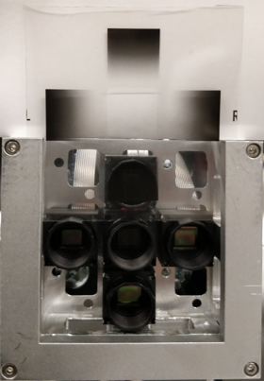
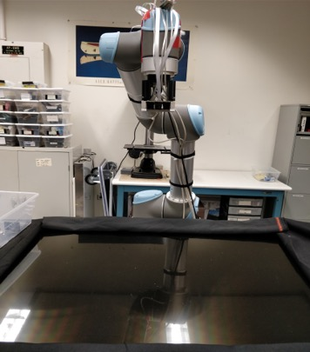
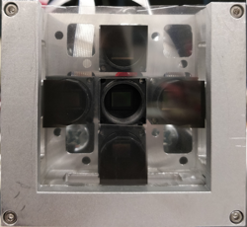
Hardware Setup
Masks
Minimalist Camera
Four mixels
Notes:
Our prototype includes four tiny cameras each of which gives one integrated scalar measurement of a mixel. The masks are printed on a transparent sheet of paper and slid into a slot in from of the cameras. The whole setup looks at the scene from a robotic arm mount.

Slide 23
Results: Tracking with “Four” Pixels
Maximum Error Rate
6.78 %
Average Error Rate
2.82 %
Notes:
Put videos here

Slide 24
Speed Estimation
Mixel
$$M_{d}\left(x,y\right)$$
$$v$$
Sinusoid Mask for the Mixel
Mixel
$$v$$
$d$
Correlation in Spatial Domain
Multiplication in Frequency Domain
Slice, $I_{t}\left(x, y\right)$
Mixel Correlates with the Road
Notes:
Slice It(x, y) should be white

Slide 25
Speed Estimation
$$P(t)$$
Mask frequency = $f$
Sampling frequency = $f$
0
Number of measurements of $P(t)$
Mixel
$$v$$
$d$
Velocity = $v$
Slice, $I_{t}\left(x, y\right)$
Mixel Correlates with the Road
Notes:
This signal is sampled by a frequency determined by the velocity.

Slide 26
Speed Estimation
$$P(t)$$
Mask frequency = $f$
Sampling frequency = $2f$
0
Number of measurements of $P(t)$
Mixel
$$2v$$
$d$
Velocity = $2v$
Slice, $I_{t}\left(x, y\right)$
Mixel Correlates with the Road
Notes:
So as the car moves faster, the frequency of the measured signal also increases. Thus the speed is encoded within the frequency of the measured signal.

Slide 27
Speed Estimation
$$P(t)$$
Mask frequency = $f$
Sampling frequency = $3f$
0
Number of measurements of $P(t)$
Mixel
$$3v$$
$d$
Velocity = $3v$
Slice, $I_{t}\left(x, y\right)$
Mixel Correlates with the Road
Notes:
And hence, can be extracted from the same.

Slide 28
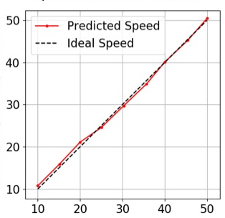
Speed Estimation: Results
Maximum Error Rate
7.55%
Predicted Speed in pixels/secs
Average Error Rate
2.85%
Correct Speed in pixels/secs
Notes:
Our results from the experiments using a prototype device shows that the predicted speed is very close to the expected measurement.

Slide 29
Summary
Complex Vision tasks can be solved using
extremely few pixels and optimal resources
Notes:
Mention training and show results

Slide 30
References
[Pooj et al. 2017] Pooj, P., Grossberg, M., Belhumeur, P., & Nayar, S. (2018). The Minimalist Camera. In Proceedings of British Machine Vision Confererence (BMVC) (p. 141).
[Duarte et al. 2008] Duarte, M. F., Davenport, M. A., Takhar, D., Laska, J. N., Sun, T., Kelly, K. F., & Baraniuk, R. G. (2008). Single-pixel imaging via compressive sampling. IEEE signal processing magazine, 25(2), 83-91.
Notes:
Our mincam estimates the correct speed of the moving object with 2.85% error rate.

