Slide 1
Network Implementation for Xen and KVM
Class project for E6998-01:
Network System Design and Implantation
12 Apr 2010
Kangkook Jee (kj2181)

Slide 2
Project goal
Explore network implementation for 2 most popular open-source virtualization architectures
  Xen, KVM (the Kernel-based Virtual Machine)
  Demystifying each VMM’s network implementation
Performance analysis for network I/O
  Compares Native OS, Xen, KVM
  Test for RX, TX and identify bottlenecks

Slide 3
Virtualization overview
Hosted Architecture
  VMWare Workstation, VirtualBox ..
Hybrid Architecture (S/W hypervisor based)
  VMWare ESX: Full-virtualization
  Xen: Para-virtualization
  KVM (the Kernel-based Virtual Machine)
  Reuse Linux code as much as possible – Tightly integrated into Linux
Hypervisor (H/W) Architecture
  IBM s/390 …

Slide 4
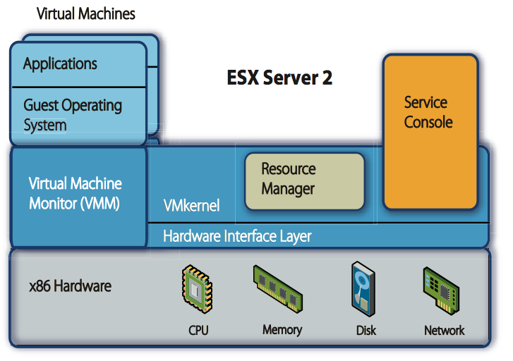
VMM architecture: VMWare
Full virtualization
Binary translation based - Full virtualization
Guest OS doesn’t aware of underlying VMM
Source: http://www.vmware.com/pdf/esx2_performance_implications.pdf

Slide 5
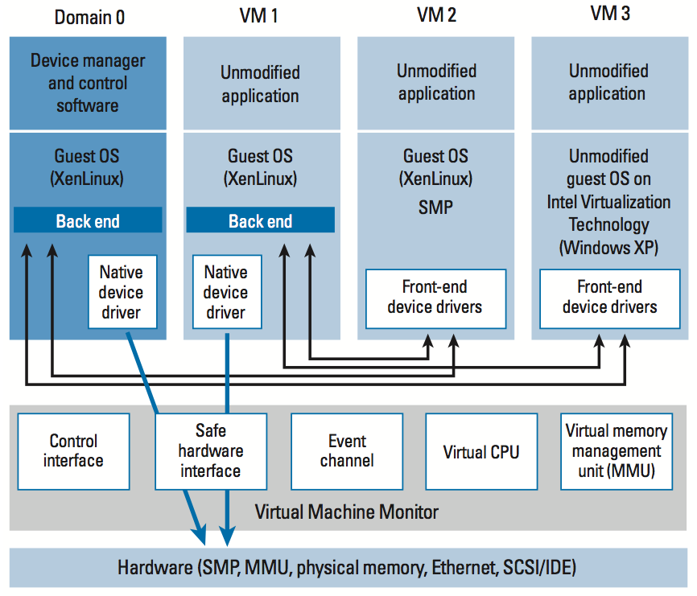
VMM architecture: Xen
Para-virtualization
OSes
Dedicated control domain: DOM0
Modified Guest OS
  - Linux Kernel (3K lines)
  - Windows XP (4.6 K lines)
Devices
Front-end (Net-front) for Guest OS to communicate Dom0
I/O channel (zero copy)
Backend (Net-back) for Dom0 to communicate with underlying systems
Source: “An overview of Xen Virtualization” from Dell power solutions

Slide 6
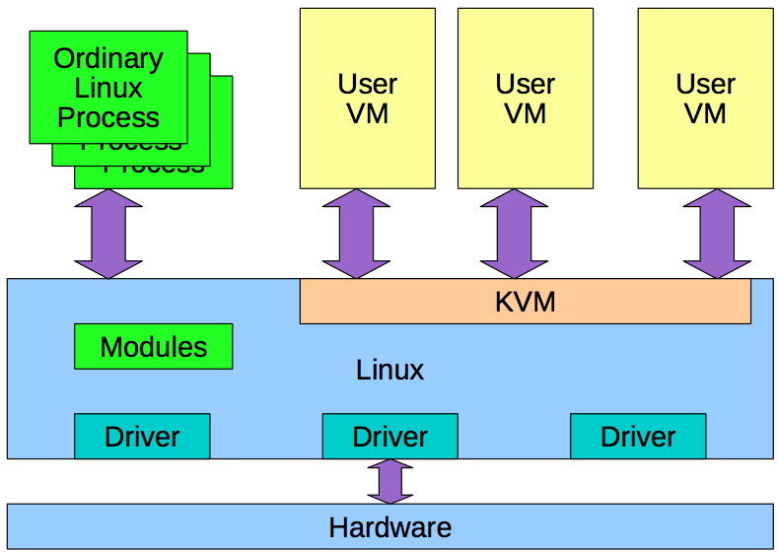
VMM architecture: KVM
Hypervisor tightly integrated into Linux code based
Hypervisor: Kernel module
Guest OS:
User space process (QEMU for x86 emulation)
Need H/W virtualization extension
QEMU
QEMU
QEMU

Slide 7
Xen vs. KVM
Xen
KVM
Strong support for para-virtualization with modified host-OS
→ Near-native performance for I/Os
Separate code based for DOM0 and device drivers
Security model
Rely on DOM0
Maintainability
Hard to catch up all versions of possible guests due to PV
Requires H/W virtualization extension – Intel VT, AMD Pacifica (AMD-V)
Limited support for para-virtualization
Code-base integrated into Linux source tree
Security model
Rely on Commodity/Casual Linux systems
Maintainability
Easy – Integrated well into infrastructure, codebase

Slide 8
Network I/O virtualization
Why I/O is hard to virtualize?
  Multiplexing/de-multiplexing for guests
  Programmed I/O, Memory-mapped I/O (mmio)
  Trap-and-emulate vs. Para-virtualization
Network I/O is even more hard to virtualize
  High packet rate: Batches often small
  Data must typically be copied to VM on receive
  Some network apps are latency sensitive

Slide 9
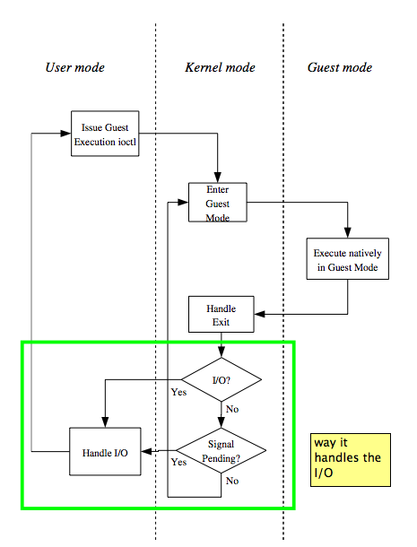
Network I/O virtualization in KVM
Native KVM I/O model
PIO: Trap
MMIO: the x86 emulator executes the faulting instruction
Slow due to mode switching
Extensions to support PV
  VirtIO: An API for Virtual I/O aims to support many hypervisors of all type
Source: “An overview of Xen Virtualization” from Dell power solutions

Slide 10
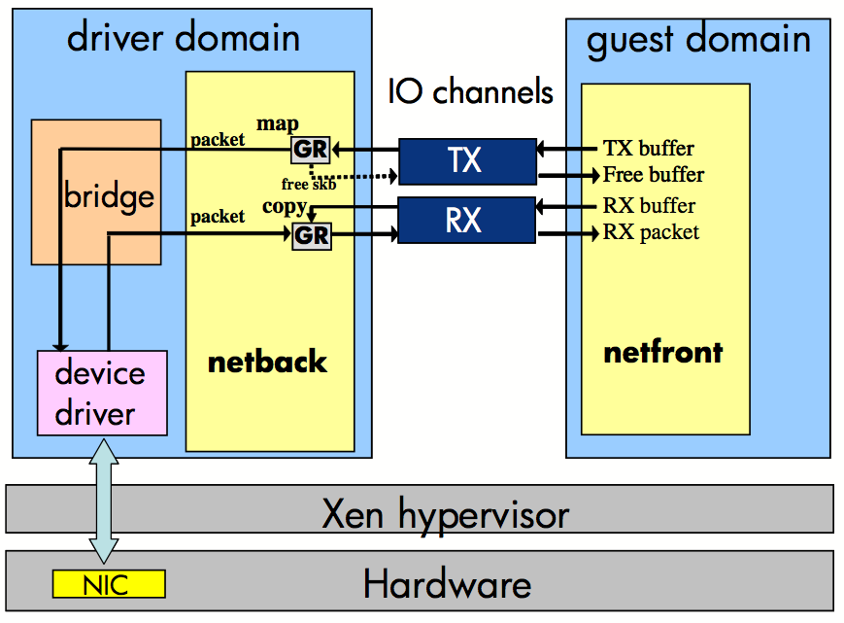
Network I/O virtualization in Xen
The bridge multiplex/de-multiplex network I/Os from guests
IO Channel
  Zero copy transfer with Grantcopy
  Enable driver domain to access I/O buffers in guest memory
Xen network I/O extension schemes
  Multiple RX queues, SR-IOV …
Source: “Bridging the gap between software and hardware techniques for i/o virtualization”
2008 Usenix Annual Technical conference

Slide 11
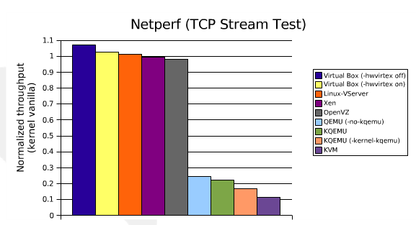
Network performance
With PV, Xen could attain near native performance
Native KVM, with trap-and-emulate, shows performance ~10%
Source: “Virtualization of Linux servers” from 2008 Ottawa Linux Symposium

Slide 12
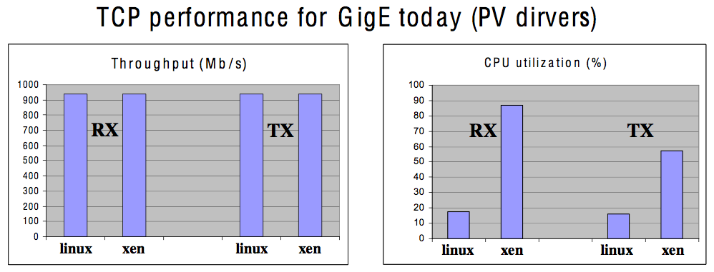
Network performance: Xen
For close-native RX/TX Xruput, Xen requires more CPU usages
Source: “Bridging the gap between software and hardware techniques for i/o virtualization”
2008 Usenix Annual Technical conference

Slide 13
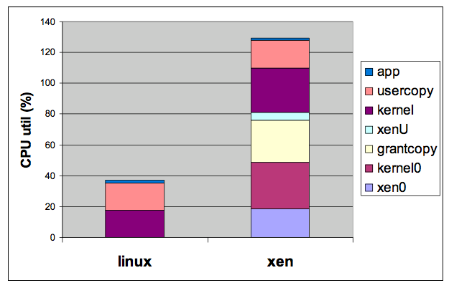
Network performance: Xen
Result for network RX path
  Cost of data copy is significant both in Linux and Xen
  Most cost for Xen code is in dom 0
  Grantcopy still requires large CPU usage
Source: “Xen network I/O performance analysis and opportunities for improvement”
from Xen submit (2007)
Notes:
XenU: Xen functions in guest context
Xen0: Xen functions in dom0 context
Grantcopy: data copy in grant code from driver domain to user domain
Usercopy: copy from kernel to user buffer
Kernel0: Kernel functions in dom0 context

Slide 14
To dos
Update/Compare test results with for network I/O for Xen and KVM
  With latest extensions e.g. – virtIO for KVM
Analysis on network stack implementations
  Identify architectural differences and argue their trade-offs

