Slide 1
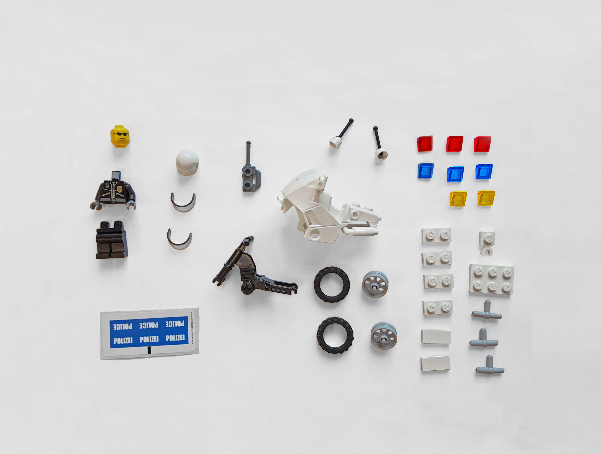
Adaptive Crowd Algorithms
For Open-Ended Problems
Lydia Chilton
University of Washington
Notes:
Thanks for having me!
My research is in human-computer interaction.
I‘m interested in people because
People can solve problems that computers can’t.

Slide 2
Notes:
For example, given these pieces of plastic
Most people can figure out what to build.
* Without instructions
* Without being told the goal.
(PAUSE)

Slide 3
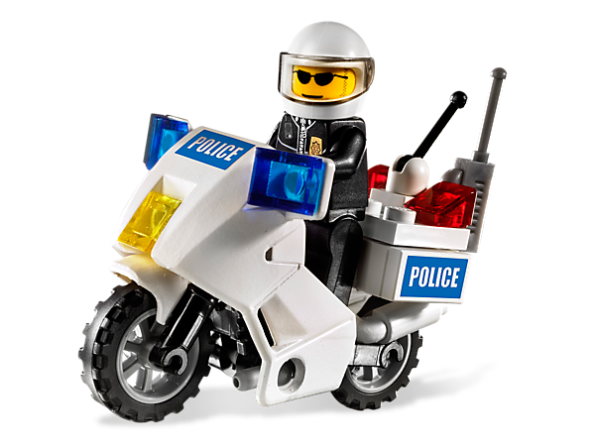
Notes:
Maybe you guess it just by looking,
This is the LEGO Motor Police.
It’s is amazing that people can figure that out.
How do we solve problems without instructions?

Slide 4

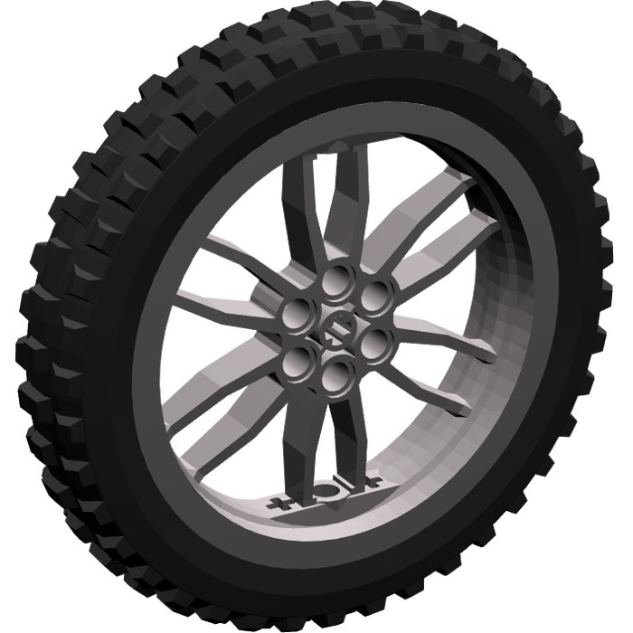
People Adapt
Adapt to inputs
Police Officer
Bicycle
Adapt to new
information
Motorcycle lights
Motorcycle
Notes:
Put simply, people adapt.
We adapt to the inputs - by looking at the pieces and make a guess
Maybe this is a police officer, maybe he’s on a bicycle
We adapt to new information –
Oh wait, maybe it’s a motorcycle
And given that it’s a motorcycle, maybe these are light.

Slide 5
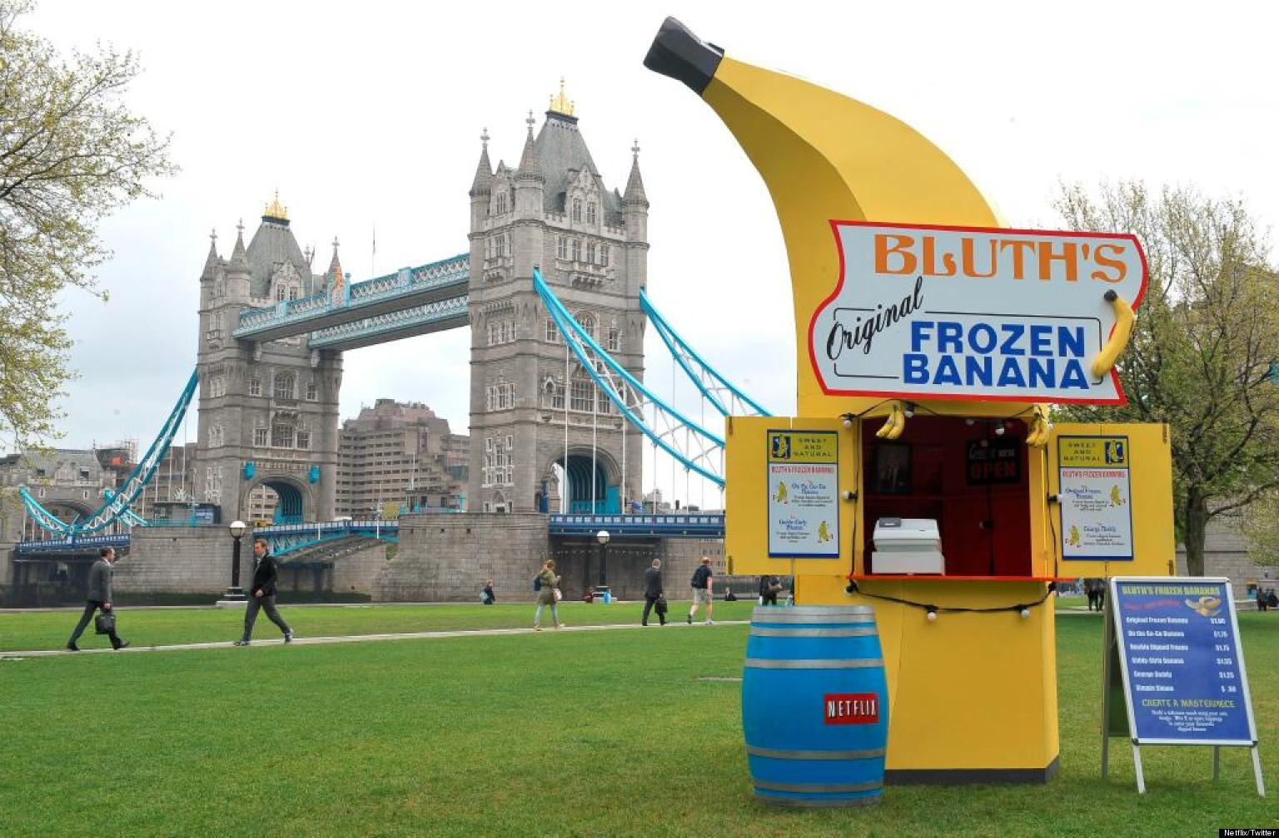
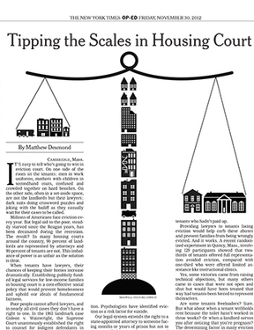
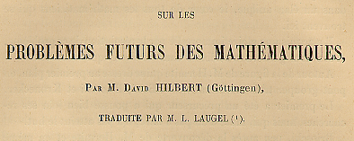
Adaptation is Necessary for
Open-Ended Problems
Notes:
Adaptation is what we use to solve open-ended problems.
Where it’s not even clear what the problem is.
Like this mystery lego task
OR writing an opinion piece for the NY Times
OR starting a business
OR Research, where part of the problem is deciding what is an important problem.
And although people can do this, we often struggle.
There is a lot of uncertainty, and as problems become large..

Slide 6
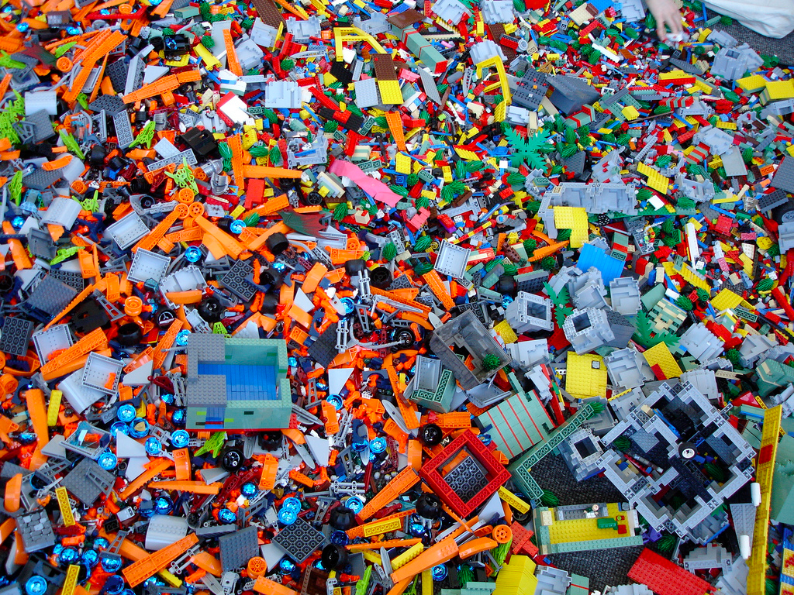
Can we solve open-ended
problems systematically?
Notes:
We get overwhelmed.
Can we find a way to solve open-ended problem systematically?
So we don’t get overwhelmed

Slide 7
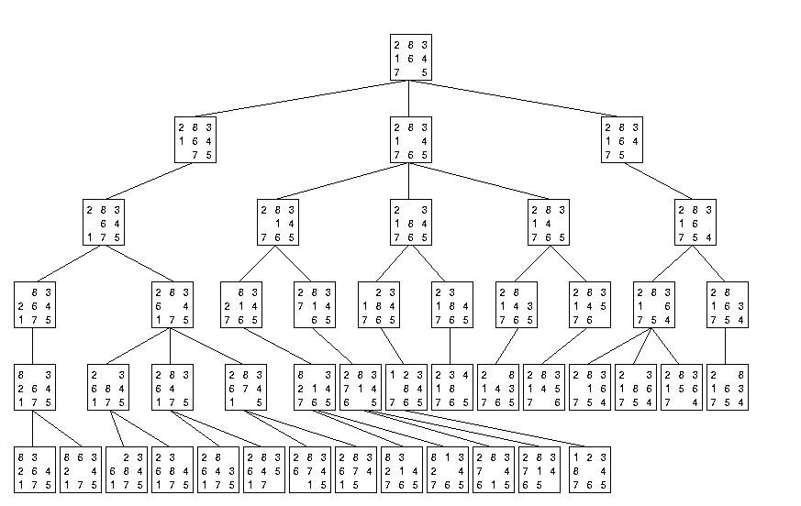
Algorithms don’t get overwhelmed
Notes:
Well, Algorithms don’t get overwhelmed.
It would be great if we could use the systematic nature of an algorithm, but involved people.
However…

Slide 8
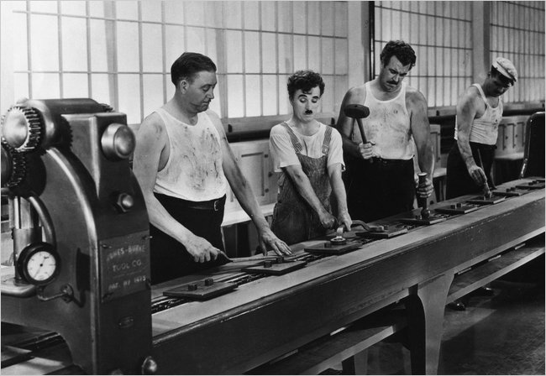
How can we combine the strengths of humans and computers to solve
open-ended problems?
Notes:
Often, when we combine people and machines, it ends up like this.
People can’t used their adaptive thinking skills because the machines are rigid.
So how can we combine the strengths of humans and computers to solve open-ended problems?

Slide 9
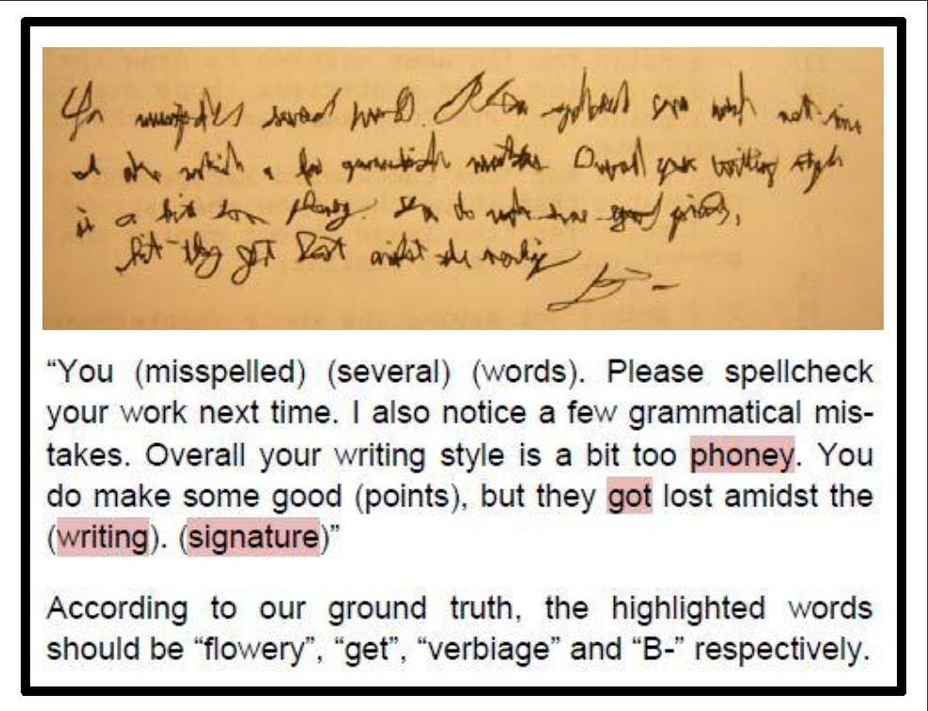
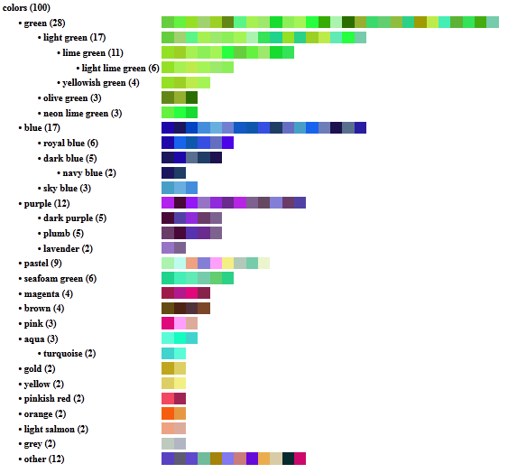
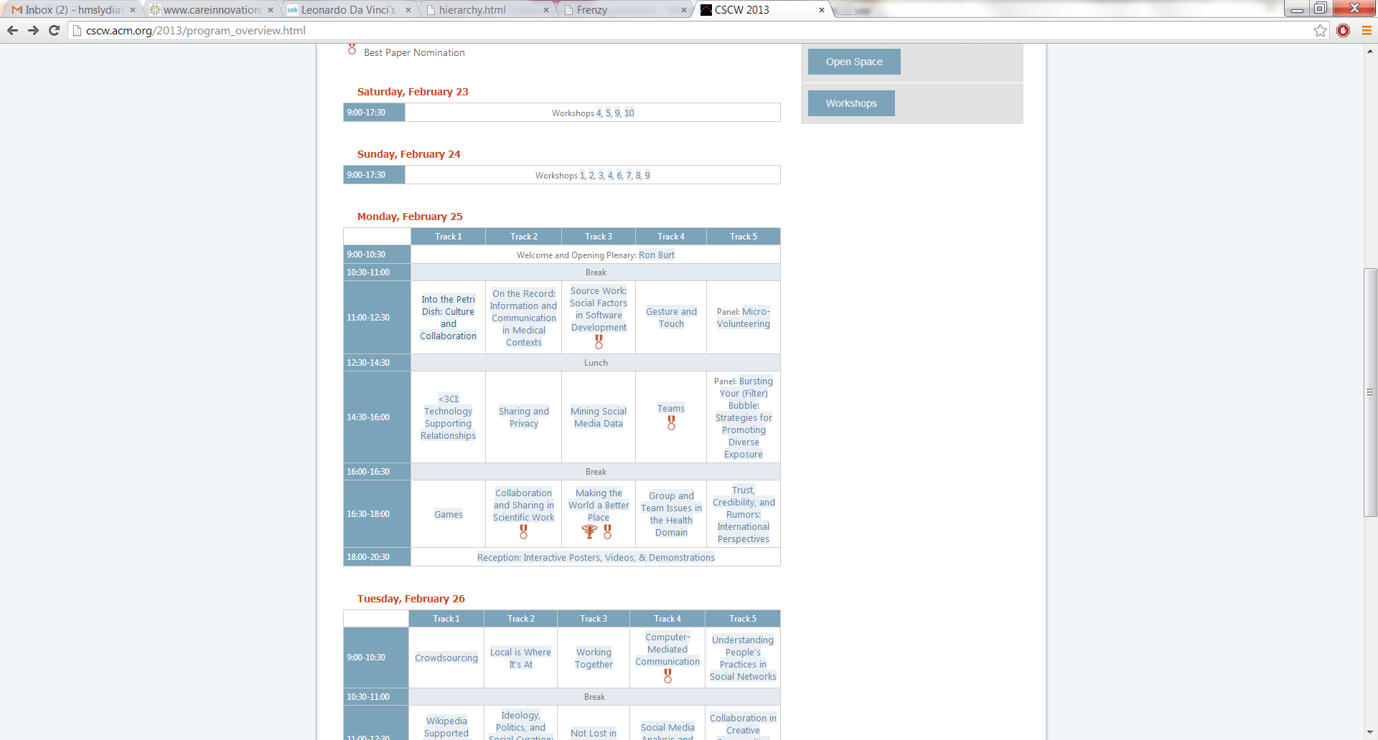
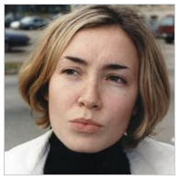
Adaptive Crowd Algorithms
1
TurKit
Problems too hard for one person
2
Cascade
Problems too big for one person
3
Frenzy
Problems too ill-defined to automate
4
HumorTools
Problems that require creativity
Notes:
I introduced Adaptive Crowd Algorithms.
I’m going to talk about four systems I built that demonstrate this technique to solve problem that are:
Too hard for one person
Too big for one person
Too ill-defined to automate
And that require creativity.

Slide 10
TurKit
Coordinates people to solve hard problems such as deciphering messy handwriting
Greg Little, Lydia B. Chilton, Max Goldman, Robert C. Miller. TurKit: Human Computation Algorithms on Mechanical Turk. UIST 2010.
Notes:
TurKit coordinates people to collectively solve problems like deciphering messy handwriting.

Slide 11
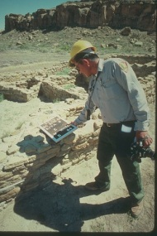
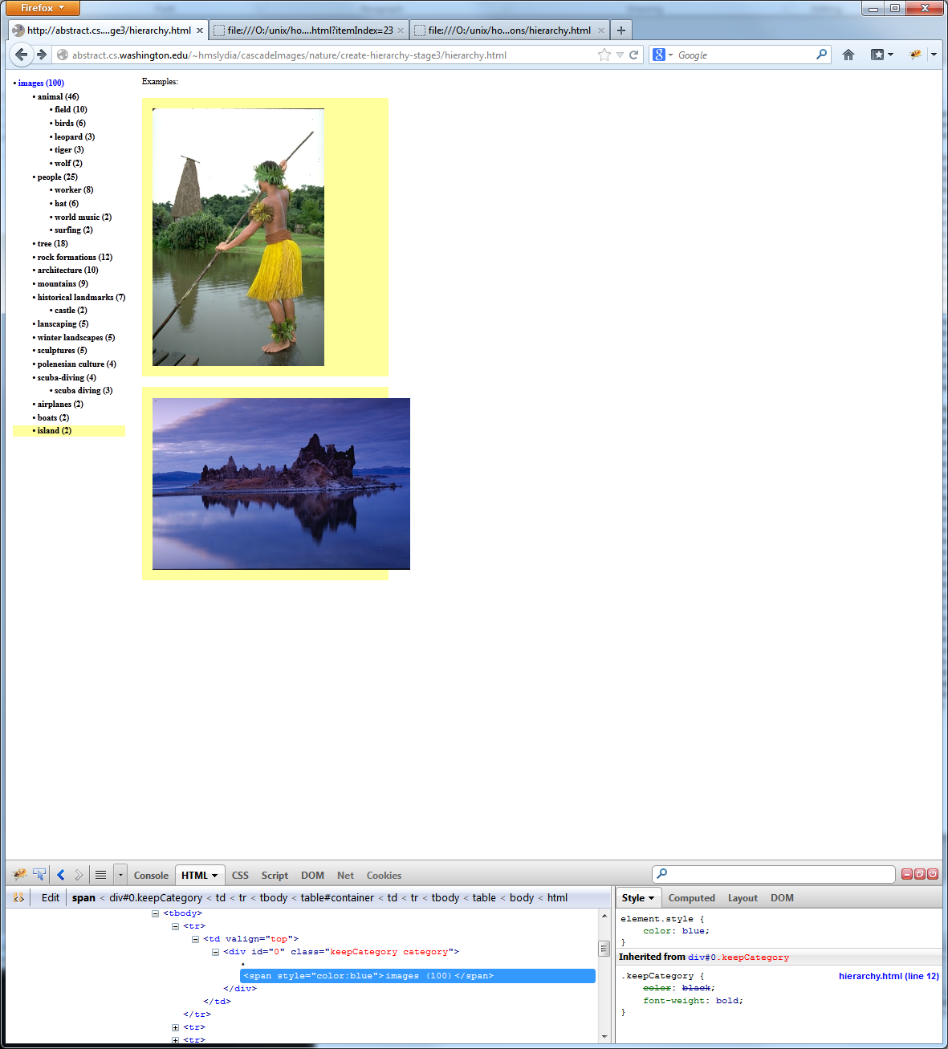
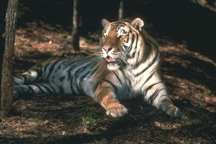
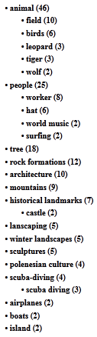
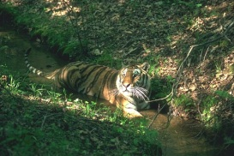
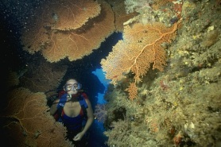
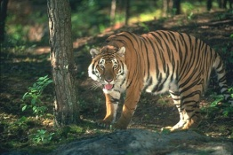
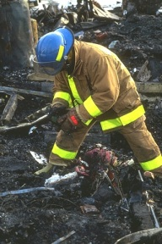
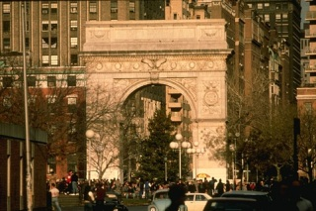
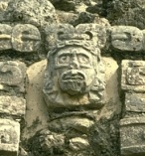
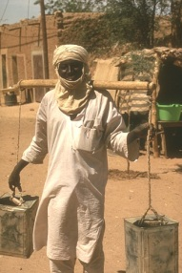
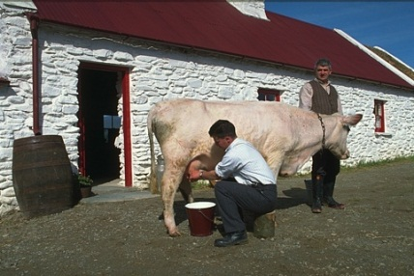
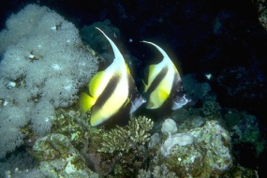
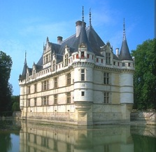
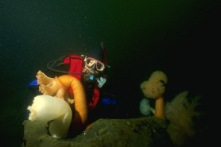
Cascade
Distributes big problems with complex interdependencies such as creating taxonomies
Lydia B. Chilton, et al.
Cascade: Crowdsourcing Taxonomy Creation. CHI 2013.
Notes:
Cascade distributes big problems with complex interdependencies like creating taxonomies

Slide 12
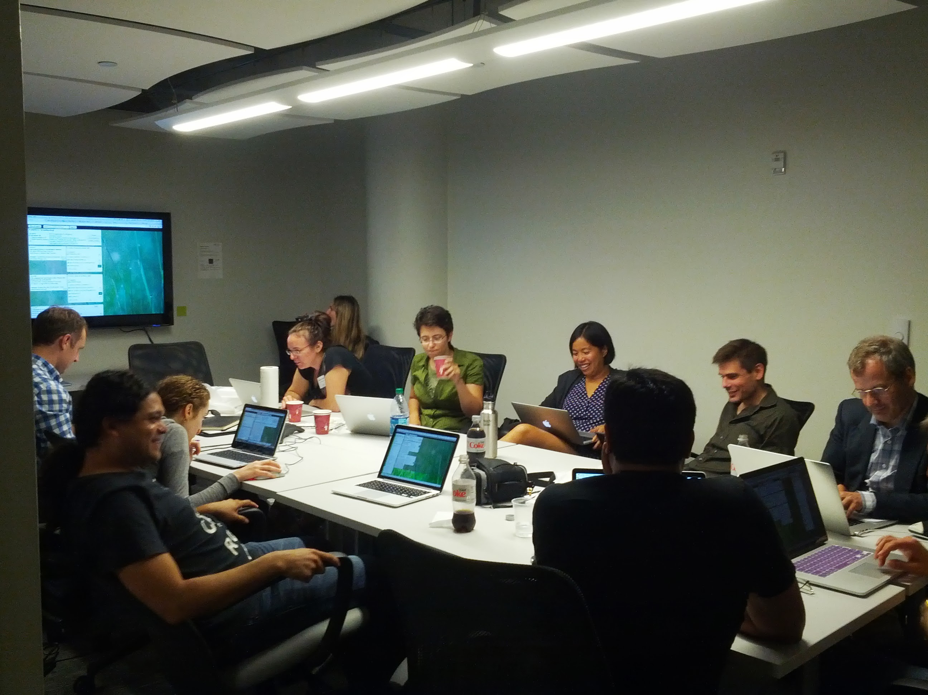
Frenzy
Combines the knowledge of many experts to meet a global constraint such as creating conference sessions
Lydia B. Chilton, et al. Frenzy: collaborative data organization for creating conference sessions. CHI 2014.
Notes:
Frenzy combines the knowledge of experts to meet a global constraint like
Grouping papers into conference sessions.

Slide 13
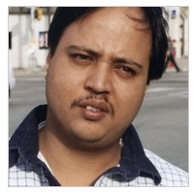
HumorTools
Decomposes creative tasks such as generating humor
?
Notes:
My ongoing and future work is to decompose creative tasks such as generating humor.

Slide 14
We can systematically solve
open-ended problems by
combining human and machine abilities
with adaptive crowd algorithms.
Notes:
Altogether, I show that…

Slide 15
Outline
1
TurKit
Problems too hard for one person
2
Cascade
Problems too big for one person
3
Frenzy
Problems too ill-defined to automate
4
HumorTools
Problems that require creativity
Notes:
Let me first talk about TurKit.

Slide 16
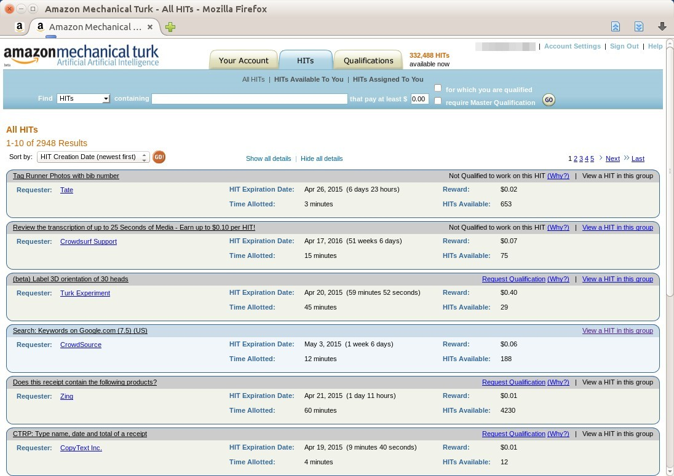
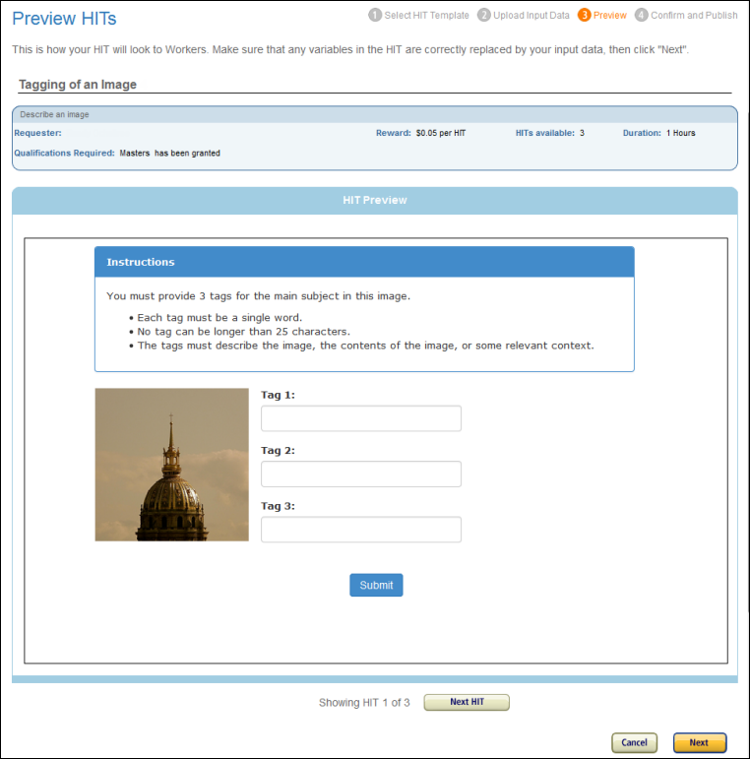
Microtask Crowdsourcing
Notes:
Crowdsourcing was invented to use people for tasks that computer can’t do like labeling images.

Slide 17
Microtasks were Parallel
Notes:
Mechanical Turk is a platform where you can pay people a few cents to do a simple task.
Turk quickly became very popular,
But for a long time, Turk was only used to do embarrassingly parallel tasks like image labeling.
So I asked:
Can we do more complex things?

Slide 18
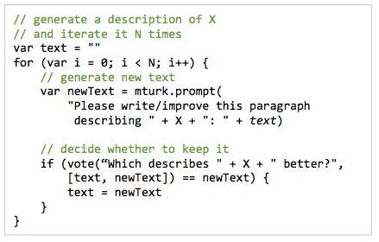

TurKit: Crowd Algorithms
Notes:
But my coauthor and I built a system called TurKit.
which introduced the concept of Crowd Algorithms.
You can write JavaScript programs that makes function calls to the crowd.

Slide 19
People are unpredictable
fish
ocean
tiger
tiger
animal
tiger
animal
fish
ocean
tiger
animal
animal
fish
ocean
fish
tiger
ocean
animal
fish
fish
ocean
tiger
animal
ocean
Notes:
However, for complex algorithms, with many layers of human input,
There is the challenge that people are unpredictable.

Slide 20


Errors Propagate
fish
ocean
tiger
animal
Crowd algorithms need mechanisms for workers to apply their adaptive thinking skills
SPAM
SPAM
animal
fish
ocean
tiger
animal
animal
fish
ocean
fish
tiger
ocean
animal
fish
fish
ocean
tiger
animal
ocean
Notes:
They don’t always do what you expect them to do
And errors propagate.
Crowd Algorithms need mechanisms for workers to applyg their adaptive thinking skills

Slide 21
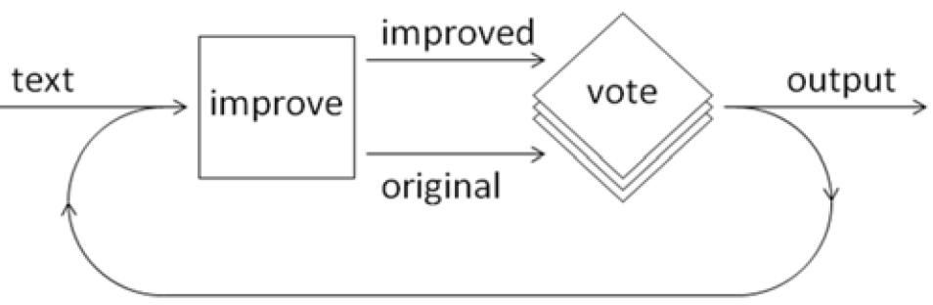
Adaptive Mechanism:
Improve-and-Vote
initial
artifact
improved
output
improve
vote
original
Notes:
The most basic adaptive mechanism is improve-and-vote.
Which allows workers to build on the work of others.

Slide 22
Problems too hard for one person
You (misspelled) (several) (words). Please spellcheck your work next time.
I also notice a few grammatical mistakes. Overall your writing style is a bit too phoney. You do make some good (points), but they get lost amidst the (writing). (signature)
Notes:
For example,
Here is some messy handwriting. No one person could read it.
I can’t even read it!
Using improve and vote, the crowd could decipher it.
Here’s how it works…

Slide 23
Improve-and-Vote Builds on
Contextual Clues from Other Workers
You (misspelled) (several) (words).
improved
initial
artifact
You (?) (?) (?) (work).
output
improve
vote
original
(?) (?) (?) (?) (?).
You (?) (?) (?) (work).
Notes:
It starts with the image,
At first we have no idea what it say, so we start with question marks
Then we ask a worker to improve it, and they get parts of the answer, but other parts are wrong.
Then we vote on which version is better.
Usually the improved version is better, but not always. Sometimes you get spam, or just really weird interpretations.
You take the version workers voted for, and you improve it again, until you get it all deciphered.
This little portion says “You misspelled several words…” and goes on.

Slide 24
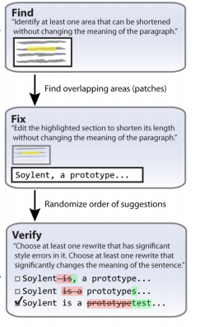
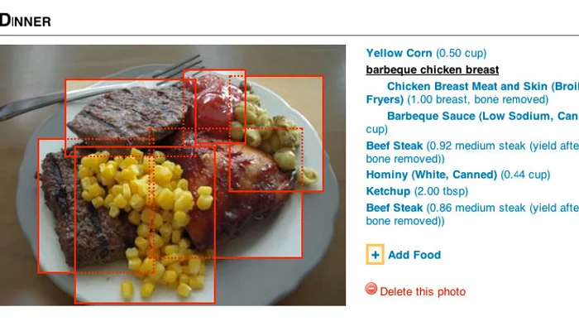
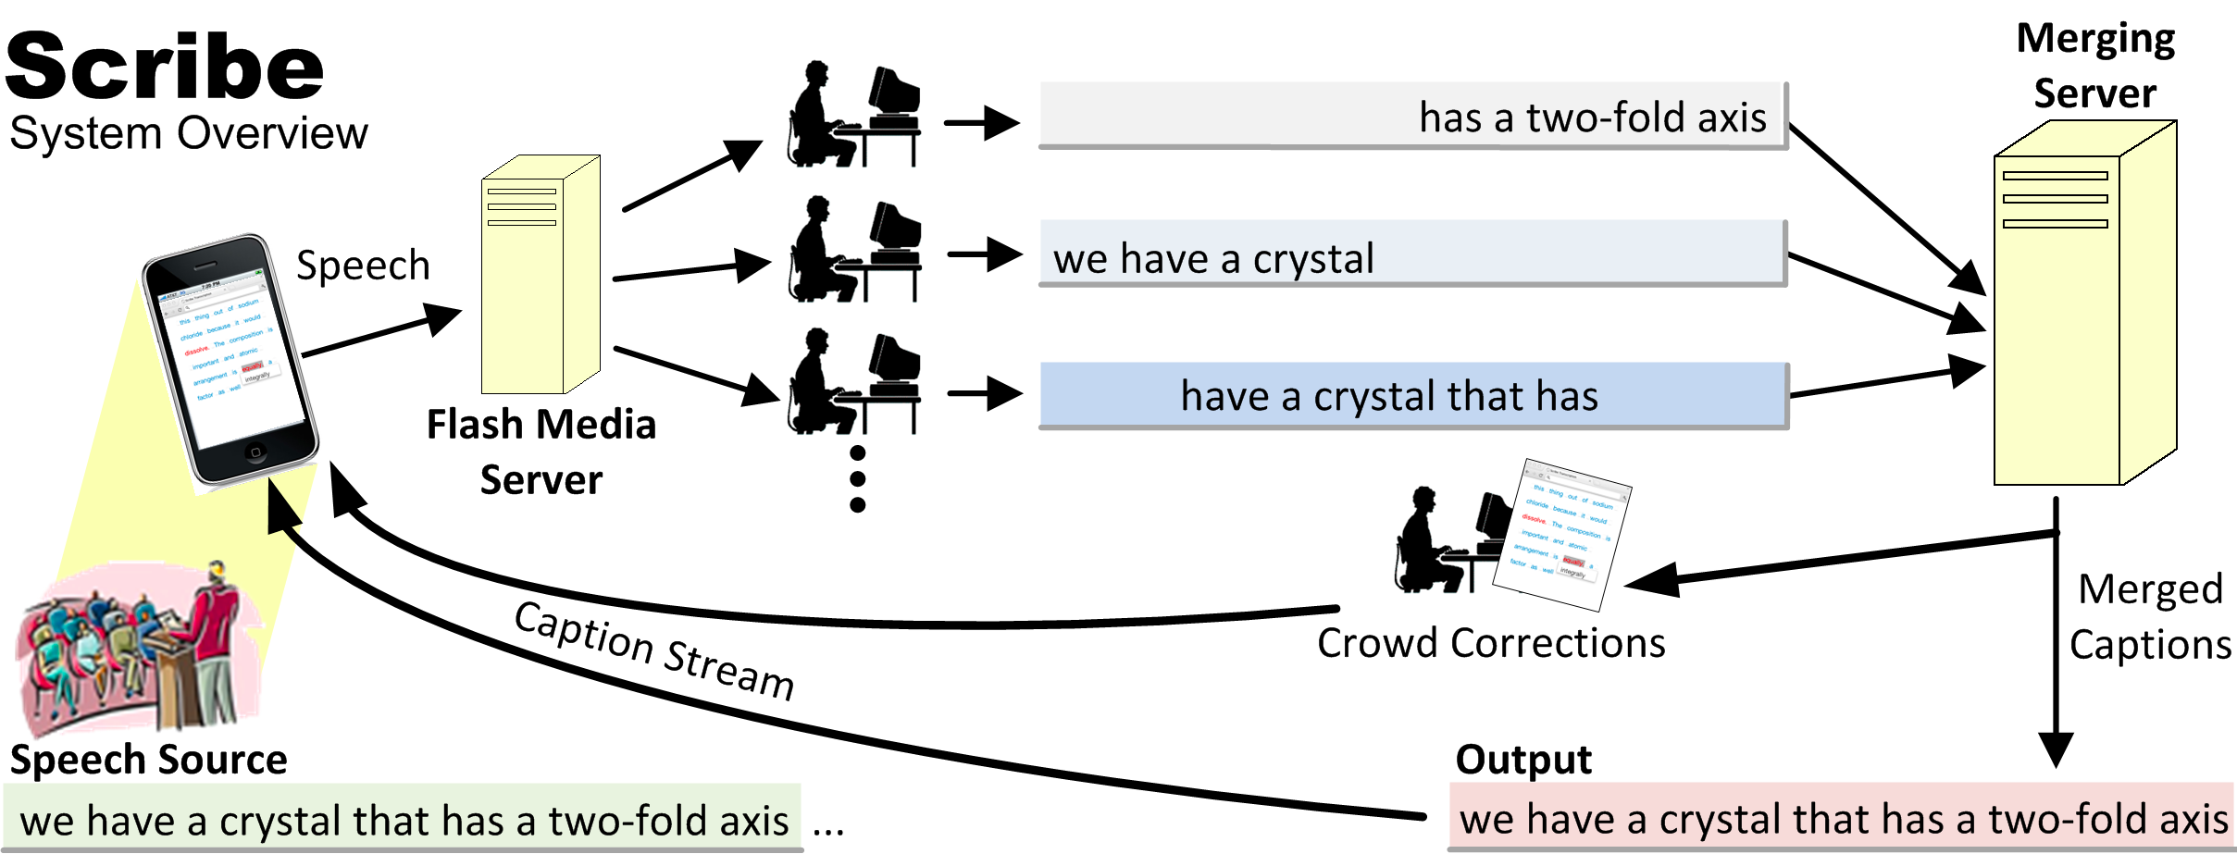
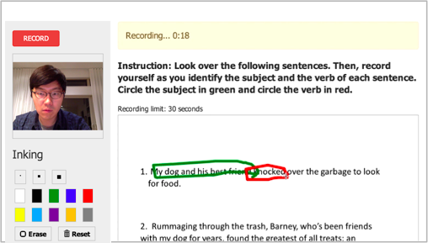
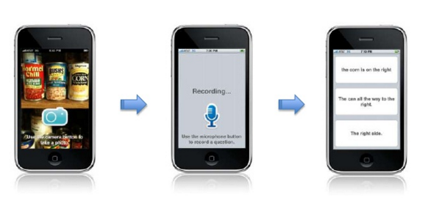
Other Crowd Algorithms
Legion
VizWiz
Seaweed
Adrenaline
…
PlateMate
…
MTurk
TurKit
Soylent
Crowdy
TurKontrol
Deluge
Cascade
Frenzy
…
Notes:
TurKit was widely adopted in research.
Systems I built are in red, but other people used TurKit and built crowd-powered systems, too.
Notably, Michael Bernstein at Stanford and
Jeff Bigham at CMU built their first crowd systems in TurKit.

Slide 25
Challenge:
Distributing problems
too big for one person
Notes:
The next challenge I undertook was distributing a task too big for one person.

Slide 26
Outline
1
TurKit
Problems too hard for one person
2
Cascade
Problems too big for one person
3
Frenzy
Problems too ill-defined to automate
4
HumorTools
Problems that require creativity
Notes:
Cascade is the name of that system.

Slide 27
Crowdsourcing Taxonomy Creation
Notes:
Cascade crowdsources taxonomy creation.
From a pile of images
Cascade find the structure and organization
The tigers under animals
Workers under people
And historical landmarks is a top level category.

Slide 28
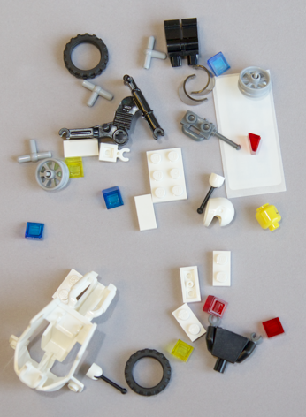
Taxonomies are a Powerful Tool
People parts
Colored 1x1’s
Wheel parts
Motorcycle parts
Notes:
Taxonomies are a powerful tool
When I jumble up these Lego pieces, it’s hard to make heads of tails of it..
But when I organize them,
the answer kinda leaps out at you.

Slide 29
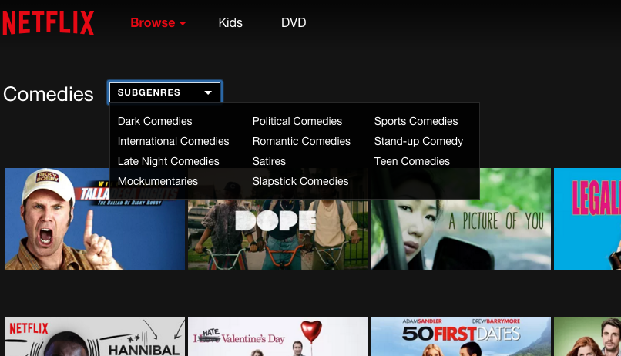
Taxonomies Support Decision Making
Notes:
Taxonomies are used by almost every company to help support decision making.
To figure out what movie you’re in the mood for.

Slide 30
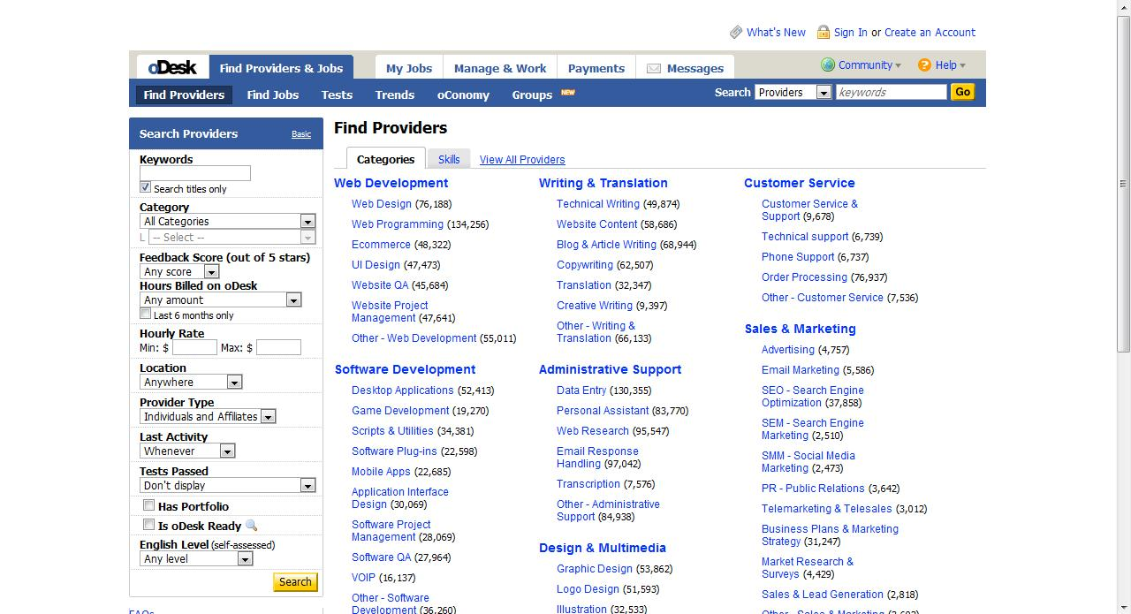
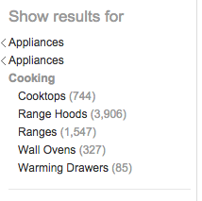
Taxonomies Support Decision Making
What products to buy?
What job to take?
Notes:
What products to buy
What jobs to take online

Slide 31
Creating Taxonomies is Overwhelming for One Person
Can we crowdsource
taxonomy creation?
Notes:
Taxonomies involve synthesizes hundreds of pieces of information.
This quickly becomes overwhelming for a single person.
There is so much data, and complex interdependencies
So can we crowdsourcing taxonomy creation?

Slide 32
Crowdsourcing Taxonomies is Hard
A good taxonomy requires a global perspective
But each worker sees a tiny fraction of data (a local view of the data)
Global-from-local
Notes:
Crowdsourcing taxonomies is hard.
A good taxonomy requires a global perspective
But each work sees a tiny fraction of data (a local view)
We call this type of challenge is called global-from-local.

Slide 33

Cascade
Crowdsourcing Taxonomy Creation
Lydia B. Chilton, Greg Little, Darren Edge, Daniel S. Weld, and James A. Landay.
Cascade: Crowdsourcing Taxonomy Creation. CHI 2013.
Notes:
I introduce Cascade for crowdsourced taxonomy creation.
Cascade works for many types of data.

Slide 34
Image Data Sets
Notes:
Image data

Slide 35
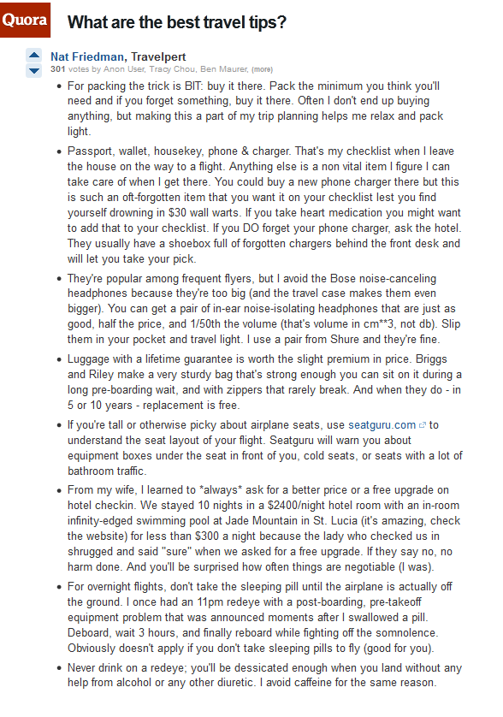
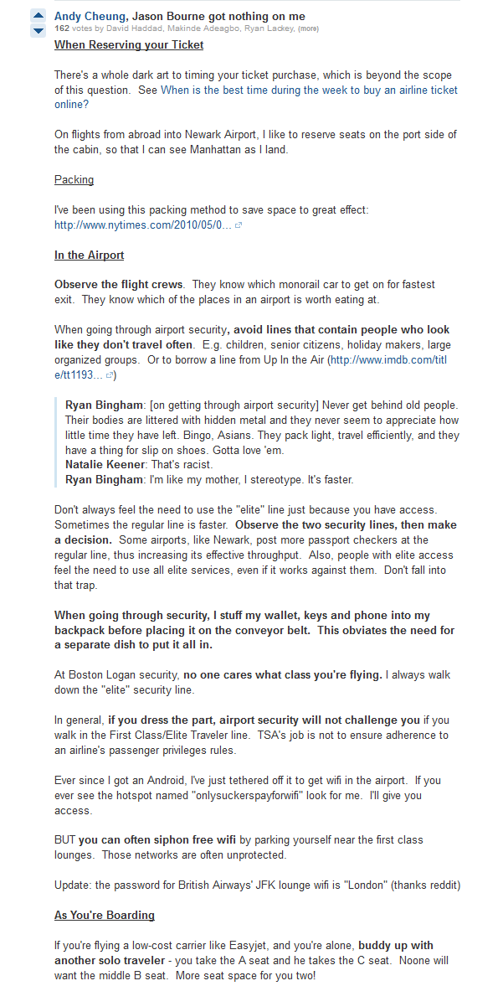
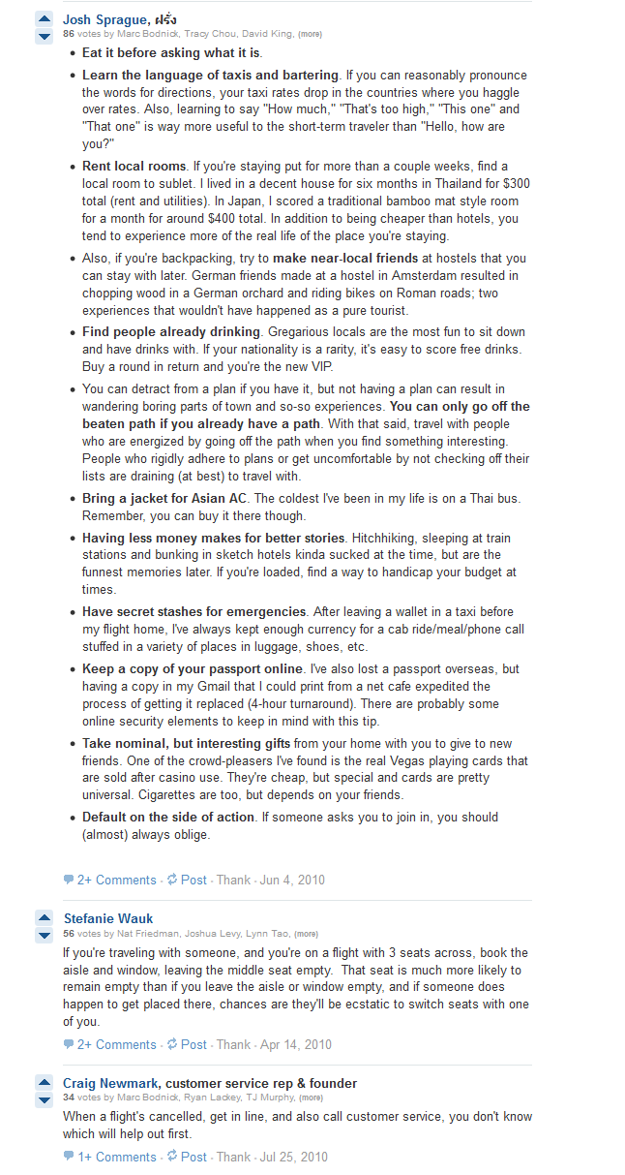
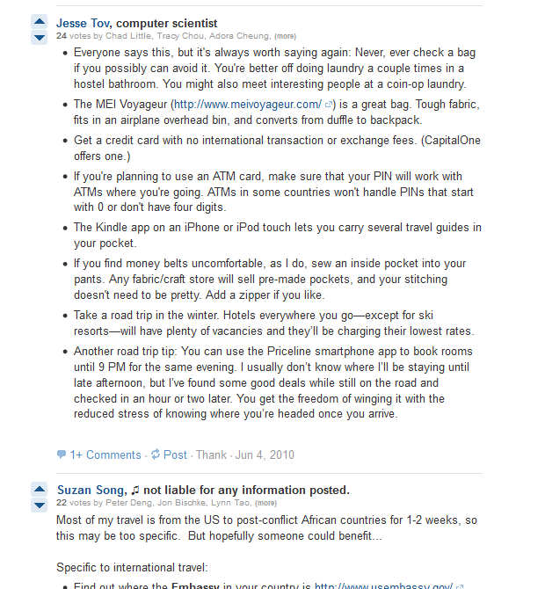
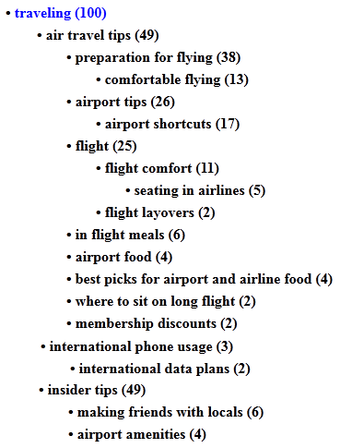
Q&A Site Responses
Notes:
Text like travel tips from a Quora.

Slide 36
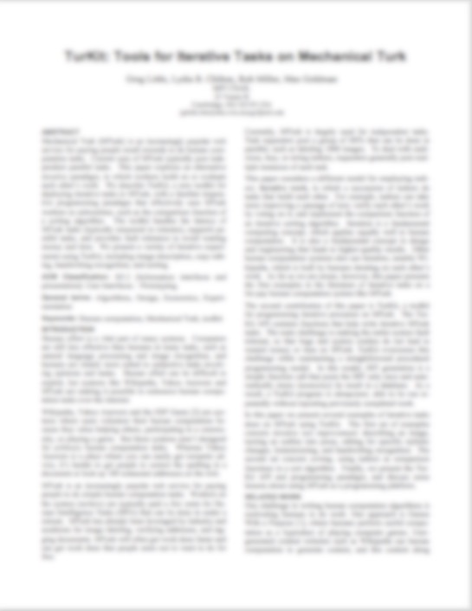
Conference Papers
Visualization (19)
  evaluating infovis (9)
    text (2)
  video (6)
  visualizing time data (5)
  gaze (4)
    gaze tracking (3)
  user requirements (3)
  color schemes (2)
Notes:
Conference papers

Slide 37

People have the Context Needed for Taxonomies
Images
    “historical landmark”
      Not just “stone” or “aztec”
Travel tips
    “finding flights”
    “saving money”
“use kayak.com”
Notes:
Creating a taxonomy requires people because.
People have that context needed to create meaningful categories.
For example, you could literally label this image as “stone” or “aztec”
But conceptually, it’s also a “historical landmark.”
Similarly, one of the travel tips was “use Kayak”
The text doesn’t say much, but people have additional context about kayak
and know that is related to “finding flights” and “saving money”.
We need people’s contextual knowledge to create taxonomies.

Slide 38
Initial Prototypes of Cascade
Notes:
I want to show two approaches to this problem that failed.

Slide 39
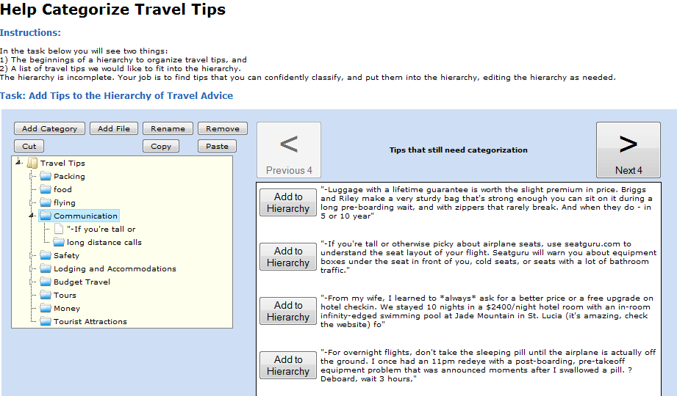

Approach 1: Improve-and-Vote
Lesson:
Break up the task more
Problems
The hierarchy grows and becomes overwhelming
Workers spend a long time deciding what to do
Notes:
The first approach was to use the improve-and-vote algorithm from TurKit.
Workers iteratively build up the taxonomy by adding one item at a time and reshuffling categories as needed.
But this had a problem.

Slide 40

Approach 2: Comparing Categories
Suggested Categories:
“Airport security”
“Airport security info
“Security”
“Flying”
“Flights”
“Packing”
“What to bring”
“Saving money”
“Savings”
Lesson:
Avoid assumptions.
Make judgments about data,
not abstractions
Problem
Categories are similar but not redundant:
flying vs. flights
packing vs. what to bring
People make different assumptions about abstractions like categories.
Notes:
Then I took a different approach.
We can get a bunch of suggested categories,
Then figure out how to merge them all together
By comparing the categories and getting rid of redundant ones
But this also had a problem:
A lot of the categories are very similar but not redundant, like “flying” and “flight”.
Are those the same or different? We don’t know. They’re abstract categories.
People make different assumptions about abstractions like categories, and we don’t reach consensus
Lesson: Avoid assumptions. Make judgments about data, Not abstractions.

Slide 41
The Cascade Algorithm
Notes:
So now let me tell you about Cascade

Slide 42
Toy Application: Colors
Notes:
I will illustrate Cascade in the toy example of colors.

Slide 43



Adaptive Mechanism:
Recursive Generate-and-Test
Use people to:
1. Generate categories locally
green
2. Test categories globally
Green?
Use machines to:
3. Infer tree structure
4. Recurse
Notes:
Use people to generate categories locally.
Look at one item an suggest a category
Test the categories globally by
Asking people whether suggested categories fit other items in the data
Use a machine to infer tree structure
Decide where to recurse.

Slide 44
Input: 100 Random Colors

Slide 45
Step 1. Generate Categories
For each color
Task
Crowd Responses
What category do you suggest for this color?
aqua
pastel
lime
green
greenish
Light green
greenish
This generates initial set of category names

Slide 46
Step 2. Select Best Categories
For each color
Task
Crowd Responses
What is the best category for this color?
Category | Votes
Aqua | 1/5
Greenish | 4/5
Lime | 0/5
Pastel | 0/5
Category
Aqua
Greenish
Lime
Pastel
Best?
x
This filters out spam and
vague category names early

Slide 47
Step 3. Categorize
For each color
and category
Task
Crowd Responses
What categories does this belong to?
Category | Votes
Green | 4/5
Greenish | 5/5
Yellow | 1/5
Pink | 0/5
Categories
Green
Greenish
Yellow
Pink
Category
Green
Greenish
Yellow
Pink
Fits
Doesn’t Fit
x
x
x
x
This determines category membership

Slide 48
Step 4. Machine Step
Blue
Light Blue
Green
Greenish
Red
Gold
redundant
Green
Blue:
  Light Blue:
Green:
Other:
nested
Blue
Light Blue
singletons

Slide 49
Recursively Running Cascade
Blue:
  Light Blue:
Green:
Other:

Slide 50
Recursively Running Cascade
Blue:
  Light Blue:
Green:
Other:

Slide 51
Recursively Running Cascade
Blue:
  Light Blue:
Green:
Other:
Notes:
Now we recurse in two ways:
First, take the categories that are now too big and recurse into them, but rerunning cascade

Slide 52
Recursively Running Cascade
Blue:
  Light Blue:
Green:
Olive:
Light Green:

Slide 53
Recursively Running Cascade
Blue:
  Light Blue:
Green:
Olive:
Light Green:
Purple:
Pink:
Brown:
Yellow:
Other:

Slide 54
Cascade Results: 100 Colors
Notes:
With the final result looking like this:

Slide 55
Cascade Evaluation
Notes:
Cascade Evaluation

Slide 56

Cascade Performance
4 min
Notes:
In terms of performance,
Cascade is highly distributed and runs quickly.
Each microtask takes less than 30 seconds.
For each type of microtask all the items can be run in parallel.
If you can get a crowd big enough to take all the tasks,
Cascade will run in 4 minutes (wall-clock time).
Obviously, lots of person-hours are going into this, but it is parallelized.

Slide 57
Cascade Quality Evaluation
Is the taxonomy structurally correct?
Do experts agree with Cascade categories?
Notes:
Next, we’ll look at the quality evaluation.
There are two ways I evaluated the quality of Cascade

Slide 58
Cascade Quality Evaluation
3 data sets from Quora.com
Topic | # tips
Tips for editing your own writing | 22
Tips for working on side projects after work | 67
Travel tips | 100
Notes:
Cascade was evaluated on three datasets from Quora.com

Slide 59
Cascade Evaluation:
Structural Correctness
Structural Correctness
Unique categories
Correct nesting
Notes:
First, Structural correctness
We are evaluating two things;
Unique categories and correct nesting
For example, in Travel Tips
Flight comfort is correctly nested under flight.
But it’s unclear why membership discounts is under air travel, so that’s an incorrect nesting.

Slide 60
80% Structural Correctness
80%

Slide 61
Cascade vs. Experts
3 data sets from Quora.com
Ground truth:
4 expert information architects created taxonomies for the data sets
Topic | # tips
Tips for editing your own writing | 22
Tips for working on side projects after work | 67
Travel tips | 100
Notes:
Next, I compared Cascade categories to expert categories.
I hired 4 expert information architects to create taxonomies for the data sets

Slide 62



Taxonomies are Open-Ended
Expert1 Taxonomy
Expert2 Taxonomy
Cascade Taxonomy
Notes:
Taxonomies are Open-Ended
Not even the experts agreed with themselves.
Here are two expert taxonomies and they have different length, different levels of nesting

Slide 63
Experts Agreement Rate with Experts
55%

Slide 64
Cascade Achieves 90% of
Agreement Rate Between Experts
50%
55%

Slide 65
Notes:
Intuitively, the outputs tend to look good.
Cascade finds the major themes organizing, and makes useful nestings

Slide 66

Cascade Summary
Microtasks for labeling and categorizing
Algorithm to recursively generate-and-test
Notes:
To summarize, Cascade used…
PAUSE
Cascade creates taxonomies with anonymous crowds.
But there are other forms of data organization needed within a company or community.
That require expert knowledge…

Slide 67

Creating an Album of Wedding Photos
Notes:
For example, creating a wedding album is a type of data organization.
And it requires expert knowledge to do the work.
To the the crowd, this may look like a sweet family photo.
But the bride knows this is really her creepy Uncle Paul, and there’s no way she wants him in her wedding album.

Slide 68

30% External Knowledge
(Verbalized)
Tacit Knowledge Makes Tasks Ill-Defined
70% Tacit Knowledge
(Not-Yet-Verbalized)
Notes:
This is an example of tacit knowledge.
Rules that are very important, but are never written down.
But experts know them when they see them.
The prevalence of tacit knowledge makes many data organization ill-defined.
We have to adapt to new constraints as they come up.

Slide 69
Challenge:
Use expert knowledge when data organization tasks are ill-defined

Slide 70
Outline
1
TurKit
Problems too hard for one person
2
Cascade
Problems too big for one person
3
Frenzy
Problems too ill-defined to automate
4
HumorTools
Problems that require creativity
Notes:
To solve this, I introduce Frenzy

Slide 71

Frenzy:
Social Data Organization for Experts
Notes:
Frenzy is a website that enables social approach to
data organization for experts

Slide 72



Expert Data Organization
Photos
Feedback
Hackathon teams
Conference sessions
Notes:
Frenzy has been used for many applications:
Organizing photos
finding themes in feedback (from a practice talk.)
Picking hackathon teams
Grouping papers into session at conferences

Slide 73
Creating Conference Sessions
Notes:
In fact, I was asked to use Frenzy to help the conference organizers at the two largest conferences in HCI
Take hundreds of accepted papers, and to group papers into sessions.

Slide 74
Creating Conference Sessions
Four papers per session
Unique names
431 papers at CHI 2014
136 papers at CSCW 2013
Notes:
Session have a hard constraint – papers must be grouped into session of four, and each session needs a unique name.
HCI conferences are larger than most: hundreds of accepted papers, which makes this is an overwhelming problem.
Frenzy was deployed at CSCW and CHI.
CSCW is where I evaluated Frenzy.

Slide 75
Session Creation is Governed by Tacit Knowledge
External Knowledge
“Collaborative Crowdsourcing” (4)
Aniket Kittur
HCII CMU
Pittsburgh, PA
nkittur@cs.cmu.edu
Tacit Knowledge
75
Notes:
Session Creation governed by tacit knowledge.
For example, there were 4 papers that would make a great session
But, they all have the same author.
Before this example, nobody bothered to write down this rule.
But now that it’s been identified, we have to adapt.
So to accommodate this tacit knowledge, we have to put experts in control of the workflow.

Slide 76

Previous Session Creation Process
Can we parallelize session creation
but leave experts collectively in control?
6-8 Hours
Notes:
Previously, the process was entirely human-driven.
The PC would get together in a room and shuffle papers around until they created the sessions.
This way the experts are in control and can use their tacit knowledge.
But it takes 6-8 hours.
it hard to parallelize.
So, can we parallelize session creation but leave experts collectively in control?

Slide 77

Frenzy:
Social Data Organization for Experts
  Like Twitter
    All the papers are searchable
    All the tasks are available
    Other people’s work updates in real time
  Experts in control
    No task assignment
    No inference of tree structure
Notes:
Frenzy takes a social approach.
The interface looks and feels like Twitter.

Slide 78
Adaptive Mechanism:
Goals + Scaffolding
Microtasks
Goal 1
Every paper needs
to be in a session
Goal 2
Every session needs
4 papers
Label
Vote
Categorize
Goals are global constraints allow
adaptation to tacit knowledge
Notes:
The adaptive mechanism behind Frenzy is goals and scaffolding.
Frenzy provide the experts with global goals, such as:
Every paper needs to be in a session
Every session needs 4 papers
To help reach this goal, Frenzy provides microtasks experts can do.
Goals are global constraints that allow adaptation to tacit knowledge.
Leaves room for emerging constraints, like “The Niki Kittur sessIon” created

Slide 79

Goals + Scaffolding
  Global view of the data
    Sessions that violate constraints are red.
    Clicking on them directs attention to papers that need work.
Notes:
In the goals section of Frenzy, experts see a global view of the data.
Sessions that violate contstraints are in red.
Clicking on them will search for papers that need work.
Frenzy directs attention without explicitly assigning tasks

Slide 80
Goals + Scaffolding 1
Socially Embedded Microtasks
Single Paper
Microtasks
Label
Vote
Categorize
80
Notes:
To help reach the goal, Frenzy has scaffolding - First
It has microtasks, but they’re socially embedded.
Each item in the feed shows one paper,
And associated microtasks.
These are actually the same microtasks from Cascade,
They look completely different, but they are socially embedded, but they are still
Label, vote, categorize.

Slide 81

Goals + Scaffolding 2
Flare and Focus
Notes:
The overall goal of creating session is too hard, too constrained,
So we add another type of scaffolding: Flare and focus.
Generate many potential categories before meeting the hard constraint.
This is an easier and intermediate step because unlike sessions, categories can be of any size, and can overlap.

Slide 82
Frenzy Evaluation
before
using Frenzy
6-8 hours
88 minutes
Notes:
I evaluated Frenzy at CSCW.
Before, session making took 6-8 hours in wall clock time.
At CSCW, it took only 88 minutes.
The PC chair had to personally vouch for the quality of the sessions, and Frenzy was only over when the PC chair deemed the quality equal to previous years.

Slide 83


60 Experts Collaborating Simultaneously
Notes:
A lot of these gains are coming from parallelization
Frenzy got 60 experts collaborating simultaneously each with their own view of the data, but working towards a common goal.

Slide 84


1
2
3
4
number of actions
time (minutes)
category updated
session updated
category removed
category liked
Notes:
I looked at activity during Frenzy to see
How was that 88 minutes used.
There were 4 stages.

Slide 85
1. Make Obvious Sessions
1
2
3
4
number of actions
time (minutes)
category updated
session updated
category removed
category liked
Notes:
First making obvious sessions from categories

Slide 86
2. Remove Clutter
1
2
3
4
number of actions
time (minutes)
category updated
session updated
category removed
category liked
Notes:
Next removing the useless categories to help focus on the good ones.

Slide 87
3. Adapt to Ill-Defined Constraints
1
2
3
4
number of actions
time (minutes)
category updated
session updated
category removed
category liked
Notes:
Next tacit knowledge came into play.
Experts noticed ill-defined constraints, like “The Niki Kittur session”, broke them apart and found new homes for them.
Sometimes the PC had to talk to each other to make sure they were doing the right thing.

Slide 88
4. Creativity for Misfit Papers
1
2
3
4
number of actions
time (minutes)
category updated
session updated
category removed
category liked
Notes:
Lastly, the PC had to find creative solutions for the misfit papers.
Those last few that don’t really fit anywhere.
The experts were mostly talking to each other, brainstorming new categories, then entering them into frenzy.

Slide 89


Frenzy Summary
Social platform with Cascade microtasks puts experts in control of the workflow
Goals with scaffolding directs experts attention and allows adaptation to tacit knowledge
Single data item
Label
Vote
Categorize
1
2
3
4
Notes:
Frenzy is a social platform that puts experts in control of the workflow
It gets experts to converge on a solution by providing goals with feedback.
This directs attention rather than dictating where to work.
And adapts to tacit knowledge and newly discovered constraints.
But there was this stage that needed creativity that wasn’t very parallelizable…

Slide 90
Challenge:
Can we decompose creativity into microtasks?
Ongoing work
Notes:
The biggest open question in crowdsourcing is how do we decompose creativity into microtasks.
I’m going to present early results from ongoing work.

Slide 91
Outline
1
TurKit
Problems too hard for one person
2
Cascade
Problems too big for one person
3
Frenzy
Problems too ill-defined to automate
4
HumorTools
Problems that require creativity
Notes:
This is the final project I’m going to talk about.

Slide 92



What type of creative artifact should we decompose first?
E = mc²
Notes:
Creativity takes on many forms – art, science, literature, and humor.
PAUSE
If we are going decompose the creation of a creative artifact,
we should select a domain where we can most easily experiment with it.
So what type of creative artifcat should we decompose first?

Slide 93
Humor
Notes:
I chose humor.
This is strategic.
Let me tell you why.

Slide 94
Properties of Humor
Creative
  Novel - something you’ve never seen before
  Hard - not something you’d obviously think of
Suited for Experimentation
  Short - can iterate on it quickly
  Expert examples to learn from
Notes:
Writing jokes is clearly creative.
Jokes are novel – you’ve never heard it before
Jokes are hard – it’s not something you’d obviously think of
Humor is well-suited to experimentation
Short so we can iterate on it quickly
There are lots of expert examples to learn from

Slide 95
Approach To Decomposing Humor
Examples + Theory
Model + System + Study
Notes:
Humanity has been wondering about humor for over 2,000 years, so I’m obviously not go to start from scratch.
My approach is to mine lots of examples and theories, and build a system that embodies them.
It basically takes descriptive theories and turns them into generative theories.

Slide 96


Examples
American Voices
Input
Friday September 30, 2014
People Bending iPhones At Apple Stores
Output
“I can’t believe people would just walk into an Apple store and start breaking things like it’s a Best Buy.”
Notes:
For examples, I decided to narrow in on one very special form of humor.
It’s made by The Onion, called American Voices.
It takes real news headlines like this one:
“People Bending iPhones At Apple Stores”
And The Onion write fake man-on-the-street style responses:
What’s special about this is that the headline and joke represent input and output pairs that we can study.

Slide 97







Books on humor by philosophers, linguists, comedians
Theory
Associations
Expectation Violation
Notes:
But what are we going to going to analyze these jokes for?
Well, I distilled a lot of books on humor by philosophers, linguists, and comedians, and two ideas kept coming up:
Associations
Expectation Violation.

Slide 98
Satisfying a Constraint by searching a space of associations
Model
Headline
Apple
Best Buy
Best Buy
Broken Displays
Associations
Alternative
Insult
ExpectationViolation
Bait-and-Switch
Unexpected
Angle
Sarcasm
Joke
Notes:
I prototyped a number of different generative models of humor, I settled on this model:
Satisfying a constraint by search a space of associations.
Expectation Violations is a goal. But it’s too hard to hit right off the bat.
So I use associations to search for possible ways to violate expectations.
By looking at examples, I found concrete mechanisms that could be applied. For example,
Apple Store to Best Buy are Alternatives. That’s one type of association
Best Best to Broken Displays is an Insult. That’s a different type of association.
And there are multiple types of expectation violation.
Let me explain each of those.

Slide 99
Expectation Violation #1
People Bending iPhones At Apple Stores
Bait-and-Switch
Bait: Expectation: This is bad.
Switch: Insult: Best Buy sucks.
I can’t believe people would just walk into an Apple store and start breaking things like it’s a Best Buy.
Notes:
In the Best buy joke, it starts my aggressing with your expectation. This is horrible, I can’t believe it.
Then at the last minute, it switches to be a Best Buy insult.
I call this “bait-and-switch”.

Slide 100
Expectation Violation #2
Stephen Hawking: AI Could Spell the End for Mankind
Inspired by the film Transcendence, Stephen Hawking wrote that is a mistake to dismiss the threat of AI.
Unexpected
Angle
Expected Focus: End for Mankind
Unexpected Focus: Transcendence
“So did he think Transcendence was good, or what?”
Notes:
For another example of Violation Mechanisms, here’s a different joke.
The headline is HEALDINE
The Onion writes: “So did he think Transcendence was good, or what?”
You expect the focus to be the end for Mankind, and how horrible that would be.
But instead, the focus is on the movie.

Slide 101
Expectation Violation #3
Mick Jagger Blamed for Brazil’s World Cup Defeat
Sarcasm
“There is absolutely no other explanation.”
Notes:
Lastly is sarcasm. Which hardly needs to be explained.

Slide 102
HumorTools
Adaptive Workflow
Headline
Aspects
Apply microtasks to the headline
Until you can find a way of violating an expectation
Follow your train of thought, until you get stuck, then backtrack
Not yet crowdsourced
But it is decomposed into microtasks
Expected Reactions
Associations
Violation Mechanism
Prototype & Test
Joke
Notes:
I built a system called HumorTools that teaches people the microtasks for creating humor and helps them follow them.
The general guideline is that you
Apply microtasks…
Find a way of violating an expectation
There are a lot of options, so just follow your train of thought until you get stuck, then backtrack.

Slide 103


HumorTools Interface
Justin Bieber was baptized this weekend in an attempt to wash away his sins following a scandal in which the singer appears in videos uses racial slurs
Notes:
Here is what one real user interface looks like:
This asks users to decompose a headline into aspects.
There are 20 of microtasks..
It’s too big to show you all of it.
Instead, let me walk you through an example that illustrates the process.

Slide 104
Headline
Justin Bieber Baptized In NYC Bathtub
Joke
Notes:
We start with the headline
Justin Bieber Basptized in NYC Bathtub

Slide 105
Headline
Justin Bieber Baptized In NYC Bathtub
Headline
Aspects
Justin Bieber
Baptized
Bathtub
Joke
Notes:
We break it into aspects

Slide 106
Headline
Justin Bieber Baptized In NYC Bathtub
Headline
Aspects
Justin Bieber
Baptized
Bathtub
Expected
Reactions
Bad.
His music sucks.
Joke
Notes:
We pick the aspect “Justin Bieber” and start writing our expected reactions.
I expect this is bad. His music sucks, he’s a bad role model.

Slide 107
Headline
Justin Bieber Baptized In NYC Bathtub
Headline
Aspects
Justin Bieber
Baptized
Bathtub
Expected
Reactions
Bad.
His music sucks.
Violation
Mechanism
Joke
Notes:
But I can’t think of a violation mechanism for that.

Slide 108
Headline
Justin Bieber Baptized In NYC Bathtub
Headline
Aspects
Justin Bieber
Baptized
Bathtub
Bad.
His music sucks.
Joke
Notes:
So the I forget that chain of reasoning, and backtrack

Slide 109
Headline
Justin Bieber Baptized In NYC Bathtub
Headline
Aspects
Justin Bieber
Baptized
Bathtub
Bad.
His music sucks.
Associations
Bieber’s PR people
Joke
Notes:
Let’s try an association.
Bieber has PR people who cover up for his stupid behavior.
They’re the ones working hard to make it seem like he’s repentant.

Slide 110
Headline
Justin Bieber Baptized In NYC Bathtub
Headline
Aspects
Justin Bieber
Baptized
Bathtub
Bad.
His music sucks.
Associations
Bieber’s PR people
Unexpected Angle:
Expected Reaction: Bad
Angle: PR people are clever
Angle Reaction: Good.
Violation
Mechanism
Joke
Notes:
Ah! And there’s a violation here!
Although we expect the headline to be bad,
From the perspective of the PR people it’s good

Slide 111
Headline
Justin Bieber Baptized In NYC Bathtub
Headline
Aspects
Justin Bieber
Baptized
Bathtub
Bad.
His music sucks.
Associations
Bieber’s PR people
Unexpected Angle:
Expected Reaction: Bad
Angle: PR people are clever
Angle Reaction: Good.
Violation
Mechanism
Prototype
…
…
Test
…
…
Never let it be said that Bieber’s PR people aren’t bringing new ideas to the table.
Joke
Joke
Notes:
“Never let it be said that Bieber’s PR people aren’t brining new ideas to the table.”

Slide 112
Headline
Justin Bieber Baptized In NYC Bathtub
Headline
Aspects
Justin Bieber
Baptized
Bathtub
Bad.
His music sucks.
Associations
Bieber’s PR people
Unexpected Angle:
Expected Reaction: Bad
Angle: PR people are clever
Angle Reaction: Good.
Violation
Mechanism
Prototype
…
…
Test
…
…
Never let it be said that Bieber’s PR people aren’t bringing new ideas to the table.
Joke
Joke
Notes:
And to get there we followed a train of thought, and did a little backtracking.

Slide 113
Headline
Justin Bieber Baptized In NYC Bathtub
Headline
Aspects
Justin Bieber
Baptized
Bathtub
Bad.
His music sucks.
Bieber’s PR people
Unexpected Angle:
Expected Reaction: Bad
Angle: PR people are clever
Angle Reaction: Good.
…
…
…
…
Joke
Joke
Notes:
We can write multiple jokes this way.

Slide 114
Headline
Justin Bieber Baptized In NYC Bathtub
Headline
Aspects
Justin Bieber
Baptized
Bathtub
Expected
Reactions
Bad.
His music sucks.
Bad.
Dirty, Gross
Bieber’s PR people
Unexpected Angle:
Expected Reaction: Bad
Angle: PR people are clever
Angle Reaction: Good.
…
…
…
…
Joke
Joke
Notes:
If we start with Bathtub, we expect that to be dirty and gross

Slide 115
Headline
Justin Bieber Baptized In NYC Bathtub
Headline
Aspects
Justin Bieber
Baptized
Bathtub
Expected
Reactions
Bad.
His music sucks.
Bad.
Dirty, Gross
Bieber’s PR people
Unexpected Angle:
Expected Reaction: Bad
Angle: PR people are clever
Angle Reaction: Good.
Unexpected Angle:
A Bieber fan who’d
worship his dirty
bathtub
Violation
Mechanism
…
…
…
…
Joke
Joke
Notes:
But to a fan, that they’d worship him anyway.

Slide 116
Headline
Justin Bieber Baptized In NYC Bathtub
Headline
Aspects
Justin Bieber
Baptized
Bathtub
Expected
Reactions
Bad.
His music sucks.
Bad.
Dirty, Gross
Bieber’s PR people
Unexpected Angle:
Expected Reaction: Bad
Angle: PR people are clever
Angle Reaction: Good.
Unexpected Angle:
A Bieber fan who’d
worship his dirty
bathtub
Violation
Mechanism
Prototype
…
…
…
…
…
…
Test
…
Joke
Joke
Notes:
That’s a different unexpected angle joke.

Slide 117
Headline
Justin Bieber Baptized In NYC Bathtub
Headline
Aspects
Justin Bieber
Baptized
Bathtub
Expected
Reactions
Bad.
His music sucks.
Bad.
Dirty, Gross
Bieber’s PR people
Unexpected Angle:
Expected Reaction: Bad
Angle: PR people are clever
Angle Reaction: Good.
Unexpected Angle:
A Bieber fan who’d
worship his dirty
bathtub
Violation
Mechanism
Prototype
…
…
…
…
…
…
Test
…
Joke
Oh my God! Can I lick the tub?
Joke

Slide 118
HumorTools Study
20 users: Stanford undergraduates
Humor novices
60-80 minutes:
  Tutorial on 20 microtasks
  Humor Writing
Write jokes for 3 headlines
Rate jokes against The Onion (21 people)
Notes:
I ran a study on HumorTools using 20 Stanford undergraduates.

Slide 119
HumorTools Study Headlines
PETA Seeks Copyright for Primate
A lawsuit filed by PETA claims that “monkey selfies” snapped by a macaque who stole a photographer’s camera should be considered the legal property of the macaque himself.
Can users synthesize humor?
Liquid Water Found on Mars
NASA revealed Monday that they have found evidence of liquid water on the Mars, pointing to the possibility of life on the red planet.
Notes:
I’m going to read you two headlines from the study.
…
The question is can users synthesize humor for them?

Slide 120
HumorTools Evaluation
75% of participants were able to synthesize humor
25% of the HumorTools jokes were rated funny
Notes:
The evaluation showed that
75% of participatns were able
25% of the jokes were rated funny

Slide 121

PETA Seeks Copyright for Primate
This is why you always get the macaque to sign a release.
This is great news for animal rights.
Now my neighbor can take my dog to court instead of me the next time he deposits some of his “legal property” in their front lawn.
Notes:
Let me read show you some jokes:
For the PETA headline where PETA seeks copyright for primate
Here are two jokes for this headline:
(read)
Both have the look and feel of the Onion, and are amusing.

Slide 122

PETA Seeks Copyright for Primate
This is why you always get the macaque to sign a release.
47% Funny
This is great news for animal rights.
Now my neighbor can take my dog to court instead of me the next time he deposits some of his “legal property” in their front lawn.
HumorTools
62% Funny
Notes:
The first one was actually written by The Onion.
The second was synthesized with HumorTools
Raters found the HumorTools joke funnier than The Onion

Slide 123
Liquid Water Found on Mars
I think it’s more convenient for me to get it from the tap.
In other news, Pluto has been called even less of a planet now.
Sounds refreshing!
Notes:
For the Mars headline where Liquid Water Found on Mars, indicting the strong possibility of life on the red planet.
Here are three jokes for this headline:
(read)
All 3 have the look and feel of the Onion, and are amusing.

Slide 124
Liquid Water Found on Mars
I think it’s more convenient for me to get it from the tap.
HumorTools
45% Funny
In other news, Pluto has been called even less of a planet now.
HumorTools
45% Funny
Sounds refreshing!
15% Funny
Notes:
The first two are humorTools
And “sounds refreshing” is The Onion
Both HumorTools jokes were funnier than The Onion

Slide 125
Future: Continuous Improvement
Theory + Examples
Model + System + Study
Notes:
This is on-going work.
I can continue to improve the system by finding areas of improvement in jokes
and looking for more microtasks and constraints to generate jokes

Slide 126

Grant: Be funnier than the Onion
Notes:
I have a grant to fund myself and 6 students this summer to be funnier than The Onion and release HumorTools

Slide 127
HumorTools Summary:
Decomposing Creativity
Notes:
HumorTools decomposes creativity by posing it as a constraint satisfaction that is satisfied by having people search over conceptual spaces and adapt to the headline.
Not every path works, so we need backtracking when necessary.

Slide 128
Future Work

Slide 129
Crowdsource HumorTools
Headline
Associations
ExpectationViolation
Joke
Notes:
For HumorTools so far, each joke is actually completed by one person.
Distribute the creation of a joke by having people brainstorm associations and build on them.
Or build on the associations of others to see new expectation mechanisms they could lead to.

Slide 130
Automate Some Microtasks
Train ML system with user collected data
Entity extraction
Sentiment analysis
Semantic parsing
Notes:
HumorTools is currently done completely by people, but since each microtask is fairly small, we could start to
Train Machine learning systems with user-collected data, leading to hybrid human-computer joke generation

Slide 131
Extend HumorTools Approach to Other Creative, Open-Ended Domains
Step 1
Synthesize theories
Step 2
Analyze examples for
concrete mechanisms
Apple Stores
Best Buy
Step 3
Identify microtasks that
define the search space
Alternative Thing
Step 4
Define Constraints
Violation Mechanism
Notes:
I want to extend the HumorTools approach to other creative and open-ended domains.
I can follow the same meta-approach: …

Slide 132

New Domain:
Persuasive Argumentation
Notes:
In 1-2 years I will extend this to writing persuasive argumentation.

Slide 133
New Domain:
Persuasive Argumentation
Step 1
Synthesize theories
Rhetoric
Step 2
Analyze Op-Eds for
mechanisms
Metaphor
Step 3
Identify microtasks that define the search space
Find facts to support arguments
Step 4
Define constraints
Thesis Statement
Notes:
The theories come from the long tradition of rhetoric.
I can analyze op-eds for mechanisms like metaphor
Microtasks might be finding facts to support arguments
The the major constraint is to have a thesis that you can support.

Slide 134
Vision:
Answer Social and Scientific Questions
Constraint
Scrape MTurk
Data Set
Research Question
Evaluation Mechanism
How do people search
for work on Mturk?
Use Revealed Preferences
to infer search strategy
Notes:
7-10 years out, I want to tackle the open ended problem of answering social and scientific questions.
I have also done research in Economics.
Research in economics involves 3 things:
A question
A dataset
An evaluation mechanism.
And they all have to work together – that’s the tough constraint that lives in this tiny intersect.

Slide 135
Parallelize Science
Research Question
Data set
Evaluation
Mechanism
Notes:
We don’t have to wait for one person to magically have all three of these come together.
We can parallelize the search.
We mine the literature for questions, datasets, evaluation mechanisms
We use the crowd to conduct a search process over these things. Backtracking when they fail.
Exploring many ideas in parallel.

Slide 136
We can systematically solve
open-ended problems by
combining human and machine abilities
with adaptive crowd algorithms.
Notes:
I am going to continue to push this idea:
{THESIS}

Slide 137
Increasingly Adaptive Mechanisms
1
TurKit
Improve-and-Vote
2
Cascade
Recursive Generate-and-Test
3
Frenzy
Goals with scaffolding
4
HumorTools
Satisfy a constraint by searching a conceptual space
Notes:
I did foundational work on crowd algorithms
I introduced increasingly adaptive algorithmic mechanisms
{READ}

Slide 138
Adaptive Crowd Algorithms
For Open-Ended Problems
1
TurKit
Problems too hard for one person
2
Cascade
Problems too big for one person
3
Frenzy
Problems too ill-defined to automate
4
HumorTools
Problems that require creativity
Lydia Chilton
University of Washington
Notes:
And demonstrated that adaptive crowd algorithms can solve problems that are
hard, big, ill-defined, and require creativity.
You’ve been a great audience,
I’m happy to take your questions!

Slide 139
User Comments
[Associations] helped me think of jokes in a wider conceptual space than I previously had.” (p9)
Before this, I never really knew where to start with joke writing I just kind of sat and thought until I came up with something. (p5)

