Slide 1
Regular Expressions
and
Pattern Matching
The true power of the Multi-State NFA Approach

Slide 2
Overview
The Perl Approach (recursive backtracking) VS The egrep Approach (Thompson Multi-State NFA)
Matching:
  29 Character String, Perl: >60 seconds, Thompson NFA: 20 microseconds
  100 Character String, Perl: 10¹⁵ years, Thompson NFA: < 100 microseconds
“Why doesn't Perl use the Thompson NFA approach?”
  2 Answers:
    “it can”
    “it should”

Slide 3
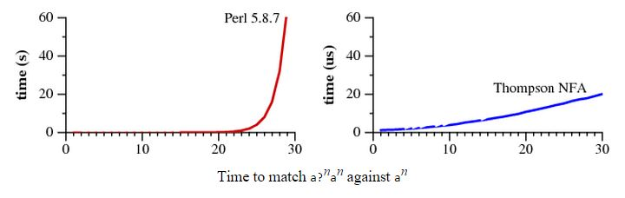
Runtime
Image: Cox

Slide 4
A Brief History of Pattern Matching
“originally developed by theorists as a simple computational model
Michael Rabin and Dana Scott introduced non-deterministic finite automata and the concept of non-determinism in 1959 [7], showing that NFAs can be simulated by (potentially much larger) DFAs in which each DFA state corresponds to a set of NFA states. (They won the Turing Award in 1976 for the introduction of the concept of non-determinism in that paper.)
Ken Thompson introduced them to programmers in his implementation of the text editor QED for CTSS.
Dennis Ritchie followed suit in his own implementation of QED, for GE-TSS
Thompson and Ritchie would go on to create Unix, and they brought regular expressions with them.
By the late 1970s, regular expressions were a key feature of the Unix landscape, in tools such as ed, sed, grep, egrep, awk, and lex
“Thompson chose not to use his algorithm when implementing the text editor ed …. Instead, these venerable Unix tools used recursive backtracking! Backtracking was justifiable because the regular expression syntax was quite limited…. Al Aho's egrep, which first appeared in the Seventh Edition (1979), was the first Unix tool to provide the full regular expression syntax, using a precomputed DFA.”
Notes:
Thompson's paper marked the beginning of a long line of regular expression implementations. Thompson chose not to use his algorithm when implementing the text editor ed, which appeared in First Edition Unix (1971), or in its descendant grep, which first appeared in the Fourth Edition (1973). Instead, these venerable Unix tools used recursive backtracking! Backtracking was justifiable because the regular expression syntax was quite limited: it omitted grouping parentheses and the |, ?, and + operators. Al Aho's egrep, which first appeared in the Seventh Edition (1979), was the first Unix tool to provide the full regular expression syntax, using a precomputed DFA.

Slide 5
Syntax
Characters
  Literals: a, b, c, …
  Metacharacters:
    * (zero or more, possibly different)
    + (one or more)
    ? (zero or one)
    ()
    | for e1 matches s and e2 matches t, e1|e2 matches s or t
    Escape each with backslash to treat as a literal, eg \+
Precedence
  Alternation -> Concatenation -> Repetition (weakest -> strongest binding)

Slide 6
Syntax (cont.)
The previous subset suffices to describe all regular languages: “loosely speaking”
“regular language: a set of strings that can be matched in a single pass through the text using only a fixed amount of memory.
new operators and escape sequences, of Perl and related implementations…
  “These additions make the regular expressions more concise, and sometimes more cryptic, but usually not more powerful: these fancy new regular expressions almost always have longer equivalents using the traditional syntax.”

Slide 7
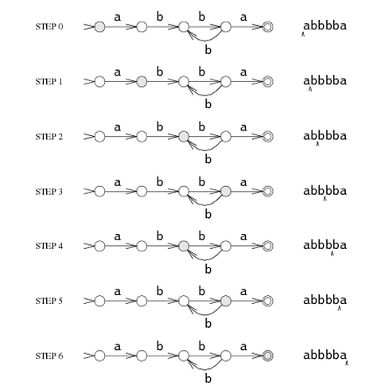


Finite Automata
Regular Expression: a(bb)+a
Sample Input on DFA: abbbba
DFA
NFA
Image: Cox

Slide 8
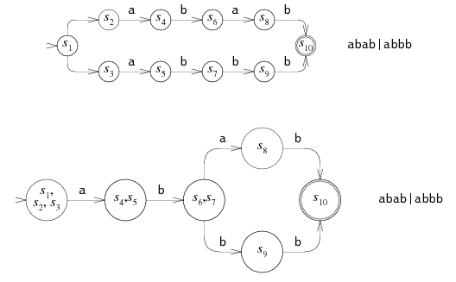
Finite Automata
NFA -> DFA:
Image: Cox

Slide 9


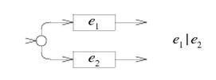



Regular Expression -> NFA
(It has also been proven that an equal DFA can be created to implement the logic of any NFA, and so any Regular Expression)
Image: Cox

Slide 10
The Algorithm
The Multi-State Approach (max n states)
VS
Recursive Backtracking (up to 2^{n} reachable paths)

Slide 11
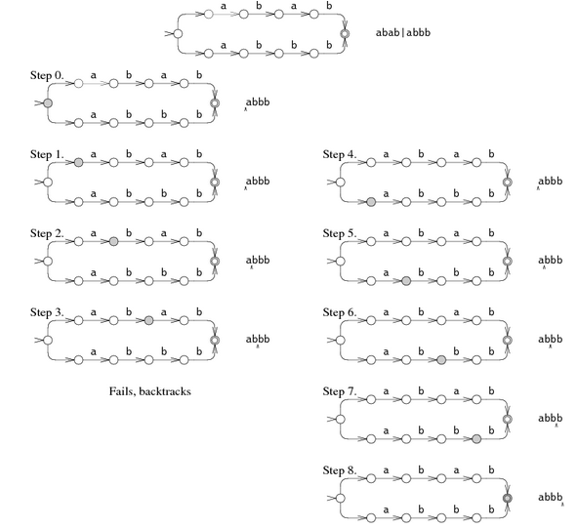
Algorithm (cont.)
Regular Expression: abab|abbb
Sample Input: abbb
Recursive Backtracking
EXPONENTIAL RUNTIME
Image: Cox

Slide 12
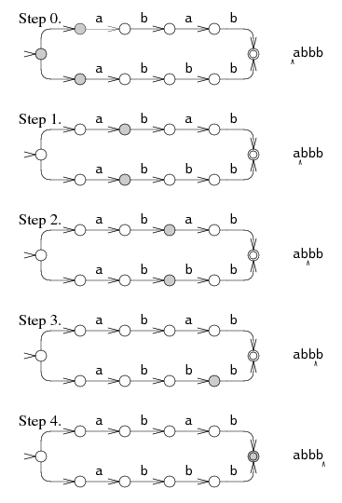
Algorithm (cont.)
Multi-State
LINEAR RUNTIME
Image: Cox

Slide 13
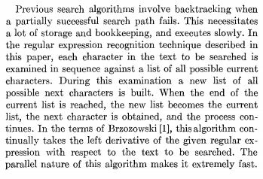
Algorithm (cont.)
Multi-State
LINEAR RUNTIME
From Thompson’s
Regular Expression Search Algorithm Paper:

Slide 14
The Compiler and Implementation
Thompson: Algol
Cox: ANSI C Implementation
Ignoring exact efficiency, both approaches exemplify the linear nature of the multi-state approach

Slide 15
The Compiler and Implementation
example regular expression: a(b | c)*d
Thompson:
3 Stages:
  Sift for only syntactically correct expressions, insert “.” for juxtaposition of regular expressions
  Convert regular expressions to reverse Polish form
    Result of stages 1 and 2: abc | * . d .
  Production of Object Code

Slide 16
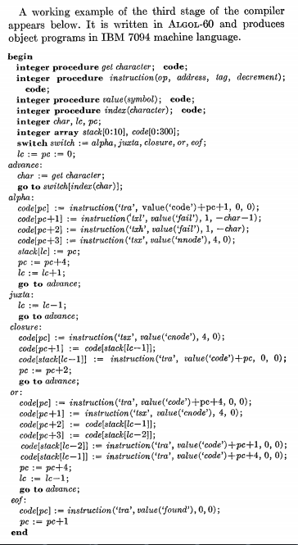
Compiler and Implementation
Thompson:
(STAGE 3)
Notes:
Integer procedure “get character” returns next character from stage 2
Integer procedure “index” returns index to classify the next character
“value” returns location of a named subroutine
“instruction” returns an assembled 7094 instruction

Slide 17
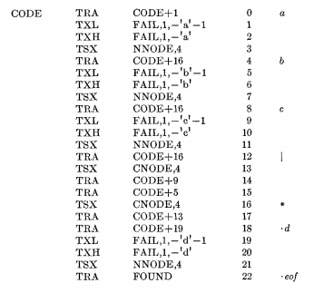
The Compiler and Implementation
example regular expression: a(b | c)*d
Thompson:
Resultant code from receiving the example regular expression:

Slide 18
example regular expression: a(b | c)*d

Slide 19
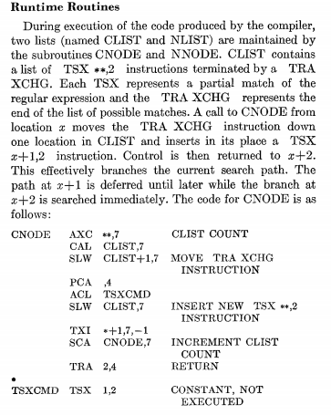
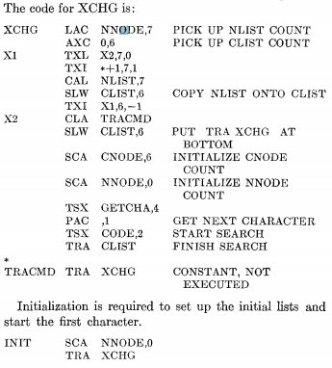
The Compiler and Implementation
example regular expression: a(b | c)*d

Slide 20
The Compiler and Implementation
Cox’s ANSI C Implementation

Slide 21
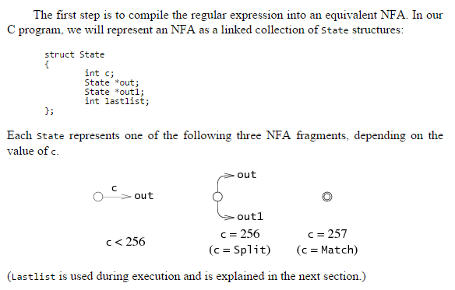
The Compiler and Implementation
Cox:

Slide 22
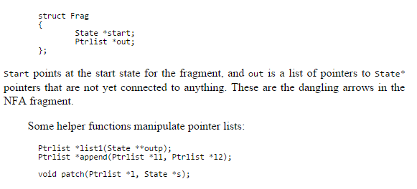
The Compiler and Implementation
Cox:

Slide 23
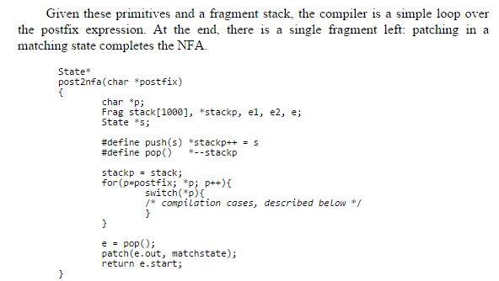
The Compiler and Implementation
Cox:

Slide 24
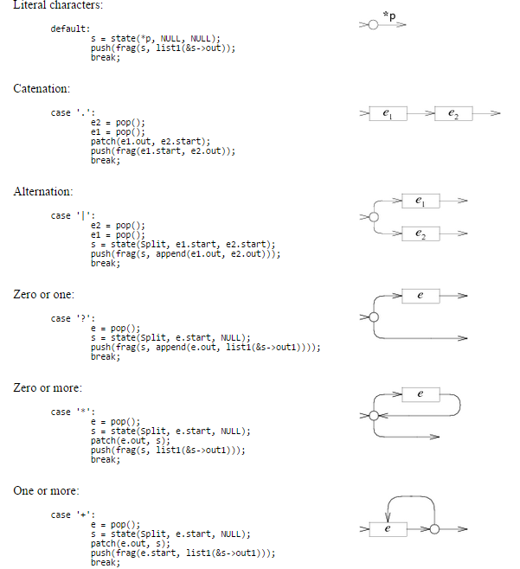
Cox:

Slide 25
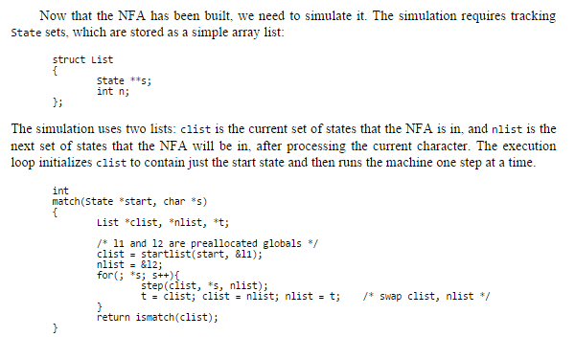
Simulation of the Cox ANSCI C NFA
Cox:

Slide 26
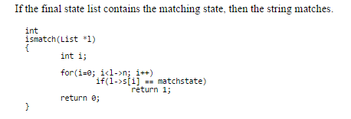
Simulation of the Cox ANSCI C NFA
Cox:

Slide 27
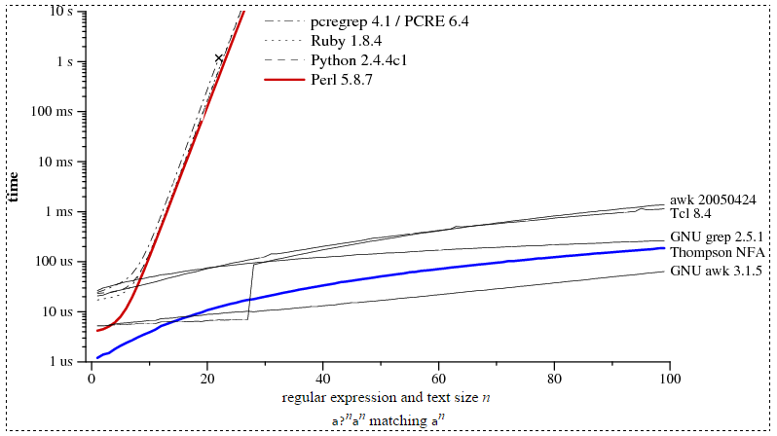
Performance
check whether a?n a n matches a n:
Image: Cox

Slide 28
Why not switch to the multi-state approach?
“Perl, PCRE, Python, Ruby, Java, and many other languages have regular expression implementations based on recursive backtracking that are simple but can be excruciatingly slow.
“As of Perl 5.6, Perl's regular expression engine is said to memoize the recursive backtracking search, which should, at some memory cost, keep the search from taking exponential amounts of time unless backreferences are being used.
“With the exception of backreferences, the features provided by the slow backtracking implementations can be provided by the automata-based implementations at dramatically faster, more consistent speeds.”
        -Cox

Slide 29
Backreferences
“One common regular expression extension that does provide additional power is called backreferences.
A backreference like \1 or \2 matches the string matched by a previous parenthesized expression, and only that string: (cat|dog)\1 matches catcat and dogdog but not catdog nor dogcat.
As far as the theoretical term is concerned, regular expressions with backreferences are not regular expressions.
The power that backreferences add comes at great cost: in the worst case, the best known implementations require exponential search algorithms, like the one Perl uses.
“Perl (and the other languages) could not now remove backreference support, of course, but they could employ much faster algorithms when presented with regular expressions that don't have backreferences, like the ones considered above. This article is about those faster algorithms.”

Slide 30
Conclusion
The multi-state NFA approach to pattern matching is WAY faster than the recursive backtracking approach of Perl and related implementations, and should be adopted to compute pattern-matching on strings that do not include backreferences
Russ Cox:
  “Regular expression matching can be simple and fast, using finite automata-based techniques that have been known for decades. In contrast, Perl, PCRE, Python, Ruby, Java, and many other languages have regular expression implementations based on recursive backtracking that are simple but can be excruciatingly slow. With the exception of backreferences, the features provided by the slow backtracking implementations can be provided by the automata-based implementations at dramatically faster, more consistent speeds.”

Slide 31
References
Cox, Russ. "Regular Expression Matching Can Be Simple And Fast (but Is Slow in Java, Perl, PHP, Python, Ruby, ...)." Regular Expression Matching Can Be Simple And Fast. N.p., n.d. Web. 7 Oct. 2014. <http://swtch.com/~rsc/regexp/regexp1.html>.
Ken Thompson, “Regular expression search algorithm,” Communications of the ACM 11(6) (June 1968), pp. 419–422. http://doi.acm.org/10.1145/363347.363387
Aho, Alfred V., Ravi Sethi, and Jeffrey D. Ullman. Compilers, Principles, Techniques, and Tools. Reading, MA: Addison-Wesley Pub., 1986. Print.

