Slide 1
Owl
_________
/_ ___ \
/@ \/@ \ \
\__/\___/ /
\_\/______/
/ /\\\\\
| |\\\\\\
\ \\\\\\\
\______/\\\\\
_||_||_
A language for finite automata
Team 20
Andrew Olowude
Ben Klingher
Belai Lencho
Kenneth Cheng
Martin Li
Project Manager
Language Guru
System Architect
System Integrator
Verification and Validation
Notes:
Andrew Start: Good afternoon, we are Team 20 *Introductions* We are the creators of Owl, a language for finite automata
Cambria 24 text, 36 Bold header
Courier New
Bullets: >>

Slide 2

What is Owl?
» General purpose programming language with domain-specific functionality for building finite state machines
Notes:
Owl is a gen purp lang with tools that make it easy to build a finite state automata
Many of us were interested in finite state automata from previous courses, and felt that there was little software support for it.
Thus came owl, which makes state machines easy to implement and run, and provides a simple interface between the DFA and the programmer.

Slide 3

Buzz Words
✓ Simple
✓ General Purpose
✓ Domain Specific Tools
✓ Educational
✓ Practical
✓ Automata-Based
Notes:
Andrew End
Simple: Easily recognizable prog constructs without need for semicolons or indentation
G.Purp: Features such as Control Flow, Type Casting but D. Spec Tools embeeded in Owl for manipulating state machines
Educational: DFA's are important in CS theory. Owl lets you conveniently simulate Finite Automata with Software
Practical -> A.B: Practical as the ease of use of the state machines encourages the use of automata or state-based programming

Slide 4
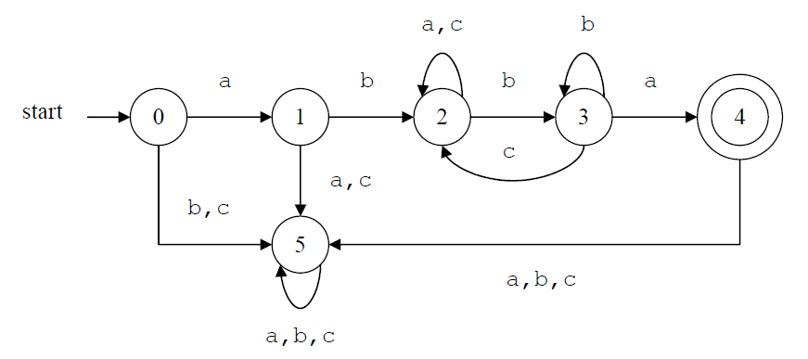
Sample DFA (from HW2 solutions)
How does this look in Owl?
Notes:
Ben Start

Slide 5
bool accept = False
machine m = {
node s0
node s1
node s2
node s3
node s4
node dead
s0("a") -> s1
s0() -> dead
s1("b") -> s2
s1() -> dead
s2("a") -> s2
s2("b") -> s3
s2("c") -> s2
s3("a") -> s4
s3("b") -> s3
s3("c") -> s2
enter(s4) {
accept = True
}
exit(s4) {
accept = False
}
s4() -> dead
dead() -> dead
}
# Input: abacbba
m.step("a")
m.step("b")
m.step("a")
m.step("c")
m.step("b")
m.step("b")
m.step("a")
if(accept) {
print("Accepted")
} else {
print("Rejected")
}
# Output: Accepted
m.step("a")
if(accept) {
print("Accepted")
} else {
print("Rejected")
}
# Output: Rejected
Notes:
Default: First node is Start State
Nodes declared at top of machines by Owl convention
Transitions: Defined as, Name, ( trans input ) -> Go to State
Enter and Exit: Functions that can be applied to nodes and execute based on transitions
Globally defined variables can be manipulated within functions

Slide 6
Some Owl Features
» Machines, Machine Functions
» Transition Functions, Default Transitions
» Control Flow, Iteration
» Lists, List Iteration, Range Function
» Functions
» Type Casting
» Regular Expression Transitions
» User Input
» Hoot
Notes:
Owl includes other useful features: regex, user input

Slide 7
machine m = {
node s0
node s1
exit (s0) {
print("hello")
}
enter (s1) {
print("!!!")
}
s0("go") -> s1 {
print("world")
}
s0("stop") -> s1
s0() -> s0
s1() -> s1
}
bool play = True
if (play) {
m.step("go")
} else {
m.step("stop")
}
# hello
# world
# !!!
string[] list = ["a","b","c"]
string s
for s in list {
print(s)
}
# a
# b
# c
int x
for x in range(5,10) {
print("x: "+toString(x))
}
# x: 5
# x: 6
# x: 7
# x: 8
# x: 9
float square(float x) {
return x*x
}
string y = "2"
float z = square(3.0) + toFloat(y)
print(z)
# 11.0
while (True) {
hoot()
}
Notes:
Ben End

Slide 8
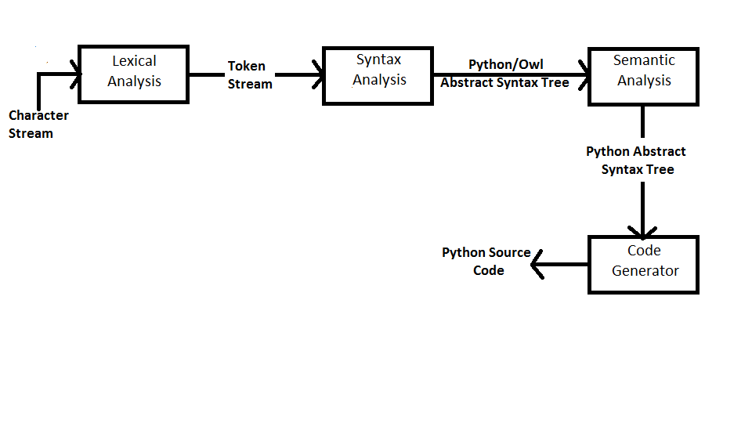
Translation Block Diagram
Notes:
Belai Start

Slide 9
Semantic Analysis
» TypeChecker
» MachineCodeGenerator
» ScopeResolver
» StandardLibraryAdder
» PostProcessor

Slide 10
$ python compile.py hello_world.owl > hello_world.py
hello_world.owl
machine hello = {
node s0
s0("a") -> s0 {
print("hello world")
}
}
hello.step("a")
hello_world.py
import re
from lib.automata import *
groups = []
s0 = State()
def trans_s0_s0_0cc175b9c0f1b6a831c399e269772661(groups):
global _hello, _s0
print 'hello world'
_s0_s0_0cc175b9c0f1b6a831c399e269772661 = Transition(s0, s0, 'a')
_s0_s0_0cc175b9c0f1b6a831c399e269772661.on_enter+=trans_s0_s0_0cc175b9c0f1b6a831c399e269772661
_hello = Automaton([s0], [_s0_s0_0cc175b9c0f1b6a831c399e269772661], s0)
_hello.step('a')
Notes:
Transitions identified by 3 things: starting state, end state and the input to take the transition.
Groups = [] for regex

Slide 11
Intermediate AST
Module(body=[
Machine(name=Name(id='hello', ctx=Store()), body=[
Node(name='s0'),
Transition(left='s0', arg=Str(s='a'), right='s0', body=[
Print(dest=None, values=[
Str(s='hello world'),
], nl=True),
]),
]),
Expr(value=Call(func=Attribute(value=Name(id='hello', ctx=Load()), attr='step', ctx=Load()), args=[
Str(s='a'),
], keywords=[], starargs=None, kwargs=None)),
])
Symbol table:
{'s0': 'node', 'hello': 'machine', '_trans_s0_s0_a': {'symbols': {}, 'params': [], 'type': 'void'}}
Notes:
Belai End
Final AST is Python-format AST for the Python code above

Slide 12
Runtime Environment
Python, PLY, codegen
Scripts for viewing state after
each step of compilation
lex.py, ptree.py, tree.py, compile.py, run.py
run.py calls Python's exec on final AST
~/owl$ python run.py my_owl_program.owl
Notes:
Kenneth Start

Slide 13







Software Development Environment
Python and PLY
Command Line
Git/Github
Google Drive
Various Editors

Slide 14
Testing
» Some aspects of test driven development
» unittest - Python's unit testing framework
» python -m unittest discover
» Test cases:
LexerTestCase – tests whether a character stream is lexed into the expected tokens according to the language's grammar
ParserTestCase – tests whether an AST generated from an Owl program matches the AST generated from the corresponding Python program
TransformTestCase – an extension of ParserTestCase for a transformed AST
OutputTestCase – tests whether the output of a Owl program (when run) matches what the expected output
Notes:
Martin Start

Slide 15
Example Test
Possible test failure:
AssertionError: Generated ASTs are not equal.
Owl:
Module(body=[
Assign(targets=[
Name(id='x', ctx=Store()),
], value=Num(n=0)),
If(test=Compare(left=Name(id='x', ctx=Load()), ops=[
Eq(),
], comparators=[
Num(n=3),
]), body=[
Print(dest=None, values=[
Str(s="it's 3"),
], nl=True),
], orelse=[]),
])
Python:
Module(body=[
Assign(targets=[
Name(id='x', ctx=Store()),
], value=Num(n=0)),
If(test=Compare(left=Name(id='x', ctx=Load()), ops=[
Eq(),
], comparators=[
Num(n=3),
]), body=[
Print(dest=None, values=[
Str(s="it's 3"),
], nl=True),
], orelse=[
Print(dest=None, values=[
Str(s="it's not 3"),
], nl=True),
]),
])
test_selection_statement.py
import unittest
import textwrap
from test.parse_helper import ParserTestCase
class TestSelectionStatements(ParserTestCase):
def test_if_else_statements(self):
owl = textwrap.dedent(
r"""
int x
if(x == 3) {
print("it's 3")
} else {
print("it's not 3")
}
""")
python = textwrap.dedent(
r"""
x = 0
if x == 3:
print "it's 3"
else:
print "it's not 3"
""")
self.assertAST(owl, python)

Slide 16
Project Management
» Weekly meetings to discuss language, divvy up work and set weekly deliverables
» Each member added individual features through all compiler stages (full compiler stack)
» Version control: Git
» Document collaboration: Google Drive
Notes:
Andrew
- For example: Adding lists to Owl.
--Define necess lex symbols, add productions to grammar, perform basic tests at each case
-- Then respective job titles then performed their specific tasks
Fluid roles between teammates

Slide 17
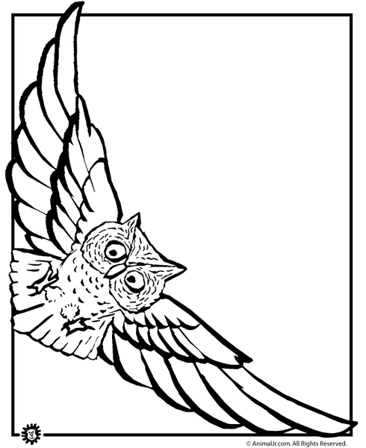
DEMO
Notes:
Kenneth
Mention Regex and User Input

Slide 18
Conclusions
» What went wrong:
» Difficulty of using static typing when translating to dynamically typed language
» Language grammar too big
» What went well:
» Test driven development
» Division of labor, collaborative workflow
Notes:
Martin

Slide 19
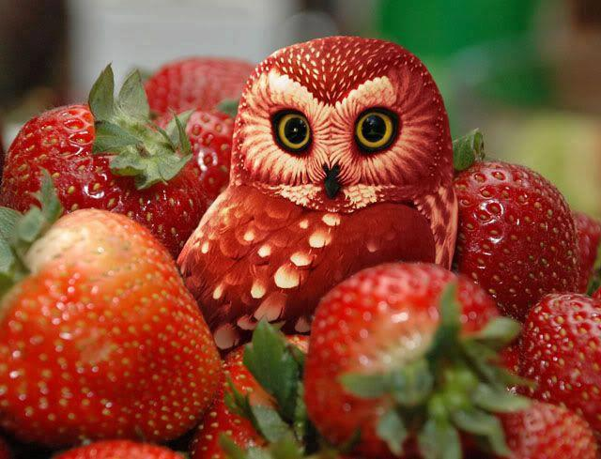
Thank you!
O>O

