Slide 1




Greetings From Team CAL!
Andrei Tapai (Language Guru)
Fei-Tzin Lee (System Integrator)
Ramses Driskell (System Architect)
Geoffrey Loss (Tester and Validator)
Percee Goings (Project Manager)

Slide 2


Who is Cal
Mrs. Flexyacc
Mr. Java

Slide 3




Can I play with Cal

Slide 4


Why is Cal bothering me

Slide 5

Management
?

Slide 6


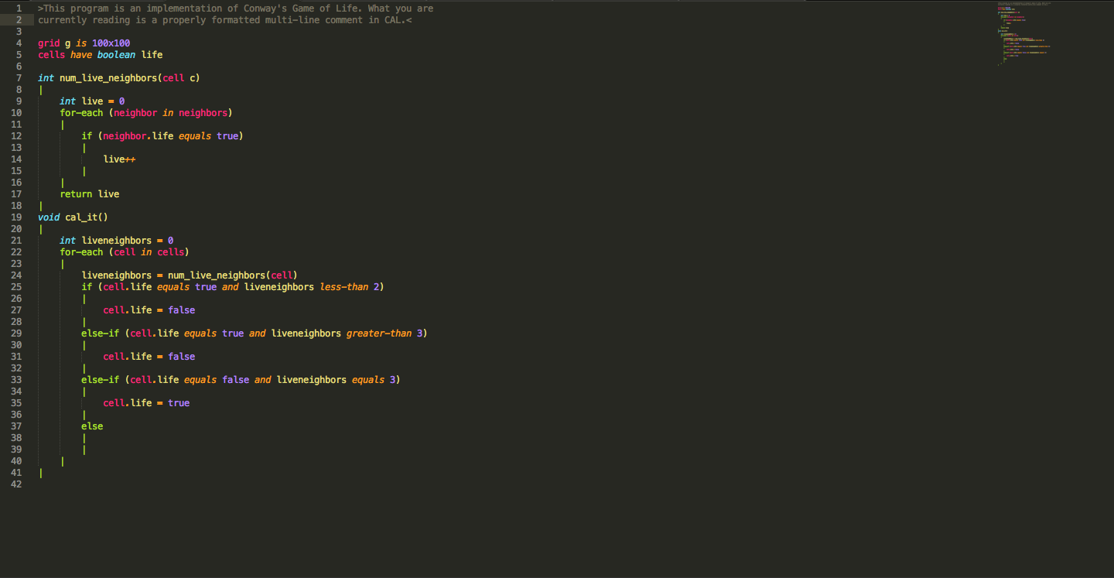

Source

Slide 7

Motivations and
Inception of CAL
*This pattern is “Rule 90”
1 part high-school
computer science nostalgia
+
1 part fascination with
Cellular automatons
= Cal

Slide 8

Motivations and
Inception of CAL
*This pattern is “Rule 90”
1 part high-school
computer science nostalgia
+
1 part fascination with
Cellular automatons
= Cal

Slide 9

The Properties of CAL Programs
We wanted only the essentials
1. A specification for the grid
2. A specification of what properties cells have and how they are initialized
3. A main function that is applied to all cells to take them from state T to state T+1
4. All helper functions associated with the main function
*This pattern is “Rule 3283936144”

Slide 10
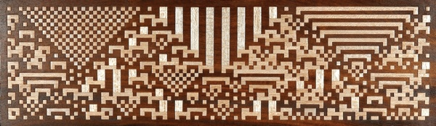
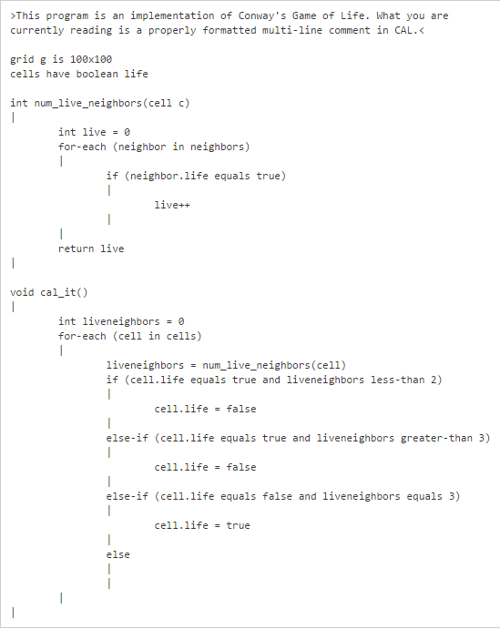

Syntactic Constructs of CAL
Meanwhile in other languages:
Classes
Constructors
Incomprehensible GUI code
X and Y coordinates
X = Y + (1/2 + windowWidth) +
… border + padding…. What.
Annoying string constructs
Get() and set()
SEMICOLONS
And especially…
Failing to work because
You put a semicolon
After an if statement.
Definition of grid size
Definition of cells
3. functions!
(type name (parameters)
|
Statements
|
4. But wait, what is this!
5. …at last: The cal_it() function!
Think of it as main!
Execution begins here
Provides the specification for
a “tick” of an automaton.
Note: We’re still not sure if its pronounced “call it”
or “cal it” (as in cal-culator). Maybe we’ll never know.

Slide 11
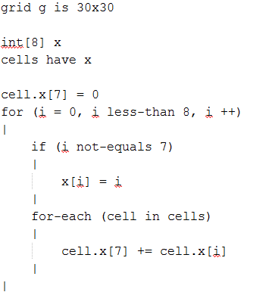

Slide 12
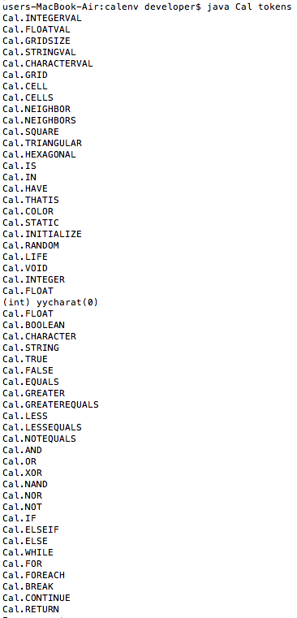

Slide 13
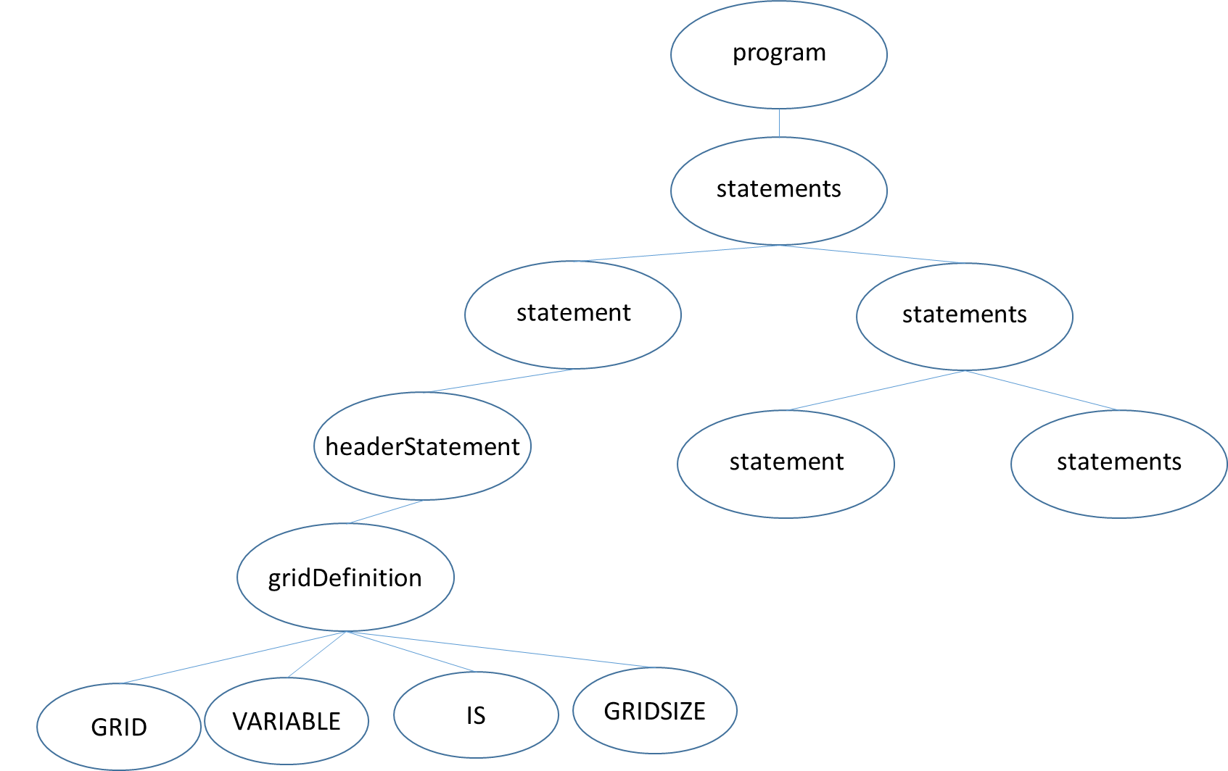

Slide 14
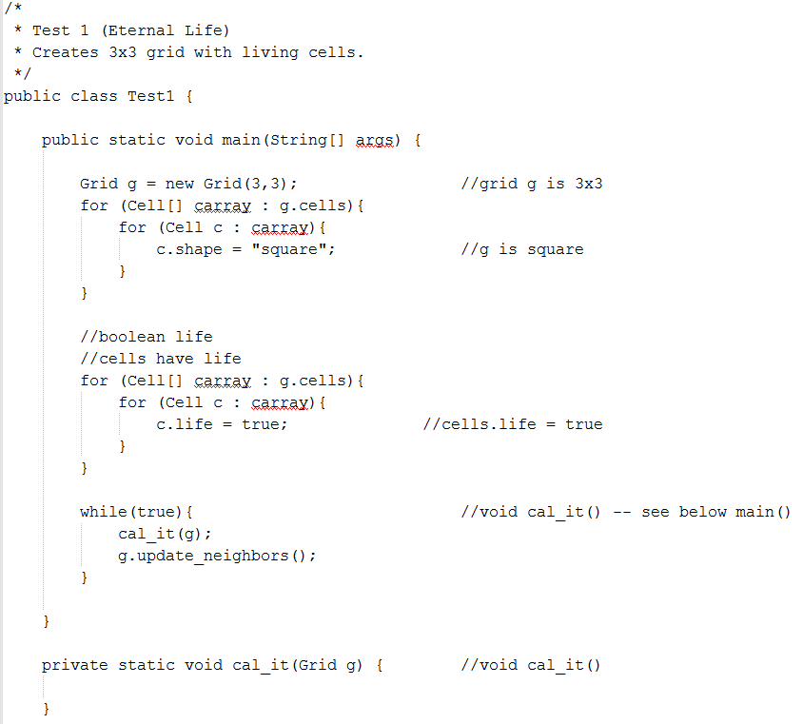

Slide 15
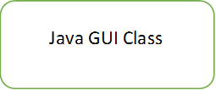
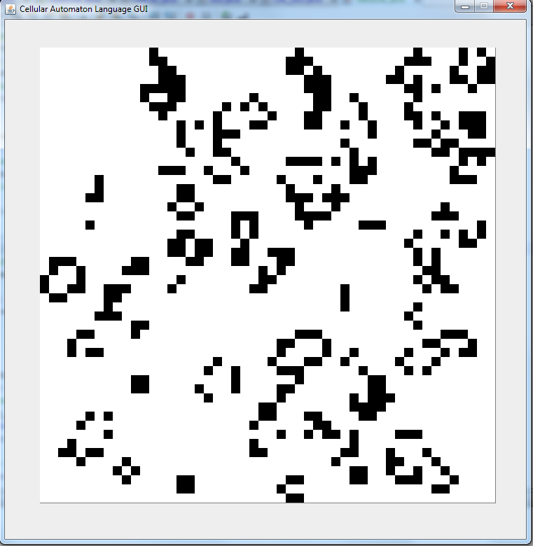

Slide 16
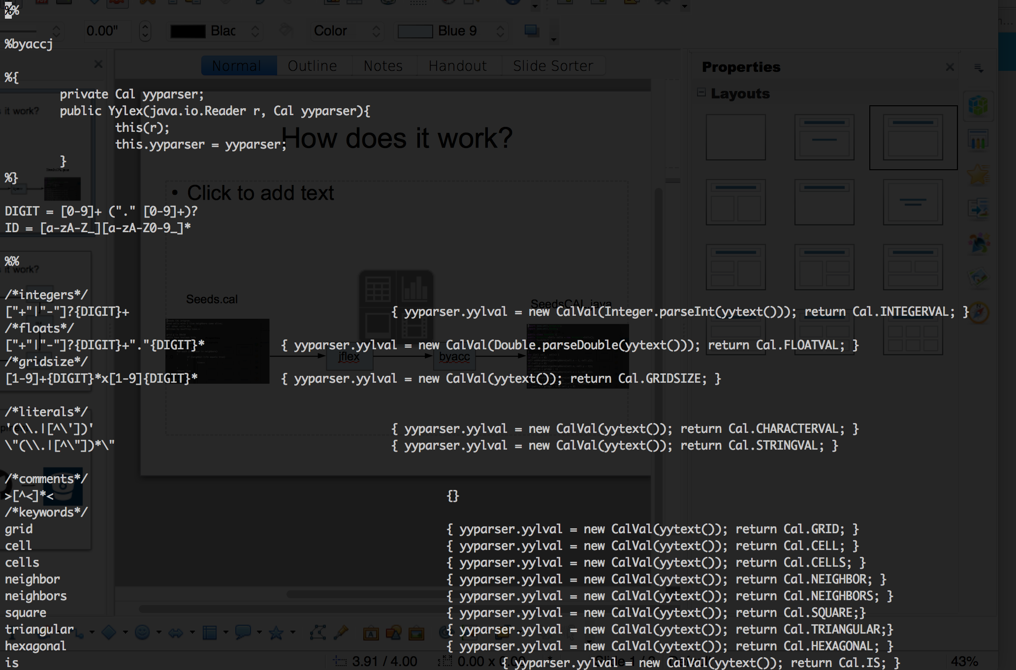
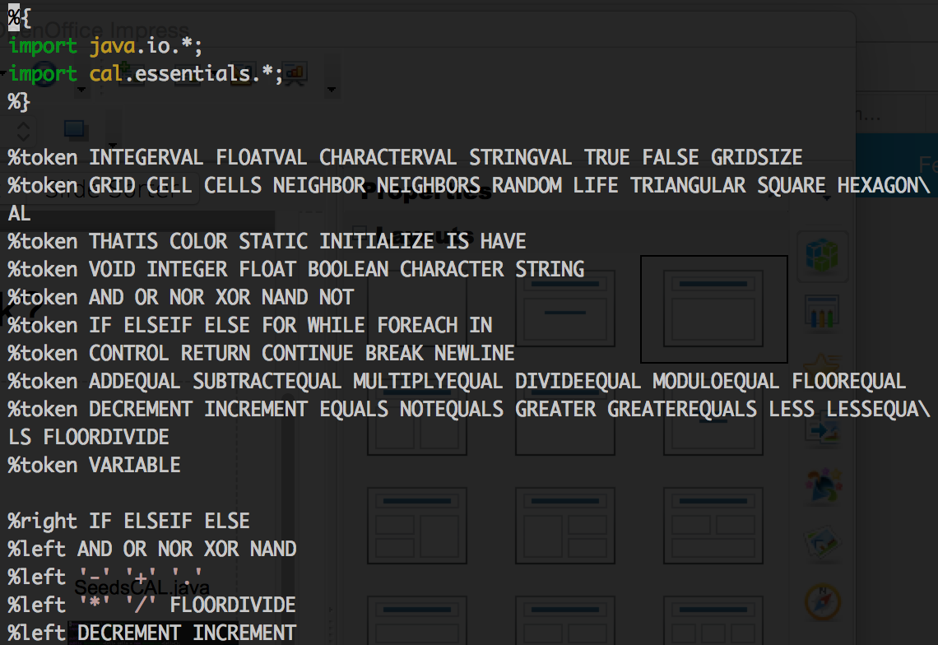
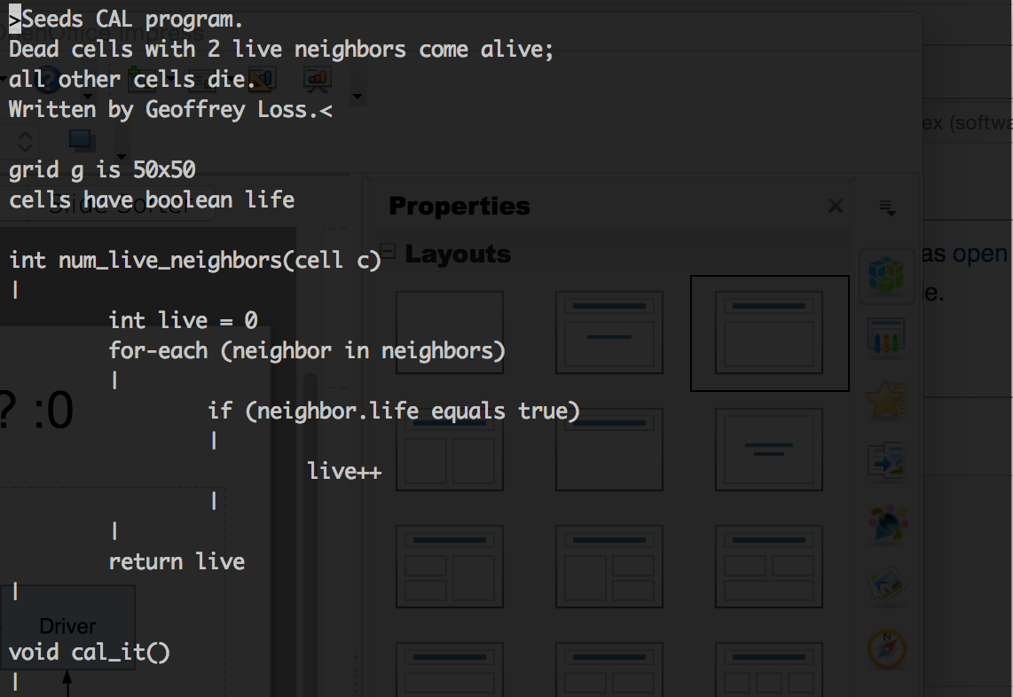
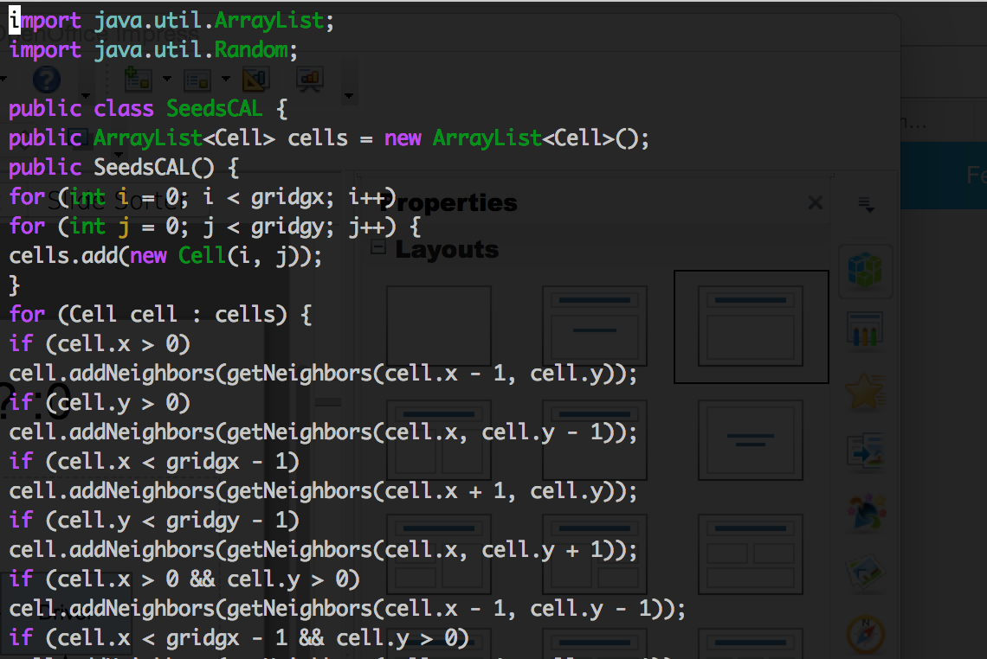
Overview
cal.flex
cal.y
Seeds.cal
SeedsCAL.java
jflex
byacc

Slide 17
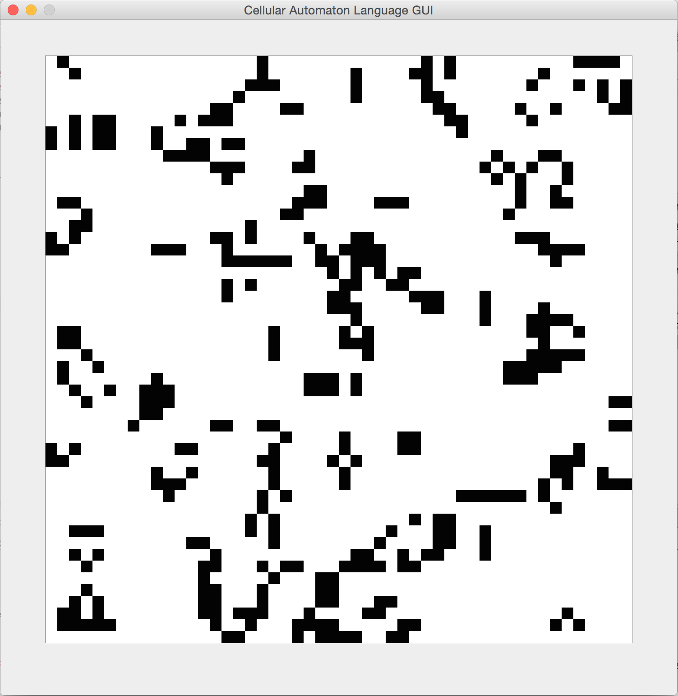
Overview
SeedsCAL.java
Driver
GUI
CAL_GUI

Slide 18
Runtime
Driver
“SeedsCAL.java”
SeedsCAL class
Java reflection
GUI
inner Cell class
CAL_GUI

Slide 19



Development

Slide 20
TESTING
By Geoffrey Loss

Slide 21
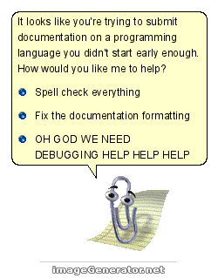

Slide 22
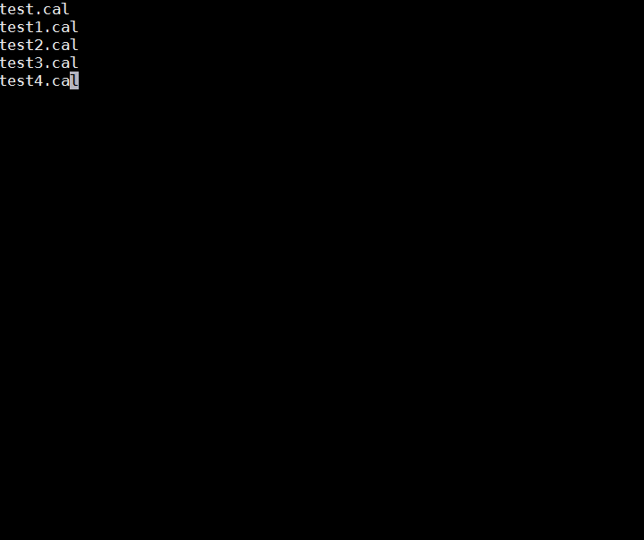


Slide 23
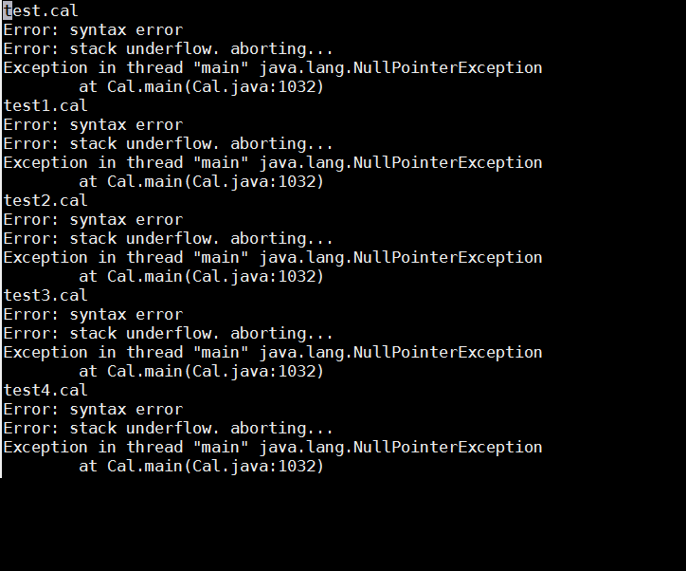


Slide 24





STILL LIFES

Slide 25

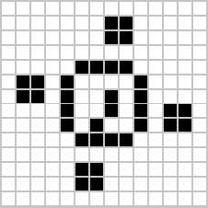
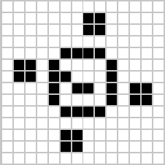


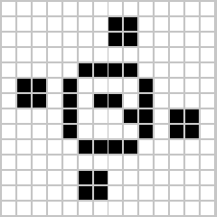
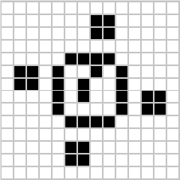
OSCILLATORS

Slide 26
Now for a quick Demo…

Slide 27
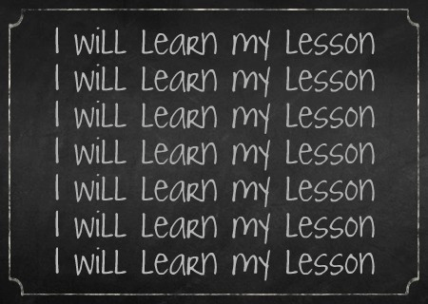
Lessons Learned!
Starting early!
Compilers can be/are extremely rewarding ventures
Get a barebones up and running ASAP
Don’t break your compiler by trying to implement too many things at once
Integrating a GUI can be very difficult
Decide on the specifics early on!

Slide 28
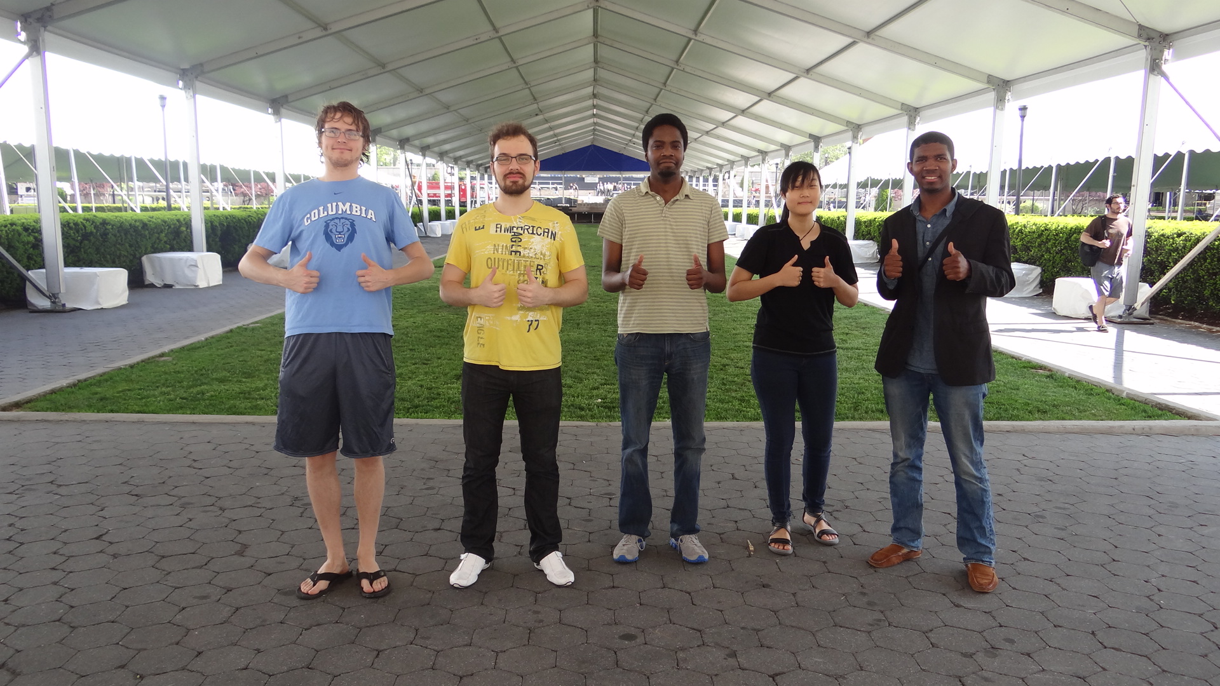
Thanks Folks!

