Slide 1
Regrasping and Unfolding of Garments Using Predictive Thin Shell Modeling
Columbia University
Yinxiao Li, Danfei Xu, Yonghao Yue, Yan Wang,
Shih-Fu Chang, Eitan Grinspun, Peter Allen

Slide 2
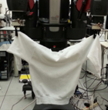
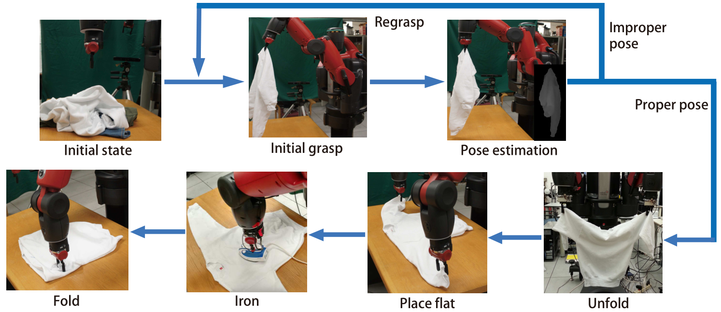
Pipeline
ICRA2015

Slide 3
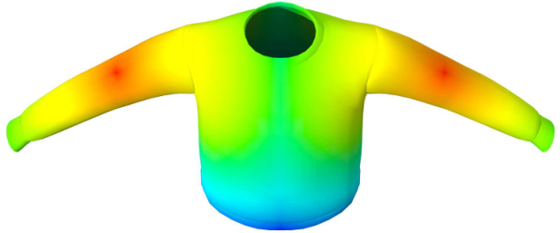
Problem Formulation
ICRA2015
Evaluation of two grasping points by
Gaussian probability distribution

Slide 4
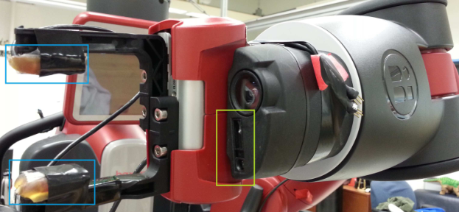
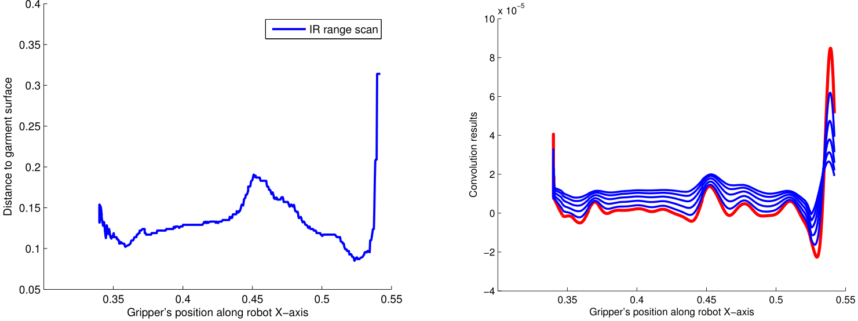
Grasping Point Localization
ICRA2015
Find best local curvature for grasp to improve stability
Laplacian-Gaussian Kernel

Slide 5
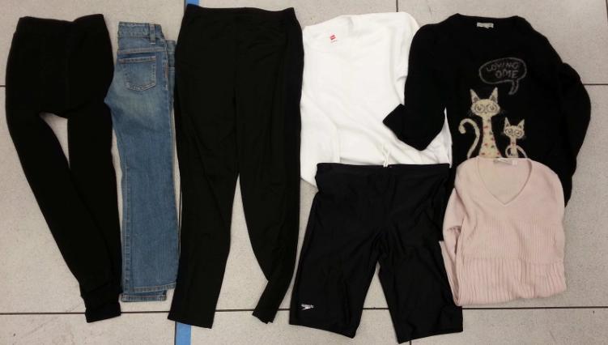
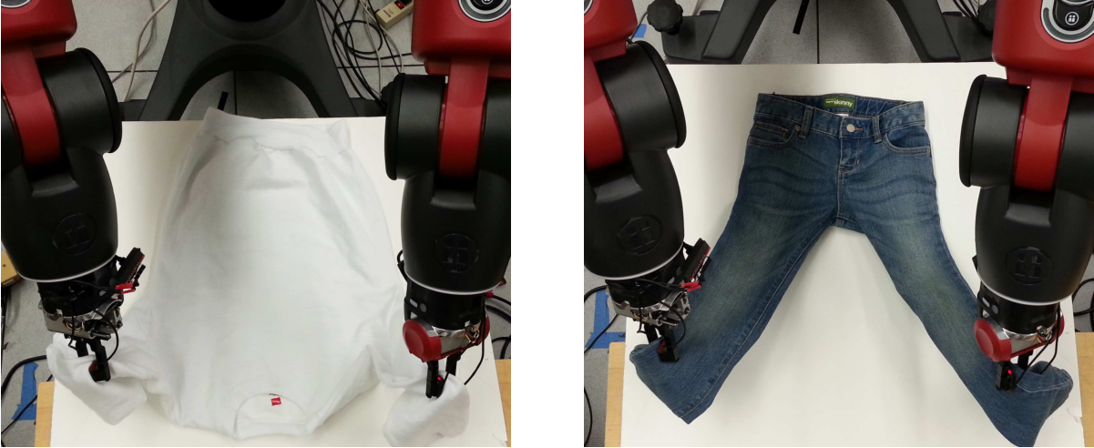
Experimental Results
ICRA2015
Unfolding results
7 garments
Sweater
Jeans
Pants
Shorts
etc.

Slide 6
Implement on a robot -- Video
ICRA2015

