Slide 1
Learning Mixtures of Structured Distributions over Discrete Domains
Xiaorui Sun
Columbia University
Joint work with Siu-On Chan(UC Berkeley), Ilias Diakonikolas(U Edinburgh), Rocco Servedio(Columbia University)

Slide 2
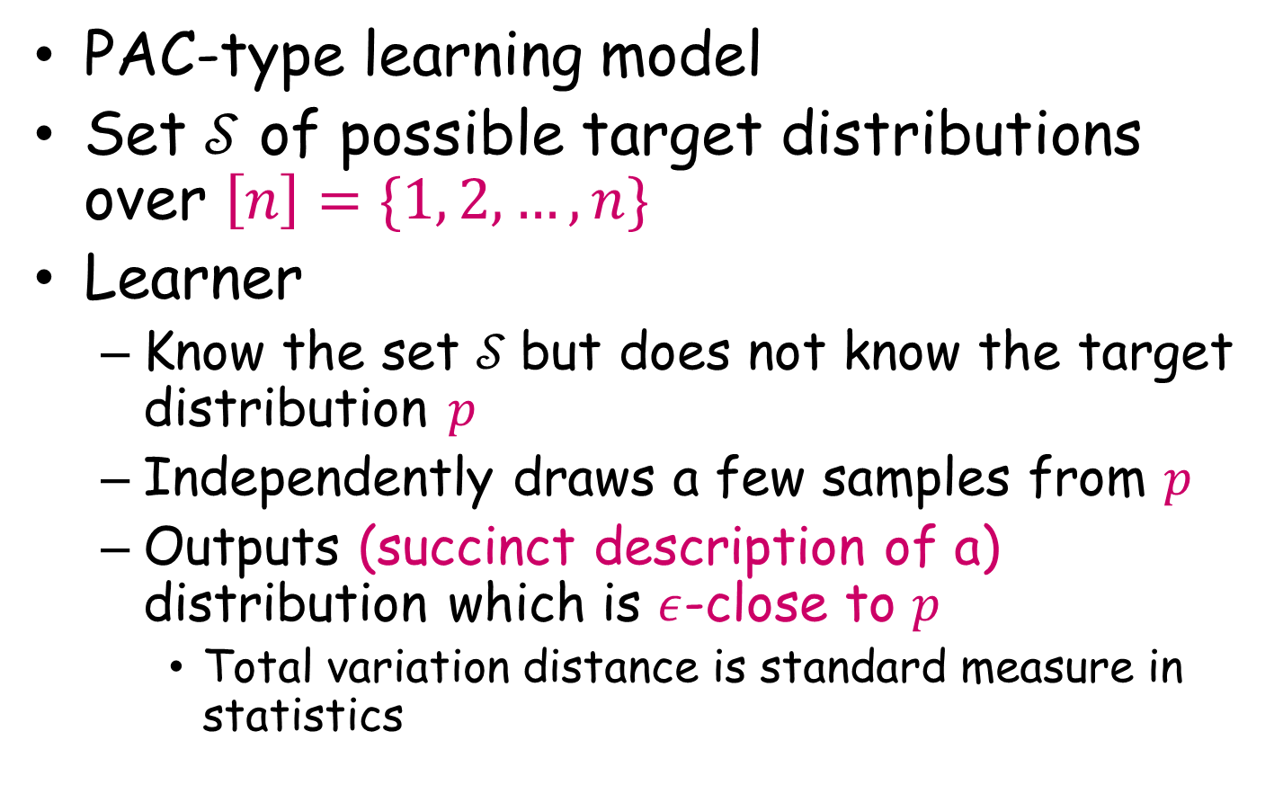
Density Estimation
PAC-type learning model
Set $𝒮$ of possible target distributions over $\left[n\right]=\{1, 2,…, n\}$
Learner
Know the set $𝒮$but does not know the target distribution $p$
Independently draws a few samples from $p$
Outputs (succinct description of a) distribution which is $ε$-close to $p$
Total variation distance is standard measure in statistics

Slide 3
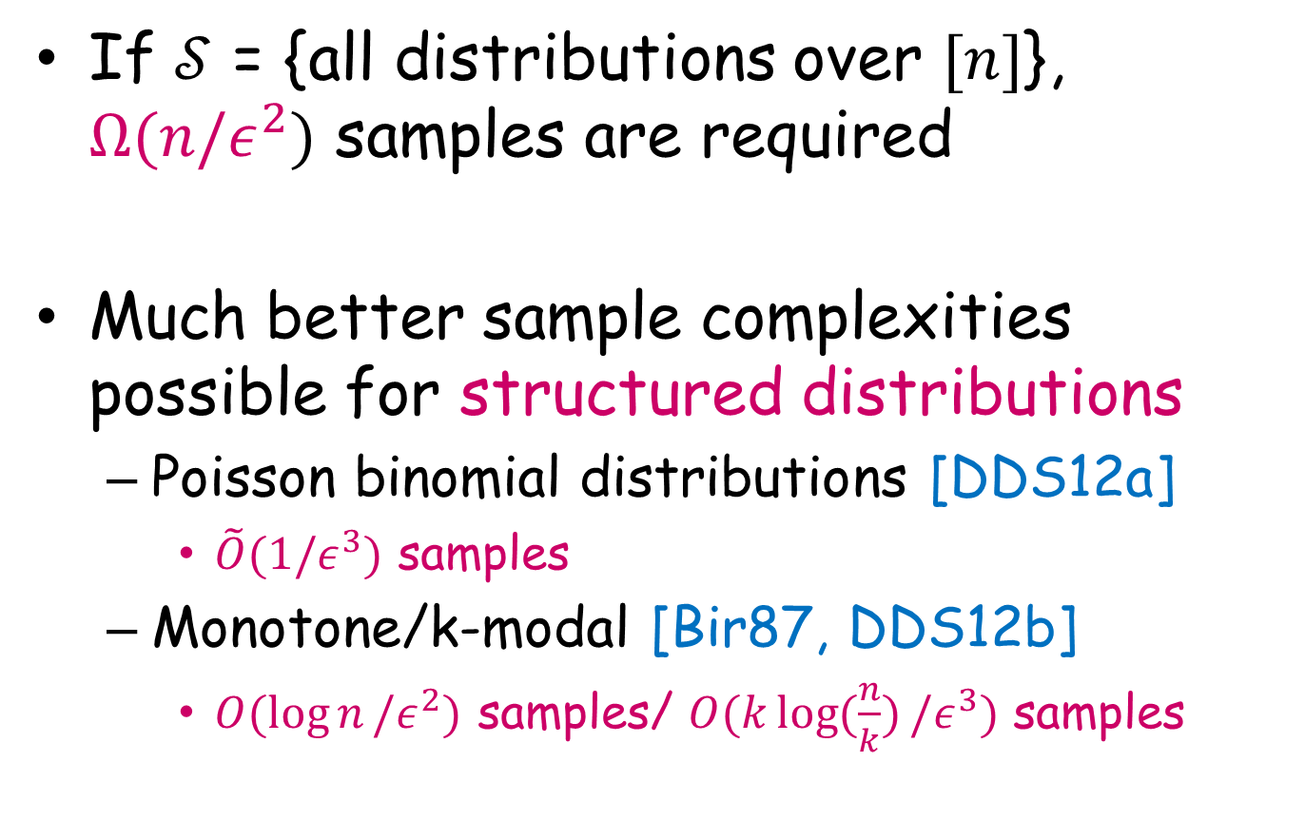
Learn a structured distribution
If $𝒮$ = {all distributions over $[n]$}, $Ω(n/ε^{2})$ samples are required
Much better sample complexities possible for structured distributions
Poisson binomial distributions [DDS12a]
$\tilde{O}(1/ε^{3})$ samples
Monotone/k-modal [Bir87, DDS12b]
$O(\log{n}/ε^{2})$ samples/ $O(k\log{(\frac{n}{k})}/ε^{3})$ samples

Slide 4
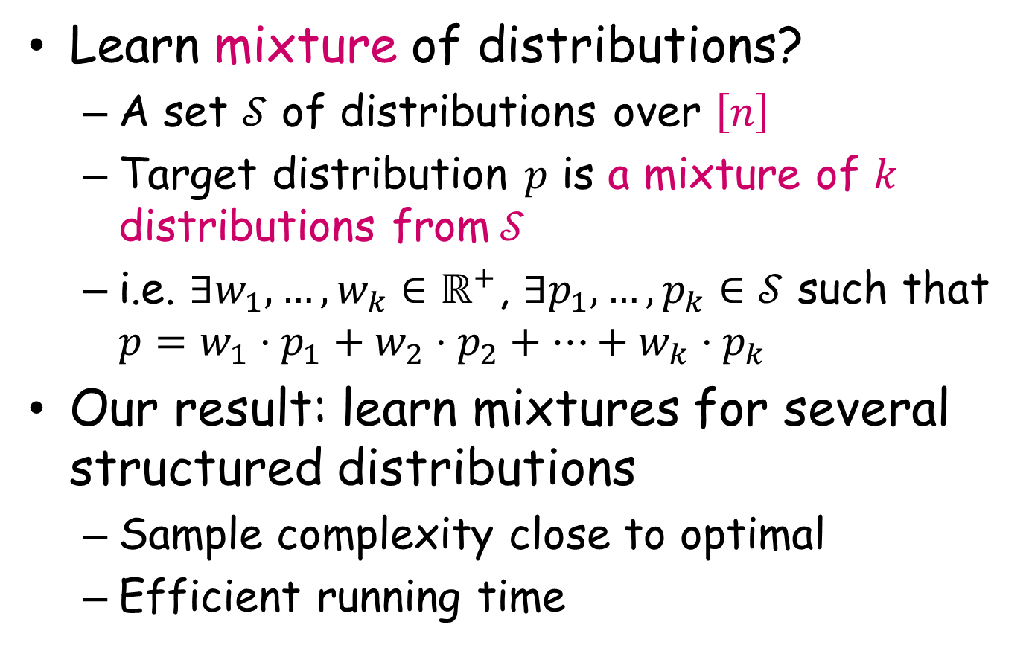
This work: Learn mixture of structured distributions
Learn mixture of distributions?
A set $𝒮$ of distributions over $\left[n\right]$
Target distribution $p$ is a mixture of $k$ distributions from$𝒮$
i.e. $∃w_{1},…,w_{k}∈ℝ^{+}$, $∃p_{1},…,p_{k}∈𝒮$ such that $p=w_{1}⋅p_{1}+w_{2}⋅p_{2}+…+{w_{k}⋅p}_{k}$
Our result: learn mixtures for several structured distributions
Sample complexity close to optimal
Efficient running time

Slide 5

Our results: learning mixture of log-concave
Log-concave distribution over [n]
$p{\left(k\right)}^{2}≥p\left(k−1\right)⋅p(k+1)$
$p\left(i\right)p\left(k\right)>0⟹p\left(j\right)>0$ for $1≤i<j<k≤n$
1
n

Slide 6
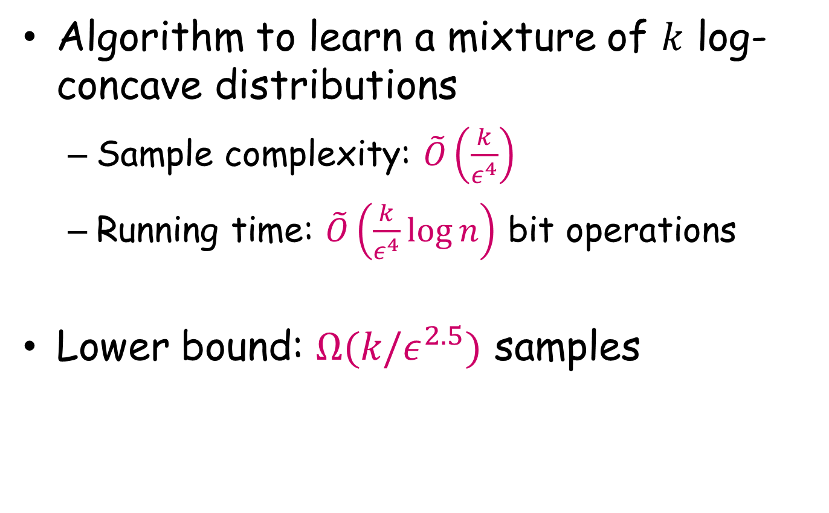
Our results: log-concave
Algorithm to learn a mixture of $k$ log-concave distributions
Sample complexity: $\tilde{O}\left(\frac{k}{ε^{4}}\right)$
Running time: $\tilde{O}\left(\frac{k}{ε^{4}}\log{n}\right)$ bit operations
Lower bound: $Ω(k/ε^{2.5})$ samples

Slide 7

Our results: mixture of unimodal
Unimodal distribution over [n]
$∃i$ s.t.
$∀1≤k<i, p\left(k\right)≤p\left(k+1\right)$
$∀i<k≤n, p\left(k−1\right)≥p(k)$
1
n

Slide 8
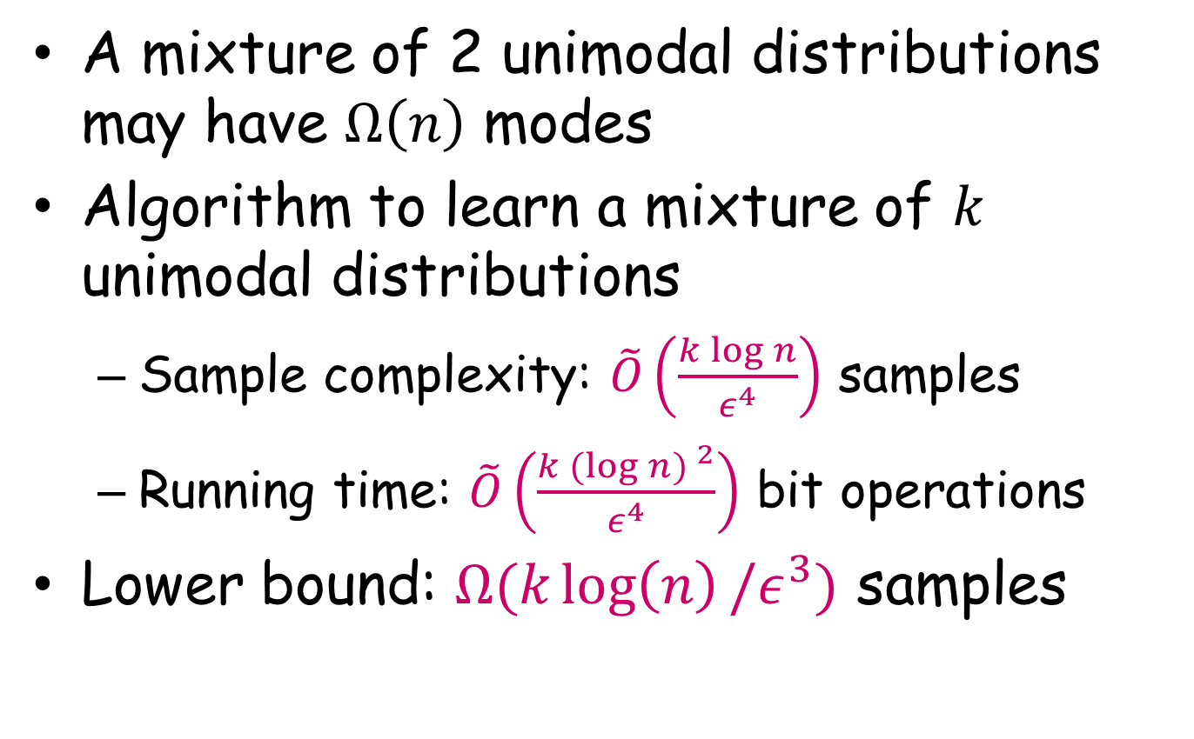
Our results: mixture of unimodal
A mixture of 2 unimodal distributions may have $Ω\left(n\right)$ modes
Algorithm to learn a mixture of $k$ unimodal distributions
Sample complexity: $\tilde{O}\left(\frac{k\log{n}}{ε^{4}}\right)$ samples
Running time: $\tilde{O}\left(\frac{k{(log{n) }}^{2}}{ε^{4}}\right)$ bit operations
Lower bound: $Ω(k\log\left(n\right)/ε^{3})$ samples

Slide 9
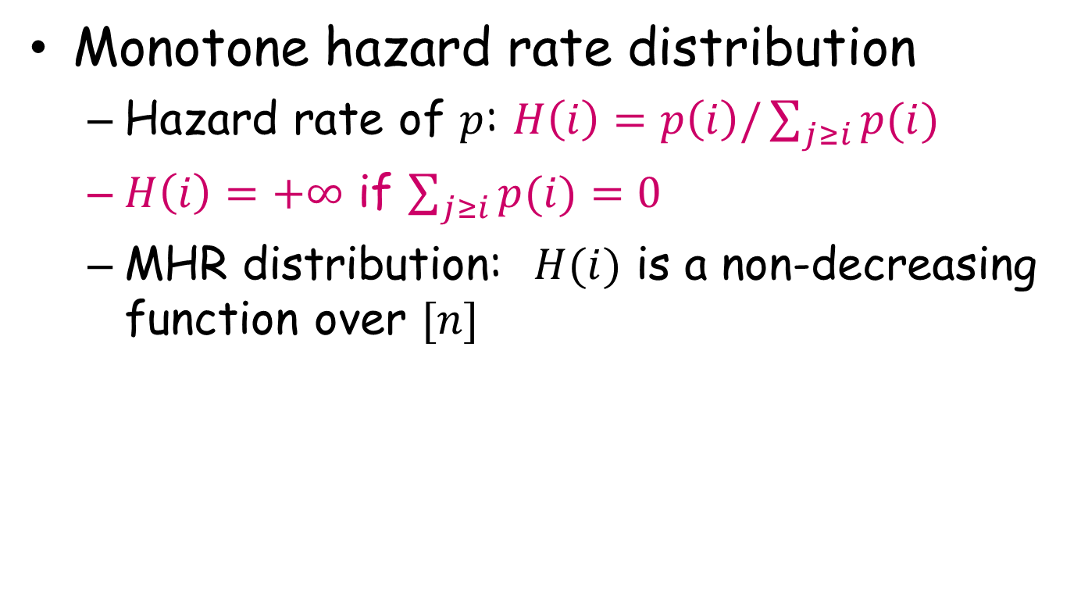
Our results: mixture of MHR
Monotone hazard rate distribution
Hazard rate of $p$: $H\left(i\right)=p\left(i\right)/\sum_{j≥i}{p(i)}$
$H\left(i\right)=+∞$ if $\sum_{j≥i}{p(i)}=0$
MHR distribution: $H(i)$ is a non-decreasing function over $[n]$
1
n

Slide 10
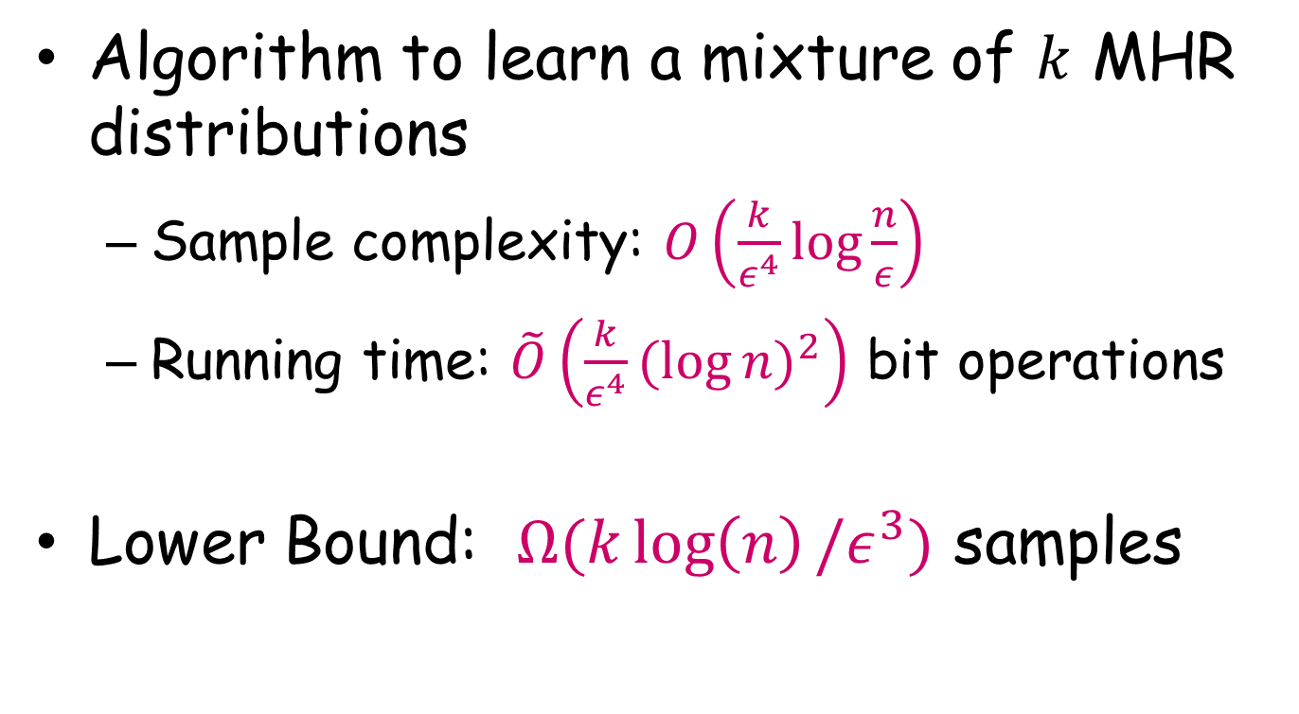
Our results: mixture of MHR
Algorithm to learn a mixture of $k$ MHR distributions
Sample complexity: $O\left(\frac{k}{ε^{4}}\log{\frac{n}{ε}}\right)$
Running time: $\tilde{O}\left(\frac{k}{ε^{4}}{(log{n)}}^{2}\right)$ bit operations
Lower Bound: $Ω(k\log\left(n\right)/ε^{3})$ samples

Slide 11
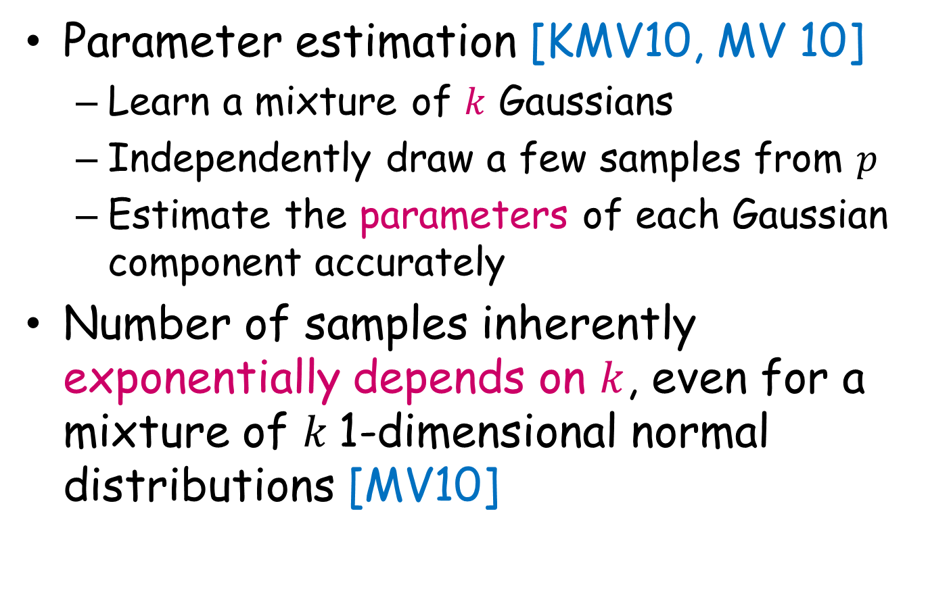
Compare with parameter estimation
Parameter estimation [KMV10, MV 10]
Learn a mixture of $k$ Gaussians
Independently draw a few samples from $p$
Estimate the parameters of each Gaussian component accurately
Number of samples inherently exponentially depends on $k$, even for a mixture of $k$1-dimensional normal distributions [MV10]

Slide 12
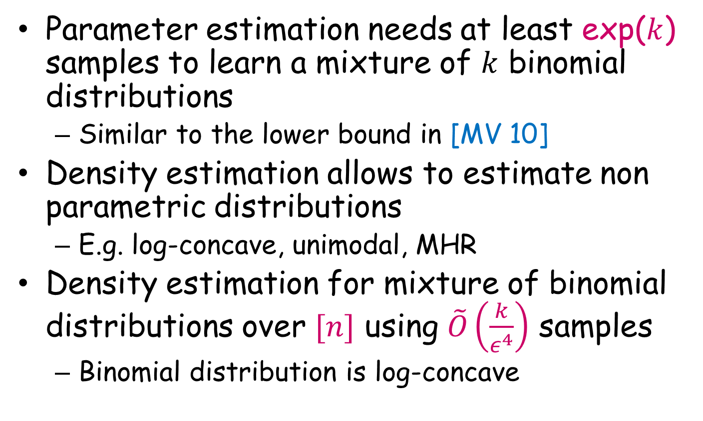
Compare with parameter estimation
Parameter estimation needs at least exp($k$) samples to learn a mixture of $k$ binomial distributions
Similar to the lower bound in [MV 10]
Density estimation allows to estimate non parametric distributions
E.g. log-concave, unimodal, MHR
Density estimation for mixture of binomial distributions over $[n]$ using $\tilde{O}\left(\frac{k}{ε^{4}}\right)$ samples
Binomial distribution is log-concave

Slide 13
Outline
Learning algorithm based on decomposition
Structural results for log-concave, unimodal, MHR distributions

Slide 14
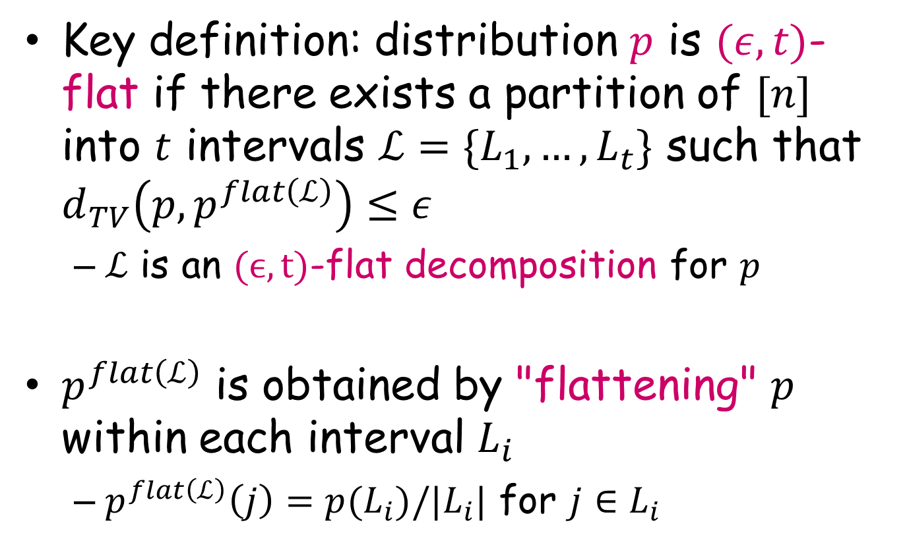
Flat decomposition
Key definition: distribution $p$ is $(ε,t)$-flat if there exists a partition of $[n]$ into $t$ intervals $ℒ=\{L_{1}, …, L_{t}\}$ such that $d_{TV}\left(p, p^{flat\left(ℒ\right)}\right)≤ε$
$ℒ$ is an $(ϵ,t)$-flat decomposition for $p$
$p^{flat\left(ℒ\right)}$ is obtained by "flattening" $p$ within each interval $L_{i}$
$p^{flat\left(ℒ\right)}\left(j\right)=p(L_{i})/|L_{i}|$ for $j∈L_{i}$

Slide 15
Flat decomposition
1
n

Slide 16
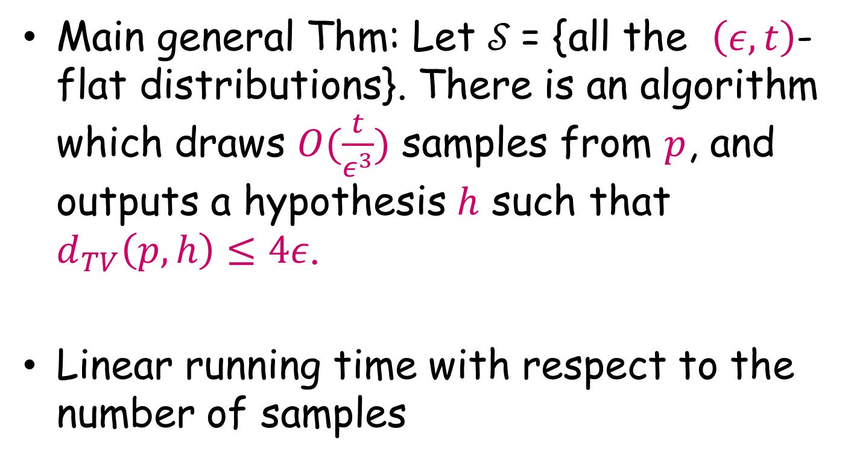
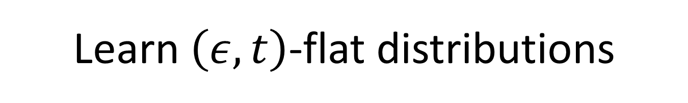
Learn $\left(ε, t\right)$-flat distributions
Main general Thm: Let $𝒮$= {all the $\left(ε, t\right)$-flat distributions}. There is an algorithm which draws $O(\frac{t}{ε^{3}})$ samples from $p$, and outputs a hypothesis $h$ such that $d_{TV}\left(p, h\right)≤4ε$.
Linear running time with respect to the number of samples

Slide 17
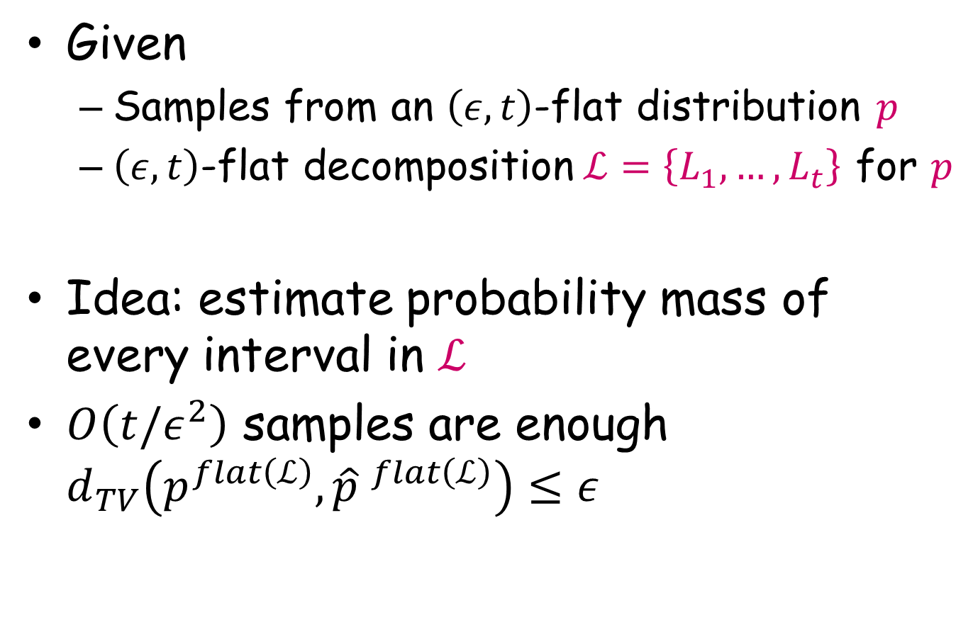
Easier problem: known decomposition
Given
Samples from an $\left(ε, t\right)$-flat distribution $p$
$\left(ε, t\right)$-flat decomposition$ℒ=\left\{L_{1}, …, L_{t}\right\}$ for $p$
Idea: estimate probability mass of every interval in $ℒ$
$O\left(t/ε^{2}\right)$ samples are enough $d_{TV}\left(p^{flat\left(ℒ\right)},{\hat{p} }^{flat\left(ℒ\right)}\right)≤ε$

Slide 18
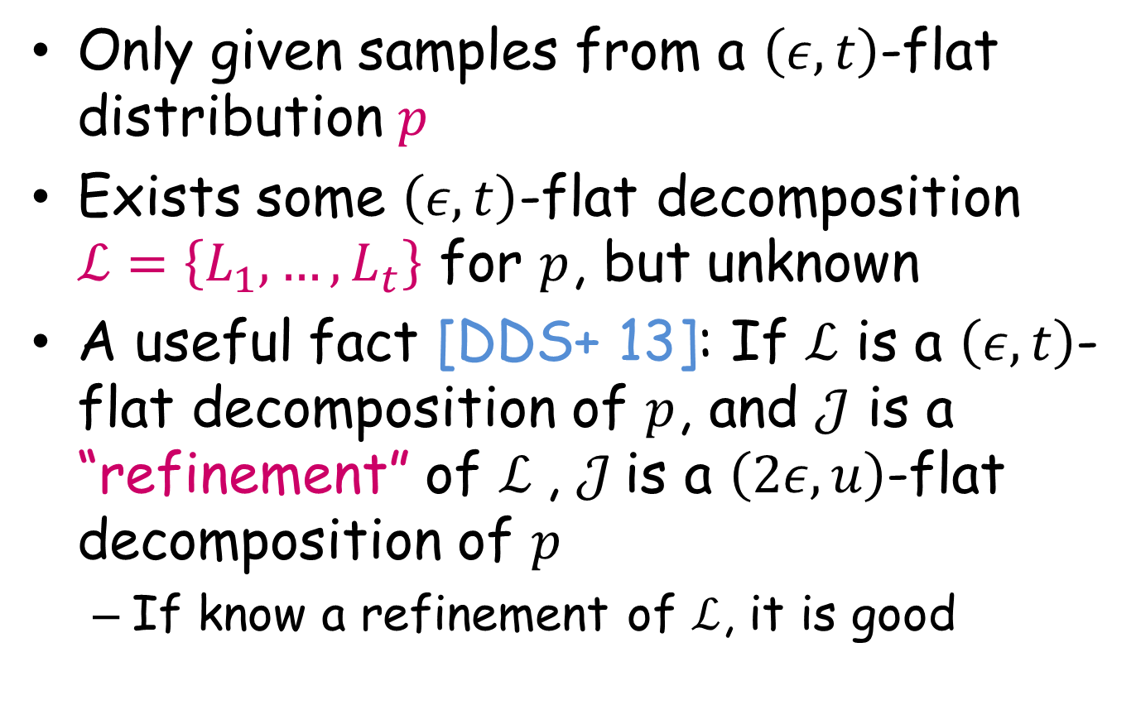
Real problem: unknown decomposition
Only given samples from a $\left(ε, t\right)$-flat distribution $p$
Exists some $\left(ε, t\right)$-flat decomposition $ℒ=\left\{L_{1}, …, L_{t}\right\}$ for $p$, but unknown
A useful fact [DDS+ 13]: If $ℒ$ is a $\left(ε,t\right)$-flat decomposition of $p$, and $𝒥$ is a “refinement” of $ℒ$, $𝒥$is a $\left(2ε,u\right)$-flat decomposition of $p$
If know a refinement of $ℒ$, it is good

Slide 19



Unknown flat decomposition (cont)
Idea: partition [n] into intervals each with small probability mass, $𝒦=\left\{k_{1}, …, k_{t′}\right\}$
Achieve by sampling from $p$
$$ℒ$$
$$𝒦$$
1
n

Slide 20

Unknown flat decomposition (cont)
Exist $𝒥$(unknown)
Refinement of both$ℒ=\left\{L_{1}, …, L_{t}\right\}$ and$𝒦=\left\{k_{1}, …, k_{t′}\right\}$
$t+t′$ intervals
$$ℒ$$
$$𝒦$$
1
n

Slide 21

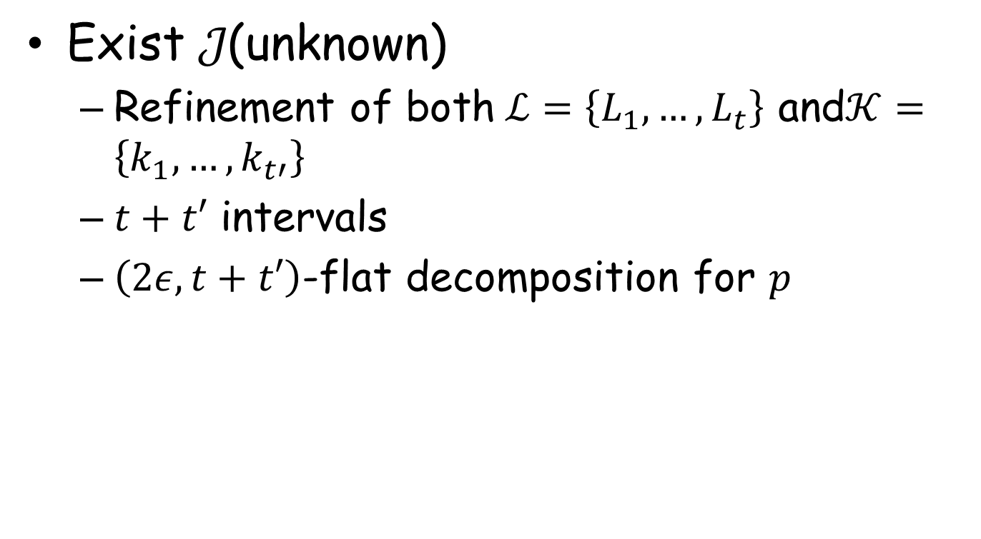
Unknown flat decomposition (cont)
Exist $𝒥\text{(}\text{unknown}\text{)}$
Refinement of both$ℒ=\left\{L_{1}, …, L_{t}\right\}$ and$𝒦=\left\{k_{1}, …, k_{t′}\right\}$
$t+t′$ intervals
$\left(2ε,t+t′\right)$-flat decomposition for $p$
$$𝒥$$
1
n

Slide 22


Unknown flat decomposition (cont)
Compare $𝒥$ and $𝒦$
$$𝒦$$
$$𝒥$$
$$𝒥$$
1
1
n
n

Slide 23
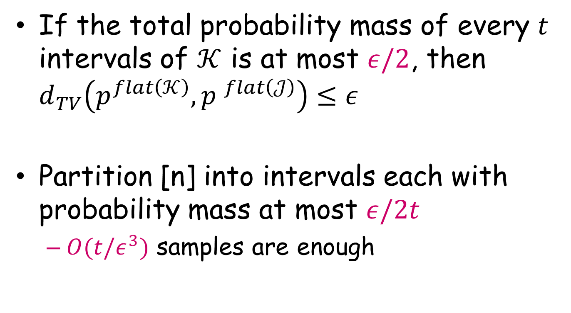
Unknown flat decomposition (cont)
If the total probability mass of every $t$ intervals of $𝒦$ is at most $ε/2$, then $d_{TV}\left(p^{flat\left(𝒦\right)},{p }^{flat\left(𝒥\right)}\right)≤ε$
Partition [n] into intervals each with probability mass at most $ε/2t$
$O(t/ε^{3})$ samples are enough

Slide 24
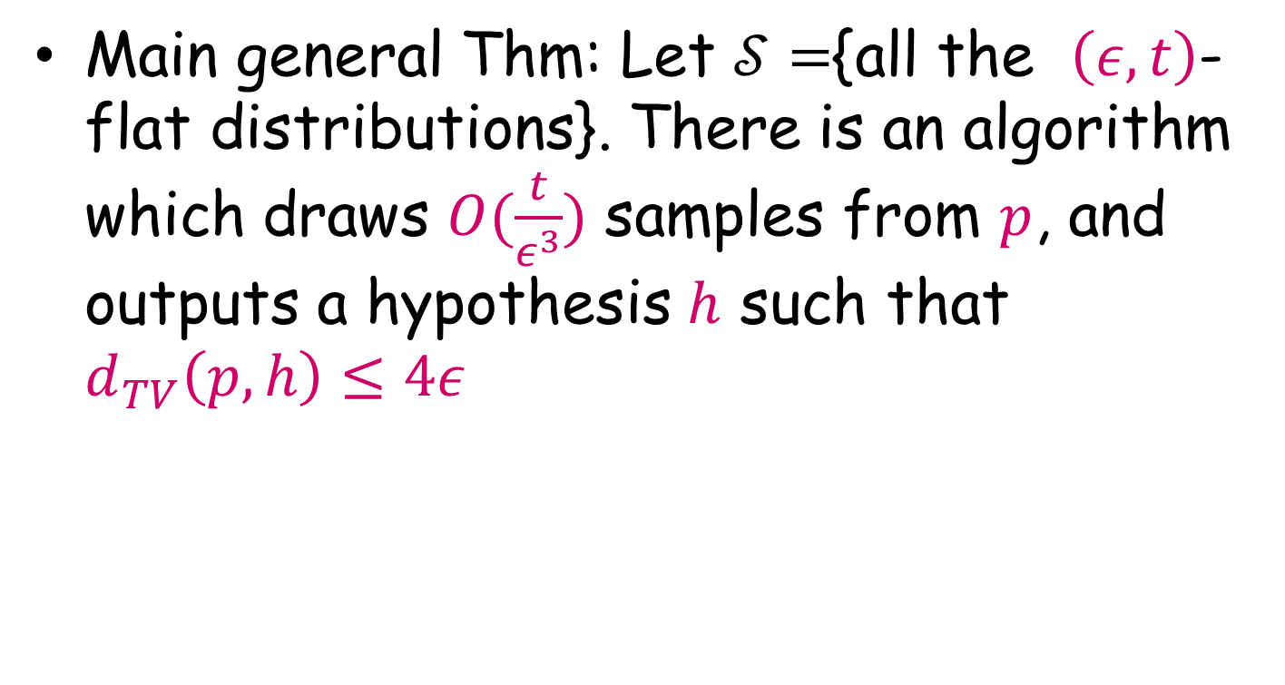
Learn $\left(ε, t\right)$-flat distributions
Main general Thm: Let $𝒮=${all the $\left(ε, t\right)$-flat distributions}. There is an algorithm which draws $O(\frac{t}{ε^{3}})$ samples from $p$, and outputs a hypothesis $h$ such that $d_{TV}\left(p, h\right)≤4ε$

Slide 25
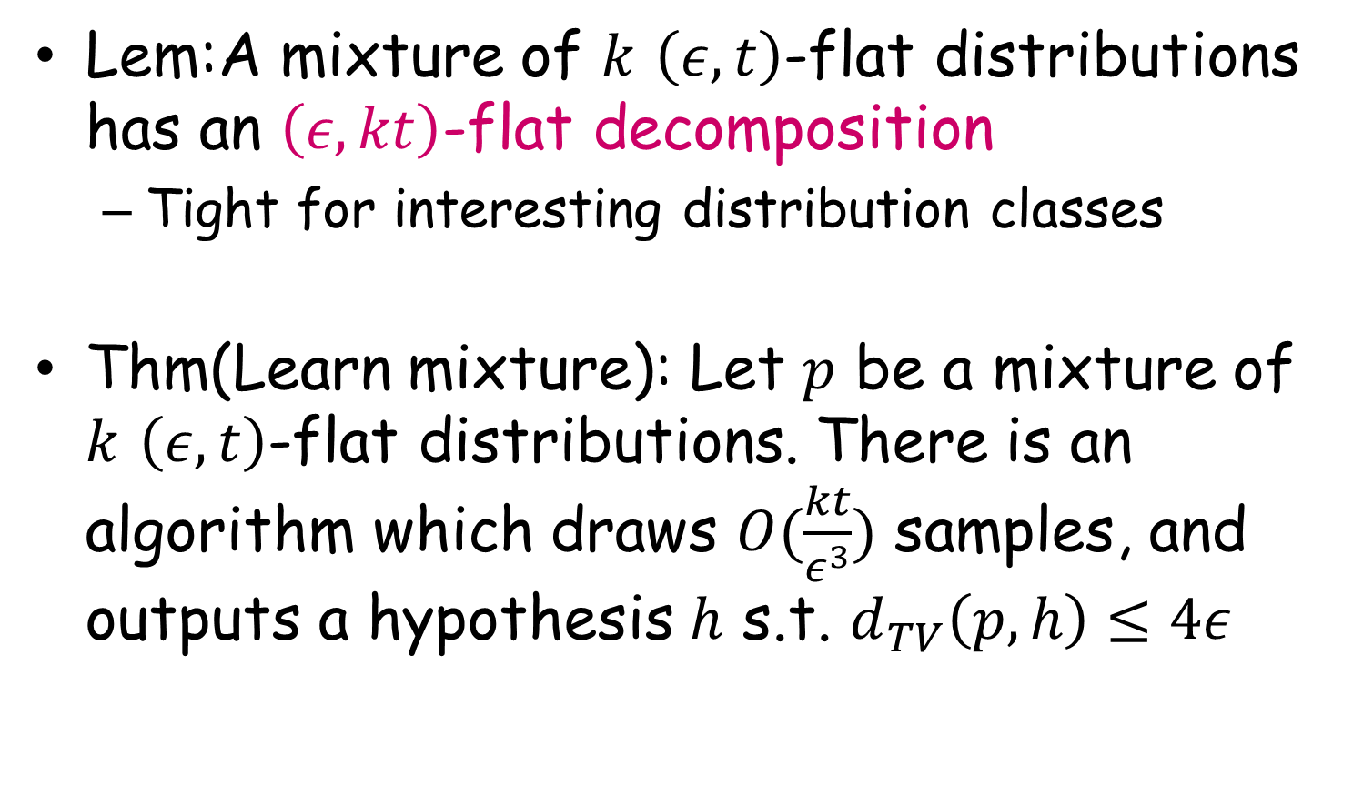
Learn mixture of distributions
Lem:A mixture of $k$ $\left(ε, t\right)$-flat distributions has an $\left(ε, kt\right)$-flat decomposition
Tight for interesting distribution classes
Thm(Learn mixture): Let $p$ be a mixture of $k$ $\left(ε, t\right)$-flat distributions. There is an algorithm which draws $O(\frac{kt}{ε^{3}})$ samples, and outputs a hypothesis $h$ s.t. $d_{TV}\left(p, h\right)≤4ε$

Slide 26
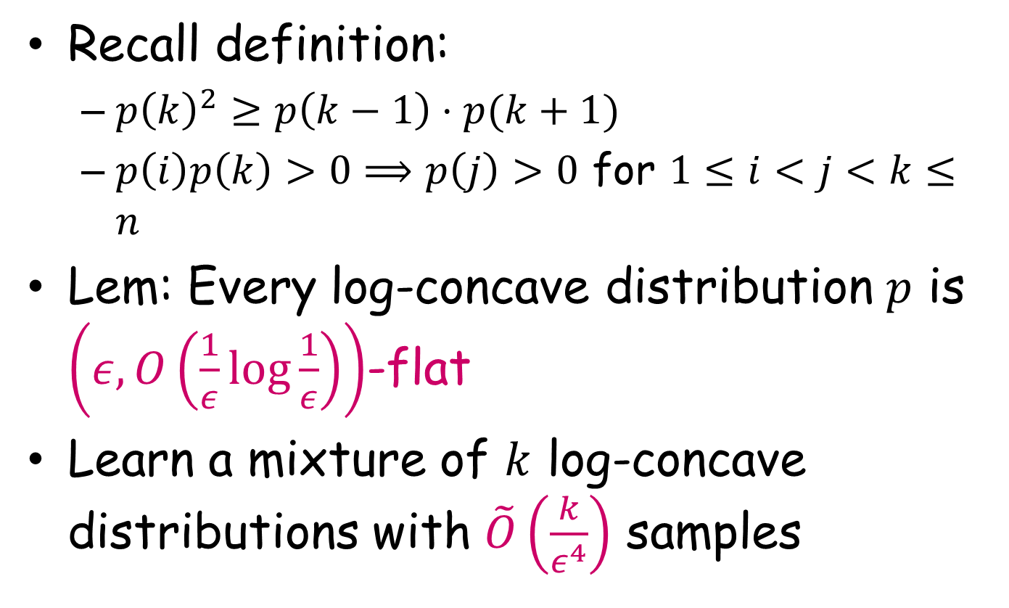
First application: learning mixture of log-concave distributions
Recall definition:
$p{\left(k\right)}^{2}≥p\left(k−1\right)⋅p(k+1)$
$p\left(i\right)p\left(k\right)>0⟹p\left(j\right)>0$ for $1≤i<j<k≤n$
Lem: Every log-concave distribution $p$ is $\left(ε, O\left(\frac{1}{ε}log{\frac{1}{ε}}\right)\right)$-flat
Learn a mixture of $k$ log-concave distributions with $\tilde{O}\left(\frac{k}{ε^{4}}\right)$ samples

Slide 27
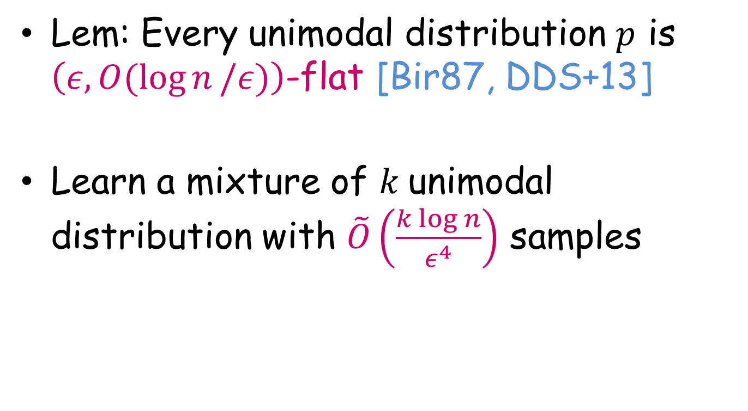
Second application: learning mixture of unimodal distribution
Lem: Every unimodal distribution $p$ is $\left(ε, O(\log{n}/ε)\right)$-flat [Bir87, DDS+13]
Learn a mixture of $k$unimodal distribution with $\tilde{O}\left(\frac{k\log{n}}{ε^{4}}\right)$ samples

Slide 28
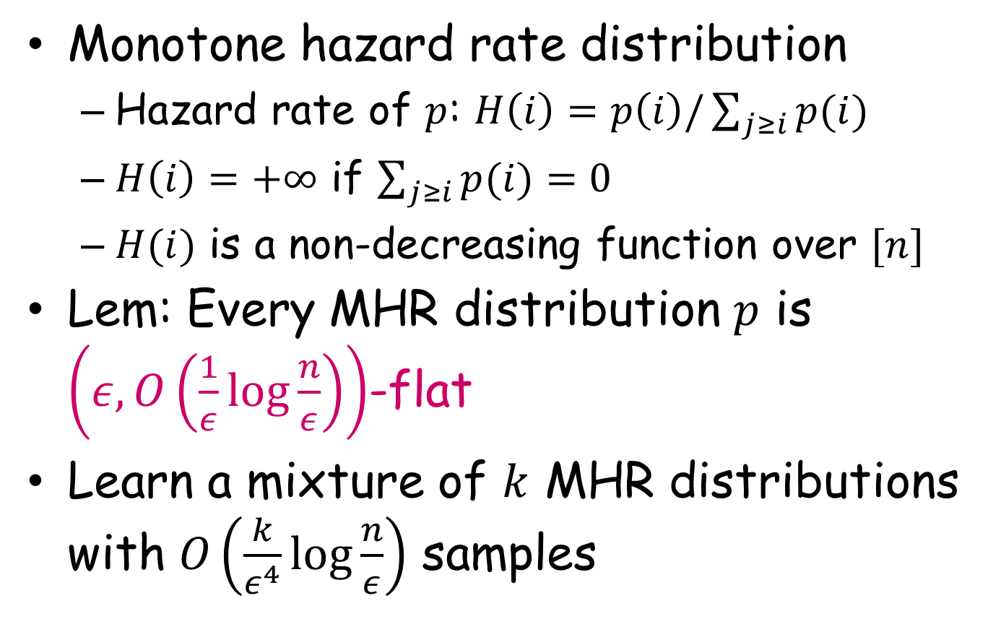
Third application: learning mixture of MHR distribution
Monotone hazard rate distribution
Hazard rate of $p$: $H\left(i\right)=p\left(i\right)/\sum_{j≥i}{p(i)}$
$H\left(i\right)=+∞$ if $\sum_{j≥i}{p(i)}=0$
$H(i)$ is a non-decreasing function over $[n]$
Lem: Every MHR distribution $p$ is $\left(ε, O\left(\frac{1}{ε}log{\frac{n}{ε}}\right)\right)$-flat
Learn a mixture of $k$ MHR distributions with $O\left(\frac{k}{ε^{4}}\log{\frac{n}{ε}}\right)$ samples

Slide 29
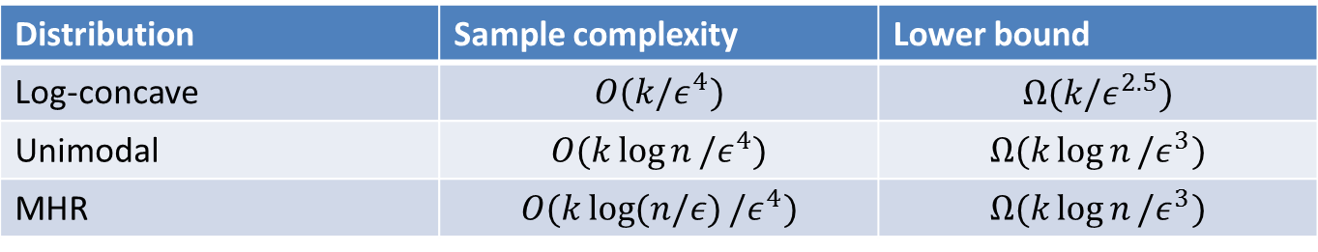
Conclusion and further directions
Flat decomposition is a useful way to study mixtures of structured distributions
Extend to higher dimension?
Efficient algorithm with optimal sample complexity
Distribution | Sample complexity | Lower bound
Log-concave | $$O(k/ε^{4})$$ | $$Ω(k/ε^{2.5})$$
Unimodal | $$O(k\log{n}/ε^{4})$$ | $$Ω(k\log{n}/ε^{3})$$
MHR | $$O(k\log{(n/ε)}/ε^{4})$$ | $$Ω(k\log{n}/ε^{3})$$

Slide 30
Thank you !

