Slide 1
UIMA
David Gondek
Knowledge Capture and Learning
DeepQA Team @ IBM Research
Notes:
1

Slide 2
Deep QA Architecture
Related Content
(Structured & Unstructured)
In 1894 C.W. Post created his warm cereal drink Postum in this Michigan city
Keywords: 1894, C.W. Post,
created …
Lexical AnswerType:
(Michingan city)
Date(1984)
Relations:
Create(Post, cereal drink)
…
Primary
Search
Question
Analysis
Candidate Answer Generation
Taxonomic
Temporal
Lexical
Spatial
…
General Foods
[0.58 0 -1.3 … 0.97]
1985
[0.71 1 13.4 … 0.72]
Post Foods
aramour
[0.12 0 2.0 … 0.40]
Battle Creek
[0.84 1 10.6 … 0.21]
Battle Creek (0.85)
Post Foods ( 0.20)
1985 (0.05)
Grand Rapids
[0.33 0 6.3 … 0.83]
…
[0.21 1 11.1 … 0.92]
…
[0.91 0 -8.2 … 0.61]
Merging &
Ranking
…
[0.91 0 -1.7 … 0.60]
Evidence
Retrieval
Evidence
Scoring
Question & Topic Analysis
Question
Decomposition
Hypothesis
Generation
Hypothesis and Evidence Scoring
Synthesis
Final Confidence Merging & Ranking

Slide 3
Why Semantics? Deeper Evidence
In May 1898 Portugal celebrated the 400th anniversary of this explorer’s arrival in India.
On 27th May 1498, Vasco da Gama landed in Kappad Beach
On 27th May 1498, Vasco da Gama landed in Kappad Beach
On 27th May 1498, Vasco da Gama landed in Kappad Beach
On the 27th of May 1498, Vasco da Gama landed in Kappad Beach
Search Far and Wide
Explore many hypotheses
Find Judge Evidence
Many inference algorithms
Built over parsing, PAS, NED, entity/ predicate disambig, negation, relation extraction, frames, topic detection, taxonomic reasoning, etc..
celebrated
landed in
Portugal
May 1898
400th anniversary
Temporal Reasoning
27th May 1498
Statistical Paraphrasing
Date
Math
arrival in
We use many semantic substrategies for similarity
GeoSpatial Reasoning
Para-phrases
India
Kappad Beach
Geo-KB
explorer
Vasco da Gama
Wait! This is more than just annotation. Can UIMA handle all these artifacts?
Question
Passage (showing one here, but there may be many)
Background Resources(KBs, axioms, etc)
3
Notes:
Here we see the same question, the same parse, but on the other side we see that there exists a passage containing the RIGHT answer BUT with only one key word in common.
<read the green passage>
The system must consider in parallel and in detail a huge amount of content just to get a SHOT at this evidence and then must find and weigh the right inferences that will allow it to match and score with an accurate confidence, for example in this case
<click>
Date Math, Statistical Paraphrasing and Geospatial reasoning.
And its still not 100% certain
What if, for example, the passage said “considered landing in” rather than “landed in” or what if there was just a preponderance of weaker evidence for another answer.
Question Answering Technology tries to understand what the user is really asking for and to deliver precise and correct responses. But Natural language is hard.
Meaning can be expressed in so many different ways and to achieve high levels of precision and confidence you must consider much more information and analyze it much more deeply.
We is needed is a radically different approach that explores many different plaussive interpretations in parallel and collects and evaluates all sorts of evidence in support or in refutation of those possibilities.
3

Slide 4
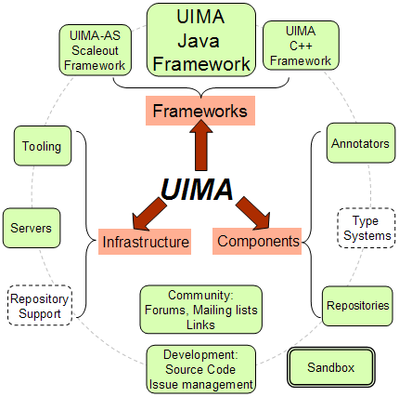
http://uima.apache.org/index.html

Slide 5
UIMA Links
UIMA
Annotations (stored in the CAS: Common Analysis Structure)
Pipeline
Multimodal (SOFA )
Collection Processing Engine
UIMA AS (Asynchronous Scale-out)
Tools
Components (Apache, CMU, JULIE lab)

