Slide 1
How do you tell a blackbird from a crow?
Thomas Berg
Peter N. Belhumeur
Columbia University

Slide 2
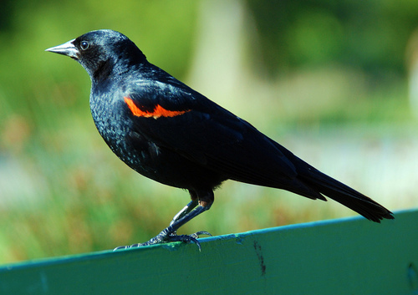
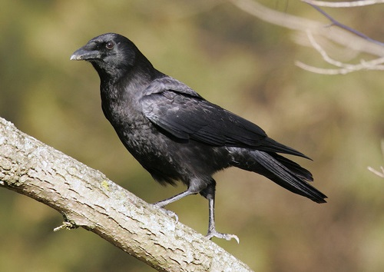
How do you tell a blackbird from a crow?

Slide 3
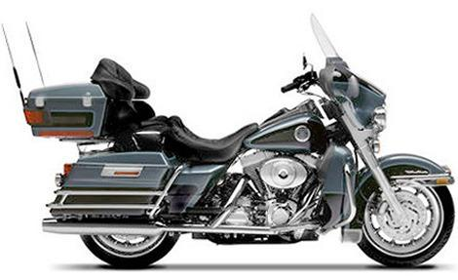
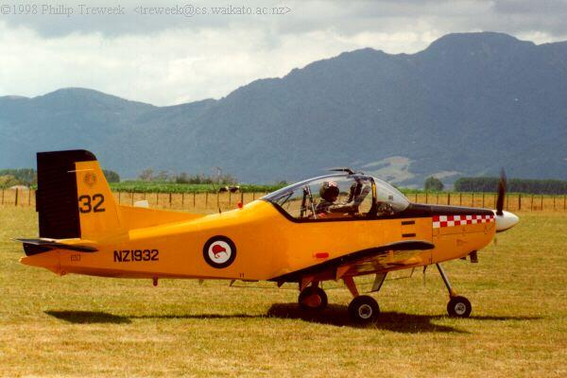
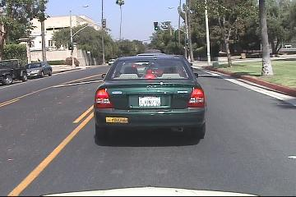
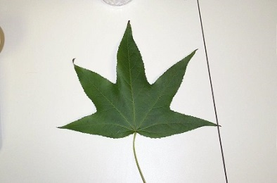
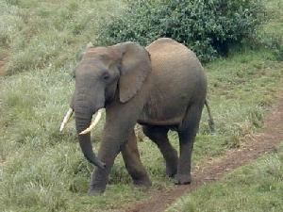
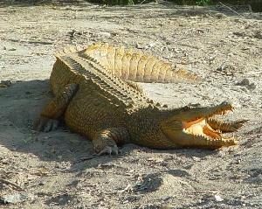
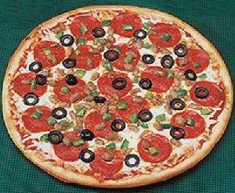
There’s a lot of work on recognition.
Caltech Categories (5 categories)
Caltech-101

Slide 4
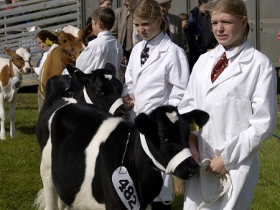
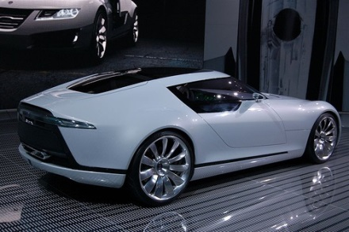
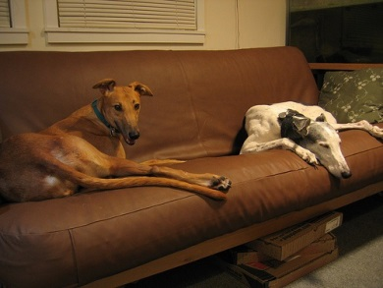
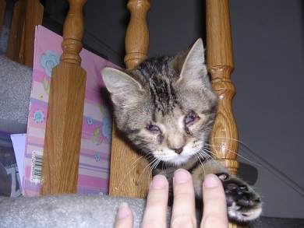
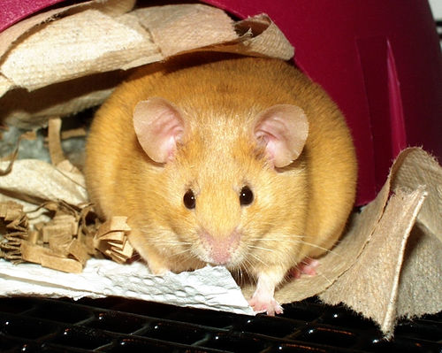
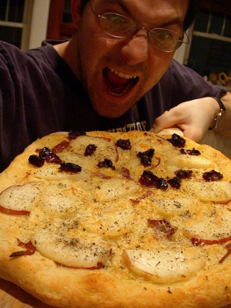
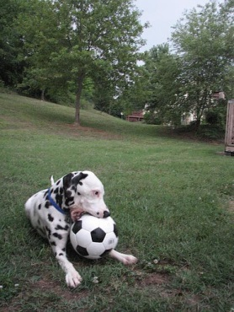
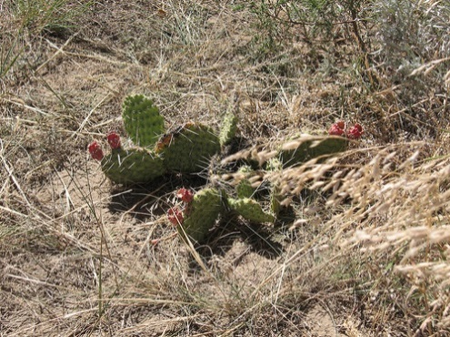
There’s a lot of work on recognition.
PASCAL VOC (20 classes, less controlled)
ImageNet (1000 classes in challenge set)

Slide 5
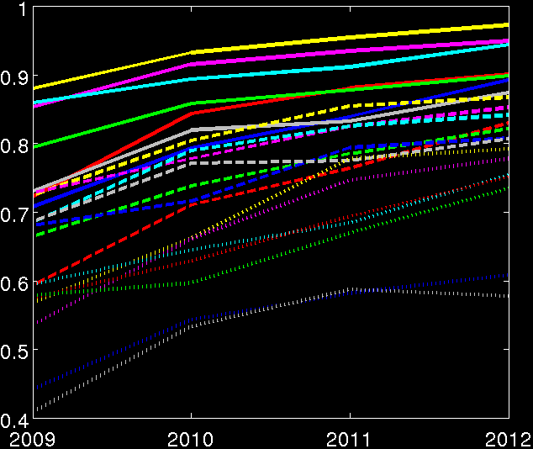
There’s a lot of progress on recognition.
Average Precision
Year
PASCAL VOC Classification Challenge

Slide 6
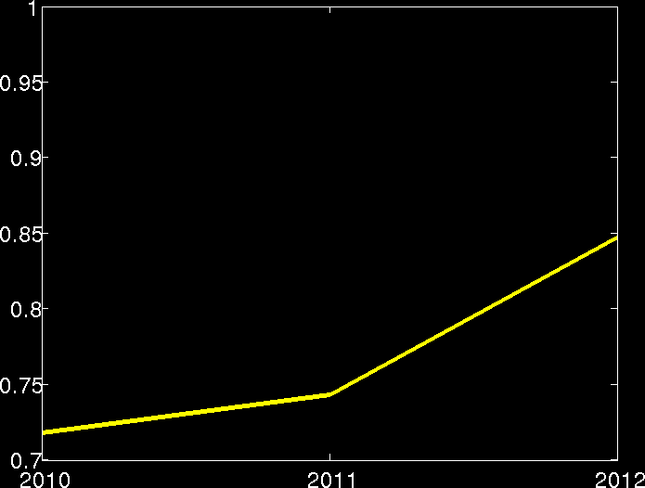
There’s a lot of progress on recognition.
Accuracy (5 predictions)
Year
ImageNet Large Scale Visual Recognition Challenge: Classification

Slide 7
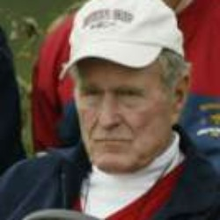
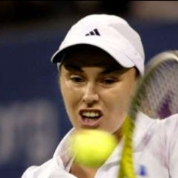
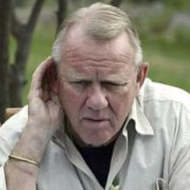
There’s a lot of work on face recognition.
Yale Faces (15 subjects)
Labeled Faces in the Wild (5749 subjects, less controlled)

Slide 8
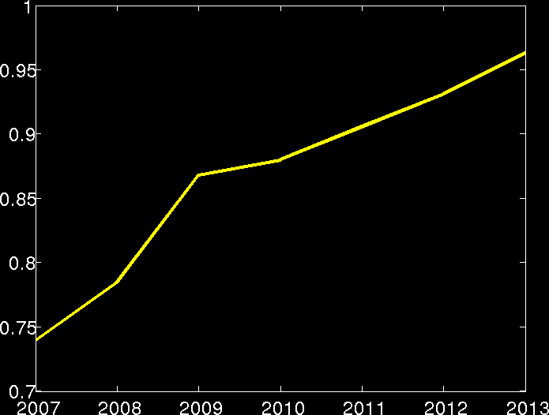
There’s a lot of progress on recognition.
Accuracy
Year
Labeled Faces in the Wild: Image-Restricted Benchmark

Slide 9
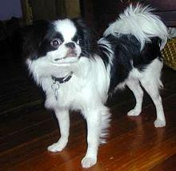
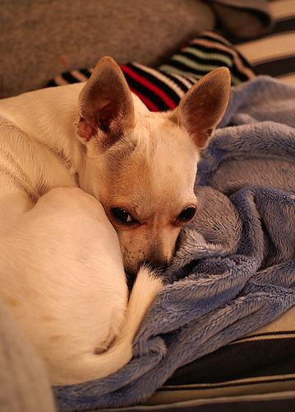
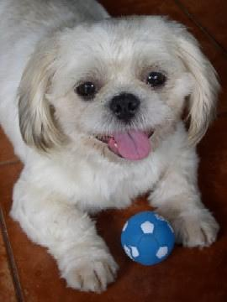
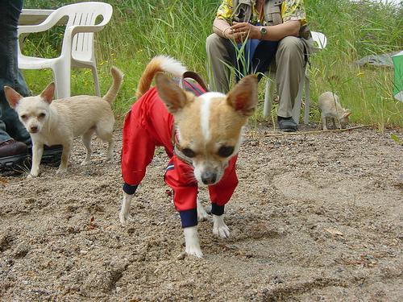
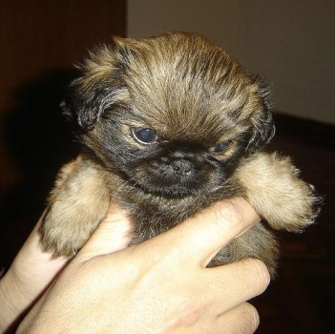
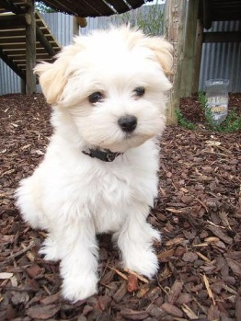
Fine-grained visual categorization.
Leafsnap (184 species)
Stanford Dogs (120 species)

Slide 10
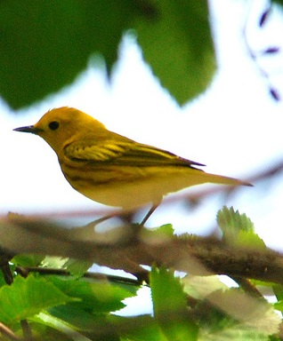
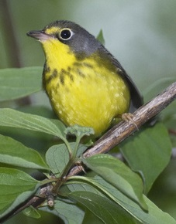
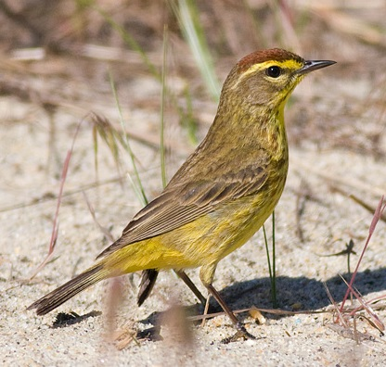
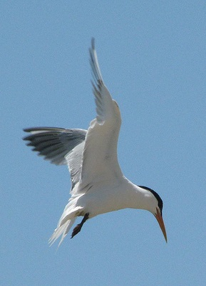
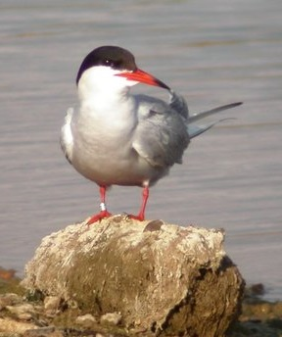
Fine-grained visual categorization.
Caltech-UCSD Birds (200 species)

Slide 11
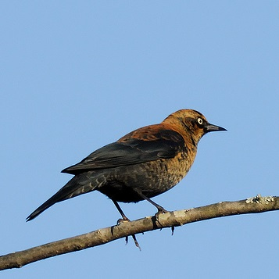
What bird is this?
Rusty Blackbird

Slide 12
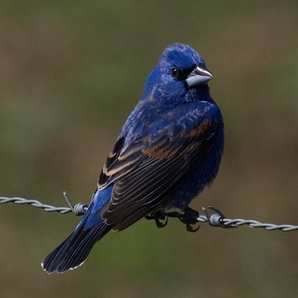
What bird is this?
Blue Grosbeak

Slide 13
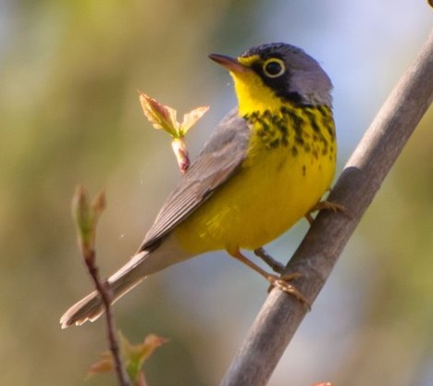
What bird is this?

Slide 14
Fine-grained recognition is difficult for humans.
Can computers teach us to be better?

Slide 15
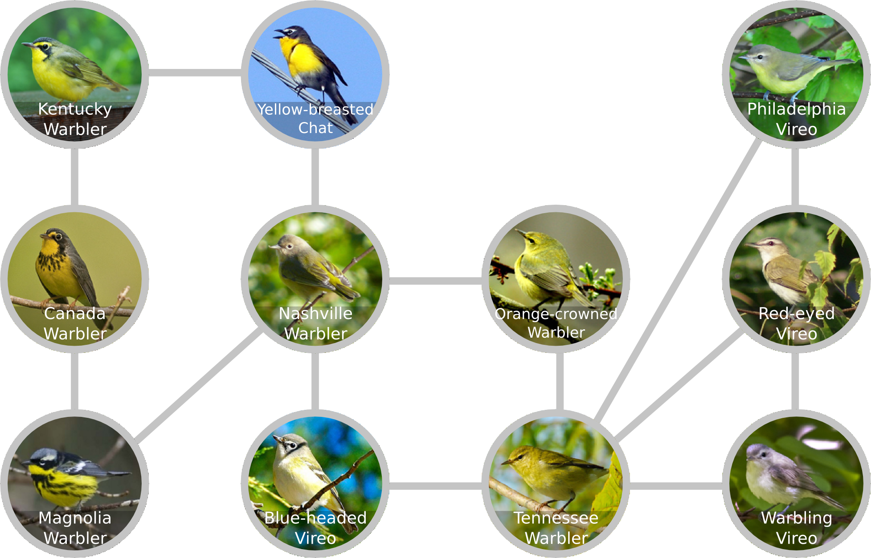
Goal: Build an understanding of a visual domain.
Which classes are most similar to each other?

Slide 16
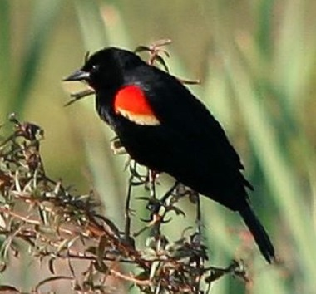
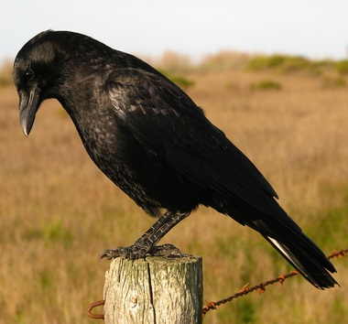
Goal: Build an understanding of a visual domain.
Which classes are most similar to each other?
What distinguishes classes from each other?
Red-winged Blackbird
American Crow

Slide 17
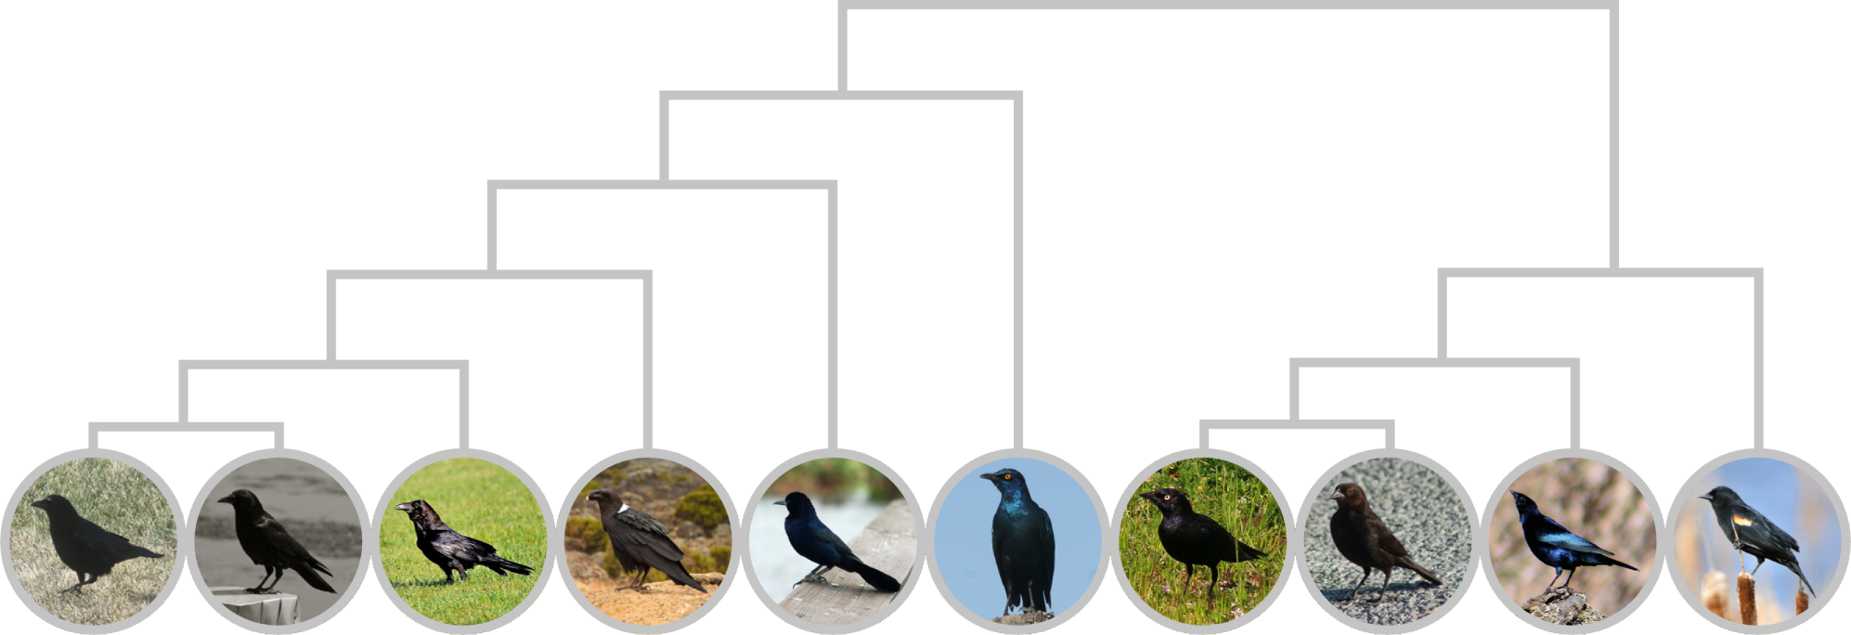
Goal: Build an understanding of a visual domain.
Which classes are most similar to each other?
What distinguishes classes from each other?
Is there a structure (hierarchy) of classes?
Crows, Ravens, and Grackles
Cowbirds and Blackbirds

Slide 18
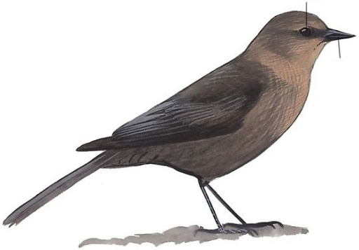
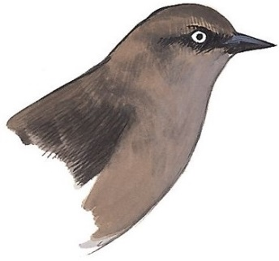
Field guides describe similarities and differences.
Brewer’s Blackbird
Slender and long-tailed. Distinguished from cowbirds by thinner bill, long tail, long legs, and dark-edged primaries.
Adult ♀
dark eye
short, straight bill
occasional ♀ has pale eye
From The Sibley Guide to Birds

Slide 19
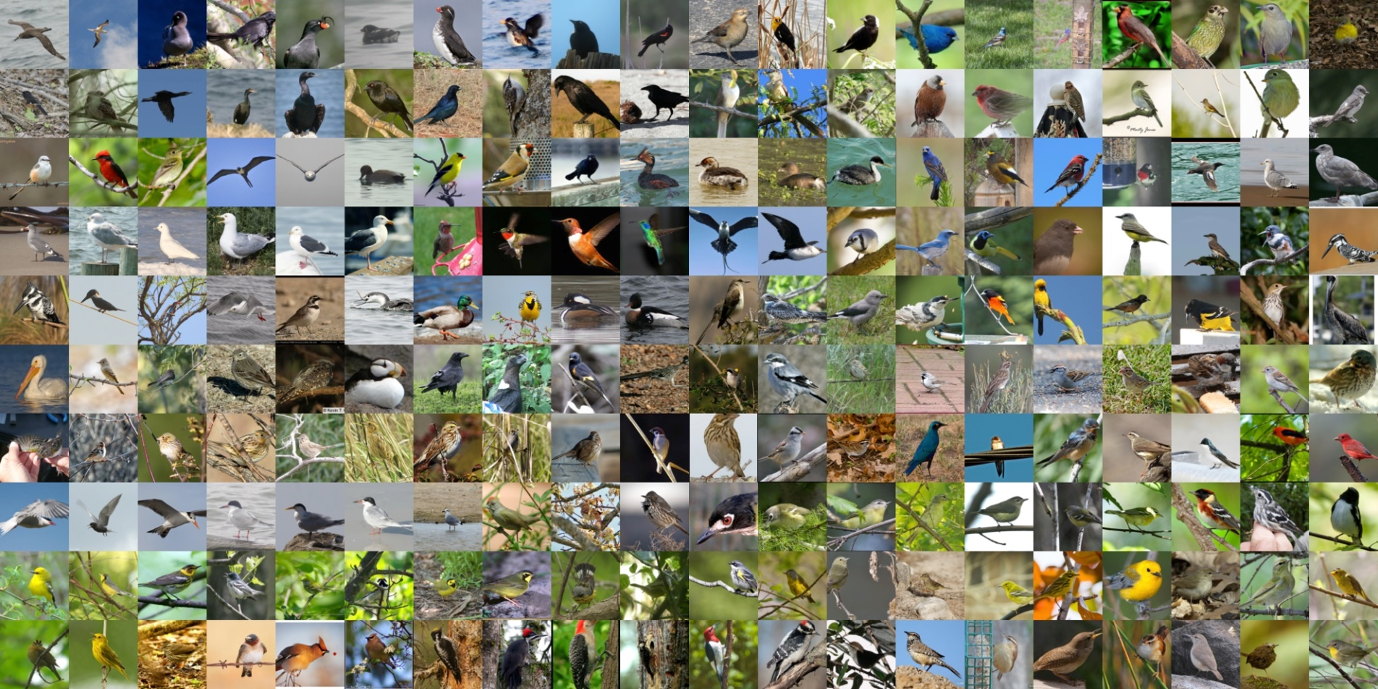
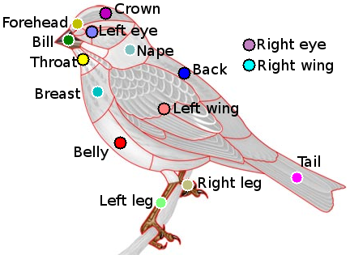
Let’s build a field guide, automatically.
(Given a dataset of images with species and part labels)
The CUB-200-2011 dataset.

Slide 20
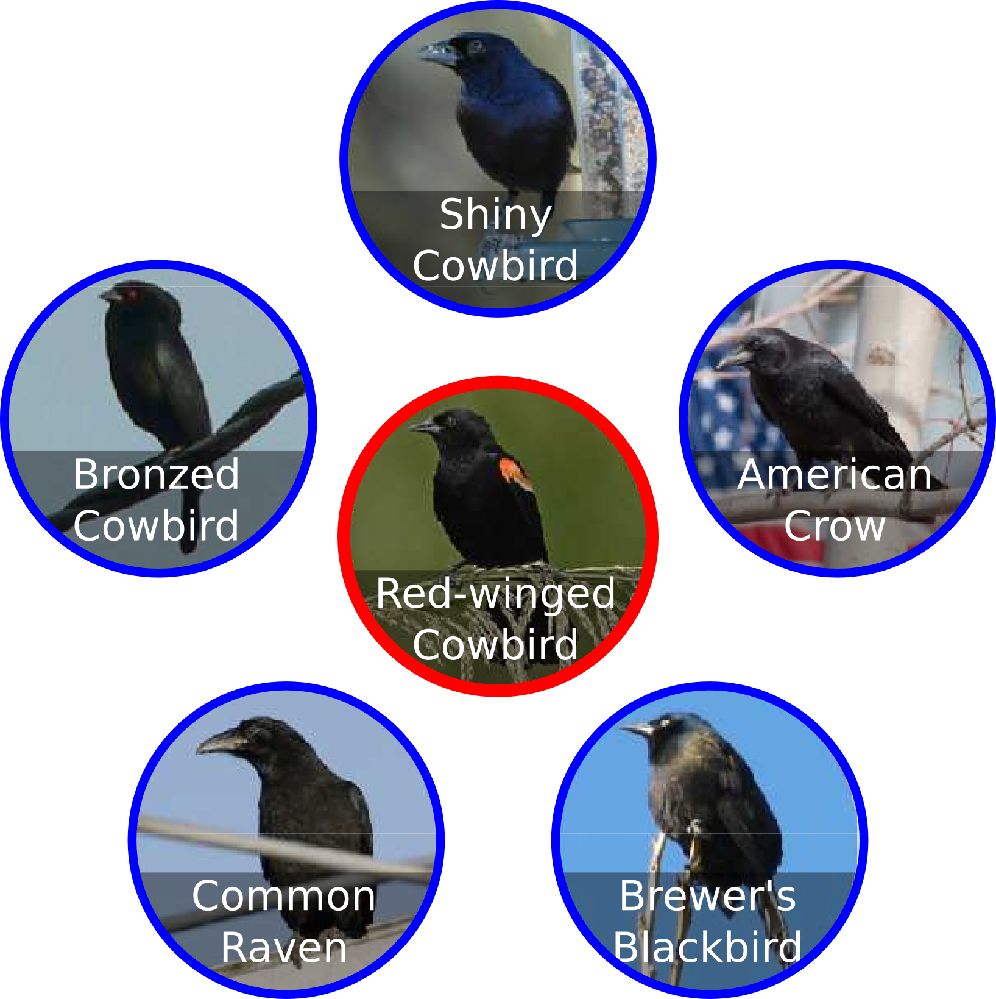
Our field guide entry for the Red-winged Blackbird.
Species similar to the Red-winged Blackbird (Agelaius phoeniceus)

Slide 21
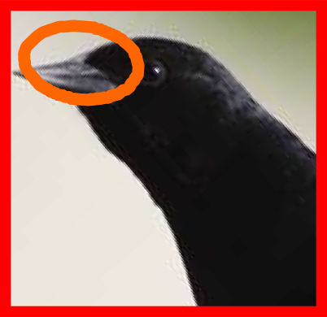
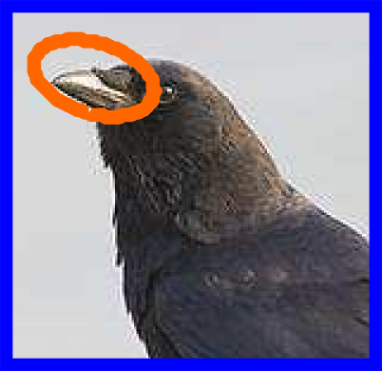
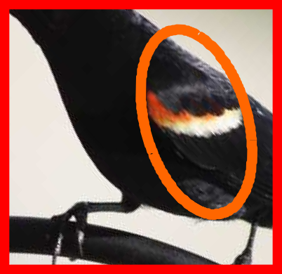
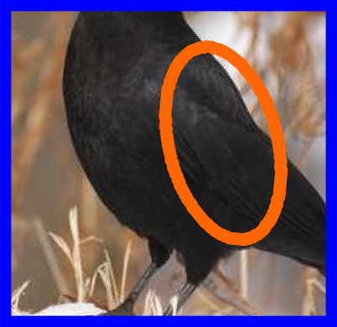
Our field guide entry for the Red-winged Blackbird.
Distinguishing the Red-winged Blackbird from the American Crow:
Red-winged Blackbird
American Crow

Slide 22
We need a feature space.
Discriminative
Part-based
High-level
Part-based One-vs-One Features (POOFs)
vs
Common Tern
Louisiana Waterthrush
Discrimination Map
(CVPR 2013)

Slide 23
Choose two species
common tern
Louisiana waterthrush

Slide 24
Choose two parts

Slide 25
Align and crop

Slide 26
Align and crop
Low-level features: HOG
Low-level features: HOG, color histogram grid

Slide 27
Train SVM
Like Louisiana thrush
Like common tern

Slide 28
Evaluate POOF score
Like Louisiana thrush
Like common tern
score

Slide 29
The field guide shows similar species.
Species similar to the Red-winged Blackbird (Agelaius phoeniceus)

Slide 30
Visual similarity approximates phylogenetic similarity.
similar
different
Years since most recent common ancestor.

Slide 31
Estimate similarity by difficulty of discrimination.
similar
different
Confusion matrix

Slide 32
Estimate similarity by difficulty of discrimination.
similar
different
L1 distance between mean POOF vectors

Slide 33
Estimate similarity by difficulty of discrimination.
similar
different
L1 distance after LDA on mean POOF vectors

Slide 34
Visual similarity approximates phylogenetic similarity.
Waterbirds
Crows & Ravens
Passerines
Blackbirds & Cowbirds
Visual Similarity
Phylogenetic Similarity

Slide 35
Show the most similar species to each species.
Species similar to the Red-winged Blackbird (Agelaius phoeniceus)

Slide 36
Our field guide entry for the Red-winged Blackbird.
Distinguishing the Red-winged Blackbird from the American Crow:
Red-winged Blackbird
American Crow

Slide 37
Choose the most discriminative features.

Slide 38
Chose image pairs that illustrate the difference.
…
…
Strong positive and negative POOF scores
Similar scores for other POOFs
Similar pose

Slide 39
I saw a bird… What is it?

Slide 40
Field guides are indexed by taxonomy.
From The Sibley Guide to Birds

Slide 41
Field guides are indexed by the Tree of Life.

Slide 42
The tree of life is based on similarity.
Neighbor-joining method
Saitou and Nei, “The Neighbor-Joining Method: A New Method for Reconstructing Phylogenetic Trees,” Molecular Biology and Evolution, 4(4), 1987

Slide 43
We build a tree of visual similarity.
Neighbor-joining method
Saitou and Nei, “The Neighbor-Joining Method: A New Method for Reconstructing Phylogenetic Trees,” Molecular Biology and Evolution, 4(4), 1987

Slide 44
Some similar species are not closely related.
Phylogenetic Tree

Slide 45
The visual similarity tree enables quick search.
Similarity Tree

Slide 46
Scroll through the tree of similarity.
?
Scott Oriole
Baltimore Oriole
Hooded Oriole
Orange-crowned Warbler
Magnolia Warbler

Slide 47
Navigate the similarity graph to refine search.
?

Slide 48
Navigate the similarity graph to refine search.
?

Slide 49
Look at differences to confirm class.
Canada Warbler
Magnolia Warbler
Canada Warbler
?

Slide 50
Thank you.

Slide 51
Equations (Windows only)
$$d_{f}=\frac{{\left(μ_{1}−μ_{2}\right)}^{2}}{σ_{1}σ_{2}}$$

